Slide 1
Networking Fundamentals
By: Pierce Rogg

Slide 2
Purpose
To learn Networking fundamentals.
Demonstrate mastery of basic networking concepts and implementation

Slide 3
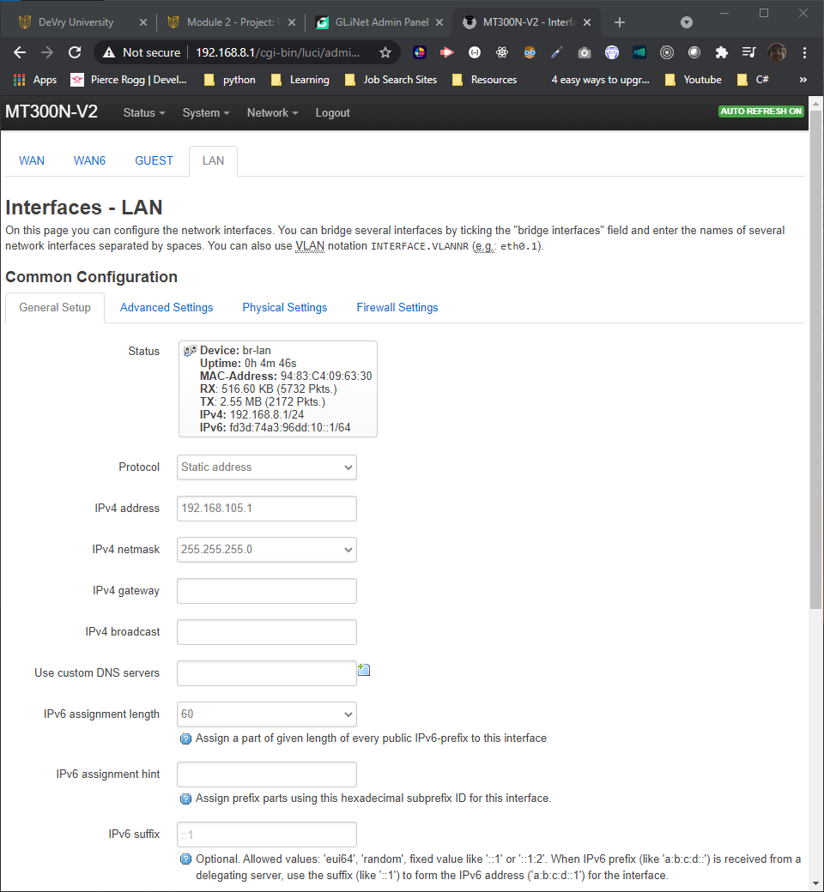
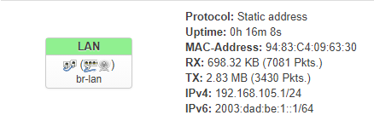
IPv4 and IPv6 Addressing

Slide 4
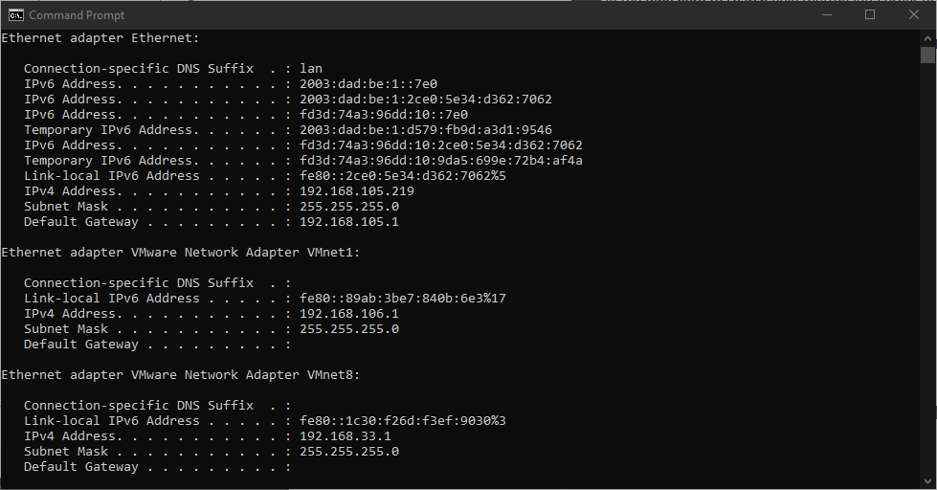
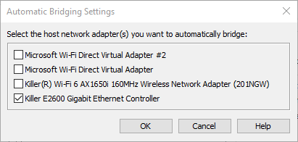
Virtual Machine (VM) Dynamic IP Assignment

Slide 5
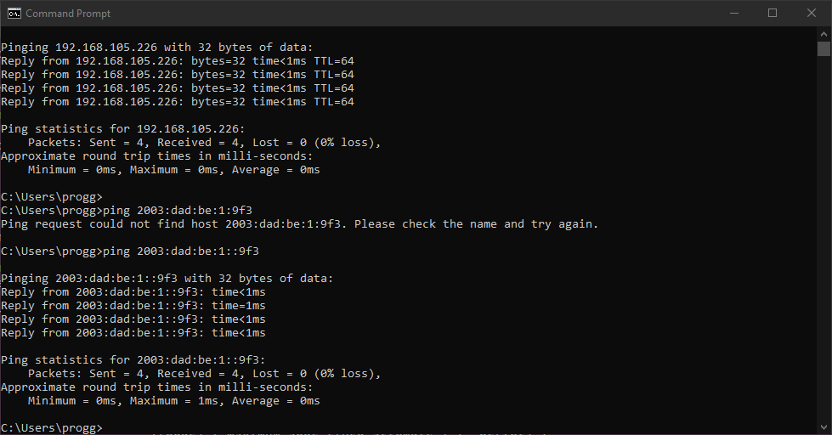
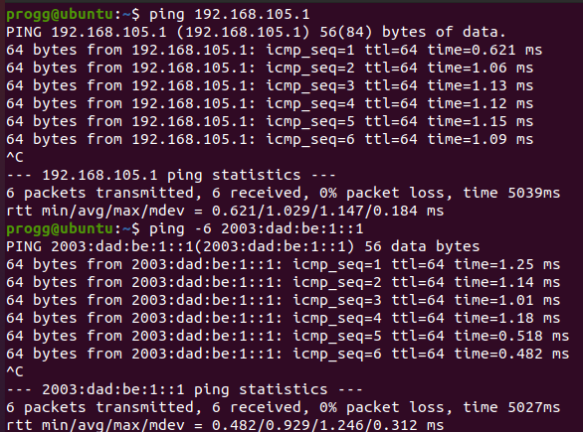
Connectivity Test and Visio Network Diagram

Slide 6
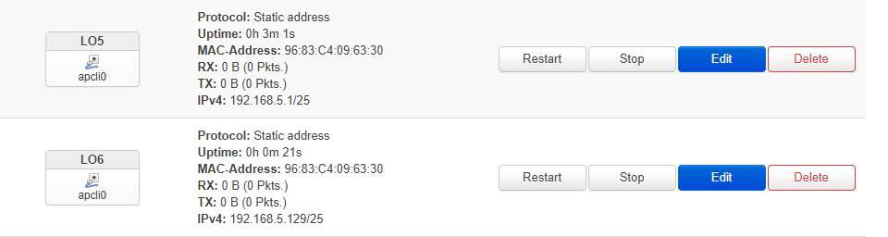
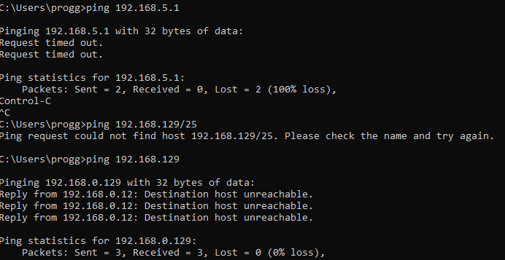
IP Subnetting and Loopback Interfaces

Slide 7
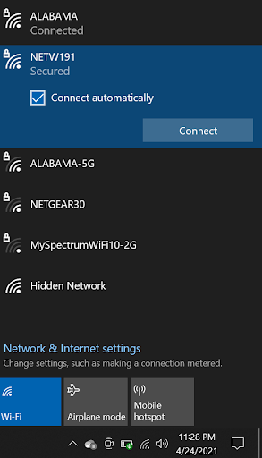
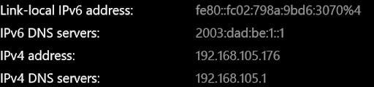
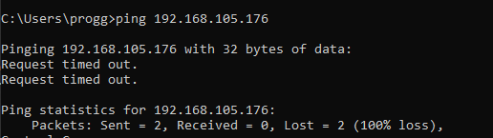
WLAN Implementation

Slide 8
Challenges
Getting the travel router to work
Travel Router not connecting with the VM
Getting the right IP addresses
Ping utility not working because of wrong IP addresses
Keeping up with all of the assignments as well as work.

Slide 9
Conclusion
Networking is a huge field that is complex.
Networking is interesting and I look forward to practicing the skills I have learned and learning new ones.

