Slide 1
Python Weather Tracker
By: Pierce rogg

Slide 2
Introduction
Have you ever wondered how accurate the weatherman is?
Well know you can find out by running the Python Weather Tracker and looking at what the Temperature and Humidity has been for the last two weeks and then compare it to the weatherman’s predictions.

Slide 3
Development Process

Slide 4
Step 1: Design and Library setup

Slide 5
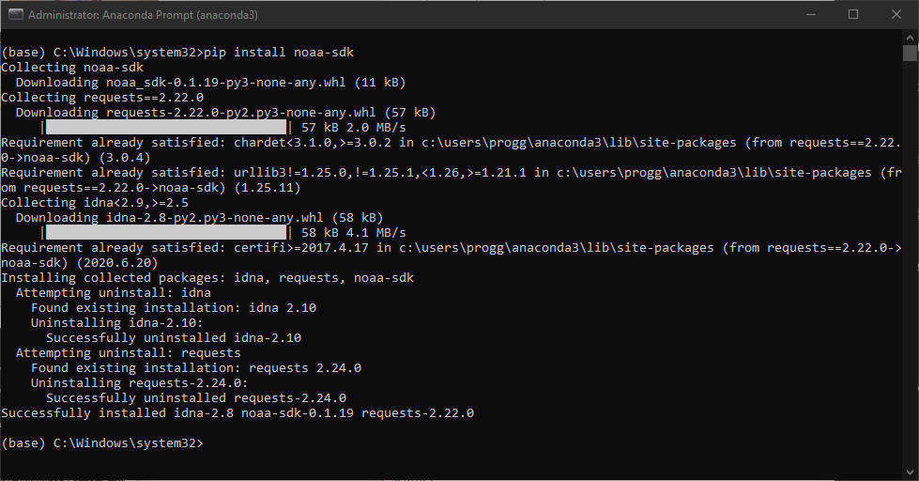
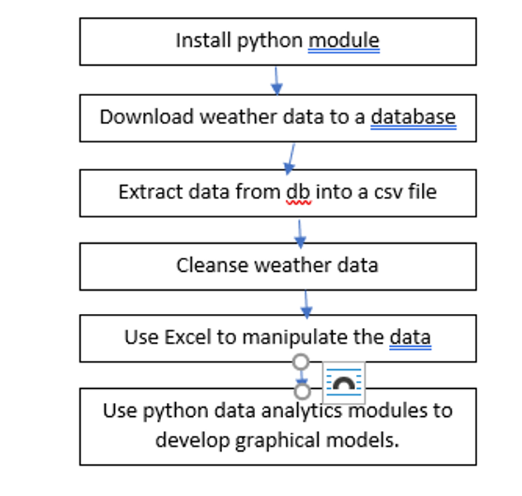
Install Noaa-sdk Module
Flow Chart

Slide 6
Step 2: Download weather data

Slide 7
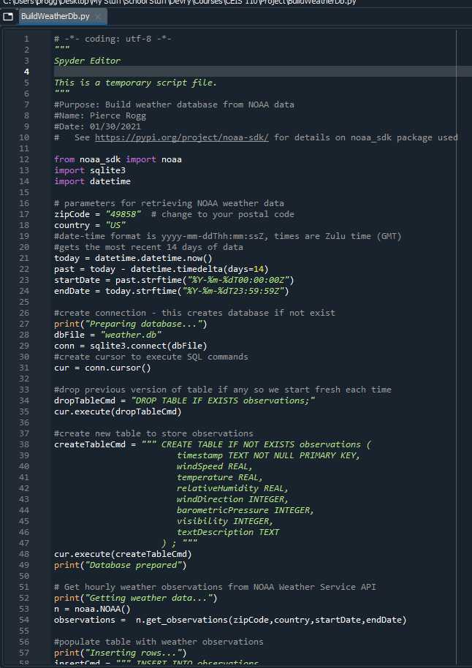
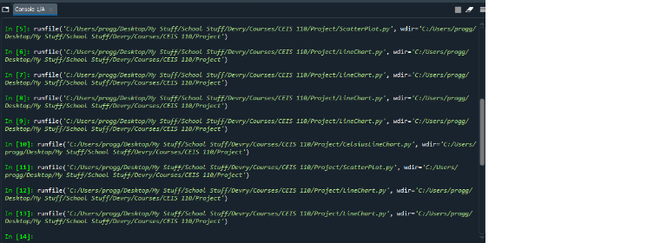
Code to create the Database
Console after running the code

Slide 8
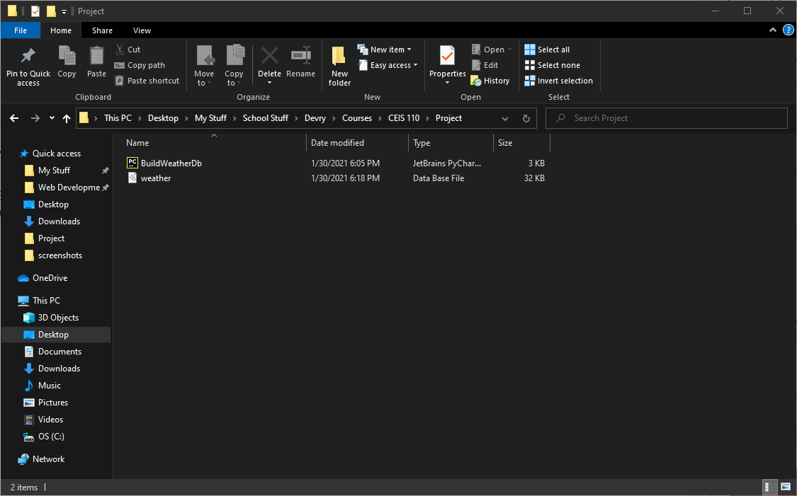
Project Directory with the Weather Database Created

Slide 9
Step 3: Query the Database with SQL

Slide 10
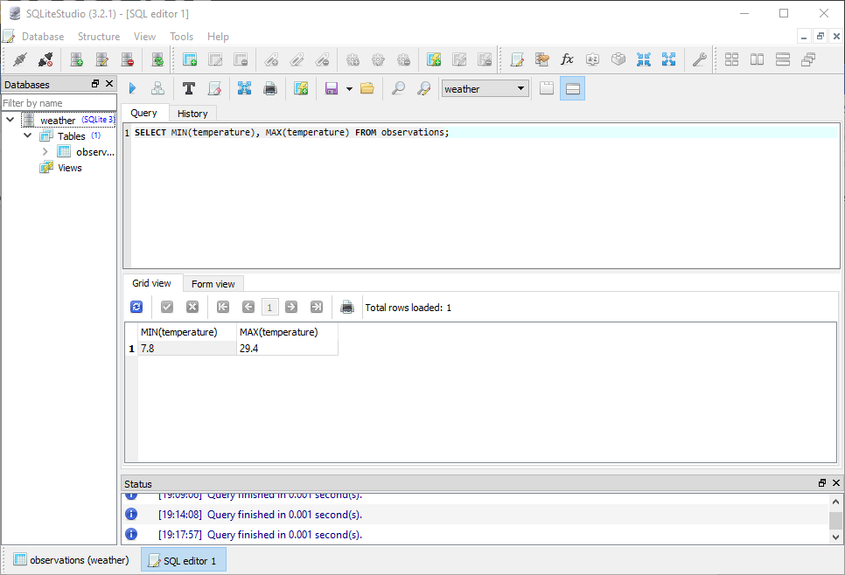
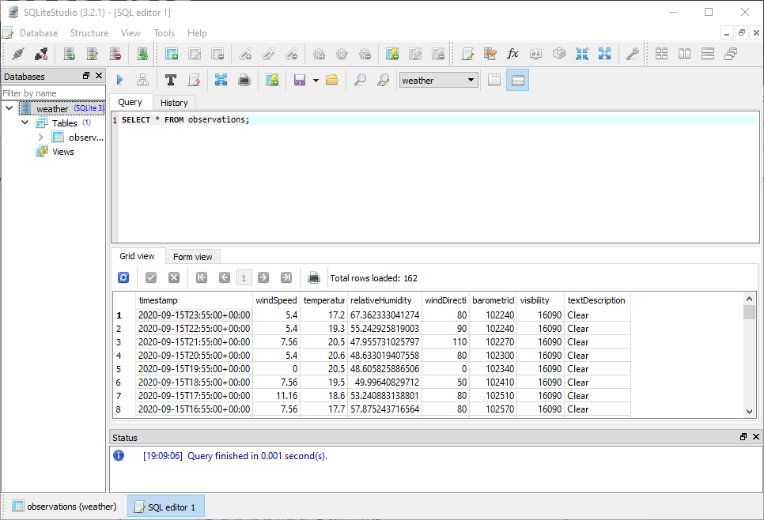
Getting the Min and max temperatures from database
Getting all the data from the database

Slide 11
Project Directory with the Weather Database Created

Slide 12
Step 4: Querying and Manipulating Data with SQL and Python

Slide 13
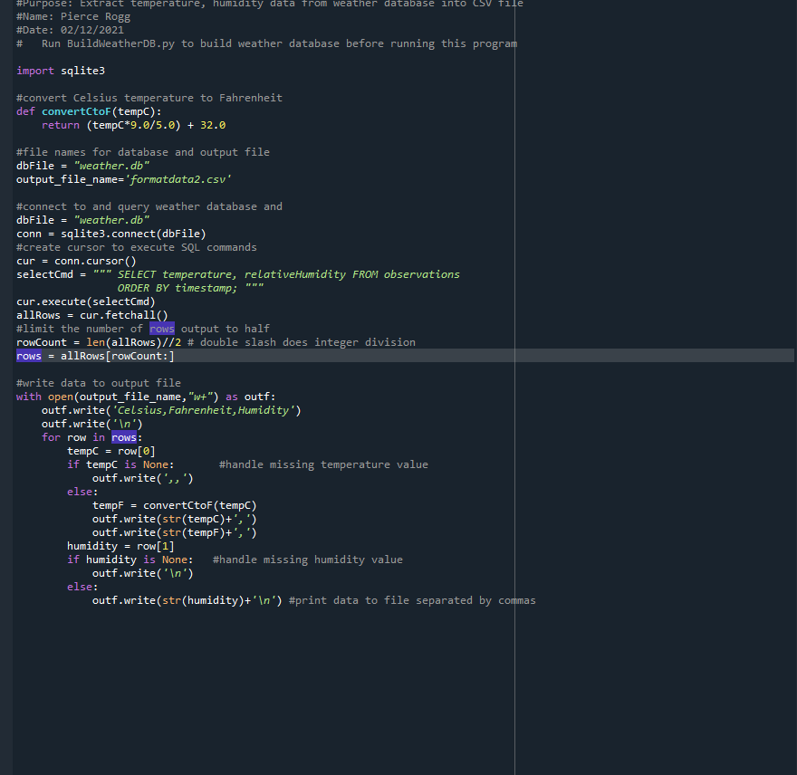
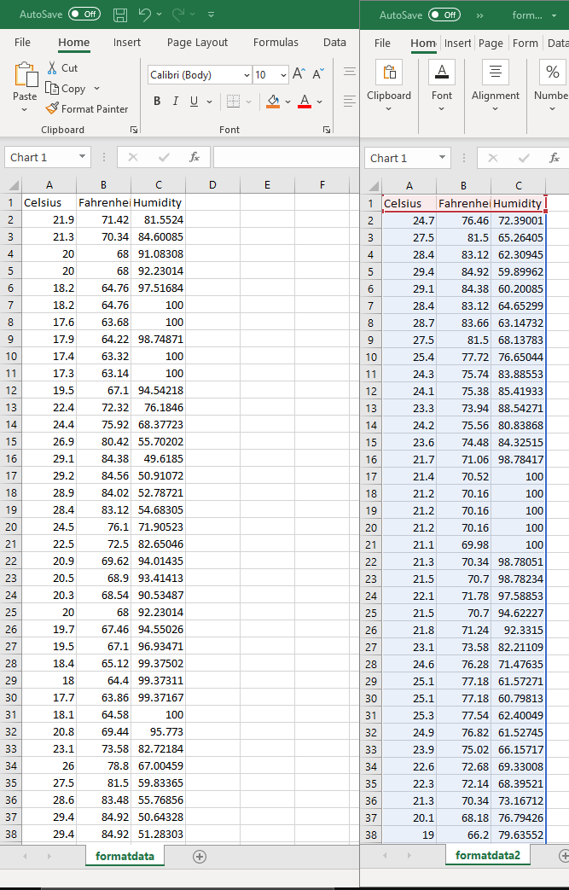
Code to write the data to csv file
Csv file with all of the data

Slide 14
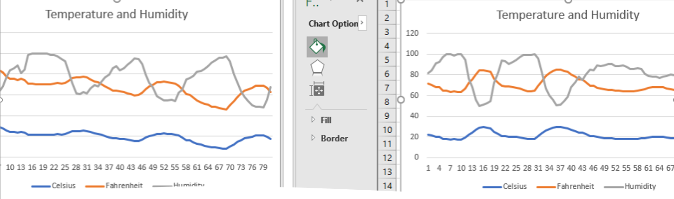
Graph of Temperature and Humidity From CSV File

Slide 15
Step 5: Develop Graphical Models and Interpret Results

Slide 16
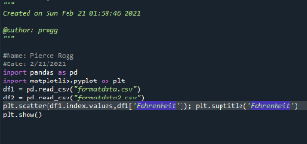
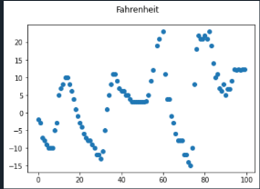
Code to Create the Scatter Plot
Scatter plot of temperature

Slide 17
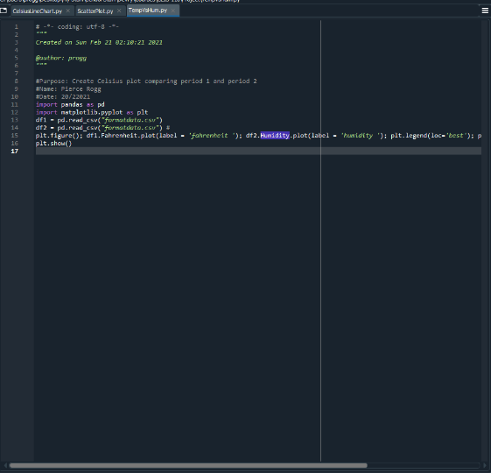
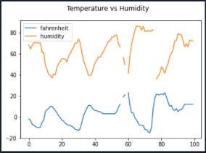
Code to Create the line graph
Line Graph temp vs humidity

Slide 18
Step 6: Analysis

Slide 19
Question and answer
Prediction
How does the temperature compare to the humidity for the week of 2/14/2021?
As the temperature goes down the humidity goes up.
As winter turns into spring and the temperature starts to go up, I expect for the humidity to decrease.

Slide 20
Challenges
The biggest challenge was working with Python
I am a web developer and utilize JavaScript daily. I found it confusing going back and forth because JavaScript is not tab sensitive and Python is.
Getting the weather data from NOAA-SDK
The NOAA-SDK service ended up going down the week that I needed it to complete Step 2 of this project. Luckily I was able to use a sample weather database until it came back up.

Slide 21
Career Skills Learned
Data Analysis and Visualization
Python Programming
Software Development Life Cycle
Planning and Designing a Project

Slide 22
Conclusion
All in all, this was a fun project and I really enjoyed learning another programming language.

