Slide 1

Health Predictor
A submission to NTT Data AI Hackathon 2022
Atrij Talgery
(Team ATR21)

Slide 2
Context
Health and wellbeing are central to the human experience
Yet, nine million people die every year without proper healthcare services
The healthcare journey needs to be improved for everyone by reducing cost and improving accessibility
AI/ML can help with accessibility, early detection and management of diseases
Team ATR21 Slide 2

Slide 3
Solution Concept
Use historical diagnostic data to train AI/ML models
Models learn continuously with latest data
Models deployed and made accessible via ubiquitous webapp
Webapp designed to assist user and help with early disease detection
Team ATR21 Slide 3

Slide 4
Data, ML models & training
Publicly available datasets from Kaggle used
ML ensemble model: Random Forest
Jupyter Lab used to train, fine-tune and serialize ML models
Team ATR21 Slide 4

Slide 5
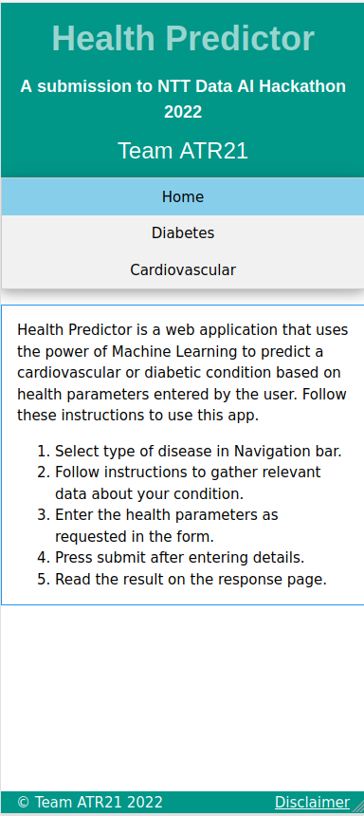
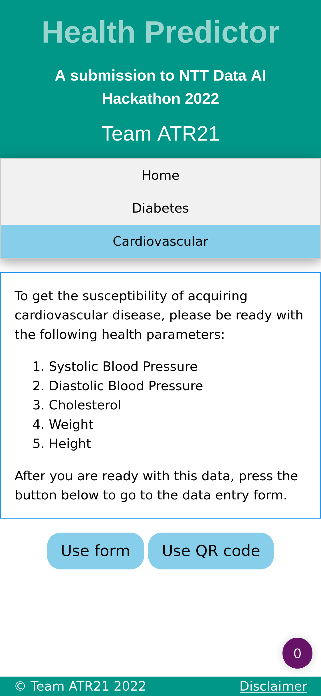
Features
Help for two most common health conditions: Cardiovascular and Diabetic disease
Easy, responsive web interface with simple navigation heirarchy
Easy to use with landing page help
Easy to use entry forms with option to upload pregenerated QR code
Reports probability of incidence to facilitate fuzzy interpretation
Team ATR21 Slide 5

Slide 6
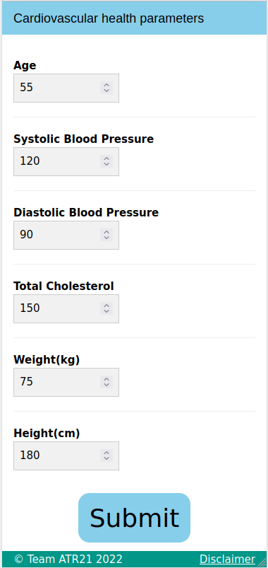
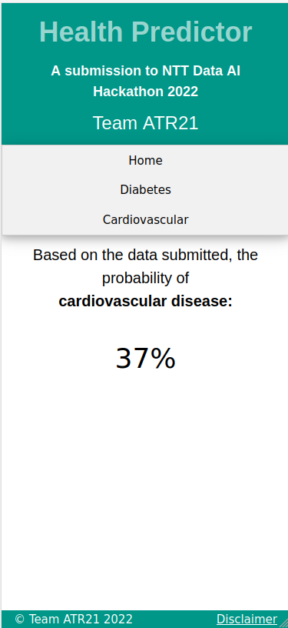
Benefits
People can get prediagnostic overview prior to medical consultation
Doctors & patients can save time by avoiding prediagnostic consultations
Easy access anytime, anywhere and free of cost.
Hospitals can deploy this app in kiosk mode in reception areas
Team ATR21 Slide 6

Slide 7
Tech Stack Usage
Front end: HTML/w3.CSS, JavaScript
Programming and ML libraries: Jupyter Lab, Python pandas, numpy, matplotlib/seaborn, sklearn
Backend and deployment: Python Flask for creating the webapp; deployment on LAN
Team ATR21 Slide 7

Slide 8
Dev/Deployment Environment
Anaconda version: 4.12.0
Python 3.8.5
Flask 2.0.1
Developed on Ubuntu 20.04
Team ATR21 Slide 8

Slide 9
Pitch for the final round
The concept is promising and can morph to its full potential with better quality data
Can be used as knowledge-base for doctors with a continuously updated model(s)
Better predictions
Opportunity for low cost, ubiquitous access to a healthcare app(all you need is a web browser)
Team ATR21 Slide 9

Slide 10
Thank You

