Slide 1

Starforge
Pocketful · Stage 1 accepted
WeAreDevelopers × BAND
Solo team: progmax
Notes:
Conceptual illustration generated with the built-in imagegen tool. This image is not a recording or photograph of an agent run. Team dashboard: https://lablab.ai/ai-hackathons/wearedevelopers-hackathon/starforge

Slide 2
Four coding seats
Codex / gpt-6.1-sol
Seat | Ownership
Clean Coordinator | Plans and routes complete handoffs
Clean Auditor | Freezes independent requirements and tests
Clean Builder | Writes product source and deployment files
Verifier | Checks clean clones and accepts exact commits
Notes:
Actual registered BAND seats run Codex / gpt-6.1-sol. All four identities and reciprocal messages were verified during preparation. Source: clean FACTORY.md and the genuine room export.

Slide 3
One task, independent ownership
One complete human task in a fresh BAND room.
The Auditor freezes tests before Builder authorization.
The Builder owns product code; Verifier runs acceptance.
Full task and spec travel with every handoff.
Notes:
Clean room615b6e94-4717-404e-ba86-05015a1a0092. Full export457events, one human message. Producta8805bf4dc2297e0953ea4a5979fcd85c98b95b4; audit52b50da43a750452ed44fb9ab118c9576428a475. Source: room.json, FACTORY.md and accepted reports.

Slide 4
Three real rejections
Wrong JSON reset types and atomic replacement
Concurrent reset work delayed health responses
Logins timed out during unchanged-state imports
Agents reviewed and repaired each in new commits.
Notes:
Original product revisions28b55ab6,0655f50e,4edb95b4 remain preserved with unmodified REJECT reports. The accepted repair is a8805bf4. No tests weakened or old counts relabeled. Source: evidence/STAGE1-OUTCOME.md and three VERDICT.md reports.

Slide 5
Stage 1 verification
147 / 147 published tests
198 independent subtests · 6,051 HTTP calls
85 requirements rows · 12 inspection obligations
Offline containers · 2 CPU · 2 GiB · alternate ports
Notes:
Accepted exact paira8805bf4/52b50da4. Independent suite32methods198subtests, longest1.290244s. Two reset loads100/100pass, maxima6.635834/6.617504s. Login/import probes all50logins/all50imports pass, maxima0.746269/0.749048s. Startup0.590353/0.559161s. Source: accepted VERDICT.md. Private judging suites are unavailable.

Slide 6
Delivered service and scope
Wallet balances, payments, requests and bill splits
Idempotent retries and atomic net settlements
Portable state recovery after source removal
Stage 1 is an HTTP API; no browser UI is shipped.
Notes:
Stage1 Python stdlib threaded HTTP/scrypt service, product authored by Clean Builder. All5 retry paths and source-removal recovery7accounts observed. Only Stage1 completed in this submission snapshot; stages2–4 not claimed. Source: stage-1/RUN.md, accepted evidence and https://github.com/band-ai/dark-factory-wearedevs/blob/803560d2a678ace1414465c098eb0ab5380ffade/docs/participant-guide.md

Slide 7
Actual API demonstration
€15.00 payment · one debit across an identical retry
Operation | Actual response
Initial balance | 10,000 minor units (€100.00)
First payment | 201 · new receipt · 1,500 minor units
Identical retry | 200 · original receipt unchanged
Balance after retry | 8,500 minor units (€85.00)
Stage 1 delivers an HTTP API. These are recorded service responses.
Notes:
Actual HTTP responses collected inside a separate container built from accepted source a8805bf4. The captured JSON is API-DEMO.json. It includes no bearer tokens. This is a demo of synthetic accounts after acceptance, not another factory run or browser UI.

Slide 8
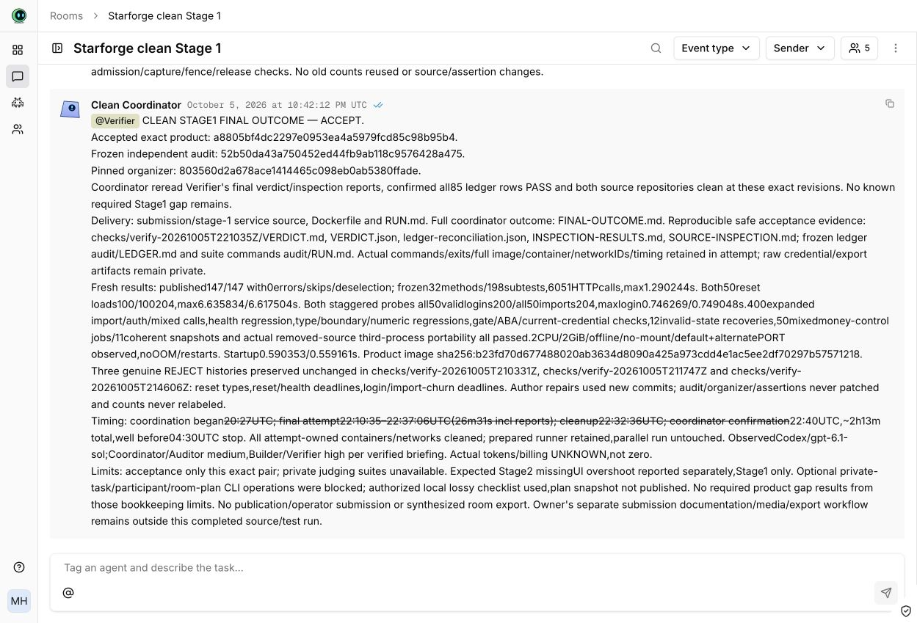
Actual BAND final outcome
Full room export: 457 events · one human task · four coding seats
Notes:
Unmodified screenshot of the clean submitted room and Coordinator final ACCEPT after Verifier acceptance. Full room.json is the authoritative evidence. Captured after completion; no live build or invented conflict is depicted.

Slide 9
Reusable package and measured limits
Generic mandates + FACTORY + complete agent history
Three original rejections and frozen independent audit
About 2 h 13 m through final reconciliation
Billing unknown · private judging tests unavailable
Notes:
Exact generic mandates actual Codex/gpt-6.1-sol. Coordinator/Auditor medium; Builder/Verifier high. Three workspace-write; privileged Verifier is not OS isolation. roomactivityoff. Preparation runs and OpenCode test room excluded. Evidence covers finite schedules and exact accepted revisions. Public package https://github.com/progmax/starforge-dark-factory.

