Slide 1
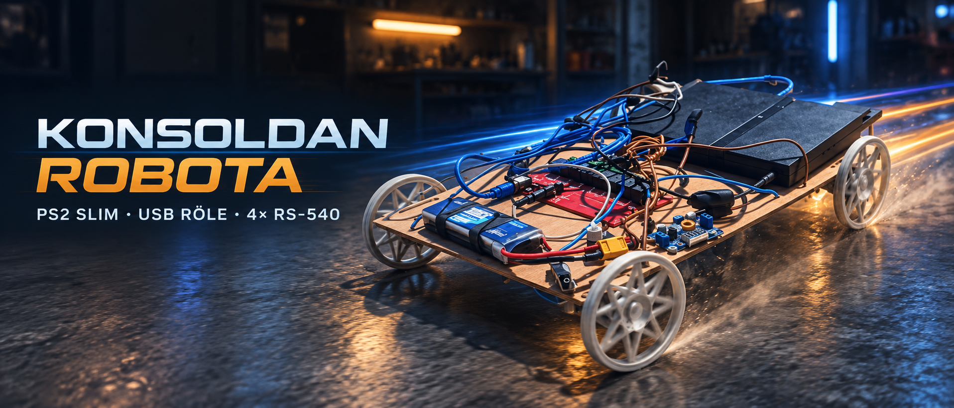
PS2 Robot Vehicle
From a 1.44 MB developer ELF to a 248 KB road-tested console robot
Hardware • software • problems • solutions • road test
Notes:
Repository story and user-confirmed field experience.

Slide 2
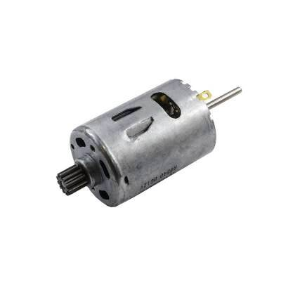
01
Project in one view
PS2 Slim SCPH-70004 runs the vehicle application
DualShock 2 controls four RS-540 motors
Seda 8-channel USB HID relay board switches polarity
One 11.1 V 3S LiPo feeds two protected branches
Notes:
Content verified against repository source, documentation, and the project conversation.

Slide 3
02
Automatic boot on real hardware
Copy role.elf to the Free McBoot memory card with uLaunchELF
Open Free McBoot Configurator → Configure E1 launch keys
Set AUTO to the role.elf path and save the CNF to MC0
At power-on, the app initializes IOP/LoadFile/SBV itself and launches automatically
Notes:
Content verified against repository source, documentation, and the project conversation.

Slide 4
03
Software path: controller to relay
At boot, the embedded USB stack and relay IOP module are loaded
main.c reads DualShock state and applies interlocks
SIF RPC transfers one relay command to the IOP
The IOP HID driver sends an 8-byte USB report to the board
Notes:
Content verified against repository source, documentation, and the project conversation.

Slide 5
04
Example relay commands
ON: relay 1=1, relay 2=2, relay 3=3, relay 4=4
OFF: relay 1=17, relay 2=18, relay 3=19, relay 4=20
Payload example: [01 00 00 CMD 00 00 00 00]
AUTO mode first tries interrupt OUT, then diagnostic transfer variants
Notes:
Content verified against repository source, documentation, and the project conversation.

Slide 6
05
Electrical connection diagram
XL4015 → 8.50 V
PS2 Slim SCPH-70004
Branch 1
11.1 V 3S LiPo
Branch 2
COM1+COM2 → left motors
NC1–NC4 → negative (−)
NO1–NO4 → positive (+)
COM3+COM4 → right motors
The relay board uses both PS2 USB ports: one for 5 V power and one for HID data.
Notes:
Content verified against repository source, documentation, and the project conversation.

Slide 7
06
Physical problem: melting wire and resets
Thin wire looked fine with the PS2 and idle relays
Connecting the motors caused high start-up current and voltage drop
The cable insulation began to melt and the PS2 reset immediately
Solution: thicker correctly sized cable, solid joints, fusing, and branch protection
Notes:
Content verified against repository source, documentation, and the project conversation.

Slide 8
07
Software problems and solutions
Undocumented HID behavior → 12 selectable transfer modes plus AUTO probing
Opposite direction inputs → software interlock forces all movement relays OFF
Relay arcing on reversal → OFF-before-ON sequence and 100 ms dead time
Disconnect or exit → verified individual OFF commands for every relay
Notes:
Content verified against repository source, documentation, and the project conversation.

Slide 9
08
Why 1.44 MB became 248 KB
relay.elf keeps DWARF debug maps: symbols, source lines, types, and variables
The PS2 executes LOAD segments; it does not need that debug map
build.ps1 copies relay.elf and runs strip --strip-debug on role.elf
Result: 1,509,884 bytes → 254,224 bytes (248.3 KiB), with the same executable LOAD data
Notes:
Content verified against repository source, documentation, and the project conversation.

Slide 10
09
Motion programming and field diagnosis
Record up to 128 one-second movement or wait steps
L1 saves ROLEPRG.TXT; L2 loads it; START replays it
R1 opens settings for VID, PID, send mode, AUTO USB, and dead time
On-screen result/status/control/interrupt values expose real USB outcomes
Notes:
Content verified against repository source, documentation, and the project conversation.

Slide 11
10
Road tests and videos
Phase 1 is battery-powered, controller-driven, and test-driven
Video 1: youtube.com/shorts/x-vaeMoXdgk
Video 2: youtube.com/shorts/5uW2evH4y8U
PCSX2 validates menus; relay behavior is verified on the real SCPH-70004
Real driving evidence
Notes:
Content verified against repository source, documentation, and the project conversation.

Slide 12
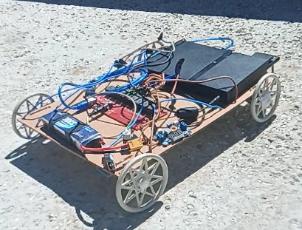
11
Completed vehicle
Four RS-540 motors • two drive groups • PS2 Slim • USB relay • 3S LiPo
Notes:
Content verified against repository source, documentation, and the project conversation.

