Slide 1
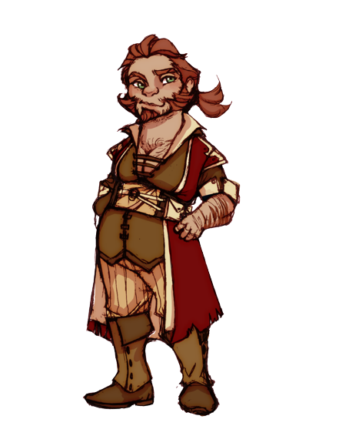
The Dwarves Solution
Ruben Larrazolo

Slide 2
the Data
* Perform data preparation & cleaning using Pandas & Numpy
* Perform exploratory analysis & visualization using Matplotlib & Seaborn
* Ask & answer questions about the data in a Jupyter notebook
* Summarize your inferences & write a conclusion

Slide 3
PROBLEMs
THE BABY'S
There aren’t many baby-dwarves, not sure why.
THE holiday
Is there a dwarven holiday, why ?
THE BEARD situation
How to distinguish between males and females.
THE CHIEF ASTRONOMER
He Keeps telling Darf that dwarves born on June are sensitive and caring.

Slide 4
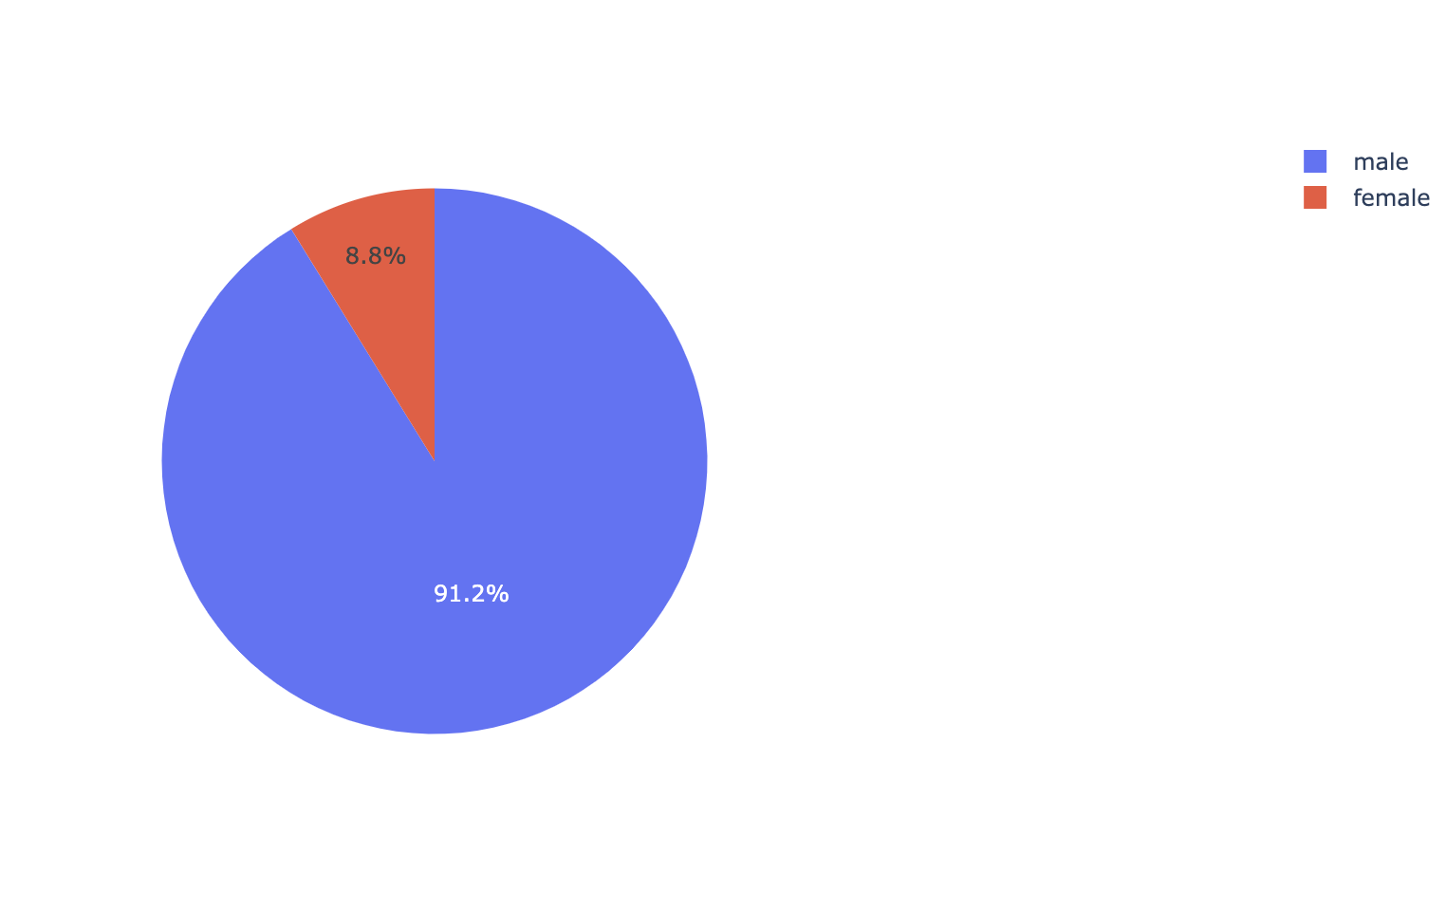
There aren’t many baby-dwarves, not sure why.
The reason there are not too many baby dwarves is because the number of male dwarves completely outnumbers the female dwarves. Out of the 48,270 only 4,250 are females which is only about 8.8% of the dwarf population in Dwarvenmark.

Slide 5
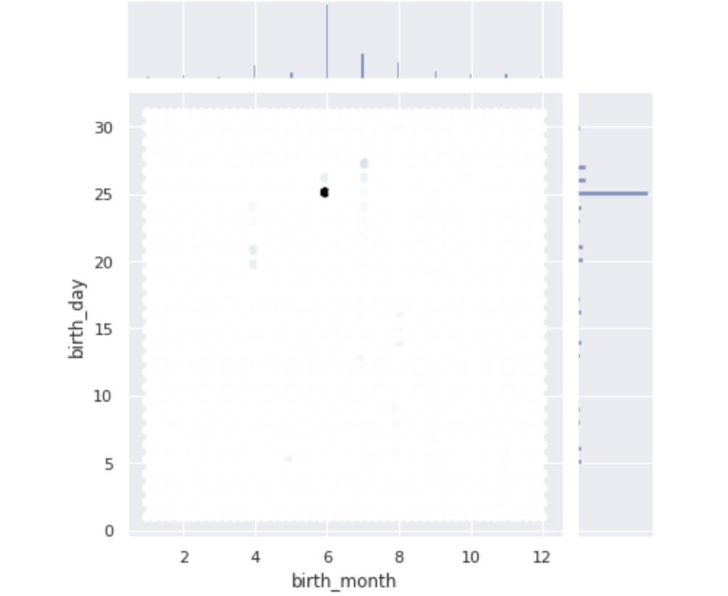
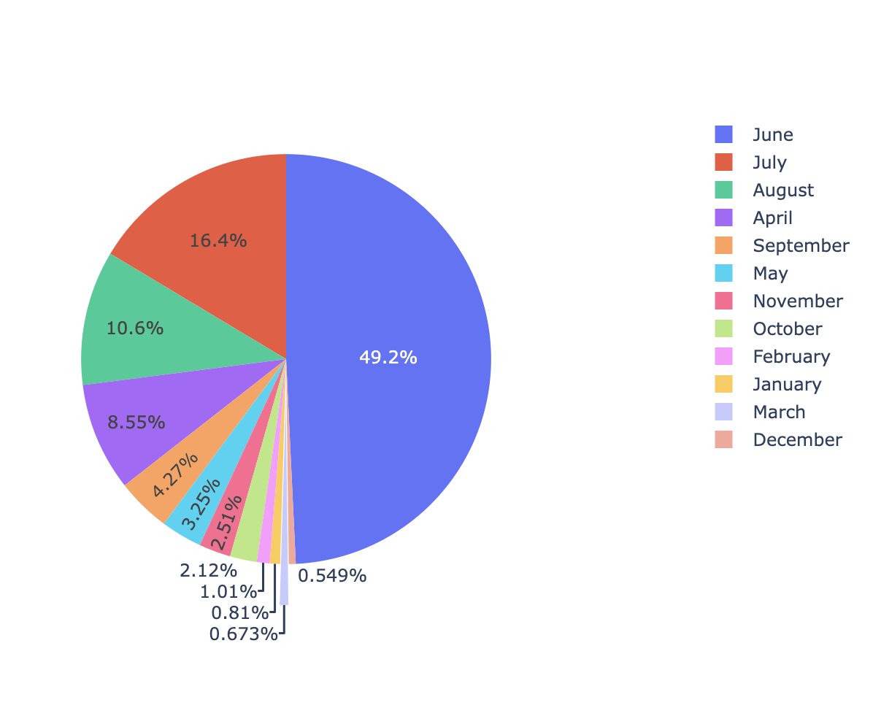
The holiday
June 25 is a very important day in Dwarvenmark, why ? Because it is about half of the population’s birthdays, now I understand why they are pusing to make it a holiday!

Slide 6
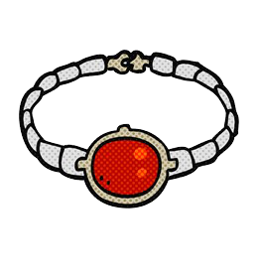
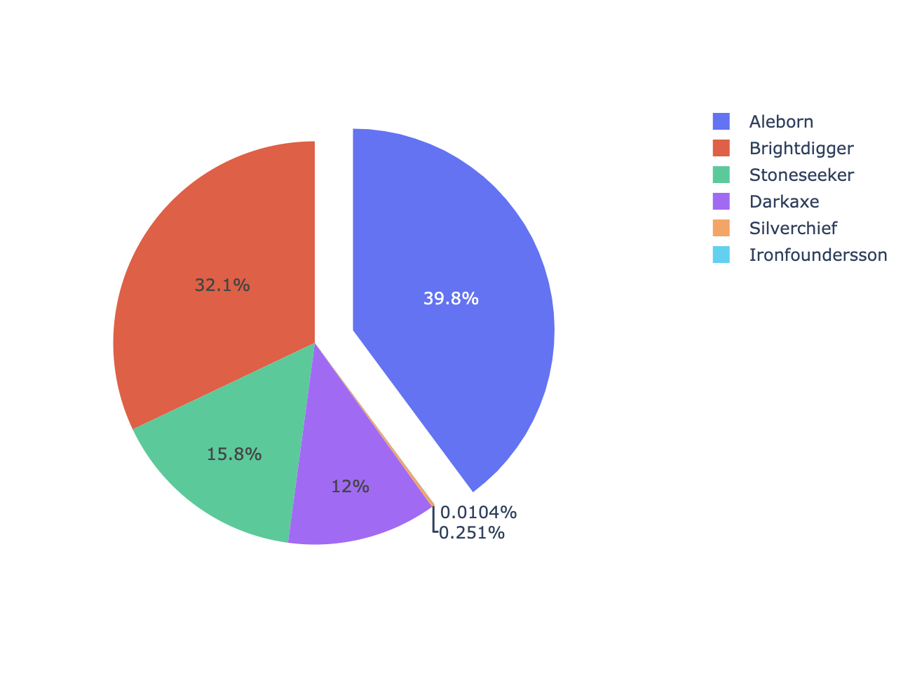
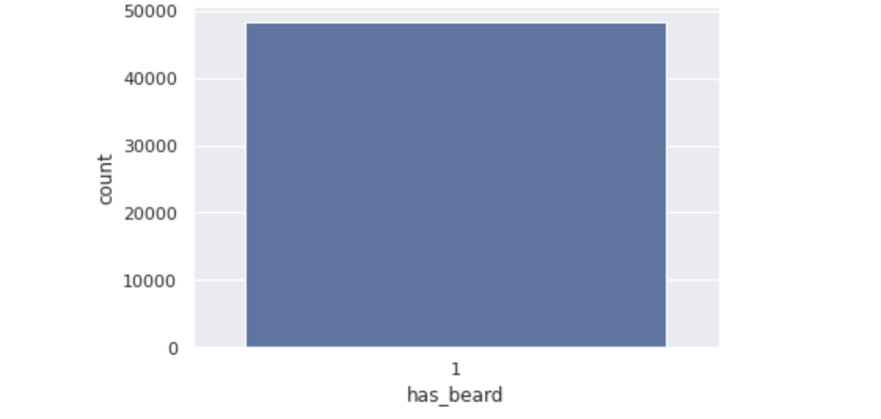
THE BEARD situation
The problem
the Solution
BRACELET IN COLOR
All the population of Dwarvenmark has beard .
I have found that all females have the same surname, all 4,250 females are Aleborns.
Bracelet for dwarves with last name Aleborns.

Slide 7
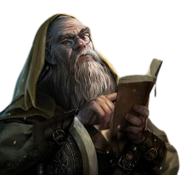
THE CHIEF ASTRONOME
Maybe Clan Chief Astrologer was onto something when he said that dwarves born in June are sensitive and caring, or he just thinks that most dwarves he knows are sensitive and caring given that being born in July isn’t too specific in Dwarvenmark.

Slide 8
SUMMARY
Darf the dwarf’s gut feeling was correct in a few things, for example based on my findings while using my cömp-û-trrr thing I was able to conclude that the reason there are not too many baby dwarves is because the number of male dwarves completely outnumbers the female dwarves. Out of the 48,270 only 4,250 are females which is only about 8.8% of the dwarf population in Dwarvenmark. Darf the dwarf was onto something with a few things, for example going off of his gut feeling again I discovered that June 25 is a very important day in Dwarvenmark, why ? Because it is about half of the population’s birthdays, now I understand why they are pushing to make it a holiday! Maybe Clan Chief Astrologer was onto something when he said that dwarves born in June are sensitive and caring, or he just thinks that most dwarves he knows are sensitive and caring given that being born in July isn’t too specific in Dwarvenmark. Should he be executed for being too vague? Maybe. Another reason why there aren’t too many babies could be because of how hard it is to distinguish males from females, my solution ? Bracelets ! I have found that all females have the same surname, all 4,250 females are Aleborns. That should definitely narrow things down for any dwarf bachelor. In conclusion the new major definitely has a lot of work on his hands with Dwarvenmark but nothing data can’t solve!

Slide 9
THANK YOU
Ruben Larrazolo
415-8320067
Ruben.larrazolo@gmail.com

