Slide 1
Web Fundamentals Project
BADA Abderrahmane
08/07/2022

Slide 2
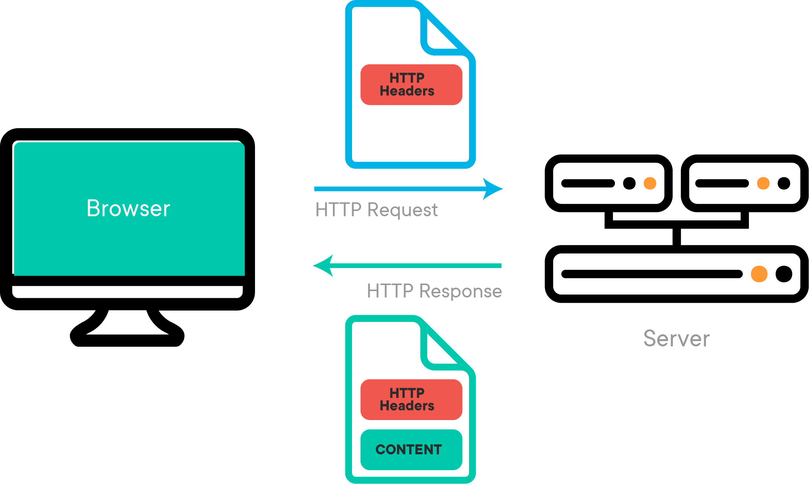
How does the web work?
the Web is an information-sharing model that is built on top of the Internet.
We can access the web via a browser, the web browser communicate with the web server via HTTP (hypertext transfer protocol) who will ensures that all parts of the web page are delivered .
Example: so when you enter URL like www.google.com in browser (client) request is sent to your ISP( Internet Service Provider) , who will communicates with DNS (Domain Name System) and checks the IP address for the server that hosts your website. when the ISP receiving the IP address of the destination server sends it to your browser.
The IP address tells that where is the server located.
The browser sent http request to the Server , he will treated the request the sent http response , That displayed by the web browser

Slide 3

What do you need to be a web developer?
Web development is building websites and web application, it’s using code and programming language to design and make the web site function .
Web developer need at least one of the three major skills , Client-side coding (front-end) , Server-side coding (back-end) ,Database technology.
Front-end Developer: code is executed on a web browser , what people see when they visit a website. Things like layout, fonts, colors, menus, and contact forms are all designed by the front-end, they using (HTML,CSS, JavaScript , JQuery , Bootstrap , React…).
Back-end Developer: the part of a website that the user doesn’t see , It is responsible for storing and organizing data like email and password , and check the validation of them , using (PHP , ASP , Python , Node).
Full Stack Developer: A full stack web developer is a person who can develop both client and server software.

Slide 4
Why did you choose to learn web development?
Because I love developing web sites. I have always been curious about how a world wide web and web sites work, and i’m sure that is the main reason why i chose to lean web develpement. And it everywhere, and the are the easiest way to communicate.

