Slide 1
App description
Sedaruta mern app project
BADA Abderrahmane

Slide 2
Description of the topic of the application :
Sedaruta is E-commerce web application, used to sell clothes online, easy to use for the seller and the buyer, responcive to all screens and devices, with high security, fast and efficient service.

Slide 3
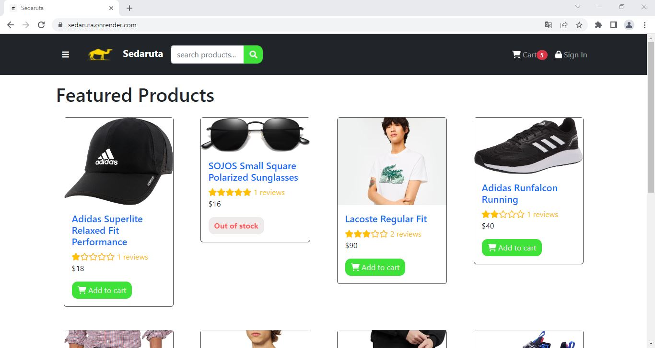
Sedaruta screen :

Slide 4
Actors in Sedaruta :
Visitors: A visitor has a little freedom, he can see all products, descriptions , details and prices for each products, and he can add it to the cart with the quantity he wants, but he cannot procced with the purchase process until he logs into his account (become a user).

Slide 5
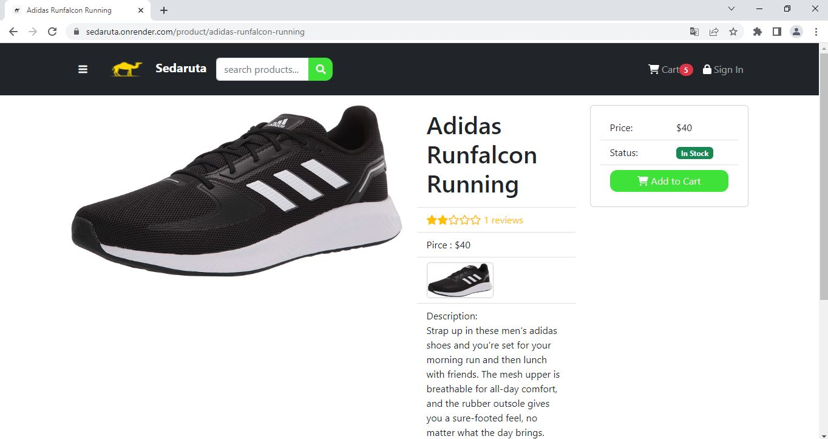
Product Details :

Slide 6
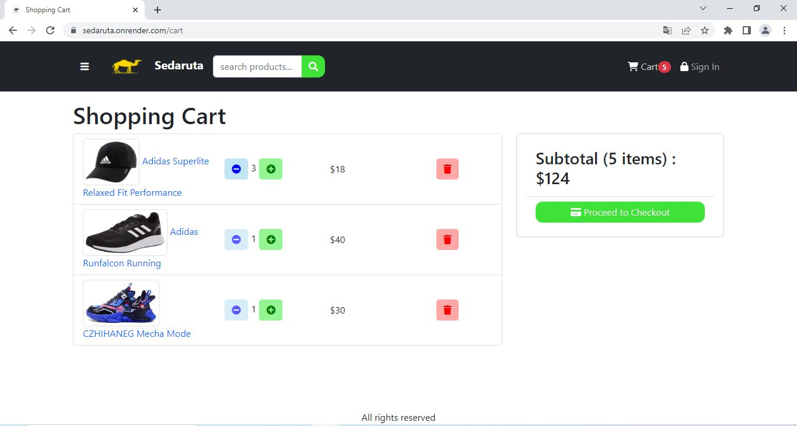
Cart :

Slide 7
Actors in Sedaruta :
Users: A user is the one who can make a purchase, and in order to be able to become a user, he must create an account, then log in and complete the purchase process, which includes entering some information about him like full name , address , city and country, payment method, and by this he can buy from sedaruta .
He can also see the order history and modify account information (username , password , email).

Slide 8
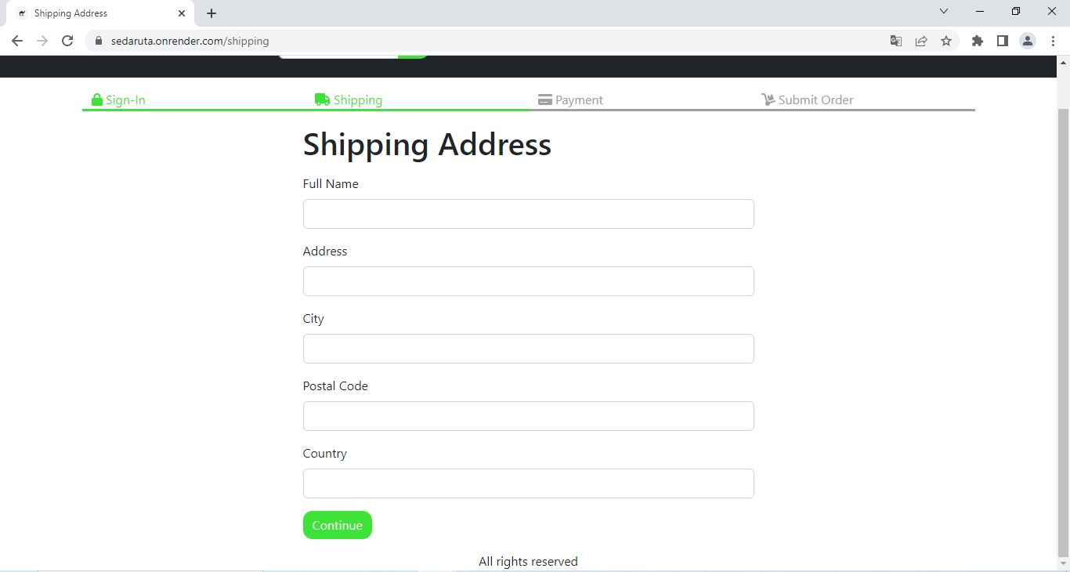
Payment Process :

Slide 9
Actors in Sedaruta :
Admins : admin is the person who has all user privileges in addition to other privileges such as modifying products, adding and deleting product, modifying user profile, and also has a platform to follow all orders by means of a graph.

Slide 10
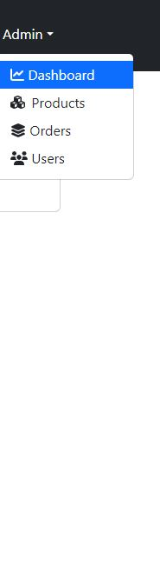
Admin field :

Slide 11
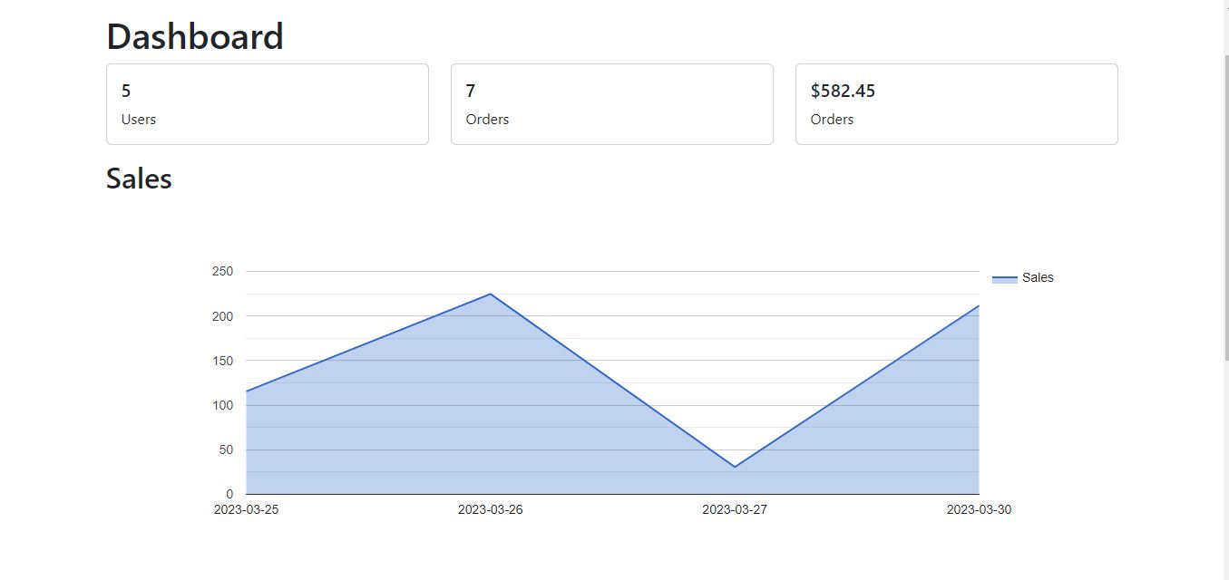
Dashboard:

Slide 12
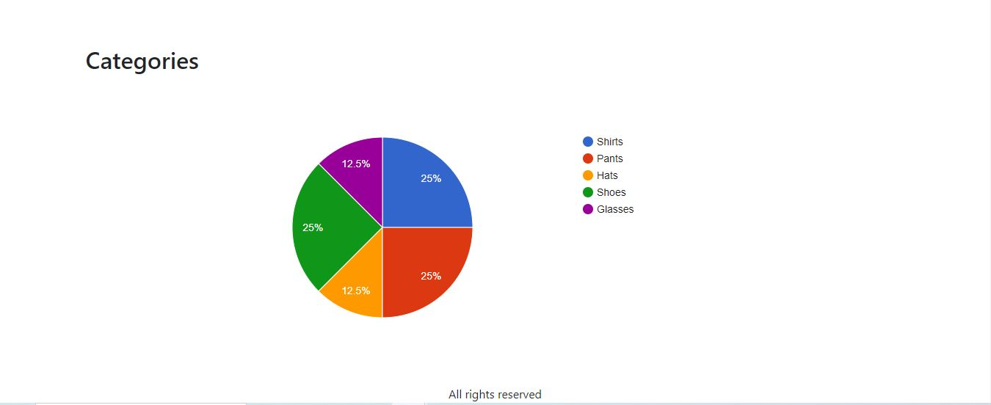
Dashboard:

Slide 13
Instructions
Frontend :
developed by React
# run this command to run the project
cd frontend
npm install
npm start
Backend :
developed by NodeJS , ExpressJS , MongoDB for the database .
# run this command to run the project
cd backend
npm install
npm start

Slide 14
Instructions
About env file:
you need to configure MAILGUN for the reset password functionality .
you need to configure Couldinary for the uplaod images functionality .

