Slide 1
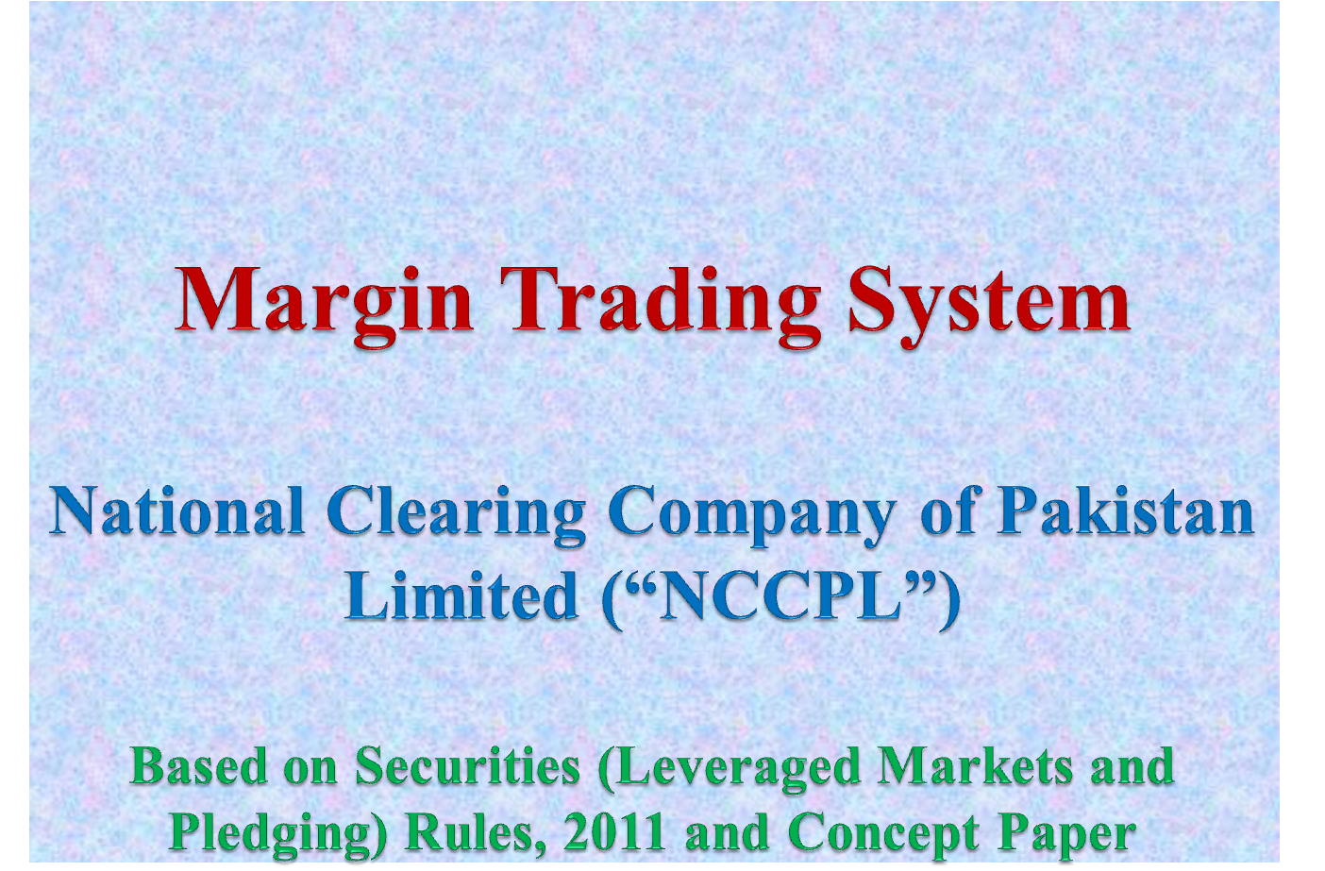


Slide 2

Margin Trading System- MTS
Legal Frame Work
The operations of MTS are governed under the following:
Securities (Leveraged Market and Pledging) Rules, 2011;
NCCPL Regulations;
NCSS Procedures;
Relevant Regulations of the Stock Exchange; and
CDC Regulations.

Slide 3
Margin Trading System- MTS
Overview
The term “margin trading” refers to the purchase of securities in ready market by equity participation.
Financing are available only on pre-identified ready market purchases, termed as ‘Leverage Buy’ to be executed in the trading systems through a separate function key i.e. F7.
Margin Trading is done on an undisclosed manner through a platform provided by NCCPL, as an Authorized Intermediary, to Financees and Financiers.
Margin Trading facility is made available only in Eligible Securities .
The maximum mark-up rate in MTS Market is KIBOR+8%.

Slide 4
Margin Trading System- MTS
Overview
All transactions executed in MTS Market are based on Financing Participation Ratio (“FPR”) i.e. equity participation by Financees.
Equity participation to be paid by the Financee for the settlement of each MT Transaction is 15% of MT Transaction Value. Whereas, Trading Financier is required to settle 85% of MT Transaction Value on respective settlement date.
Maximum duration of MT Contract is sixty (60) calendar days. However, on every fifteenth (15th) calendar day, MTS will automatically release one fourth quantity of the MT Contract Value

Slide 5
Margin Trading System- MTS
Overview
  The Financees are allowed to release their MT Contract at any given point of time during the entire MT Contract period and can roll-over in MT Market. However, in case of same day release one day mark-up will be charged.
  MTS will compare UIN-wise net position, in ready market, at the day end and any excessive volume of MTS, over and above the net leverage buy, shall be force released on the same day.
  All Trading Financiers are required to open a separate MT Blocked Account in CDS. Accordingly, all MT Financed Securities are moved in the respective client/house accounts in blocked status

Slide 6
Margin Trading System- MTS
Overview
  Broker Trading Financiers are allowed to provide financing in MTS through their own funds, funds borrowed from financial institution and through their individual clients as well.
  Broker Trading Financiers will be required to enter into a separate agreement with their clients in accordance with the provisions of the Rules.

Slide 7
Margin Trading System- MTS
Overview
  Risk management measures such as exposure margins, concentration margins, liquidity margins and MTM are applied on MT Contract. Capital adequacy limits and position limits are also applied on Financiers and Financees in accordance with the Regulations.
  MT (R) Transaction margins are required to be paid by the Financees in the form of cash, bank guarantee and/or MT Eligible Securities. Whereas, MTM Losses are collected in the form of cash only. However, such MTM losses are paid to the respective Financiers on daily basis.
With the payment of such daily MTM payment, MT Contract value is aligned and mark-up is charged on the reducing balance accordingly.
After settlement, all MT Financed Securities will be moved to respective house/sub-accounts of Trading Financier in its separate MT Blocked Account in CDS.
.

Slide 8
Margin Trading System- MTS
Eligible Trading Financiers
The following entities will be eligible to apply to NCCPL for admission as Trading Financiers:
“broker” of stock exchange meets the minimum net capital balance and paid up capital requirements;
“banking company” allocated minimum short-term credit rating of A3;
“financial institution” allocated minimum short-term credit rating of A3;
“collective investment scheme” allocated minimum short-term credit rating of A3;
“investment finance company” allocated minimum management quality rating of AM3 minus; and
any other entity admitted by NCCPL Board and approved by SECP.

Slide 9
Margin Trading System- MTS
Eligible Financee
Broker Clearing Members (“BCM”) will be the Financees in MT Market subject to the following conditions:
  BCM holds a membership of stock exchange;
  no action is pending in any court or has been initiated by the stock exchange or the SECP against such BCM;
  BCM is not in breach of NCCPL Regulations or any law or other regulations;
  BCM submitted an addendum to the agreement to NCCPL; and
  BCM meets the minimum net capital balance requirement.

Slide 10
Margin Trading System- MTS
MT Eligible Securities
NCCPL declares list of MT Eligible Securities based on the eligibility criteria.
Corporate Entitlements, if any, in MT Eligible Securities (having open position in MTS i.e. MT Financed Securities), will be credited automatically in the respective Financee’s accounts in CDS.

Slide 11
Margin Trading System- MTS
Risk Management Measures
A. Capital Adequacy Requirements
Following conditions are applicable on MT Participant w.r.t. Capital Adequacy requirements:
  Financee’s Capital Adequacy Limits:
Financee Location | Minimum Net Capital Balance | Capital Adequacy Limit in MTS | Capital Adequacy Limit in all Markets
PSX | Rs. 10 million | 5 times of net capital balance | 25 times of net capital balance
LSE | Rs. 4 million
ISE | Rs. 4 million

Slide 12
Margin Trading System- MTS
Risk Management Measures
Trading Financier’s Minimum NCB and Paid-up Capital:
Broker Trading Financier Location | Minimum Net Capital Balance | Minimum Paid up Capital
PSX | Rs. 20 million | Rs. 50 million
LSE | Rs. 8 million | Rs. 20 million
ISE | Rs. 5 million | Rs. 10 million

Slide 13
Margin Trading System- MTS
Risk Management Measures
C. Position Limits for Financees
Market wide position limit | 20% of free-float for each MT Eligible Security subject to maximum of Rs. 10 billion
Member wide position limit | 2% of free-float of the MT Eligible Security subject to maximum of Rs. 1 billion.
Client wide position limit | 0.5% of free-float of the MT Eligible Security. Client position will be universal and determined on UIN basis subject to maximum of Rs. 250 million for each MT Eligible Security. Provided that overall financing availed in all MT Eligible Securities shall not exceed Rs.1.00 billion.
Maximum exposure in all leverage markets | 7.5 times of the net capital balance of a Broker Clearing Member.

Slide 14
Margin Trading System- MTS
Default Management
NCCPL shall manage default on MT Contract as per the following Procedures:
  Financee Default (Marked-to Market Losses)
  In case of non-payment of MTM Losses, Financee shall be required to identify the defaulted UIN of its client to NCCPL.
  NCCPL shall suspend such UIN for taking position in all Markets.
  Financee shall be required to square up the open position and MT (R) Transactions margins of the defaulted client within 3 hours on next Trading Day and deposit the MtM Losses to NCCPL.
  In case of non-squaring-up by the Financee, NCCPL shall initiates squaring-up of the open position and MT (R) Transactions margins of such defaulted client on the same day.

Slide 15
Margin Trading System- MTS
Financee Default (Marked-to Market Losses)
  In case of non-squaring-up by NCCPL, all open MTS Contracts of such defaulted UIN shall be Released. Accordingly, MT Financed Securities and MT (R) Transactions margins of such defaulted UIN will be allocated to the respective Trading Financiers by NCCPL.
  MT Contract of such defaulted UIN shall be treated as closed.
  NCCPL shall restrict such defaulted UIN from taking new positions in all Markets for a period of six-months.
  In case of second default of same UIN(s), NCCPL may block such UIN for the period of three years.

Slide 16
Margin Trading System- MTS
Financee Default (Marked-to Market Losses)
Relevant Financee shall also be penalized as follows:
  In case of first default by the Financee: 2% of the defaulted amount shall be charged and will be restricted in leverage markets for three months.
  In case of second default by the Financee: 4% of the defaulted amount shall be charged and will be restricted in leverage markets for six months.
  On any subsequent default by the Financee, permanent restriction will be applied in leverage markets.

Slide 17
Margin Trading System- MTS
Financee Default (Settlement)
  In case where Financee fails to settle his money obligation on the settlement date of MTS (R), NCCPL shall suspend such Financee in all Markets.
  All margins of a suspended Financee, held by NCCPL/Stock Exchange, shall be liquidated.
  In case of shortfall still persists, NCCPL shall initiate squaring-up process of open MT Contracts and MT (R) Transactions margins of such suspended Financee for two consecutive working days.
  In case of shortfall persists even after the said squaring-up, NCCPL shall allocate MT Financed Securities and MT (R) Transactions margins to the respective Trading Financiers.

Slide 18
Margin Trading System- MTS
Trading Financier’s Default
  In case where Trading Financier fails to settle his money obligation on the settlement date, NCCPL shall suspend such Trading Financier for all Markets.
  All margins of a suspended Trading Financier, held by NCCPL shall be liquidated.
  Respective Financees shall be given an opportunity to re-finance from MT Market.
  In case where Financees unable to re-finance the leverage buys, such Financees shall be required to settle such leverage buys through NCSS Balance Order.
  All other open MT Contracts of the suspended Trading Financier shall be released on their respective Maturity Dates and will be settled in accordance with the relevant Regulations of NCCPL and CDC

Slide 19
Margin Trading System- MTS
Market Information
NCCPL disseminates the following key statistics pertaining to MTS through its website:
  Funds to be force released in 3 days advance with respective 1/4th and 15th day philosophy
  Scrip wise total amount of released transactions in the day.
  Total funding provided in each MT Eligible Security.
  Total amount of MTS funds released during the day and re-financed.
  Weighted average rate of mark-up charged in each of the MT Eligible Security for the day.

Slide 20
Thank you !

