Slide 1

Shor's Algorithm
Factoring by finding a period
Visual walkthrough screenshots from the interactive demo · Example N = 15, a = 2
Fazil Mohammad Shahbaz · ITCS 411 · University of Bahrain
1 / 11

Slide 2
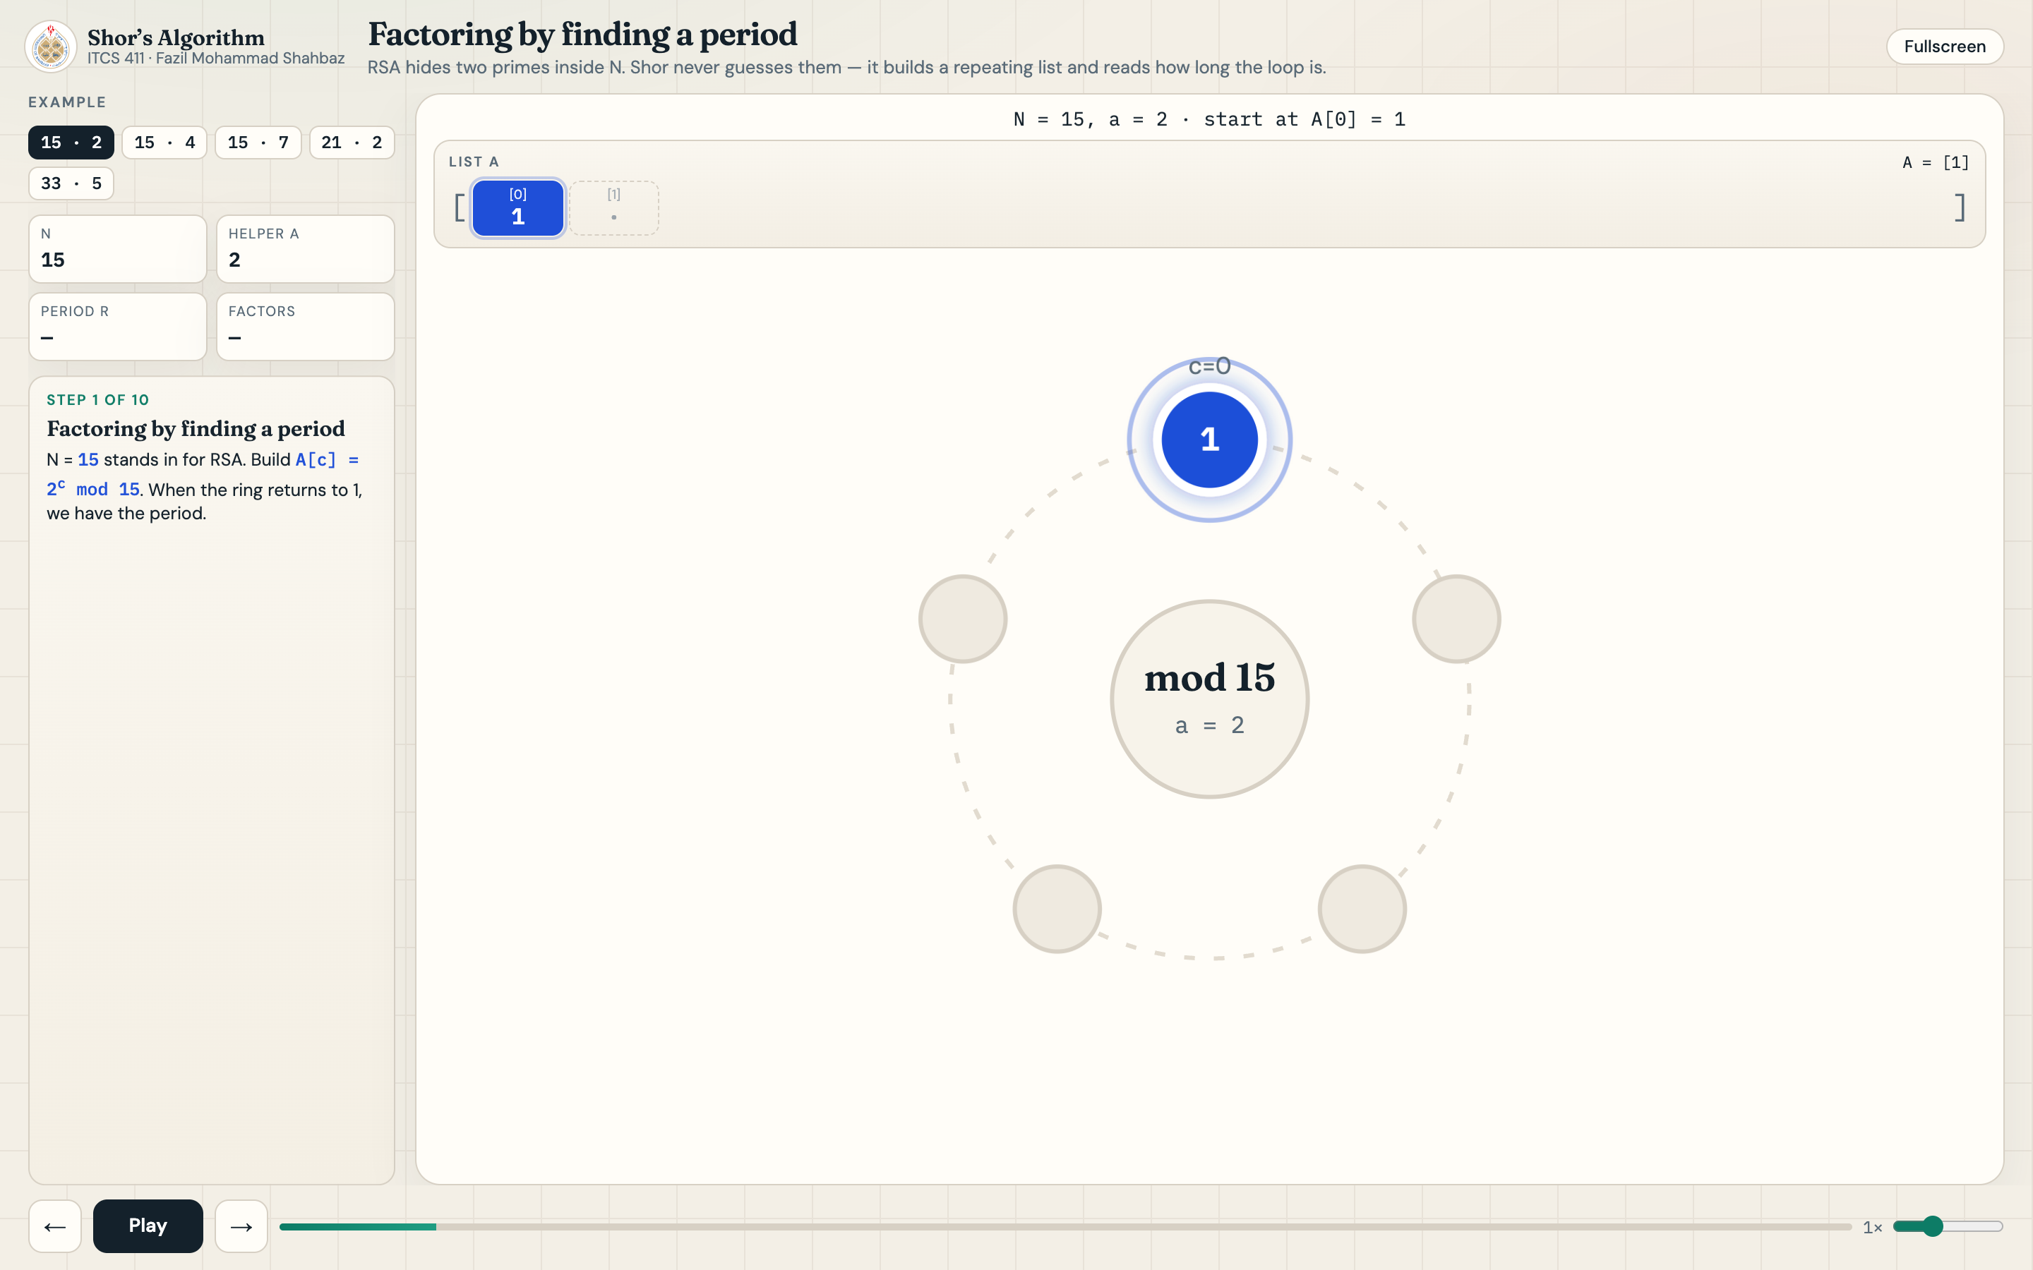
01 · The idea — factoring by finding a period
2 / 11

Slide 3
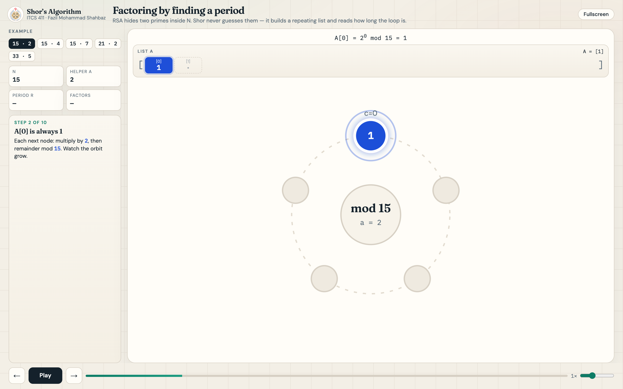
02 · Start at A[0] = 1
3 / 11

Slide 4
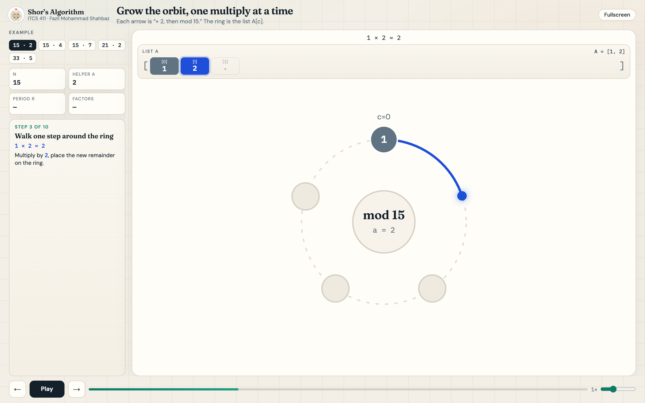
03 · Multiply: 1 × 2 = 2
4 / 11

Slide 5
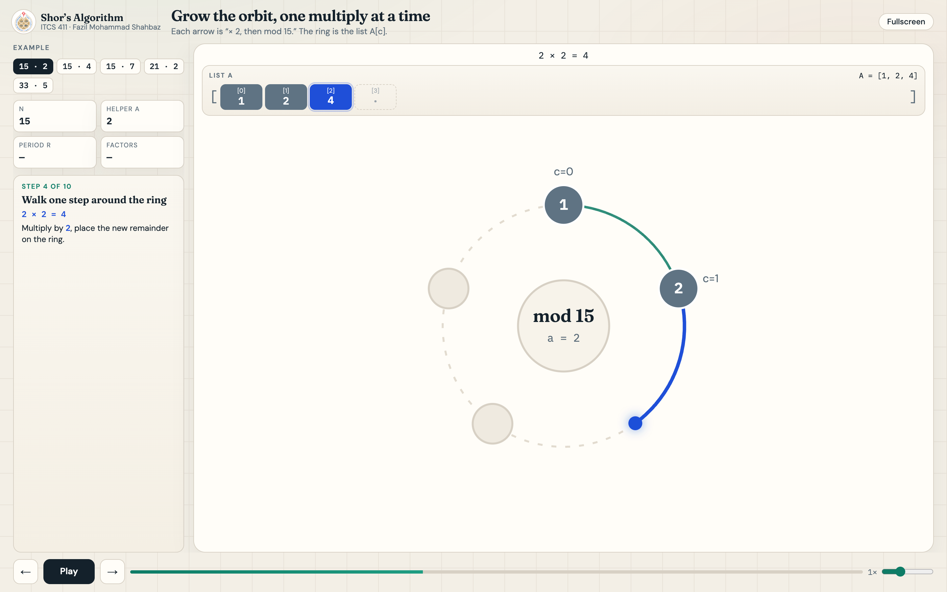
04 · Multiply: 2 × 2 = 4
5 / 11

Slide 6
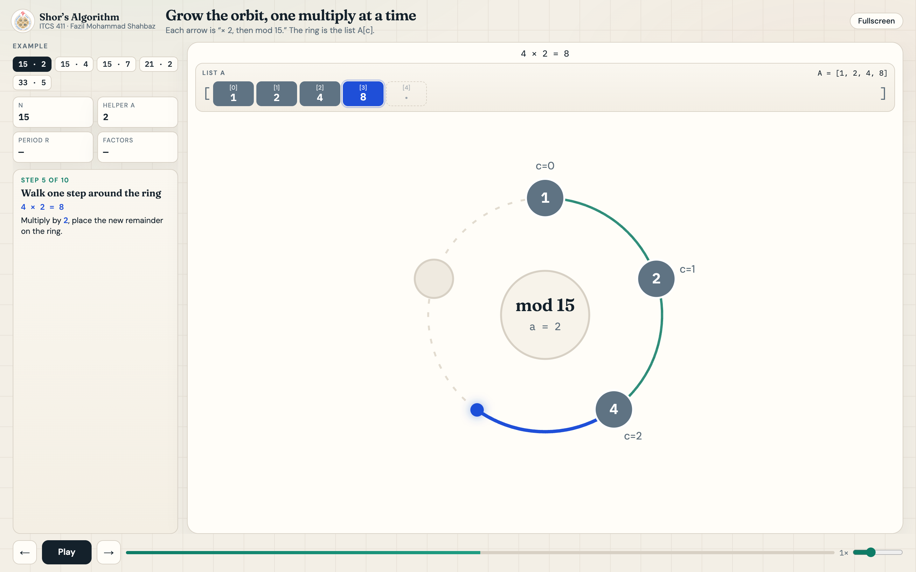
05 · Multiply: 4 × 2 = 8
6 / 11

Slide 7
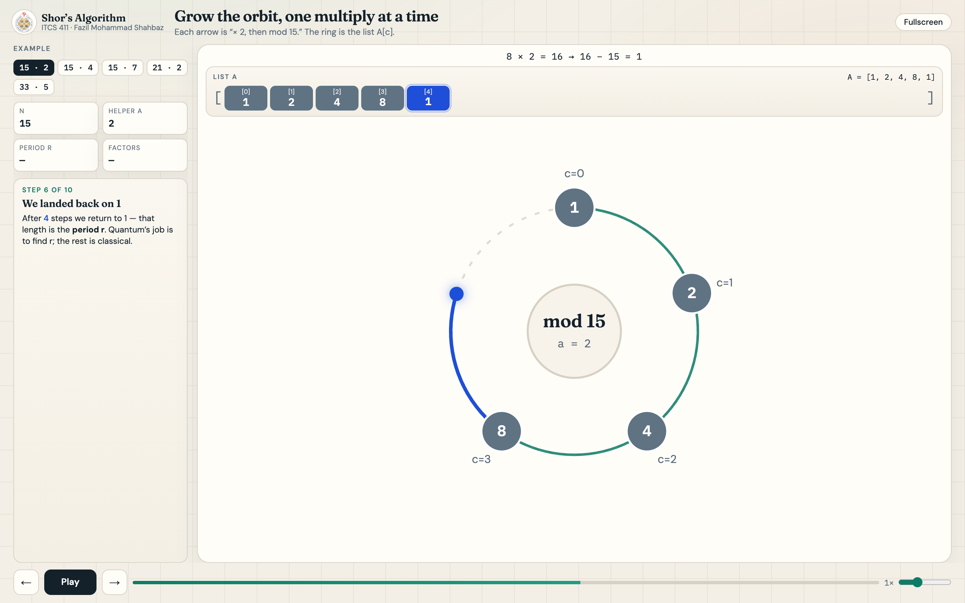
06 · Loop closes — back to 1
7 / 11

Slide 8
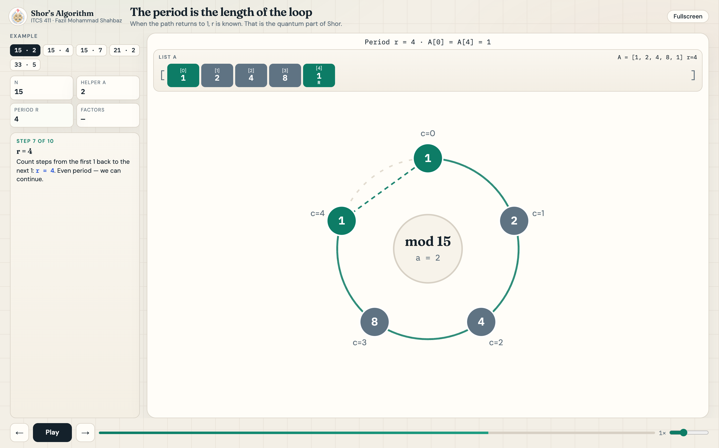
07 · Period r = 4
8 / 11

Slide 9
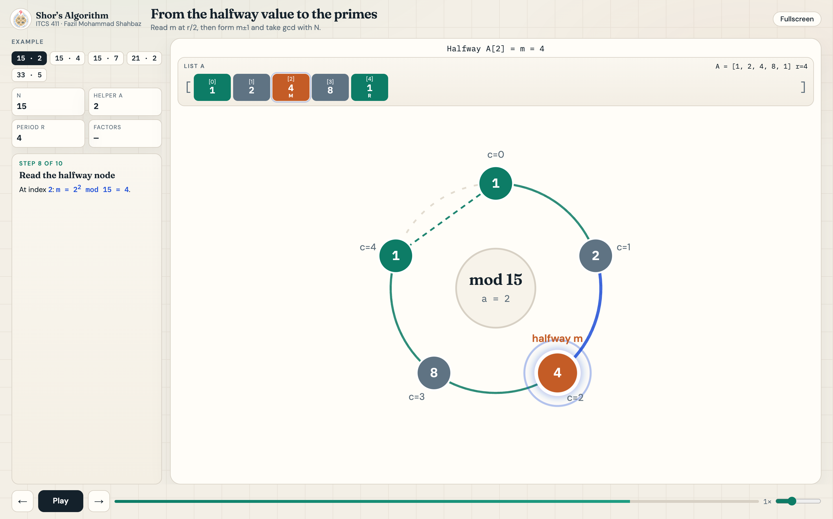
08 · Halfway value m = 4
9 / 11

Slide 10
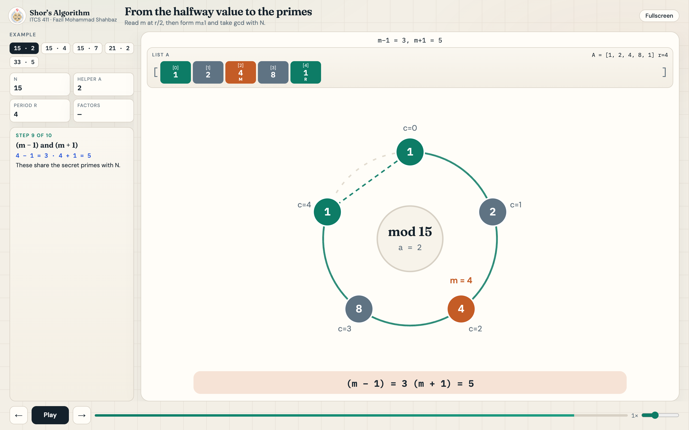
09 · Split m ± 1 → 3 and 5
10 / 11

Slide 11
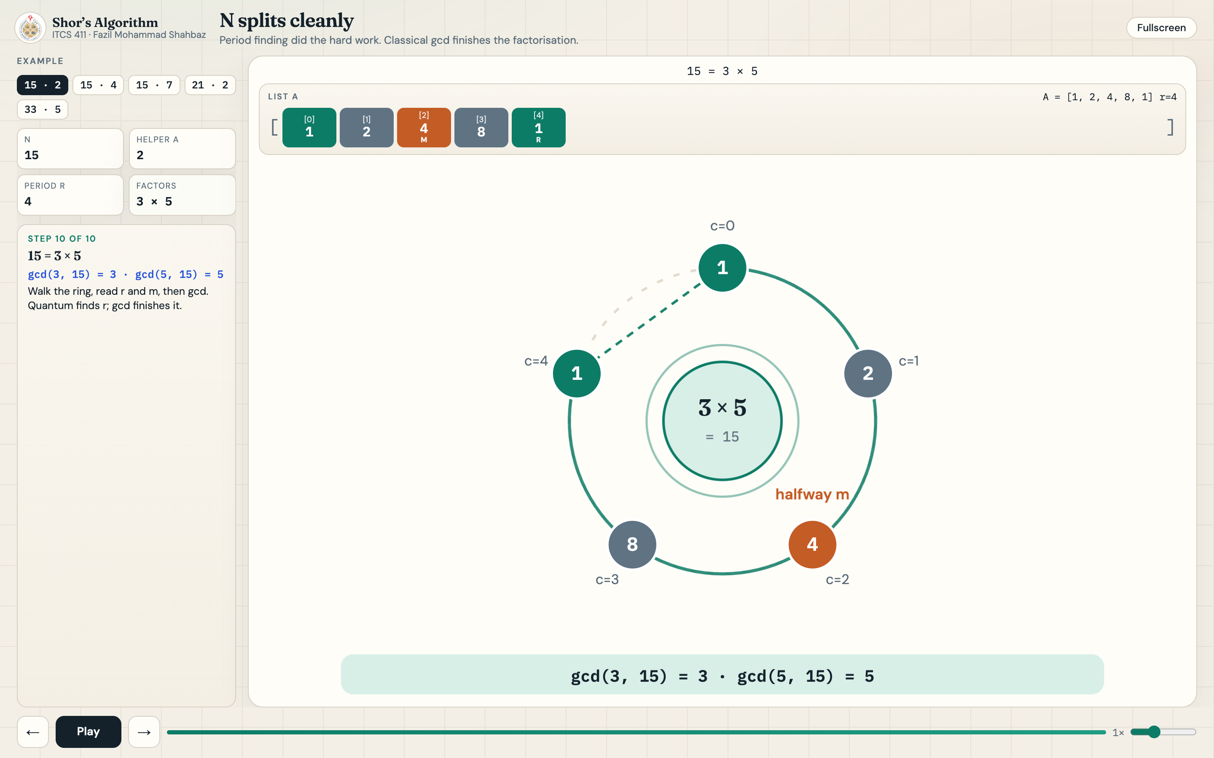
10 · gcd → 15 = 3 × 5
11 / 11

