Slide 1

NARAINA VIDYA PEETH ENGINEERING AND MANAGEMENT INSTITUTE , KANPUR
DEPARTMENT OF COMPUTER SCIENCE AND ENGINEERING
Project Presentation
On
HSDCS
(Hand Sign Detection Control System)
Under the guidance of
Mr- Alok Kumar Yadav
Team members
Neha – 2004290100017
Nitin Kumar Maurya – 2004290100018
Payal Rajput -2004290100019
Rishabh Raj -2004290100021

Slide 2
PROBLEM STATEMENT
User friendly interface or intuitive interface
Demand for natural user interface
Sign language recognition or gesture recognition technology
Notes:
Demand for intuitive and accessible interfaces that allow seamless interaction between humans and technology.
In modern human-computer interaction paradigms, there is a growing demand for natural and intuitive interfaces that enable users to interact with technology effortlessly.
People use hand signs to communicate, hence normal people face problem in recognizing their language by signs made. Hence there is a need of the systems which recognizes the different signs and conveys the information to the normal people.

Slide 3
OBJECTIVE
Developing hand gesture based interface or sign language interface development.
Comprehensive gesture recognition training
Real time gesture recognition system architecture
Notes:
1.Developing a such human computer interface which uses hand sign to interact with the system.
2. Developing a gesture recognition system trained on a diverse dataset of hand sign images, encompassing a wide range of gestures, hand orientations, and environmental factors.
3. Integrating the detection and recognition modules into a cohesive system architecture capable of real-time performance on hardware platforms ranging from embedded devices to desktop computers.

Slide 4
LITERATURE REVIEW
Sr.no | Title of the paper | Authors of this paper | Findings | Main Focus | Year
1 | “Hand Gesture Recognition System based in Computer Vision and Machine Learning” | Paulo Trigueiros, Fernando Ribeiro and Luís Paulo Reis. | Describes the vision based hand gesture recognition system architecture, gives hand gesture classification in which dynamic gesture classification is one of that. | Hand gesture recognition | August 2015
2 | “Vision Based Hand Gesture Recognition” | Pragati Garg, Naveen Aggarwal and Sanjeev Sofat | Highlights the various aspects of hand posture and gesture recognition technology, discusses the available algorithms for hand posture and gesture recognition, discussing their advantages and shortcomings, describes various application areas of hand gesture recognition, | Vision based Hand Gesture Recognition techniques for human computer interaction. | 11 June 2009

Slide 5
LITERATURE REVIEW
Sr.no | Title of the paper | Authors of this paper | Finding | Main Focus | Year
3 | “Skeleton-based Dynamic hand gesture recognition” | Quentin De Smedt Hazem Wannous Jean Philippe Vandeborre | Explains about dynamic Hand Gesture dataset and its protocol and features | Recognizing skeleton model of any object | July 1, 2016
4 | “Hand Gesture Recognition Systems: A Survey” | Arpita Ray Sarkar G. Sanyal S. Majumder | This research paper describes the hand modelling for gesture recognition and also make comparison of different parameters of surveyed Hand gesture recognition system. | Hand gesture recognition, comparison | 15 May 2013

Slide 6
RESEARCH GAP
Functionality:-Around 72.2% of users of the world uses windows operating system in comparisons to other operating system but functionality of the Hand Sign Detection Control System is not available on this common platform.
Hardware Optimization:- : External Keyboard and mouse are required for any work on the personal computer, which increase the cost of system. And also increase the probability of getting any external damage on keyboard and mouse.
Portable:-. Most of the personal computers are less portable due to load of keyboard and mouse. So it is hard to bring from one place to another place.
Interface:- The interface which are provided now are not compactable with those person who cannot speak , read or hear. As we know for running any computer system you should know the language in the computer system operates. It will be by dumb people
Notes:
1.Around 72.2% of users of the world uses windows operating system in comparisons to other operating system but functionality of the Hand Sign Detection Control System is not available on this common platform.
2. : External Keyboard and mouse are required for any work on the personal computer, which increase the cost of system. And also increase the probability of getting any external damage on keyboard and mouse.
3. Most of the personal computers are less portable due to load of keyboard and mouse. So it is hard to bring from one place to another place.
4. The interface which are provided now are not compactable with those person who cannot speak , read or hear. As we know for running any computer system you should know the language in the computer system operates. It will be by dumb people

Slide 7
METHODOLOGY
Real time captured image
Matching action
DEFINED ACTION
HAND SIGN
Real time capturing image
CAMERA
MODEL
Match image
Detected sign
Response
DATA SET OF VARIOUS HAND SIGN IMAGES
OUTPUT
Notes:
1 :- here camera act as a sensor which receive input through real time capturing images.
2 :- model receive the images and detect the hand as object and compares various hand sign images from the data sets.
3 :- here for each sign a particular action will be defined so that it can produce response.

Slide 8
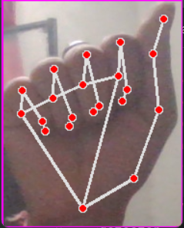
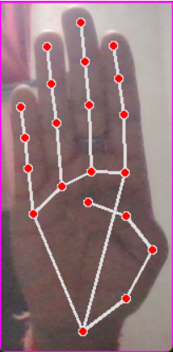
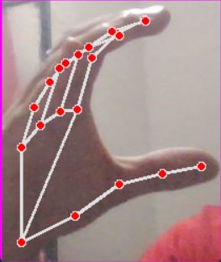
RESULT AND DISCUSSION
THESE HAND SIGN DETERMINING SOME ALPHABET
A
B
C

Slide 9
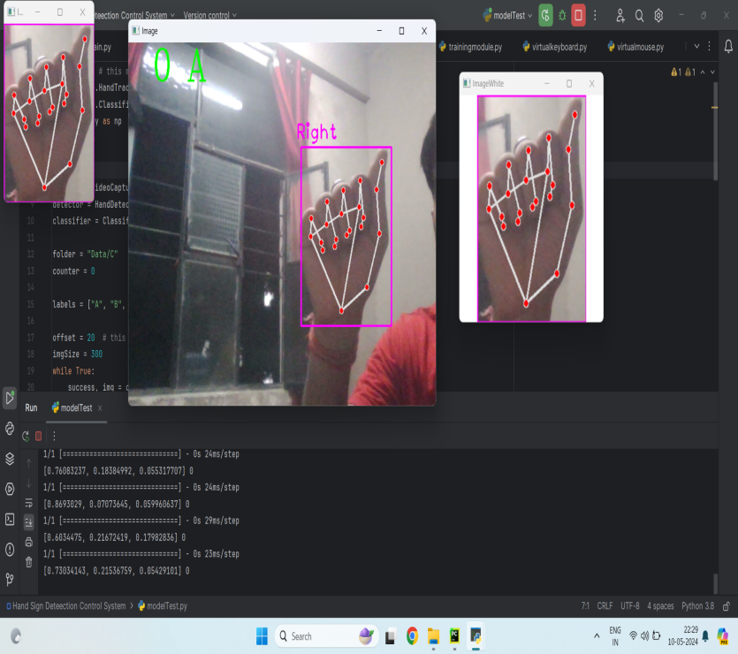
RESULT AND DISCUSSION
Sign Detect of A

Slide 10
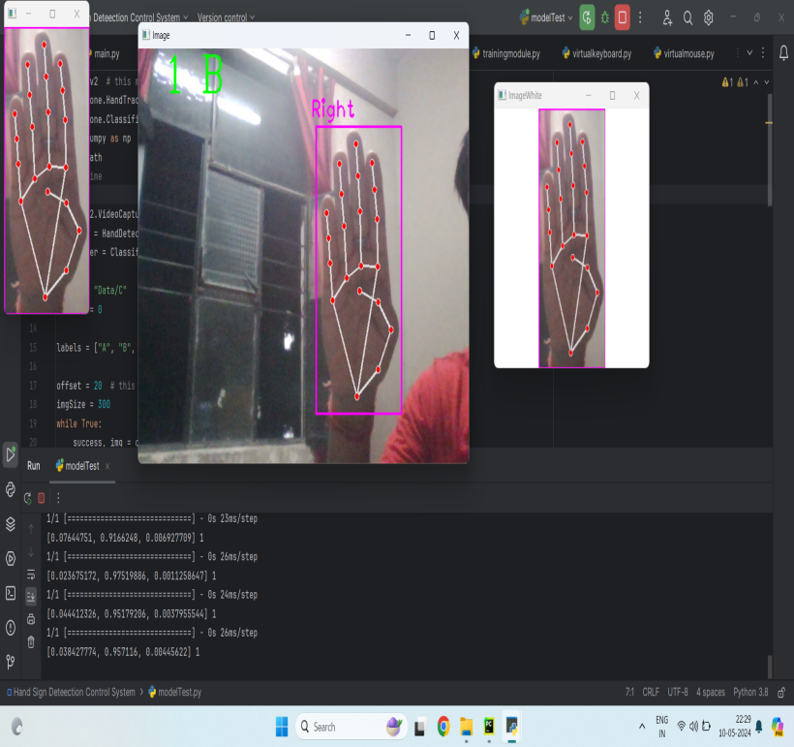
RESULT AND DISCUSSION
Sign Detect of B

Slide 11
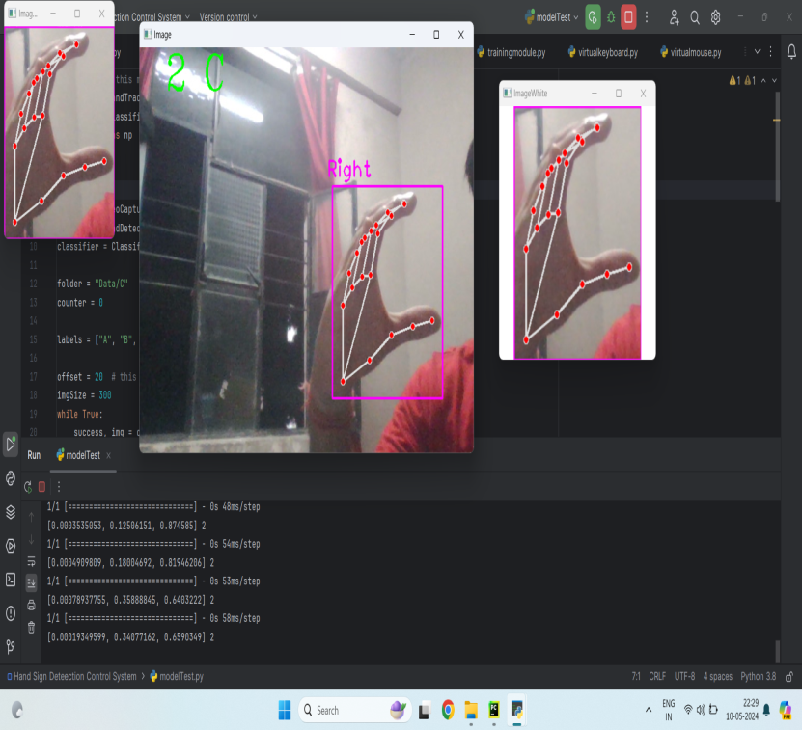
RESULT AND DISCUSSION
Sign Detect of C

Slide 12
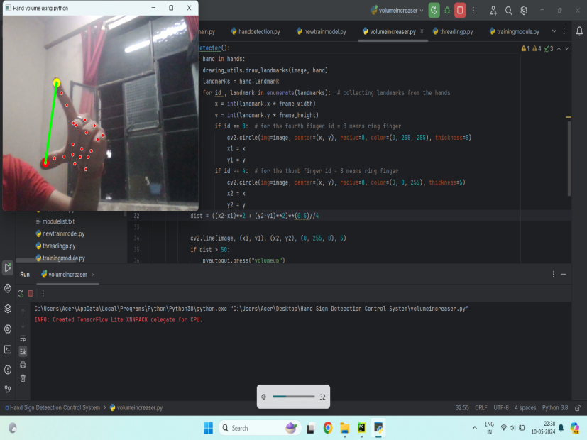
RESULT AND DISCUSSION
Volume is Decreased

Slide 13
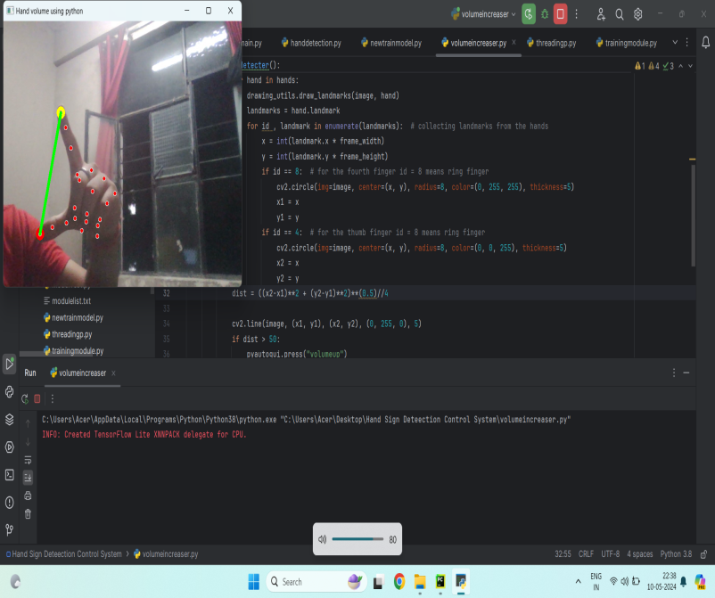
RESULT AND DISCUSSION
Volume is Increase

Slide 14
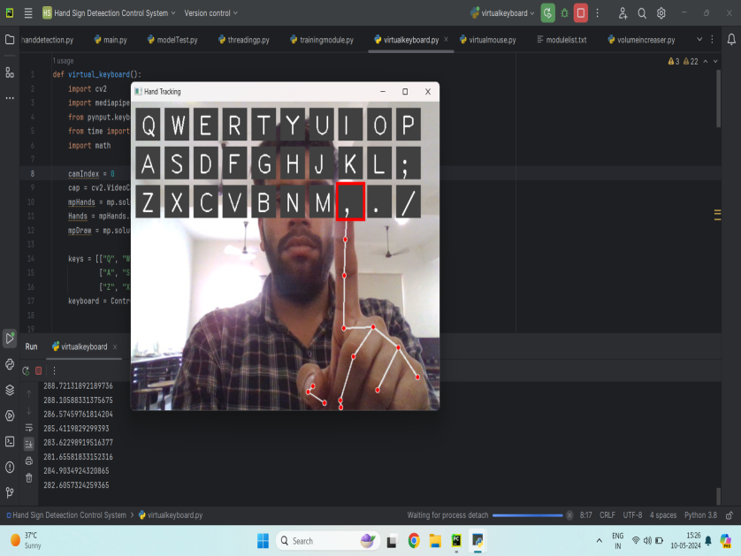
RESULT AND DISCUSSION
Virtual Keyboard

Slide 15
CONCLUSION
Enhanced Accuracy and Robustness
Real-time Performance Optimization
Gesture Recognition Beyond Hand Signs
Mobile and Wearable Applications
Notes:
1. Continue research into advance computer vision techniques ,such as deep learning architectures can further improve the accuracy and robustness.
2. Further optimization of algorithms and hardware can enhance the real-time performance of the system, reducing latency and enabling seamless interaction in time-sensitive applications.
3.Expanding the system to recognize and interpret gestures beyond hand signs, such as facial expressions and body movements, can enrich communication and interaction for I
individuals with hearing impairments.
4.Exploration of mobile and wearable applications of the hand sign detection control system can increase accessibility and convenience for users in various contexts, such as on-the-go communication or immersive experiences.

Slide 16
Thank you

