Slide 1

Laundry Management System
Jahangirnagar University, Savar, Dhaka.

Slide 2
Submitted By:
Sl. No. | Name | ID
1 | Md. Sohaq Ali | 23314
2 | Mohammad Ziaul Hoq | 23319

Slide 3
🧺 Project Overview: Laundry Management System
This project is designed to develop a smart and efficient Laundry Management System that:
Streamlines daily operations
Boosts staff productivity
Enhances customer satisfaction
It is built to serve both small laundry businesses and large-scale service providers through:
A user-friendly interface
Real-time garment tracking
A centralized, efficient data system
🎯 Key Objectives
Design an intuitive interface for seamless laundry order management
Implement garment tracking across every stage of the cleaning process — from drop-off to delivery

Slide 4
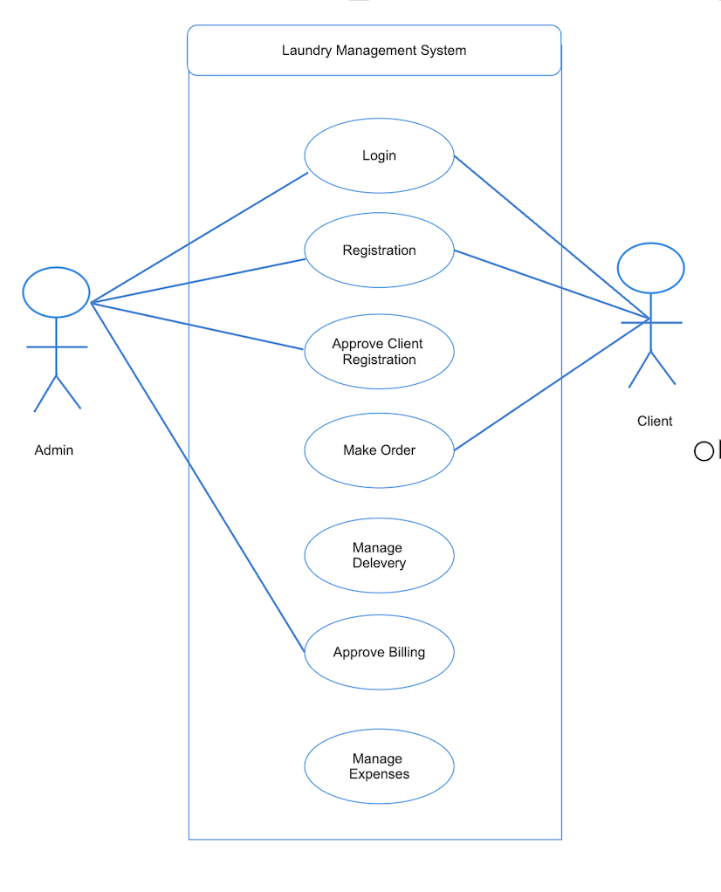
📊 Analysis
🎨 Design
💻 Software Specifications
🖥️ Hardware Specifications

Slide 5
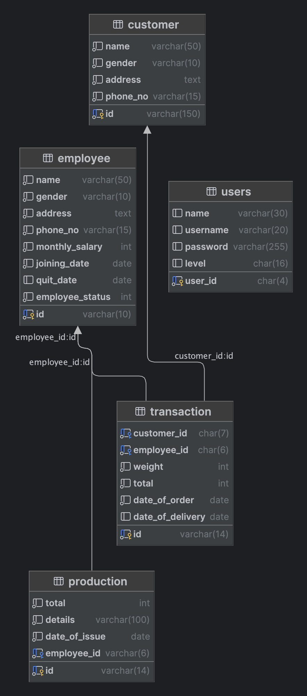
🗂️ Database Design
💾 Software Implementation
🖥️ Front End (Client Side)
🧩 Back End (Server Side)

Slide 6
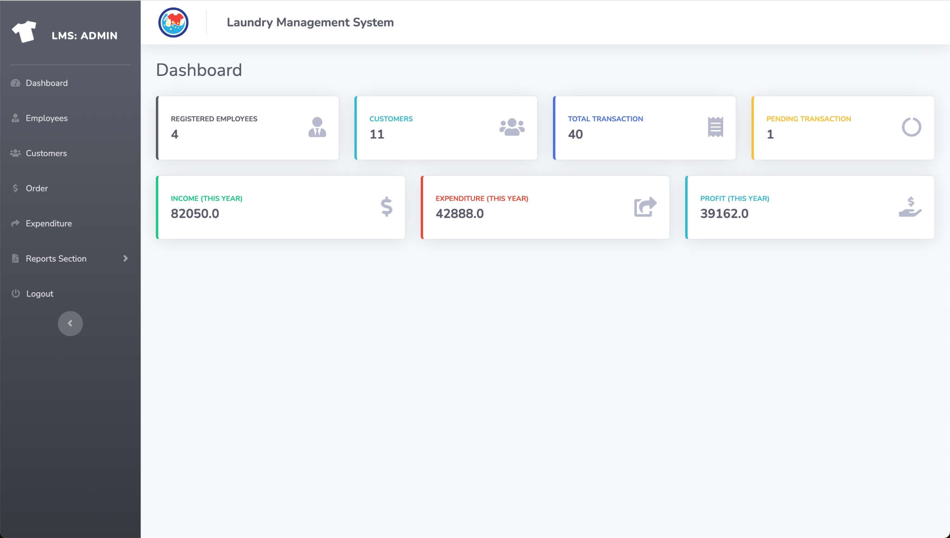
📈 Results & Discussion
🔑 Login Page
🧭 Administrator Dashboard

Slide 7
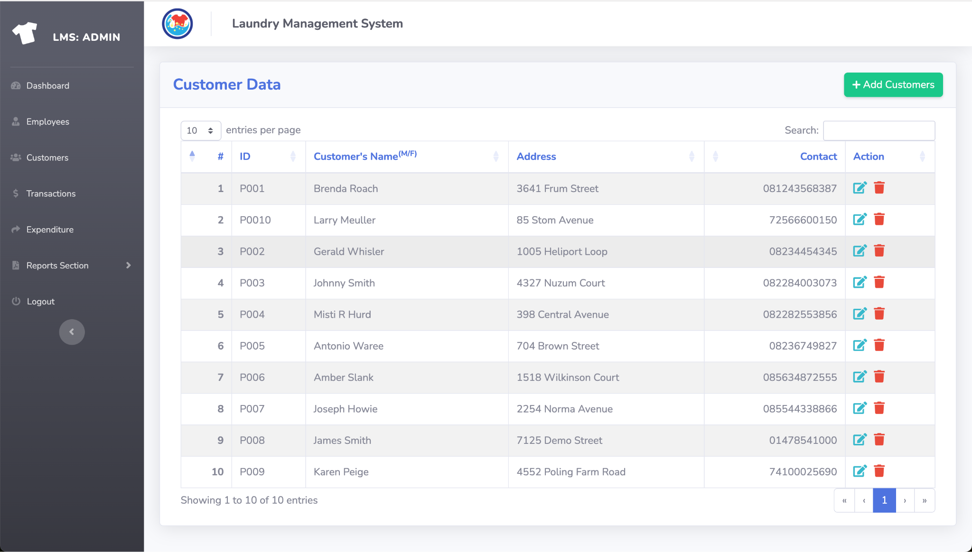
📈 Results & Discussion
📝 Customer Creation
📂 Customer Information

Slide 8
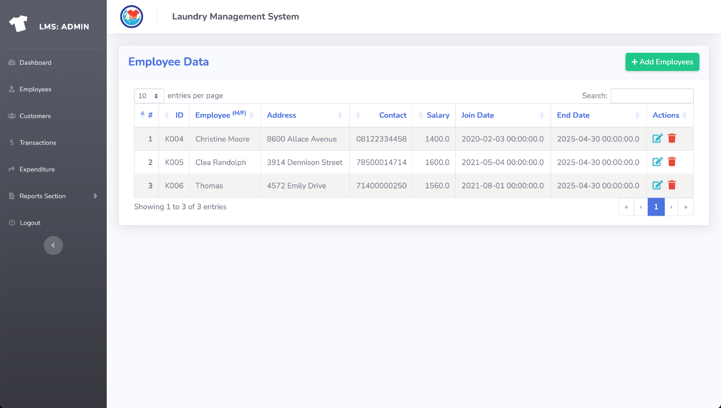
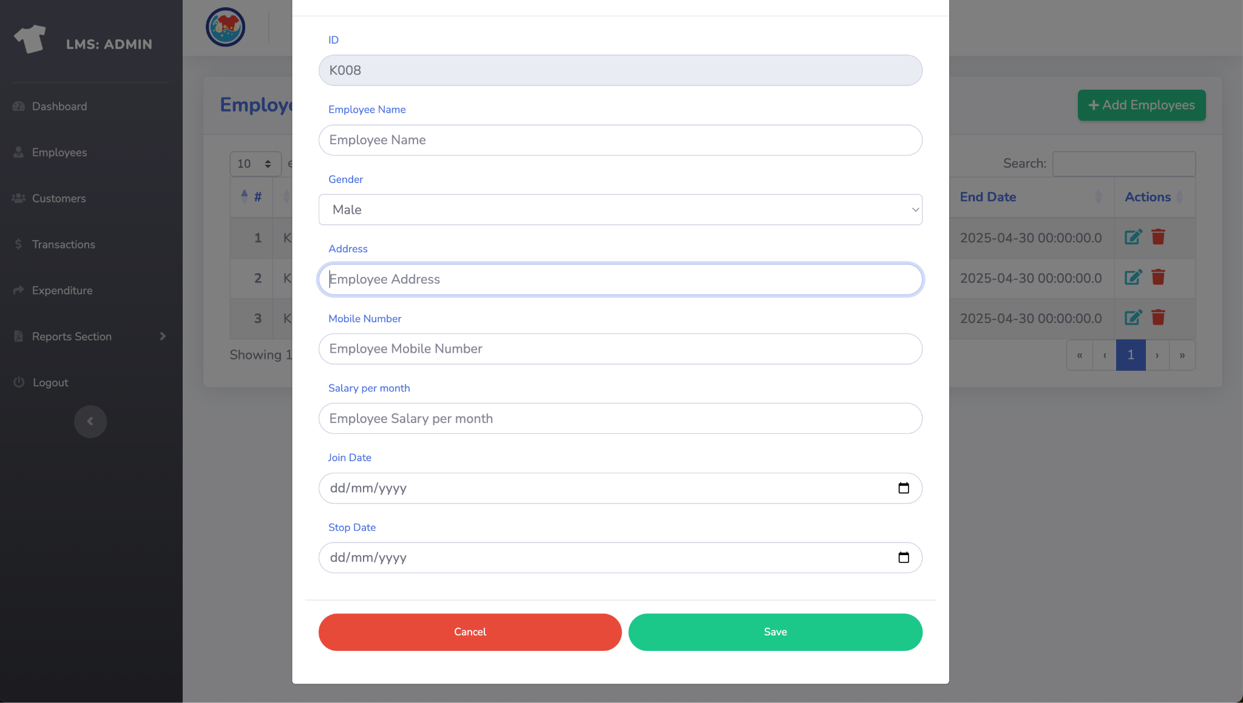
📈 Results & Discussion
📝 Employee Creation
📂 Employee Information

Slide 9
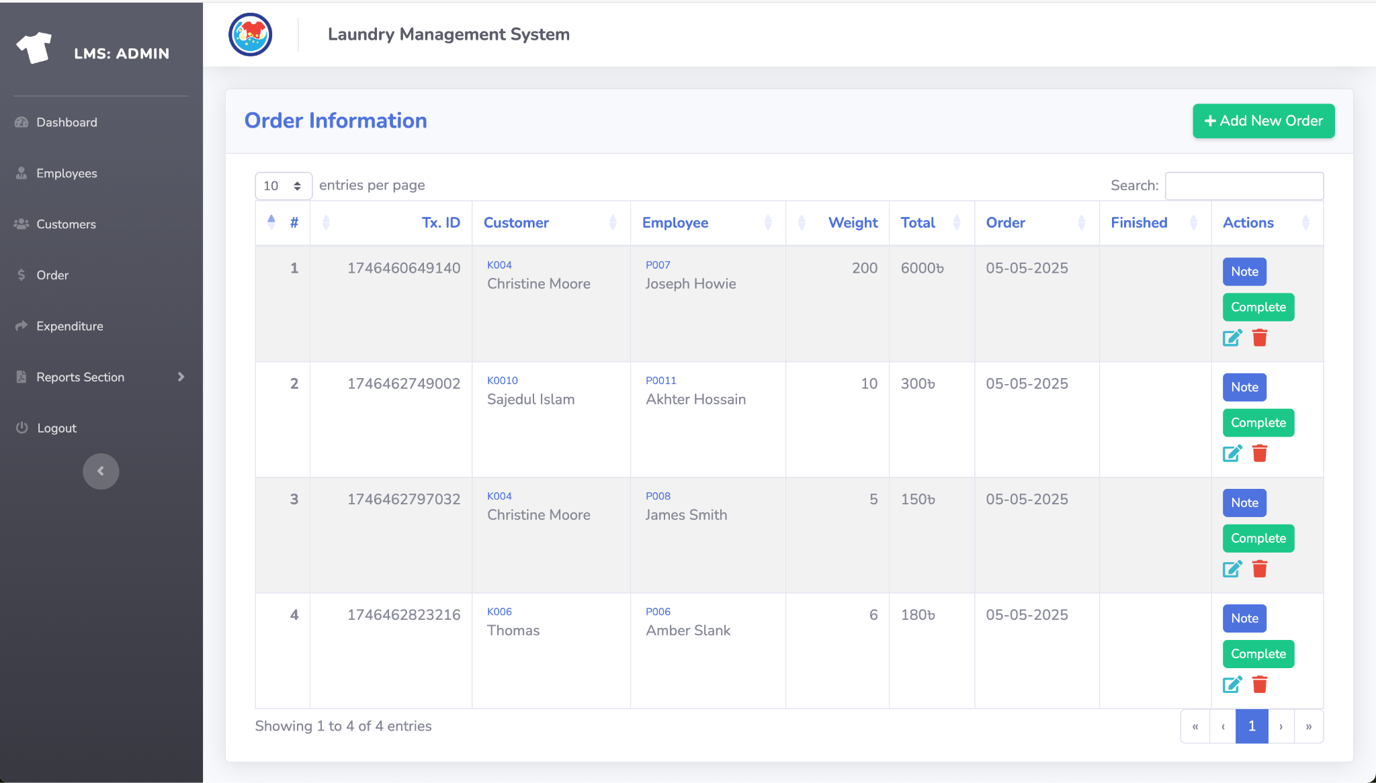
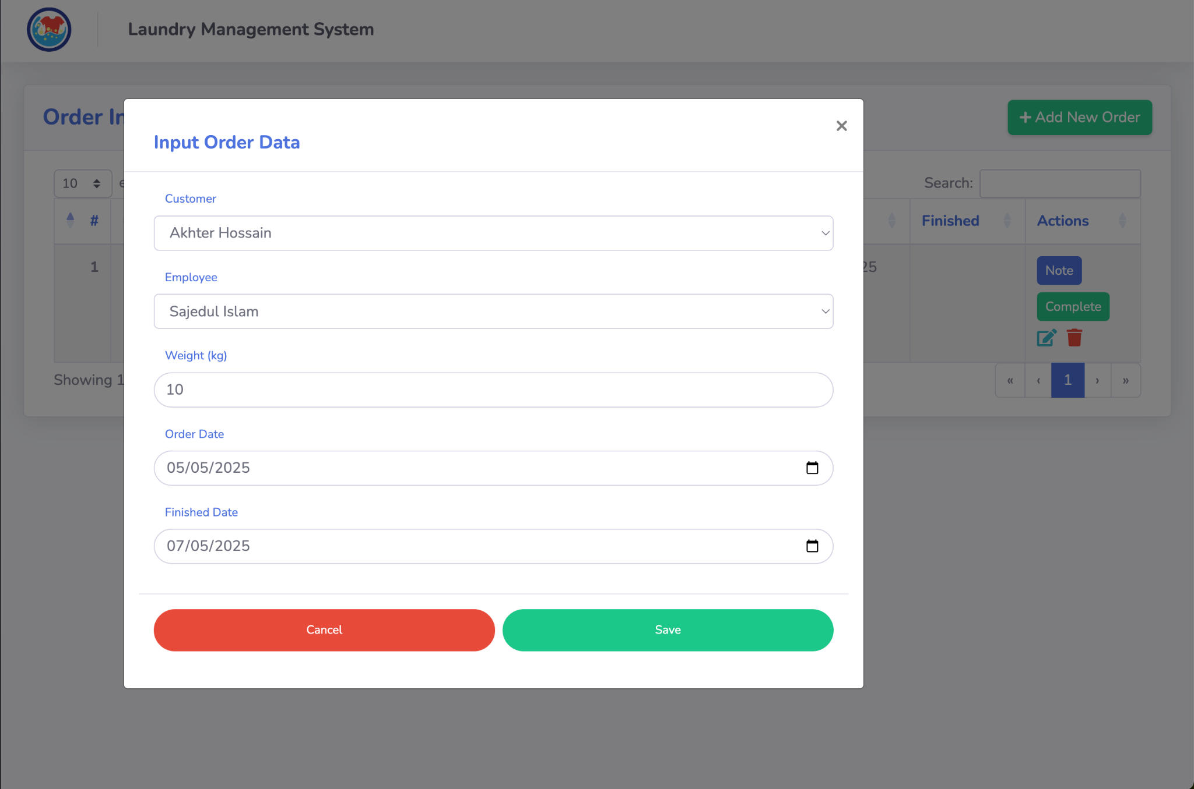
📈 Results & Discussion
📝 Order Creation
📂 Order Information

Slide 10
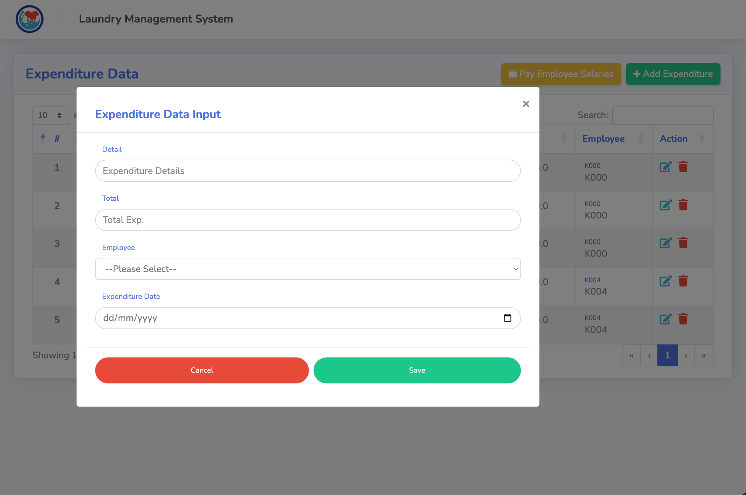
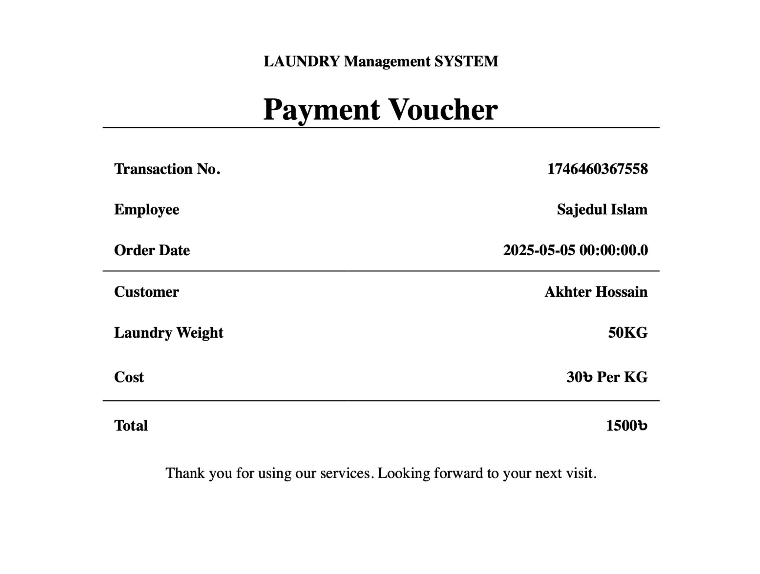
📈 Results & Discussion
📝 Expense Creation
📂 Payment Voucher Information

Slide 11
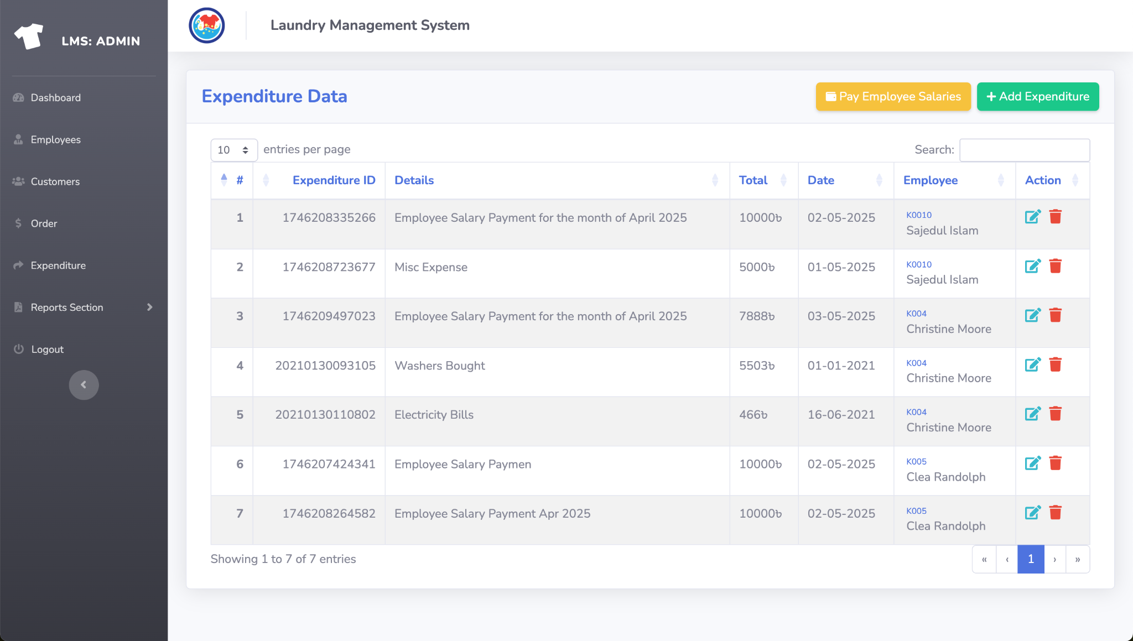
📈 Results & Discussion
📊 Expense Information

Slide 12
Recap & Way Forward
The Laundry Management System developed in this project has successfully achieved its core objectives by offering a streamlined, automated solution for managing laundry services. ✔️ Improved operational accuracy ✔️ Boosted service efficiency ✔️ Enhanced customer satisfaction 🚀 Future Enhancements: 💳 Online booking & payment integration 📱 Mobile app version 🔔 SMS/Email notification system 🧷 RFID/NFC garment tracking 🏢 Multi-branch management ⚠️ Current Limitations: - No SMS/Email alert system yet - Limited to Customer, Employee, Order & Expense modules - Online payment system not implemented currently

Slide 13
Q & A …

Slide 14
THANK YOU.

