Slide 1

鸽巢原理与容斥原理
赵明勋
计算机学院2006级
jmhbodab@gmail.com
2008. 11. 9

Slide 2

Contents
鸽巢原理：简单形式
鸽巢原理：加强形式
容斥原理

Slide 3
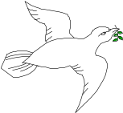
Pigeonhole Principle
If 7 pigeons are to live in 6 boxes (holes), then there is at least one box containing two or more pigeons.

Slide 4
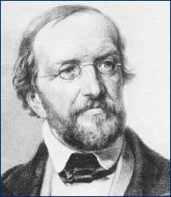
Dirichlet (狄里克雷)
“鸽巢原理”，最先是由19世纪的德国数学家狄里克雷应用于解决问题，后人们为了纪念他从这么平凡的事情中发现的规律，就把这个规律用他的名字命名，叫“狄里克雷原理”，又把它叫做“抽屉原理”。

Slide 5
Pigeonhole Principle
If we put n+1 balls into n boxes, then at least one box must contain two or more balls.
将n+1个球放入n个盒子内, 最小有一个盒子藏有2个或以上的球。

Slide 6
Proof
We want to prove that ‘at least one box must contain two or more balls’.
反证法
Assume that the statement above is wrong then all the n boxes contains 1 or 0 ball. Therefore the total number of balls is less than or equal to n. This is a contradiction (矛盾). The contradiction is due to our assumption that the ‘statement is wrong’.
We conclude that the statement must be true.

Slide 7
Examples
For any 368 people, at least two of them must have the same birthday.
There are at least two people in the world having same number of hair.
At least two of you in this class (assuming the class size >12) born in the same month.

Slide 8
Exercise
There are 10 married couples. How many of the 20 people must be selected in order to guarantee that one has selected a married couple ?
Answer: 11

Slide 9
Pigeonhole Principle : Strong Form
(鸽巢原理－加强形式)
If we put (k*n+1) balls in n boxes, then
at least one box must contain k+1 or
more balls.
将 (k*n+1) 个球放入n个盒子內, 最小有一个盒子藏有k+1个或以上的球。

Slide 10
Proof
We want to prove that at least one box must contain k+1 or more balls.
Assume that the statement above is wrong then all the n boxes contains k or less balls. Therefore the total number of balls is less than or equal to n*k. This is a contradiction (矛盾). The contradiction is due to the assumption that ‘the statement is wrong’.
We conclude that the statement must be true.

Slide 11
Exercise
There are 90 people in a hall. Some of them know each other, some are not.
Prove that there are at least two persons in the hall who know the same number of people in the hall.
What should be the holes and pigeons? How many holes are there?

Slide 12
Solution
If there is a person in the hall who does not know any other people, then each of the other persons in the hall may know either 0, or 1, or 2, or 3, ... , or 88 people. Therefore we have 89 `holes' numbered 0, 1, 2, 3, ... , 88, and have to distribute among 90 people.
Next, assume that every person in the hall know at least one other person. Again, we have 89 holes 1, 2, 3, ... , 89 and 90 people.
In either case, we can apply the Pigeonhole Principle to get the conclusion.

Slide 13
Pigeonhole Principle : Strong Form
(鸽巢原理－加强形式)
令q₁, q₂, …, q_{n}为正整数。 如果将
q₁ + q₂ …+ q_{n}– n + 1
个物体放入n个盒子内，那么， 或者第一个盒子至少含有q₁个物体，或者第二个盒子至少含有q₂个物体，…,
或者第n个盒子至少含有q_{n}个物体。

Slide 14
Pigeonhole Principle : Strong Form
(鸽巢原理－加强形式)
证明：（反证法）
设将q₁ + q₂ …+ q_{n}– n + 1个物体分到n个盒子中。 如果对于每个i=1, 2, …, n, 第i个盒子含有少于q_{i}个物体， 那么所有盒子中的物体总数不超过
(q₁-1) + (q₂-1) …+ (q_{n}-1) = q₁ + q₂ …+ q_{n} – n
该数比所分发的物体总数少1， 因此我们断言， 对于某一个i=1, 2, …, n, 第i个盒子至少包含 q_{i}个物体。

Slide 15
Pigeonhole Principle : Strong Form
(鸽巢原理－加强形式)
将m个物体放入n个盒子内，那么总有一个盒子含有 m/n 个物体。

Slide 16

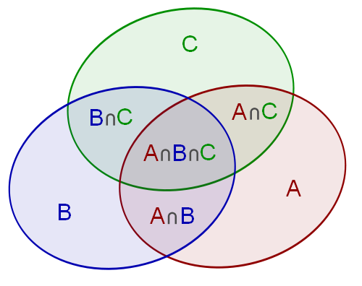
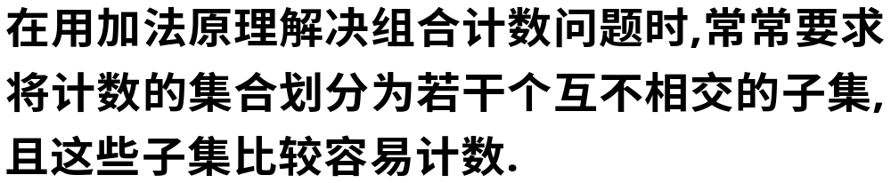
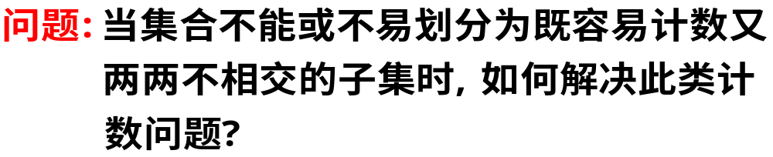
容斥原理
引言

Slide 17
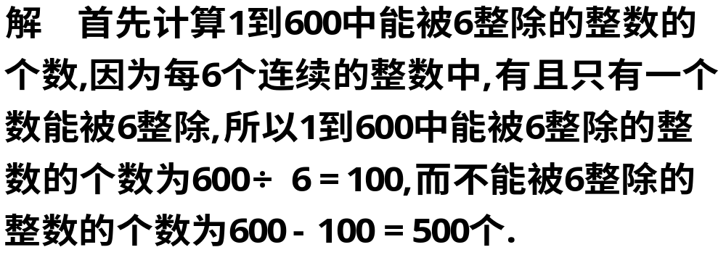
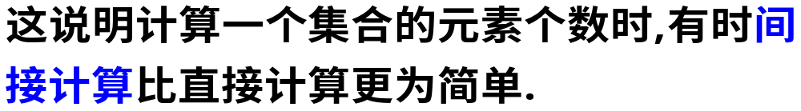

Slide 18
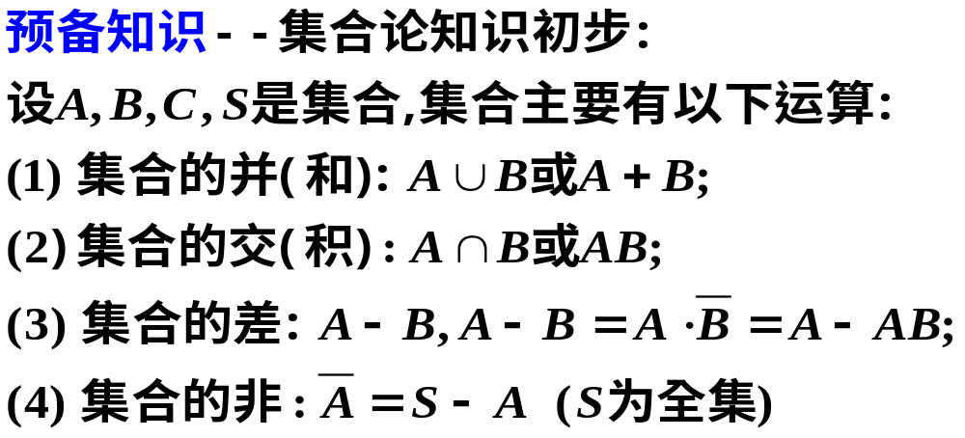
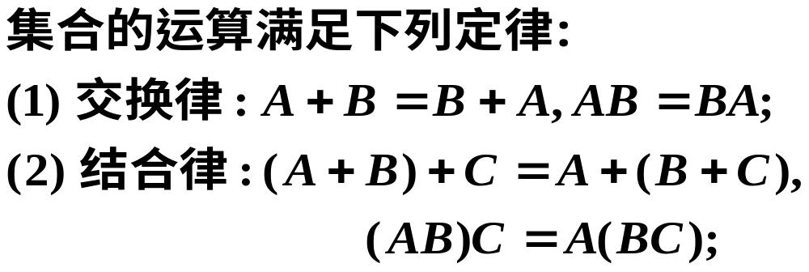

Slide 19
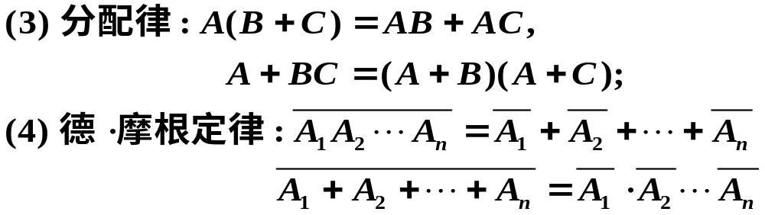
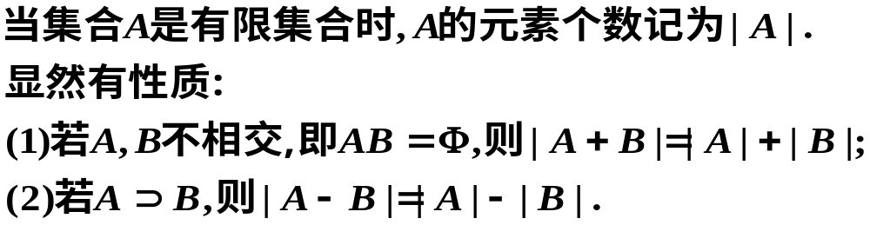

Slide 20
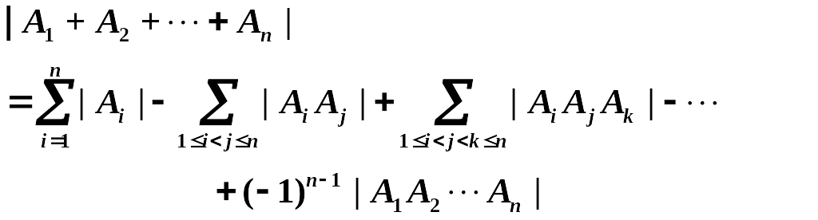
容斥原理
引理1. 设A, B为有限集合, 则有
| A + B | = |A| + |B| - |AB|
定理 1. 设A1, A2, ..., An是有限集合， 则

Slide 21
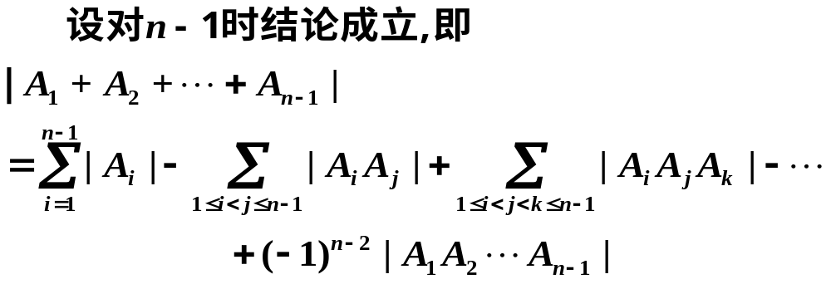
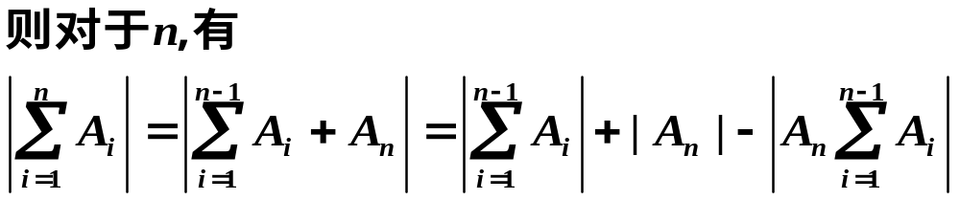

Slide 22
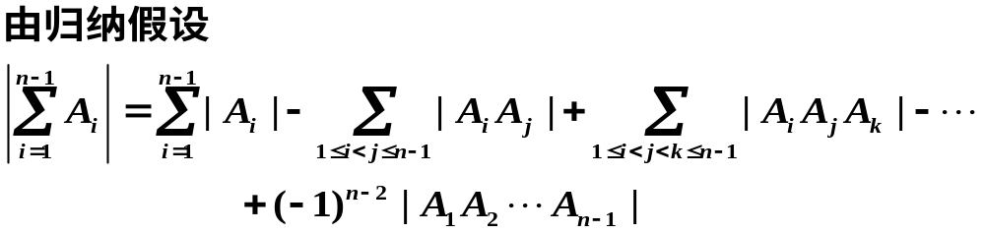
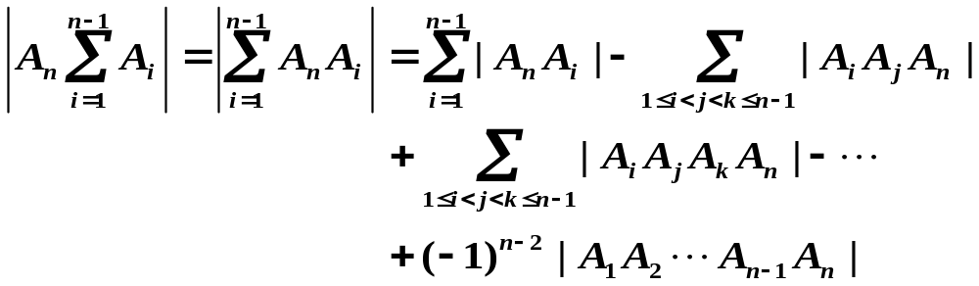

Slide 23
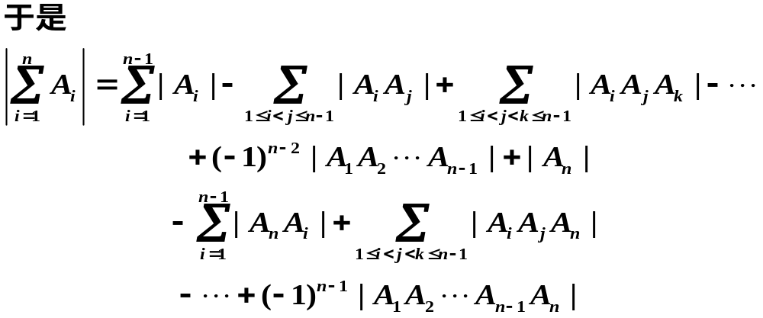
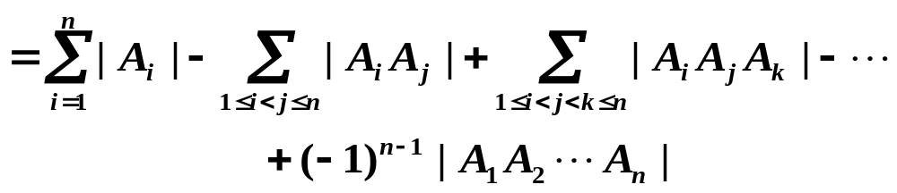

Slide 24
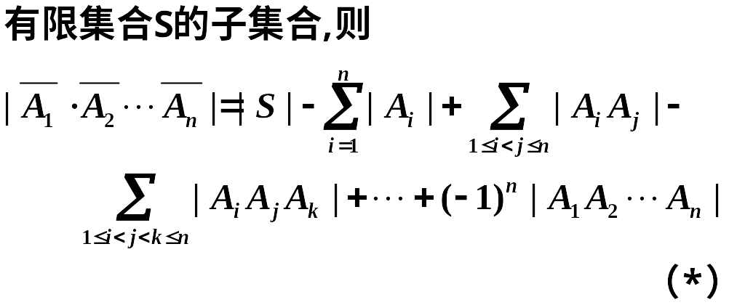
定理2. （逐步淘汰原理） 设A1, A2, ..., An为

Slide 25
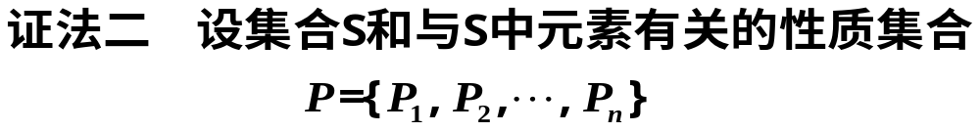
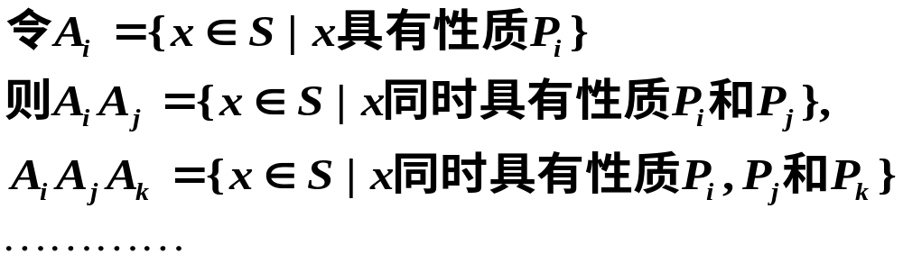
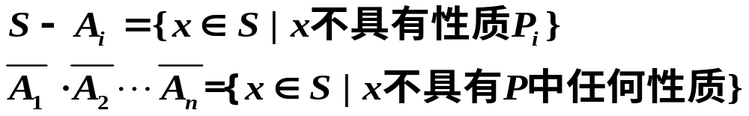

Slide 26
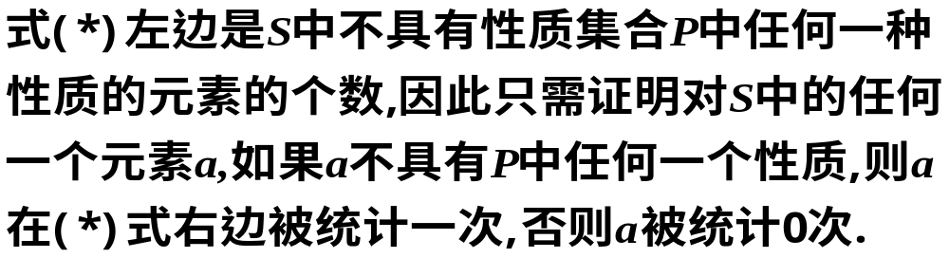
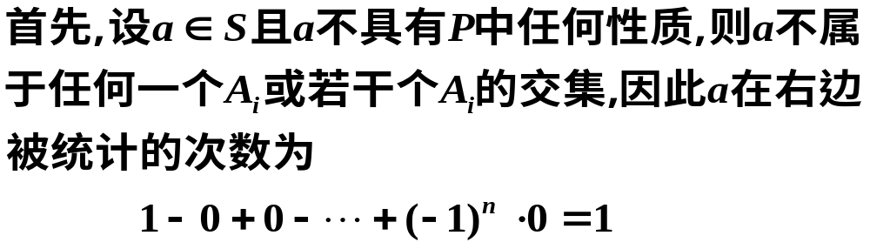

Slide 27
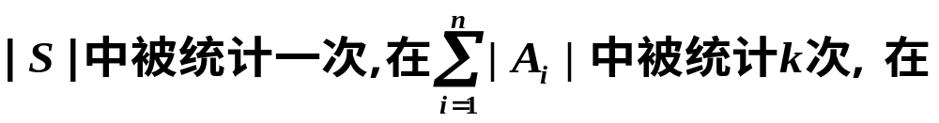
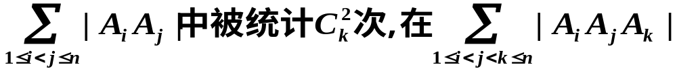
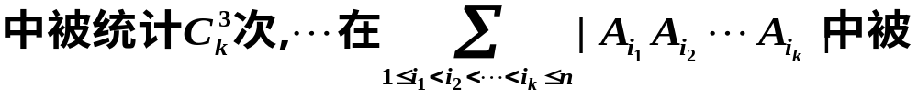
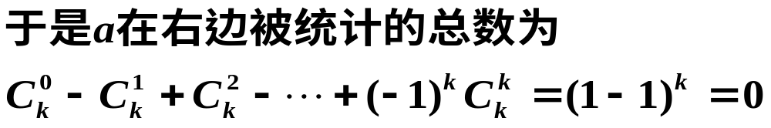

Slide 28
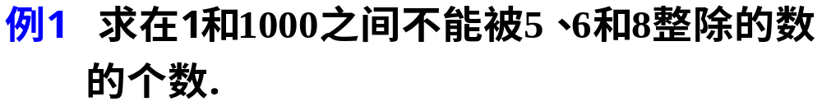
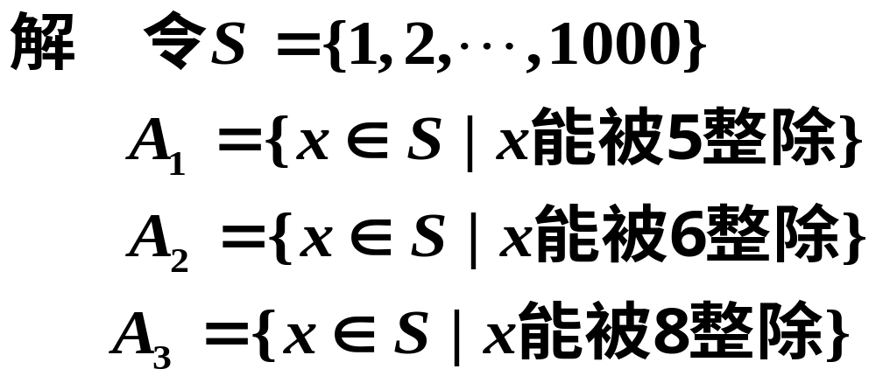
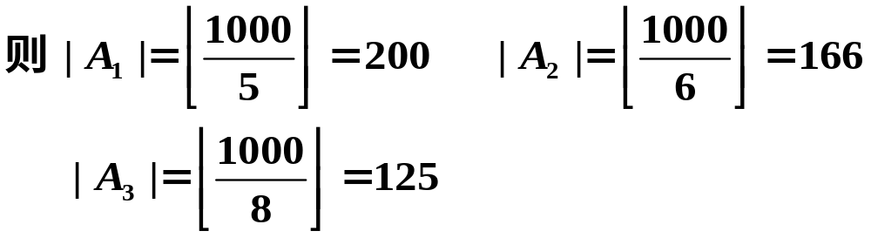

Slide 29
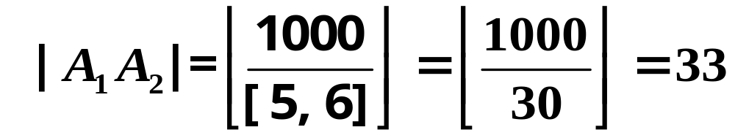
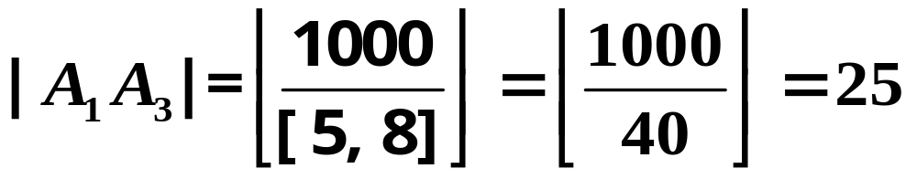
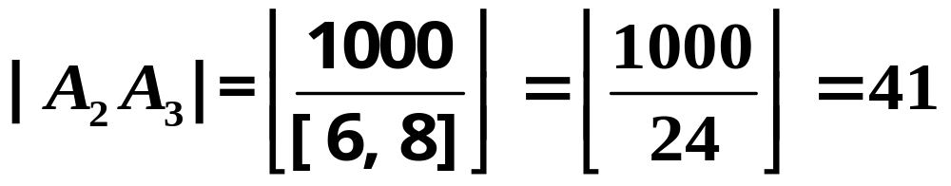
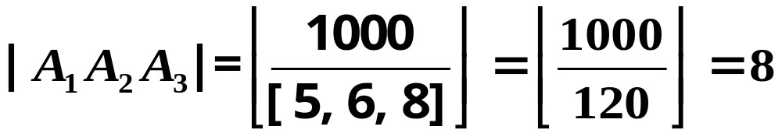

Slide 30
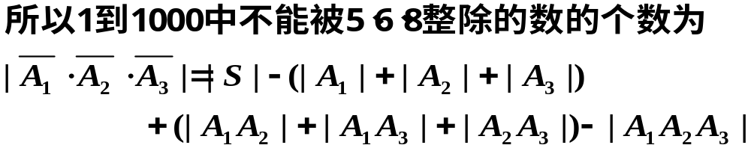
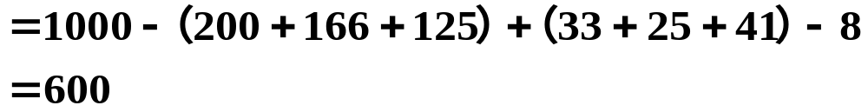

Slide 31

Thank you!!!

