Slide 1
Data Mining: Data
Lecture Notes for Chapter 2
Introduction to Data Mining
by
Tan, Steinbach, Kumar

Slide 2

What is Data?
Collection of data objects and their attributes
An attribute is a property or characteristic of an object
  Examples: eye color of a person, temperature, etc.
  Attribute is also known as variable, field, characteristic, or feature
A collection of attributes describe an object
  Object is also known as record, point, case, sample, entity, or instance
Attributes
Objects

Slide 3
Attribute Values
Attribute values are numbers or symbols assigned to an attribute
Distinction between attributes and attribute values
  Same attribute can be mapped to different attribute values
    Example: height can be measured in feet or meters
  Different attributes can be mapped to the same set of values
    Example: Attribute values for ID and age are integers
    But properties of attribute values can be different
      ID has no limit but age has a maximum and minimum value

Slide 4
Types of Attributes
There are different types of attributes
  Nominal
    Examples: ID numbers, eye color, zip codes
  Ordinal
    Examples: rankings (e.g., taste of potato chips on a scale from 1-10), grades, height in {tall, medium, short}
  Interval
    Examples: calendar dates, temperatures in Celsius or Fahrenheit.
  Ratio
    Examples: temperature in Kelvin, length, time, counts

Slide 5
Properties of Attribute Values
The type of an attribute depends on which of the following properties it possesses:
  Distinctness: = ≠
  Order: < >
  Addition: + -
  Multiplication: * /
  Nominal attribute: distinctness
  Ordinal attribute: distinctness & order
  Interval attribute: distinctness, order & addition
  Ratio attribute: all 4 properties

Slide 6
Attribute Type
Description
Examples
Operations
Nominal
The values of a nominal attribute are just different names, i.e., nominal attributes provide only enough information to distinguish one object from another. (=, ≠)
zip codes, employee ID numbers, eye color, sex: {male, female}
mode, entropy, contingency correlation, χ² test
Ordinal
The values of an ordinal attribute provide enough information to order objects. (<, >)
hardness of minerals, {good, better, best},
grades, street numbers
median, percentiles, rank correlation, run tests, sign tests
Interval
For interval attributes, the differences between values are meaningful, i.e., a unit of measurement exists.
(+, - )
calendar dates, temperature in Celsius or Fahrenheit
mean, standard deviation, Pearson's correlation, t and F tests
Ratio
For ratio variables, both differences and ratios are meaningful. (*, /)
temperature in Kelvin, monetary quantities, counts, age, mass, length, electrical current
geometric mean, harmonic mean, percent variation

Slide 7
Attribute Level
Transformation
Comments
Nominal
Any permutation of values
If all employee ID numbers were reassigned, would it make any difference?
Ordinal
An order preserving change of values, i.e.,
new_value = f(old_value)
where f is a monotonic function.
An attribute encompassing the notion of good, better best can be represented equally well by the values {1, 2, 3} or by { 0.5, 1, 10}.
Interval
new_value =a * old_value + b where a and b are constants
Thus, the Fahrenheit and Celsius temperature scales differ in terms of where their zero value is and the size of a unit (degree).
Ratio
new_value = a * old_value
Length can be measured in meters or feet.

Slide 8
Discrete and Continuous Attributes
Discrete Attribute
  Has only a finite or countably infinite set of values
  Examples: zip codes, counts, or the set of words in a collection of documents
  Often represented as integer variables.
  Note: binary attributes are a special case of discrete attributes
Continuous Attribute
  Has real numbers as attribute values
  Examples: temperature, height, or weight.
  Practically, real values can only be measured and represented using a finite number of digits.
  Continuous attributes are typically represented as floating-point variables.

Slide 9
Symmetric and Asymmetric Attributes
A binary variable contains two possible outcomes: 1 (positive/present) and 0 (negative/absent)
If there is no preference for which outcome should be coded as 0 and which as 1, the binary variable is called symmetric
Example: the binary variable “is evergreen” for a plant has two possible outcomes: “loses leaves in winter” and “does not lose leaves in winter”
Both are equally valuable and important
If the outcomes of a binary variable are not equally important, it is called asymmetric
Only presence (a non-zero attribute value) is regarded as important
Example: words present in documents, items present in customer transactions
If we met a friend at the grocery store, would we ever make the following statement?
“I see our purchases are very similar, since we did not buy most of the same things”

Slide 10
Important Characteristics of Structured Data
  Dimensionality
    Curse of Dimensionality
    Text data has dimensionality of the order of tens of thousands
  Sparsity
    Only presence counts
    Document-Term matrix is a sparse matrix
  Resolution
    Patterns depend on the scale

Slide 11
Record Data
Data that consists of a collection of records, each of which consists of a fixed set of attributes

Slide 12
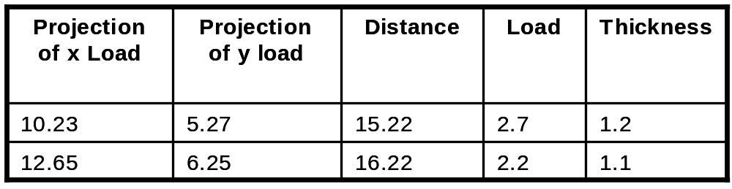
Data Matrix
If data objects have the same fixed set of numeric attributes, then the data objects can be thought of as points in a multi-dimensional space, where each dimension represents a distinct attribute
Such data set can be represented by an m by n matrix, where there are m rows, one for each object, and n columns, one for each attribute

Slide 13

Document Data
Each document becomes a `term' vector,
  each term is a component (attribute) of the vector,
  the value of each component is the number of times the corresponding term occurs in the document.

Slide 14

Transaction Data
A special type of record data, where
  each record (transaction) involves a set of items.
  For example, consider a grocery store. The set of products purchased by a customer during one shopping trip constitute a transaction, while the individual products that were purchased are the items.

Slide 15
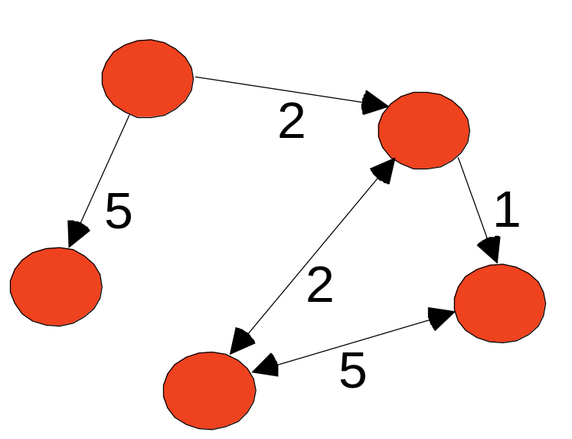
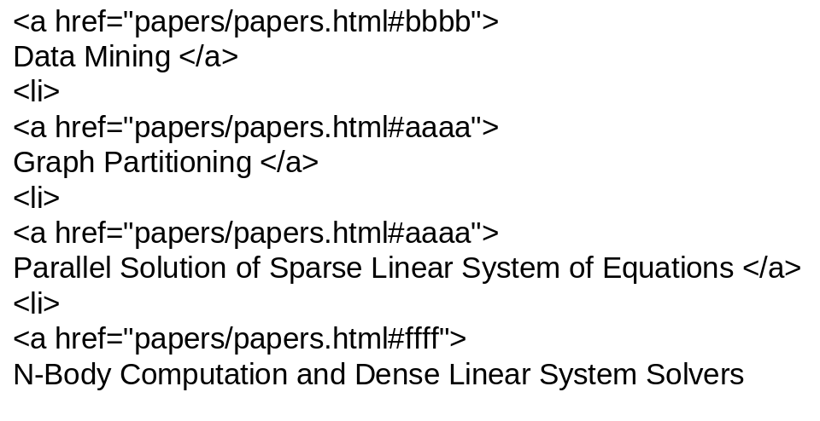
Graph Data
Examples: Generic graph and HTML Links

Slide 16
Data Quality
What kinds of data quality problems?
How can we detect problems with the data?
What can we do about these problems?
Examples of data quality problems:
  Noise and outliers
  missing values
  duplicate data

Slide 17


Noise
Noise refers to modification of original values
  Examples: distortion of a person’s voice when speaking over a poor communication channel
Two Sine Waves
Two Sine Waves + Noise

Slide 18

Outliers
Outliers are data objects with characteristics that are considerably different than most of the other data objects in the data set

Slide 19
Missing Values
Reasons for missing values
  Information is not collected
  (e.g., people decline to give their age and weight)
  Attributes may not be applicable to all cases
  (e.g., annual income is not applicable to children)
Handling missing values
  Eliminate Data Objects
  Estimate Missing Values
  Ignore the Missing Value During Analysis

Slide 20
Duplicate Data
Data set may include data objects that are duplicates, or almost duplicates of one another
  Major issue when merging data from heterogeous sources
Examples:
  Same person with multiple email addresses
Data cleaning
  Process of dealing with duplicate data issues

Slide 21
Data Preprocessing
Aggregation
Sampling
Dimensionality Reduction
Feature subset selection
Feature creation
Discretization and Binarization
Attribute Transformation

Slide 22
Aggregation
Combining two or more attributes (or objects) into a single attribute (or object)
Purpose
  Data reduction
    Reduce the number of attributes or objects
  Change of scale
    Cities aggregated into regions, states, countries, etc
  More “stable” data
    Aggregated data tends to have less variability

Slide 23
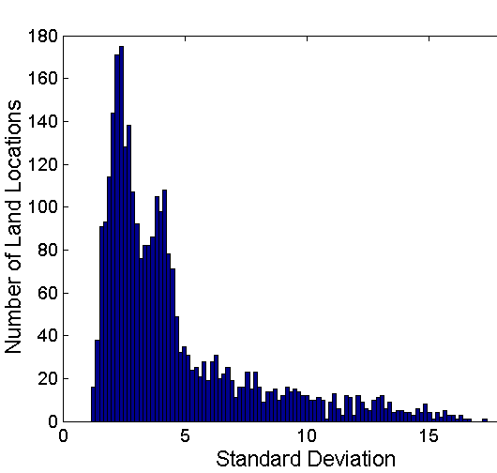
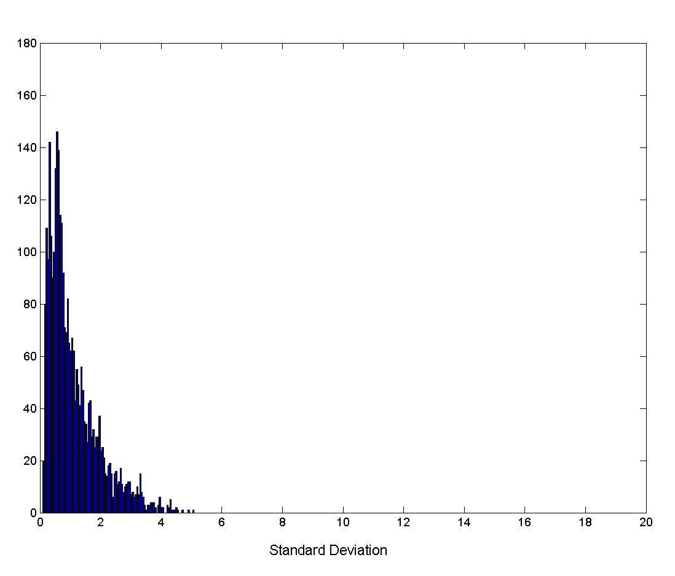
Aggregation
Variation of Precipitation in Australia
Standard Deviation of Average Monthly Precipitation
Standard Deviation of Average Yearly Precipitation

Slide 24
Sampling
Sampling is the main technique employed for data selection.
  It is often used for both the preliminary investigation of the data and the final data analysis.
Statisticians sample because obtaining the entire set of data of interest is too expensive or time consuming.
Sampling is used in data mining because processing the entire set of data of interest is too expensive or time consuming.

Slide 25
Sampling …
The key principle for effective sampling is the following:
  using a sample will work almost as well as using the entire data sets, if the sample is representative
  A sample is representative if it has approximately the same property (of interest) as the original set of data

Slide 26
Types of Sampling
Simple Random Sampling
  There is an equal probability of selecting any particular item
Sampling without replacement
  As each item is selected, it is removed from the population
Sampling with replacement
  Objects are not removed from the population as they are selected for the sample.
    In sampling with replacement, the same object can be picked up more than once
Stratified sampling
  Split the data into several partitions; then draw random samples from each partition

Slide 27

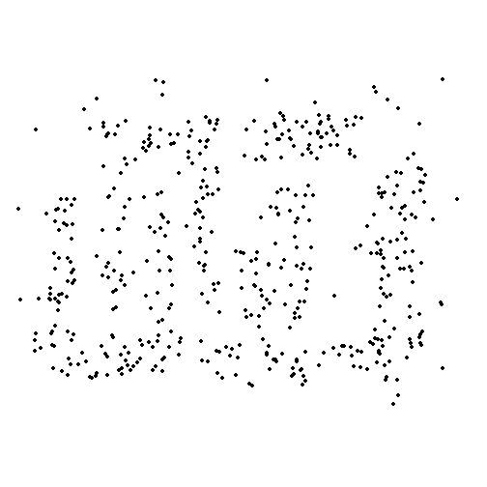
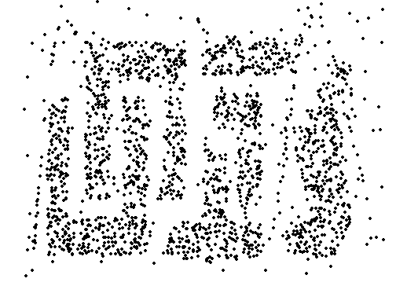
Sample Size
8000 points 2000 Points 500 Points

Slide 28
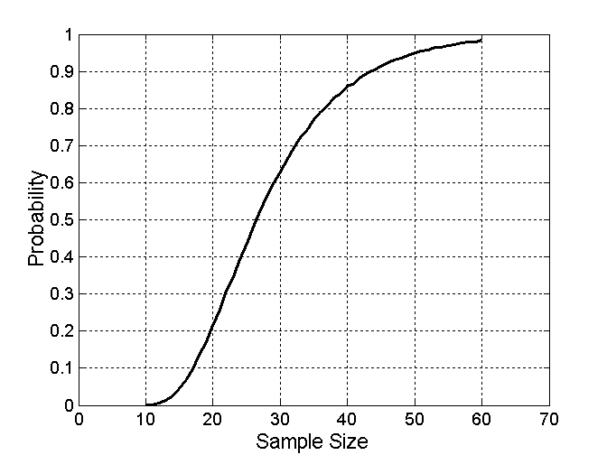

Sample Size
What sample size is necessary to get at least one object from each of 10 groups.

Slide 29


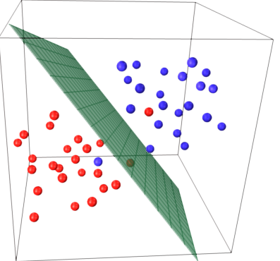
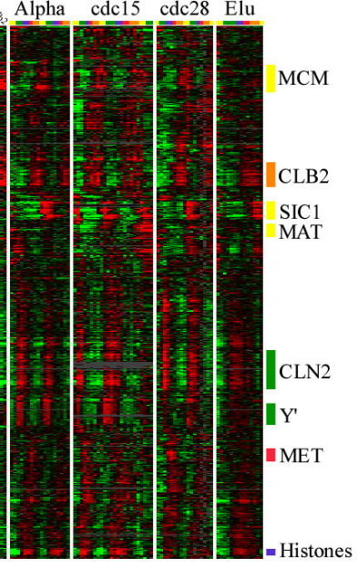
Curse of Dimensionality
Computationally
Expensive
Difficult to Store
Difficult to Visualize beyond 3 dimensions
Small Intrinsic Dimension

Slide 30
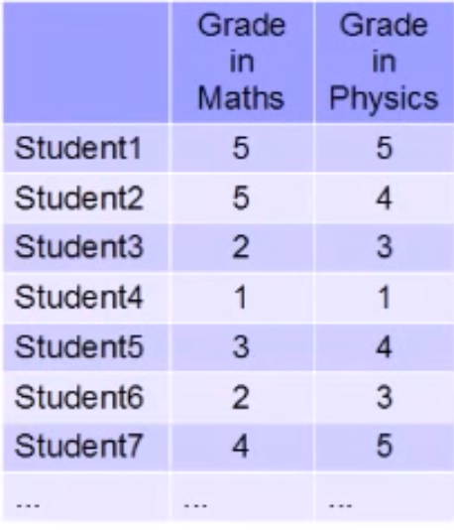
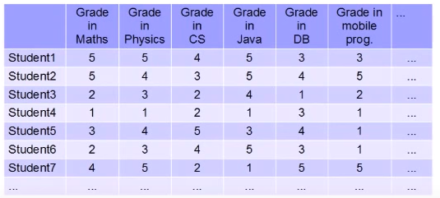
Curse of Dimensionality
When dimensionality increases, data becomes increasingly sparse in the space that it occupies
2D space – grades in maths and physics
Each grade ranges from 1(min) to 5(max)
Total number of possible combinations = 5*5 = 25
100 students -> each combination appears 4 times on average
6D space – grades in 6 subjects
Each grade ranges from 1 to 5
Total number of possible combinations = 5⁶ = 15,625
100 students -> many combinations are not seen (sparse data)
Difficult to make inferences/conclusions
Number of training samples needed grows exponentially

Slide 31
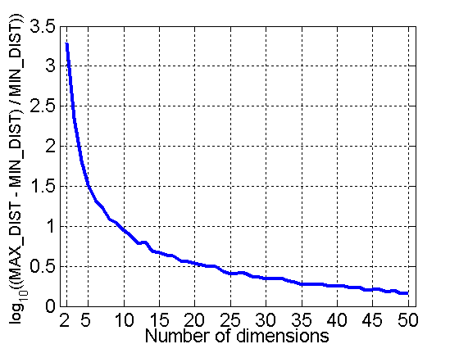
Curse of Dimensionality
Definitions of density and distance between points, which is critical for clustering and outlier detection, become less meaningful
Randomly generate 500 points
Compute difference between max and min distance between any pair of points

Slide 32
Dimensionality Reduction
Purpose:
  Avoid curse of dimensionality
  Reduce amount of time and memory required by data mining algorithms
  Allow data to be more easily visualized
  May help to eliminate irrelevant features or reduce noise
Techniques
  Principle Component Analysis
  Singular Value Decomposition
  Others: supervised and non-linear techniques

Slide 33
Dimensionality Reduction: PCA
Goal is to find a projection that captures the largest amount of variation in data
x₂
e
x₁

Slide 34
Dimensionality Reduction: PCA
Find the eigenvectors of the covariance matrix
The eigenvectors define the new space
x₂
e
x₁

Slide 35
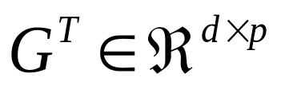

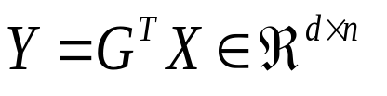

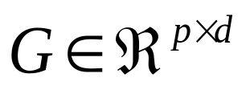
Dimensionality Reduction: PCA
Original
Data
Matrix
Projection Matrix
Reduced
Data
Matrix
Reconstructed
Data
Matrix
Projection
Matrix
Reduced
Data
Matrix

Slide 36
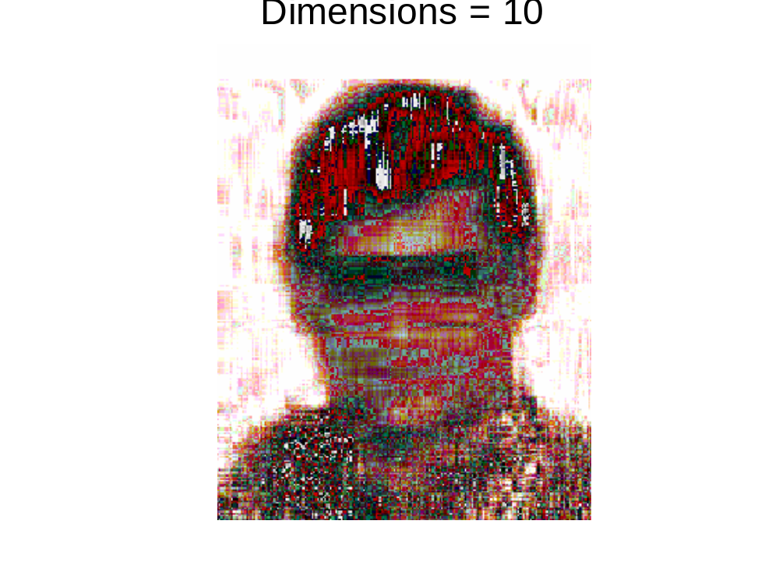
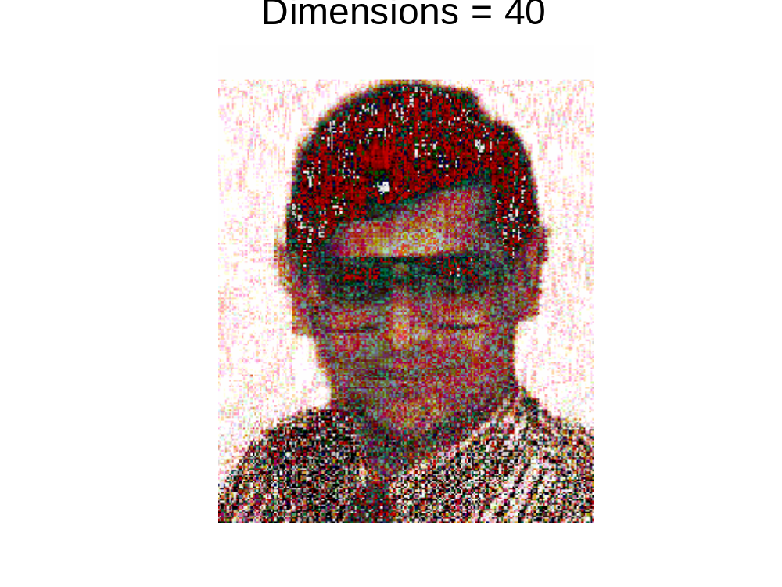
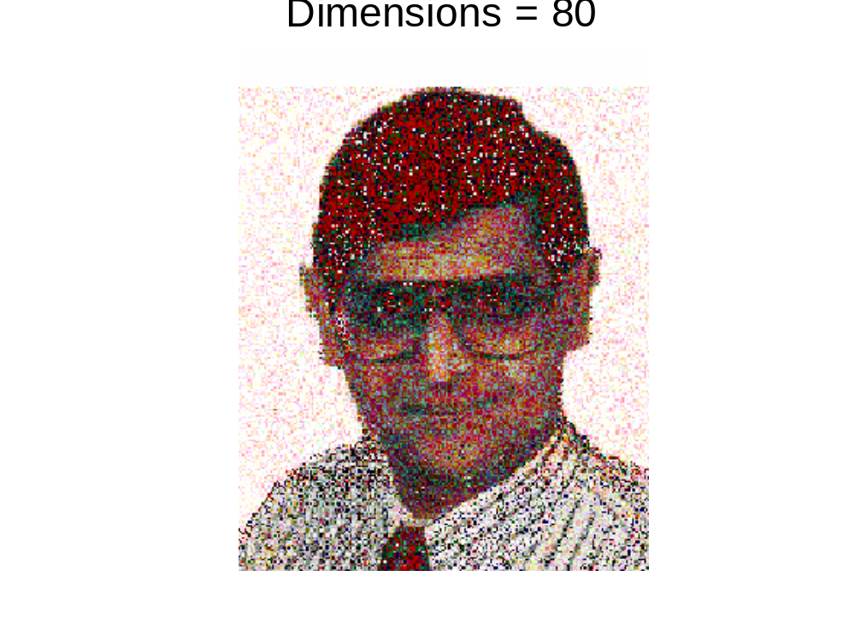
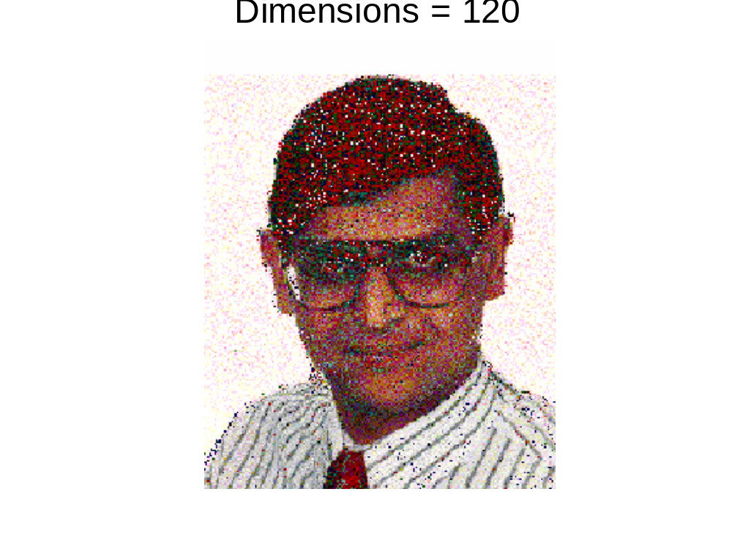
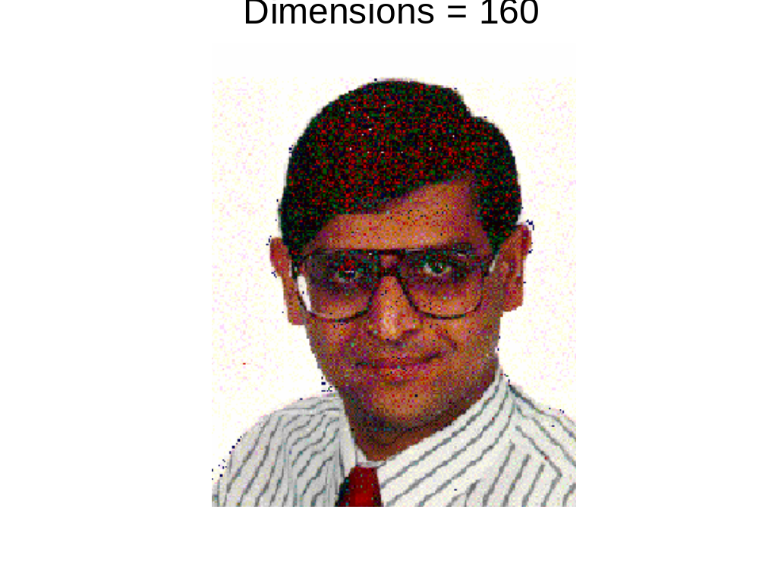
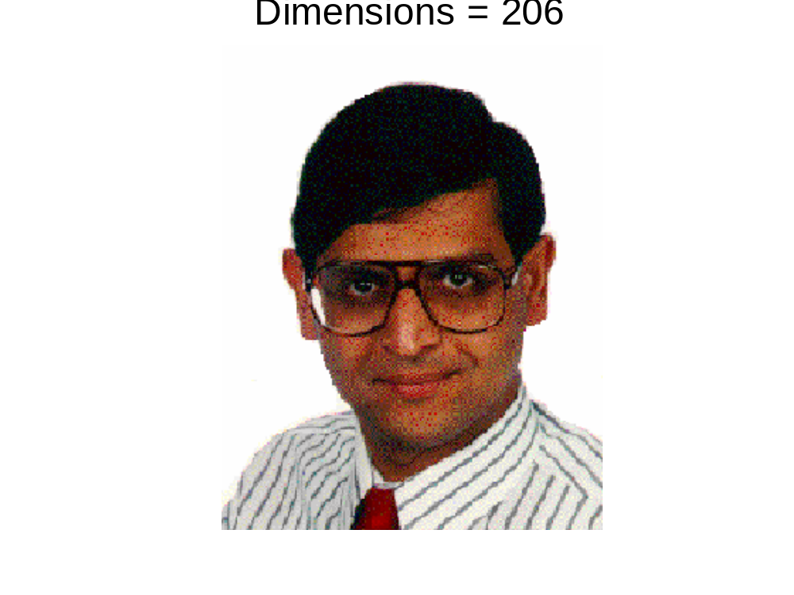
Dimensionality Reduction: PCA

Slide 37
Similarity and Dissimilarity
Similarity
  Numerical measure of how alike two data objects are.
  Is higher when objects are more alike.
  Often falls in the range [0,1]
Dissimilarity
  Numerical measure of how different are two data objects
  Lower when objects are more alike
  Minimum dissimilarity is often 0
  Upper limit varies
Proximity refers to a similarity or dissimilarity

Slide 38
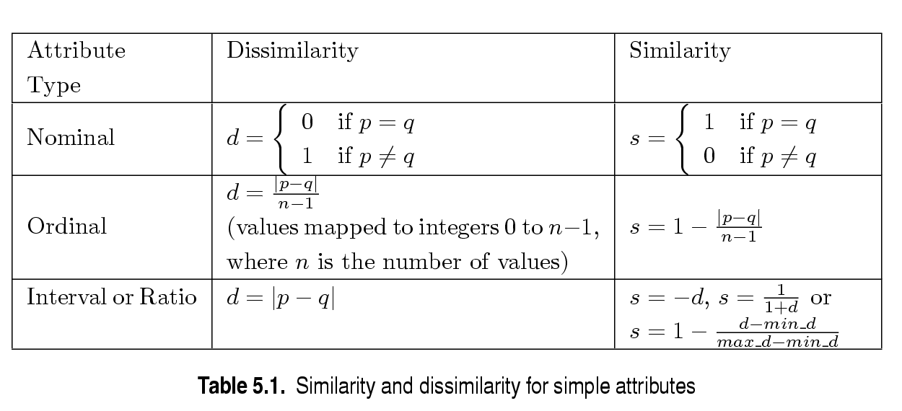
Similarity/Dissimilarity for Simple Attributes
p and q are the attribute values for two data objects.

Slide 39
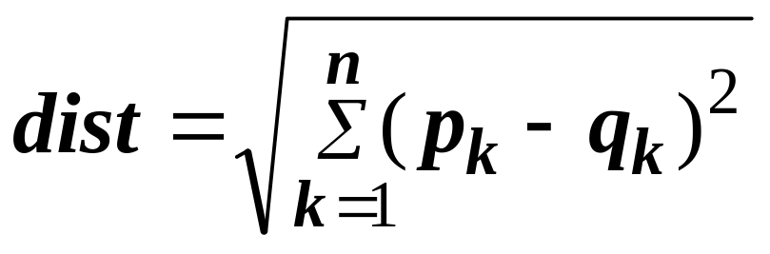
Euclidean Distance
Euclidean Distance
  Where n is the number of dimensions (attributes) and p_{k} and q_{k} are, respectively, the k^{th} attributes (components) or data objects p and q.
Standardization is necessary, if scales differ.

Slide 40
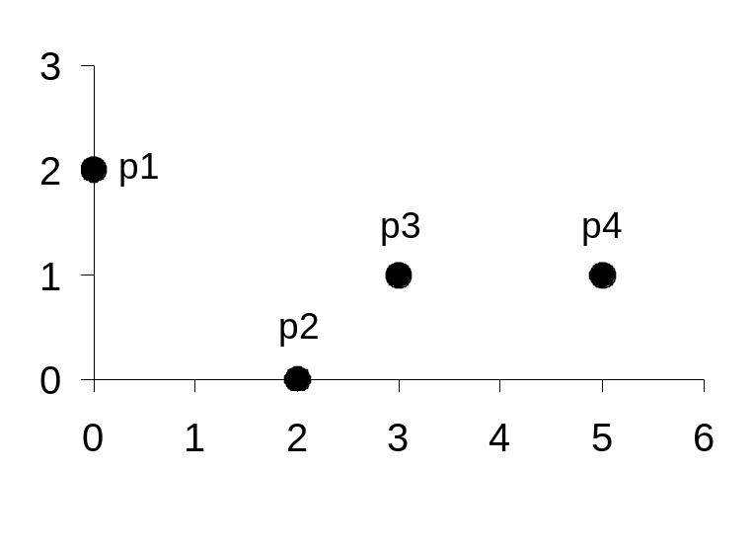
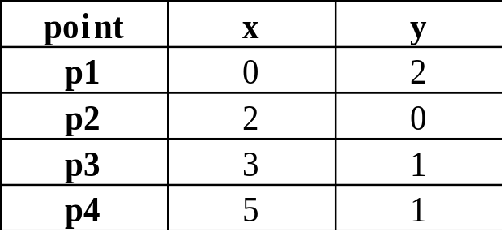
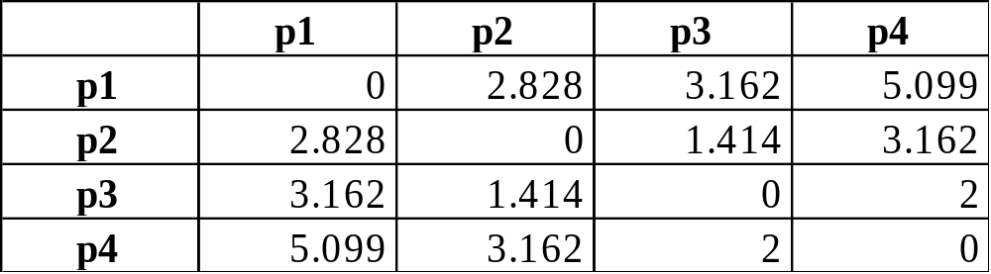
Euclidean Distance
Distance Matrix

Slide 41
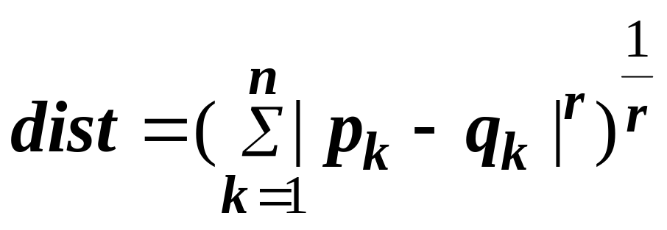
Minkowski Distance
Minkowski Distance is a generalization of Euclidean Distance
  Where r is a parameter, n is the number of dimensions (attributes) and p_{k} and q_{k} are, respectively, the kth attributes (components) or data objects p and q.

Slide 42
Minkowski Distance: Examples
r = 1. City block (Manhattan, taxicab, L₁ norm) distance.
  A common example of this is the Hamming distance, which is just the number of bits that are different between two binary vectors
r = 2. Euclidean distance
r → ∞. “supremum” (L_{max} norm, L∞ norm) distance.
  This is the maximum difference between any component of the vectors
Do not confuse r with n, i.e., all these distances are defined for all numbers of dimensions.

Slide 43
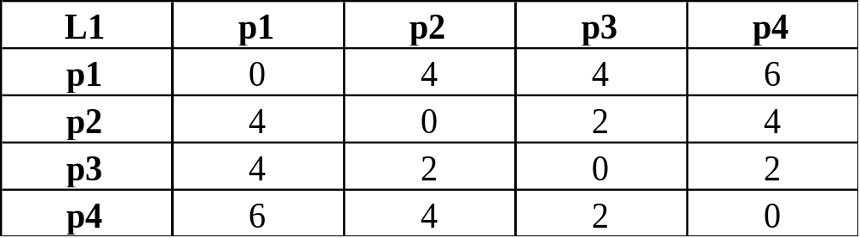
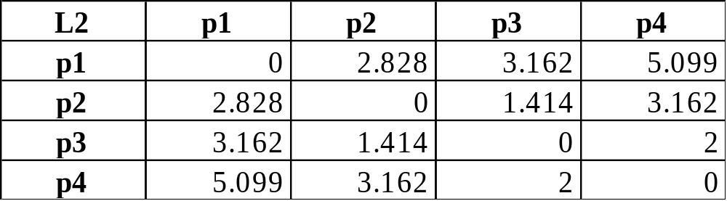
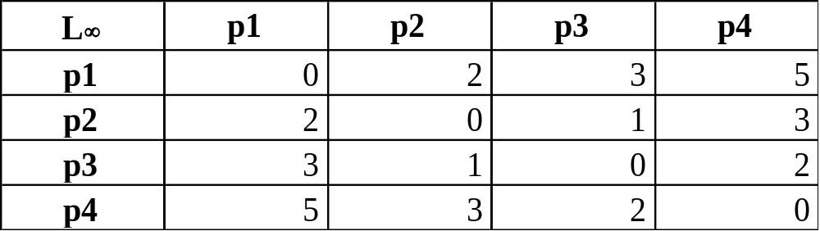
Minkowski Distance
Pairwise Distance Matrices

Slide 44
Common Properties of a Distance
Distances, such as the Euclidean distance, have some well known properties.
  d(p, q) ≥ 0 for all p and q and d(p, q) = 0 only if
  p = q. (Positive definiteness)
  d(p, q) = d(q, p) for all p and q. (Symmetry)
  d(p, r) ≤ d(p, q) + d(q, r) for all points p, q, and r.
  (Triangle Inequality)
where d(p, q) is the distance (dissimilarity) between points (data objects), p and q.
A distance that satisfies these properties is a metric

Slide 45
Common Properties of a Similarity
Similarities, also have some well known properties.
  s(p, q) = 1 (or maximum similarity) only if p = q.
  s(p, q) = s(q, p) for all p and q. (Symmetry)
where s(p, q) is the similarity between points (data objects), p and q.

Slide 46
Similarity Between Binary Vectors
Common situation is that objects, p and q, have only binary attributes
Compute similarities using the following quantities
M₀₁ = the number of attributes where p was 0 and q was 1
M₁₀ = the number of attributes where p was 1 and q was 0
M₀₀ = the number of attributes where p was 0 and q was 0
M₁₁ = the number of attributes where p was 1 and q was 1
Simple Matching and Jaccard Coefficients
SMC = number of matches / number of attributes
= (M₁₁ + M₀₀) / (M₀₁ + M₁₀ + M₁₁ + M₀₀)
J = number of 11 matches / number of not-both-zero attributes values
= (M₁₁) / (M₀₁ + M₁₀ + M₁₁)

Slide 47
SMC versus Jaccard: Example
p = 1 0 0 0 0 0 0 0 0 0
q = 0 0 0 0 0 0 1 0 0 1
M₀₁ = 2 (the number of attributes where p was 0 and q was 1)
M₁₀ = 1 (the number of attributes where p was 1 and q was 0)
M₀₀ = 7 (the number of attributes where p was 0 and q was 0)
M₁₁ = 0 (the number of attributes where p was 1 and q was 1)
SMC = (M₁₁ + M₀₀)/(M₀₁ + M₁₀ + M₁₁ + M₀₀) = (0+7) / (2+1+0+7) = 0.7
J = (M₁₁) / (M₀₁ + M₁₀ + M₁₁) = 0 / (2 + 1 + 0) = 0

Slide 48
Cosine Similarity
If d₁ and d₂ are two vectors, then
cos( d₁, d₂ ) = (d₁ • d₂) / ||d₁|| ||d₂|| ,
where • indicates vector dot product and || d || is the length of vector d.
Measure of the cosine of the angle between d1 and d2
Ranges between -1 and 1
Example:
d₁ = 3 2 0 5 0 0 0 2 0 0
d₂ = 1 0 0 0 0 0 0 1 0 2
d₁ • d₂= 3*1 + 2*0 + 0*0 + 5*0 + 0*0 + 0*0 + 0*0 + 2*1 + 0*0 + 0*2 = 5
||d₁|| = (3*3+2*2+0*0+5*5+0*0+0*0+0*0+2*2+0*0+0*0)^{0.5} = (42) ^{0.5} = 6.481
||d₂|| = (1*1+0*0+0*0+0*0+0*0+0*0+0*0+1*1+0*0+2*2) ^{0.5} = (6) ^{0.5} = 2.245
cos( d₁, d₂ ) = .3150

Slide 49
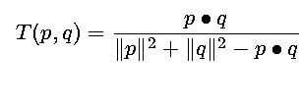
Extended Jaccard Coefficient (Tanimoto)
Variation of Jaccard for continuous or count attributes
  Reduces to Jaccard for binary attributes

Slide 50

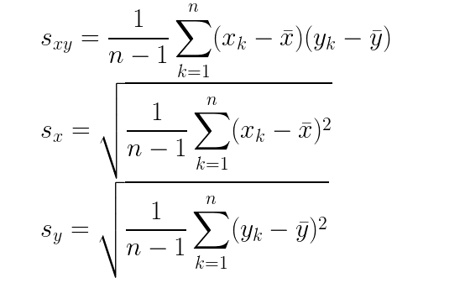
Correlation
Correlation measures the linear relationship between objects

Slide 51
Correlation
Correlation is always in the range -1 to 1
A correlation of 1(-1) means that the vectors have a perfectly positive(negative) linear relationship, that is p_{k} = a.q_{k} + b, where a and b are constants
Example: x = [3, 3, 6], y = [2, 3, 4], n = 3 here
mean(x) = 4, std(x) = sqrt(3) = 1.732
mean(y) = 3, std(y) = sqrt(1) = 1
s(x,y) = [(-1)(-1) + (-1)(0) + (2)(1)]/2 = 1.5
corr(x,y) = 1.5 / (1.732*1) = 0.86
Example: x = [-3, -2, -1, 0, 1, 2, 3], y = [9, 4, 1, 0, 1, 4, 9]
Perfect non-linear relationship: y(k) = x(k)²
But corr(x,y) = 0

Slide 52

Visually Evaluating Correlation
Scatter plots showing the similarity from –1 to 1.

Slide 53
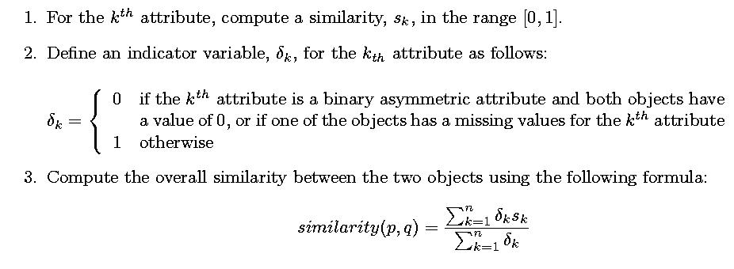
General Approach for Combining Similarities
Sometimes attributes are of many different types, but an overall similarity is needed.

Slide 54

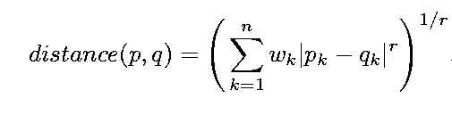
Using Weights to Combine Similarities
May not want to treat all attributes the same.
  Use weights w_{k} which are between 0 and 1 and sum to 1.

Slide 55
Density
Density-based clustering require a notion of density
Examples:
  Euclidean density
    Euclidean density = number of points per unit volume
  Probability density
  Relative likelihood for a random variable to take on a given value
  Graph-based density
  Number of edges in comparison to the maximal number of edges

Slide 56
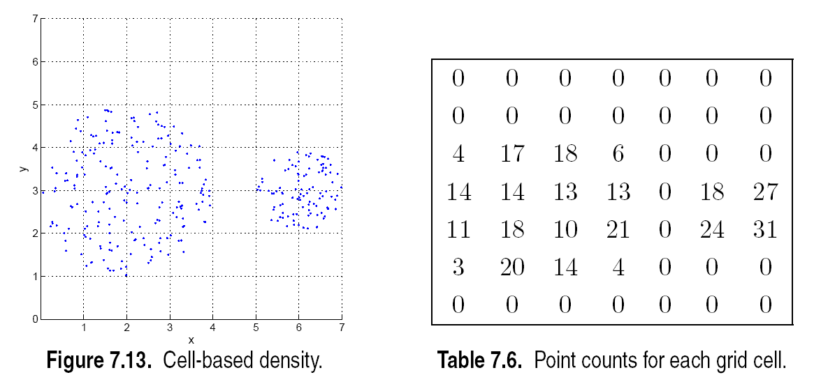
Euclidean Density – Cell-based
Simplest approach is to divide region into a number of rectangular cells of equal volume and define density as # of points the cell contains

Slide 57
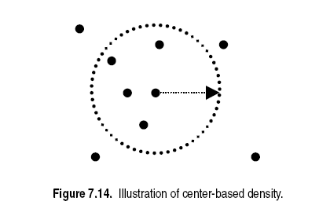
Euclidean Density – Center-based
Euclidean density is the number of points within a specified radius of the point

