Slide 1
Data Mining
Classification: Basic Concepts, Decision Trees, and Model Evaluation
Lecture Notes for Chapter 4
Introduction to Data Mining
by
Tan, Steinbach, Kumar
© Tan,Steinbach, Kumar Introduction to Data Mining 4/18/2004 <number>

Slide 2
Classification: Definition
Given a collection of records (training set )
  Each record contains a set of attributes, one of the attributes is the class.
Find a model for class attribute as a function of the values of other attributes.
Goal: previously unseen records should be assigned a class as accurately as possible.
  A test set is used to determine the accuracy of the model. Usually, the given data set is divided into training and test sets, with training set used to build the model and test set used to validate it.

Slide 3

Illustrating Classification Task

Slide 4
Classification Techniques
Decision Tree based Methods
Rule-based Methods
Memory based reasoning
Neural Networks
Naïve Bayes and Bayesian Belief Networks
Support Vector Machines

Slide 5

Example of a Decision Tree
categorical
categorical
continuous
class
Splitting Attributes
Refund
Yes
No
NO
MarSt
Single, Divorced
Married
TaxInc
NO
< 80K
> 80K
NO
YES
Training Data
Model: Decision Tree

Slide 6
Another Example of Decision Tree
categorical
categorical
continuous
class
MarSt
Single, Divorced
Married
NO
Refund
Yes
No
NO
TaxInc
< 80K
> 80K
NO
YES
There could be more than one tree that fits the same data!

Slide 7

Decision Tree Classification Task
Decision Tree

Slide 8

Apply Model to Test Data
Test Data
Start from the root of tree.
Refund
Yes
No
NO
MarSt
Single, Divorced
Married
TaxInc
NO
< 80K
> 80K
NO
YES

Slide 9
Apply Model to Test Data
Test Data
Refund
Yes
No
NO
MarSt
Single, Divorced
Married
TaxInc
NO
< 80K
> 80K
NO
YES

Slide 10

Apply Model to Test Data
Test Data
Refund
Yes
No
NO
MarSt
Single, Divorced
Married
TaxInc
NO
< 80K
> 80K
NO
YES

Slide 11
Apply Model to Test Data
Test Data
Refund
Yes
No
NO
MarSt
Single, Divorced
Married
TaxInc
NO
< 80K
> 80K
NO
YES

Slide 12

Apply Model to Test Data
Test Data
Refund
Yes
No
NO
MarSt
Single, Divorced
Married
TaxInc
NO
< 80K
> 80K
NO
YES

Slide 13
Apply Model to Test Data
Test Data
Refund
Yes
No
NO
MarSt
Single, Divorced
Married
Assign Cheat to “No”
TaxInc
NO
< 80K
> 80K
NO
YES

Slide 14
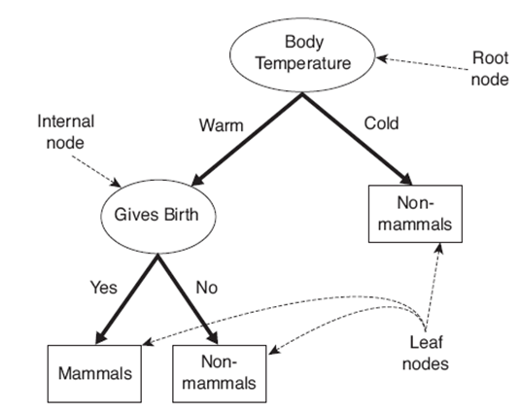
Nodes in a Decision Tree
A Root Node: No incoming edges and zero or more outgoing edges
Internal Nodes: Exactly one incoming edge and two or more outgoing edges
Leaf or Terminal Nodes: Exactly one incoming edge and no outgoing edges
A Decision Tree for the Mammal Classification Problem

Slide 15

Decision Tree Classification Task
Decision Tree

Slide 16
Decision Tree Induction
Many Algorithms:
  Hunt’s Algorithm (one of the earliest)
  CART
  ID3, C4.5
  SLIQ,SPRINT

Slide 17

General Structure of Hunt’s Algorithm
Let D_{t} be the set of training records that reach a node t
General Procedure:
  If D_{t} contains records that belong the same class y_{t}, then t is a leaf node labeled as y_{t}
  If D_{t} is an empty set, then t is a leaf node labeled by the default class, y_{d}
  If D_{t} contains records that belong to more than one class, use an attribute test to split the data into smaller subsets. Recursively apply the procedure to each subset.
D_{t}
?

Slide 18

Hunt’s Algorithm
Refund
Don’t
Cheat
Yes
No
Don’t
Cheat
Don’t
Cheat
Refund
Refund
Yes
No
Yes
No
Don’t
Cheat
Marital
Status
Don’t
Cheat
Marital
Status
Single,
Divorced
Single,
Divorced
Married
Married
Cheat
Don’t
Cheat
Taxable
Income
Don’t
Cheat
< 80K
>= 80K
Don’t
Cheat
Cheat

Slide 19
Tree Induction
Greedy strategy.
  Split the records based on an attribute test that optimizes certain criterion.
Issues
  Determine how to split the records
    How to specify the attribute test condition?
    How to determine the best split?
  Determine when to stop splitting

Slide 20
Tree Induction
Greedy strategy.
  Split the records based on an attribute test that optimizes certain criterion.
Issues
  Determine how to split the records
    How to specify the attribute test condition?
    How to determine the best split?
  Determine when to stop splitting

Slide 21
How to Specify Test Condition?
Depends on attribute types
  Nominal
  Ordinal
  Continuous
Depends on number of ways to split
  2-way split
  Multi-way split

Slide 22
Splitting Based on Nominal Attributes
Multi-way split: Use as many partitions as distinct values.
Binary split: Divides values into two subsets.
Need to find optimal partitioning.
CarType
Family
Luxury
Sports
CarType
CarType
{Sports, Luxury}
OR
{Family,
Luxury}
{Family}
{Sports}

Slide 23
Splitting Based on Ordinal Attributes
Multi-way split: Use as many partitions as distinct values.
Binary split: Divides values into two subsets.
Need to find optimal partitioning.
What about this split?
Size
Small
Large
Medium
Size
Size
{Small, Medium}
OR
{Medium,
Large}
{Large}
{Small}
Size
{Small, Large}
Violates order among the attribute values
{Medium}

Slide 24
Splitting Based on Continuous Attributes
Different ways of handling
  Discretization to form an ordinal categorical attribute
    Static – discretize once at the beginning
    Dynamic – ranges can be found by equal interval bucketing, equal frequency bucketing
    (percentiles), or clustering.
  Binary Decision: (A < v) or (A ≥ v)
    consider all possible splits and finds the best cut
    can be more computationally intensive

Slide 25
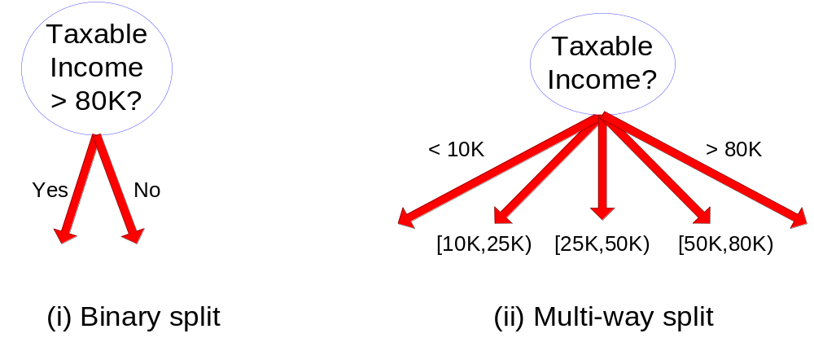
Splitting Based on Continuous Attributes

Slide 26
Tree Induction
Greedy strategy.
  Split the records based on an attribute test that optimizes certain criterion.
Issues
  Determine how to split the records
    How to specify the attribute test condition?
    How to determine the best split?
  Determine when to stop splitting

Slide 27

How to determine the Best Split
Before Splitting: 10 records of class 0,
10 records of class 1
Which test condition is the best?

Slide 28


How to determine the Best Split
Greedy approach:
  Nodes with homogeneous class distribution are preferred
Need a measure of node impurity:
Non-homogeneous,
High degree of impurity
Homogeneous,
Low degree of impurity

Slide 29
Measures of Node Impurity
Gini Index
Entropy
Misclassification error

Slide 30





How to Find the Best Split
Before Splitting:
M0
A?
B?
Yes
No
Yes
No
Node N1
Node N2
Node N3
Node N4
M1
M2
M3
M4
M12
M34
Gain = M0 – M12 vs M0 – M34

Slide 31





Measure of Impurity: GINI
Gini Index for a given node t :
    (NOTE: p( j | t) is the relative frequency of class j at node t).
  Maximum (1 - 1/n_{c}) when records are equally distributed among all classes, implying least interesting information
  Minimum (0.0) when all records belong to one class, implying most interesting information

Slide 32



Examples for computing GINI
P(C1) = 0/6 = 0 P(C2) = 6/6 = 1
Gini = 1 – P(C1)² – P(C2)² = 1 – 0 – 1 = 0
P(C1) = 1/6 P(C2) = 5/6
Gini = 1 – (1/6)² – (5/6)² = 0.278
P(C1) = 2/6 P(C2) = 4/6
Gini = 1 – (2/6)² – (4/6)² = 0.444

Slide 33

Splitting Based on GINI
Used in CART, SLIQ, SPRINT.
When a node p is split into k partitions (children), the quality of split is computed as,
where, n_{i} = number of records at child i,
n = number of records at node p.

Slide 34
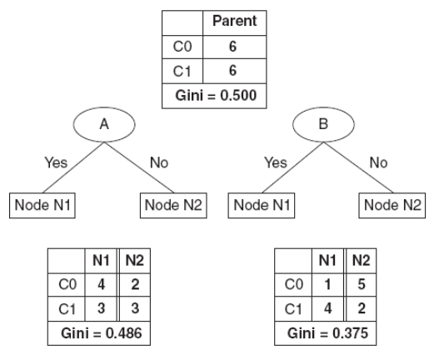
Binary Attributes: Computing GINI Index
Splits into two partitions
Suppose there are two ways to split the data into smaller subsets, based on attributes A and B
Using attribute A
GINI(N1) = 1 – (4/7)² – (3/7)² = 0.489
GINI(N2) = 1 – (2/5)² – (3/5)² = 0.48
Weighted GINI index for the split = (7/12)*0.489 + (5/12)*0.48 = 0.486
Using attribute B
GINI(N1) = 1 – (1/5)² – (4/5)² = 0.32
GINI(N2) = 1 – (5/7)² – (2/7)² = 0.408
Weighted GINI index for the split = (5/12)*0.32 + (7/12)*0.408 = 0.37
B is preferred over A

Slide 35
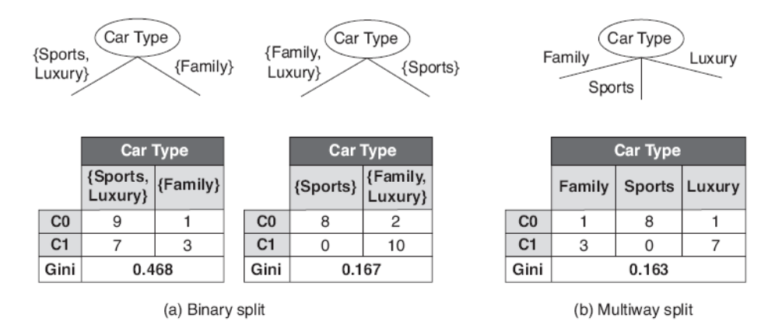
Nominal Attributes: Computing Gini Index
Nominal attributes can produce binary or multiway splits
Gini for binary splits is computed the same way as for binary attributes
For multiway splits, Gini is computed for every attribute value
The second binary split produces lower Gini index as the corresponding subsets are much purer
Multiway split produces the least Gini index

Slide 36

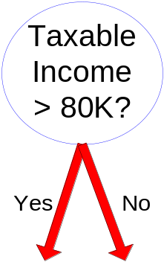
Continuous Attributes: Computing Gini Index
Use Binary Decisions based on one value
Several Choices for the splitting value
  Number of possible splitting values
  = Number of distinct values
Each splitting value has a count matrix associated with it
  Class counts in each of the partitions, A < v and A ≥ v
Simple method to choose best v
  For each v, scan the database to gather count matrix and compute its Gini index
  Computationally Inefficient! Repetition of work.

Slide 37

Continuous Attributes: Computing Gini Index...
For efficient computation: for each attribute,
  Sort the attribute on values
  Linearly scan these values, each time updating the count matrix and computing gini index
  Choose the split position that has the least gini index
Sorted Values
Split Positions

Slide 38

Alternative Splitting Criteria based on INFO
Entropy at a given node t:
    (NOTE: p( j | t) is the relative frequency of class j at node t).
  Measures homogeneity of a node.
    Maximum (log n_{c}) when records are equally distributed among all classes implying least information
    Minimum (0.0) when all records belong to one class, implying most information
    log is computed with a base of 2
  Entropy based computations are similar to the GINI index computations
0.log₂0 = 0 in entropy calculations

Slide 39

Examples for computing Entropy
P(C1) = 0/6 = 0 P(C2) = 6/6 = 1
Entropy = – 0 log 0 – 1 log 1 = – 0 – 0 = 0
P(C1) = 1/6 P(C2) = 5/6
Entropy = – (1/6) log₂ (1/6) – (5/6) log₂ (5/6) = 0.65
P(C1) = 2/6 P(C2) = 4/6
Entropy = – (2/6) log₂ (2/6) – (4/6) log₂ (4/6) = 0.92

Slide 40

Splitting Criteria based on Classification Error
Classification error at a node t :
Measures misclassification error made by a node.
    Maximum (1 - 1/n_{c}) when records are equally distributed among all classes, implying least interesting information
    Minimum (0.0) when all records belong to one class, implying most interesting information

Slide 41
Examples for Computing Error
P(C1) = 0/6 = 0 P(C2) = 6/6 = 1
Error = 1 – max (0, 1) = 1 – 1 = 0
P(C1) = 1/6 P(C2) = 5/6
Error = 1 – max (1/6, 5/6) = 1 – 5/6 = 1/6
P(C1) = 2/6 P(C2) = 4/6
Error = 1 – max (2/6, 4/6) = 1 – 4/6 = 1/3

Slide 42

Comparison among Splitting Criteria
For a 2-class problem:
p = fraction of records that belong to one of the two classes
Value of the Impurity Measure

Slide 43
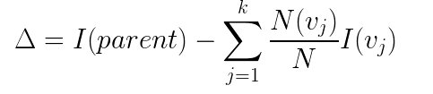

Gain
The gain is a criterion that can be used to determine the goodness of a split
Gain is defined as follows
I(.) is the impurity measure at a given node, N is the total number of records at the parent node, N(v_{j}) is the number of records in child node v_{j} and k is the number of child nodes
We prefer splits which produce maximal gain
Since I(parent) is the same for all test conditions, maximizing gain is equivalent to minimizing the weighted average impurity measure of the child nodes
When entropy is used as the impurity measure, the gain is known as information gain
Information gain is used in ID3 and C4.5 implementations of decision trees

Slide 44
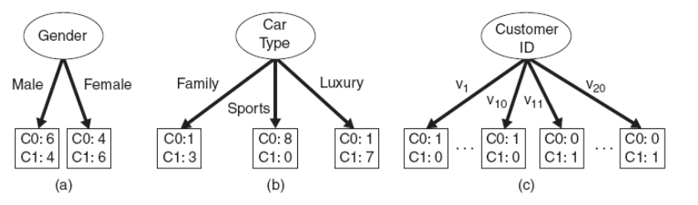
Gain Ratio
Impurity measures like Gini index and entropy tend to favor attributes that have a large number of distinct values
Results in a large number of partitions, which are small, but pure
In the following example, customer ID is not a predictive attribute as its value is unique for each record
If the number of records associated with each partition is very small, it is difficult to make reliable predictions

Slide 45


Gain Ratio
    Parent Node, p is split into k partitions
    n_{i} is the number of records in partition i
  Adjusts Information Gain by the entropy of the partitioning (SplitINFO).
  If an attribute produces a large number of splits, the SplitINFO will also be high, which in turn will reduce the gain ratio
  Penalizes large number of small partitions
  Used in C4.5
  Designed to overcome the disadvantage of Gain
  log is computed with a base of 2

Slide 46
SplitINFO Illustration
Suppose the parent node has 10 records
Case 1: Consider 10 partitions with 1 record in each
(n_{i}/n) = 1/10
SplitINFO = - 10 * (1/10) * log (1/10) = log (10) = 3.32
Case 2: Consider 2 partitions containing 4 and 6 records
SplitINFO = - (4/10)*log (4/10) – (6/10)*log(6/10) = 0.97
The first case has higher value of SplitINFO as it produces a large number of small partitions

Slide 47
Tree Induction
Greedy strategy.
  Split the records based on an attribute test that optimizes certain criterion.
Issues
  Determine how to split the records
    How to specify the attribute test condition?
    How to determine the best split?
  Determine when to stop splitting

Slide 48
Stopping Criteria for Tree Induction
Stop expanding a node when all the records belong to the same class
Stop expanding a node when all the records have similar attribute values
Early termination (to be discussed later)

Slide 49
Decision Tree Based Classification
Advantages:
  Inexpensive to construct
  Extremely fast at classifying unknown records
  Easy to interpret for small-sized trees
  Accuracy is comparable to other classification techniques for many simple data sets

Slide 50
Example: C4.5
Simple depth-first construction.
Uses Information Gain
Sorts Continuous Attributes at each node.
Needs entire data to fit in memory.
Unsuitable for Large Datasets.

Slide 51
Practical Issues of Classification
Underfitting and Overfitting
Costs of Classification

Slide 52
Underfitting and Overfitting
Training Error / Re-substitution Error: Number of errors committed on training records
Generalization Error: Expected error of the model on previously unseen records
A good model must have low training error and low generalization error
A model that fits the training data too well can have poorer generalization error than a model with a higher training error. Such a situation is called model overfitting
Training error can be reduced by increasing the model complexity e.g. nodes of a DT can be expanded until it perfectly fits the training data
Training error for such a complex tree is 0, but test error is large as tree may contain nodes that accidentally fit some noise points in the training data
Such nodes do not generalize well to the test examples and can degrade the performance of the tree

Slide 53

Underfitting and Overfitting (Example)
500 circular and 500 triangular data points.
Circular points:
0.5 ≤ sqrt(x₁²+x₂²) ≤ 1
Triangular points:
sqrt(x₁²+x₂²) > 0.5 or
sqrt(x₁²+x₂²) < 1
Use 30% points for training and 70% for testing
Train a decision tree classifier with different number of nodes

Slide 54

Underfitting and Overfitting
Underfitting
When model is too simple (size of tree is very small), both the training and test errors are large
Model underfitting
Model has not learnt the true structure of the data
Performs poorly on both training and test sets
Overfitting
Once tree becomes too large, test error begins to increase even though training error continues to decrease
Model overfitting
Overfitting
Underfitting

Slide 55

Overfitting due to Noise
Decision boundary is distorted by noise point
Noise point results in a decision boundary that is more complex than necessary

Slide 56
Notes on Overfitting
Overfitting results in decision trees that are more complex than necessary
Training error no longer provides a good estimate of how well the tree will perform on previously unseen records
Need new ways for estimating errors

Slide 57
Occam’s Razor
Given two models of similar generalization errors, one should prefer the simpler model over the more complex model
For complex models, there is a greater chance that it was fitted accidentally by errors in data
Therefore, one should include model complexity when evaluating a model

Slide 58
Estimating Generalization Errors
Re-substitution errors: error on training (Σ e(t) )
Generalization errors: error on testing (Σ e’(t))
Methods for estimating generalization errors:
  Optimistic approach: e’(t) = e(t) (assumes training set is a good representation of the overall data)
  Pessimistic approach (incorporates model complexity in error computation):
    For each leaf node, add a penalty term (say, 0.5)
    Total errors: e’(T) = e(T) + N × 0.5 (N: number of leaf nodes)
    For a tree with 30 leaf nodes and 10 errors on training
    (out of 1000 instances):
    Training error = 10/1000 = 1%
    Generalization error = (10 + 30×0.5)/1000 = 2.5%
  Reduced Error Pruning
    uses validation data set to estimate generalization
    error

Slide 59
Estimating Generalization Errors
Validation Set
Divide the original training data into two smaller subsets
Train the model on one subset
Use the other subset (validation set) to estimate generalization error
The validation set is assumed to mimic the test set; the error on the validation set is taken as an estimate of the generalization error
The model attaining the lowest error on the validation set is selected as the final model
Drawback: less data available for training

Slide 60
How to Address Overfitting
Pre-Pruning (Early Stopping Rule)
  Stop the algorithm before it becomes a fully-grown tree
  Typical stopping conditions for a node:
    Stop if all instances belong to the same class
    Stop if all the attribute values are the same
  More restrictive conditions:
    Stop if number of instances is less than some user-specified threshold
    Stop if expanding the current node does not improve impurity
    measures (e.g., Gini or information gain) over a certain threshold
    Difficult to choose the right threshold
      Too high threshold: underfitted models
      Too low threshold: insufficient to overcome model overfitting

Slide 61
How to Address Overfitting…
Post-pruning
  Grow decision tree to its entirety
  Trim the nodes of the decision tree in a bottom-up fashion
  If generalization error improves after trimming, replace sub-tree by a leaf node.
  Class label of leaf node is determined from majority class of instances in the sub-tree

Slide 62
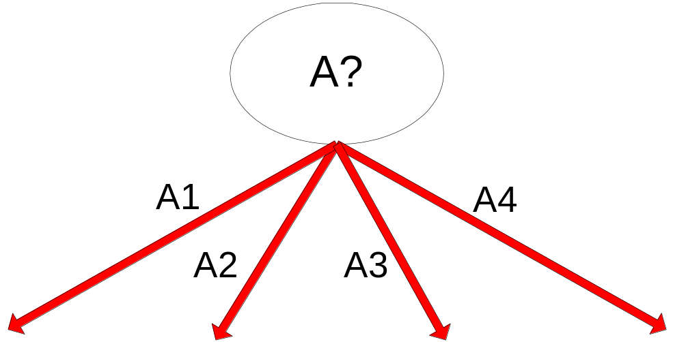
Example of Post-Pruning
Training Error (Before splitting) = 10/30
Pessimistic error = (10 + 0.5)/30 = 10.5/30
Training Error (After splitting) = 9/30
Pessimistic error (After splitting)
= (9 + 4 × 0.5)/30 = 11/30
PRUNE!
Class = Yes | 20
Class = No | 10
Error = 10/30
Class = Yes | 8
Class = No | 4
Class = Yes | 3
Class = No | 4
Class = Yes | 4
Class = No | 1
Class = Yes | 5
Class = No | 1

Slide 63
Examples of Post-pruning
  Optimistic error
  Case 1
  Error before splitting = 7/20 = 0.35
  Error after splitting = 5/20 = 0.25
  Don’t prune
  Case 2
  Error before splitting = 5/21 = 0.238
  Error after splitting = 5/21 = 0.238
  Don’t prune
  Pessimistic error
  Case 1
  Error before splitting = (7+0.5)/20 = 0.375
  Error after splitting = (5 + 2*0.5)/20 = 0.3
  Don’t prune
  Case 2
  Error before splitting = (5+0.5)/21 = 0.262
  Error after splitting = (5 + 2*0.5)/21 = 0.286
  Prune
C0: 13
C1: 7
Case 1:
C0: 11
C1: 3
C0: 2
C1: 4
C0: 16
C1: 5
Case 2:
C0: 14
C1: 3
C0: 2
C1: 2

Slide 64
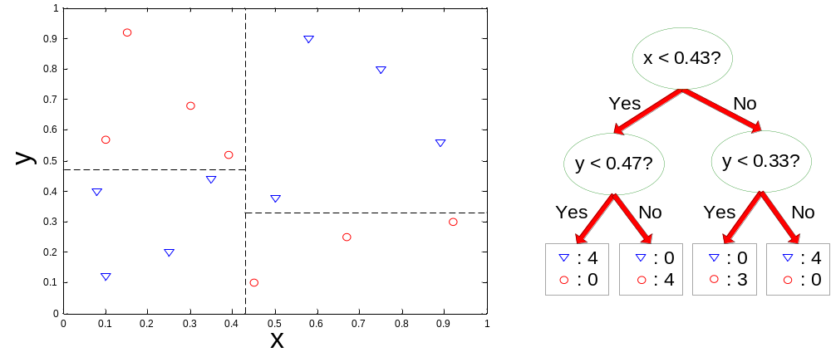
Decision Boundary
Border line between two neighboring regions of different classes is known as decision boundary
Decision boundary is parallel to axes because test condition involves a single attribute at-a-time
Limited expressive power

Slide 65
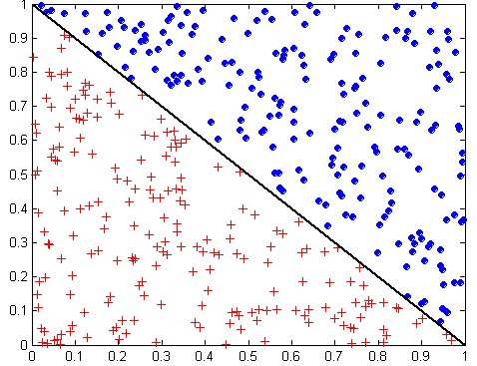
Oblique Decision Trees
x + y < 1
Class = +
Class =
Test condition may involve multiple attributes
More expressive representation
Finding optimal test condition is computationally expensive

Slide 66

The Bias Variance Tradeoff
The prediction errors of models can be decomposed into two main components: error due to bias and error due to variance
There is a tradeoff between a model’s ability to minimize bias and variance
Noise
Suppose you want to develop a data mining model from a given training set
Assume that you can repeat the model building process more than once on different training sets sampled from the same underlying distribution
Each time you will get a different model due to the underlying randomness and variability of the data
Therefore the model predictions on a given test sample will be different
The error due to bias is computed as the difference between the expected (or average) prediction of our model and the correct value we are trying to predict
Bias measures how far off in general the model predictions are from the correct value
The error due to variance is computed as the variability of the model predictions for a given data sample
Variance measures how much the predictions for a given data sample vary between different realizations of the model

Slide 67
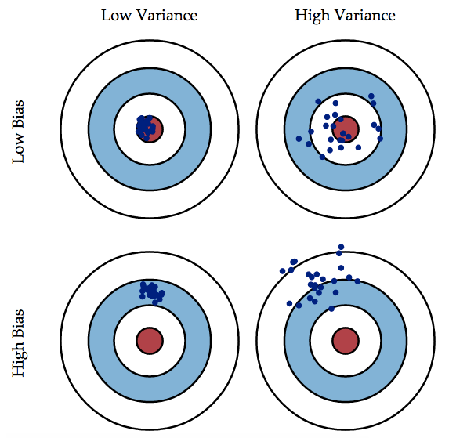
The Bias Variance Tradeoff
Graphical representation of bias and variance using bulls-eye diagram
Center of the target is a model that perfectly predicts the correct values
Each hit represents an individual realization of our model

Slide 68

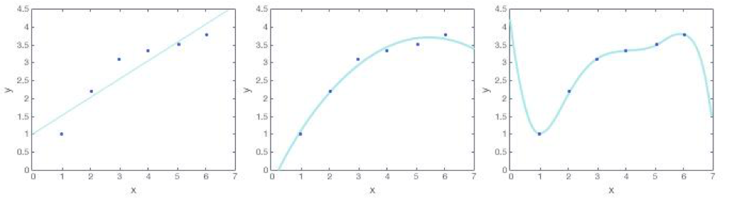
The Bias Variance Tradeoff
Consider a regression problem where we want to represent a function f(x) as a polynomial of a certain degree
As the degree gets higher, the function becomes more complicated
Consider degree 1, degree 2 and degree 5 polynomials to fit the data
Degree 5 Polynomial
Fits the data perfectly, so it has low bias
But behavior of the polynomial is erratic; if we slightly move one point, the curve will have to change dramatically to still fit all the points. So it has high variance
Degree 1 Polynomial
Does not fit the data well, so it has high bias
But if we slightly move one point, there will be very little change in the line; it is more consistent. So it has low variance
The degree 2 polynomial represents the best fit with low bias and variance
degree 1
degree 2
degree 5

Slide 69
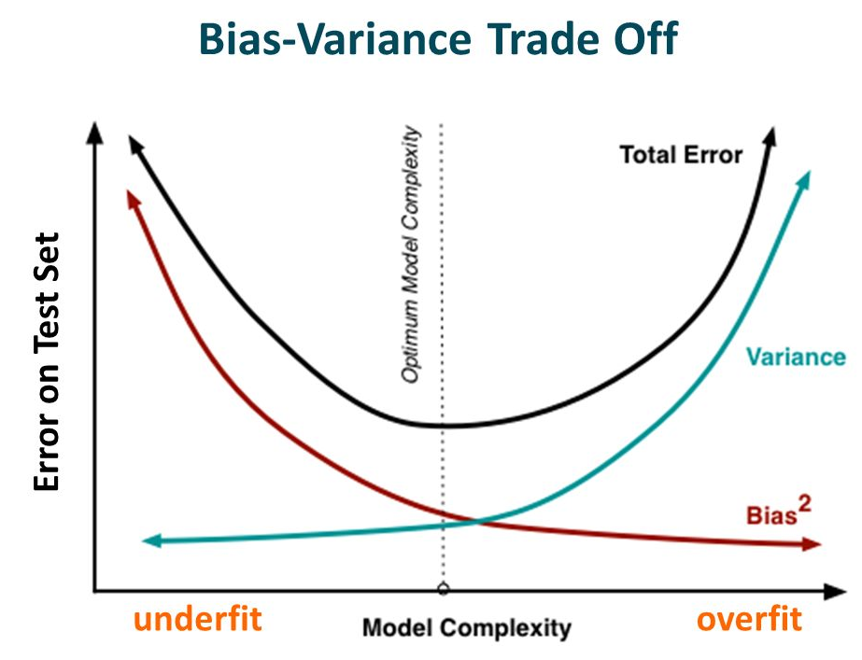
The Bias Variance Tradeoff
Simple Models
High bias
Low Variance
Underfit
Complex Models
Low Bias
High Variance
Overfit

Slide 70
Model Evaluation
Metrics for Performance Evaluation
  How to evaluate the performance of a model?
Methods for Performance Evaluation
  How to obtain reliable estimates?
Methods for Model Comparison
  How to compare the relative performance among competing models?

Slide 71
Model Evaluation
Metrics for Performance Evaluation
  How to evaluate the performance of a model?
Methods for Performance Evaluation
  How to obtain reliable estimates?
Methods for Model Comparison
  How to compare the relative performance among competing models?

Slide 72
Metrics for Performance Evaluation
Focus on the predictive capability of a model
  Rather than how fast it takes to classify or build models, scalability, etc.
Confusion Matrix:
 | PREDICTED CLASS
ACTUAL CLASS |  | Class=Yes | Class=No
 | Class=Yes | a | b
 | Class=No | c | d
a: TP (true positive)
b: FN (false negative)
c: FP (false positive)
d: TN (true negative)
a+b: Total number of samples with actual class = Yes
c+d: Total number of samples with actual class = No

Slide 73
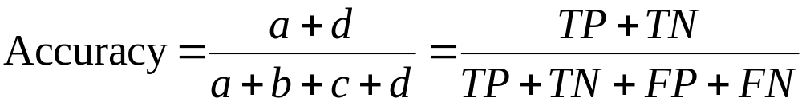
Metrics for Performance Evaluation…
Most widely-used metric:
 | PREDICTED CLASS
ACTUAL CLASS |  | Class=Yes | Class=No
 | Class=Yes | a (TP) | b (FN)
 | Class=No | c (FP) | d (TN)

Slide 74
Limitation of Accuracy: Class Imbalance
Consider a 2-class problem
  Number of Class 0 examples = 9990
  Number of Class 1 examples = 10
If model predicts everything to be class 0, accuracy is 9990/10000 = 99.9 %
  Accuracy is misleading because model does not detect any class 1 example

Slide 75
Strategy 1: Alternative Metrics
True Positive Rate (TPR) or sensitivity is defined as the fraction of positive examples predicted correctly by the model:
TPR = TP / (TP + FN)
True Negative Rate (TNR) or specificity is defined as the fraction of negative examples predicted correctly by the model:
TNR = TN / (TN + FP)
False Positive Rate (FPR) is the fraction of negative examples predicted as a positive class:
FPR = FP / (FP + TN)
False Negative Rate (FNR) is the fraction of positive examples predicted as a negative class:
FNR = FN / (FN + TP)

Slide 76


Strategy 1: Alternative Metrics
Precision and Recall are two widely used metrics employed in applications where successful detection of one class is considered more significant than detection of the other class
The positive class is usually considered more significant than the negative class
Precision
Recall
Precision computes the fraction of records that actually turn out to be positive in the group the classifier has declared as positive class
Higher precision implies a lower number of false positive errors committed by the classifier
Recall computes the fraction of positive examples correctly predicted by the classifier
Higher recall implies very few positive examples are misclassified as the negative class
Recall is equivalent to the true positive rate (TPR)

Slide 77

Strategy 1: Alternative Metrics
A good model should maximize the values of both precision and recall
It is easy to construct models that maximize one metric, but not the other
A model that predicts every sample to be positive will have a perfect recall, but very poor precision
A model that assigns a positive class to every test record that matches one of the positive records in the training set has very high precision, but low recall
Developing models with high values of BOTH precision and recall is the key challenge of classification algorithms
Precision and Recall can be summarized into another metric, called the F₁ Measure, which is the harmonic mean of precision and recall
The harmonic mean of two numbers tends to be closer to the smaller of the two numbers
Thus, a high value of the F₁ measure ensures that both precision and recall are high

Slide 78
Strategy 2: Cost Matrix
 | PREDICTED CLASS
ACTUAL CLASS | C(i|j) | Class=Yes | Class=No
 | Class=Yes | C(Yes|Yes) | C(No|Yes)
 | Class=No | C(Yes|No) | C(No|No)
C(i|j): Cost of misclassifying class j example as class i

Slide 79
Computing Cost of Classification
Cost Matrix | PREDICTED CLASS
ACTUAL CLASS | C(i|j) | + | -
 | + | -1 | 100
 | - | 1 | 0
Model M₁ | PREDICTED CLASS
ACTUAL CLASS |  | + | -
 | + | 150 | 40
 | - | 60 | 250
Model M₂ | PREDICTED CLASS
ACTUAL CLASS |  | + | -
 | + | 250 | 45
 | - | 5 | 200
Accuracy = 80%
Cost = 150(-1) + 60*1 + 40*100 = 3910
Accuracy = 90%
Cost = 250(-1) + 5*1 + 45*100 = 4255
M2 has a higher accuracy as it improves both true positive and false positive counts
But M2 is still inferior as the improvement comes at the expense of increasing the more costly false negative errors

Slide 80
Model Evaluation
Metrics for Performance Evaluation
  How to evaluate the performance of a model?
Methods for Performance Evaluation
  How to obtain reliable estimates?
Methods for Model Comparison
  How to compare the relative performance among competing models?

Slide 81
Methods of Estimation
Holdout
  Partition the set of labeled samples into two disjoint sets
  Reserve 2/3 for training and 1/3 for testing
  Accuracy estimated on the test set
  Fewer labeled samples are available for training and the induced model may not be as good
  A lot depends on the partition; a class over-represented in one set may be under-represented in the other
Random subsampling
  Repeated holdout
  Improved estimation of a classifier’s performance
  Overall accuracy is an average of the individual accuracies

Slide 82
Methods of Estimation
Cross validation
  Partition data into k disjoint subsets of equal size
  k-fold: train on k-1 partitions, test on the remaining one
  Repeat the process for all the partitions
  Accuracy is estimates as the average accuracy over all the k-folds
  The test sets are all mutually exclusive and cover the entire dataset
  Leave-one-out: special case with k=n; each test set contains only one record
  Computationally expensive
Bootstrap
  Training records are sampled with replacement
  The same training record can be selected multiple times
  Records not included in the bootstrap sample form the test set
  Process repeated multiple times and the average accuracy is computed

Slide 83
Model Evaluation
Metrics for Performance Evaluation
  How to evaluate the performance of a model?
Methods for Performance Evaluation
  How to obtain reliable estimates?
Methods for Model Comparison
  How to compare the relative performance among competing models?

Slide 84
ROC (Receiver Operating Characteristic)
Developed in 1950s for signal detection theory to analyze noisy signals
  Characterize the trade-off between positive hits and false alarms
ROC curve plots TPR (on the y-axis) against FPR (on the x-axis)
Each point on the curve corresponds to one of the models induced by the classifier
Changing the threshold of algorithm, sample distribution or cost matrix changes the location of the point

Slide 85
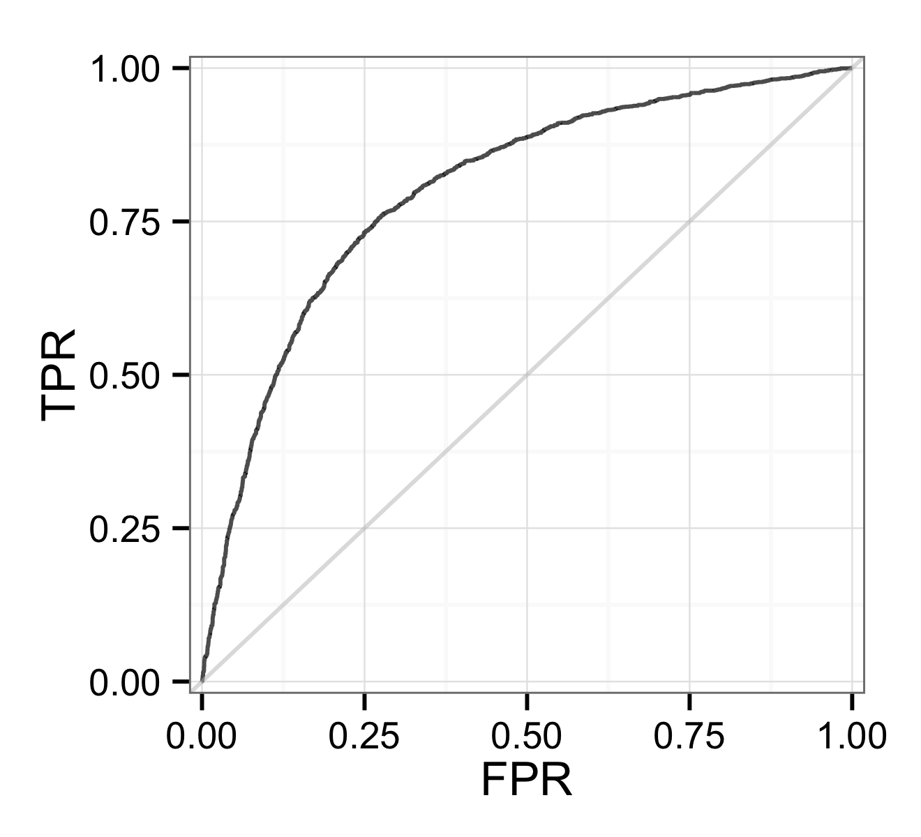
ROC Curve
Several critical points on the curve with well-known interpretations
(TPR=0,FPR=0): Model predicts every instance to be a negative class
(TPR=1,FPR=1): Model predicts every instance to be a positive class
(TPR=1,FPR=0): Ideal model
A good model should be located as close as possible to the upper left corner

Slide 86

ROC Curve
A model that makes random guesses is located along the main diagonal connecting the points (TPR=0,FPR=0) and (TPR=1,FPR=1)
Random guessing means that a record is classified as positive with fixed probability p
Suppose a dataset n+ positive instances and n- negative instances
Random classifier is expected to classify pn+ of the positive instances and misclassify pn- of the negative instances
TPR = (pn+) / n+ = p and FPR = (pn-) / n- = p
Since TPR = FPR, an ROC curve for a random classifier will reside along the main diagonal
A classifier worse than random guessing will reside below the main diagonal

Slide 87
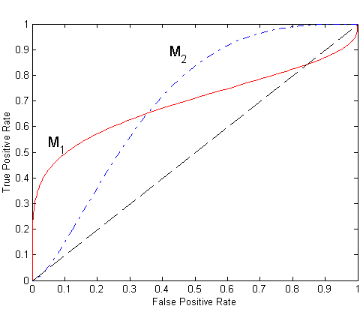
Using ROC for Model Comparison
No model consistently outperform the other
M₁ is better for small FPR
M₂ is better for large FPR
Area Under the ROC curve (AUC)
Evaluates which model is better on average
Higher area implies better model
  Ideal: Area = 1
  Random guess: Area = 0.5

Slide 88
How to Construct an ROC curve
To draw an ROC curve, the classifier should be able to produce a continuous valued output that can be used to rank its predictions
Use classifier that produces posterior probability for each test instance P(+|A)
Sort the instances according to P(+|A) in decreasing order
Apply threshold at each unique value of P(+|A)
Assign the selected record and those ranked above it to the positive class and those ranked below it as negative
Count the number of TP, FP, TN, FN at each threshold
TP rate, TPR = TP/(TP+FN)
FP rate, FPR = FP/(FP + TN)
Instance | P(+|A) | True Class
1 | 0.95 | +
2 | 0.93 | +
3 | 0.87 | -
4 | 0.85 | -
5 | 0.85 | -
6 | 0.85 | +
7 | 0.76 | -
8 | 0.53 | +
9 | 0.43 | -
10 | 0.25 | +

Slide 89
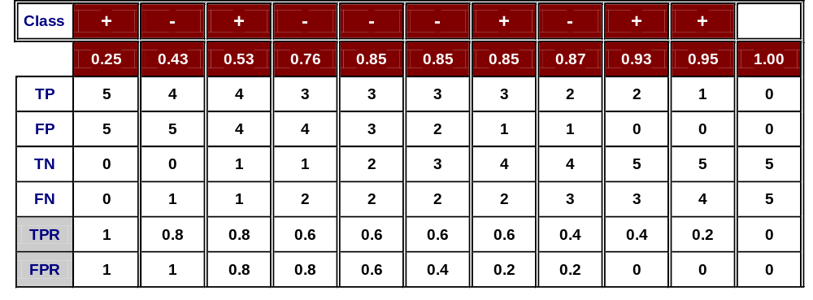
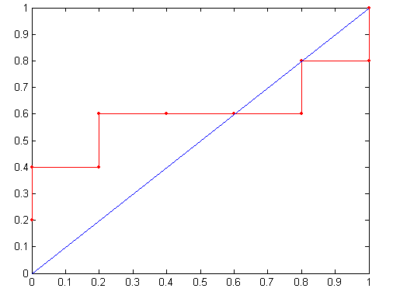
How to construct an ROC curve
Threshold >=
ROC Curve:

