Slide 1
Project Four Proposal:
Natris
March 18th, 2016

Slide 2
Table of Contents
Project Objective
Research
Competitive Analysis
Wireframes & Key Features
Constraints

Slide 3
Project 4 Objective
Create a Tetris Clone that runs on Android whose feature includes multiplayer head to head game play using Google Game Services

Slide 4
Research & Analysis
Key Findings:
  Casual games are enjoyed by people who don’t consider themselves gamers
  Casual games are usually played as a distraction, mostly on long commutes
  The casual player enjoys simple games, with little learning curve, and no need to constantly play
  Bonuses include the ability to play against friends
Conclusion:
  There is a market for familiar, easy to play games and games with multiplayer are even more appealing

Slide 5
Competitive Analysis
 | Price | In-app price | Multi-player | In Game Items | Storyline | Gameplay | In Game ads
Candy Crush | free | range from .99 to 99 | compares high score | yes | no | easy to play, but difficult to win | yes
Crossy Road | free to download | ranges from .99 to 3.99 | yes | yes | no | casual | yes
Machinarium | 4.99 |  |  | no | yes | adventure | no
Word with Friends | free | ranges from .99 to 9.99 | yes | yes | no | easy to play | no
Solitaire | free |  | no | no | no | easy to play | no
Natris | free | free | head to head play | no | no | easy to play | no

Slide 6
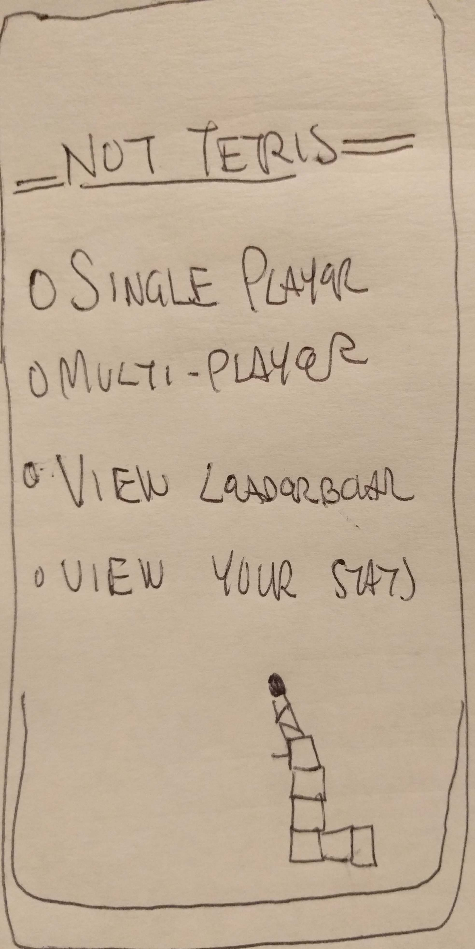
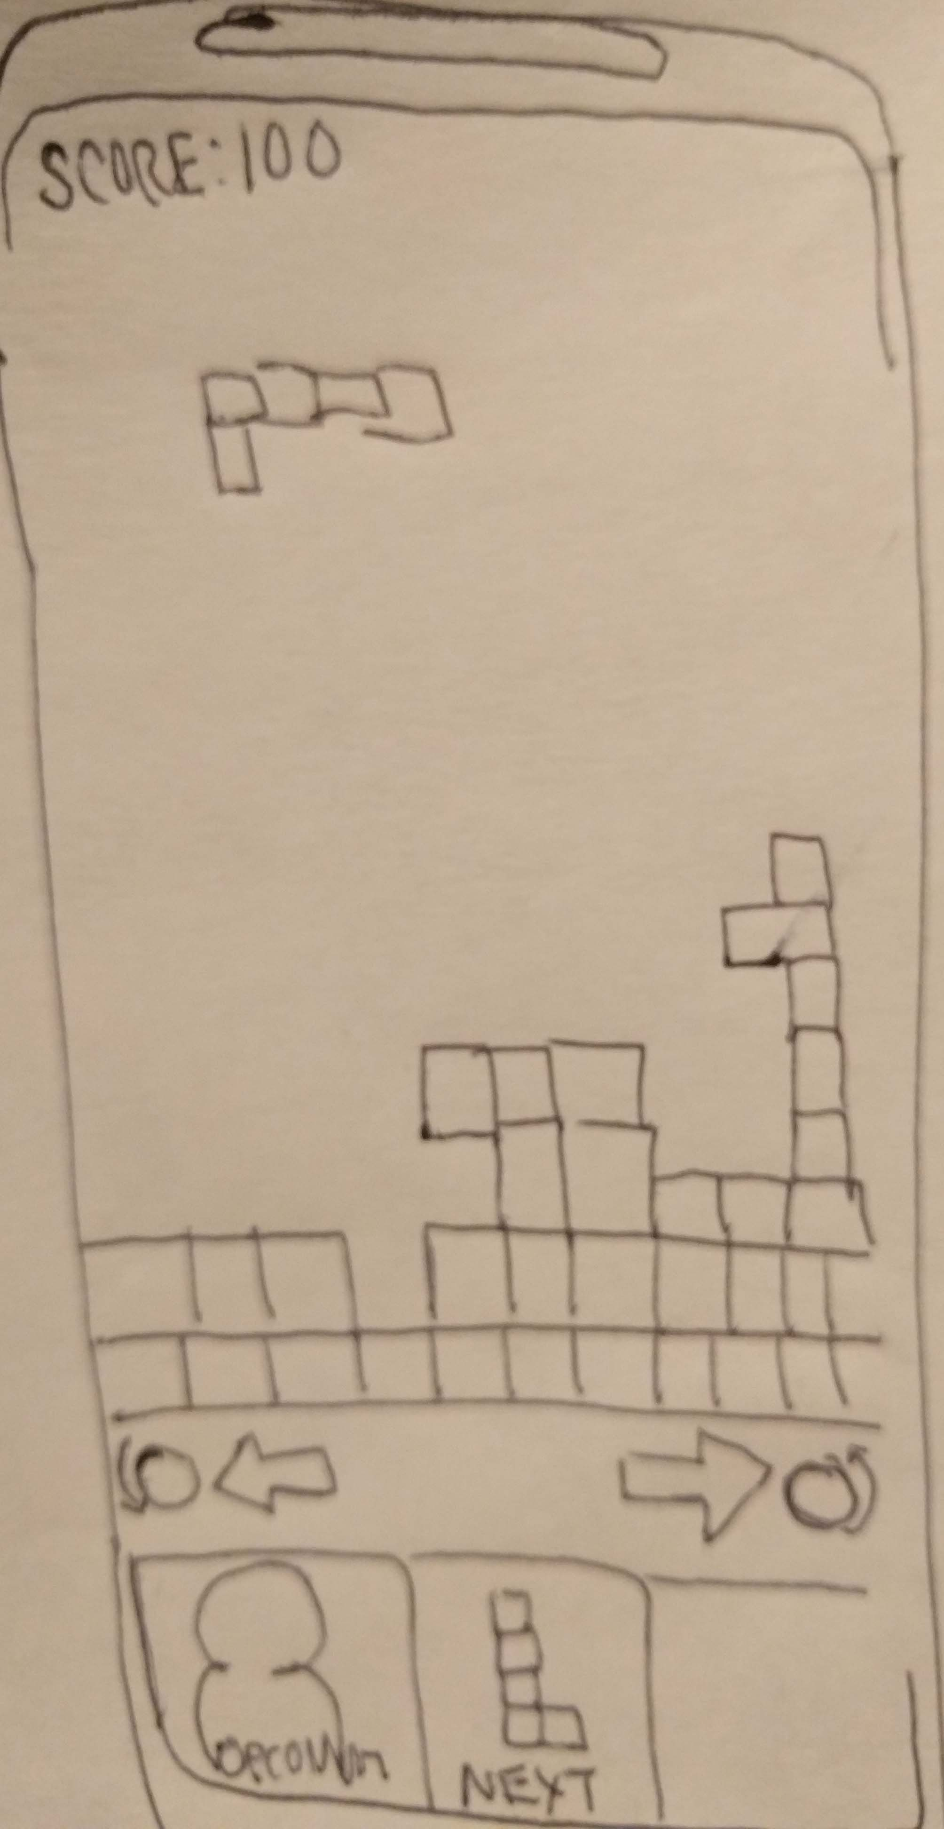
Wireframes

Slide 7
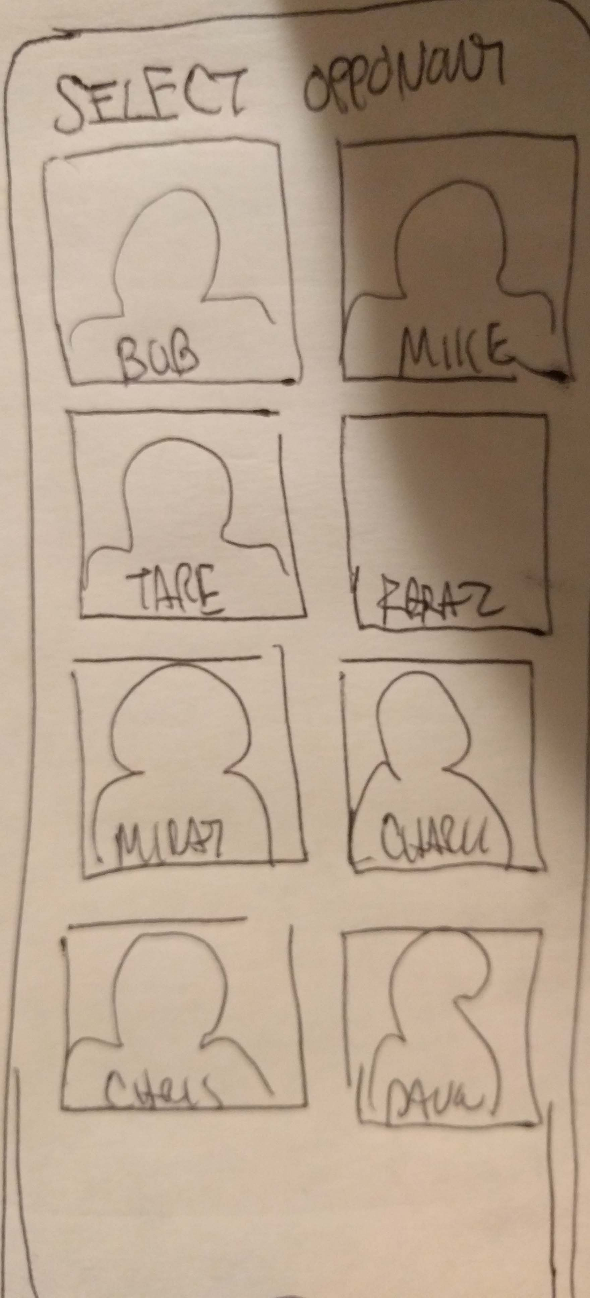
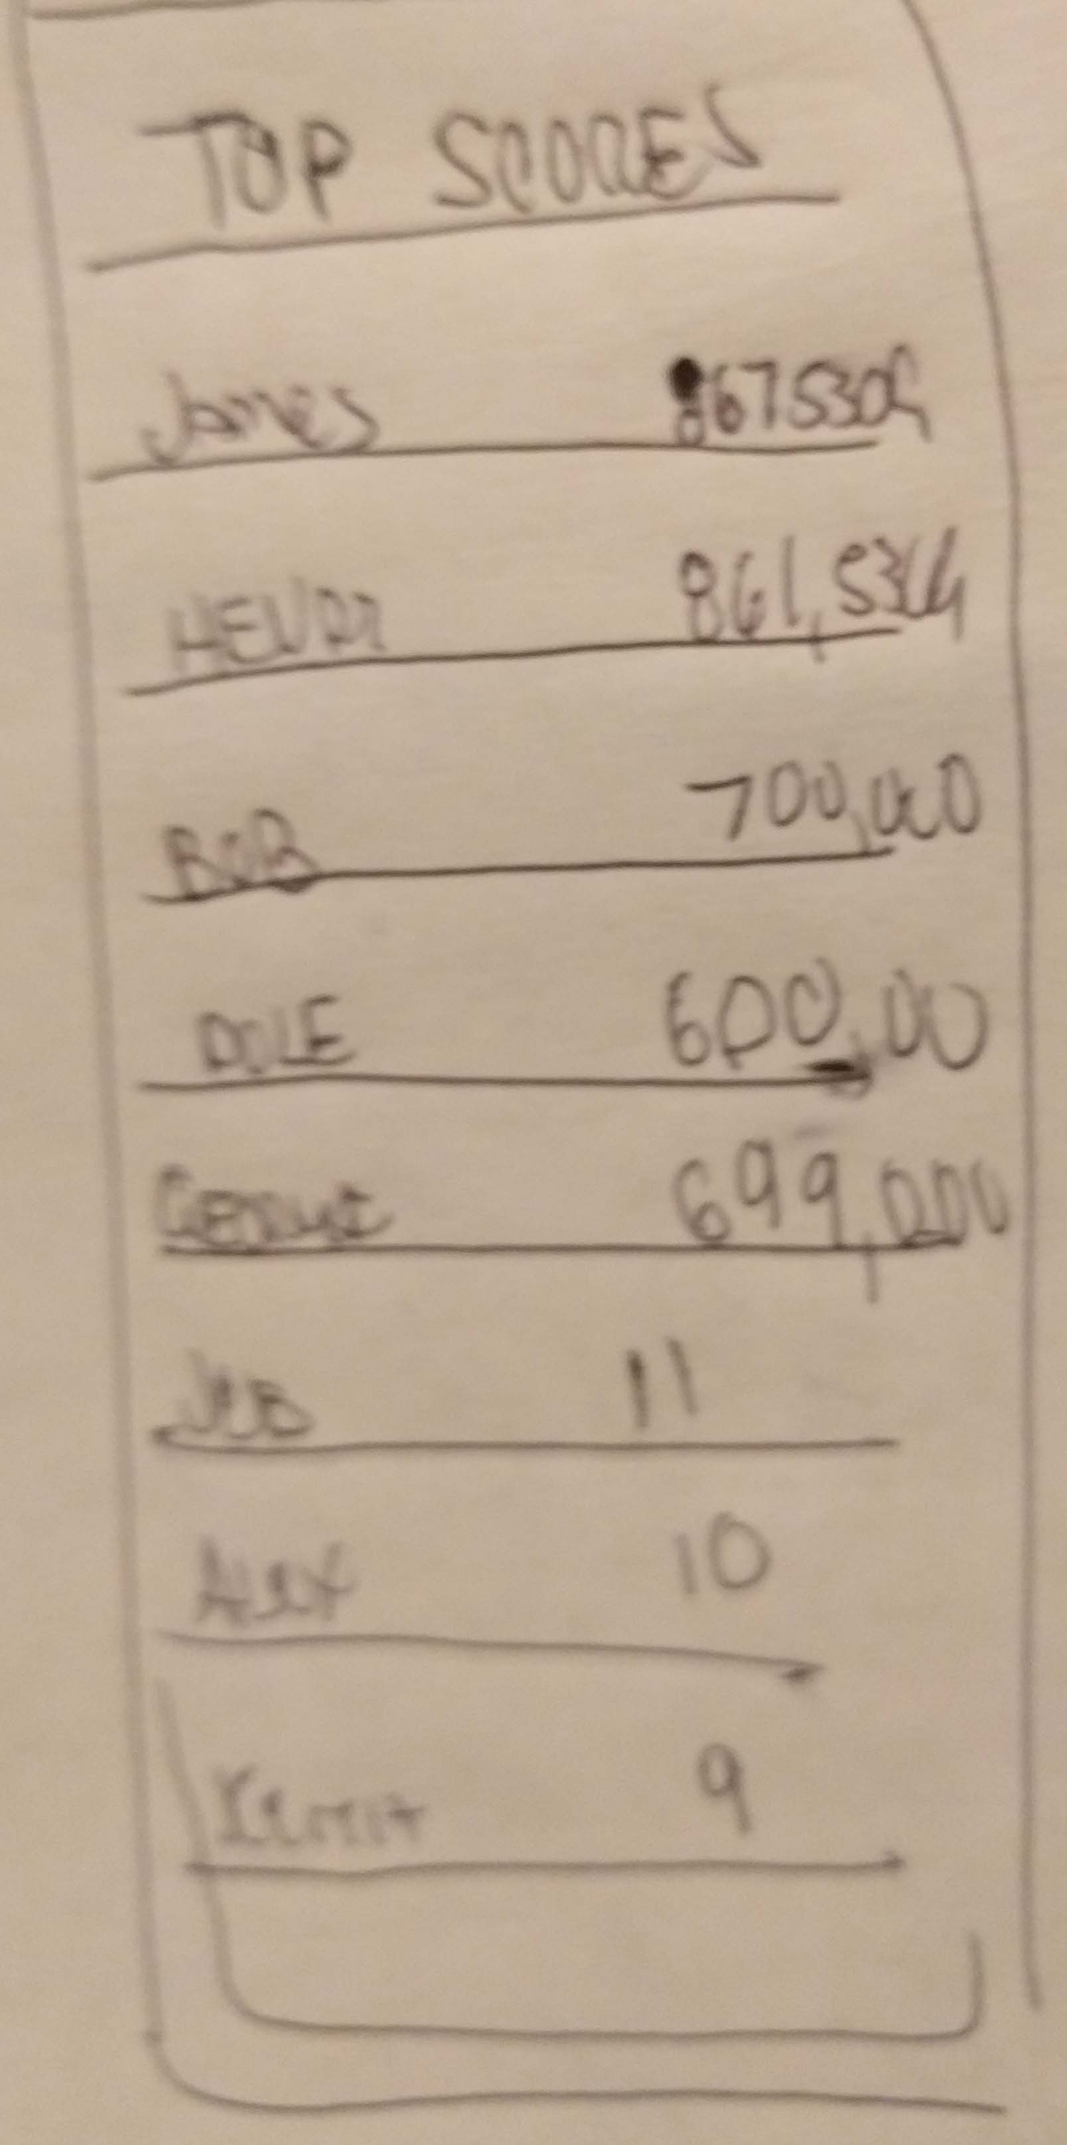
WireFrames: Opponents and Top Scores
Selection of opponents, head to head play and leaderboard aided by Google Play Game services

Slide 8
Constraints
Short time schedule: although a tetris clone doesn’t require all the components of a game with physics and character, it is still a lot to implement within a short period of time
Much of the multiplayer technology relies on Google Play Services Game, which is a API I have never worked with
Even if the Google Play Game Services works, setting up Multi Player- Head to head may be a challenge

