Slide 1
JAVA —Introduction to Java—
*
Java and Web Programming
‹#›
Notes:
‹#›

Slide 2
Introduction to Java
History of Java
Introduction to Java
The java buzzwords
Why java is important to the internet
Java’s magic: The Byte code
Overview of java
Lexical issues
Programming
*
Java and Web Programming
‹#›

Slide 3
Some Basics
Q. What is a program?
Ans. A sequence of instructions that a computer can interpret and execute.
Q. Why Java and not Hindi / Malayalam / English?
Ans. Since, so far, computer is not intelligent enough to understand natural languages.
*
Java and Web Programming
‹#›
Notes:
‹#›

Slide 4
History of Java
Computer language innovation and development occurs for two fundamental reasons:
to adapt to changing environments and uses
to implement improvements in the art of programming
The development of Java was driven by both in equal measures
Many Java features are inherited from the earlier languages:
B C C++ Java
*
Java and Web Programming
‹#›
Notes:
‹#›

Slide 5
Before Java : C
Designed by Dennis Ritchie in 1970s
Before C: BASIC, COBOL, FORTRAN, PASCAL
C- structured, efficient, high-level language that could replace assembly code when creating systems programs
Designed, implemented and tested by programmers
*
Java and Web Programming
‹#›
Notes:
‹#›

Slide 6
Before Java : C++
Designed by Bjarne Stroustrup in 1979
Response to the increased complexity of programs and respective improvements in the programming paradigms and methods:
assembler languages
high-level languages
structured programming
object-oriented programming (OOP)
OOP – methodology that helps organize complex programs through the use of inheritance, encapsulation and polymorphism
C++ extends C by adding object-oriented features
*
Java and Web Programming
‹#›
Notes:
‹#›

Slide 7
Java : History
In 1990, Sun Microsystems started a project called Green
Objective: to develop software for consumer electronics
Project was assigned to James Gosling, a veteran of classic network software design
Others included Patrick Naughton, ChrisWarth, Ed Frank, and Mike Sheridan
The team started writing programs in C++ for embedding into
– toasters
– washing machines
– VCR’s
Aim was to make these appliances more “intelligent”
*
Java and Web Programming
‹#›
Notes:
‹#›

Slide 8
Java : History
C++ is powerful, but also dangerous
The power and popularity of C/C++ derived from the extensive use of pointers
However, any incorrect use of pointers can cause memory leaks, leading the program to crash
(occurs when a computer program(occurs when a computer program consumes memory but is unable to release it back to the operating system)
In a complex program, such memory leaks are often hard to detect
*
Java and Web Programming
‹#›
Notes:
‹#›

Slide 9
Java : History
Robustness is essential
Users have come to expect that Windows may crash or that a program running under Windows may crash
“This program has performed an illegal operation and will be shut down”
However, users do not expect toasters to crash, or washing machines to crash
A design for consumer electronics has to be robust
Replacing pointers by references, and automating memory management was the proposed solution
*
Java and Web Programming
‹#›
Notes:
‹#›

Slide 10
Java : History
Hence, the team built a new programming language called Oak, which avoided potentially dangerous constructs in C++, such as
pointers, pointer arithmetic, operator overloading etc.
Introduced automatic memory management, freeing the programmer to concentrate on other things
*
Java and Web Programming
‹#›
Notes:
‹#›

Slide 11
Java : History
Architecture neutrality (Platform independence)
Many different CPU’s are used as controllers
Hardware chips are evolving rapidly
As better chips become available, older chips become obsolete and their production is stopped
Manufacturers of toasters and washing machines would like to use the chips available off the shelf, and would not like to reinvest in compiler development every two-three years
So, the software and programming language had to be architecture neutral
*
Java and Web Programming
‹#›
Notes:
‹#›

Slide 12
Java : History
It was soon realized that these design goals of consumer electronics perfectly suited an ideal programming language for the Internet and WWW, which should be:
object-oriented (& support GUI)
– robust
– architecture neutral
Internet programming presented a BIG business opportunity
Much bigger than programming for consumer electronics
*
Java and Web Programming
‹#›
Notes:
‹#›

Slide 13
Java : History
Java was “re-targeted” for the Internet
The team was expanded to include Bill Joy (developer of Unix), Arthur van Hoff, Jonathan Payne, Frank Yellin, Tim Lindholm etc.
In 1994, an early web browser called WebRunner was written in Oak
WebRunner was later renamed HotJava
In 1995, Oak was renamed Java
A common story is that the name Java relates to the place from where the development team got its coffee
The name Java survived the trade mark search
*
Java and Web Programming
‹#›
Notes:
‹#›

Slide 14
Introduction to Java
History of Java
Introduction to Java
The java buzzwords
Why java is important to the internet
Java’s magic: The Byte code
Overview of java
Lexical issues
Programming
*
Java and Web Programming
‹#›

Slide 15
What is Java?
A programming language
As defined by Gosling, Joy, and Steele in the Java Language Specification
A platform
A virtual machine (JVM) definition
Standard APIs for GUI, data storage, processing, I/O, and networking
*
Java and Web Programming
‹#›

Slide 16
The Java Programming Language
The Java programming language is a high-level language that can be characterized by all of the following buzzwords
Simple
Secure
Portable
Object-oriented
Robust
Multithreaded
Architecture-neutral
Interpreted
High performance
Distributed
Dynamic
*
Java and Web Programming
‹#›

Slide 17
The Java Platform
A platform is the hardware or software environment in which a program runs
Microsoft Windows, Linux, Solaris OS, and Mac OS
Most platforms can be described as a combination of the operating system and underlying hardware
The Java platform differs from most other platforms in that it's a software-only platform that runs on top of other hardware-based platforms
The Java platform has two components:
The Java Virtual Machine
The Java Application Programming Interface (API)
*
Java and Web Programming
‹#›
Notes:
‹#›

Slide 18
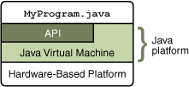
The Java Platform
Java Virtual Machine is the base for the Java platform and is ported onto various hardware-based platforms
The API is a large collection of ready-made software components that provide many useful capabilities
It is grouped into libraries of related classes and interfaces; these libraries are known as packages
*
Java and Web Programming
‹#›
Notes:
‹#›

Slide 19
Introduction to Java
History of Java
Introduction to Java
The java buzzwords
Why java is important to the internet
Java’s magic: The Byte code
Overview of java
Lexical issues
Programming
*
Java and Web Programming
‹#›

Slide 20
The Java buzzwords
The Java programming language is a high-level language that can be characterized by all of the following buzzwords
Simple
Secure
Portable
Object-oriented
Robust
Multithreaded
Architecture-neutral
Interpreted
High performance
Distributed
Dynamic
*
Java and Web Programming
‹#›

Slide 21
The Java buzzwords
Simple: Java is designed to be easy for the professional programmer to learn and use
object-oriented: a clean, usable, pragmatic approach to objects, not restricted by the need for compatibility with other languages
Robust: restricts the programmer to find the mistakes early, performs compile-time (strong typing) and run-time (exception-handling) checks, manages memory automatically
Multithreaded: supports multi-threaded programming for writing program that perform concurrent computations
*
Java and Web Programming
‹#›

Slide 22
The Java buzzwords
Architecture-neutral: Java Virtual Machine provides a platform independent environment for the execution of Java byte code
“write once; run anywhere, any time, forever.”
Interpreted and high-performance: Java programs are compiled into an intermediate representation – byte code:
can be later interpreted by any JVM
can be also translated into the native machine code for efficiency
Distributed: Java handles TCP/IP protocols, accessing a resource through its URL much like accessing a local file
Dynamic: substantial amounts of run-time type information to verify and resolve access to objects at run-time
*
Java and Web Programming
‹#›

Slide 23
The Java buzzwords
Secure: programs are confined to the Java execution environment and cannot access other parts of the computer
Portability: Many types of computers and operating systems are in use throughout the world—and many are connected to the Internet
For programs to be dynamically downloaded to all the various types of platforms connected to the Internet, some means of generating portable executable code is needed
The same mechanism that helps ensure security also helps create portability
Indeed, Java's solution to these two problems is both elegant and efficient
*
Java and Web Programming
‹#›

Slide 24

An overview of the program development process
In the Java programming language, all source code is first written in plain text files ending with the .java extension
Those source files are then compiled into .class files by the javac compiler
A .class file does not contain code that is native to your processor; it instead contains bytecodes — the machine language of the Java Virtual Machine (Java VM)
The java launcher tool then runs your application with an instance of the Java Virtual Machine
*
Java and Web Programming
‹#›
Notes:
‹#›

Slide 25
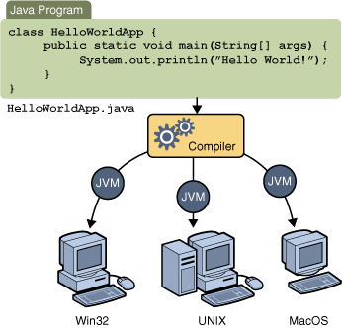
Platform independence
Through the Java VM, the same application is capable of running on multiple platforms
*
Java and Web Programming
‹#›
Notes:
‹#›

Slide 26
Introduction to Java
History of Java
Introduction to Java
The java buzzwords
Why java is important to the internet
Java’s magic: The Byte code
Overview of java
Lexical issues
Programming
*
Java and Web Programming
‹#›

Slide 27
Java’s Magic: The Bytecode
The output of a Java compiler is not executable code
it is bytecode
Bytecode is a highly optimized set of instructions designed to be executed by the Java run-time system, which is called the Java Virtual Machine (JVM)
That is, in its standard form, the JVM is an interpreter for bytecode
*
Java and Web Programming
‹#›
Notes:
‹#›

Slide 28
Java’s Magic: The Bytecode
Translating a Java program into bytecode helps makes it much easier to run a program in a wide variety of environments
The reason is straightforward: only the JVM needs to be implemented for each platform
Once the run-time package exists for a given system, any Java program can run on it
Although the details of the JVM will differ from platform to platform, all interpret the same Java bytecode
If a Java program were compiled to native code, then different versions of the same program would have to exist for each type of CPU connected to the Internet - not a feasible solution
The interpretation of bytecode is the easiest way to create truly portable programs
*
Java and Web Programming
‹#›
Notes:
‹#›

Slide 29
Java’s Magic: The Bytecode
The fact that a Java program is interpreted also helps to make it secure
The execution of every Java program is under the control of the JVM, the JVM can contain the program and prevent it from generating side effects outside of the system
Safety is also enhanced by certain restrictions that exist in the Java language
When a program is interpreted, it generally runs substantially slower than it would run if compiled to executable code
The use of bytecode enables the Java run-time system to execute programs much faster than you might expect
*
Java and Web Programming
‹#›
Notes:
‹#›

Slide 30
Java’s Magic: The Bytecode
Sun supplies its Just In Time (JIT) compiler for bytecode
When the JIT compiler is part of the JVM, it compiles bytecode into executable code in real time, on a piece-by-piece, demand basis
It is not possible to compile an entire Java program into executable code all at once, because Java performs various run-time checks that can be done only at run time
Instead, the JIT compiles code as it is needed, during execution
The just-in-time approach still yields a significant performance boost
Even when dynamic compilation is applied to bytecode, the portability and safety features still apply, because the run-time system is in charge of the execution environment
Whether your Java program is actually interpreted in the traditional way or compiled on-the-fly, its functionality is the same
*
Java and Web Programming
‹#›
Notes:
‹#›

Slide 31
Introduction to Java
History of Java
Introduction to Java
The java buzzwords
Why java is important to the internet
Java’s magic: The Byte code
Overview of java
Lexical issues
Programming
*
Java and Web Programming
‹#›

Slide 32
Object-Oriented Programming
Two Paradigms
All computer programs consist of two elements: code and data
A program can be conceptually organized around its code or around its data
Some programs are written around “what is happening” and others are written around “who is being affected”
These are the two paradigms that govern how a program is constructed
*
Java and Web Programming
‹#›
Notes:
‹#›

Slide 33
Object-Oriented Programming
process-oriented model
what is happening
This approach characterizes a program as a series of linear steps (that is, code)
The process-oriented model can be thought of as code acting on data
Problems with this approach appear as programs grow larger and more complex
object-oriented programming
who is being affected
Object-oriented programming organizes a program around its data (that is, objects) and a set of well-defined interfaces to that data
An object-oriented program can be characterized as data controlling access to code
manage increasing complexity
*
Java and Web Programming
‹#›
Notes:
‹#›

Slide 34
Abstraction
An essential element of object-oriented programming
Humans manage complexity through abstraction
A powerful way to manage abstraction is through the use of hierarchical classifications
Hierarchical abstractions of complex systems can also be applied to computer programs
The data from a traditional process-oriented program can be transformed by abstraction into its component objects
A sequence of process steps can become a collection of messages between these objects
Thus, each of these objects describes its own unique behavior
*
Java and Web Programming
‹#›
Notes:
‹#›

Slide 35
The Three OOP Principles
Encapsulation
Encapsulation is the mechanism that binds together code and the data it manipulates, and keeps both safe from outside interference and misuse
as a protective wrapper that prevents the code and data from being arbitrarily accessed by other code defined outside the wrapper
Access to the code and data inside the wrapper is tightly controlled through a well-defined interface
In Java the basis of encapsulation is the class
*
Java and Web Programming
‹#›
Notes:
‹#›

Slide 36
The Three OOP Principles
Inheritance
Inheritance is the process by which one object acquires the properties of another object
it supports the concept of hierarchical classification
*
Java and Web Programming
‹#›
Notes:
‹#›

Slide 37
The Three OOP Principles
Polymorphism
Polymorphism (from the Greek, meaning “many forms”) is a feature that allows one interface to be used for a general class of actions
The specific action is determined by the exact nature of the situation
The concept of polymorphism is often expressed by the phrase “one interface, multiple methods”
This means that it is possible to design a generic interface to a group of related activities
This helps reduce complexity by allowing the same interface to be used to specify a general class of action
It is the compiler’s job to select the specific action (that is, method) as it applies to each situation
*
Java and Web Programming
‹#›
Notes:
‹#›

Slide 38
Polymorphism, Encapsulation, and Inheritance Work Together
Polymorphism, encapsulation, and inheritance combine to produce a programming environment that supports the development of more robust and scalable programs
A well-designed hierarchy of classes is the basis for reusing the code in which you have invested time and effort developing and testing
Encapsulation allows you to migrate your implementations over time without breaking the code that depends on the public interface of your classes
Polymorphism allows you to create clean, sensible, readable, and resilient code
*
Java and Web Programming
‹#›
Notes:
‹#›

Slide 39
Introduction to Java
History of Java
Introduction to Java
The java buzzwords
Why java is important to the internet
Java’s magic: The Byte code
Overview of java
Lexical issues
Programming
*
Java and Web Programming
‹#›

Slide 40
Lexical Issues
Java programs are a collection of whitespace, identifiers, comments, literals, operators, separators, and keywords
Whitespace
Java is a free-form language
no need to follow any special indentation rules
In Java, whitespace is a space, tab, or newline
*
Java and Web Programming
‹#›
Notes:
‹#›

Slide 41
Lexical Issues
Identifiers
Identifiers are used for class names, method names, and variable names
An identifier may be any descriptive sequence of uppercase and lowercase letters, numbers, or the underscore and dollar-sign characters
They must not begin with a number
Java is case-sensitive, so VALUE is a different identifier than Value
Some examples of valid identifiers are:
AvgTemp count a4 $test this_is_ok
Invalid variable names include:
2count high-temp Not/ok
*
Java and Web Programming
‹#›
Notes:
‹#›

Slide 42
Lexical Issues
Literals
A constant value in Java is created by using a literal representation of it
For example, here are some literals:
100 98.6 ‘X’ “This is a test”
Left to right,
the first literal specifies an integer,
the next is a floating-point value,
the third is a character constant, and
the last is a string
A literal can be used anywhere a value of its type is allowed
*
Java and Web Programming
‹#›
Notes:
‹#›

Slide 43
Lexical Issues
Comments
There are three types of comments defined by Java
single-line - //
multiline - /* …… */
documentation comment - /** and ends with a */
This type of comment is used to produce an HTML file that documents your program
*
Java and Web Programming
‹#›
Notes:
‹#›

Slide 44
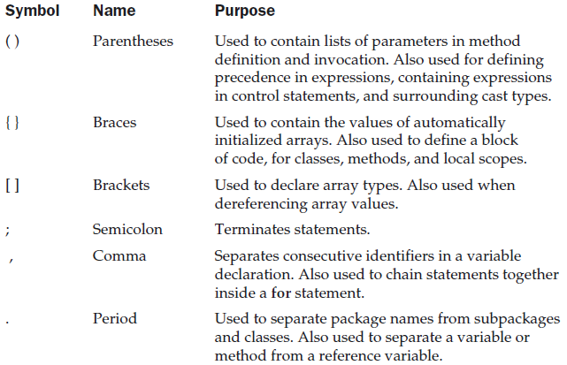
Lexical Issues
Separators
The separators are shown in the following table:
*
Java and Web Programming
‹#›
Notes:
‹#›

Slide 45
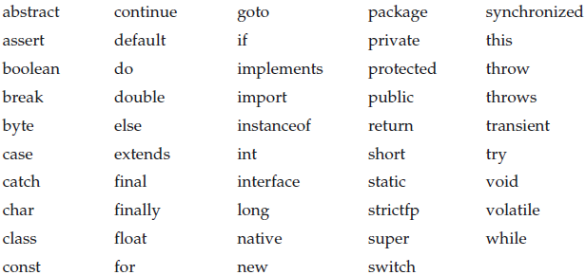
Lexical Issues
The Java Keywords
There are 49 reserved keywords currently defined in the Java language
In addition to the keywords, Java reserves the following: true, false, and null
These are values defined by Java
You may not use these words for the names of variables, classes, and so on
*
Java and Web Programming
‹#›
Notes:
‹#›

Slide 46
Introduction to Java
History of Java
Introduction to Java
The java buzzwords
Why java is important to the internet
Java’s magic: The Byte code
Overview of java
Lexical issues
Programming
*
Java and Web Programming
‹#›

Slide 47
An overview of the program development process
In the Java programming language, all source code is first written in plain text files ending with the .java extension
Those source files are then compiled into .class files by the javac compiler
A .class file does not contain code that is native to your processor; it instead contains bytecodes — the machine language of the Java Virtual Machine (Java VM)
The java launcher tool then runs your application with an instance of the Java Virtual Machine
*
Java and Web Programming
‹#›
Notes:
‹#›

Slide 48
Platform independence
Through the Java VM, the same application is capable of running on multiple platforms
*
Java and Web Programming
‹#›
Notes:
‹#›

Slide 49
Structure of Java Programs
class class-name {
public static void main(String args[]) {
statement1;
statement2;
…
…
}
}
*
Java and Web Programming
‹#›
Notes:
‹#›

Slide 50
Example Program
public class HelloWorld {
public static void main(String args[]) {
System.out.println("Hello World");
}
}
*
Java and Web Programming
‹#›

Slide 51
Compiling & Running the Program
Compiling: is the process of translating source code written in a particular programming language into computer-readable machine code that can be executed
$ javac HelloWorld.java
This command will produce a file ‘HelloWorld.class’, which is used for running the program with the command ‘java’
Running: is the process of executing program on a computer
$ java HelloWorld
*
Java and Web Programming
‹#›
Notes:
‹#›

Slide 52
Compiling & Running the Program
javac HelloWorld.java
HelloWorld.java
compile
run
source code
java HelloWorld
HelloWorld.class
bytecode
*
Java and Web Programming
‹#›

Slide 53
"Hello World" for Microsoft Windows
First, start your editor
You can launch the Notepad editor from the Start menu by selecting Programs > Accessories > Notepad
In a new document, type in the following code:
/**
* The HelloWorldApp class implements an application that
* simply prints "Hello World!" to standard output. */
class HelloWorldApp {
public static void main(String[] args) {
System.out.println("Hello World!"); // Display the string.
}
}
*
Java and Web Programming
‹#›
Notes:
‹#›

Slide 54
"Hello World" for Microsoft Windows
Save the code in a file with the name HelloWorldApp.java
To do this in Notepad, first choose the File > Save As menu item
Then, in the Save As dialog box:
Using the Save in combo box, specify the folder (directory) where you'll save your file (In this example, the directory is java on the C drive)
In the File name text field, type "HelloWorldApp.java", including the quotation marks
From the Save as type combo box, choose Text Documents (*.txt)
In the Encoding combo box, leave the encoding as ANSI
*
Java and Web Programming
‹#›
Notes:
‹#›

Slide 55
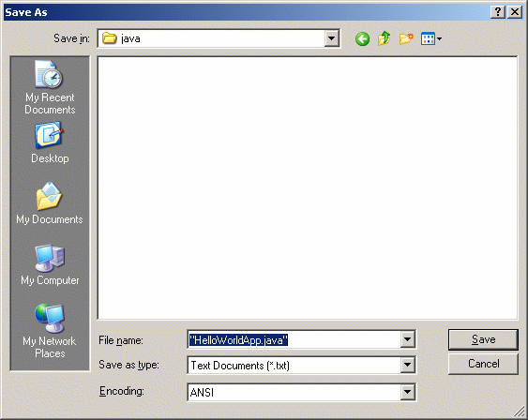
"Hello World" for Microsoft Windows
When you're finished, the dialog box should look like this
Now click Save, and exit Notepad
*
Java and Web Programming
‹#›
Notes:
‹#›

Slide 56
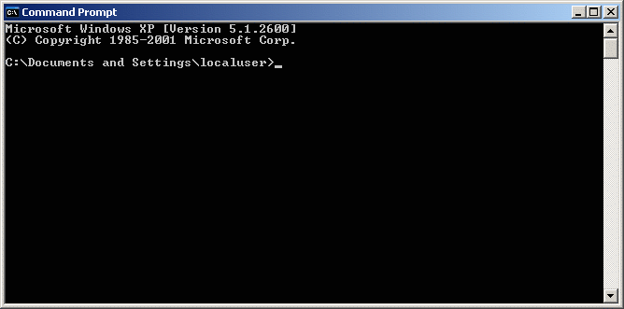
"Hello World" for Microsoft Windows
Bring up a shell, or "command," window
You can do this from the Start menu by choosing Command Prompt (Windows XP), or by choosing Run... and then entering cmd
The shell window should look similar to the following figure
*
Java and Web Programming
‹#›
Notes:
‹#›

Slide 57
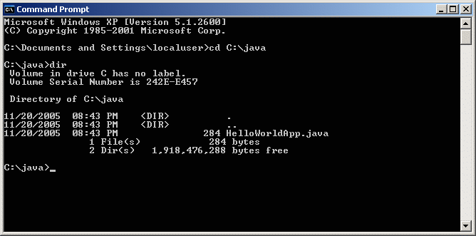
"Hello World" for Microsoft Windows
To compile your source file, change your current directory to the directory where your file is located
If your source directory is java on the C drive, type the following command at the prompt and press Enter
cd C:\java
*
Java and Web Programming
‹#›
Notes:
‹#›

Slide 58
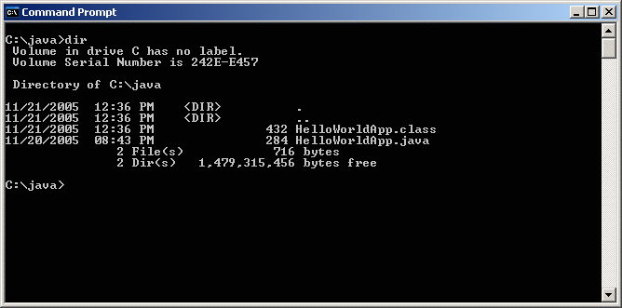
"Hello World" for Microsoft Windows
Now you are ready to compile. At the prompt, type the following command and press Enter
javac HelloWorldApp.java
The compiler has generated a bytecode file, HelloWorldApp.class
At the prompt, type dir to see the new file that was generated, as shown in the following figure
*
Java and Web Programming
‹#›
Notes:
‹#›

Slide 59
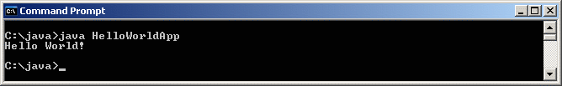
"Hello World" for Microsoft Windows
In the same directory, enter the following command at the prompt
java HelloWorldApp
The next figure shows what you should now see
The program prints "Hello World!" to the screen
*
Java and Web Programming
‹#›
Notes:
‹#›

Slide 60
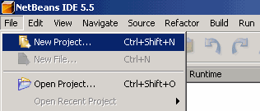
"Hello World!" for the NetBeans IDE
To create an IDE project:
Launch the NetBeans IDE - you can use the NetBeans IDE item in the Start menu
In the NetBeans IDE, choose File | New Project
*
Java and Web Programming
‹#›
Notes:
‹#›

Slide 61
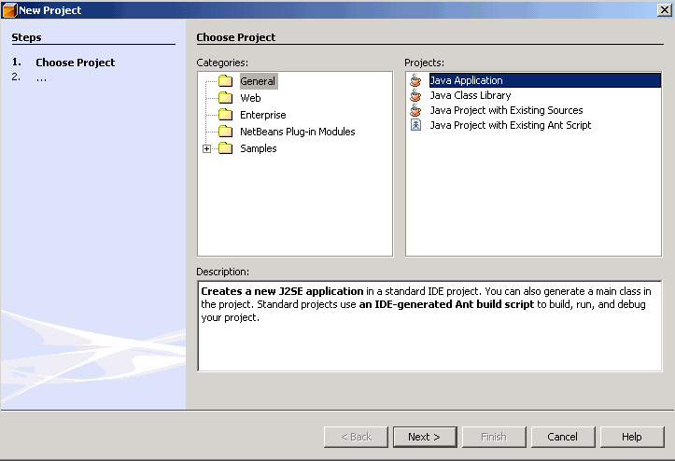
"Hello World!" for the NetBeans IDE
In the New Project wizard, expand the General category and select Java Application as shown in the following figure
*
Java and Web Programming
‹#›
Notes:
‹#›

Slide 62
"Hello World!" for the NetBeans IDE
In the Name and Location page of the wizard, do the following (as shown in the figure):
In the Project Name field, type Hello World App
In the Create Main Class field, type helloworldapp.HelloWorldApp
Leave the Set as Main Project checkbox selected
*
Java and Web Programming
‹#›
Notes:
‹#›

Slide 63
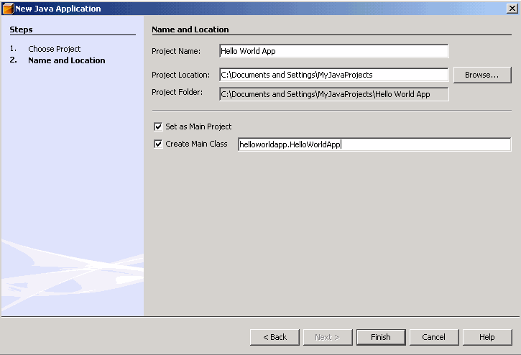
"Hello World!" for the NetBeans IDE
Click Finish
*
Java and Web Programming
‹#›
Notes:
‹#›

Slide 64
"Hello World!" for the NetBeans IDE
The project is created and opened in the IDE
You should see the following components:
The Projects window, which contains a tree view of the components of the project, including source files, libraries that your code depends on, and so on
The Source Editor window with a file called HelloWorldApp open
The Navigator window, which you can use to quickly navigate between elements within the selected class
*
Java and Web Programming
‹#›
Notes:
‹#›

Slide 65
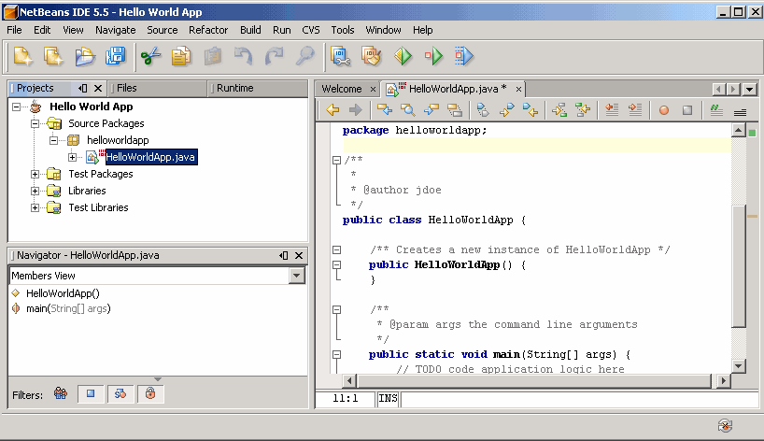
"Hello World!" for the NetBeans IDE
*
Java and Web Programming
‹#›
Notes:
‹#›

Slide 66
"Hello World!" for the NetBeans IDE
Add Code to the Generated Source File
When you created this project, you left the Create Main Class checkbox selected in the New Project wizard
The IDE has therefore created a skeleton class for you
You can add the "Hello World!" message to the skeleton code by replacing the line:
// TODO code application logic here
with the line: System.out.println("Hello World!"); // Display the string.
Optionally, you can replace these four lines of generated code:
/**
*
* @author */
with these lines:
/**
* The HelloWorldApp class implements an application that
* simply prints "Hello World!" to standard output. */
These four lines are a code comment and do not affect how the program runs
*
Java and Web Programming
‹#›
Notes:
‹#›

Slide 67
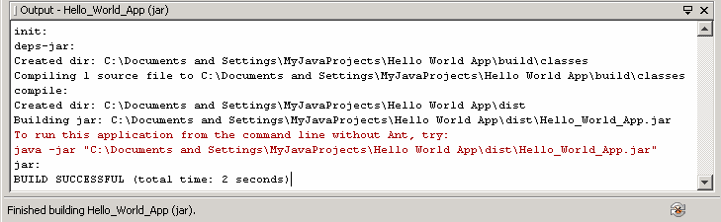
"Hello World!" for the NetBeans IDE
Compile the Source File into a .class File
To compile your source file, choose Build | Build Main Project from the IDE's main menu
The Output window opens and displays output similar to what you see in the following figure:
*
Java and Web Programming
‹#›
Notes:
‹#›

Slide 68
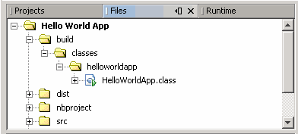
"Hello World!" for the NetBeans IDE
When you build the project, the bytecode file HelloWorldApp.class is generated
You can see where the new file is generated by opening the Files window and expanding the Hello World App/build/classes/helloworldapp node as shown in the following figure:
*
Java and Web Programming
‹#›
Notes:
‹#›

Slide 69
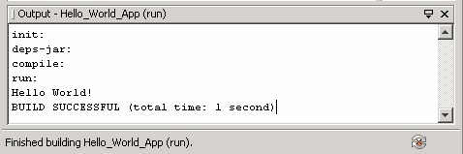
"Hello World!" for the NetBeans IDE
Run the Program
From the IDE's menu bar, choose Run | Run Main Project
The next figure shows what you should now see
*
Java and Web Programming
‹#›
Notes:
‹#›

