Slide 1
JAVA —Java Basics—
*
Java and Web Programming
‹#›
Notes:
‹#›

Slide 2
Java Basics
Data types, variables and arrays
Operators
Control statements
*
Java and Web Programming
‹#›

Slide 3
Java Is a Strongly Typed Language
Every variable has a type, every expression has a type, and every type is strictly defined
all assignments, whether explicit or via parameter passing in method calls, are checked for type compatibility
There are no automatic coercions or conversions of conflicting types
The Java compiler checks all expressions and parameters to ensure that the types are compatible
Any type mismatches are errors that must be corrected before the compiler will finish compiling the class
*
Java and Web Programming
‹#›
Notes:
‹#›

Slide 4
The Simple Types
Java defines eight simple (or elemental) types of data:
byte, short, int, long, char, float, double, and boolean
These can be put in four groups:
Integers: This group includes byte, short, int, and long, which are for wholevalued signed numbers
Floating-point numbers: This group includes float and double, which represent numbers with fractional precision
Characters: This group includes char, which represents symbols in a character set, like letters and numbers
Boolean: This group includes boolean, which is a special type for representing true/false values
*
Java and Web Programming
‹#›
Notes:
‹#›

Slide 5
Data Types
Java’s eight simple types:
byte – 8-bit integer type
short – 16-bit integer type
int – 32-bit integer type
long – 64-bit integer type
float – 32-bit floating-point type
double – 64-bit floating-point type
char – symbols in a character set (16 bit)
boolean – logical values true and false
*
Java and Web Programming
‹#›

Slide 6
Integers
The integer types are for numbers without fractional parts
Four integer types: byte, short, int, and long
All of these are signed, positive and negative values
Java does not support unsigned, positive-only integers
The width and ranges of these integer types vary widely, as shown in this table:
Name Width Range
long 64 –9,223,372,036,854,775,808 to 9,223,372,036,854,775,807
int 32 –2,147,483,648 to 2,147,483,647
short 16 –32,768 to 32,767
byte 8 –128 to 127
*
Java and Web Programming
‹#›
Notes:
‹#›

Slide 7
byte
The smallest integer type is byte
This is a signed 8-bit type that has a range from –128 to 127
Variables of type byte are especially useful when you’re working with a stream of data from a network or file
They are also useful when you’re working with raw binary data that may not be directly compatible with Java’s other built-in types
Byte variables are declared by use of the byte keyword
byte b, c;
*
Java and Web Programming
‹#›
Notes:
‹#›

Slide 8
byte
byte: 8-bit integer type.
Range: -128 to 127.
Example: byte b = -15;
Usage: particularly when working with data streams.
*
Java and Web Programming
‹#›

Slide 9
short
Short is a signed 16-bit type
It has a range from –32,768 to 32,767
It is probably the least-used Java type, since it is defined as having its high byte first (called big-endian format)
This type is mostly applicable to 16-bit computers, which are becoming increasingly scarce
Here are some examples of short variable declarations:
short t, s;
*
Java and Web Programming
‹#›
Notes:
‹#›

Slide 10
short
short: 16-bit integer type.
Range: -32768 to 32767.
Example: short c = 1000;
Usage: probably the least used simple type.
*
Java and Web Programming
‹#›

Slide 11
int
The most commonly used integer type is int
It is a signed 32-bit type that has a range from –2,147,483,648 to 2,147,483,647
In addition to other uses, variables of type int are commonly employed to control loops and to index arrays
Any time you have an integer expression involving bytes, shorts, ints, and literal numbers, the entire expression is promoted to int before the calculation is done
*
Java and Web Programming
‹#›
Notes:
‹#›

Slide 12
int
int: 32-bit integer type.
Range: -2147483648 to 2147483647.
Example: int b = -50000;
Usage:
Most common integer type.
Typically used to control loops and to index arrays.
Expressions involving the byte, short and int
values are promoted to int before calculation.
*
Java and Web Programming
‹#›

Slide 13
long
long is a signed 64-bit type and is useful for those occasions where an int type is not large enough to hold the desired value
The range of a long is quite large
This makes it useful when big, whole numbers are needed
For example, a variable that stores the number of miles that light will travel in a specified number of days
*
Java and Web Programming
‹#›
Notes:
‹#›

Slide 14
long
long: 64-bit integer type.
Range: -9223372036854775808 to 9223372036854775807.
Example: long l = 10000000000000000;
Usage:
useful when int type is not large enough to hold the desired value
*
Java and Web Programming
‹#›

Slide 15
Floating-Point Types
Floating-point numbers, also known as real numbers, are used when evaluating expressions that require fractional precision
For example, calculation such as square root
There are two kinds of floating-point types, float and double, which represent single- and double-precision numbers, respectively
Their width and ranges are shown here:
Name Width in Bits Approximate Range
double 64 4.9e–324 to 1.8e+308
float 32 1.4e−045 to 3.4e+038
*
Java and Web Programming
‹#›
Notes:
‹#›

Slide 16
float
The type float specifies a single-precision value that uses 32 bits of storage
Single precision is faster on some processors and takes half as much space as double precision, but will become imprecise when the values are either very large or very small
Variables of type float are useful when you need a fractional component, but don’t require a large degree of precision
For example, float can be useful when representing dollars and cents
Here are some example float variable declarations:
float hightemp, lowtemp;
*
Java and Web Programming
‹#›
Notes:
‹#›

Slide 17
float
float: 32-bit floating-point number.
Range: 1.4e-045 to 3.4e+038.
Example: float f = 1.5;
Usage:
fractional part is needed
large degree of precision is not required
*
Java and Web Programming
‹#›

Slide 18
double
Double precision, as denoted by the double keyword, uses 64 bits to store a value
Double precision is actually faster than single precision on some modern processors that have been optimized for high-speed mathematical calculations
All transcendental math functions, such as sin( ), cos( ), and sqrt( ), return double values
When you need to maintain accuracy over many iterative calculations, or are manipulating large-valued numbers, double is the best choice
*
Java and Web Programming
‹#›
Notes:
‹#›

Slide 19
double
double: 64-bit floating-point number.
Range: 4.9e-324 to 1.8e+308.
Example: double pi = 3.1416;
Usage:
accuracy over many iterative calculations
manipulation of large-valued numbers
*
Java and Web Programming
‹#›

Slide 20
Characters
Java uses Unicode to represent characters
Unicode defines a fully international character set that can represent all of the characters found in all human languages
It is a unification of dozens of character sets, such as Latin, Greek, Arabic, Cyrillic, Hebrew, Katakana, Hangul, and many more
For this purpose, it requires 16 bits
Thus, in Java char is a 16-bit type
The range of a char is 0 to 65,536
There are no negative chars
*
Java and Web Programming
‹#›
Notes:
‹#›

Slide 21
char
char: 16-bit data type used to store characters.
Range: 0 to 65536.
Example: char c = ‘a‘;
Usage:
Represents both ASCII and Unicode character sets;
Unicode defines a character set with characters found in (almost) all human languages.
Not the same as in C/C++ where char is 8-bit and represents ASCII only.
*
Java and Web Programming
‹#›

Slide 22
booleans
Java has a simple type, called boolean, for logical values
It can have only one of two possible values, true or false
This is the type returned by all relational operators, such as a < b
boolean is also the type required by the conditional expressions that govern the control statements such as if and for
*
Java and Web Programming
‹#›
Notes:
‹#›

Slide 23
booleans
boolean: Two-valued type of logical values.
Range: values true and false.
Example: boolean b = (1<2);
Usage:
returned by relational operators, such as 1<2
required by branching expressions such as if or for
*
Java and Web Programming
‹#›

Slide 24
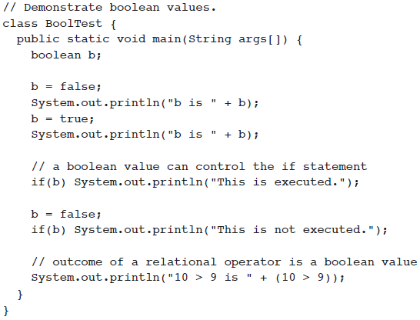

booleans
*
Java and Web Programming
‹#›

Slide 25
Literals
Integer Literals
Uses three forms – Decimal, octal, or hexadecimal
2 The decimal value is two.
077 The leading zero indicates an octal value.
0xBAAC The leading 0x indicates a hexadecimal value.
Has a default int
Defines long by using the letter L or l
Largest long 0x7ffffffffffffffL or 9223372036854775807L
*
Java and Web Programming
‹#›

Slide 26
Literals
Floating-Point Literals
Standard notation consists of a whole number component followed by a decimal point followed by a fractional component
For example, 2.0, 3.14159, and 0.6667
Scientific notation uses a standard-notation, floating-point number plus a suffix that specifies a power of 10 by which the number is to be multiplied
The exponent is indicated by an E or e followed by a decimal number, which can be positive or negative
Examples include 6.022E23, 314159E–05, and 2e+100
*
Java and Web Programming
‹#›

Slide 27
Literals
Floating-Point Literals
Numbers of type float have a suffix F (for example, 3.402F)
Floating-point numbers without an F suffix (such as 3.402) are always considered to be of type double
You can optionally supply the D suffix (for example, 3.402D)
The only reasons to use float are in the rare situations in which the slightly faster processing of single-precision numbers is important or when you need to store a large number of them
*
Java and Web Programming
‹#›
Notes:
‹#›

Slide 28
Literals
Boolean Literals
Boolean literals are simple
There are only two logical values that a boolean value can have, true and false
The values of true and false do not convert into any numerical representation
The true literal in Java does not equal 1, nor does the false literal equal 0
In Java, they can only be assigned to variables declared as boolean, or used in expressions with Boolean operators
*
Java and Web Programming
‹#›

Slide 29
Literals
Character Literals
Characters in Java are indices into the Unicode character set
A literal character is represented inside a pair of single quotes
All of the visible ASCII characters can be directly entered inside the quotes, such as ‘a’, ‘z’, and ‘@’
For characters that are impossible to enter directly, there are several escape sequences, which allow you to enter the character you need
*
Java and Web Programming
‹#›

Slide 30
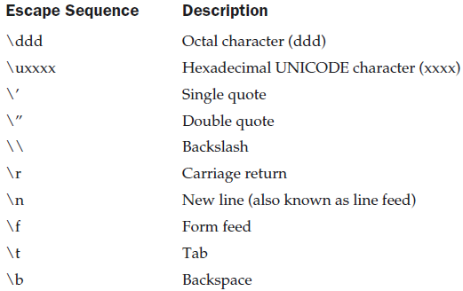
Literals
Character Literals
*
Java and Web Programming
‹#›

Slide 31
Literals
String Literals
String literals in Java are specified like they are in most other languages—by enclosing a sequence of characters between a pair of double quotes
Examples of string literals are
“Hello World”
“two\nlines”
“\”This is in quotes\””
Java strings is that they must begin and end on the same line
*
Java and Web Programming
‹#›

Slide 32
Variables
declaration – how to assign a type to a variable
initialization – how to give an initial value to a variable
scope – how the variable is visible to other parts of the program
lifetime – how the variable is created, used and destroyed
type conversion – how Java handles automatic type conversion
type casting – how the type of a variable can be narrowed down
type promotion – how the type of a variable can be expanded
*
Java and Web Programming
‹#›

Slide 33
Variables
Java uses variables to store data.
To allocate memory space for a variable JVM requires:
to specify the data type of the variable
to associate an identifier with the variable
optionally, the variable may be assigned an initial value
All done as part of variable declaration.
*
Java and Web Programming
‹#›

Slide 34
Basic Variable Declaration
datatype identifier [=value];
datatype must be
– A simple datatype
– User defined datatype (class type)
Identifier is a recognizable name confirmed to identifier rules
Value is an optional initial value.
*
Java and Web Programming
‹#›

Slide 35
Variable Declaration
We can declare several variables at the same time:
type identifier [=value][, identifier [=value] …];
Examples:
int a, b, c;
int d = 3, e, f = 5;
byte g = 22;
double pi = 3.14159;
char ch = 'x';
*
Java and Web Programming
‹#›

Slide 36
Variable Scope
Scope determines the visibility of program elements with respect to other program elements.
In Java, scope is defined separately for classes and methods:
variables defined by a class have a global scope
variables defined by a method have a local scope
A scope is defined by a block:
{
…
}
A variable declared inside the scope is not visible outside:
{
int n;
}
n = 1;// this is illegal
*
Java and Web Programming
‹#›

Slide 37
Variable Lifetime
Variables are created when their scope is entered by control flow and destroyed when their scope is left
A variable declared in a method will not hold its value between different invocations of this method.
A variable declared in a block looses its value when the block is left.
Initialized in a block, a variable will be reinitialized with every re-entry.
Variables lifetime is confined to its scope!
*
Java and Web Programming
‹#›

Slide 38
Type Conversion
Size Direction of Data Type
– Widening Type Conversion (Casting down)
Smaller Data Type -> Larger Data Type
– Narrowing Type Conversion (Casting up)
Larger Data Type -> Smaller Data Type
Conversion done in two ways
– Implicit type conversion
Carried out by compiler automatically
– Explicit type conversion
Carried out by programmer using casting
*
Java and Web Programming
‹#›

Slide 39
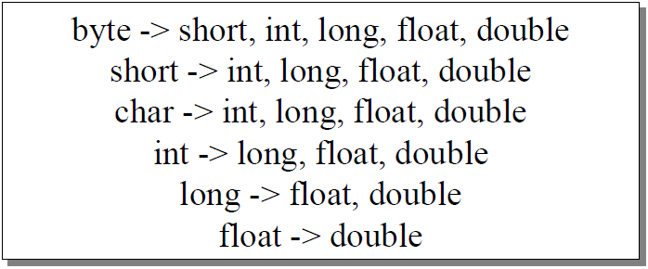
Type Conversion
Widening Type Convertion
– Implicit conversion by compiler automatically
*
Java and Web Programming
‹#›

Slide 40
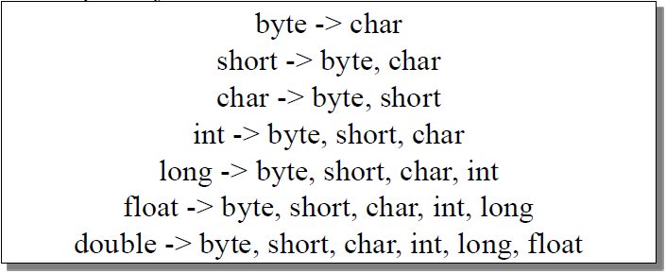
Type Conversion
Narrowing Type Conversion
– Programmer should describe the conversion explicitly
*
Java and Web Programming
‹#›

Slide 41
Type Conversion
byte and short are always promoted to int
if one operand is long, the whole expression is promoted to long
if one operand is float, the entire expression is promoted to float
if any operand is double, the result is double
*
Java and Web Programming
‹#›

Slide 42
Type Casting
General form: (targetType) value
Examples:
integer value will be reduced modulo bytes range:
int i;
byte b = (byte) i;
floating-point value will be truncated to integer value:
float f;
int i = (int) f;
*
Java and Web Programming
‹#›

Slide 43
Expressions
The data type of the value returned by an expression depends on the elements used in the expression.
The expression number = 0 returns an int because the assignment operator returns a value of the same data type as its left-hand operand; in this case, number is an int.
As you can see from the other expressions, an expression can return other types of values as well, such as boolean or String.
The Java programming language allows you to construct compound expressions from various smaller expressions as long as the data type required by one part of the expression matches the data type of the other.
Here's an example of a compound expression: 1 * 2 * 3
*
Java and Web Programming
‹#›

Slide 44
Arrays
An array is a group of liked-typed variables referred to by a common name, with individual variables accessed by their index.
Arrays are:
Declared
Created
Initialized
Used
Also, arrays can have one or several dimensions.
*
Java and Web Programming
‹#›

Slide 45
Array Declaration
Array declaration involves:
declaring an array identifier
declaring the number of dimensions
declaring the data type of the array elements
Two styles of array declaration:
type array-variable[];
or
type [] array-variable;
*
Java and Web Programming
‹#›

Slide 46
Array Creation
After declaration, no array actually exists.
In order to create an array, we use the new operator:
type array-variable[];
array-variable = new type[size];
This creates a new array to hold size elements of type type, which reference will be kept in the variable array-variable.
*
Java and Web Programming
‹#›

Slide 47
Array Indexing
Later we can refer to the elements of this array through their indexes:
array-variable[index]
The array index always starts with zero!
The Java run-time system makes sure that all array indexes are in the correct range, otherwise raises a run-time error.
*
Java and Web Programming
‹#›

Slide 48
Array Initialization
Arrays can be initialized when they are declared:
int monthDays[] = {31,28,31,30,31,30,31,31,30,31,30,31};
Note:
there is no need to use the new operator
the array is created large enough to hold all specified elements
*
Java and Web Programming
‹#›

Slide 49
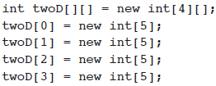
Multidimensional Arrays
Multidimensional arrays are arrays of arrays:
declaration: int array[][];
creation: int array = new int[2][3];
initialization
int array[][] = { {1, 2, 3}, {4, 5, 6} };
*
Java and Web Programming
‹#›

Slide 50
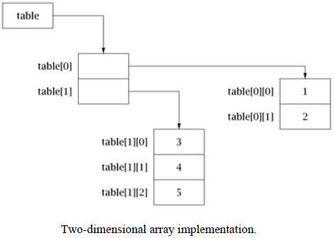
Multidimensional Arrays
Multidimensional arrays are arrays of arrays:
*
Java and Web Programming
‹#›

Slide 51
Java Basics
Data types, variables and arrays
Operators
Control statements
*
Java and Web Programming
‹#›

Slide 52
Operators Types
Java operators are used to build value expressions.
Java provides a rich set of operators:
Arithmetic
Bitwise
Relational
Logical
Assignment
*
Java and Web Programming
‹#›

Slide 53
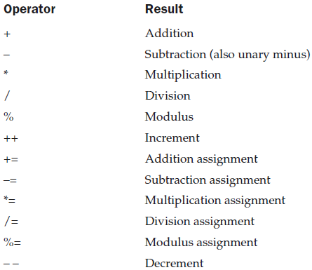
Arithmetic Operators
Java Arithmetic operators are used in mathematical expressions in the same way that they are used in algebra.
The following table lists the arithmetic operators:
*
Java and Web Programming
‹#›

Slide 54
The Bitwise Operators
Java defines several bitwise operators which can be applied to the integer types, long, int, short, char, and byte
These operators act upon the individual bits of their operands
They are summarized in the following table:
*
Java and Web Programming
‹#›

Slide 55
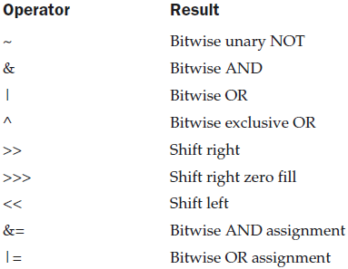
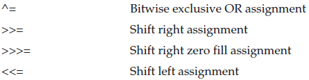
The Bitwise Operators
*
Java and Web Programming
‹#›

Slide 56
The Bitwise Operators
how Java stores integer values and how it represents negative numbers?
All of the integer types are represented by binary numbers of varying bit widths.
For example, the byte value for 42 in binary is 00101010
Java uses an encoding known as two’s complement, which means that negative numbers are represented by inverting all of the bits in a value, then adding 1 to the result.
For example, –42 is represented by inverting all of the bits in 42, or 00101010, which yields 11010101, then adding 1, which results in 11010110, or –42
The reason Java (and most other computer languages) uses two’s complement is easy to see when you consider the issue of zero crossing
*
Java and Web Programming
‹#›

Slide 57
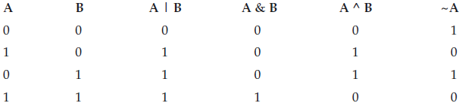
The Bitwise Logical operators
The bitwise logical operators are &, |, ^, and ~
The following table shows the outcome of each operation :
*
Java and Web Programming
‹#›

Slide 58
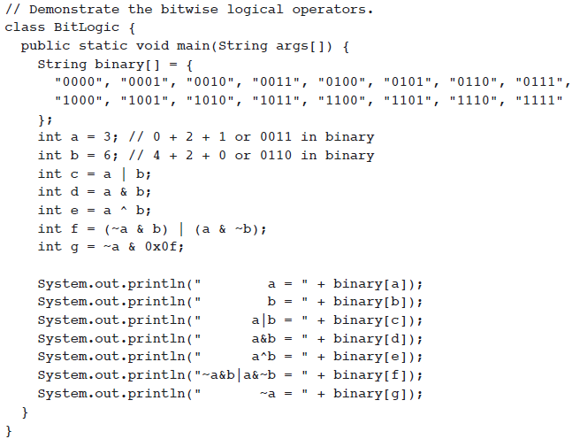
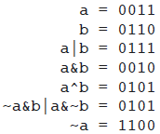
The Bitwise Logical operators
*
Java and Web Programming
‹#›

Slide 59
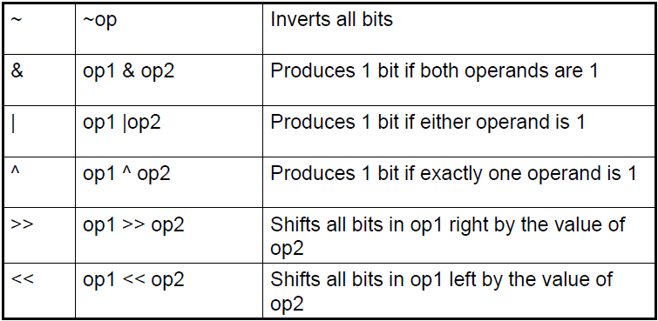
Bit wise operators
*
Java and Web Programming
‹#›

Slide 60
The Bitwise Logical operators
The Left Shift
The left shift operator, <<, shifts all of the bits in a value to the left a specified number of times
It has this general form:
value << num
Here, num specifies the number of positions to left-shift the value in value
For each shift left, the high-order bit is shifted out (and lost), and a zero is brought in on the right
This means that when a left shift is applied to an int operand, bits are lost once they are shifted past bit position 31
If the operand is a long, then bits are lost after bit position 63
*
Java and Web Programming
‹#›

Slide 61
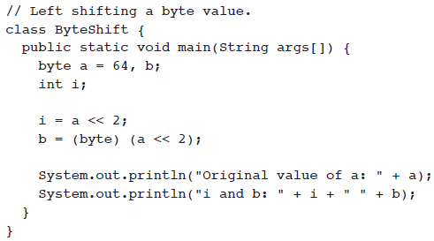

The Bitwise Logical operators
The Left Shift
*
Java and Web Programming
‹#›

Slide 62
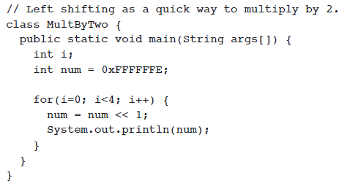

The Bitwise Logical operators
The Left Shift
*
Java and Web Programming
‹#›

Slide 63
The Bitwise Logical operators
The Right Shift
The right shift operator, >>, shifts all of the bits in a value to the right a specified number of times
Its general form is:
value >> num
Here, num specifies the number of positions to right-shift the value in value
int a = 32;
a = a >> 2; // a now contains 8
int a = 35;
a = a >> 2; // a still contains 8
When you are shifting right, the top (leftmost) bits exposed by the right shift are filled in with the previous contents of the top bit
This is called sign extension and serves to preserve the sign of negative numbers when you shift them right
*
Java and Web Programming
‹#›

Slide 64
The Bitwise Logical operators
The Unsigned Right Shift
In case where you want to shift a zero into the high-order bit no matter what its initial value was
To accomplish this, you will use Java’s unsigned, shift-right operator, >>>, which always shifts zeros into the high-order bit
*
Java and Web Programming
‹#›

Slide 65
The Bitwise Logical operators
Bitwise Operator Assignments
All of the binary bitwise operators have a shorthand form similar to that of the algebraic operators, which combines the assignment with the bitwise operation
*
Java and Web Programming
‹#›

Slide 66
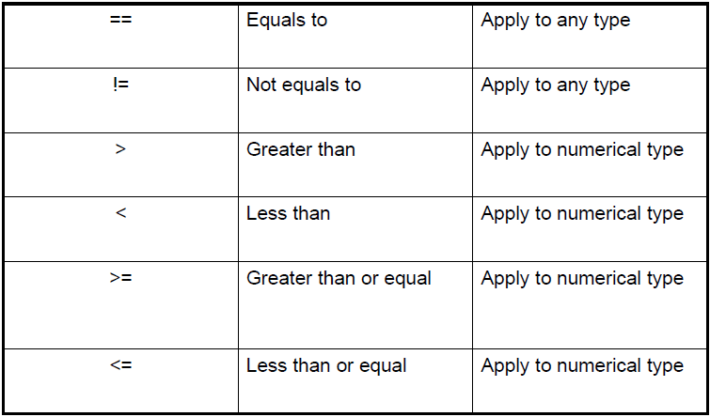
Relational operator
The relational operators determine the relationship that one operand has to the other
Specifically, they determine equality and ordering
The relational operators are shown here
*
Java and Web Programming
‹#›

Slide 67
Relational operator
The outcome of these operations is a boolean value
The relational operators are most frequently used in the expressions that control the if statement and the various loop statements
int a = 4;
int b = 1;
boolean c = a < b;
*
Java and Web Programming
‹#›

Slide 68
Boolean Logical Operators
The Boolean logical operators shown here operate only on boolean operands
All of the binary logical operators combine two boolean values to form a resultant boolean value
*
Java and Web Programming
‹#›

Slide 69
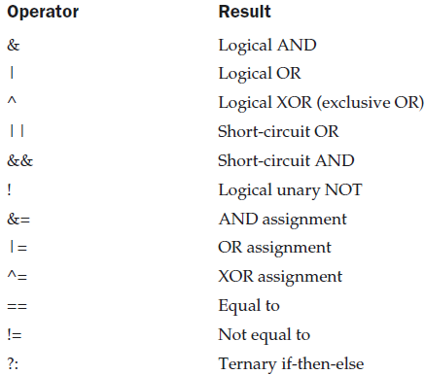
Boolean Logical Operators
*
Java and Web Programming
‹#›

Slide 70
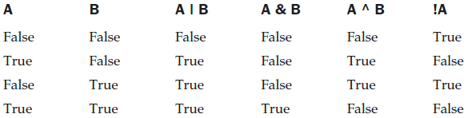
Boolean Logical Operators
The logical Boolean operators, &, |, and ^, operate on boolean values in the same way that they operate on the bits of an integer
The logical ! operator inverts the Boolean state:
!true == false and !false == true
The following table shows the effect of each logical operation:
*
Java and Web Programming
‹#›

Slide 71
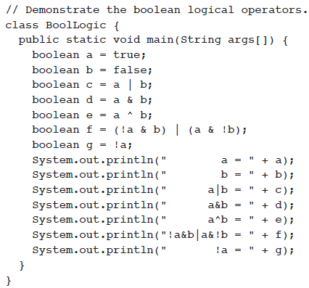
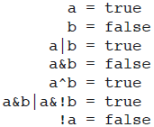
Boolean Logical Operators
*
Java and Web Programming
‹#›

Slide 72
Boolean Logical Operators
Short-Circuit Logical Operators
If you use the || and && forms, Java will not bother to evaluate the right-hand operand when the outcome of the expression can be determined by the left operand alone
if (denom != 0 && num / denom > 10)
if(c==1 & e++ < 100) d = 100;
*
Java and Web Programming
‹#›

Slide 73
The Assignment Operator
The assignment operator is the single equal sign, =
It has this general form:
var = expression;
Here, the type of var must be compatible with the type of expression
*
Java and Web Programming
‹#›

Slide 74
The ? Operator
Java includes a special ternary (three-way) operator that can replace certain types of if-then-else statements
The ? has this general form:
expression1 ? expression2 : expression3
E.g. ratio = denom == 0 ? 0 : num / denom;
*
Java and Web Programming
‹#›

Slide 75
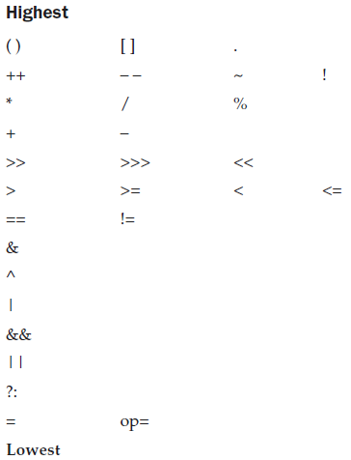
Operator Precedence
*
Java and Web Programming
‹#›

Slide 76
Java Basics
Data types, variables and arrays
Operators
Control statements
*
Java and Web Programming
‹#›

Slide 77
Control Statements
Java control statements cause the flow of execution to advance and branch based on the changes to the state of the program.
Control statements are divided into three groups:
selection statements allow the program to choose different paths of the execution based on the outcome of an expression
iteration statements enable program execution to repeat one or more statements
jump statements enable your program to execute in a non-linear fashion
*
Java and Web Programming
‹#›

Slide 78
Selection Statements
Java selection statements allow to control the flow of program‘s execution based upon conditions known only during run-time.
Java provides four selection statements:
if
if-else
if-else-if
switch
*
Java and Web Programming
‹#›

Slide 79

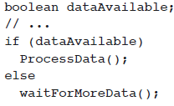
Selection Statements
If
if-else
*
Java and Web Programming
‹#›

Slide 80
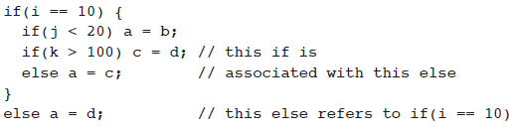
Selection Statements
Nested ifs
A nested if is an if statement that is the target of another if or else
*
Java and Web Programming
‹#›

Slide 81

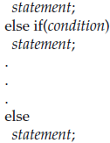
Selection Statements
The if-else-if Ladder
A common programming construct that is based upon a sequence of nested ifs is the if-else-if ladder
*
Java and Web Programming
‹#›

Slide 82
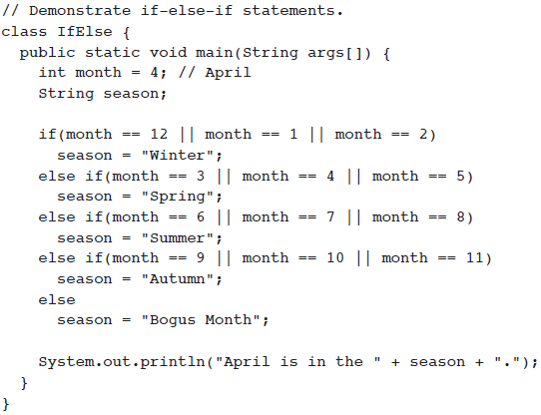
Selection Statements
*
Java and Web Programming
‹#›

Slide 83
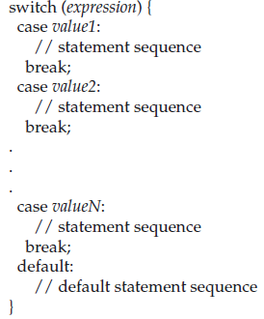
Selection Statements
Switch
The switch statement is Java’s multiway branch statement
It provides an easy way to dispatch execution to different parts of your code based on the value of an expression
It often provides a better alternative than a large series of if-else-if statements
*
Java and Web Programming
‹#›

Slide 84
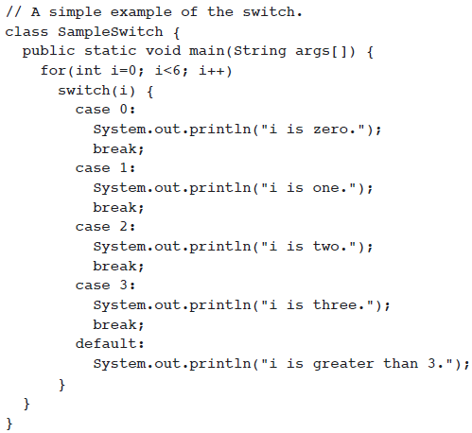
Selection Statements
*
Java and Web Programming
‹#›

Slide 85
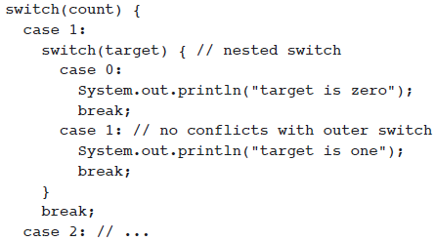
Selection Statements
Nested Switch
You can use a switch as part of the statement sequence of an outer switch
Since a switch statement defines its own block, no conflicts arise between the case constants in the inner switch and those in the outer switch
*
Java and Web Programming
‹#›

Slide 86
Selection Statements
Important features of the switch statement:
The switch differs from the if in that switch can only test for equality, whereas if can evaluate any type of Boolean expression
That is, the switch looks only for a match between the value of the expression and one of its case constants
No two case constants in the same switch can have identical values
A switch statement enclosed by an outer switch can have case constants in common
A switch statement is usually more efficient than a set of nested ifs
*
Java and Web Programming
‹#›

Slide 87
Iteration Statements
Java iteration statements enable repeated execution of part of a program until a certain termination condition becomes true.
Java provides three iteration statements:
while
do-while
for
*
Java and Web Programming
‹#›

Slide 88
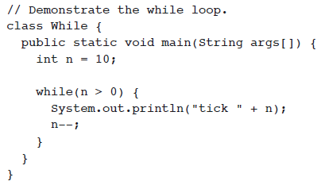
Iteration Statements
while
*
Java and Web Programming
‹#›

Slide 89
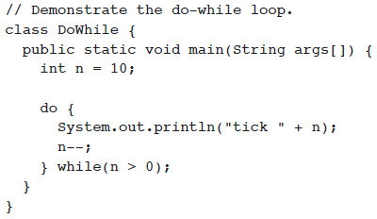
Iteration Statements
do-while
*
Java and Web Programming
‹#›

Slide 90
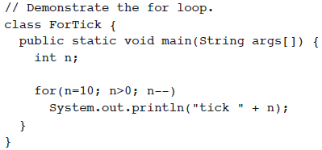
Iteration Statements
for
*
Java and Web Programming
‹#›

Slide 91
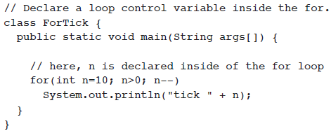
Iteration Statements
Declaring Loop Control Variables Inside the for Loop
*
Java and Web Programming
‹#›

Slide 92
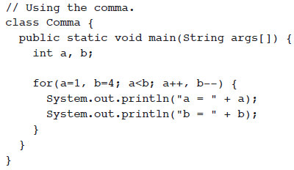
Iteration Statements
Using the Comma
*
Java and Web Programming
‹#›

Slide 93



Iteration Statements
Some for Loop Variations
the condition controlling the for can be any Boolean expression
You can intentionally create an infinite loop
*
Java and Web Programming
‹#›

Slide 94
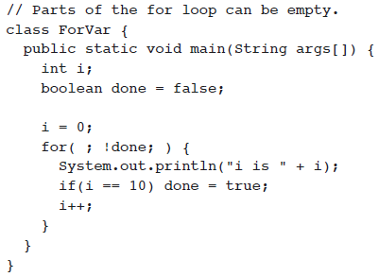
Iteration Statements
Some for Loop Variations
Parts of the for loop can be empty
*
Java and Web Programming
‹#›

Slide 95
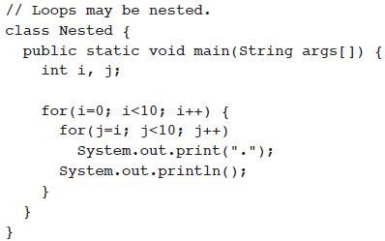
Iteration Statements
Nested Loops
*
Java and Web Programming
‹#›

Slide 96
Jump Statements
Java jump statements enable transfer of control to other parts of program.
Java provides three jump statements:
Break
Using break as a Form of Goto
continue
return
In addition, Java supports exception handling that can also alter the control flow of a program.
*
Java and Web Programming
‹#›

Slide 97
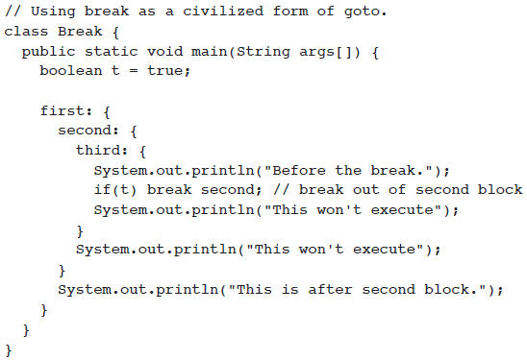
Jump Statements
Using break as a Form of Goto
*
Java and Web Programming
‹#›

Slide 98
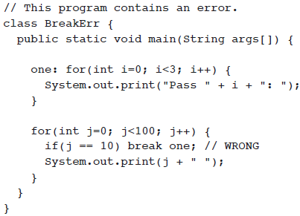
Jump Statements
Using break as a Form of Goto
*
Java and Web Programming
‹#›

Slide 99
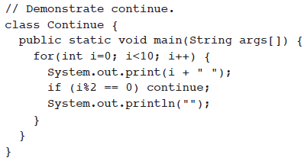
Jump Statements
Using continue
*
Java and Web Programming
‹#›

Slide 100
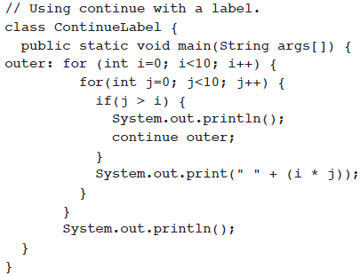
Jump Statements
Using continue with a label
*
Java and Web Programming
‹#›

Slide 101

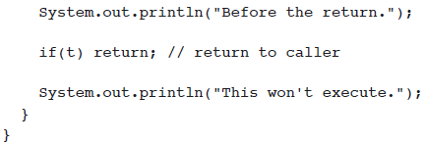
Jump Statements
Using return
*
Java and Web Programming
‹#›

