Slide 1
JAVA —Inheritance—
*
Java and Web Programming
‹#›
Notes:
‹#›

Slide 2
Inheritance
The ability of a class of objects to inherit the properties and methods from another class
The class that inherits the data members and methods is known as subclass or child class (specialized version of superclass)
The class from which the subclass inherits is known as base / parent class
We can create a general class that defines traits common to a set of related items
*
Java and Web Programming
‹#›

Slide 3
Inheritance
Incorporate the definition of one class into another
Implemented using extends keyword
It allows the creation of hierarchical classifications
In Java, a class can only extend one parent.
No Multiple Inheritance in Java
Java supports multilevel inheritance
No class can be a super class of itself
Adv: reusability of classes
*
Java and Web Programming
‹#›

Slide 4
Inheritance
General form:
class subclass-name extends superclass-name {
// body of class
}
*
Java and Web Programming
‹#›

Slide 5
Inheritance
Here ‘extends’ keyword, signaling inheritance
Parent
Child
class Person {
String name;
void setName(String name) {
this.name = name;
}
String getName() {
return name;
}
}
class Employee extends Person {
String eid;
void setEid(String eid) {
this.eid=eid;
}
String getEid() {
return eid;
}
}
*
Java and Web Programming
‹#›
Notes:
‹#›

Slide 6
Inheritance
Member access
A class member that has been declared as private will remain private to its class
It is not accessible by any code outside its class, including subclasses
Once you have created a superclass that defines the attributes common to a set of objects,
it can be used to create any number of more specific subclasses
each subclass can precisely tailor its own classification
*
Java and Web Programming
‹#›

Slide 7
Inheritance
A superclass variable can reference a subclass object
A reference variable of a superclass can be assigned a reference to any subclass derived from that superclass
It is the type of the reference variable that determines what members can be accessed
not the type of the object that it refers to
That is, when a reference to a subclass object is assigned to a superclass reference variable, you will have access only to those parts of the object defined by the superclass
the superclass has no knowledge of what a subclass adds to it
*
Java and Web Programming
‹#›

Slide 8
Types of Inheritance
1. Single Level Inheritance
Derives a subclass from a single superclass.
Example
Class Person
Class Employee
Class Student
*
Java and Web Programming
‹#›
Notes:
‹#›

Slide 9
Types of Inheritance
2. Multilevel Inheritance
Inherits the properties of another subclass.
Example
Class Person
Class Employee
Class Regular
*
Java and Web Programming
‹#›
Notes:
‹#›

Slide 10
Using super keyword
There are demerits if the constructor for a subclass explicitly initializes the instance variables of superclass
code duplication in its superclass, which is inefficient,
it implies that a subclass must be granted access to these members
Whenever a subclass needs to refer to its immediate superclass, it can do so by use of the keyword super
super has two general forms
The first calls the superclass’ constructor
The second is used to access a member of the superclass that has been hidden by a member of a subclass
*
Java and Web Programming
‹#›

Slide 11
Using super keyword
A subclass can call a constructor method defined by its superclass by use of the following form of super:
super(parameter-list);
Here, parameter-list specifies any parameters needed by the constructor in the superclass
super( ) must always be the first statement executed inside a subclass’ constructor
*
Java and Web Programming
‹#›

Slide 12
Using super to Call Superclass Constructors
Allows you to access methods and properties of the parent class
class Person {
private String name;
Person(String name) {
this.name = name;
}
String getName() {
return name;
}
}
class Employee extends Person {
private String empID;
Employee(String Ename) {
super(Ename); // Calls Person constructor
}
void setID(String empID){
this.empID=empID;
}
String getID(){
return empID;
}
}
*
Java and Web Programming
‹#›
Notes:
‹#›
The nice thing about the Student constructor is that it doesn’t have to know exactly what the Person constructor does, it can just initialize its private members and then ask Person to do the same; it’s opaque.

Slide 13
Using super to access hidden members
The second form of super always refers to the superclass of the subclass in which it is used
This usage has the following general form:
super.member
Here, member can be either a method or an instance variable
This second form of super is most applicable to situations in which member names of a subclass hide members by the same name in the superclass
*
Java and Web Programming
‹#›

Slide 14
Using super to access hidden members
Allows you to access methods and properties of the parent class
class Person {
private String name;
int empID
Person(String pname) {
name = name;
}
String getName() {
return name;
}
}
class Employee extends Person {
int empID;
Employee(String name) {
super(name); // Calls Person constructor
}
void setID(String ID){
super.empID= ID;
}
String getID(){
return empID;
}
}
*
Java and Web Programming
‹#›
Notes:
‹#›
The nice thing about the Student constructor is that it doesn’t have to know exactly what the Person constructor does, it can just initialize its private members and then ask Person to do the same; it’s opaque.

Slide 15
Creating a Multilevel Hierarchy
You can build hierarchies that contain as many layers of inheritance as you like
For example, given three classes called A, B, and C, C can be a subclass of B, which is a subclass of A
Each subclass inherits all of the traits found in all of its superclasses
In a class hierarchy, if a superclass constructor requires parameters, then all subclasses must pass those parameters “up the line”
super( ) always refers to the constructor in the closest superclass
*
Java and Web Programming
‹#›
Notes:
‹#›

Slide 16
When Constructors Are Called
In a class hierarchy, constructors are called in order of derivation, from superclass to subclass
If super( ) is not used, then the default or parameterless constructor of each superclass will be executed
A superclass has no knowledge of any subclass,
any initialization it needs to perform is separate from and possibly prerequisite to any initialization performed by the subclass
*
Java and Web Programming
‹#›
Notes:
‹#›

Slide 17
Overriding Members
Method Overriding
Method overriding is defined as creating a method in the subclass that has the same return type and signature as a method defined in the superclass.
Signature of a method includes
name
number
sequence
type
of arguments in a method
*
Java and Web Programming
‹#›
Notes:
‹#›

Slide 18
Overriding Members
Method Overriding
You can override (most) methods in a parent class by defining a method with the same name and parameter list in the child class.
This is useful for changing the behavior of a class without changing its interface.
You cannot override the static and final methods of a superclass.
A subclass must override the abstract methods of a superclass.
*
Java and Web Programming
‹#›
Notes:
‹#›

Slide 19
Overriding Members
class Person {
private String name;
private String ssn;
public void setName(String name) {
this.name = name;
}
String getName() {
return name;
}
class Employee extends Person
{
private String empId;
void setID(String empID)
{
this.empID=empID;
}
getID method is overridden
String getId() {
return ssn;
}
String getId() {
return empID;
}
}
}
*
Java and Web Programming
‹#›

Slide 20
Overriding Members
Method Overriding
In a class hierarchy, when a method in a subclass has the same name and type signature as a method in its superclass,
then the method in the subclass is said to override the method in the superclass
When an overridden method is called from within a subclass,
it will always refer to the version of that method defined by the subclass
The version of the method defined by the superclass will be hidden
*
Java and Web Programming
‹#›
Notes:
‹#›

Slide 21
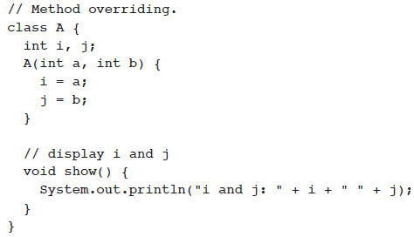
Method Overriding
*
Java and Web Programming
‹#›
Notes:
‹#›

Slide 22
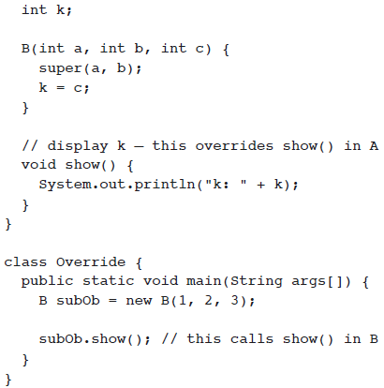
Method Overriding
The version of the method defined by the superclass will be hidden
*
Java and Web Programming
‹#›
Notes:
‹#›

Slide 23
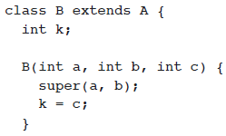
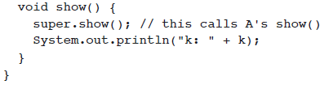
Method Overriding
If you wish to access the superclass version of an overridden function, you can do so by using super
*
Java and Web Programming
‹#›
Notes:
‹#›

Slide 24
Dynamic Method Dispatch
One of Java’s most powerful concepts - method overriding forms the basis
The mechanism by which a call to an overridden method is resolved at run time, rather than compile time
this is how Java implements run-time polymorphism
A superclass reference variable can refer to a subclass object - Java uses this fact to resolve calls to overridden methods at run time
When an overridden method is called through a superclass reference, Java determines which version of that method to execute based upon the type of the object being referred to at the time the call occurs
Dynamic, run-time polymorphism is one of the most powerful mechanisms that object-oriented design brings to bear on code reuse and robustness
*
Java and Web Programming
‹#›
Notes:
‹#›

Slide 25
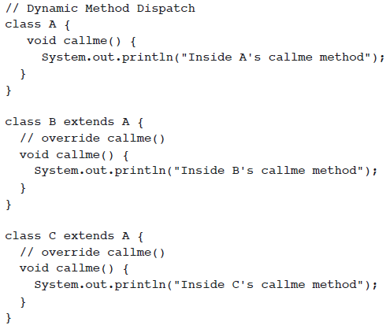
Dynamic Method Dispatch
*
Java and Web Programming
‹#›
Notes:
‹#›

Slide 26
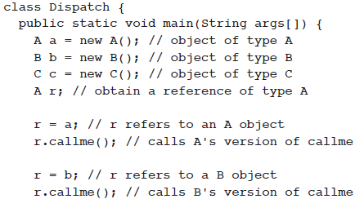


Dynamic Method Dispatch
*
Java and Web Programming
‹#›
Notes:
‹#›

Slide 27
Using Abstract Classes
To create a superclass that only defines a generalized form that will be shared by all of its subclasses, leaving it to each subclass to fill in the details
Define a superclass that declares the structure of a given abstraction without providing a complete implementation of every method
Context - when a superclass is unable to create a meaningful implementation for a method
Methods may be simply placeholders
*
Java and Web Programming
‹#›
Notes:
‹#›

Slide 28
Using Abstract Classes
You can require that certain methods be overridden by subclasses by specifying the abstract type modifier
These methods are sometimes referred to as subclasser responsibility because they have no implementation specified in the superclass
Thus, a subclass must override them — it cannot simply use the version defined in the superclass
To declare an abstract method, use this general form:
abstract type name(parameter-list);
no method body is present
*
Java and Web Programming
‹#›
Notes:
‹#›

Slide 29
Using Abstract Classes
Any class that contains one or more abstract methods must also be declared abstract
To declare a class abstract, you simply use the abstract keyword in front of the class keyword at the beginning of the class declaration
There can be no objects of an abstract class
That is, an abstract class cannot be directly instantiated with the new operator
Also, you cannot declare abstract constructors, or abstract static methods
Any subclass of an abstract class must either implement all of the abstract methods in the superclass, or be itself declared abstract
*
Java and Web Programming
‹#›
Notes:
‹#›

Slide 30
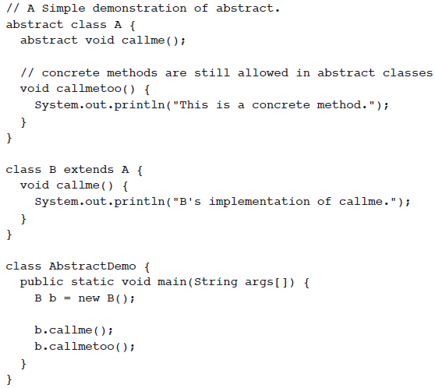
Using Abstract Classes
*
Java and Web Programming
‹#›
Notes:
‹#›

Slide 31
Using final with Inheritance
The keyword final has three uses
First, it can be used to create the equivalent of a named constant
The other two uses of final apply to inheritance
Using final to prevent Inheritance
Using final to prevent Overriding
*
Java and Web Programming
‹#›
Notes:
‹#›

Slide 32

Restricting Inheritance
Parent
final
Using modifier with a class will restrict
the inheritance capability of that class
Restricting
Inherited capability
Child
*
Java and Web Programming
‹#›

Slide 33
Final Classes: A way for Preventing Classes being extended
We can prevent an inheritance of classes by other classes by declaring them as final classes
This is achieved in Java by using the keyword final as follows:
final class Regular
{ // members
}
final class Employee extends Person
{ // members
}
Any attempt to inherit these classes will cause an error
*
Java and Web Programming
‹#›

Slide 34
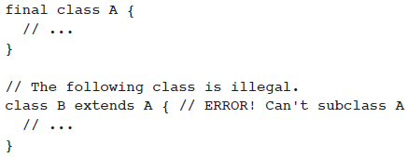
Final Classes: A way for Preventing Classes being extended
*
Java and Web Programming
‹#›

Slide 35
Final Members: A way for Preventing Overriding of Members in Subclasses
All methods and variables can be overridden by default in subclasses.
This can be prevented by declaring them as final using the keyword “final” as a modifier
For example:
final int marks = 100;
final void display();
This ensures that functionality defined in this method cannot be altered
Similarly, the value of a final variable cannot be altered
*
Java and Web Programming
‹#›

Slide 36
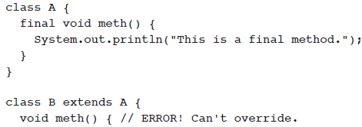

Final Members: A way for Preventing Overriding of Members in Subclasses
*
Java and Web Programming
‹#›

