Slide 1
JAVA —Introducing Classes—
*
Java and Web Programming
‹#›
Notes:
‹#›

Slide 2
Introducing Classes
The class is at the core of Java
It is the logical construct upon which the entire Java language is built because it defines the shape and nature of an object
As such, the class forms the basis for object-oriented programming in Java
Any concept you wish to implement in a Java program must be encapsulated within a class
*
Java and Web Programming
‹#›

Slide 3
What is an Object?
Real world objects are things that have:
state
behavior
Example: your dog:
state – name, color, breed, sits?, barks?, wages tail?, runs?
behavior – sitting, barking, waging tail, running
A software object is a bundle of variables (state) and methods (operations).
*
Java and Web Programming
‹#›
Notes:
‹#›

Slide 4
What is a Class?
A class is a blueprint that defines the variables and methods common to all objects of a certain kind.
Example: ‘your dog’ is an object of the class Dog.
An object holds values for the variables defines in the class.
An object is called an instance of the Class
*
Java and Web Programming
‹#›
Notes:
‹#›

Slide 5
Object Creation
A variable is declared to refer to the objects of type/class String:
String s;
The value of s is null; it does not yet refer to any object.
A new String object is created in memory with initial “abc” value:
String s = new String(“abc”);
Now s contains the address of this new object.
*
Java and Web Programming
‹#›

Slide 6
Object Destruction
A program accumulates memory through its execution.
Two mechanism to free memory that is no longer need by the program:
manual – done in C/C++
automatic – done in Java
In Java, when an object is no longer accessible through any variable, it is eventually removed from the memory by the garbage collector.
Garbage collector is parts of the Java Run-Time Environment.
*
Java and Web Programming
‹#›
Notes:
‹#›

Slide 7
Class Fundamentals
A basis for the Java language.
Each concept we wish to describe in Java must be included inside a class.
A class defines a new data type, whose values are objects:
A class is a template for objects
An object is an instance of a class
*
Java and Web Programming
‹#›
Notes:
‹#›

Slide 8
The General Form of a Class
A class contains a name, several variable declarations (instance variables) and several method declarations
All are called members of the class.
General form of a class:
class classname {
type instance-variable-1;
…
type instance-variable-n;
type method-name-1(parameter-list) { … }
type method-name-2(parameter-list) { … }
…
type method-name-m(parameter-list) { … }
}
*
Java and Web Programming
‹#›

Slide 9
Example: Class Usage
class Box {
double width;
double height;
double depth;
}
class BoxDemo {
public static void main(String args[]) {
Box mybox = new Box();
double vol;
mybox.width = 10;
mybox.height = 20;
mybox.depth = 15;
vol = mybox.width * mybox.height * mybox.depth;
System.out.println ("Volume is " + vol);
} }
*
Java and Web Programming
‹#›
Notes:
‹#›

Slide 10
Declaring Objects
Obtaining objects of a class is a two-step process
First, you must declare a variable of the class type
This variable does not define an object
It is simply a variable that can refer to an object
Second, you must acquire an actual, physical copy of the object and assign it to that variable
You can do this using the new operator
The new operator dynamically allocates (that is, allocates at run time) memory for an object and returns a reference to it
This reference is the address in memory of the object allocated by new.
This reference is then stored in the variable
Thus, in Java, all class objects must be dynamically allocated
*
Java and Web Programming
‹#›

Slide 11
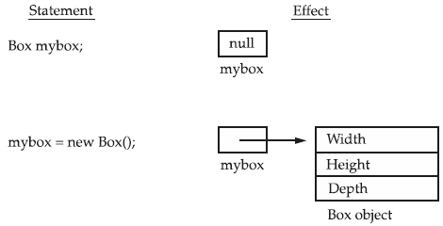
Declaring Objects
Box mybox; // declare reference to object
mybox = new Box(); // allocate a Box object
*
Java and Web Programming
‹#›

Slide 12
A Closer Look at new
The new operator dynamically allocates memory for an object
General form:
class-var = new classname( );
class-var is a variable of the class type being created
The classname is the name of the class that is being instantiated
The class name followed by parentheses specifies the constructor for the class
A constructor defines what occurs when an object of a class is created
Constructors are an important part of all classes and have many significant attributes
*
Java and Web Programming
‹#›

Slide 13
A Closer Look at new
You do not need to use new for Java’s simple types as integers or characters
Java’s simple types are not implemented as objects
Rather, they are implemented as “normal” variables
This is done in the interest of efficiency
*
Java and Web Programming
‹#›

Slide 14
Class Vs Object
A class creates a new data type that can be used to create objects
That is, a class creates a logical framework that defines the relationship between its members
When you declare an object of a class, you are creating an instance of that class
Thus, a class is a logical construct
An object has physical reality
That is, an object occupies space in memory
*
Java and Web Programming
‹#›

Slide 15
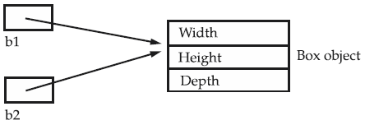
Assigning Object Reference Variables
Box b1 = new Box();
Box b2 = b1;
Box b1 = new Box();
Box b2 = b1;
// ...
b1 = null;
Here, b1 has been set to null, but b2 still points to the original object
*
Java and Web Programming
‹#›

Slide 16
Methods
General form of a method definition:
type name(parameter-list) {
… return value;
…
}
Components:
type - type of values returned by the method
If a method does not return any value, its return type must be void
name is the name of the method
parameter-list is a sequence of type-identifier lists separated by commas
return value indicates what value is returned by the method
*
Java and Web Programming
‹#›
Notes:
‹#›

Slide 17
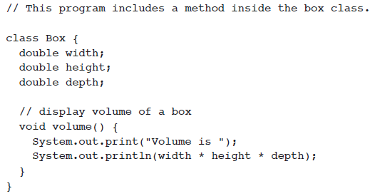
Adding a Method to the Box Class
Classes declare methods to hide their internal data structures, as well as for their own internal use
*
Java and Web Programming
‹#›

Slide 18
Method
Within a class, we can refer directly to its member variables
A method is always invoked relative to some object of its class
Once this invocation has occurred, the object is known
Thus, within a method, there is no need to specify the object a second time
When an instance variable is accessed by code that is not part of the class in which that instance variable is defined, it must be done through an object, by use of the dot operator
When an instance variable is accessed by code that is part of the same class as the instance variable, that variable can be referred to directly
The same thing applies to methods
*
Java and Web Programming
‹#›

Slide 19
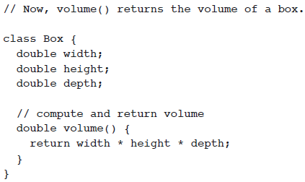
Method: Returning a Value
A better way to implement volume( ) is to have it compute the volume of the box and return the result to the caller
*
Java and Web Programming
‹#›

Slide 20
Method: Returning a Value
There are two important things to understand about returning values:
The type of data returned by a method must be compatible with the return type specified by the method
For example, if the return type of some method is boolean, you could not return an integer
The variable receiving the value returned by a method must also be compatible with the return type specified for the method
*
Java and Web Programming
‹#›

Slide 21
Parameterized Method
Parameters increase generality and applicability of a method:
method without parameters
int square() { return 10*10; }
method with parameters
int square(int i) { return i*i; }
Parameter: a variable receiving value at the time the method is invoked.
Argument: a value passed to the method when it is invoked.
*
Java and Web Programming
‹#›
Notes:
‹#›

Slide 22
Constructor
A constructor initializes the instance variables of an object.
It is called immediately after the object is created but before the new operator completes.
it is syntactically similar to a method:
it has the same name as the name of its class
it is written without return type; the default return type of a class constructor is the same class
When the class has no constructor, the default constructor automatically initializes all its instance variables with zero.
*
Java and Web Programming
‹#›

Slide 23
Example: Constructor
class Box {
double width;
double height;
double depth;
Box() {
System.out.println("Constructing Box");
width = 10; height = 10; depth = 10;
}
double volume() {
return width * height * depth;
}
}
*
Java and Web Programming
‹#›
Notes:
‹#›

Slide 24
Example: Constructor
class-var = new classname( );
Now you can understand why the parentheses are needed after the class name
What is actually happening is that the constructor for the class is being called
Thus, in the line
Box mybox1 = new Box();
new Box( ) is calling the Box( ) constructor
*
Java and Web Programming
‹#›
Notes:
‹#›

Slide 25
Parameterized Constructor
class Box {
double width;
double height;
double depth;
Box(double w, double h, double d) {
width = w; height = h; depth = d;
}
double volume()
{ return width * height * depth;
}
}
*
Java and Web Programming
‹#›

Slide 26
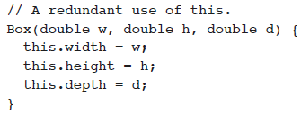
Keyword this
Can be used by any object to refer to itself in any class method
Typically used to
Avoid variable name collisions
Pass the receiver as an argument
*
Java and Web Programming
‹#›
Notes:
‹#›

Slide 27
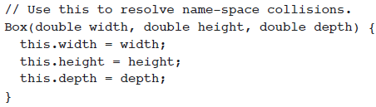
Keyword this
Keyword this allows a method to refer to the object that invoked it.
Instance Variable Hiding
when a local variable has the same name as an instance variable, the local variable hides the instance variable
It can be used inside any method to refer to the current object:
*
Java and Web Programming
‹#›
Notes:
‹#›

Slide 28
Garbage Collection
Garbage collection is a mechanism to remove objects from memory when they are no longer needed.
Garbage collection is carried out by the garbage collector:
The garbage collector keeps track of how many references an object has.
It removes an object from memory when it no longer has any references.
Thereafter, the memory occupied by the object can be allocated again.
The garbage collector invokes the finalize method.
*
Java and Web Programming
‹#›

Slide 29
finalize() Method
A constructor helps to initialize an object just after it has been created.
In contrast, the finalize method is invoked just before the object is destroyed:
implemented inside a class as:
protected void finalize() { … }
called just prior to garbage collection
implemented when the usual way of removing objects from memory is insufficient, and some special actions has to be carried out
*
Java and Web Programming
‹#›
Notes:
‹#›

Slide 30
A Stack Class
A stack stores data using first-in, last-out ordering
Stacks are controlled through two operations traditionally called push and pop
*
Java and Web Programming
‹#›
Notes:
‹#›

Slide 31
Access Control: Data Hiding and Encapsulation
Java provides control over the visibility of variables and methods
Encapsulation
safely sealing data within the capsule of the class
Prevents programmers from relying on details of class implementation, so you can update without worry
Helps in protecting against accidental or wrong usage
Keeps code elegant and clean (easier to maintain)
*
Java and Web Programming
‹#›
Notes:
‹#›

Slide 32
Controlling Access to Members of a Class
Access level modifiers determine whether other classes can use a particular field or invoke a particular method
There are two levels of access control:
At the top level—public, or package-private (no explicit modifier).
At the member level—public, private, protected, or package-private (no explicit modifier).
A class may be declared with the modifier public, in which case that class is visible to all classes everywhere
If a class has no modifier (the default, also known as package-private), it is visible only within its own package
packages are named groups of related classes
*
Java and Web Programming
‹#›
Notes:
‹#›

Slide 33
Controlling Access to Members of a Class
At the member level,
you can also use the public modifier or no modifier (package-private) just as with top-level classes, and with the same meaning
For members, there are two additional access modifiers: private and protected
The private modifier specifies that the member can only be accessed in its own class
The protected modifier specifies that the member can only be accessed within its own package (as with package-private) and, in addition, by a subclass of its class in another package
*
Java and Web Programming
‹#›
Notes:
‹#›

Slide 34
Controlling Access to Members of a Class
The following table shows the access to members permitted by each modifier
Access Levels
Modifier | Class | Package | Subclass | World
public | Y | Y | Y | Y
protected | Y | Y | Y | N
no modifier | Y | Y | N | N
private | Y | N | N | N
*
Java and Web Programming
‹#›
Notes:
‹#›

Slide 35
Access Modifiers: Public, Private, Protected
Public: keyword applied to a class, makes it available/visible everywhere
Applied to a method or variable, completely visible.
Default(No visibility modifier is specified): it behaves like public in its package and private in other packages.
Private fields or methods for a class only visible within that class
Private members are not visible within subclasses, and are not inherited
Protected members of a class are visible within the class, subclasses and also within all classes that are in the same package as that class
*
Java and Web Programming
‹#›

Slide 36
Visibility
public class Circle {
private double x,y,r;
// Constructor
public Circle (double x, double y, double r) {
this.x = x;
this.y = y;
this.r = r;
}
//Methods to return circumference and area
public double circumference() { return 2*3.14*r;}
public double area() { return 3.14 * r * r; }
}
*
Java and Web Programming
‹#›

Slide 37
Method Overloading
It is legal for a class to have two or more methods with the same name (different parameter declarations).
Java is able to uniquely associate the invocation of a method with its definition relying on the number and types of arguments.
Therefore the same-named methods must be distinguished:
by the number of arguments, and/or
by the types of arguments
Overloading and inheritance are two ways to implement polymorphism.
*
Java and Web Programming
‹#›

Slide 38
Example: Overloading
class OverloadDemo {
void test() {
System.out.println("No parameters");
}
void test(int a) {
System.out.println("a: " + a);
}
void test(int a, int b) {
System.out.println("a and b: " + a + " " + b);
}
double test(double a) {
System.out.println("double a: " + a); return a*a;
}
}
*
Java and Web Programming
‹#›

Slide 39
Method Overloading
Eg.
abs() – Java
abs(), fabs(), labs() - C
Return type do not play a role in overload resolution
Java will employ its automatic type conversions only if no exact match is found
Methods need not be related to the same purpose
*
Java and Web Programming
‹#›

Slide 40
Constructor Overloading
Overloading constructor methods
The proper overloaded constructor is called based upon the parameters specified when new is executed
*
Java and Web Programming
‹#›

Slide 41
Constructor Overloading
class Box {
double width, height, depth;
Box(double w, double h, double d) {
width = w; height = h; depth = d;
}
Box() {
width = -1; height = -1; depth = -1;
}
Box(double len) {
width = height = depth = len;
}
double volume() { return width * height * depth; }
}
*
Java and Web Programming
‹#›

Slide 42
Parameter Passing
Two types of variables:
simple types
class types
Two corresponding ways of how the arguments are passed to methods:
by value a method receives a copy of the argument
parameters of simple types
by reference a method receives the reference to an argument, not the value of the argument
this reference is used to access the actual argument specified in the call
parameters of class types
*
Java and Web Programming
‹#›

Slide 43
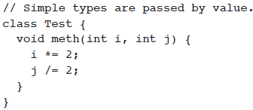
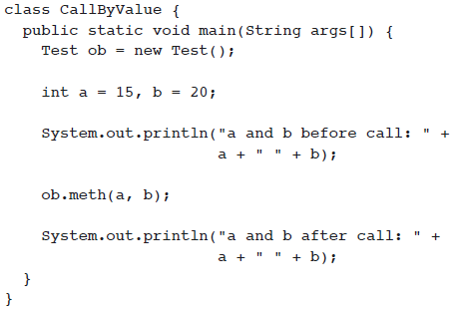
Call by value
*
Java and Web Programming
‹#›

Slide 44
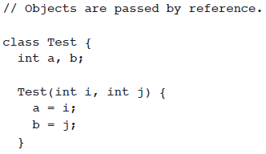
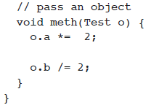
Call by reference
*
Java and Web Programming
‹#›

Slide 45
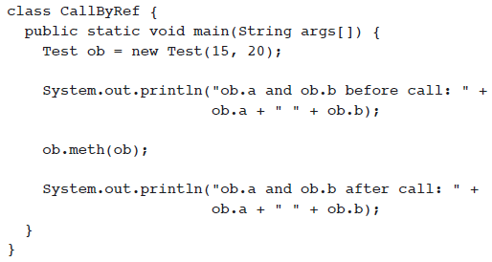

Call by reference
*
Java and Web Programming
‹#›

Slide 46
Call by reference
As the parameter hold the same address as the argument, changes to the object inside the method do affect the object used by the argument – side effects will be there
When a simple type is passed to a method, it is done by use of call-by-value. Objects are passed by use of call-by-reference
*
Java and Web Programming
‹#›

Slide 47
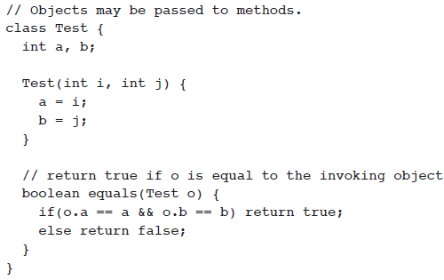
Using Objects as Parameters
*
Java and Web Programming
‹#›

Slide 48

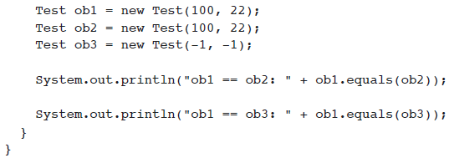

Using Objects as Parameters
*
Java and Web Programming
‹#›

Slide 49
Recursion
Recursion is the process of defining something in terms of itself
A recursive method is a method that calls itself
When a method calls itself,
all method parameters and local variables are allocated storage on the stack
the method code is executed for the new arguments
upon return, all parameters and variables are removed from the stack
the execution continues immediately after the invocation point
*
Java and Web Programming
‹#›

Slide 50
Example: Recursion
class Factorial {
int fact(int n) {
if (n==1) return 1;
return fact(n-1) * n;
}
}
class Recursion {
public static void main(String args[]) {
Factorial f = new Factorial();
System.out.print("Factorial of 5 is ");
System.out.println(f.fact(5));
}
}
*
Java and Web Programming
‹#›

Slide 51
static
To define a class member that will be used independently of any object of that class
When a member is declared static, it can be accessed before any objects of its class are created, and without reference to any object
You can declare both methods and variables to be static
Instance variables declared as static are, essentially, global variables
When objects of its class are declared, no copy of a static variable is made
Instead, all instances of the class share the same static variable
*
Java and Web Programming
‹#›

Slide 52
static
Methods declared as static have several restrictions:
They can only call other static methods.
They must only access static data.
They cannot refer to this or super in any way.
If you need to initialize your static variables, you can declare a static block which gets executed exactly once, when the class is first loaded
Outside of the class in which they are defined, static methods and variables can be used independently of any object
To do so, you need only specify the name of their class followed by the dot operator
classname.method( )
Here, classname is the name of the class in which the static method is declared
*
Java and Web Programming
‹#›

Slide 53
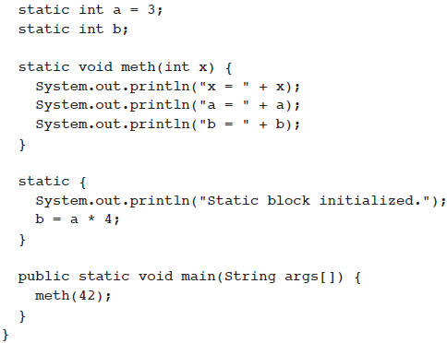
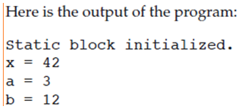
static
*
Java and Web Programming
‹#›

Slide 54
final
A variable can be declared as final
Doing so prevents its contents from being modified
This means that you must initialize a final variable when it is declared
A final variable is essentially a constant
final int FILE_NEW = 1;
final int FILE_OPEN = 2;
It is a common coding convention to choose all uppercase identifiers for final variables
*
Java and Web Programming
‹#›

Slide 55
Nested and Inner Classes
Nested classes – a class defined within another class
The scope of a nested class is bounded by the scope of its enclosing class
Thus, if class B is defined within class A, then B is known to A, but not outside of A
A nested class has access to the members, including private members, of the class in which it is nested
However, the enclosing class does not have access to the members of the nested class
There are two types of nested classes: static and non-static
An inner class is a non-static nested class
*
Java and Web Programming
‹#›

Slide 56

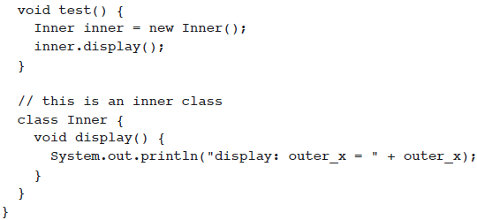
Nested and Inner Classes
*
Java and Web Programming
‹#›

Slide 57
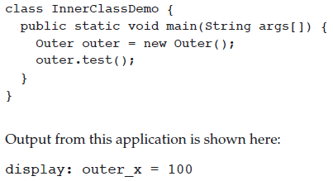
Nested and Inner Classes
*
Java and Web Programming
‹#›

Slide 58
Command-Line Arguments
To pass information into a program when you run it
This is accomplished by passing command-line arguments to main( )
A command-line argument is the information that directly follows the program’s name on the command line when it is executed
To access the command-line arguments inside a Java program is quite easy—
they are stored as strings in the String array passed to main( )
*
Java and Web Programming
‹#›

Slide 59
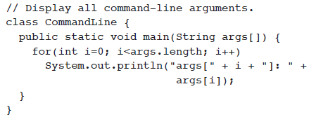
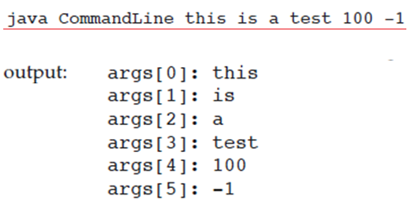
Command-Line Arguments
*
Java and Web Programming
‹#›

