Slide 1
IT Alumni Database ETL
Ricky Parks
Vy Duong
Desiree Smokes
Zack Downing

Slide 2
Background
KSU would like to know what their students are doing after they graduate
LinkedIn profiles contain some of this information
Inputting data manually is tedious
We wanted to automate the process!

Slide 3
Our Approach
Milestone 1: Implement the database
Milestone 2: Ability to insert data into our database
Milestone 3: Updating the database

Slide 4
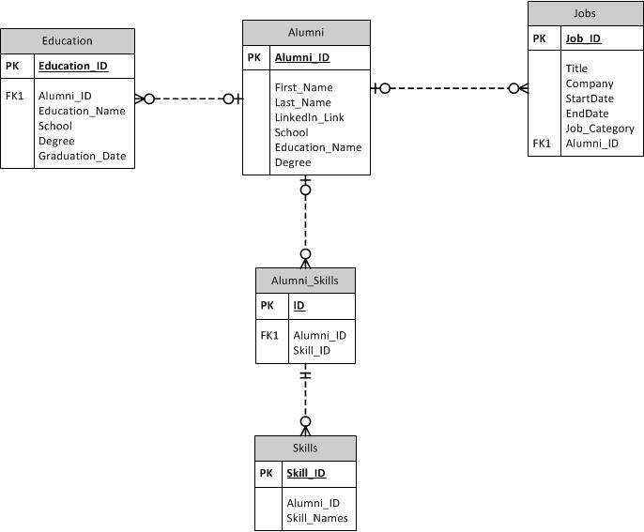
Database design

Slide 5
Technologies used
SQL
SQL Server Management Studio
Python/Pycharm Community edition IDE
BeautifulSoup
PyODBC
JSON
Microsoft Azure

Slide 6
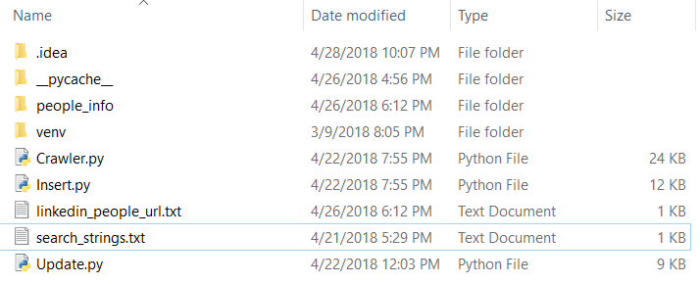
Project structure

Slide 7
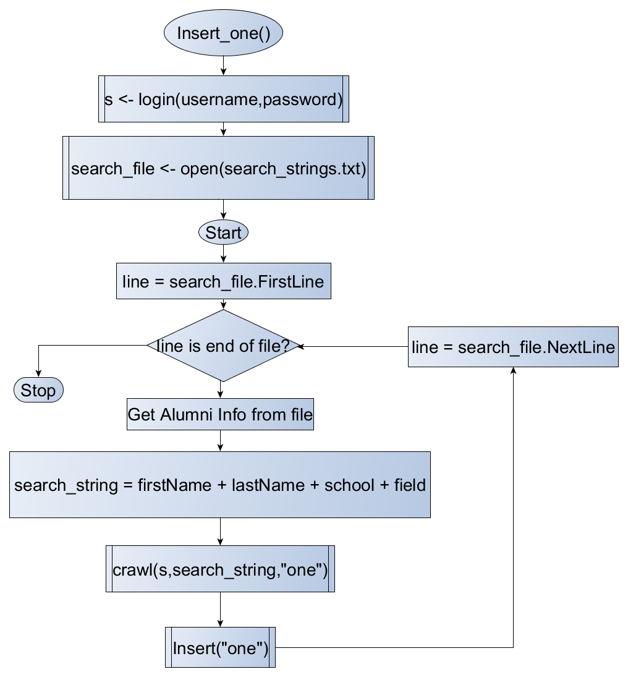
Requesting new data

Slide 8
Summary of Inserting data
Read each student’s JSON file
Store into an array of classes
For each alumni class, insert the data into the database
Clear the directory of files

Slide 9
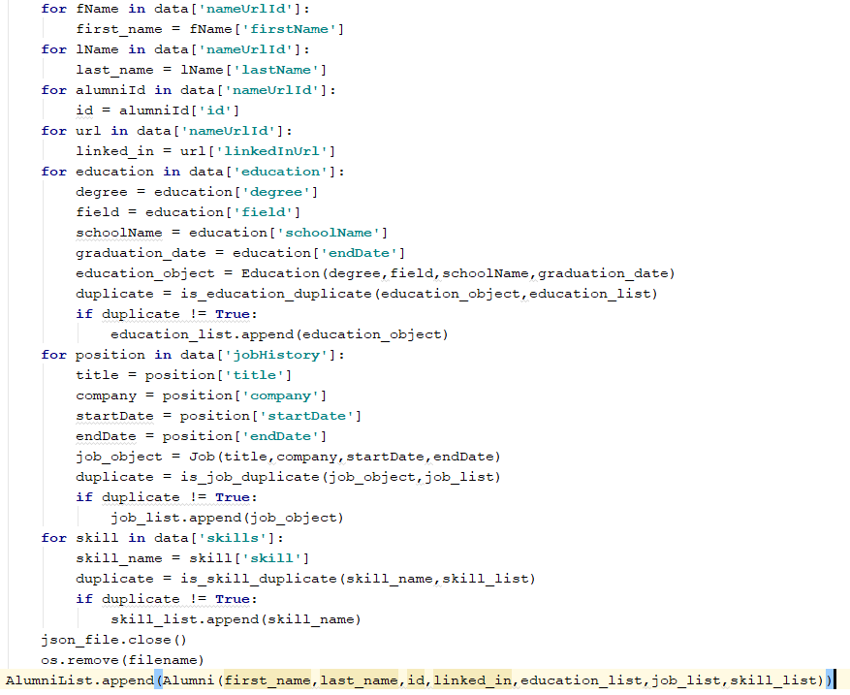

Slide 10
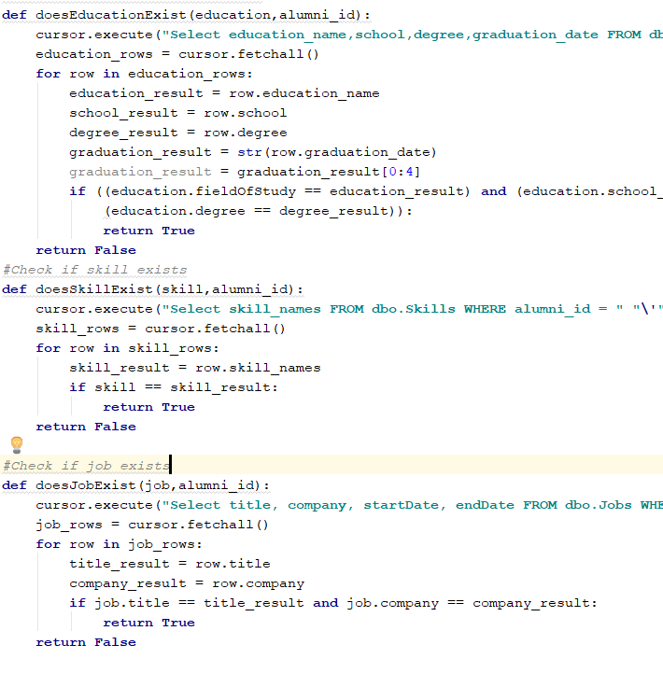
Updating

Slide 11
CHallenges
Formatting data into the right form
Data originally raw text, changed to JSON
Playing nice with LinkedIn
Connection requests
Out of network profiles
Coordinating our schedules

Slide 12
Role Summary
Desiree Smokes(SQL/Python)
Vy Duong (SQL/Python)
Ricky Parks (Project lead/Python)
Zack Downing (Python)

Slide 13
Overall Experience
Learned a lot of python
Gained understanding of web crawler functions and uses
Hands on experience setting up and using a SQL Server
What does and doesn’t work well on collaboration projects
Set team meetings
Dividing up assignments

