Slide 1
SimpleConvNetの実装
クラス図
SimpleConvNet
params … 重みパラメータ layers … ネットワーク構造 last_layer … 最終層
__init__(input_dim=(1, 28, 28), conv_param={'filter_num':30, 'filter_size':5, 'pad':0, 'stride':1}, hidden_size=100, output_size=10, weight_init_std=0.01) predict(x) loss(x, t) accuracy(x, t, batch_size=100) numerical_gradient(x, t) gradient(x, t) save_params(file_name) load_params(file_name)
初期化
推論
損失関数
勾配
（誤差逆伝播法）

Slide 2
初期化
def __init__(self, input_dim=(1, 28, 28),
conv_param={'filter_num':30, 'filter_size':5, 'pad':0, 'stride':1},
hidden_size=100, output_size=10, weight_init_std=0.01):
filter_num = conv_param['filter_num']
filter_size = conv_param['filter_size']
filter_pad = conv_param['pad']
filter_stride = conv_param['stride']
input_size = input_dim[1]
conv_output_size = (input_size - filter_size + 2*filter_pad) / filter_stride + 1
pool_output_size = int(filter_num * (conv_output_size/2) * (conv_output_size/2))
self.params = {}
self.params['W1'] = weight_init_std * \
np.random.randn(filter_num, input_dim[0], filter_size, filter_size)
self.params['b1'] = np.zeros(filter_num)
self.params['W2'] = weight_init_std * \
np.random.randn(pool_output_size, hidden_size)
self.params['b2'] = np.zeros(hidden_size)
self.params['W3'] = weight_init_std * \
np.random.randn(hidden_size, output_size)
self.params['b3'] = np.zeros(output_size)
self.layers = OrderedDict()
self.layers['Conv1'] = Convolution(self.params['W1'], self.params['b1'],
conv_param['stride'], conv_param['pad'])
self.layers['Relu1'] = Relu()
self.layers['Pool1'] = Pooling(pool_h=2, pool_w=2, stride=2)
self.layers['Affine1'] = Affine(self.params['W2'], self.params['b2'])
self.layers['Relu2'] = Relu()
self.layers['Affine2'] = Affine(self.params['W3'], self.params['b3'])
self.last_layer = SoftmaxWithLoss()
ハイパーパラメータの取得
重みパラメータの初期化
レイヤの生成

Slide 3
初期化
def __init__(self, input_dim=(1, 28, 28),
conv_param={'filter_num':30, 'filter_size':5, 'pad':0, 'stride':1},
hidden_size=100, output_size=10, weight_init_std=0.01):
filter_num = conv_param['filter_num']
filter_size = conv_param['filter_size']
filter_pad = conv_param['pad']
filter_stride = conv_param['stride']
input_size = input_dim[1]
conv_output_size = (input_size - filter_size + 2*filter_pad) / filter_stride + 1
pool_output_size = int(filter_num * (conv_output_size/2) * (conv_output_size/2))
self.params = {}
self.params['W1'] = weight_init_std * \
np.random.randn(filter_num, input_dim[0], filter_size, filter_size)
self.params['b1'] = np.zeros(filter_num)
self.params['W2'] = weight_init_std * \
np.random.randn(pool_output_size, hidden_size)
self.params['b2'] = np.zeros(hidden_size)
self.params['W3'] = weight_init_std * \
np.random.randn(hidden_size, output_size)
self.params['b3'] = np.zeros(output_size)
self.layers = OrderedDict()
self.layers['Conv1'] = Convolution(self.params['W1'], self.params['b1'],
conv_param['stride'], conv_param['pad'])
self.layers['Relu1'] = Relu()
self.layers['Pool1'] = Pooling(pool_h=2, pool_w=2, stride=2)
self.layers['Affine1'] = Affine(self.params['W2'], self.params['b2'])
self.layers['Relu2'] = Relu()
self.layers['Affine2'] = Affine(self.params['W3'], self.params['b3'])
self.last_layer = SoftmaxWithLoss()
畳み込み層・プーリング層の出力サイズの計算
ハイパーパラメータの取得
バイアスには0
重みはランダム値を設定
重みパラメータの初期化
順序保存の
dict型
最後の層のみ
別の変数に追加
レイヤの生成

Slide 4
推論
損失関数
def predict(self, x):
for layer in self.layers.values():
x = layer.forward(x) return x
1層目から最終層手前まで
順伝播
def loss(self, x, t):
y = self.predict(x)
return self.last_layer.forward(y, t)
推論＋最終層のレイヤまで
順伝播

Slide 5
誤差逆伝播法による勾配計算
def gradient(self, x, t):
# forward
self.loss(x, t)
# backward
dout = 1
dout = self.last_layer.backward(dout)
layers = list(self.layers.values())
layers.reverse()
for layer in layers:
dout = layer.backward(dout)
# 設定
grads = {}
grads['W1'], grads['b1'] = self.layers['Conv1'].dW, self.layers['Conv1'].db
grads['W2'], grads['b2'] = self.layers['Affine1'].dW, self.layers['Affine1'].db
grads['W3'], grads['b3'] = self.layers['Affine2'].dW, self.layers['Affine2'].db
return grads
各レイヤが保持する
パラメータの勾配を取得

Slide 6
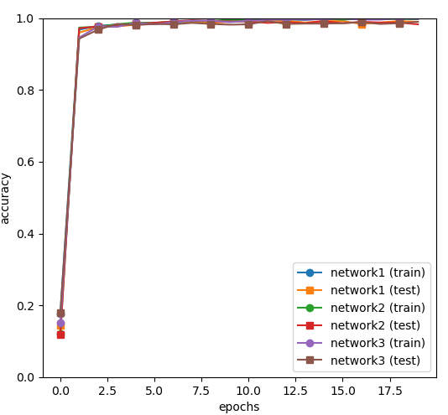
学習結果
MNISTデータを用いたクラス分類問題
Network1: input_dim=(1,28,28),
conv_param = {'filter_num': 30, 'filter_size': 5, 'pad': 0, 'stride': 1},
hidden_size=100, output_size=10, weight_init_std=0.01
Network2: filter_num=50 に変更
Network3: hidden_size=50 に変更
 | Train accuracy | Test accuracy
Network1 | 0.998 | 0.99
Network2 | 0.998 | 0.983
Network3 | 0.998 | 0.99
精度はどのネットワークでもほとんど同じ
フィルタ数を増やしたnetwork2は
学習時間が倍増した

Slide 7
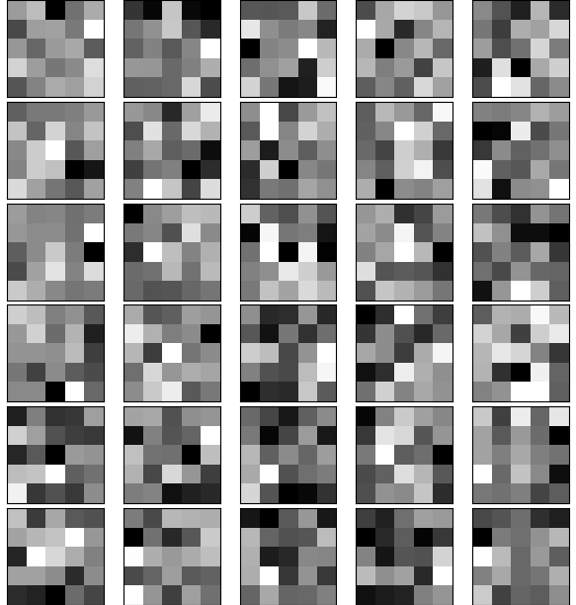
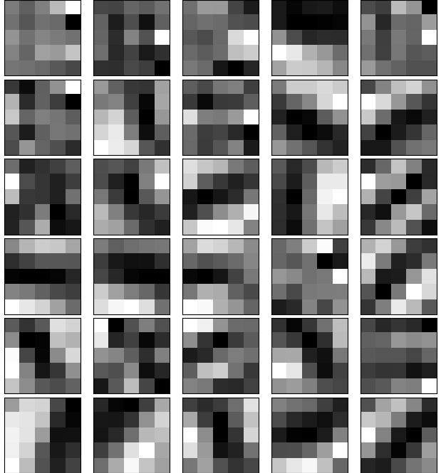

Slide 8

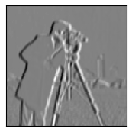
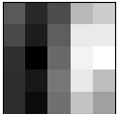

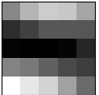
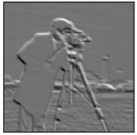
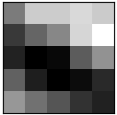
フィルター適用結果
縦のエッジが強調
横のエッジが強調
斜めのエッジが強調
フィルタ

Slide 9
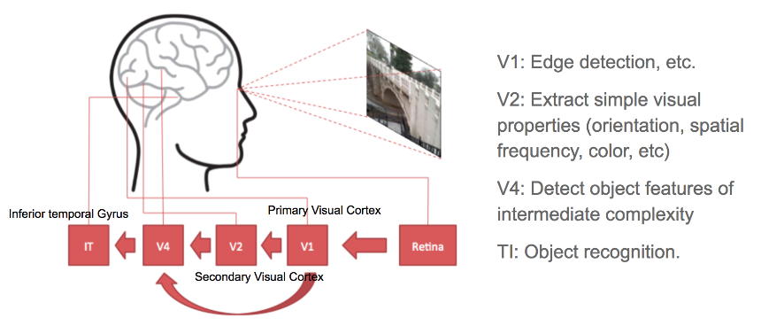
https://lilianweng.github.io/posts/2017-06-21-overview/
脳における視覚情報処理でも、
Deep Leaningで学習されたモデルと類似した階層構造を持つ

