Slide 1
449 Final Presentation
Noisy CIFAR-10 Classification
Li Yichen & Xiao Xichu

Slide 2
Classification Implement Overview
Our design is roughly divided into two parts, including a basic resnet32 method to classify images into ten classifications and a noisy-elimination method called PENCIL to improve noisy labels in provided dataset.
PENCIL is independent of the backbone network structure and does not need an auxiliary clean dataset or prior information about noise, thus it is easy and robust to apply
Acknowledgement:
“Probabilistic End-to-end Noise Correction for Learning with Noisy Labels”. Kun Yi, Jianxin Wu. 1903.07788.pdf (arxiv.org)

Slide 3
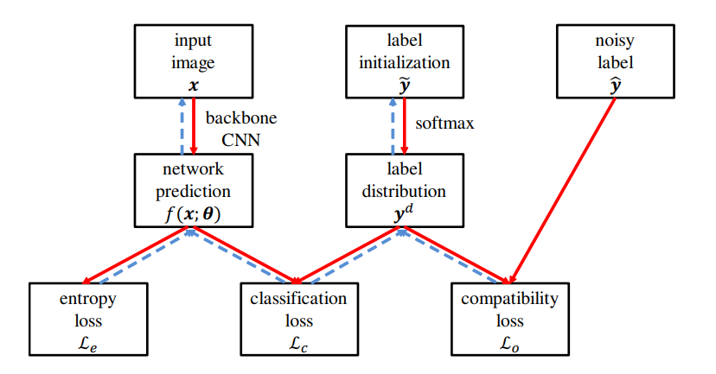
PENCIL

Slide 4
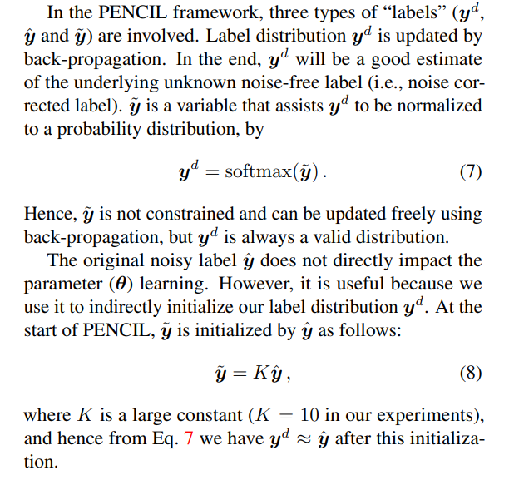
New parameter

Slide 5
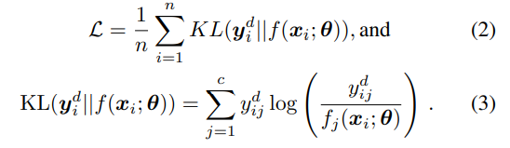
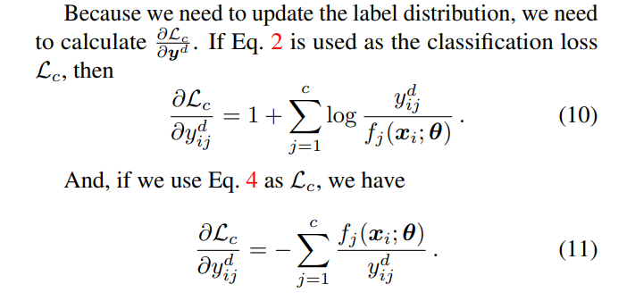
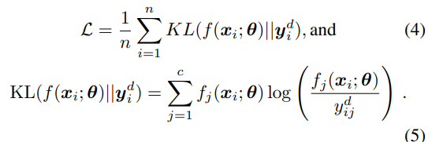
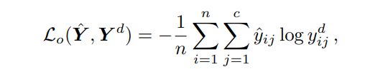
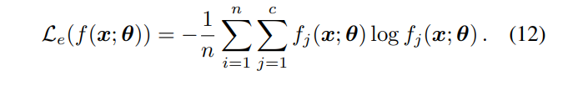
Specifically

Slide 6

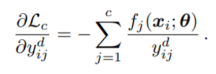
How to update y_tilda
[0, 0, 1, 0, 0, 0, 0, 0, 0, 0] Noise label
[0, 0, 0, 0, 0, 0, 0, 1, 0, 0] True label
[0, 0, 0.2, 0, 0, 0, 0, 0.8, 0, 0] f(x; θ) (ideal)
[0.08, 0.08, 0.23, 0.08, 0.08, 0.08, 0.08, 0.08, 0.08, 0.08] y_d (initial, after softmax)

Slide 7
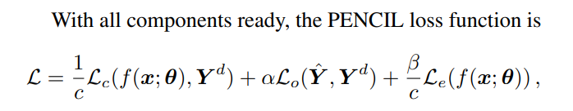
In Short
We define a new loss function combining Lo, Le, Lc together to update label distribution and net parameter θ
We try to make training labels closer to true labels to improve accuracy.

Slide 8
Next, we try to experiment

Slide 9
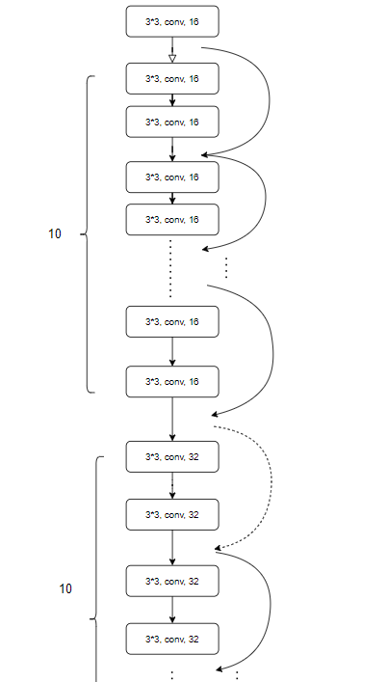
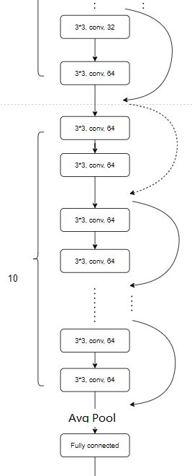
Resnet32

Slide 10
Experiment Results (try with RESNET32)
CIFAR10 Toronto dataset-RESNET32
for training(Adam) – 150 epochs
CIFAR10 Toronto dataset-RESNET32
for training(SGD)- 100 epochs
CIFAR10 given dataset with 10% error
for training（Adam）
CIFAR10 given dataset with 10% error
for training（SGD）

Slide 11
Experiment Results (with new process)
70 epochs | 70 ~ 200 epochs | 200~240 epochs | 240~280 epochs | 280~320 epochs
Update Resnet only | Update Y_tilde also | Update Resnet only | Update Resnet only | Update Resnet only
Lr: α | Lr: α | Lr: α | Lr: α/10 | Lr: α/100
CIFAR10 Toronto dataset-Pencil
for training (without Pencil but new process)

Slide 12
Experiment Results (add with Pencil)
After utilizing Pencil, we trained this model with 320 epochs and check with standard test_bench
(Reference from previous page)
CIFAR10 Toronto dataset-Pencil
for training
CIFAR10 given dataset with 10% error
for training

Slide 13
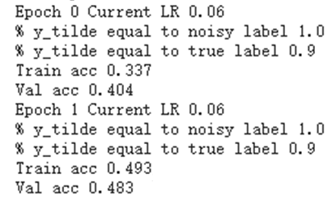
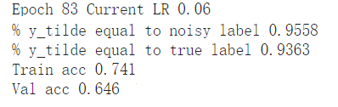
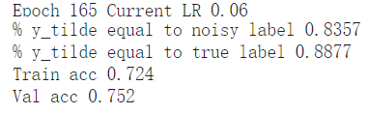
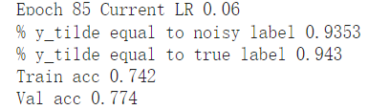
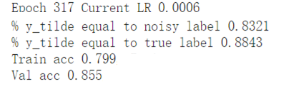
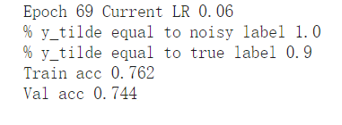
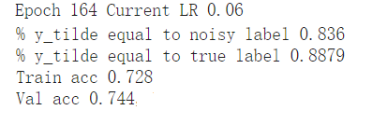
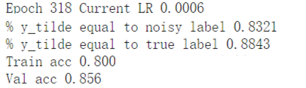
Experiment Results (with noise made by ourselves)
True label increases from epoch 70 but
decreases after about epoch 90
and remains same after epoch 200

Slide 14
How to update y_tilda
[0, 0, 1, 0, 0, 0, 0, 0, 0, 0] Noise label
[0, 0, 0, 0, 0, 0, 0, 1, 0, 0] True label
[0, 0, 0.2, 0, 0, 0, 0, 0.8, 0, 0] f(x; θ) (ideal)
(will also be updated)
[0.08, 0.08, 0.23, 0.08, 0.08, 0.08, 0.08, 0.08, 0.08, 0.08] y_d (initial, after softmax)

Slide 15
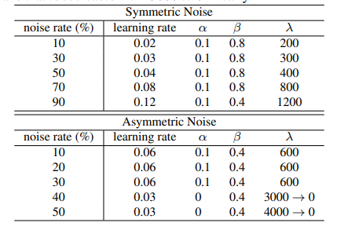
Symmetric & Asymmetric
Symmetric noise
Asymmetric noise
Symmetric: [0.9, 0.01, 0.01, 0.01, 0.01, …]
Asymmetric: [0, 0.9, 0.1, 0, 0, 0, 0, 0, 0, 0]

Slide 16
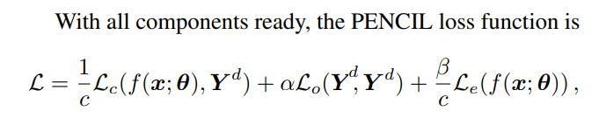
Our thoughts
To promote accuracy of current application, we try to replace the comparison between Yhat and Yd in compatibility loss, with Yd and itself, so labels can be one-hot distribution, and only point to most likely result.

Slide 17
Results
Parameters for symmetric noise
Parameters for symmetric noise

Slide 18
Another thoughts
We can use larger convolution channel (16 to 32, 32 to 64, 64 to 128) to enlarge parameter number (0.47M to 7.43M)
This method works in Resnet32 model with correct labels for training and may be feasible in other trainings.
Original (100 epochs)
Improved (100 epochs)

Slide 19
That’s all!
Thank you for your Listening

