Slide 1

BENCH-SCALE HARDWARE-IN-THE-LOOP EV PLATFORM
EV Vehicle Control Unit
& Human-Machine Interface
STM32F446RE VCU • Qt/QML Dashboard on Raspberry Pi 5
Aditya Pant, Pulkit Dhingra, Rohan Bhide • Group No. 11 • July 2026
Notes:
Good [morning/afternoon]. Today I'm presenting a two-part electric vehicle platform I built: a Vehicle Control Unit on an STM32F446RE that handles real-time motor control and sensor interfacing, and a companion Human-Machine Interface — a Qt/QML dashboard running on a Raspberry Pi 5 — that turns that telemetry into a driver- and engineer-facing display. I'll walk through the problem, the architecture, and what I learned building both sides of this signal chain.

Slide 2
MOTIVATION
Problem Statement
Commercial EV platforms employ proprietary architectures that restrict visibility into their embedded control and communication systems.
Academic implementations typically focus on individual subsystems rather than integrated vehicle architectures.
As a result, the interaction between embedded firmware, telemetry, diagnostics, and HMIs is seldom demonstrated within a single platform.
This creates a gap in system-level understanding and practical validation of modern EV software architectures.
PROBLEM STATEMENT
There is a need to develop a modular EV platform that integrates embedded control, communication, diagnostics, and a production-inspired HMI, because existing educational platforms provide limited exposure to complete vehicle system integration.
02
Notes:
Commercial EV control units are black boxes — you can't open a Tesla's VCU and see the control loop. Most embedded coursework stops at reading one sensor or blinking an LED, which doesn't teach you how a real vehicle's software stack fits together. The problem I set out to solve was building a small but complete system: real sensors, real safety logic, real telemetry, and a real dashboard — so every layer of a production EV's signal path is represented and inspectable.

Slide 3





GOALS
Objectives
01
Implement closed-loop throttle, braking, and PRND gear control on STM32
02
Add thermal protection and Coulomb-counting state-of-charge estimation
03
Stream live telemetry over UART at 10 Hz
04
Build a reactive Qt/QML dashboard consuming that telemetry in real time
05
Provide a hidden Engineer Mode for deep diagnostics
03
Notes:
There were five concrete objectives. On the firmware side: closed-loop pedal and gear control with a strict safety chain, thermal protection, and a Coulomb-counting battery model. On the HMI side: a live 10 Hz telemetry stream over UART, a reactive dashboard that updates without polling, and a hidden Engineer Mode for technician-level diagnostics. Each of these maps directly to a chapter in the two reports.

Slide 4




STACK
Technology Stack
Firmware: STM32F446RE (Cortex-M4F), STM32CubeIDE, HAL
HMI Application: Qt 6 / Qt Quick (QML), C++17
Host: Raspberry Pi 5 + 10.1" capacitive touchscreen
Link: UART @ 115200 baud, key=value telemetry frames
Tooling: CMake
Qt / QML
C++17
Raspberry Pi 5
STM32F446RE
UART 115200
CubeMX / CMake
04
Notes:
The stack splits cleanly across the UART boundary. On the vehicle side, an STM32F446RE running bare HAL firmware. On the dashboard side, Qt 6 with QML for the UI and C++17 for the backend, running on a Raspberry Pi 5 driving a 10.1-inch capacitive touchscreen. The two sides agree on one contract: a 115200-baud UART link carrying a simple key-value telemetry frame ten times a second.

Slide 5


ARCHITECTURE
Overall System Architecture
STM32 VCU
Sensors · PRND · Drive Modes
UART / SerialManager
115200 baud, QSerialPort
TelemetryParser
key=value tokenizer
VehicleData
Q_PROPERTY reactive model
Qt / QML UI
Home · Diagnostics · Engineer Mode
One reactive model feeds every screen — no polling, no duplication.
05
Notes:
This is the spine of the whole project. The STM32 emits telemetry over UART. SerialManager owns the physical serial port and hands raw lines to TelemetryParser, which tokenizes them and writes typed values into VehicleData — a single reactive C++ object. Every screen in the app, from the driver's speedometer to the engineer's fault log, binds to that same VehicleData instance, so there is exactly one source of truth and never a chance for two views to disagree.

Slide 6




ARCHITECTURE
Software Architecture (HMI)
VehicleData — reactive Q_PROPERTY model, single source of truth
TelemetryParser / SerialManager — decode + own the UART link
TelemetrySimulator — swaps in for hardware via IDataSource
LocalMusicPlayer / SpotifyAPIManager / BluetoothManager — media
Theme Engine (Colors/Typography/Theme.qml) — six-theme personalization
Parser / Serial
Theme Engine
Simulator
VehicleData
Bluetooth
Music
06
Notes:
Architecturally, everything radiates from or into VehicleData. TelemetryParser and SerialManager feed it from hardware; TelemetrySimulator feeds it identically from software, through a shared IDataSource interface — so the entire UI can be developed and demoed without any hardware attached. Media playback is deliberately kept out of VehicleData: LocalMusicPlayer, SpotifyAPIManager, and BluetoothManager each own exactly one transport, so vehicle state and music state never cross-contaminate.

Slide 7
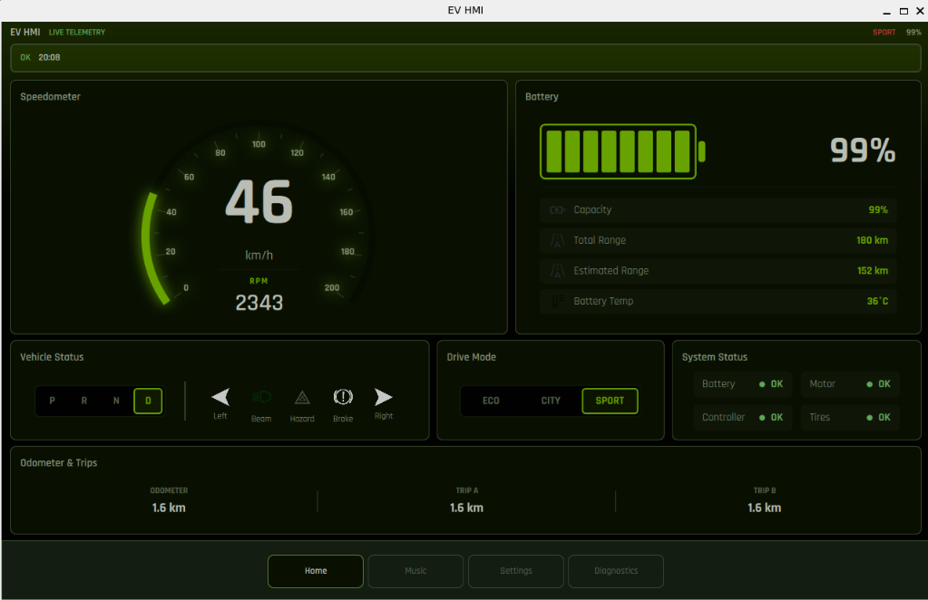



DRIVER VIEW
Dashboard Features — Home
Speedometer
Analog arc + digital RPM, one bound property
Battery
SoC, range, temperature panel
Drive Mode
ECO / CITY / SPORT selector
Indicators
PRND · turn signals · hazards · brake
07
Notes:
This is the primary driving view — the first screen shown at startup. It's laid out so the driver's eyes never have to sweep the panel: speed, RPM, and gear occupy the largest area on the left, everything else is peripheral. The speedometer arc and the digital readout are driven by the exact same bound property, so they can never disagree. Note the Drive Mode selector — in hardware mode it's read-only, reflecting physical buttons on the VCU itself.

Slide 8
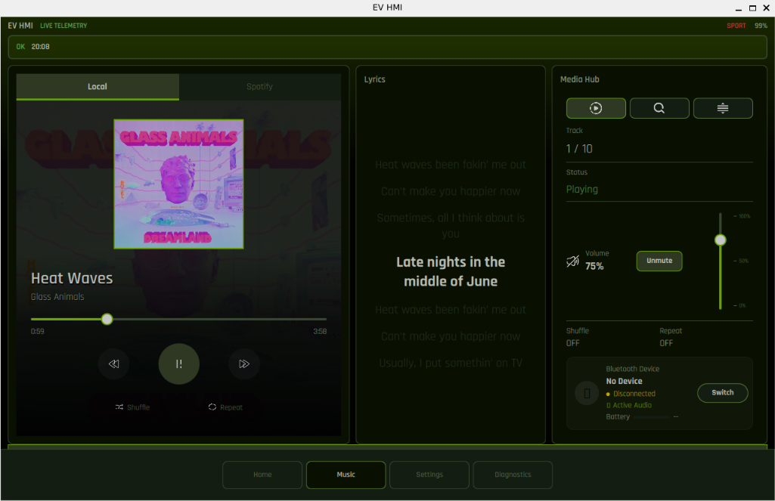


DRIVER VIEW
Music System
Spotify + Local
Tabbed interface, one shared property contract
Synced Lyrics
Teleprompter-style, centered highlight line
Bluetooth
Pairing, device + battery status
Media Hub
Volume, shuffle, repeat, queue
08
Notes:
Music was built as a case study in the same reactive-property discipline as the vehicle data. Local files and Spotify sit behind an identical property contract, so the QML layer doesn't know or care which backend is serving a given track. The center lyrics panel is synchronized to playback position for a teleprompter effect, and the right-hand Media Hub folds in Bluetooth device status using the same card language as the rest of the app.

Slide 9
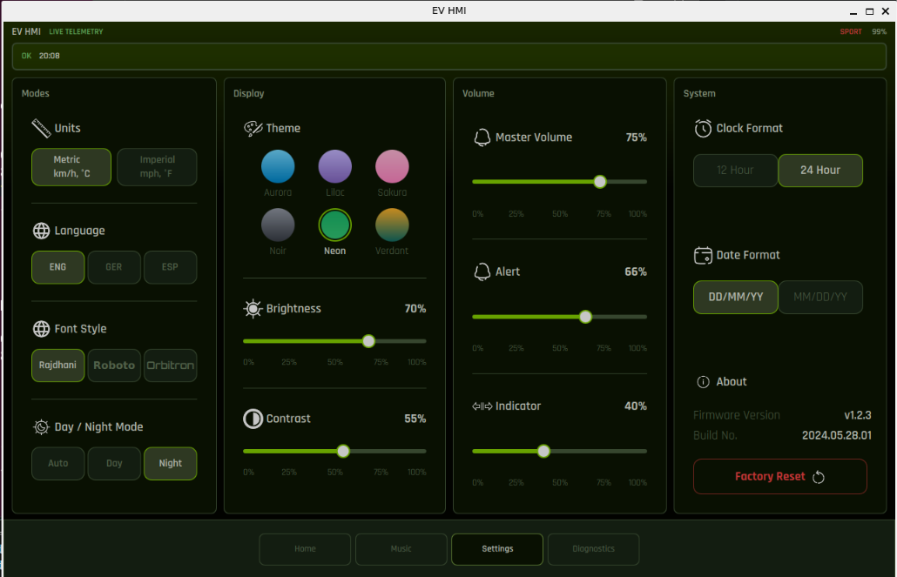



DRIVER VIEW
System Settings
Volume
System Master Volume control
Screen Visibility
Brightness, Contrast and Font style choices available
Language Support
Easily swith between English,German or Spainish for assesibility.
08
Notes:
Music was built as a case study in the same reactive-property discipline as the vehicle data. Local files and Spotify sit behind an identical property contract, so the QML layer doesn't know or care which backend is serving a given track. The center lyrics panel is synchronized to playback position for a teleprompter effect, and the right-hand Media Hub folds in Bluetooth device status using the same card language as the rest of the app.

Slide 10


PERSONALIZATION
Theme Engine
Six accent themes: Aurora, Lilac, Sakura, Noir, Neon, Verdant
Day / Night palettes — 12 total visual configurations
Two hue anchors per theme (surface + accent) drive every color
Metric/Imperial, font, and language switch instantly, app-wide
No restart — every setting flows through QML singletons
SIX ACCENT THEMES
Aurora
Lilac
Sakura
Noir
Neon
Verdant
Every theme shares one lightness ramp —
ECO green & SPORT amber stay hue-locked.
Day
Night
11
Notes:
The theming system is generative rather than hand-authored — twelve visual configurations come from just two hue anchors per theme and one shared lightness ramp, so a raised card looks exactly as elevated in every theme. Two colors — ECO green and SPORT amber — are hue-locked across all six themes so those indicators stay instantly recognizable no matter which theme is active. Every setting, from theme to language to units, takes effect within a single frame, with no apply button and no restart.

Slide 11
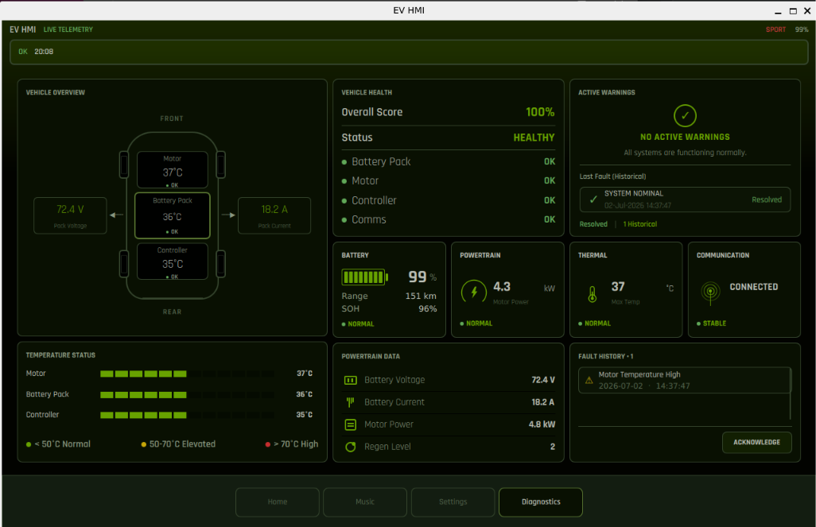


DRIVER VIEW
Diagnostics — Driver Health Summary
Vehicle Topology
Live per-node temperatures (Motor / Battery / Controller)
Health Score
HEALTHY / DEGRADED / CRITICAL
Active Warnings
Banner + last-fault history
Status Tiles
Battery · Powertrain · Thermal · Comms
09
Notes:
Diagnostics answers one question for the driver: is everything OK? It deliberately does not expose raw fault codes or thresholds — that's reserved for Engineer Mode. The topology diagram gives an at-a-glance sense of where thermal load is concentrated, and the aggregate health score is computed by WarningManager evaluating every active flag against its threshold.

Slide 12




TECHNICIAN VIEW
Engineer Mode
Hidden behind a long-press gesture — not part of normal driving UX
Live raw frame view + frame/invalid/checksum counters
Fault entries with DTC-style codes, thresholds, and root causes
Reads the same VehicleData instance — no separate data pipeline
Overview
Telemetry
Thermal
Powertrain
Communication
Faults
10
Notes:
Engineer Mode is the deep-diagnostics layer, modeled loosely on production automotive DTC tooling. It's reachable only by a long-press on the Diagnostics page to prevent accidental activation while driving. Importantly, it isn't a separate data pipeline — it's a more detailed view over the same VehicleData object, so anything added here for engineering purposes is automatically available if a later release wants to surface it to the driver.

Slide 13
DEVELOPMENT TOOLING
Simulation Framework
TelemetrySimulator stands in for the STM32 via IDataSource
Driven by PS3 controller or keyboard instead of pedals
Internal SimulationState models thermal drift and battery drain
Pushes through the same setters real telemetry would use
Any bug reproducible in simulation reproduces identically on hardware
Controller /
Keyboard
VehicleData
STM32
Hardware
Indistinguishable to the UI.
12
Notes:
Because the simulator converges on the exact same VehicleData interface as real telemetry, it functions as an informal integration test — every dashboard feature and every warning condition can be exercised and validated entirely in software. This was essential during development, since it let the entire UI and diagnostics stack be built and demoed without the STM32 or the traction motor attached.

Slide 14

DATA PIPELINE
Logging and Communication
UART link: 115200 baud, 8N1, 100 ms telemetry cadence
Key=value tagged frame format — robust to missing/unknown fields
Communication watchdog — 1000 ms timeout raises commFault
TelemetryLogger exports timestamped CSV (telemetry + fault logs)
Frame/invalid/checksum counters surfaced on the Communication page
SPD=54
RPM=2800
BAT=87
MT=41
PWR=4.3
TelemetryParser
1000 ms Watchdog
raises communicationFault on timeout
CSV Export
telemetry.csv + faults.csv per session
13
Notes:
The telemetry protocol is deliberately simple: comma-separated, tagged key=value tokens. Because every field is explicitly labeled, the parser can skip a malformed or unrecognized token without shifting every field after it — and either side of the link can add a new field without breaking the other. A one-second watchdog raises a communication fault if frames stop arriving, and every session's data — telemetry and fault events alike — is exported to timestamped CSVs for offline analysis.

Slide 15

RETROSPECTIVE
Challenges and Solutions
PROBLEM
SOLUTION
Reactive architecture
Store-then-notify pattern, applied uniformly
Media backend divergence
Shared property contract across 3 classes
Hardware dependency during dev
IDataSource simulation abstraction
Consistent theming across 6 themes
Two-hue-anchor generative model
No checksum in protocol
Identified gap, addressed in Future Scope
14
Notes:
A few design problems recurred across the project. Keeping the UI reactive without polling meant applying one disciplined setter pattern everywhere: store the value, emit a signal only if it actually changed. Keeping three different media backends interchangeable meant designing one shared property contract up front. And developing without constant hardware access is what motivated the IDataSource abstraction — probably the single most valuable architectural decision in the HMI. Not everything was solved: the telemetry protocol still has no checksum, which I'll come back to.

Slide 16






ROADMAP
Future Scope
CAN Bus / CAN FD
Android Auto / CarPlay
Cloud Diagnostics
drop-in IDataSource replacement for UART
smartphone projection
MQTT/HTTPS, fleet-level dashboard
OTA Updates
Voice Assistant
Checksum Hardening
Wi-Fi (Pi) + UART DFU (STM32)
on-device wake-word, hands-free control
CRC on the telemetry frame
15
Notes:
None of these are speculative — each is grounded directly in the existing architecture. CAN Bus, for instance, would simply be a new IDataSource implementation sitting where SerialManager sits today, with zero changes required to VehicleData or any QML file. The same is true for cloud diagnostics, voice control, and OTA updates — the abstractions built into this version were chosen specifically to make these extensions additive rather than disruptive.

Slide 17

RESULTS
Project Outcomes
Full signal path implemented: pedal sensor → dashboard pixel
Closed-loop control, thermal safety, and SoC estimation validated on bench
Reactive HMI with zero polling, six themes, hidden diagnostics layer
Key learning: interface discipline (IDataSource, shared property contracts) made both hardware and UI independently testable
2
1
subsystems
validated together
shared reactive
data contract
Interface discipline made every layer independently testable.
16
Notes:
What this project delivers is a complete, working signal path from accelerator pedal to animated speedometer arc — not just a firmware demo or just a UI demo, but both sides validated together on the bench. The biggest engineering lesson wasn't any single algorithm — it was that consistent interface discipline, the IDataSource pattern on the HMI side and the ADC-ownership discipline on the firmware side, is what let each half of this system be built, tested, and demonstrated independently.

Slide 18

DEMONSTRATION
Live Demo
Demo Recording / Live Session
Simulated drive cycle — ECO / CITY / SPORT
Thermal warning injection via Engineer Mode
Theme and language switching in real time
17
Notes:
I'll now switch to a short recorded demo [or: live demo] showing a simulated drive cycle across all three drive modes, a forced thermal warning injected through Engineer Mode's simulator controls to show the fault pathway firing end to end, and a live theme and language switch to show the personalization system responding instantly.

Slide 19
Thank You
Aditya Pant, Pulkit Dhingra, Rohan Bhide • Group No. 11
Full reports: “EV Vehicle Control Unit: Proof of Concept” & companion HMI volume
Notes:
Thank you for your time. I'm happy to take questions — whether on the firmware safety chain, the reactive UI architecture, or the roadmap toward CAN Bus and cloud diagnostics. Both full written reports are available if you'd like the complete pin maps, pseudo code, and design evaluation behind everything shown today.

