Slide 1
State-Exploration
File created on: 8/5/2021 6:04:41 PM

Slide 2
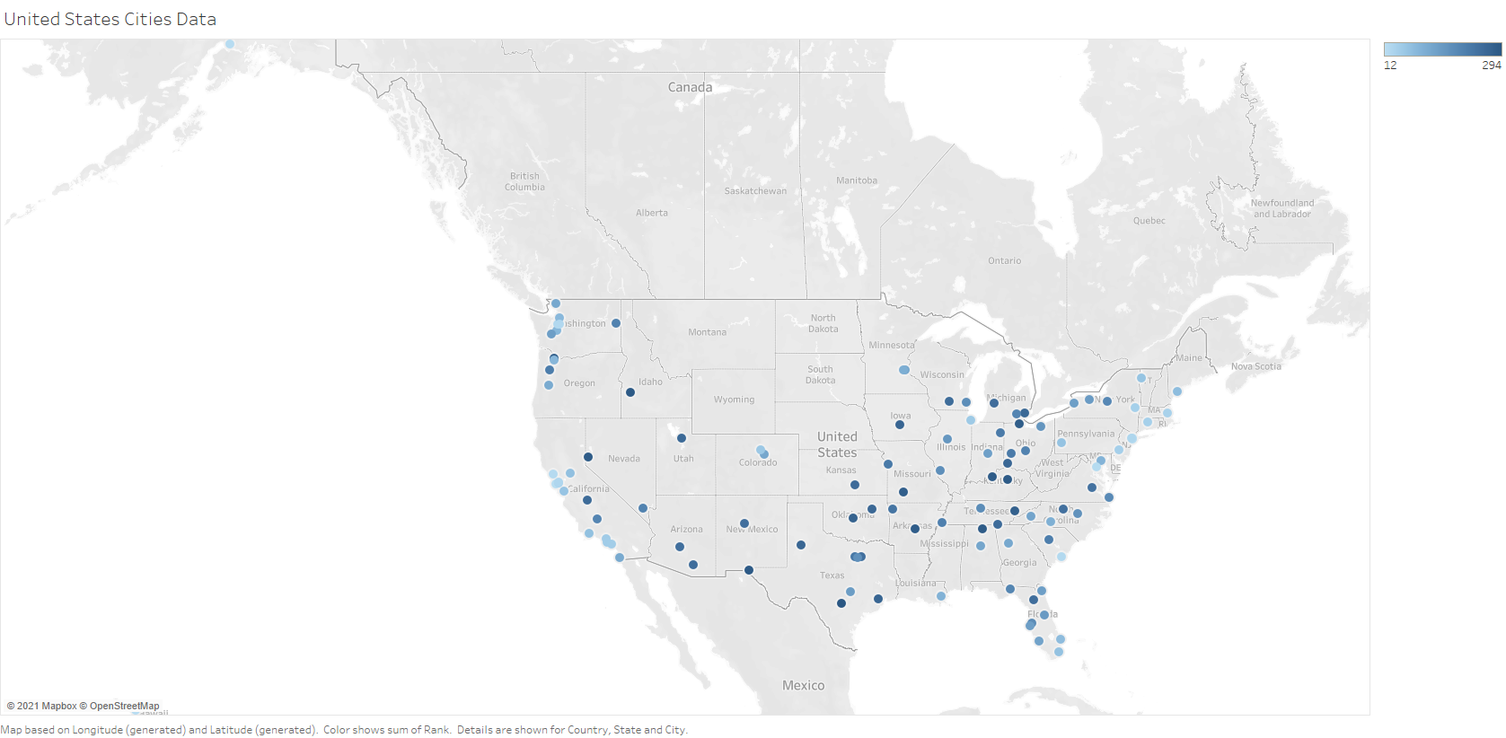

Slide 3
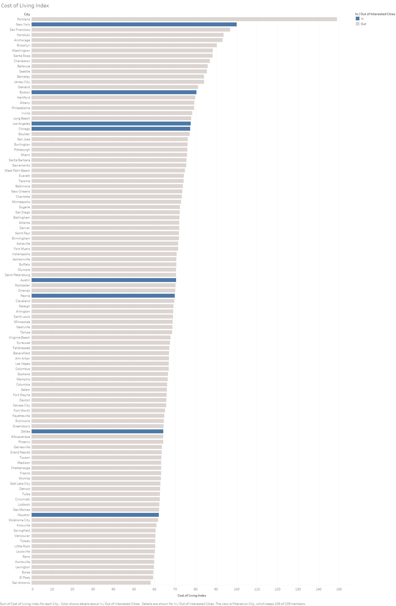

Slide 4
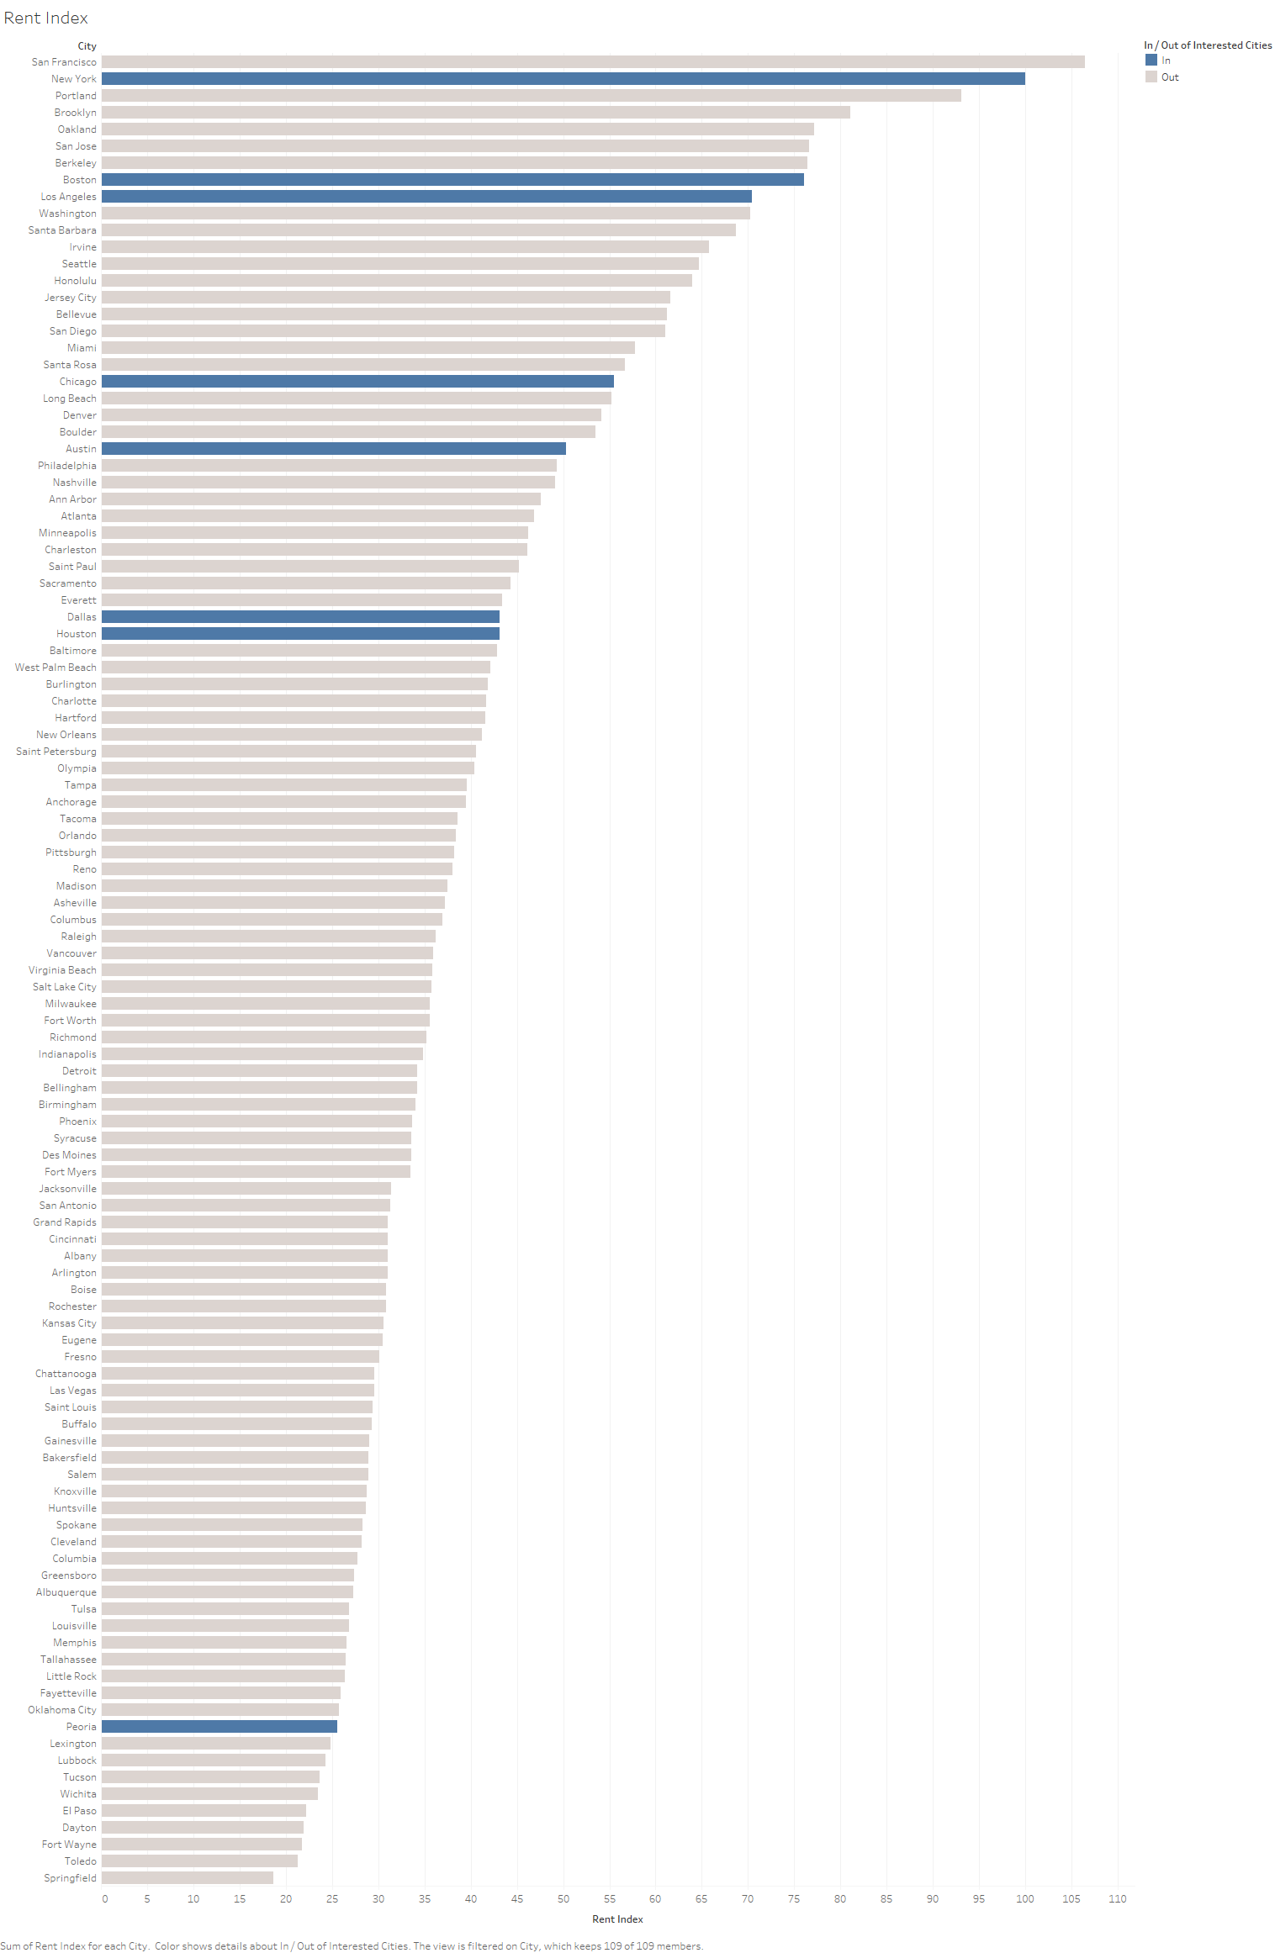

Slide 5
