Slide 1

Key Features of Git
Distributed Architecture: Central server and reduces the risk of data loss.
Branching and Merging: Git supports powerful branching and merging capabilities, allowing developers to work on different features or fixes simultaneously.
Staging Area: Before committing changes to the repository, developers can add files to a staging area.
Commit History: Git maintains a history of all changes made to the repository.
Collaboration: Developers can clone repositories, push and pull changes, and collaborate on code through pull requests and code reviews.

Slide 2

What is the Staging Area in Git (git add)
The staging area is a file, generally contained in your Git directory, that stores information about what will go into your next commit. It allows you to review and control changes before they are committed.
Stage a File: To stage a specific file, run:
$ git add <file_name>
Stage All Changes: To stage all changes at once, you can use:
$ git add *

Slide 3

Introduction of Configuration Variables
System-level Configuration
To set a system-level configuration variable, you need to have administrative privileges. Use the following command:
sudo git config --system <variable> <value>
For example:
sudo git config --system user.name "Your Name"
Global-level Configuration
To set a global configuration variable for the current user, use:
git config --global <variable> <value>
For example:
git config --global user.email your.email@example.com
Local-level Configuration
To set a configuration variable for a specific repository, navigate to the repository's directory and use:
git config <variable> <value>
For example:
git config user.name "Your Name"

Slide 4
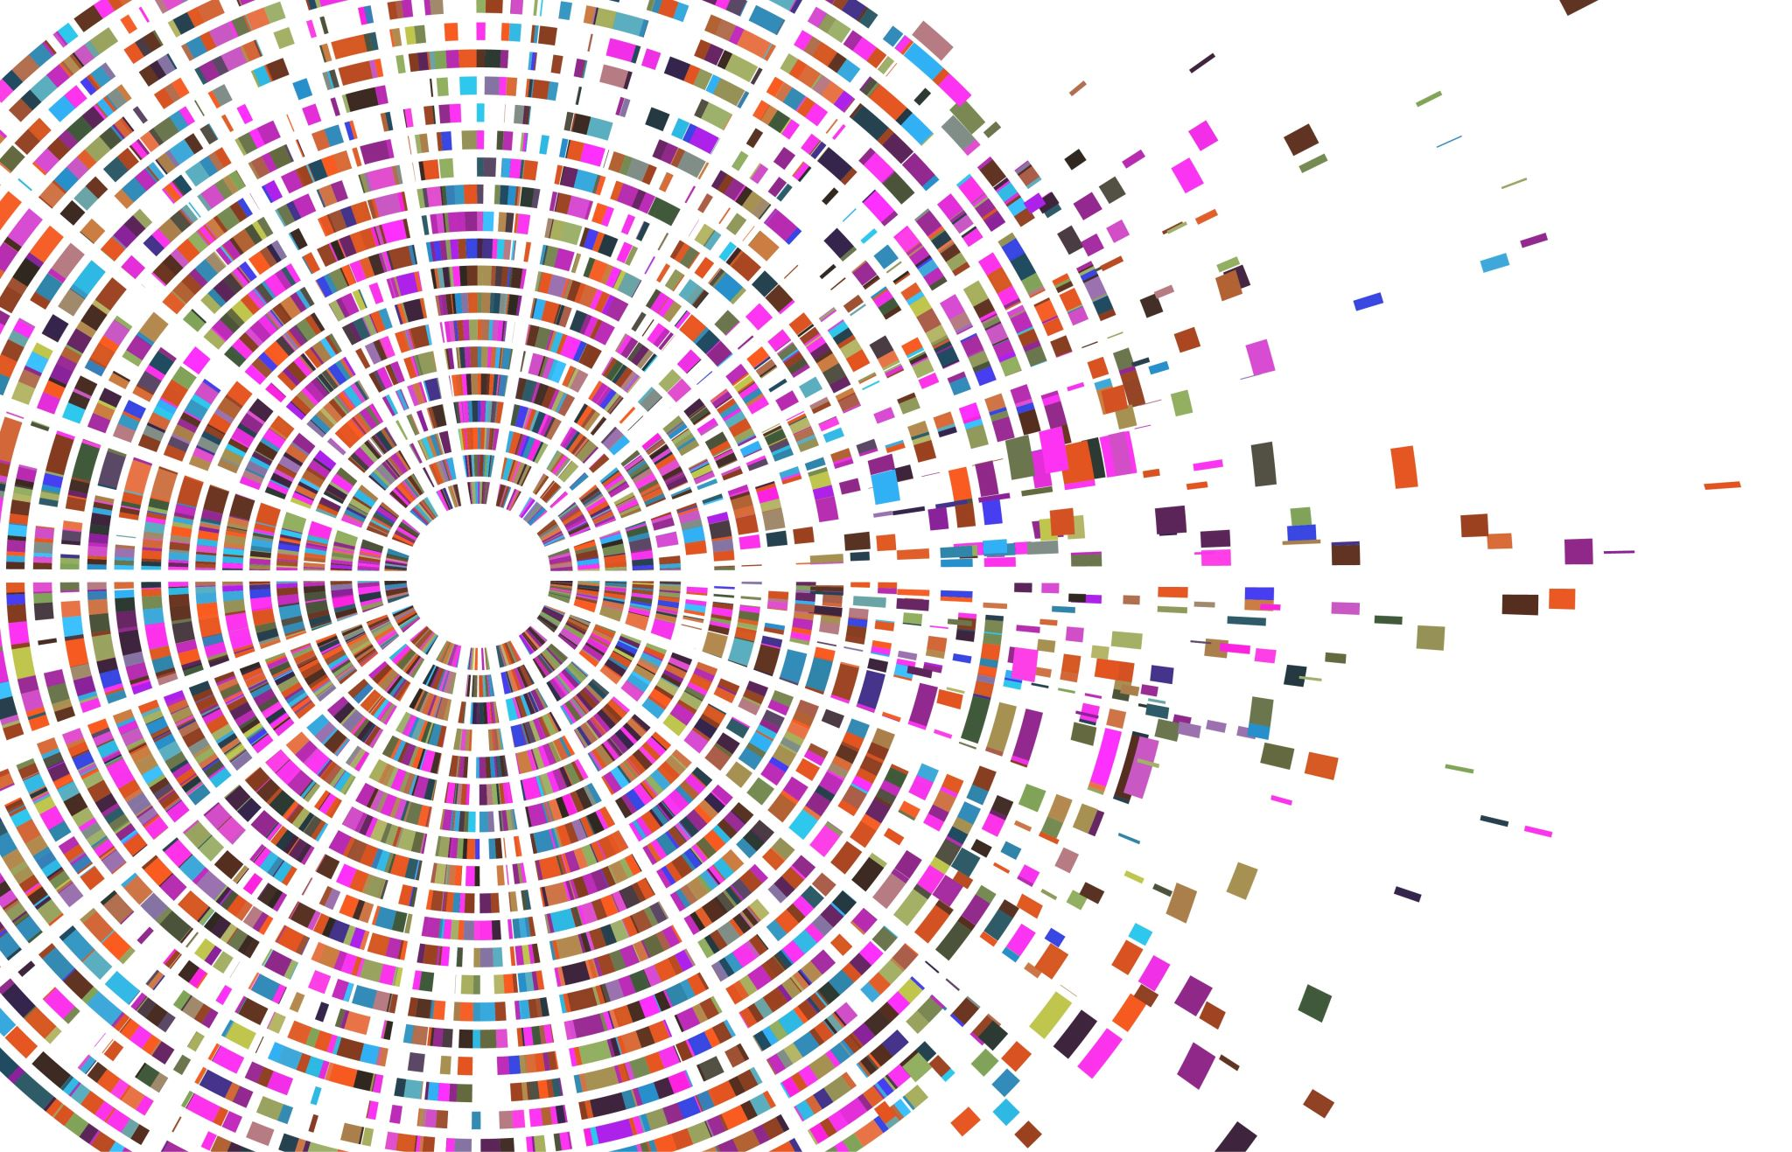
Git Workflow
Working Directory
This is your local copy of the project's files.
You can edit files here, and any changes you make will be marked as modified.
Think of it as the state of your project as it exists on your local machine.
Staging Area (Index)
This is a place where you prepare files before committing them to the local repository.
Files are moved from the working directory to the staging area using the git add command.
It acts as a buffer between the working directory and the local repository, allowing you to group changes logically before committing.
Remote Repository
This is a version of your project hosted on a remote server (like GitHub, GitLab, or Bitbucket).
It allows you to share your code with others and collaborate on the project.
You push your commits from the local repository to the remote repository using git push, and you pull updates from it using git pull.
The Workflow
Edit Files in the Working Directory.
Stage Changes using git add to move them to the Staging Area.
Commit the staged changes to the Local Repository using git commit.
Push commits from the local repository to the Remote Repository using git push

Slide 5
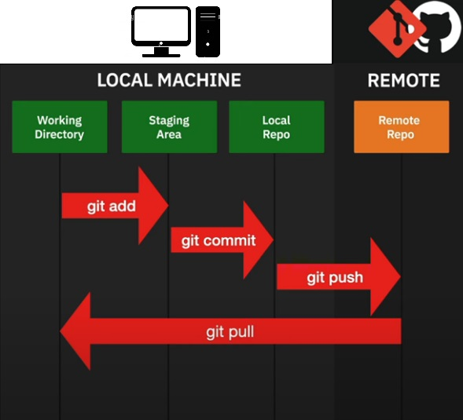
Git Workflow

Slide 6

Git Status
The git status command is a fundamental tool for understanding the current state of your Git repository. When you run git status in your terminal, it provides a detailed report on the following:
Changes to be committed: These are modifications that have been staged using git add and are ready to be committed to the repository.
Changes not staged for commit: These are modifications that have been made to tracked files but have not yet been staged.
Untracked files: These are files that are not currently being tracked by Git and haven't been added to the repository.
In summary, git status helps you keep track of your progress and understand what changes have been made, which ones are ready to be committed, and which ones still need to be staged or committed.

Slide 7

Introduction of Branching
git branch – This command lists branches, each representing an independent line of development within a Git repository.
git branch <branch-name> - This command is used to create a new branch in your Git repository.
git checkout <branch-name> - In Git, the checkout command is used to switch between branches or restore working tree files.
git branch <branch-name> -D - This command is used to delete a branch in Git forcefully .

