Slide 1
Multi-Objective Knapsack Problem Solved Using Genetic Algorithms and Wisdom of Crowds
University of Louisville
Speed School of Engineering
CECS 545
Sarah Mullins
Ashley Revlett
November 19, 2014

Slide 2
What We’re Covering
Knapsack Problem
Variations
Applications
Complexity
Solutions
Our Solution – Genetic Algorithm & Wisdom of Crowds
Encoding
Fitness Function
Mutation
Crossover
Crowd Wisdom
Results
Further Areas for Research & References

Slide 3
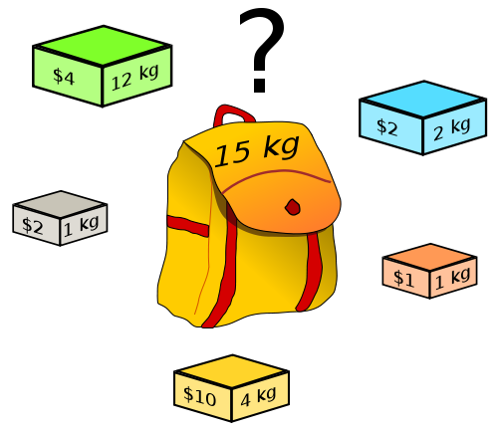
Multi-Objective 0-1 Knapsack Problem (MOKP)
General Knapsack Problem: How can you fill a knapsack with n items so that the total value is maximized without exceeding the knapsack’s capacity?
0-1 Variation: Only one instance of a specific item can appear in the knapsack.
Multi-Objective Variation: Optimize the solution so that value is maximized as well as other objectives.
Goal is to create a state of “Pareto optimality,” where it’s impossible to improve one objective’s value without making another objective worse.

Slide 4
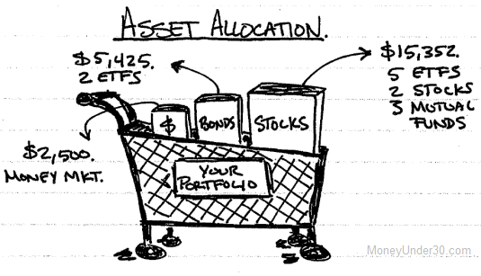
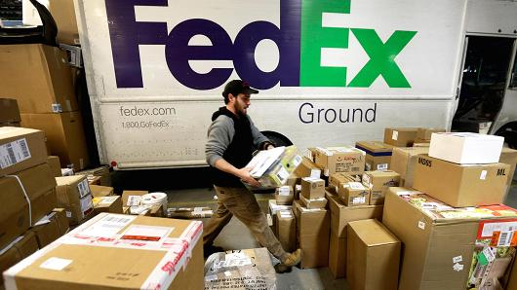
Applications of Knapsack
Allocating investments
Finding least wasteful way to cut raw materials
Loading airplanes or trucks with packages
Cryptography
Any resource allocation problem with financial and/or physical constraints

Slide 5
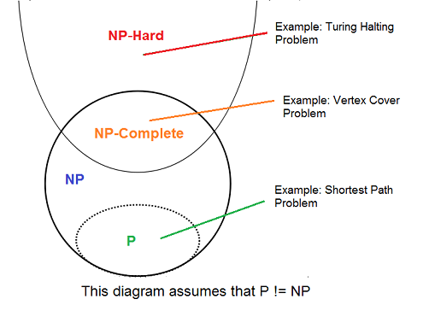
Complexity of Knapsack Problem
Decision Problem: Can a value of at least V be achieved without exceeding the weight W?
NP-complete = there is no possible algorithm both correct and fast (polynomial-time) on all cases
Optimization Problem: Find the optimal packing of a knapsack to maximize the value V without exceeding weight W.
NP-hard (Non-deterministic Polynomial-time hard) = At least as hard (or harder!) as the hardest problems in NP.
There is no known polynomial algorithm which can tell, given a solution, whether it is optimal.
Our old friend the Traveling Salesman is also NP-hard.

Slide 6
Pseudo-Polynomial Time Solutions
Greedy Algorithm (not optimal)
Dynamic Programming (optimal, similar to Brute Force but more efficient)
Allow approximation (near-optimal solutions) – Genetic Algorithms
Reduce search space by using dominance relations to remove items that will never be used by best solutions

Slide 7
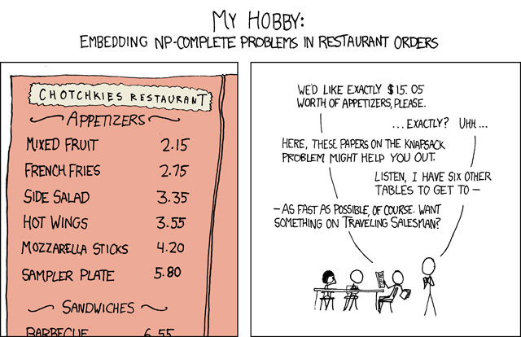
Relevant XKCD Comic

Slide 8
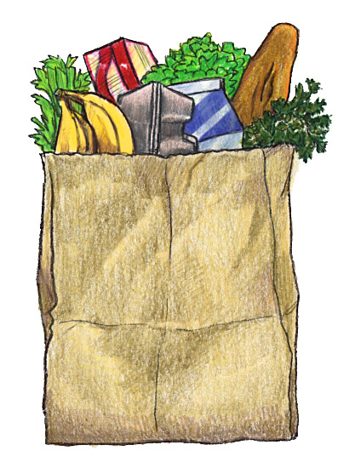
Our Scenario: Grocery Store
Given a grocery store’s worth of items, how can we most efficiently fill our grocery bag with n items that are high in nutritional value, low in price, and low in weight?
Use a Genetic Algorithm to evolve solutions, and the Wisdom of Crowds to find the best solution.

Slide 9
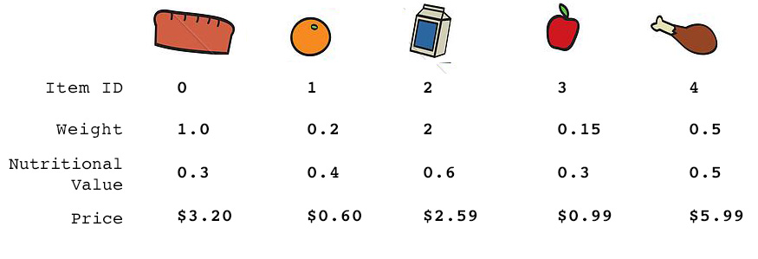

Genetically Encoding a Solution
[ 0, 1, 1, 0, 1 ]
This Knapsack contains Orange, Milk, and Chicken.
Chromosome for Solution
Notes:
Ashley end

Slide 10
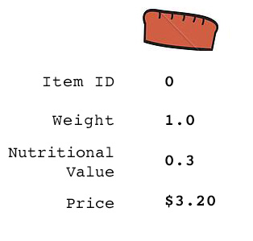
Calculating Fitness Score of an Item
For each objective, normalize values to 0-1:
Weight_score = weight/max_weight Value_score = value/max_value Price_score = price/max_price
2. For parameters to minimize, invert the scores:
Weight_score = 1 - Weight_score Price_score = 1 - Price_score
3. Sum the scores :
Fitness = Weight_score + Value_score + Price_score
4. This aggregate fitness score will be higher for items with high values and low prices and weights.
EXAMPLE:
max_weight = 10
max_value = 5
max_price = 30
Weight_score = .9
Value_score = .06 Price_score = .89
Fitness = 1.85
Notes:
Sarah start

Slide 11
Calculating Fitness Score of a Solution
The Fitness Score for a solution (knapsack packing) is the sum of the fitness scores for all items included in the knapsack.

Slide 12
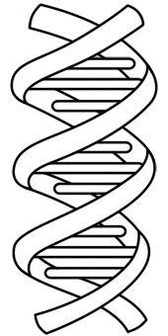
Mutation & Crossover Operators
Mutation: Flip a random number of bits in the solution’s chromosome. If the result is over capacity, remove the least fit items until within capacity.
Crossover: Choose 2 parents, A and B, and combine the first half of A’s chromosome with the second half of B’s chromosome. If the result is over capacity, remove the least fit items until within capacity.

Slide 13
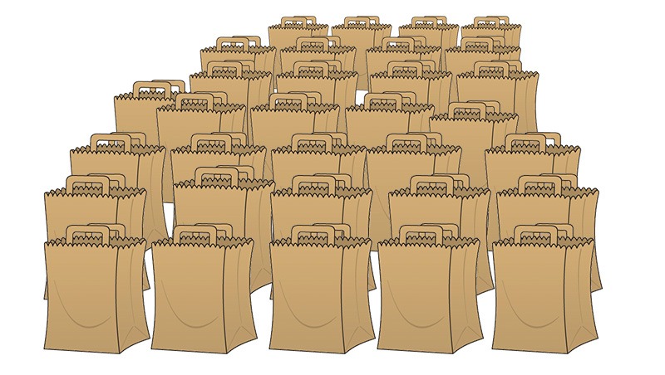
Crowd Wisdom
Genetic Algorithm is run many times to produce many good but not necessarily optimal solutions
Crowd is analyzed to determine most commonly shared items
New solution is created from these common items, then fittest remaining items are added until capacity is reached.
In our experiments, the new solution was never better than the best crowd member. Often the same solution was discovered, or a less optimal solution.

Slide 14
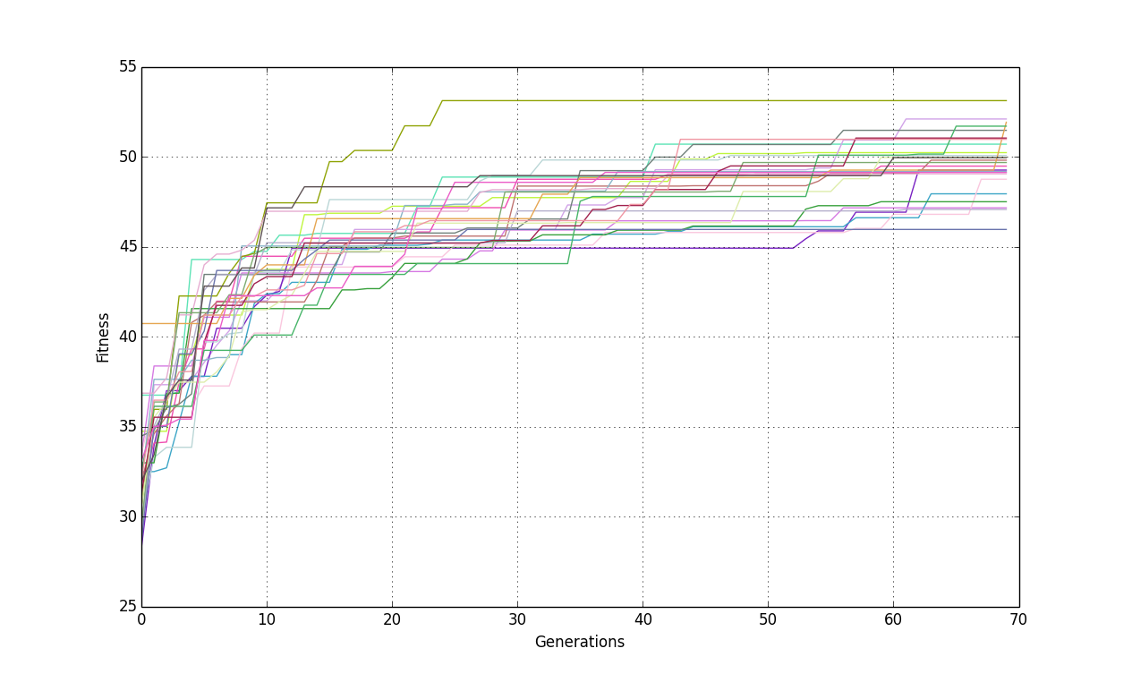
Results (n=100, c=300)
Solution evolution over 70 generations for n = 100, c = 300. Population size = 60. Crowd size = 25. Each color line is a different crowd member. Runtime: 15.34 sec

Slide 15
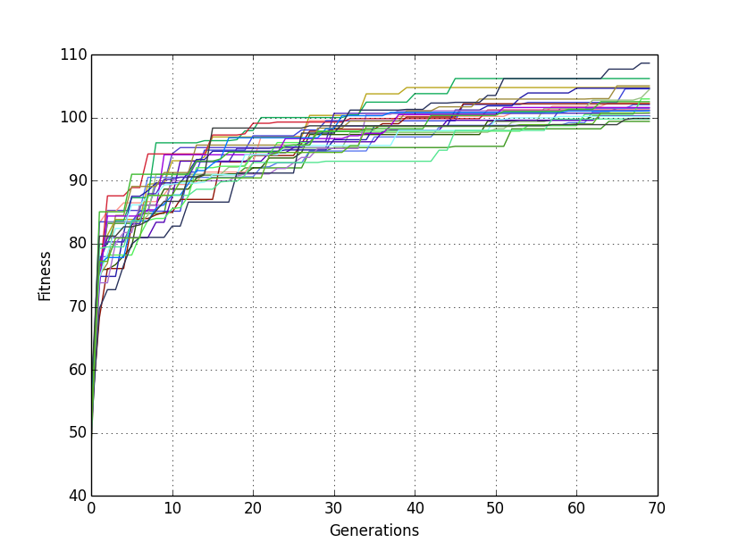
Results (n=300, c=600)
Solution evolution over 70 generations for n = 300, c = 600. Population size = 60. Crowd size = 25. Runtime: 90.55 sec

Slide 16
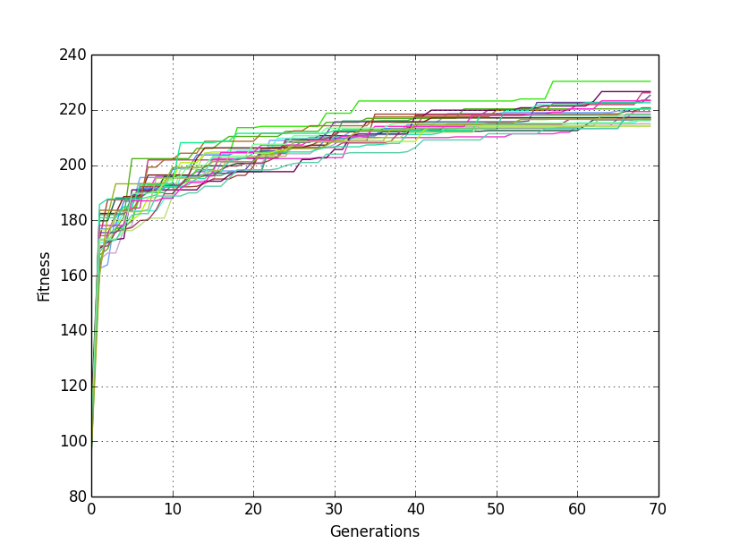
Results (n=600, c=1200)
Solution evolution over 70 generations for n = 600, c = 1200. Population size = 60. Crowd size = 25. Runtime: 316.61 sec

Slide 17
WoC Solution vs GA Solutions
n | c | Runtime | Best GA Fitness | WoC Fitness
10 | 200 | 1.646878958 | 10.44 | 4.77
20 | 200 | 2.485173941 | 18.98 | 8.01
40 | 200 | 4.592946053 | 21.16 | 7.89
80 | 200 | 10.50484800 | 39.43 | 13.69
160 | 200 | 28.08879709 | 53.98 | 13.97
320 | 200 | 100.6587601 | 106.85 | 38.68
1280 | 200 | 1196.011376 | 87.56 | 23.08
In experiments, the best GA Solution from the crowd was always better than the newly developed WoC Solution.

Slide 18
Runtime for various sizes of n
For large n, runtime increases nearly linearly.

Slide 19
Further Areas for Research
Increasing number of objectives
Adding weights to each objective
Evaluating alternate fitness measures
Improve WoC generated solution

Slide 20
References
M. Hristakeva, D. Shrestha.Solving the 0-1 knapsack problem with genetic algorithms." Midwest Instruction and Computing Symposium. 2004.
Richard M. Karp (1972). "Reducibility Among Combinatorial Problems". In R. E. Miller and J. W. Thatcher (editors). Complexity of Computer Computations. New York: Plenum. pp. 85–103.
George B. Dantzig, Discrete-Variable Extremum Problems, Operations Research Vol. 5, No. 2, April 1957, pp. 266–288,

Slide 21
Thank you for listening!
Any Questions?

