Slide 1
(Operations) Nightmare before Christmas AIOps with IBM IT Automation —
CUSTOMER
01.01.2023
Niklaus Hirt Partner Technical Specialist Cloud/ DevOps Architect
IBM AIOps & Automation

Slide 2



IBM CloudPak for AIOps
Demo Apps
Robotshop
SockShop
ACME Air
Hybrid
cloud
platform
Red Hat OpenShift

Slide 3
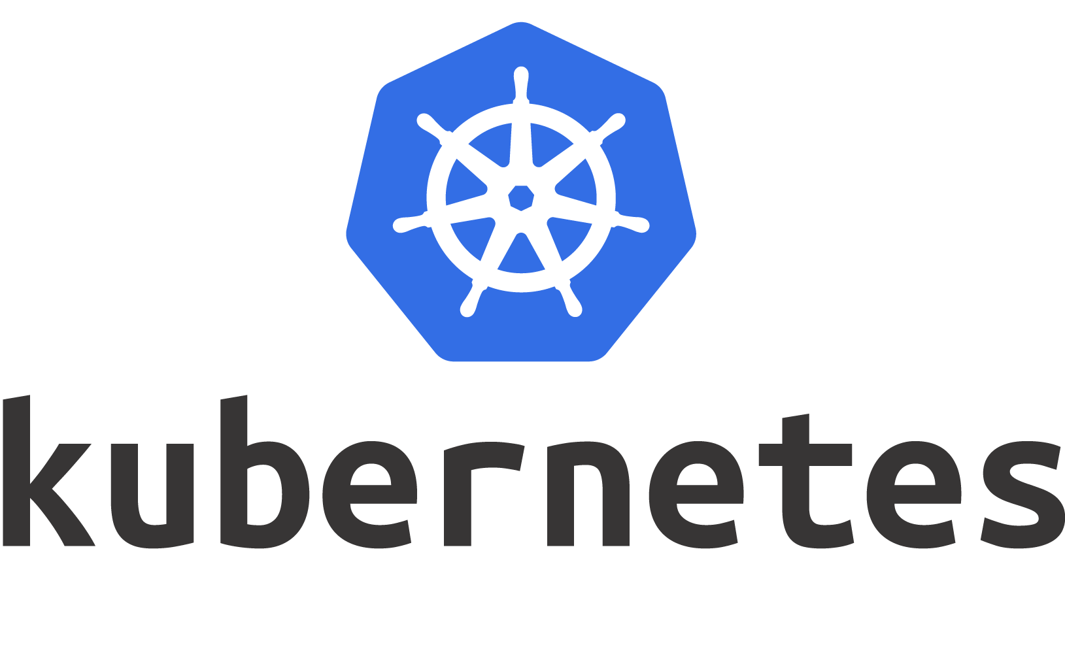




IBM CloudPak for AIOps
Demo Apps
Events
Robotshop
SockShop
ACME Air
Hybrid
cloud
platform
Red Hat OpenShift

Slide 4
IBM CloudPak for AIOps
IBM CloudPak for AIOps
Demo Apps
Log Stream
Events
Event Grouping
Robotshop
Events
SockShop
Correlation
ACME Air
Hybrid
cloud
platform
Red Hat OpenShift

Slide 5
IBM CloudPak for AIOps
IBM CloudPak for AIOps
Demo Apps
Log Stream
Events
Event Grouping
Robotshop
INCIDENT
E
Events
E
SockShop
Correlation
ACME Air
Hybrid
cloud
platform
Red Hat OpenShift

Slide 6



IBM CloudPak for AIOps
IBM CloudPak for AIOps
Demo Apps
Logs
Log Anomaly
Detection
Log Stream
Events
Event Grouping
Robotshop
INCIDENT
E
Events
E
SockShop
Correlation
ACME Air
Hybrid
cloud
platform
Red Hat OpenShift

Slide 7
IBM CloudPak for AIOps
IBM CloudPak for AIOps
Demo Apps
Logs
Log Anomaly
Detection
Log Stream
Events
Event Grouping
Robotshop
INCIDENT
E
Metrics
Metric Anomaly Prediction
E
Events
SockShop
Correlation
ACME Air
Hybrid
cloud
platform
Red Hat OpenShift

Slide 8
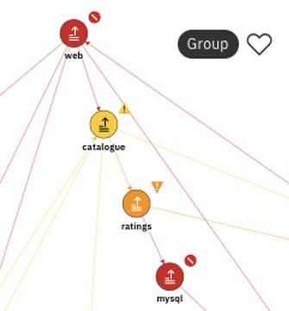
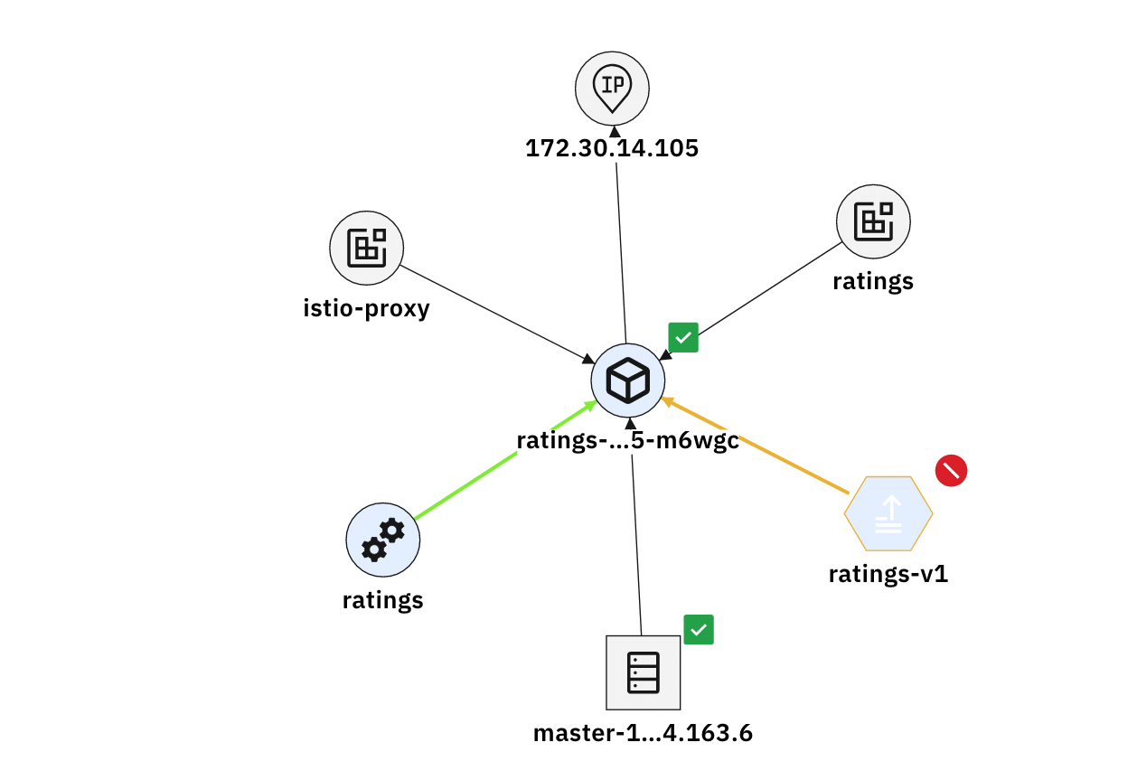

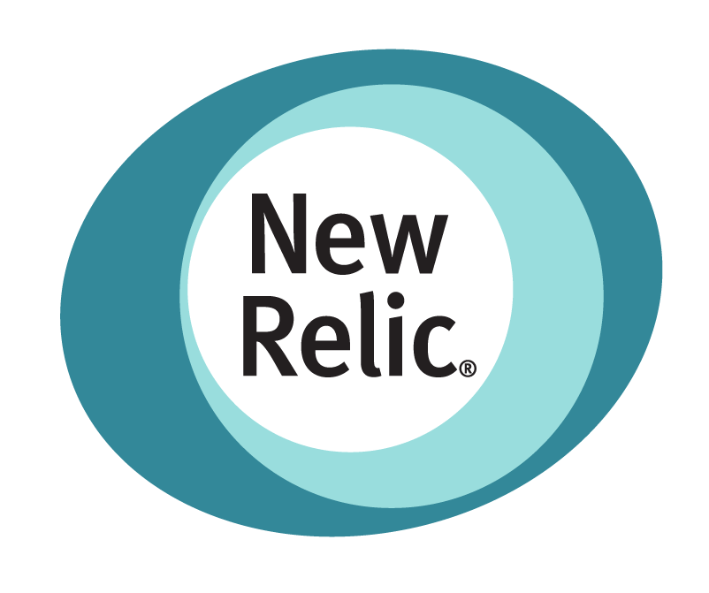

IBM CloudPak for AIOps
IBM CloudPak for AIOps
Demo Apps
Logs
Log Anomaly
Detection
Log Stream
Events
Event Grouping
Robotshop
INCIDENT
E
Metrics
Metric Anomaly Prediction
E
Events
SockShop
Topology
Topology
Correlation
Enrichment
ACME Air
Hybrid
cloud
platform
Red Hat OpenShift

Slide 9
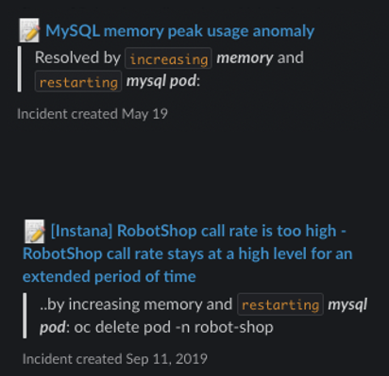

IBM CloudPak for AIOps
IBM CloudPak for AIOps
Demo Apps
Logs
Log Anomaly
Detection
Log Stream
Events
Event Grouping
Robotshop
INCIDENT
E
Metrics
Metric Anomaly Prediction
E
Events
SockShop
Topology
Topology
Correlation
Enrichment
ACME Air
Incidents
Similar Incidents
Change Risk
Enrichment
Hybrid
cloud
platform
Red Hat OpenShift

Slide 10
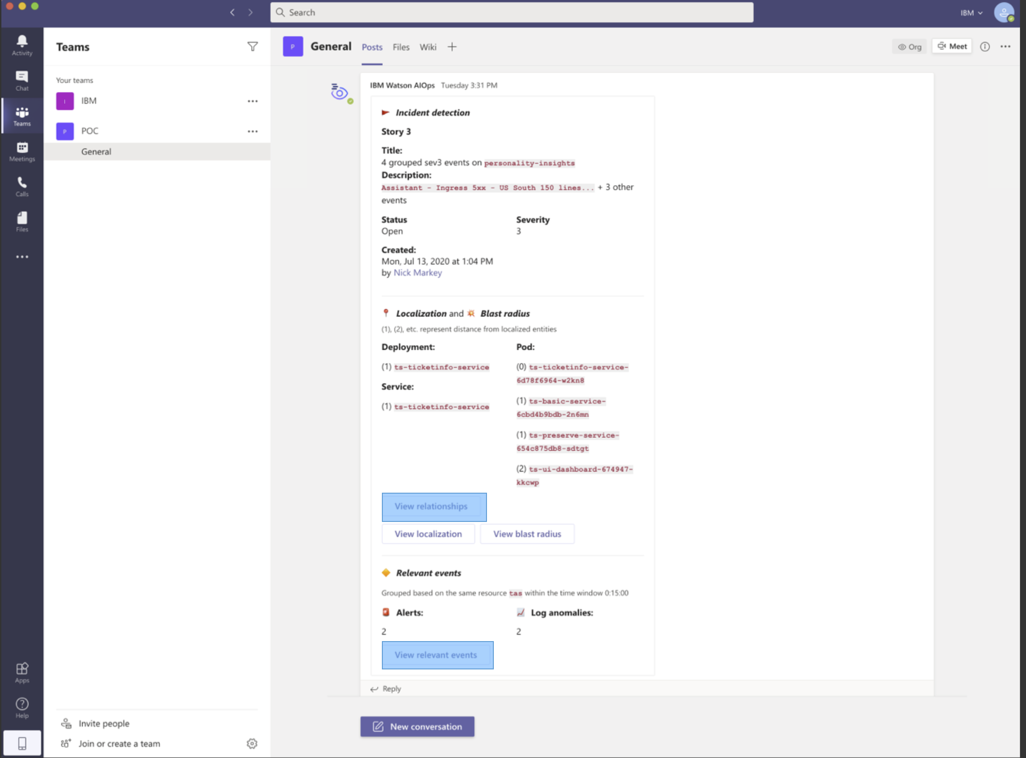
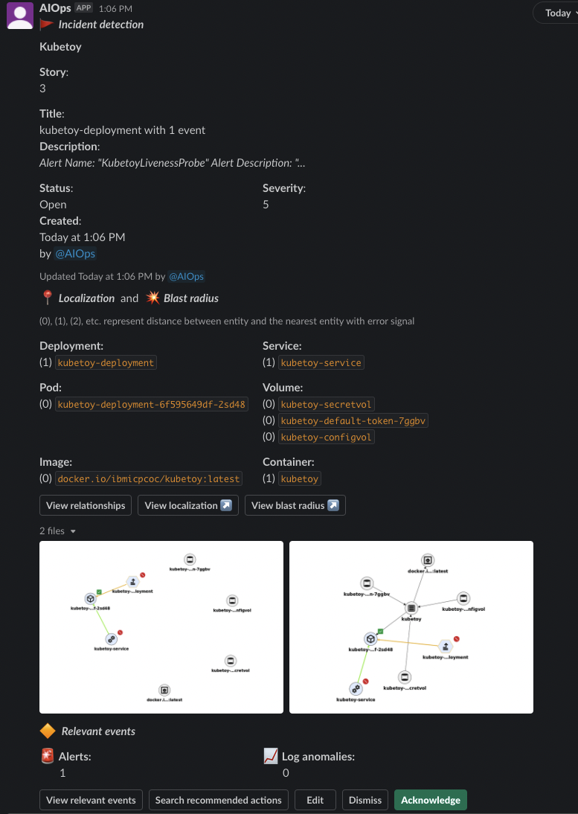
IBM CloudPak for AIOps
IBM CloudPak for AIOps
Demo Apps
Logs
Log Anomaly
Detection
Log Stream
ChatOps
Events
Event Grouping
Robotshop
INCIDENT
E
Metrics
Metric Anomaly Prediction
E
Events
SockShop
Topology
Topology
Correlation
Enrichment
ACME Air
Incidents
Similar Incidents
Change Risk
Enrichment
Hybrid
cloud
platform
Red Hat OpenShift

Slide 11
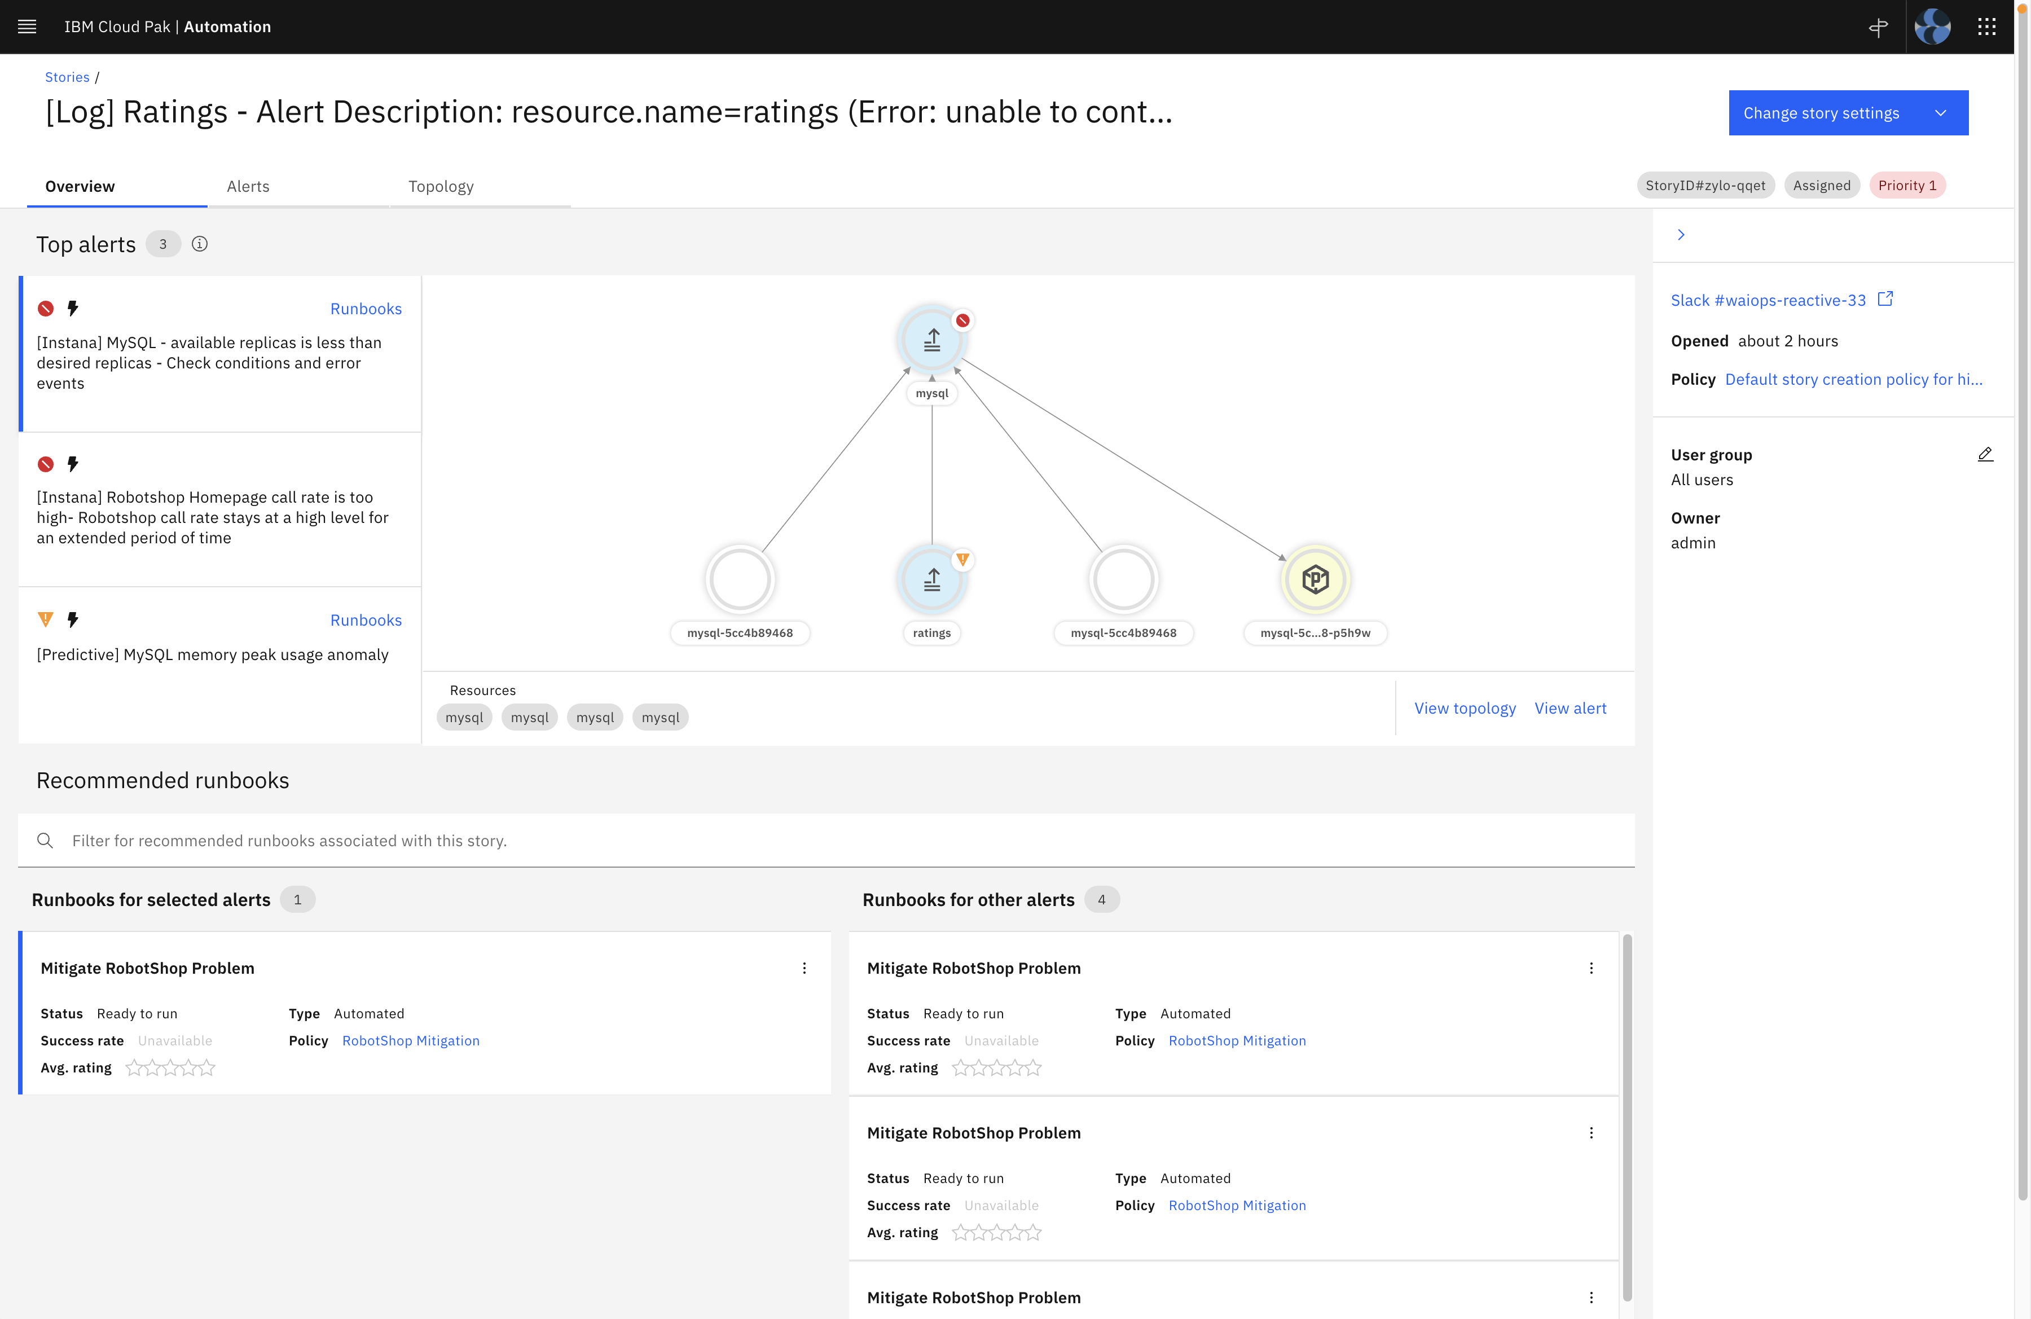
IBM CloudPak for AIOps
IBM CloudPak for AIOps
Demo Apps
Logs
Log Anomaly
Detection
Log Stream
ChatOps
Events
Event Grouping
Robotshop
INCIDENT
E
Metrics
Metric Anomaly Prediction
E
Events
SockShop
Topology
Topology
Correlation
Enrichment
ACME Air
Incident Resolution Hub
Incidents
Similar Incidents
Change Risk
Enrichment
Hybrid
cloud
platform
Red Hat OpenShift

Slide 12
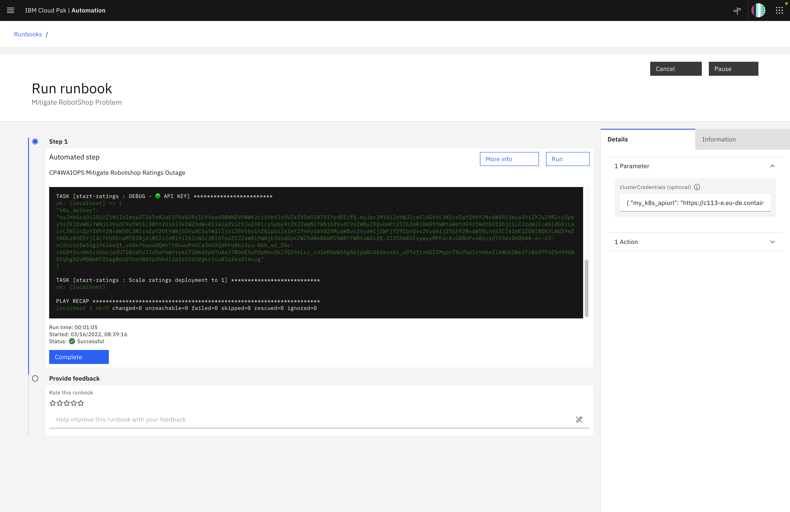


IBM CloudPak for AIOps
IBM CloudPak for AIOps
Demo Apps
Logs
Log Anomaly
Detection
Log Stream
ChatOps
Events
Event Grouping
Robotshop
INCIDENT
E
Metrics
Metric Anomaly Prediction
E
Events
SockShop
Topology
Topology
Correlation
Enrichment
ACME Air
Incident Resolution Hub
Incidents
Similar Incidents
Change Risk
Enrichment
Runbooks
Hybrid
cloud
platform
Red Hat OpenShift

Slide 13
Let’s go

Slide 14
Thank you
Niklaus Hirt
Partner Technical Specialist
Cloud / DevOps Architect
—
nikh@ch.ibm.com
+41 79 948 72 46
14

