Slide 1
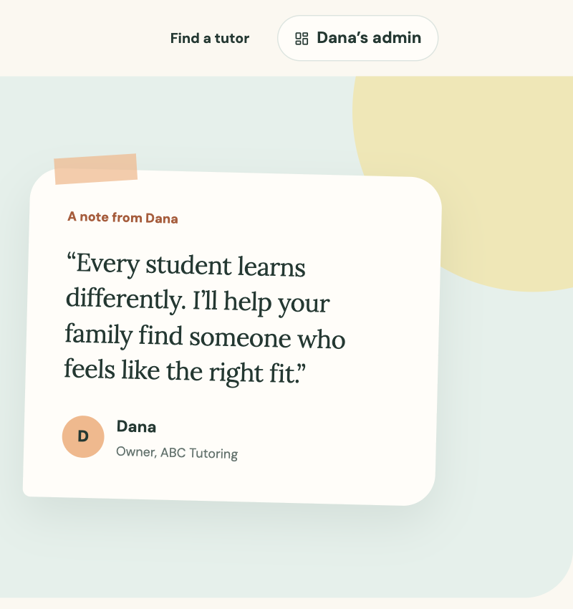
A FOLLOW-UP FOR DANA
ABC Tutoring
website prototype
A simpler way for parents to find a tutor and request a session
Prototype findings and next steps
September 2026
Notes:
Source: ABC Tutoring prototype screenshot captured from the local build on September 5, 2026.

Slide 2
What I heard from you
“I want parents to find the right tutor and book a session without everything going through my phone.”
Help parents choose
Filter by subject and grade. Compare prices, availability and teaching format.
Build trust
Show real tutor photos, personal introductions, credentials and testimonials.
Keep you in control
Collect requests for your approval and let you manage tutor availability.
Keep the first version simple
Dana, owner of ABC Tutoring
No payment or automated cancellation workflow. Parents can still call you when plans change.
02
Notes:
Source: Dana interview supplied for this presentation.

Slide 3
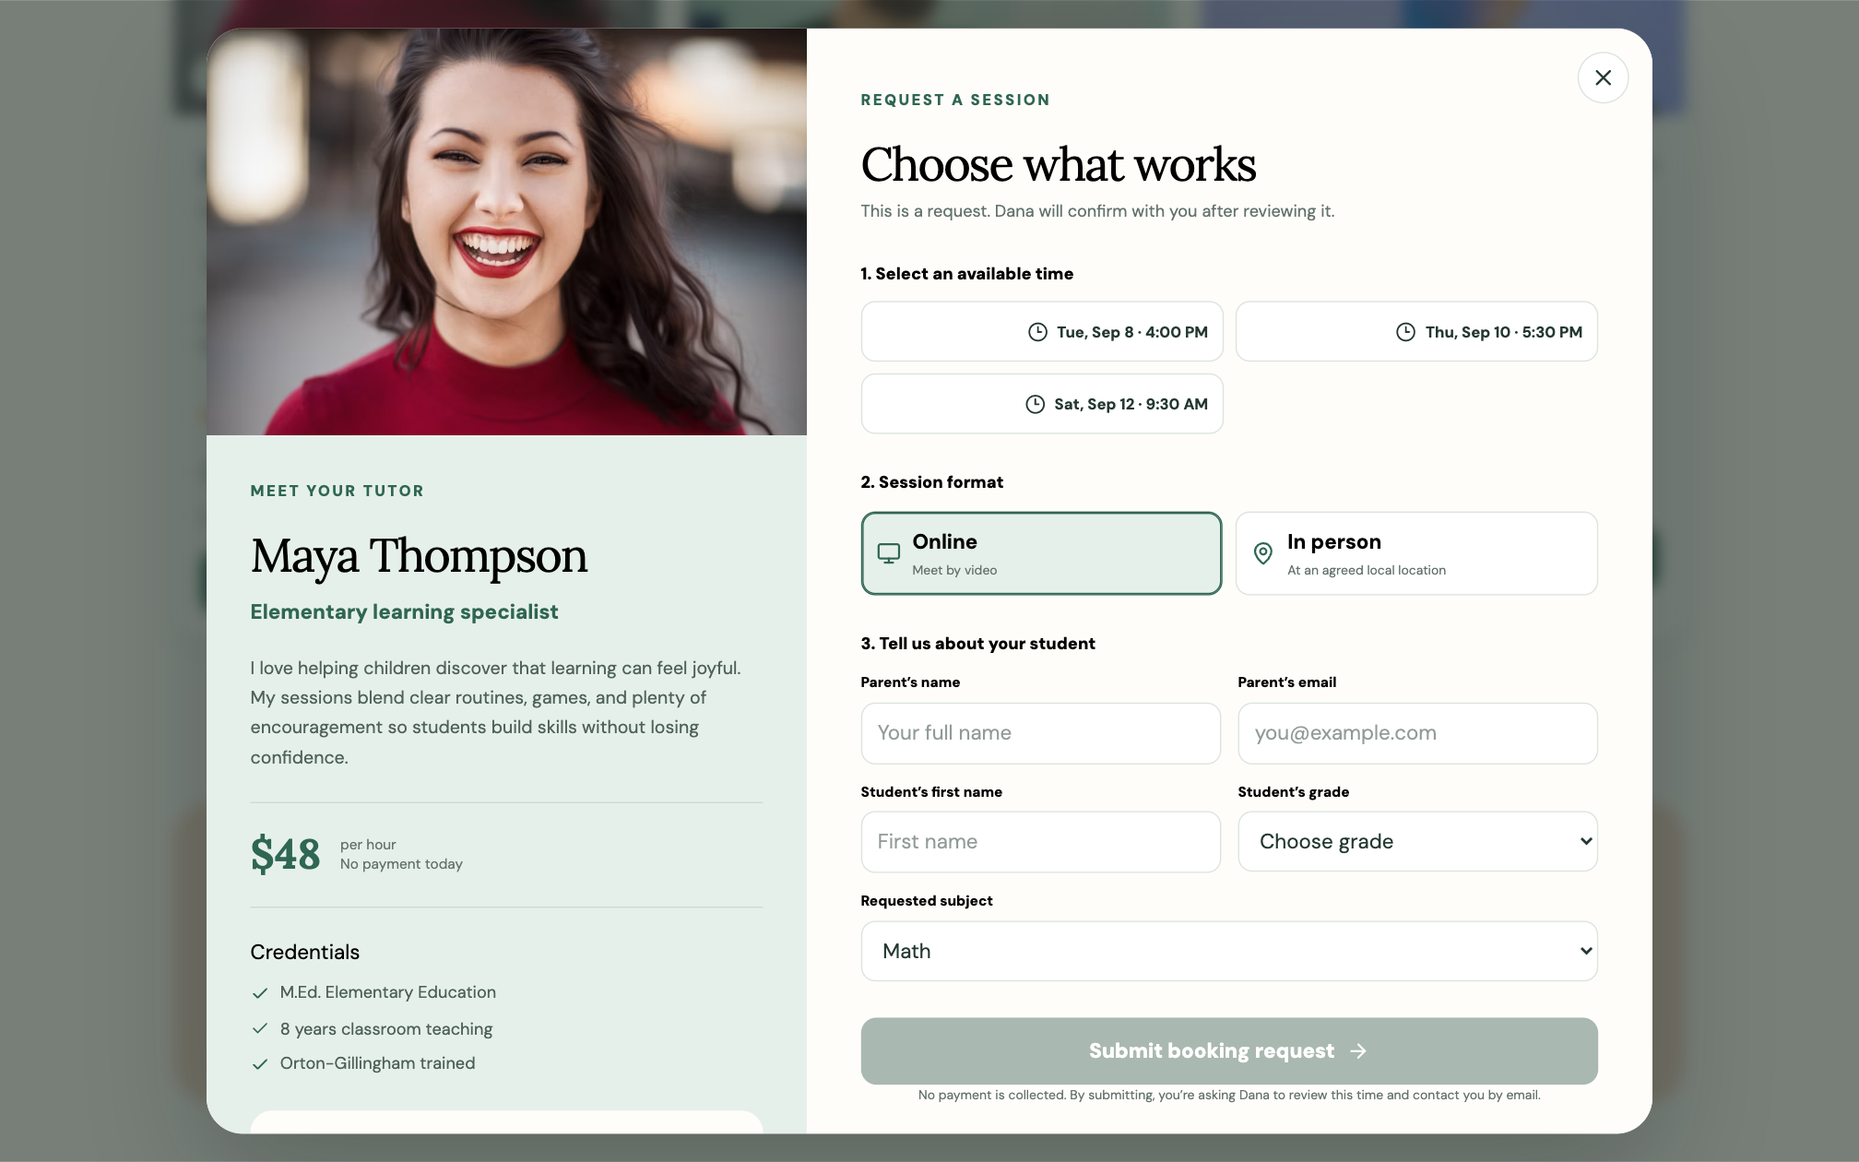
Parents can request a session in one clear flow
The prototype keeps the decision in one place and uses plain language throughout.
01
Find the right tutor
Use subject and grade filters, then compare rates and open times.
02
Choose the session
Pick an available time and choose online or in person.
03
Share the essentials
Enter the parent’s contact details and the student’s first name, grade and subject.
04
Wait for your reply
The parent sees “pending approval” while you review the request.
No payment is collected.
03
Notes:
Source: ABC Tutoring prototype screenshot. The demo tutor portrait is an Unsplash photograph: https://images.unsplash.com/photo-1494790108377-be9c29b29330

Slide 4
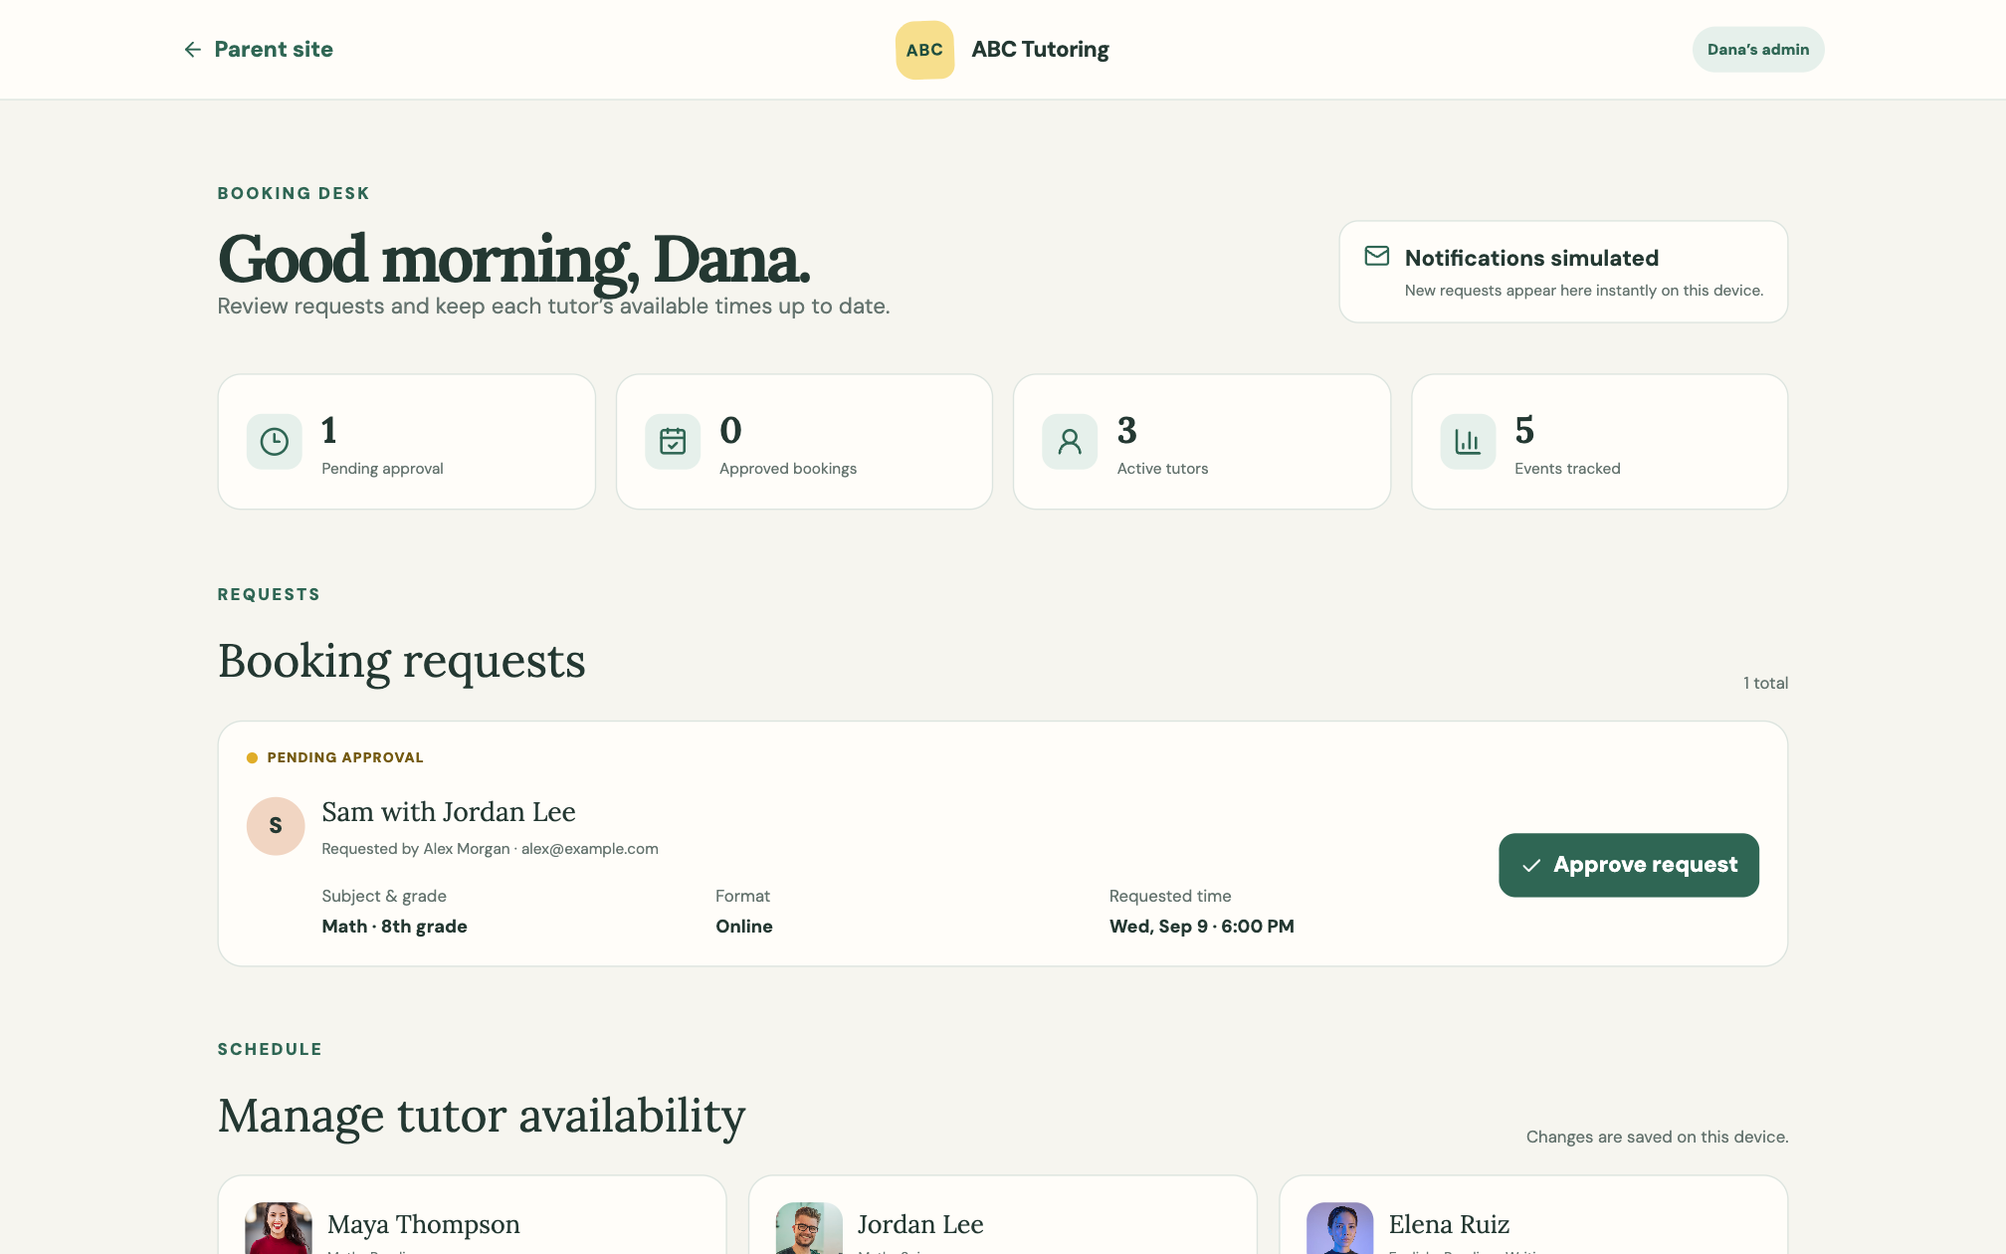
Your booking desk keeps you in control
A simple private view gives you the final say over every request.
See every request
Parent, student, tutor, subject, format and requested time appear together.
Approve on your schedule
A request stays pending until you decide. Approval removes that time from availability.
Keep tutor times current
You can add or remove each tutor’s available times yourself.
Prototype note
Notifications and schedule updates are simulated and saved on one device for now.
04
Notes:
Source: ABC Tutoring prototype screenshot. Demo tutor images shown in the screenshot are from Unsplash: https://images.unsplash.com/photo-1494790108377-be9c29b29330, https://images.unsplash.com/photo-1566753323558-f4e0952af115, and https://images.unsplash.com/photo-1534528741775-53994a69daeb

Slide 5
What you can learn from the website
PostHog follows the parent journey without collecting names, emails or student details.
1
2
3
4
Directory visits
Profile views
Booking starts
Requests sent
Parents begin browsing
Tutors draw interest
Parents choose a time
Parents complete the form
Questions the data answers
Before a real launch
Which subjects are families looking for?
Which tutors receive the most profile views?
Where do parents leave before sending a request?
Does Facebook produce visits and booking requests?
Shared scheduling so every visitor sees the same bookings and open times.
Private sign-in so only you can open the admin view.
Real notifications by email or text when a parent sends a request.
The prototype is ready to review with Dana and a small group of parents.
05
Notes:
Source: Dana interview and the analytics event plan implemented in the ABC Tutoring prototype. No external performance data is presented.

