Slide 1
llm-d-lens
For Easier Deployment with Optimal Configurations
Community Proposal · RFC llm-d/llm-d#2475
1 / 6

Slide 2
What is llm-d-lens?
A unified workspace that turns llm-d Guides into deployable serving stacks for real workloads and cluster constraints - combining models, infrastructure, AI-powered recommendations, deployment, benchmark, and real-world simulation into one adoption workflow.
Pain Points Today
llm-d-lens: A Better Adoption Experience
Configuration complexity: too many parameters and optimization choices.
Resource-blind Guides: what if considering the real cluster capacity?
Too many manual steps: multiple tools and handoffs.
Limited realistic validation: lack of actual workloads.
AI agents on top: conversational entry point, configuration recommendation, performance diagnosis.
One-click deployment: deploy the complete serving stacks
Real-world trace replay: realistic workloads evaluation
Learn from results: evidence-driven iteration.
Cluster management and observability: manage resources and keep monitoring
2 / 6

Slide 3
How llm-d-lens works: from plan to evidence
AI powered capability
core capability
ecosystem capability
AI-assistant path
TODO
TODO
TODO
DB / RAG
Storage
Performance
Diagnostic
Performance
Projection
Targets and
Preferences
Historical
Performance
Persist evidence
for retrieval
AI-powered
analysis (optional)
Agentic
Configuration
AI
assistent
AI-powered
configuration
recommendation
llm-d-
benchmark
Measured
benchmark
Results and
Evidence
Deployment
Context
Deploy
Benchmark,
simulation,
monitoring, and
resource evidence
llm-d-prism
Select Model,
Cluster, Workload,
Deploy an llm-d
serving stack
Upload, analyze,
and share results
Trace
Replayer
Manual
Configuration
Real trace replay
and simulation
Hand-crafted
deployment
config
INPUTS
PLAN
OPERATE
Models, Workloads, Clusters
Bounded Agentic Recommendation
One-Click Deployment and Evaluation
Unify model metadata, workload intent, targets, and cluster capacity.
Generate resource-valid candidates; use external AI to score and recommend.
Deploy serving stacks, run evaluations, and monitor performance.
EXPLORE
MANAGEMENT
AI ASSISTANT
Trace Replay and Simulation
Manage Resources and State
AI agent as conversational entry point
Replay production traces to explore capacity and SLO trade-offs.
Manage serving resources, model caches, deployment state, logs, and metrics.
Execute almost everything in cluster for you.
3 / 6

Slide 4
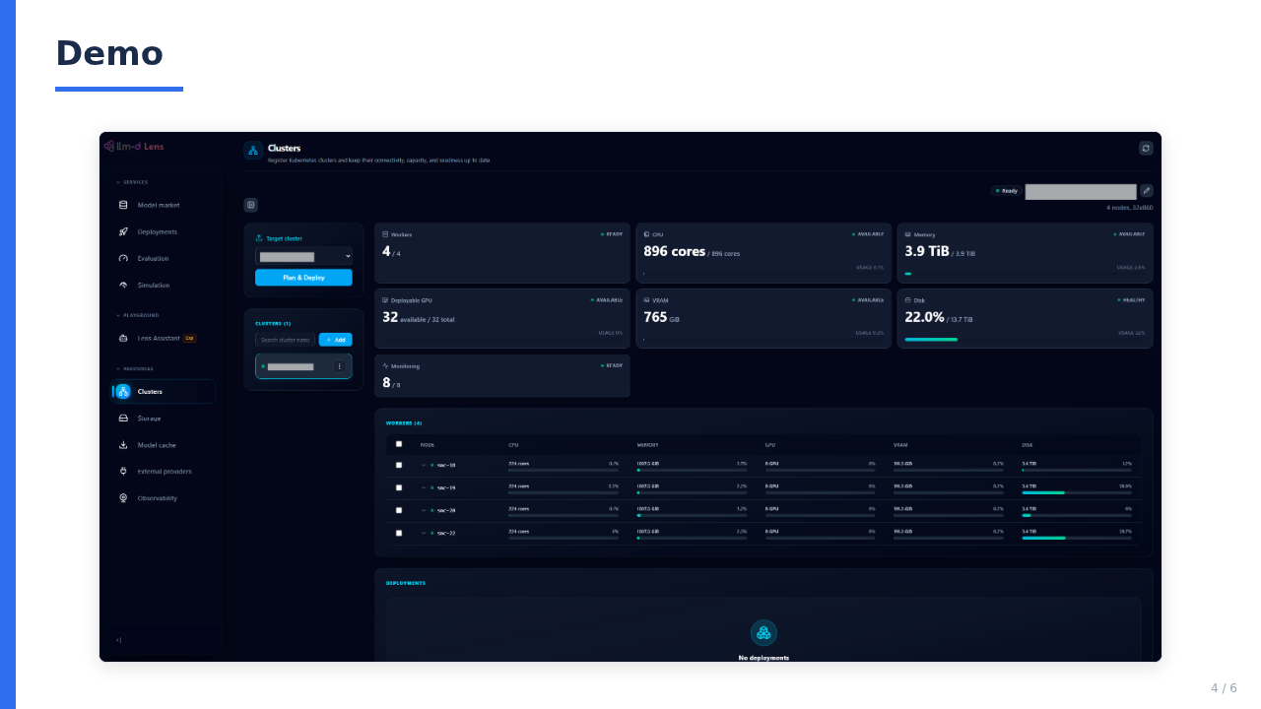

Slide 5
Q&A
Thank you!
RFC: llm-d/llm-d#2475
5 / 6

Slide 6
Backup: Next Steps
• Add RAG-based historical evidence retrieval so the Agentic Configuration Adviser can use relevant deployment, evaluation, and simulation results to improve recommendation quality and explain its rationale.
• Add role-based access control (RBAC) for platform resources and workflows, including appropriate permissions for MCP tools.
• Enhance MCP and the MCP Playground with broader workflow coverage, stronger contextual assistance, and improved operator controls.
6 / 6

