Slide 1
Visit London
London Tourism Office

Slide 2
Welcome to London, a city of free museums, royal palaces and riverside walks along the Thames.

Slide 3
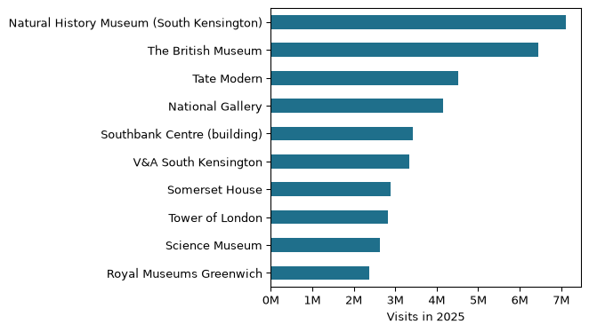
London in numbers
Most visited in 2025: the Natural History Museum (South Kensington), with 7,116,929 visits. London’s ten most visited ALVA member attractions drew 39,692,434 visits in 2025 (source: ALVA, Visits made in 2025, retrieved 2026-10-30).
Figure 1: Visits in 2025 to London’s ten most visited ALVA member attractions. Source: ALVA, retrieved 2026-10-30.

Slide 4
Five sights to start with
British Museum
Natural History Museum
Tate Modern
National Gallery
Tower of London

Slide 5
Getting around
🚇 Tube
🚌 Bus
🚲 Santander Cycles

Slide 6
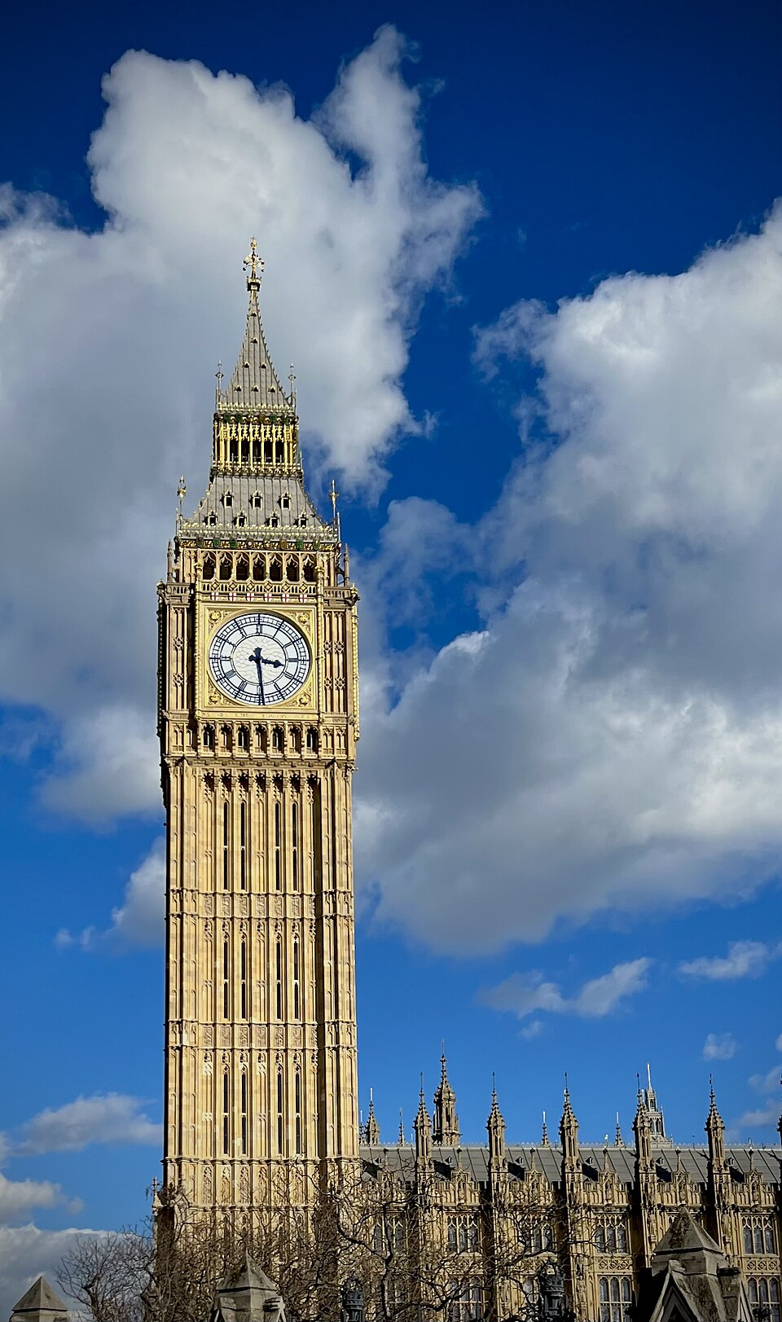
Plan your visit
Tip from a local: many of London’s big museums have free general admission. Booking a free timed ticket online can save you time in the queue.
Plan your route with the TfL Journey Planner.
Big Ben in the sun. Photo: John Dillenbeck, CC0, via Wikimedia Commons

Slide 7
Sights at a glance
Photo | Sight | Area | Price band | Nearest tube | More
The British Museum’s Great Court glass roof | British Museum | Bloomsbury | Free | Tottenham Court Road | Read more
The Natural History Museum’s empty Central Hall | Natural History Museum | South Kensington | Free | South Kensington | Read more
Tate Modern’s brick chimney | Tate Modern | Bankside | Free | Southwark | Read more
The glass dome of the National Gallery’s entrance hall | National Gallery | Trafalgar Square | Free | Charing Cross | Read more
A turret of the White Tower | Tower of London | Tower Hill | Paid | Tower Hill | Read more

Slide 8
“Free” means free general admission; some special exhibitions charge.
Photos, via Wikimedia Commons: British Museum, Mike Peel (CC BY-SA 4.0); Natural History Museum, Julian Herzog (CC BY 4.0); Tate Modern and National Gallery, Diego Delso (CC BY-SA 4.0); Tower of London, Dietmar Rabich (CC BY-SA 4.0). Full credits: images/ATTRIBUTION.md.

Slide 9
Before you go
[ ] Contactless card or Oyster card
[ ] Free museum tickets booked
[ ] Comfortable shoes and an umbrella

