Slide 1
Water safety and infant mortality in Colombian municipalities
Four kinds of municipal zone, 2016-2023 (descriptive)
For the municipal council

Slide 2
The question
How do municipalities group by drinking-water safety and context, and how do infant mortality, school results and dropout look in each group?
1,090 municipalities, 2016-2023
IRCA = utility-supplied (“prestadores”) water-risk index, INS open data

Slide 3
The four clusters
'| Cluster | Rows | Municipalities | Urban rows | Median IRCA |\n|:--------------------------------------|-------:|-----------------:|:-------------|--------------:|\n| Cities and large towns, no-risk water | 2271 | 284 | 67% | 1.6 |\n| Highland towns, no-risk water | 3750 | 558 | 95% | 4 |\n| Lowland towns, low-risk water | 2451 | 479 | 90% | 9.2 |\n| Rural, low-coverage, high-risk water | 2763 | 729 | 9% | 35.2 |'

Slide 4
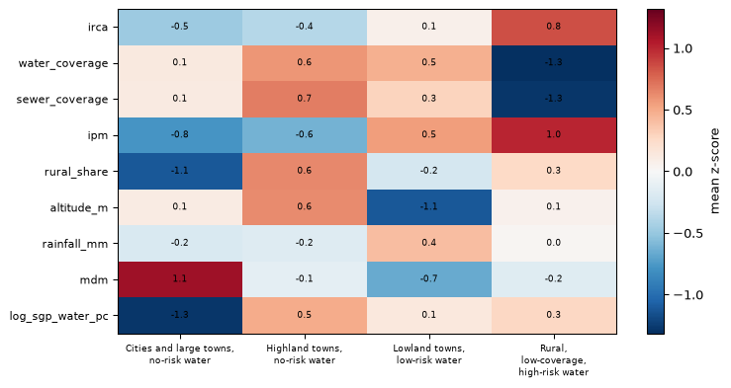
What sets them apart
Cluster mean z-scores (within year) of nine profile features; blue below average, red above.

Slide 5
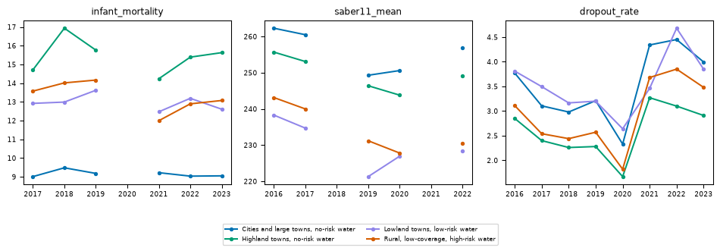
Outcomes by cluster
Median infant mortality, Saber 11 score and dropout by cluster and year; gaps where a source has no data.

Slide 6
What this does and does not show
Shows: municipalities fall into four water-and-context profiles; outcomes differ by profile
Does not show: that water quality causes any outcome
Confounders: poverty, health services, altitude, rurality
Gaps: infant mortality method changes in 2017; Saber 11 has no 2018 or 2021

