Slide 1
351-geospatial data manAgement
FİNAL PROJECT

Slide 2
TABLE OF CONTENTS
What is mean django?
Famous websites using Django
Geodjango
GeoDjango Installation
Geospatial libraries
Create a New Project
GeographIc Data
Geographıc Models
Poınt – multıpolygon fıeld
Addıng members
Komodo Edıt
Html page for check-ın and Show
Check-ın page
Members locatıon
Lıst of the members in Show.html

Slide 3
What Is mean django?
Django is a high-level web framework for the Python Programming Language licensed under a BSD license. It distinguishes itself from other server software and frameworks with its simple installation and use, detailed error report pages and brand new interface. Its name comes from the jazz guitarist Django Reinhardt.
The main purpose of the Django Project is to facilitate the use of complex web applications. Django is designed in a structure with reusability, modularity, fast development process policy.
Django also provides a dynamic management panel that includes basic record adding, deleting, editing and updating functions for each project. It is a comfortable and useful web framework for those who want to get rid of complex databases.

Slide 4
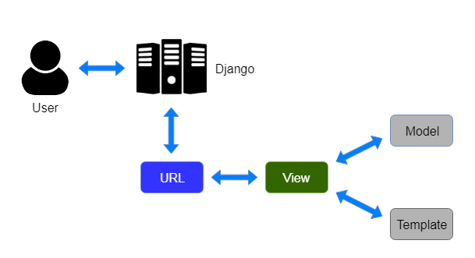
What Is mean django?

Slide 5





Famous websites using Django

Slide 6
geodjango
GeoDjango is an included contrib module for Django that turns it into a world-class geographic Web framework. GeoDjango strives to make it as simple as possible to create geographic Web applications, like location-based services. Its features include:
Django model fields for OGC geometries and raster data.
Extensions to Django’s ORM for querying and manipulating spatial data.
Loosely-coupled, high-level Python interfaces for GIS geometry and raster operations and data manipulation in different formats.
Editing geometry fields from the admin.

Slide 7
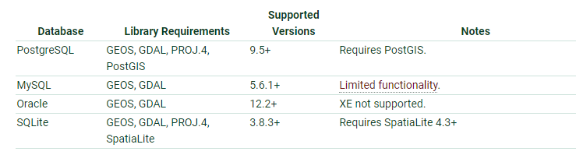
GeoDjango InstallatIon
We downloaded all libraries in PostgreSQL in order.
https://github.com/project-kgz/Final-Project

Slide 8
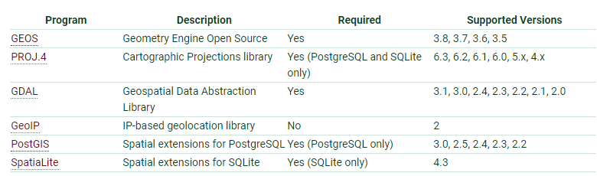
GeospatIal lIbrarIes

Slide 9


Create a New Project
Use the standard django-admin script to create a project called geodjango:
This will initialize a new project. Now, create a world Django application within the geodjango project

Slide 10
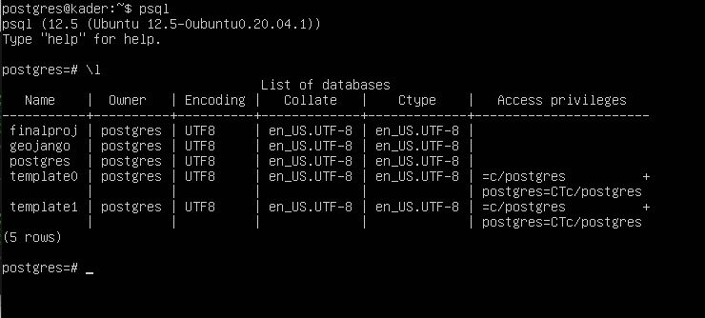
Create a New Project
We created a project and its name is «finalproj»

Slide 11
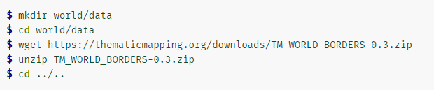
GeographIc Data
The world borders data is available in this zip file. Create a data directory in the world application, download the world borders data, and unzip. On GNU/Linux platforms, use the following commands:

Slide 12
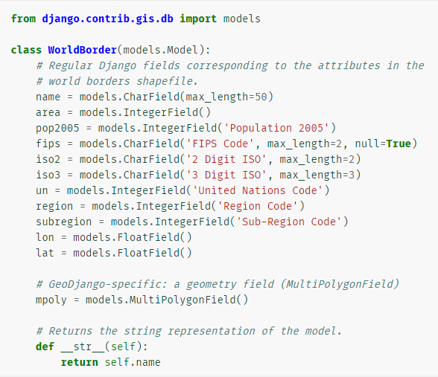
Geographıc Models

Slide 13
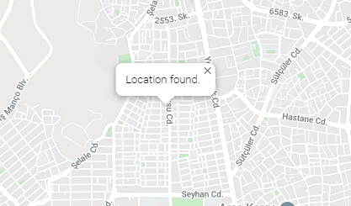
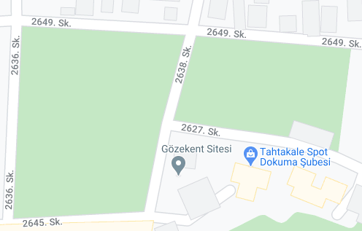
Poınt – multıpolygon fıeld

Slide 14
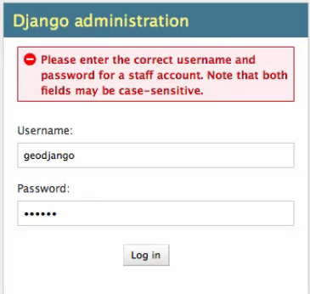
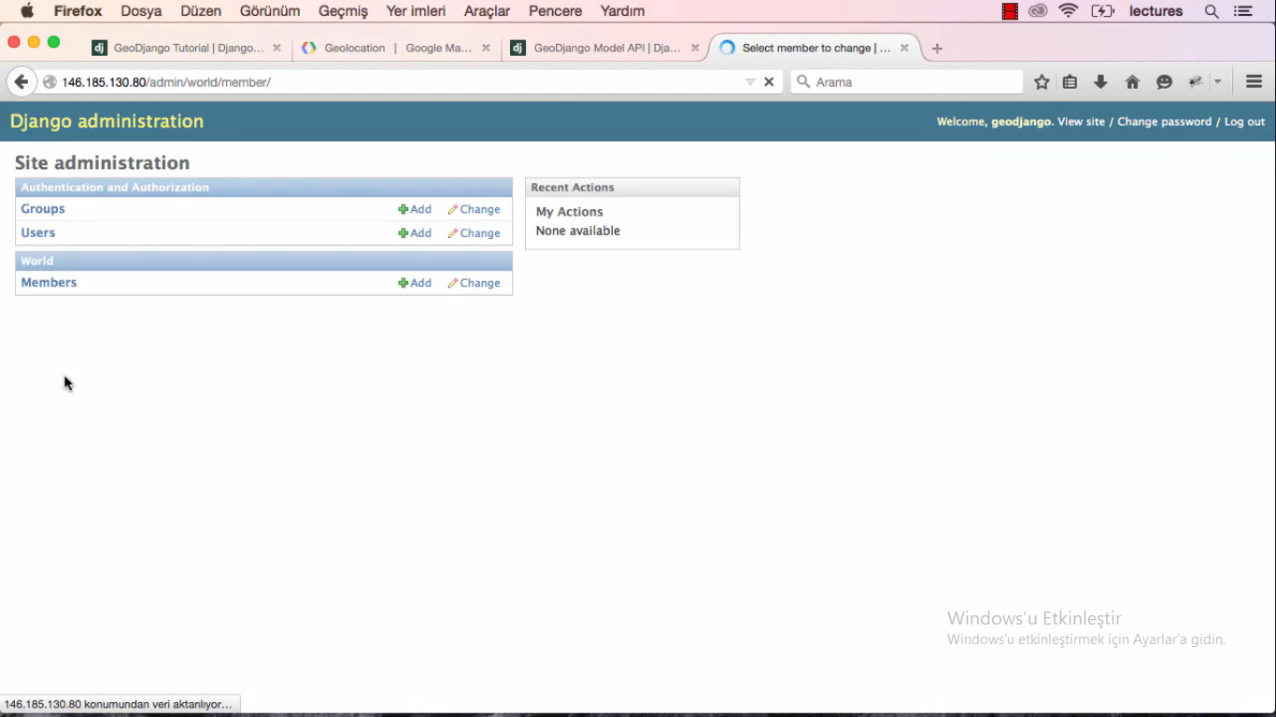
Addıng members

Slide 15
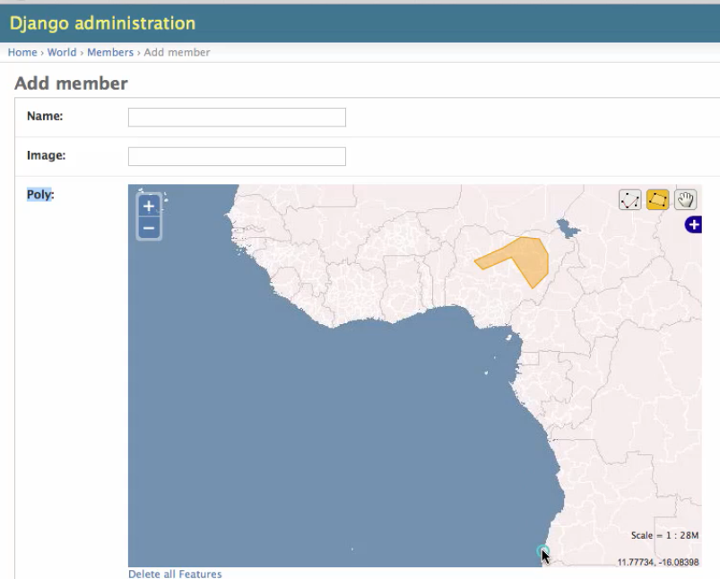
Addıng members

Slide 16

Komodo Edıt
Komodo Edit dynamic programming languages free text editor for. Komodo Edit, published in 2007 as a complement to ActiveState's Komodo IDE software, has been developed on Open Komodo software since version 4.3. Many features of Komodo Edit are derived from an embedded Python interpreter.

Slide 17
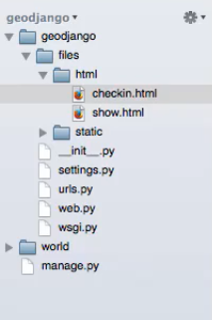
Html page for check-ın and show
We can check in
We can see the people who check in

Slide 18
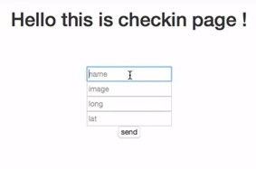
Check-ın page

Slide 19
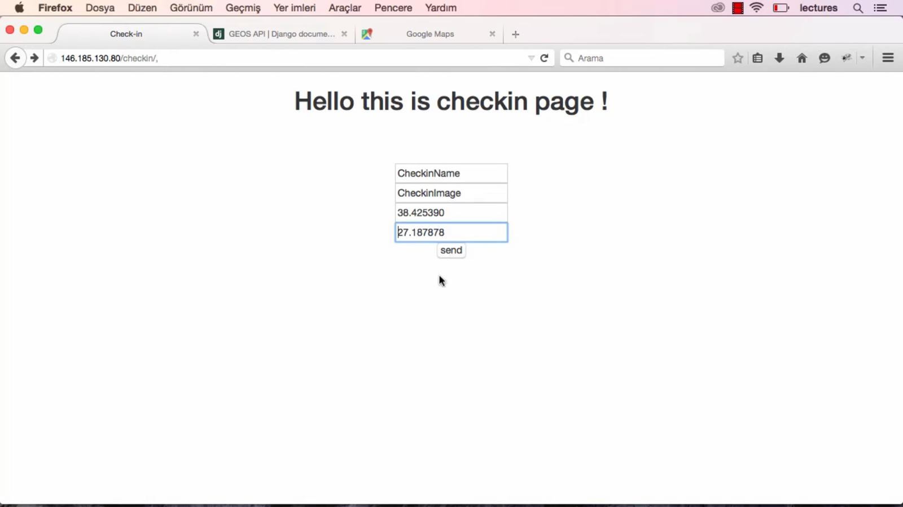
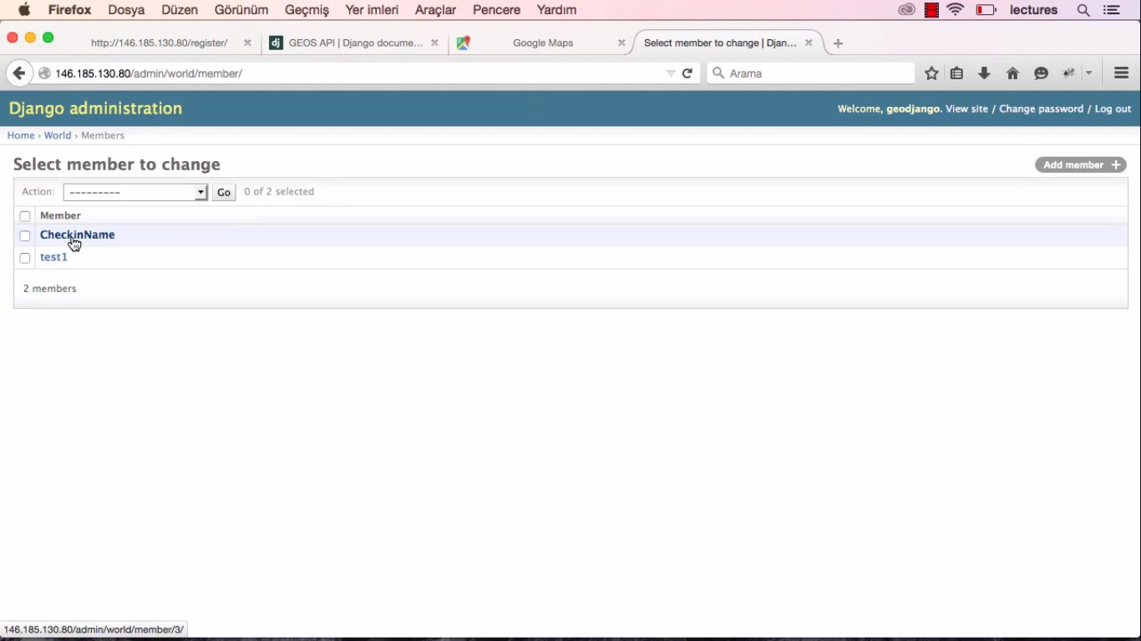
Check-ın page

Slide 20
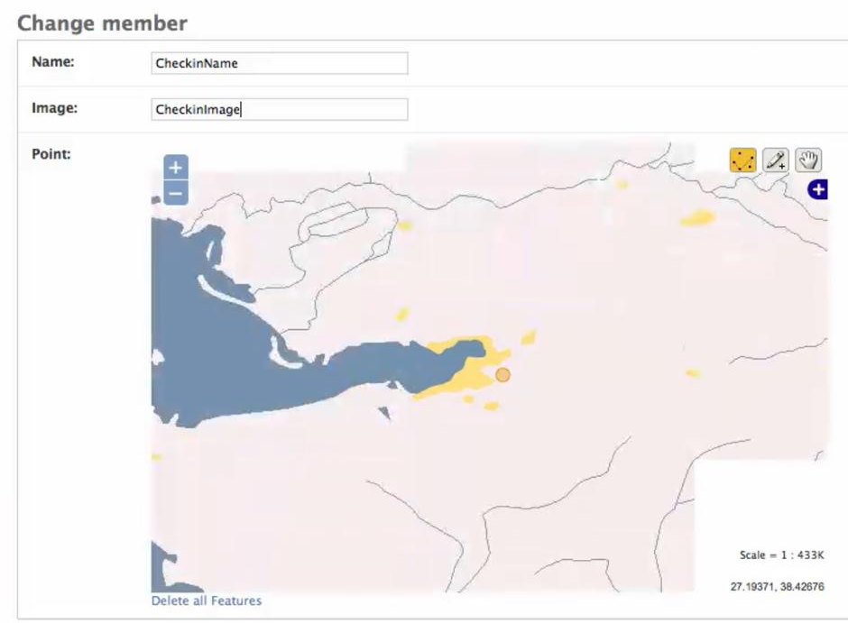
Members locatıon

Slide 21
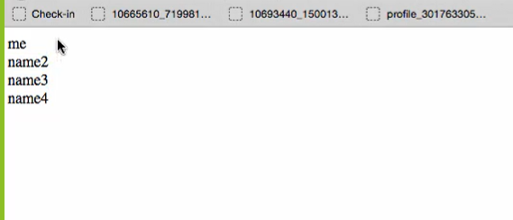
Lıst of the members in Show.html

Slide 22
THANKS FOR LİSTENİNG ☺
Kader BAYIR - 21732929
Gamze Zeynep TOPÇU - 21733318
Zeynep Ebrar CAVILDAK - 21737972

