Slide 1
PHEME – Capture Tutorial
Iván Martínez
Tomás Pariente
Atos Spain

Slide 2
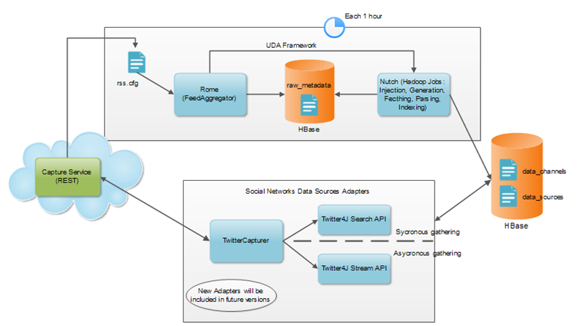


Capture: Social networks acquisition tool
Social
Big Data acquisition tool capturing social data
  Currently Twitter (tweets, followers, followees, content of links gathering)
  To be extended with connectors to other social networks

Slide 3
Capture API and quick start
Capture API REST:
  http://vphshare.atosresearch.eu/pheme-capture/
Create a Data channel with data sources:
  Step 1:
    http://vphshare.atosresearch.eu/pheme-capture/rest/datachannel/
    POST:
        <dataChannel>
        <name>ATOS TEST</name>
        <description>Poc DC</description>
        <startCaptureDate>2014-06-12 17:57:51.401</startCaptureDate>
        <endCaptureDate>2014-07-09 11:15:00.000</endCaptureDate>
        <type>search</type>
        <dataSources>
        <twitter>
        <type>Twitter</type>
        <keywords>Tour 2014</keywords>
        </twitter>
        </dataSources>
        </dataChannel>
To specify the capture time range

Slide 4
Specifying query by means of keywords tag.
Keyword operators | Finds tweets...
watching now | containing both "watching" and "now". This is the default operator.
"happy hour" | containing the exact phrase "happy hour".
love OR hate | containing either "love" or "hate" (or both).
beer -root | containing "beer" but not "root".
#haiku | containing the hashtag "haiku".
from:alexiskold | sent from person "alexiskold".
to:techcrunch | sent to person "techcrunch".
@mashable | referencing person "mashable".
superhero since:2010-12-27 | containing "superhero" and sent since date "2010-12-27" (year-month-day).
ftw until:2010-12-27 | containing "ftw" and sent before the date "2010-12-27".
movie -scary :) | containing "movie", but not "scary", and with a positive attitude.
flight :( | containing "flight" and with a negative attitude.
traffic ? | containing "traffic" and asking a question.
hilarious filter:links | containing "hilarious" and linking to URL.
news source:twitterfeed | containing "news" and entered via TwitterFeed

Slide 5
Capture API and quick start (II)
Step 2: Get paginated data captured.
    By default page = 1 and numResults = 100
    http://vphshare.atosresearch.eu/pheme-capture/rest/datachannel/{dataChannelID}/data
    To get data specifiting a concrete page next to an specific page size:
    http://vphshare.atosresearch.eu/pheme-capture/rest/datachannel/{dataChannelID}/data?page=3&numResults=150

Slide 6
Other API functionalities
Get All Data Channel in Capture instance:
  http://vphshare.atosresearch.eu/pheme-capture/rest/datachannel/{dataChannelID}
  GET
Get Data Channel Configuration:
  http://vphshare.atosresearch.eu/pheme-capture/rest/datachannel/{dataChannelID}
  GET
Update Data Channel:
    http://vphshare.atosresearch.eu/pheme-capture/rest/datachannel/{dataChannelID}
    PUT:
      <dataChannel>
      <channelID>325be839-6585-4e98-bb26-5018222fe464</channelID>
      <creationDate>2014-07-09 11:31:38.271</creationDate>
      <dataSources>
      <twitter>
      <type>Twitter</type>
      <sourceID>29413386-8351-42e2-a51f-a32f78877d3c</sourceID>
      <keywords>Tour 2014</keywords>
      </twitter>
      </dataSources>
      <description>Tour DC Updated</description>
      <endCaptureDate>2014-07-09 15:26:00.000</endCaptureDate>
      <name>Lab TEST</name>
      <startCaptureDate>2014-06-12 17:57:51.401</startCaptureDate>
      <status>active</status>
      <type>search</type>
      <updateDate>2014-07-09 11:31:38.271</updateDate>
      </dataChannel>
Don´t forget the Data Source Ids

Slide 7
Other API functionalities
Delete Data Channel (logically):
    http://vphshare.atosresearch.eu/pheme-capture/rest/datachannel/{dataChannelID}
    DELETE
Get Twitter User Profile:
  http://vphshare.atosresearch.eu/pheme-capture/rest/datachannel/twitter/user/{userId}
  GET

Slide 8
Data Representation Examples
Tweet Data Model:
    <tweet>
    <createdAt>Thu Jul 10 12:21:47 CEST 2014</createdAt>
    <favouriteCount>0</favouriteCount>
    <hashTags/>
    <inReplyToId>-1</inReplyToId>
    <latitude/>
    <longitude/>
    <originalTweetId/>
    <place/>
    <retweetCount>0</retweetCount>
    <source>
    <a href="http://www.facebook.com/twitter" rel="nofollow">Facebook</a>
    </source>
    <sourceUrls>http://t.co/1TzrY7Eg8E</sourceUrls>
    <text>
    TOUR DATES: Protoje & The Indiggnation European Summer Tour! This is how their schedule is set up: http://t.co/1TzrY7Eg8E
    </text>
    <userDescription>Latest Reggae Releases Top Reggae Artists</userDescription>
    <userFollowers>867</userFollowers>
    <userFollowes>3</userFollowes>
    <userID>315414622</userID>
    <userName/>
    <userScreenName>Reggaelizeit</userScreenName>
    </tweet>

Slide 9
Data Representation Examples (II)
Twitter User Profile:
<twitterUser>
<createdAt>Sat Jun 11 22:44:08 CEST 2011</createdAt>
<description>Latest Reggae Releases Top Reggae Artists</description>
<followersCount>867</followersCount>
<friendsCount>3</friendsCount>
<geoEnabled>false</geoEnabled>
<userID>315414622</userID>
<lang>en</lang>
<listedCount>7</listedCount>
<name>Reggaelize it!</name>
<screenName>Reggaelizeit</screenName>
<statusesCount>15181</statusesCount>
<url>http://t.co/pkex0yQcrl</url>
<userFollowers>
582394368, 252978024, 204500540, 140230564, 234620121, 578735995, 569733110, 95888090, 576218140, 558441294, 43092678, 488620523, 303561661, 15619771, 404289790, 40518810, 563773876, 561193218, 201064988, 49093007, 338776466, 555085288, 551814272, 390508066, 84951665, 265620051, 482531311, 45834903, 232691370, 407307095, 221437780, 164999440, 551580470, 547823419, 407078112, 196488483, 454716762, 533446696, 60651504, 38626929, 235238993, 244591520, 88160837, 414263314, 384907305, 73532573, 103805811, 345916295, 475617352, 37897791, 140856416, 519313681, 86586981, 436856063, 474362582, 29474343, 185600446, 465699753, 316070782, 122598667, 127455321, 495072451, 483318418, 487960200, 384040533, 485705540, 482347154, 477072947, 277732660, 16689229, 81145632, 156268289, 471394417, 257719679, 122167874, 463274541, 171150261, 464543212, 399105187, 386755312, 124838996, 298029032, 89647008, 366945751, 308379325, 98909585, 16376072, 240387511, 459106897, 186239191, 103656484, 160518343, 414242807, 452813319, 449879030, 221133610, 366738762, 38515118, 53444802, 34001252, 85144072, 387062756, 83420938, 168716188, 73203632, 154175055, 188308531, 400575684, 256317037, 322289631, 377288968, 271593446, 18898816, 281054329, 37317847, 272090101, 256748706, 92969340, 380927071, 310108327, 73511140, 172606684, 79576066, 61475335, 91368274, 242359313, 364392021, 245173902, 268072165, 83109548, 211257100, 26598601, 39255952, 352650352, 72118043, 64122121, 23902041, 98801377
</userFollowers>
<userFriends>2503810242, 63796828, 1491902778</userFriends>
<utcOffset>10800</utcOffset>
</twitterUser>

