Slide 1
Project Pierce
Team 9 (A-1) - Cindy Zhang, Tyler Kaminski, Madison Gaudet, Lasya Josyula, Anushtup Bhowmik
Notes:
Thank you tyler lmao

Slide 2
Description
Project Pierce is a website designed to display food options and combinations available to Stevens students at Pierce.
Students are able to observe the recipes which others have made, with instructions and pictures included to aid in recreation. They may also post their creations on the recipe maker page to be reviewed by Project Pierce staff for inclusion on the website.

Slide 3
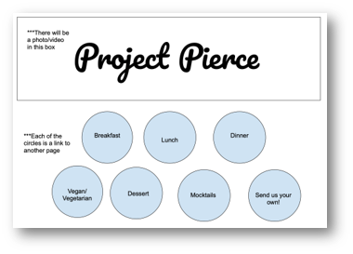
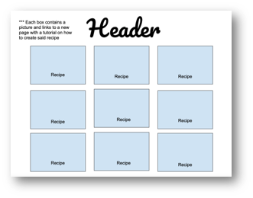
Sketch from Beginning

Slide 4
Functionality Video
With audio
https://drive.google.com/file/d/1f9UJdezE43rjaEOwPkupdqlZAoXVdLjG/view?usp=sharing
Without audio
https://drive.google.com/file/d/1yzBLXcoOu9YAK4CJ1QIizZipmdy-npxW/view?usp=sharing

Slide 5
HTML Elements Used
html
head
meta
title
body
nav
ul
li
a
main
img
article
header
h1
p
strong
em
div
details
summary
figure
figcaption
footer
video

Slide 6
Details elements are used to display recipes each within their own self-contained box
Nav element contains links to the pages to display recipes for each respective meal
The recipe maker page is accessible on the home page
The recipe maker uses a form to allow the user to input their own recipe, including what meal it belongs to and the recipe’s name, description, specifications, and image
Home page contains various sections separated by h1 elements for general info about the website and how to use the site
Each page uses details elements to display each recipe in its own container
HTML
Formatting

Slide 7
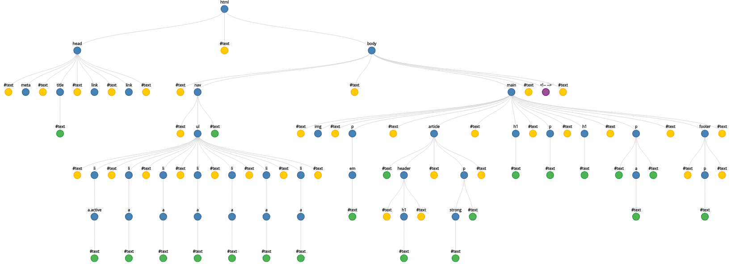
Index.html DOM Diagram

Slide 8
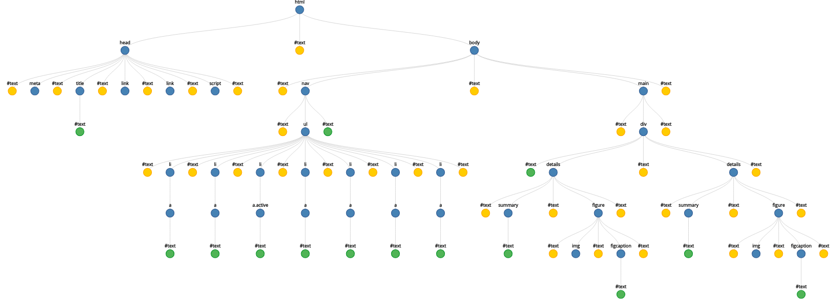
Meal Page DOM Diagram

Slide 9
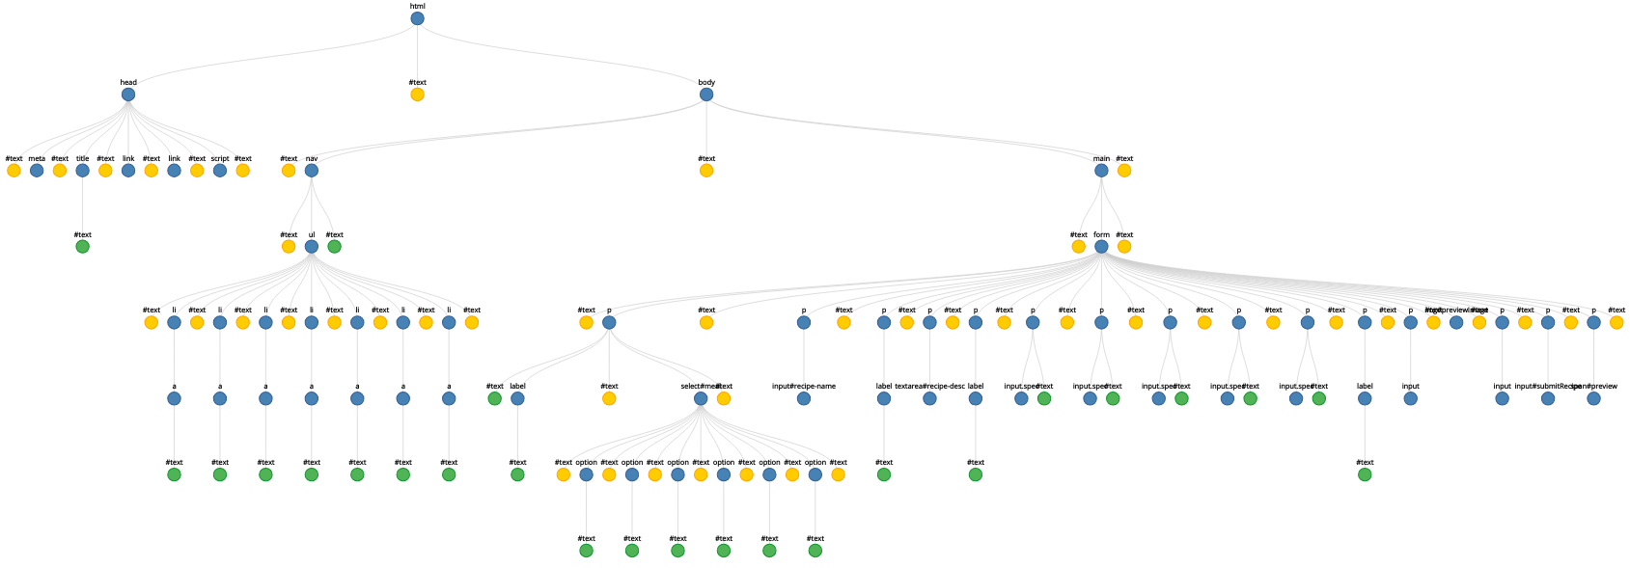
Recipe Maker Page DOM Diagram

Slide 10
CSS Selectors & Properties Used
margin
margin-right
margin-left
padding
height
width
border-bottom
border-right
position
float
text-align
color
background-color
text-decoration
display
overflow
list-style-type
font-family
body
p
h1
details
ul
li
a
a.active
img
a:hover:not(.active)
footer
main

Slide 11
CSS Formatting
Dynamically altered the nav bar’s orientation and placement based on screen size
  Vertical on side -> Horizontal on top -> Vertical on top
Placed headers in their own boxes for ease of reading and organization
Created distinctly-colored boxes adhering to website color scheme to place recipes within
Elements within each page resize based on screen size to keep the elements looking nice and readable

Slide 12
JS Functionality
Recipes expand when mouse moves over details element
An image preview is shown of the image which is uploaded on the recipe maker page
A preview of the entire new recipe block is shown upon request on the recipe maker page, showing a header for the respective recipes meal page, the recipe name, description, specifications, and image

Slide 13
Individual Contributions
Tyler - General layout, functionality, and formatting - HTML, CSS, JS
Cindy - Aesthetics, Recipes - HTML, CSS, JS
Lasya - Recipes - HTML
Madison - Recipe Pictures
Anushtup – Recipe Pictures

Slide 14
Git Repo
https://github.com/project-pierce/web
Website tested in Qutebrowser(http://qutebrowser.org/) and Chromium(https://www.chromium.org/)

