Slide 1


Divide-and-Conquer for Massive Survival Data Project supervisor ：Prof. Wen Su LU Yangjun (57996749) (Team Leader) WU Cheng (58361570) YANG Haotian (58208920) YUE Rongqi (58162998)

Slide 2

1
Introduction
2
Theory
3
Simulation
Contents
4
Application
5
Conclusion

Slide 3
Introduction
1.1
Background
1.2
Significance

Slide 4
1. Introduction
1. Background
① Exponential Data Growth:
The field of biomedical research has seen an exponential increase in data availability, mainly due to advancements in data collection and storage technologies.
② Computational Challenges:
There is an inherent computational challenge in analyzing right-censored survival data within the scope of large datasets, which has driven the need for methodological strategies

Slide 5
1. Introduction
2. Significance
① Improved Computational Efficiency:
By applying the Divide-and-Conquer (DAC) algorithm, the study significantly enhances the computational efficiency in survival data analysis of large-scale biomedical datasets, which is crucial for handling big data.
② Optimized Model Estimation:
The combination of the DAC algorithm with the adaptive LASSO penalty term allows for maintaining or improving the accuracy of model estimation while reducing computational burden, which is essential for reliable statistical inferences.

Slide 6
1. Introduction
2. Significance
③ Handling Large Datasets:
As the volume of data increases, traditional statistical methods may face computational challenges. The DAC algorithm provides an effective solution for dealing with datasets characterized by large sample sizes and high-dimensional predictors.
④ Practical Application Value:
By applying the DAC algorithm to a COVID-19 dataset, the study demonstrates the practical value of the algorithm in real-world biomedical research, especially in analyzing key factors affecting patient outcomes.

Slide 7
Theory
2.1
Notations and settings
2.2
The estimation procedure
2.3
Selection of covariates
2.4
DAC algorithm

Slide 8
2. Theory
2.1 Notations and settings
Data:
Survival time:
Censor time:
Censor status:
Vector of covariates (could be time-dependent):
Combination of survival time and censor time:
Cox’s proportional hazards model:
The vector is assumed to be sparse, and the size of data

Slide 9
2. Theory
2.2 The estimation of coefficient
We adopt the maximum likelihood estimation on the partial likelihood.
Likelihood function:
There is no arbitrary form for , so derive the partial likelihood
Property: consistency, asymptotic normal.

Slide 10
2. Theory
2.3 Selection of covariates
Background: Large number of covariates.
Adaptive LASSO penalty term:
Tuning parameter:
The objective function:
Factors with huge influence (coefficient) are expected to have smaller penalty. So those factors are more likely to be kept.
Modified Bayesian information criterion is applied to choose the best tuning parameter

Slide 11
2. Theory
2.4 Divide-and-conquer algorithm
Task: compute the estimation of coefficient faster while achieving similar properties when tackling with large dataset.
From 2.3, the estimation beta tilder is based on the full dataset. The divide-and-conquer algorithm provides a faster computational method to compute an approximation of beta tilder: It divide the whole dataset into K subsets, and use the first subset to derive beta tilder.
Besides, the least square approximation is applied to the partial likelihood. It greatly reduce the computation time.
Properties: consistency, asymptotic distribution.

Slide 12
Simulation
3.1
Objective and Settings
3.2
Time-independent Covariates
3.3
Simulation Results
3.4
Statistical Performance

Slide 13
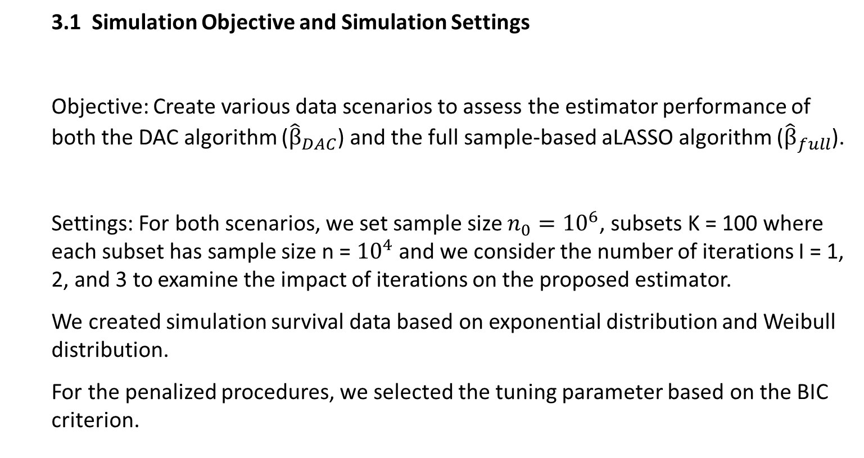
3.Simulation
3.1 Simulation Objective and Simulation Settings
Objective: Create various data scenarios to assess the estimator performance of both the DAC algorithm (${\hat{β}}_{DAC}$) and the full sample-based aLASSO algorithm (${\hat{β}}_{full}$).
Settings: For both scenarios, we set sample size $n_{0}={10}^{6}$, subsets K = 100 where each subset has sample size n = ${10}^{4}$ and we consider the number of iterations I = 1, 2, and 3 to examine the impact of iterations on the proposed estimator.
We created simulation survival data based on exponential distribution and Weibull distribution.
For the penalized procedures, we selected the tuning parameter based on the BIC criterion.

Slide 14
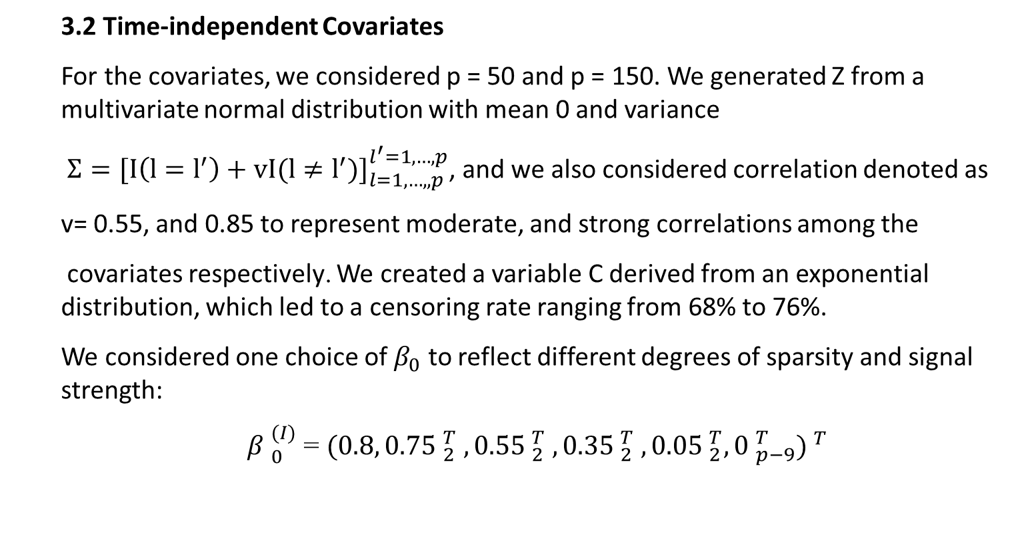
3.Simulation
3.2 Time-independent Covariates
For the covariates, we considered p = 50 and p = 150. We generated Z from a multivariate normal distribution with mean 0 and variance
${Σ=[I\left(l=l^{′}\right)+vI(l≠l^{′})]}_{l=1,…,,p}^{l^{′}=1,…,p}$, and we also considered correlation denoted as
v= 0.55, and 0.85 to represent moderate, and strong correlations among the
covariates respectively. We created a variable C derived from an exponential distribution, which led to a censoring rate ranging from 68% to 76%.
We considered one choice of $β_{0}$ to reflect different degrees of sparsity and signal strength:
${β }_{0}^{(I)}$ = ${(0.8,{0.75 }_{2}^{T} , {0.55 }_{2}^{T} , {0.35 }_{2}^{T} , {{0.05 }_{2}^{T},0 }_{p−9}^{T}) }^{T}$

Slide 15
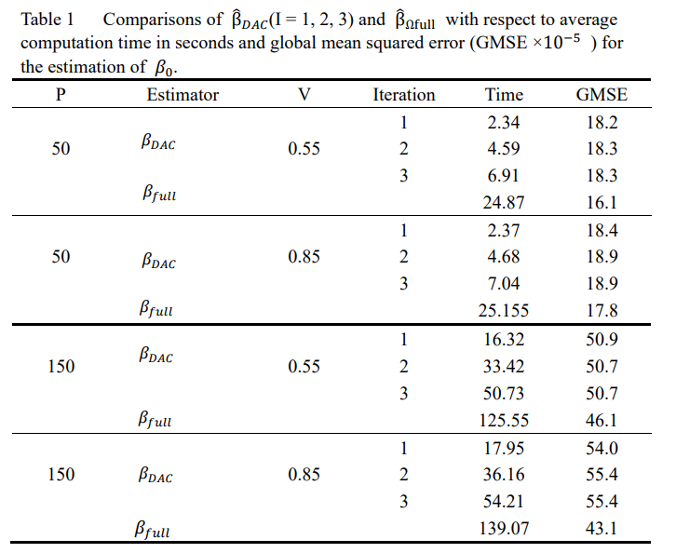
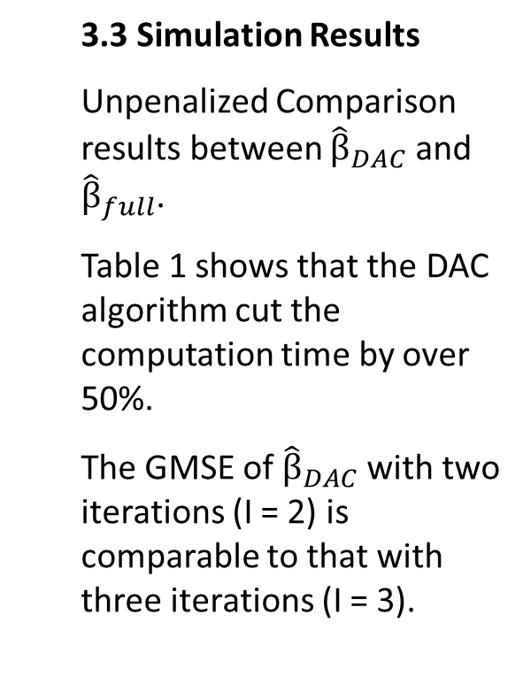
3.Simulation
3.3 Simulation Results
Unpenalized Comparison results between ${\hat{β}}_{DAC}$ and ${\hat{β}}_{full}$.
Table 1 shows that the DAC algorithm cut the computation time by over 50%.
The GMSE of ${\hat{β}}_{DAC}$with two iterations (I = 2) is comparable to that with three iterations (I = 3).

Slide 16
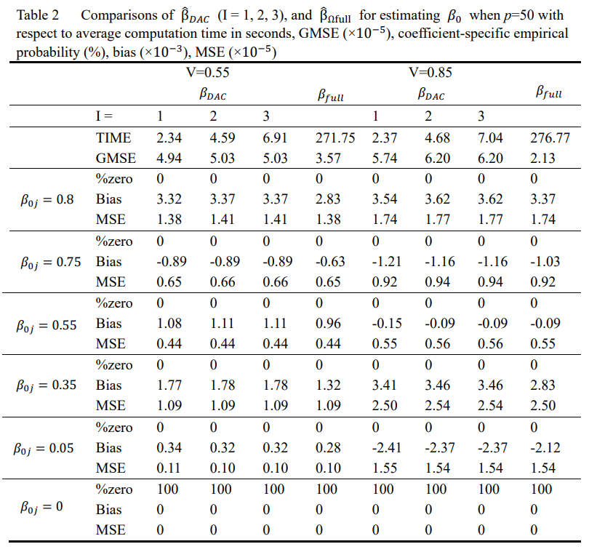
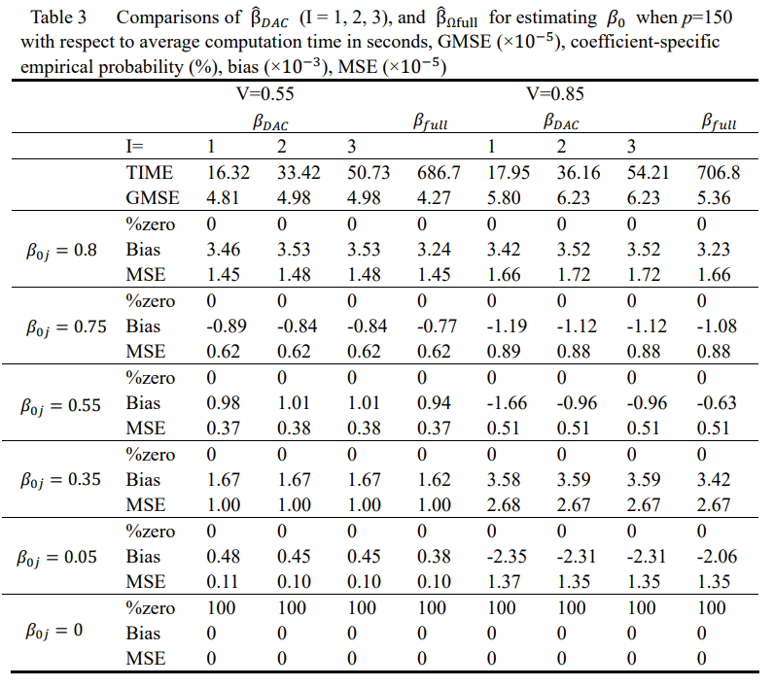
3.Simulation
3.3 Simulation Results Comparison with aLasso penalty

Slide 17
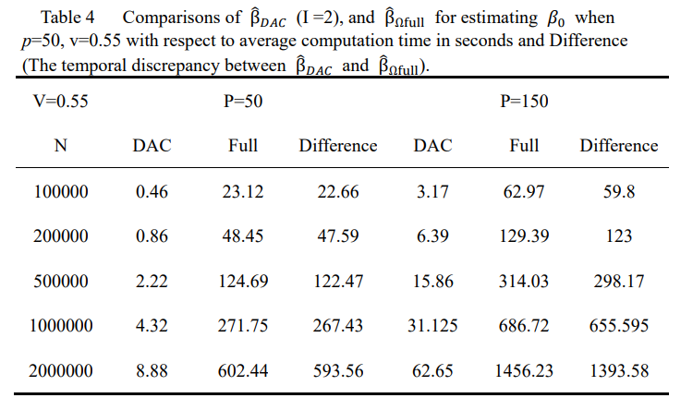
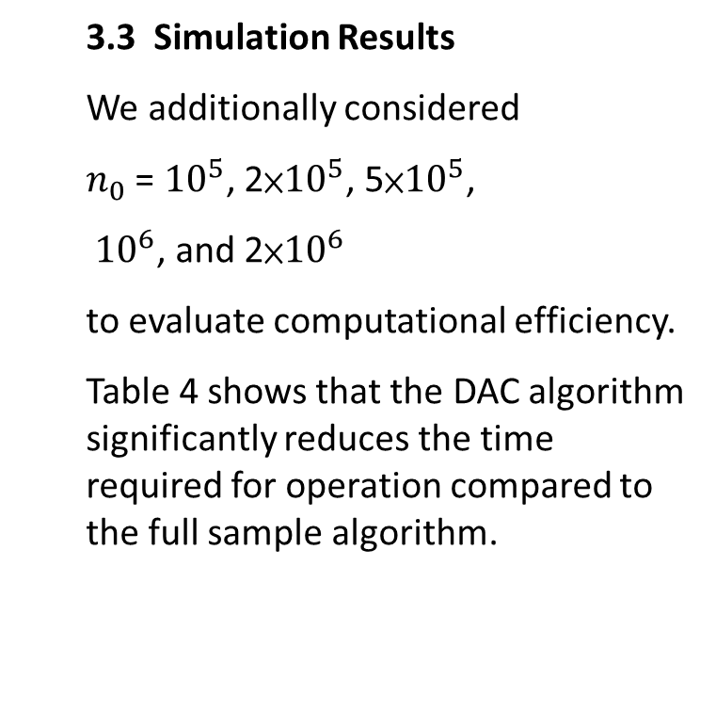
3.Simulation
3.3 Simulation Results
We additionally considered
$n_{0}$ = ${10}^{5}$, 2×${10}^{5}$, 5×${10}^{5}$,
${10}^{6}$, and 2×${10}^{6}$
to evaluate computational efficiency.
Table 4 shows that the DAC algorithm significantly reduces the time required for operation compared to the full sample algorithm.

Slide 18
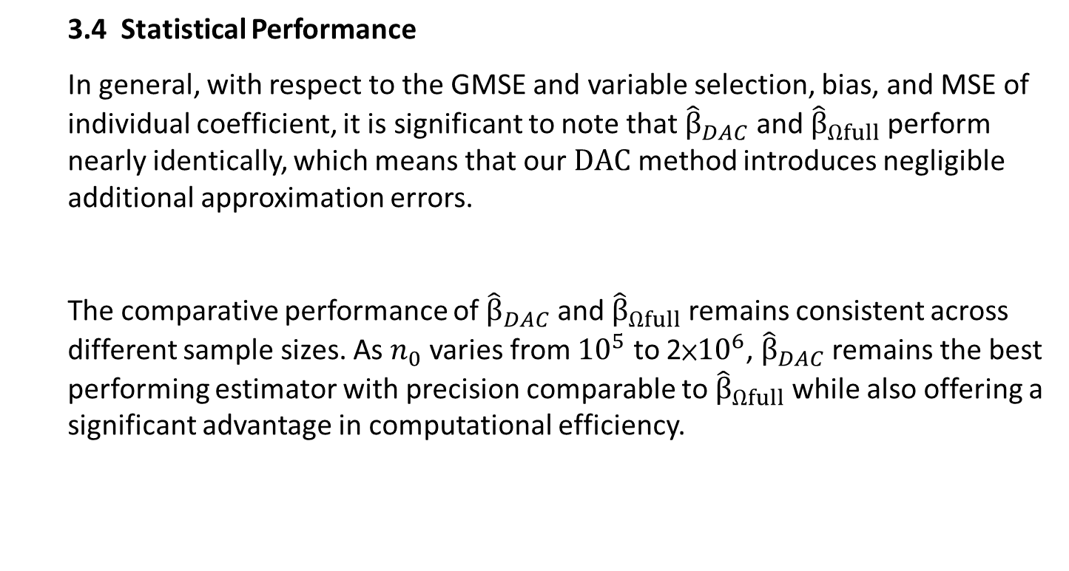
3.Simulation
3.4 Statistical Performance
In general, with respect to the GMSE and variable selection, bias, and MSE of individual coefficient, it is significant to note that ${\hat{β}}_{DAC}$ and ${\hat{β}}_{Ωfull}$ perform nearly identically, which means that our $DAC$ method introduces negligible additional approximation errors.
The comparative performance of ${\hat{β}}_{DAC}$ and ${\hat{β}}_{Ωfull}$ remains consistent across different sample sizes. As $n_{0}$ varies from ${10}^{5}$ to 2×${10}^{6}$, ${\hat{β}}_{DAC}$ remains the best performing estimator with precision comparable to ${\hat{β}}_{Ωfull}$ while also offering a significant advantage in computational efficiency.

Slide 19
Application
4.1
Data Resource
4.2
Data Preprocessing
4.3
Variable Description
4.4
Design of Application
4.5
Outcome and Conclusion

Slide 20

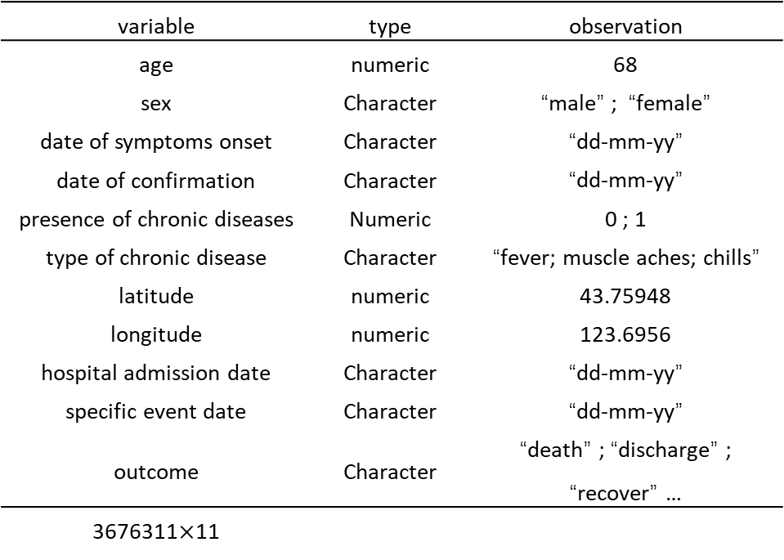
Data Preprocessing
Variable Description
Design of Application
Outcome and Conclusion
Data
Resource
The dataset collected by the Open COVID-19 Data Curation Group (Xu et al., 2020).
variable | type | observation
age | numeric | 68
sex | Character | “male” ; “female”
date of symptoms onset | Character | “dd-mm-yy”
date of confirmation | Character | “dd-mm-yy”
presence of chronic diseases | Numeric | 0 ; 1
type of chronic disease | Character | “fever; muscle aches; chills”
latitude | numeric | 43.75948
longitude | numeric | 123.6956
hospital admission date | Character | “dd-mm-yy”
specific event date | Character | “dd-mm-yy”
outcome | Character | “death” ; “discharge” ; “recover” …
3676311$×$11

Slide 21
Data Preprocessing
Variable Description
Design of Application
Outcome and Conclusion
Data
Resource
1. Data Preprocessing
Categorical variables → One-Hot Encoding
Text Processing
One-Hot Encoding
fever
fever, severe pneumonia
fever=1
pneumonia=1
cough=0
breath=0
sore body=0
pneumonia
fever
38.9 ° C, mild coughing
fever=1
pneumonia=0
cough=1
breath=0
sore body=0
cough
cough
cough difficulty breathing
fever=0
pneumonia=0
cough=1
breath=1
sore body=0
breath
fever
cold ; sore body
fever=1
pneumonia=0
cough=0
breath=0
sore body=1
sore body

Slide 22
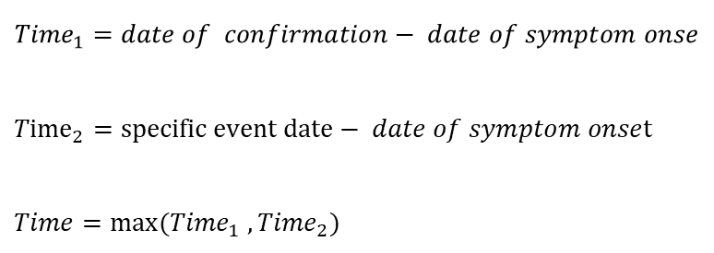
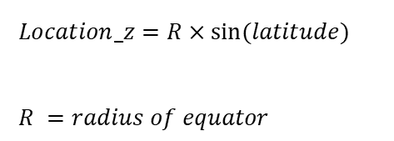
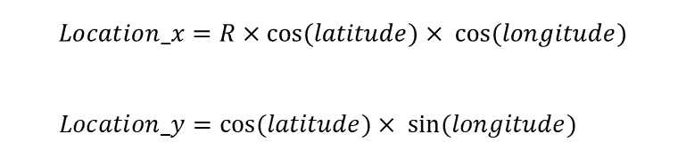
Data Preprocessing
Variable Description
Design of Application
Outcome and Conclusion
Data
Resource
2. Feature Engineering
① Time-to-event structure
②Selection of variables
③Create Euclidean distances
$${Time}_{1}=date of confirmation− date of symptom onse$$
${Time}_{2}=specific event date− date of symptom onset$
$Time=max({Time}_{1} ,{Time}_{2})$
Variable of event is based on “Categorical variables → One-Hot Encoding”. If variable of event contains “Discharge” or similar text content, then event = 1, otherwise event = 0.
PCA & elimination of highly correlated variables.
$$Location_x=R×\cos{(latitude)}× \cos{(longitude)}$$
$Location_y=\cos{(latitude)}× \sin{(longitude)}$
$Location_z=R×\sin{(latitude)}$
$R =radius of equator$

Slide 23
Data Preprocessing
Variable Description
Design of Application
Outcome and Conclusion
Data
Resource
Table 6: the name and definition & type of each variable
Variable | definition | type
Status | Discharge then Status=1; Otherwise Status=0 | binary
Time | Survival Time | numeric
Age | Age of Individual | numeric
Sex | Male then Sex=1; Otherwise Sex=0 | binary
chronic_disease | Existence of chronic disease then chronic_disease=1; Otherwise chronic_disease=0 | binary
density | Population / (Territorial Areas) | numeric
GDP | GDP (based on PPP theory) of a country | numeric
Per_GDP | GDP / (population of a country) | numeric
Symptoms_conjunctivitis | Existence of conjunctivitis then Symptoms_conjunctivitis=1；otherwise Symptoms_conjunctivitis=0 | binary
Symptoms_discomfort | Existence of discomfort then Symptoms_discomfort =1；otherwise Symptoms_ discomfort =0 | binary
Symptoms_cough | Existence of cough then Symptoms_ cough =1；otherwise Symptoms_ cough =0 | binary
Symptoms_ shortness_of_breath | Existence of shortness of breath then Symptoms_shortness_of_breath =1；otherwise Symptoms_shortnes_of_breath =0 | binary
Symptoms_headache | Existence of headache then Symptoms_headache =1；otherwise Symptoms_headache =0 | binary
Symptoms_diarrhea | Existence of diarrhea then Symptoms_diarrhea =1；otherwise Symptoms_diarrhea =0 | binary
Symptoms_sore_throat | Existence of sore throat then Symptoms_sore_throat =1；otherwise Symptoms_sore_throat =0 | binary
Symptoms_chills | Existence of chills then Symptoms_chills =1；otherwise Symptoms_chills =0 | binary
symptoms_fatigue | Existence of fatigue then symptoms_fatigue=1；otherwise symptoms_fatigue=0 | binary
symptoms_malaise | Existence of malaise then symptoms_malaise =1；otherwise symptoms_malaise =0 | binary
Location_x | Transferred Coordinates | numeric
Location_y | Transferred Coordinates | numeric
Location_z | Transferred Coordinates | numeric

Slide 24
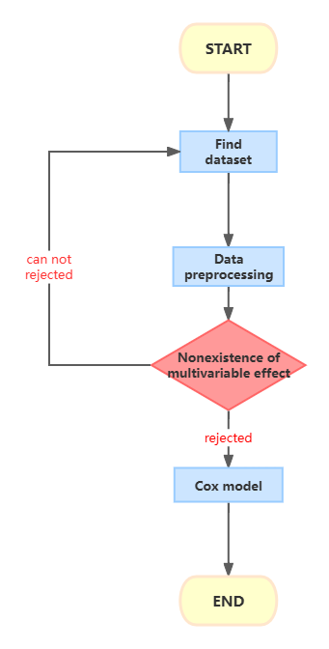
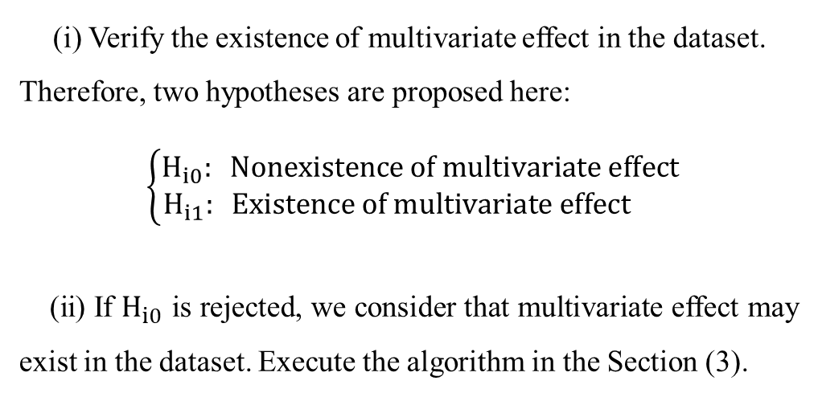
Data Preprocessing
Variable Description
Design of Application
Outcome and Conclusion
Data
Resource
(i) Verify the existence of multivariate effect in the dataset. Therefore, two hypotheses are proposed here:
$$\left\{\begin{aligned}H_{i0}: Nonexistence of multivariate effect \\ H_{i1}: Existence of multivariate effect \end{aligned}\right.$$
(ⅱ) If $H_{i0}$ is rejected, we consider that multivariate effect may exist in the dataset. Execute the algorithm in the Section (3).

Slide 25
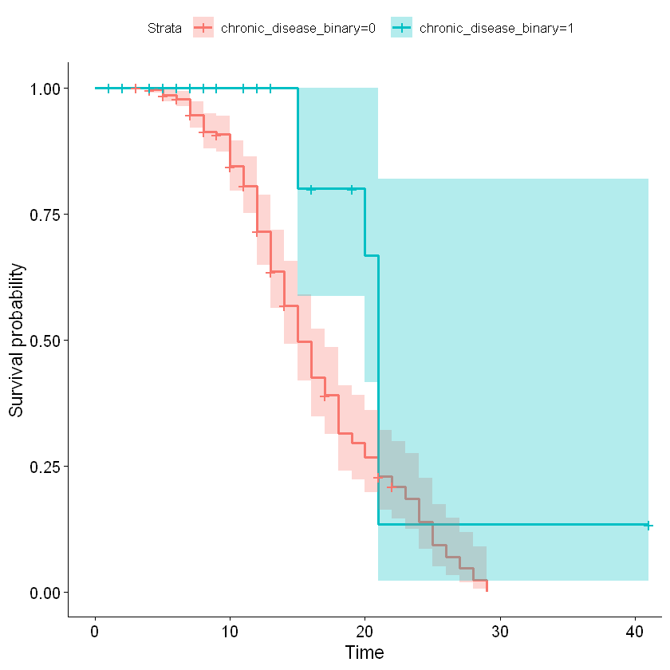
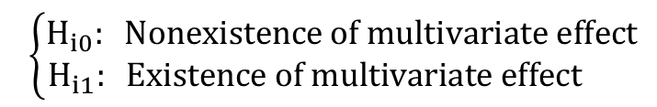
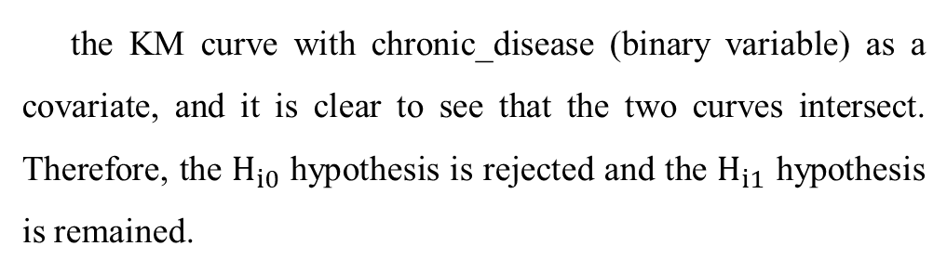
Data Preprocessing
Variable Description
Design of Application
Outcome and Conclusion
Data
Resource
Step (i):
the KM curve with chronic_disease (binary variable) as a covariate, and it is clear to see that the two curves intersect. Therefore, the $H_{i0}$ hypothesis is rejected and the $H_{i1}$ hypothesis is remained.
$$\left\{\begin{aligned}H_{i0}: Nonexistence of multivariate effect \\ H_{i1}: Existence of multivariate effect \end{aligned}\right.$$
Figure 1 : the Kaplan-Meier curve of chronic_disease covariate.

Slide 26
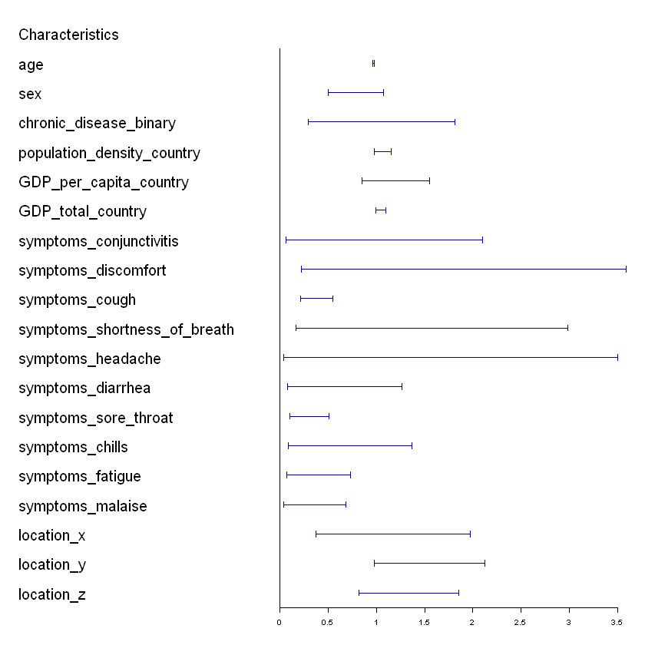
Data Preprocessing
Variable Description
Design of Application
Outcome and Conclusion
Data
Resource
Step (ⅱ):
① Time Optimization → 193.78%.
② All symptoms related variables have negative correlation on risk of discharge.
③ All point estimates for the economic variables exceed 1, indicating that an increase in economic factors is associated with a higher risk of discharge.
④ The point estimate for age is 0.97, suggesting that an increase in age is associated with a lower risk of discharge.
Figure 2: the forest plot of hazard ratios by DAC algorithm

Slide 27
Conclusion

Slide 28
5.Conclusion
This report presents the divide-and-conquer algorithm applied to a modified Cox's hazards model with a special penalty for analyzing Covid-19 clinical data. It explains the theory, demonstrates improved computational efficiency and coefficient estimation, and applies the method to real-world epidemiological data, showing multivariate effects and covariate impacts through feature engineering and Kaplan-Meier plots.

Slide 29
Thank you!

