Slide 1
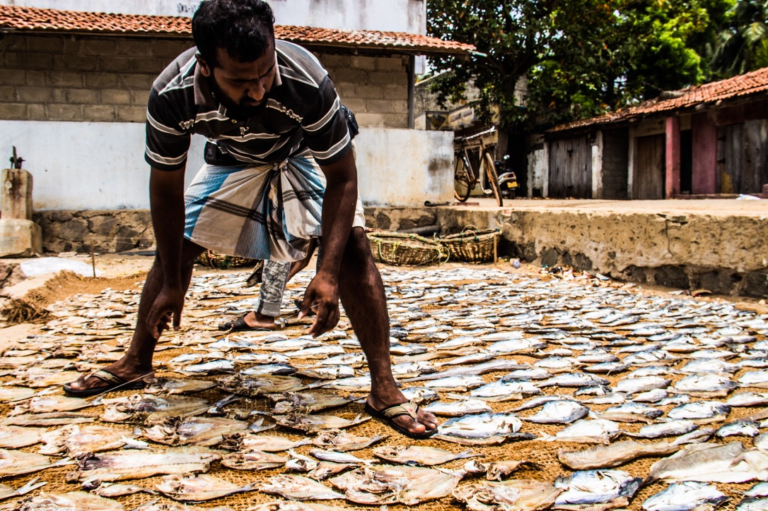
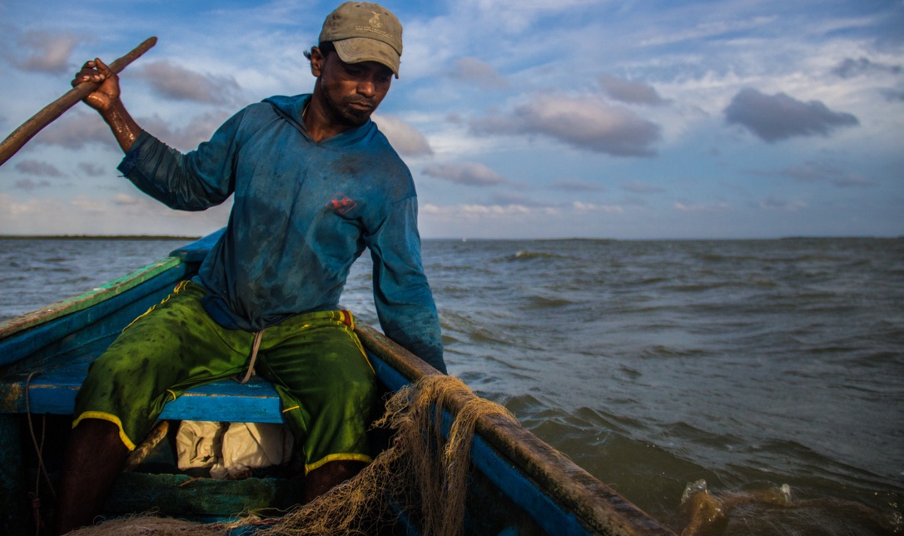
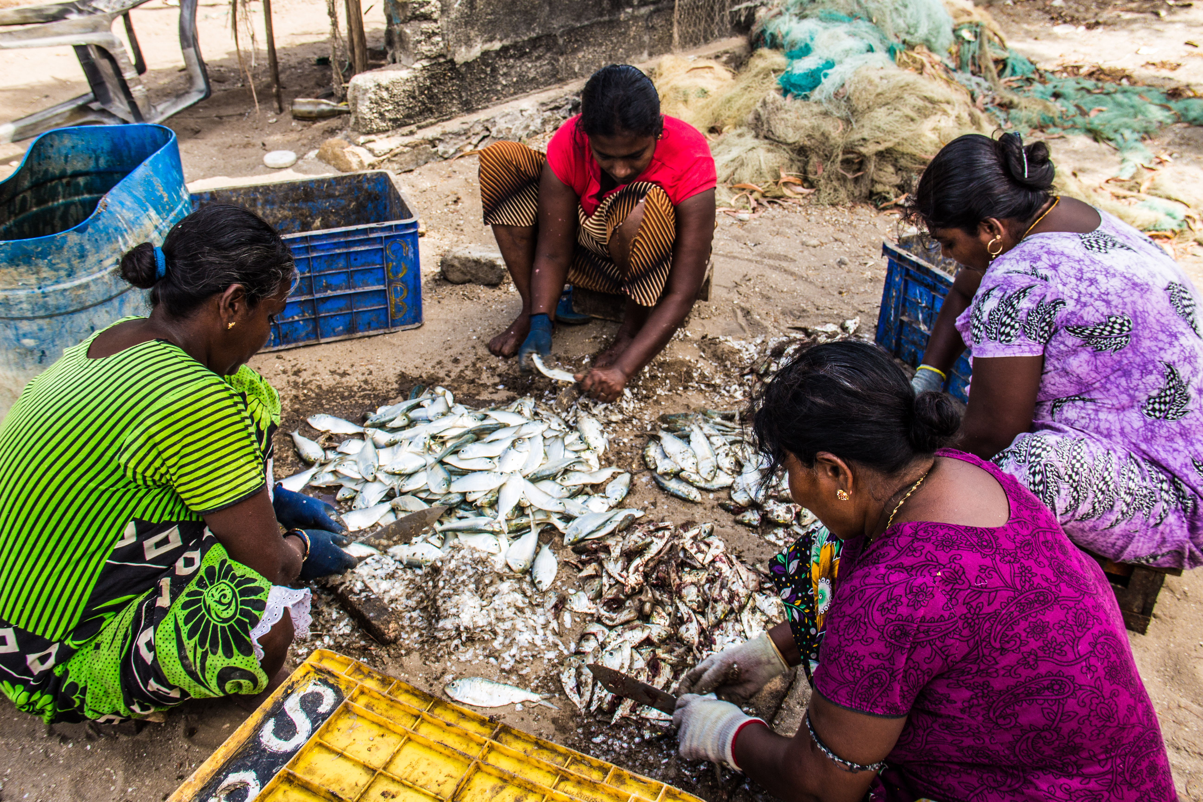

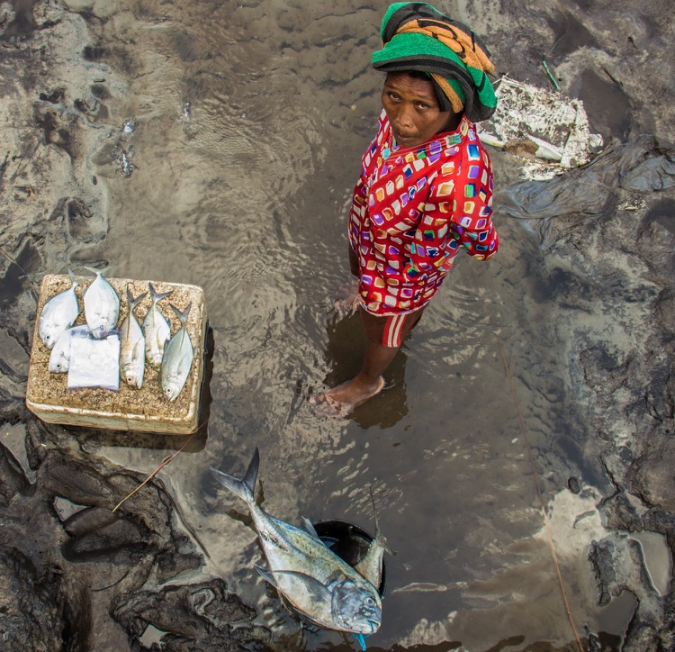


Slide 2


Best Catch Assessment
(BECAA)
Turning fisher knowledge into quantitative information to understand trends data-poor fisheries

Slide 3


By the end, you should know…
The basic logic, field steps, and safeguards for running a BECAA.
1. Why BECAA?
2. How it works
3. How to use it well
Why many fisheries are data-poor but not knowledge-poor, and why local knowledge can be collected quantitatively.
The core rule: every usable response needs a number, a year, and an effort measure.
How to choose metrics, interview diverse respondents, store data, and protect communities.
Project Seagrass · Best Catch Assessment (BECCA) training
2

Slide 4

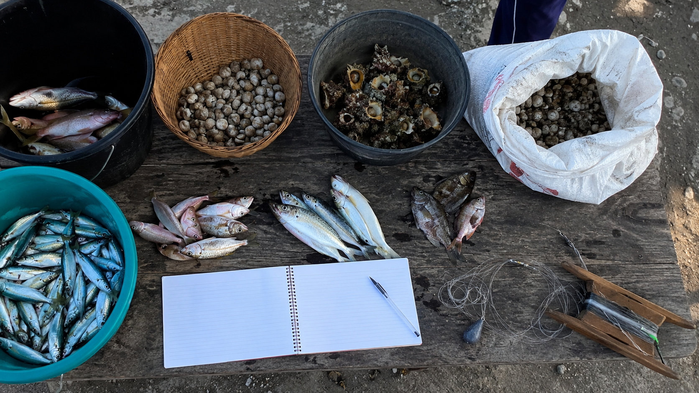
Data-poor does not mean knowledge-poor
Many fisheries lack formal monitoring, but fishers often hold decades of quantitative experience.
The problem
Long-term catch, effort and size records are often missing.
Small-scale, recreational, gleaning and subsistence fisheries are often under-recorded.
Local knowledge is often collected as stories, not as comparable numbers.
BECAA helps turn remembered fishing experience into structured evidence.
Core shift: from anecdote → analysable evidence

Slide 5
What is a Best Catch Assessment?
A standardised local knowledge survey for reconstructing change through time.
BECAA asks fishers and harvesters about their best catches now and in the past, records each answer as a number, year and effort measure, and combines many responses to reconstruct long-term change.
Not a perception survey
Not a full stock assessment
A practical bridge
It does not only ask “better or worse?” It asks for quantities linked to years.
It does not directly estimate biomass, mortality or Maximum Sustainable Yield.
It connects local knowledge with quantitative fisheries or biodiversity assessment.
Project Seagrass · Best Catch Assessment (BECCA) training
4

Slide 6
The BECAA rule: number + year + effort
Without all three, a response may be useful context but not a usable quantitative record to examine change over time.
1. Number
2. Year
3. Effort
How much was caught, collected, seen, or harvested?
Examples: 65 fish, 3 sacks, 4 bundles, 25 kg.
When did it happen?
Examples: 1989, 2004, 2012, the first-year fishing
How much fishing was needed?
Examples: hours, people, traps, net soaks, hauls, tide cycles.
A useful BECAA response sounds like:
“In 1989, my best day was 65 fish in about six hours.”

Slide 7
Ask about the present and the past
BECAA anchors current conditions against remembered historical baselines.
1
2
3
Current-year best catch
Best-ever catch
First-year catch
Mandatory. What is the best day now?
When was fishing most productive?
What was the baseline when the respondent started?
Mandatory design = current year AND best ever OR first year/early career

Slide 8
Choose metrics from the fishery itself
The right BECAA metric is the one fishers can report accurately and consistently.
Recreational
shots · eats · size
Gleaning
buckets · baskets · bags · individuals
Trap fisheries
catch per trap · soak time · individuals
Small-scale
fish · kg · boxes · baskets · crew catch
Invertebrates
number · weight · shell size · carapace width
Local units are valid if they are documented clearly.
Record the unit first. Standardise later.

Slide 9
Who should be interviewed?
Diversity is the design principle.
Older and experienced fishers
Younger and newer fishers
Extend the dataset backwards. They help recover historical baselines before formal monitoring, major habitat change, market shifts or new regulations.
Anchor the present. They provide current catch, current effort, current fishing areas and recent change.
Wisdom of Crowds: combine many partial views into a stronger collective estimate
Project Seagrass · Best Catch Assessment (BECCA) training
8

Slide 10
Running a BECAA in the field
A simple workflow, but each step matters.
Prepare
Pilot
Interview
Validate
Define fishery, partners, species, local units and sensitive questions.
Test wording with fishers. Check that questions produce numbers, years and effort.
Use respectful opening language. Record local units. Clarify effort and group catch.
Return results to fishers. Ask if the pattern makes sense and what context is missing.
Field rule: do not correct local language too early — record it, then clarify it.
Project Seagrass · Best Catch Assessment (BECCA) training
9

Slide 11
From answers to indicators
BECAA turns memories into catch-per-unit-effort and size trends.
Basic calculation
Group catch
Gear effort
Catch per unit effort = catch amount ÷ effort
Use person-hours where catches are collected by crews, households or groups.
Use trap-days, net soaks, hauls, hook-hours or tide cycles where relevant.
Example
8 buckets collected by 4 people in 4 hours = 8 ÷ 16 person-hours = 0.5 buckets per person-hour
Store data in long format: one row per catch memory or event.
Project Seagrass · Best Catch Assessment (BECCA) training
10

Slide 12

Ethics and safeguards
BECAA should make local knowledge visible without extracting it unfairly.
Obtain informed consent and explain how results will be used.
Do not publish exact sensitive fishing locations without permission.
Report community or regional patterns, not individual records.
Return findings to fishers and validate interpretations.
Do not use extracted knowledge to impose unfair decisions.
The method should support fairer management, not top-down control.
Project Seagrass · Best Catch Assessment (BECCA) training
11

Slide 13
BECAA in one sentence
A practical tool for documenting long-term change where formal data are limited.
BECAA asks fishers and harvesters about their best catches now and in the past, records each answer as a number, year and effort measure, and uses many responses together to reconstruct long-term change in data-poor fisheries.
Before we end, remember:
Number + year + effort is the foundation of this approach.
Use the metrics and units fishers actually use.
Interview diverse respondents across age, experience, gear and place.
Return results to the community before final interpretation.
Project Seagrass · Best Catch Assessment (BECCA) training
12

