Slide 1
IAS / CRM · III-BCSAD · bolanatics
CRM application security architecture
Anjelo Benedict Arnaez · K12254175
CEO / executive sponsor
Justin Andrew Ducay · A12448793
CIO / infrastructure lead
Aaliyah Marie Balocating · A12448769
CISO / risk lead
Gian Brent Maligaya · A12448912
Lead Engineer / DevSecOps
John David Bomediano · A12448927
DPO / compliance specialist
III-BCSAD · bolanatics · 5 October 2026
github.com/a-a123456789/umak-research-management
1/14
Notes:
Sources and qualification: III-BCSAD · bolanatics · 5 October 2026
III-BCSAD · bolanatics · 5 October 2026

Slide 2
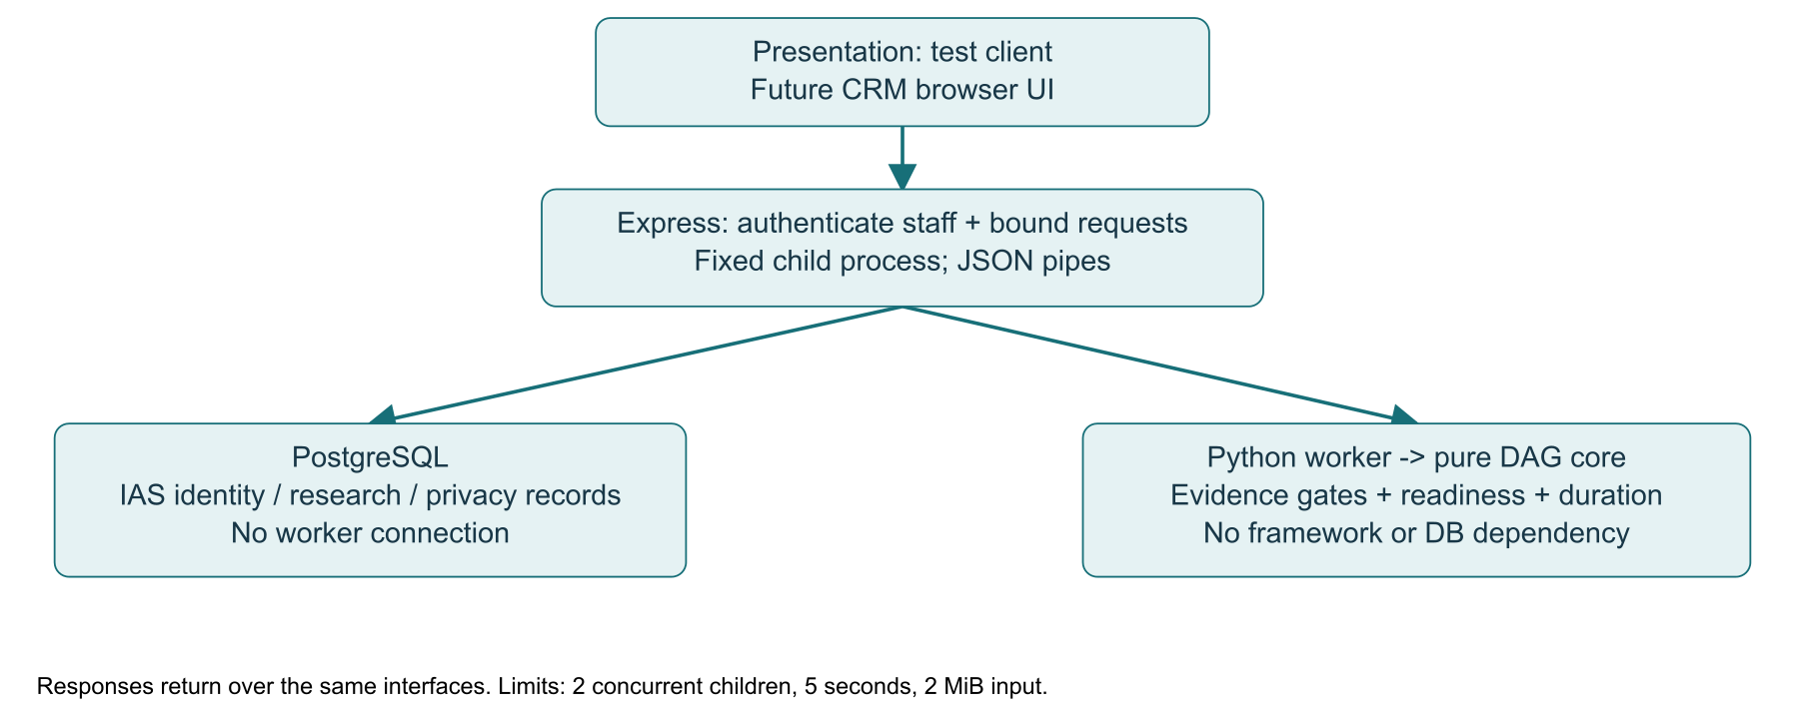
IAS / CRM · III-BCSAD · bolanatics
System architecture and real prototype assets
A-01 identity · A-02 research · A-05 credentials
A-06 source · A-07 audit · A-08 solver scenarios
A-03 persistent workflow is proposed; all records are synthetic.
[1]–[4]; asset classifications in report I
github.com/a-a123456789/umak-research-management
2/14
Notes:
A-01 identity · A-02 research · A-05 credentials
A-06 source · A-07 audit · A-08 solver scenarios
A-03 persistent workflow is proposed; all records are synthetic.
Sources and qualification: [1]–[4]; asset classifications in report I
[1]–[4]; asset classifications in report I

Slide 3
IAS / CRM · III-BCSAD · bolanatics
Attack surfaces and seven-stage scenario
Phase | Workstation-to-database hypothesis | MITRE ID
Recon | Discover reachable service | T1595.002
Weaponize | Prepare credential-stealing file | T1587.001
Deliver | Phish developer with attachment | T1566.001
Exploit | User executes malicious file | T1204.002
Install | Persist in user cron | T1053.003
C2 | Contact attacker web endpoint | T1071.001
Objective | Encrypt accessible A-02 records | T1486
[7], [8]. Hypothetical only. Surfaces: HTTP API, worker pipes, local DB, developer credentials.
github.com/a-a123456789/umak-research-management
3/14
Notes:
Sources and qualification: [7], [8]. Hypothetical only. Surfaces: HTTP API, worker pipes, local DB, developer credentials.
[7], [8]. Hypothetical only. Surfaces: HTTP API, worker pipes, local DB, developer credentials.

Slide 4
IAS / CRM · III-BCSAD · bolanatics
SQL injection: same payload, verified outcomes
VULNERABLE (isolated demo)
SQL contains keyword directly:
... title ILIKE '%${keyword}%'
Payload: ' UNION SELECT id, email,
password_hash, role FROM users--
HTTP 200: synthetic@example.test
and FAKE_HASH_NOT_A_CREDENTIAL
PATCHED (normal application)
WHERE status='Approved'
AND title ILIKE $1
ORDER BY id LIMIT 100
Values: ['%'+keyword+'%']
Same payload: HTTP 200, []
Bound value remains data, not SQL.
[5], [6]. Actual synthetic responses: evidence/integration/local-checks.txt; demo:sqli.
github.com/a-a123456789/umak-research-management
4/14
Notes:
Sources and qualification: [5], [6]. Actual synthetic responses: evidence/integration/local-checks.txt; demo:sqli.
[5], [6]. Actual synthetic responses: evidence/integration/local-checks.txt; demo:sqli.

Slide 5
IAS / CRM · III-BCSAD · bolanatics
Privacy and Philippine law mappings
RA 10173: transparency, purpose,
proportionality, rights, security.
RA 10175: illegal access; interception;
data or system interference;
misuse of devices.
Five provisions from each law
map to controls and owners in III.
POST /api/v1/users/consent
{ "policy_version":"2026-10-v1",
"choices":{
"institutional_analytics":false,
"email_notifications":false }}
Identity and time: server-derived.
Hard deletion works on live rows;
backup/key erasure remains proposed.
[9]–[11], [16], [17]; classroom mapping, not institutional legal approval.
github.com/a-a123456789/umak-research-management
5/14
Notes:
Sources and qualification: [9]–[11], [16], [17]; classroom mapping, not institutional legal approval.
[9]–[11], [16], [17]; classroom mapping, not institutional legal approval.

Slide 6
IAS / CRM · III-BCSAD · bolanatics
Incident response and NPC notification
01
Identify → Contain → Analyze → Eradicate → Recover → Lessons learned.
02
Draft notice: affected data, scope, discovery time, containment, contact and next update; fill only verified facts.
03
Academic simulation. DPO assesses whether notification conditions trigger the 72-hour requirement. No notice was sent.
[11], [12]; NPC notification draft in report III.
github.com/a-a123456789/umak-research-management
6/14
Notes:
Identify → Contain → Analyze → Eradicate → Recover → Lessons learned.
Draft notice: affected data, scope, discovery time, containment, contact and next update; fill only verified facts.
Academic simulation. DPO assesses whether notification conditions trigger the 72-hour requirement. No notice was sent.
Sources and qualification: [11], [12]; NPC notification draft in report III.
[11], [12]; NPC notification draft in report III.

Slide 7
IAS / CRM · III-BCSAD · bolanatics
EISP and default-deny access rules
Subject | Object | Action | Constraint | Decision
Anonymous | Search | POST | Approved; ≤100 rows | Allow
Student | Record | GET | Owner only | Allow
Staff | Algorithm | POST | Auth + bounded job | Allow
Runtime | Audit | UPDATE/DELETE | Any context | Deny
* | All routes | Any | Unmatched permission | Deny
EISP: philosophy · scope · roles · statutory directives · review cadence.
NIST: prioritize now; ISO: staged governance. SETA: awareness, practice, education.
[2], [3], [13]; complete ACL and implementation evidence in report IV.
github.com/a-a123456789/umak-research-management
7/14
Notes:
EISP: philosophy · scope · roles · statutory directives · review cadence.
NIST: prioritize now; ISO: staged governance. SETA: awareness, practice, education.
Sources and qualification: [2], [3], [13]; complete ACL and implementation evidence in report IV.
[2], [3], [13]; complete ACL and implementation evidence in report IV.

Slide 8
IAS / CRM · III-BCSAD · bolanatics
Git controls and the 60-second demonstration
01
Normal main: 2 approvals, strict security + algocom checks; stale/last-push review rules; no force pushes.
02
Replay secret-demo.html: A-05 → THREAT-04 → ACL-04 → SEC-04. A fake secret commit is actually rejected.
03
Hooks are bypassable; Gitleaks CI is independent. Prior authorized merge exception was restored and is not peer review.
PR #3 / bbe0a73; correction PR records its own final checks. Native private-repo secret scanning unavailable.
github.com/a-a123456789/umak-research-management
8/14
Notes:
Normal main: 2 approvals, strict security + algocom checks; stale/last-push review rules; no force pushes.
Replay secret-demo.html: A-05 → THREAT-04 → ACL-04 → SEC-04. A fake secret commit is actually rejected.
Hooks are bypassable; Gitleaks CI is independent. Prior authorized merge exception was restored and is not peer review.
Sources and qualification: PR #3 / bbe0a73; correction PR records its own final checks. Native private-repo secret scanning unavailable.
PR #3 / bbe0a73; correction PR records its own final checks. Native private-repo secret scanning unavailable.

Slide 9
IAS / CRM · III-BCSAD · bolanatics
Financial valuation: estimates, not actual loss
Calculation | PHP / assumption
Asset value | 3,600,000 (unsupported estimate)
SLE = AV × .40 | 1,440,000
ALE prior / post | 2,880,000 / 72,000
Annual safeguard cost | 240,000
CBA = prior − post − cost | 2,568,000
Lower-loss sensitivity CBA | −204,000
[4]. Empirical valuation remains incomplete; Aaliyah must obtain evidence or instructor guidance.
github.com/a-a123456789/umak-research-management
9/14
Notes:
Sources and qualification: [4]. Empirical valuation remains incomplete; Aaliyah must obtain evidence or instructor guidance.
[4]. Empirical valuation remains incomplete; Aaliyah must obtain evidence or instructor guidance.

Slide 10
IAS / CRM · III-BCSAD · bolanatics
Enterprise risk register: highest priorities
ID | Asset | Agent | Weakness | Score | Treatment | Control | PHP/yr | Target
R-04 | A-05 | Developer / attacker | Secret commit | 20 | Mitigate | Hook + CI | 35,000 | 5
R-01 | A-02 | Web attacker | Unsafe SQL | 20 | Mitigate | Bound SQL | 44,000 | 5
R-08 | A-02 | Privileged attacker | Admin compromise | 20 | Mitigate | Grants; restore | 48,000 | 5
Full nine-column register contains all eleven scenarios in report V.
Targets and DREAD scores are estimates; acceptance requires actual review.
[4]; security/data/risks.json is the calculation source.
github.com/a-a123456789/umak-research-management
10/14
Notes:
Full nine-column register contains all eleven scenarios in report V.
Targets and DREAD scores are estimates; acceptance requires actual review.
Sources and qualification: [4]; security/data/risks.json is the calculation source.
[4]; security/data/risks.json is the calculation source.

Slide 11
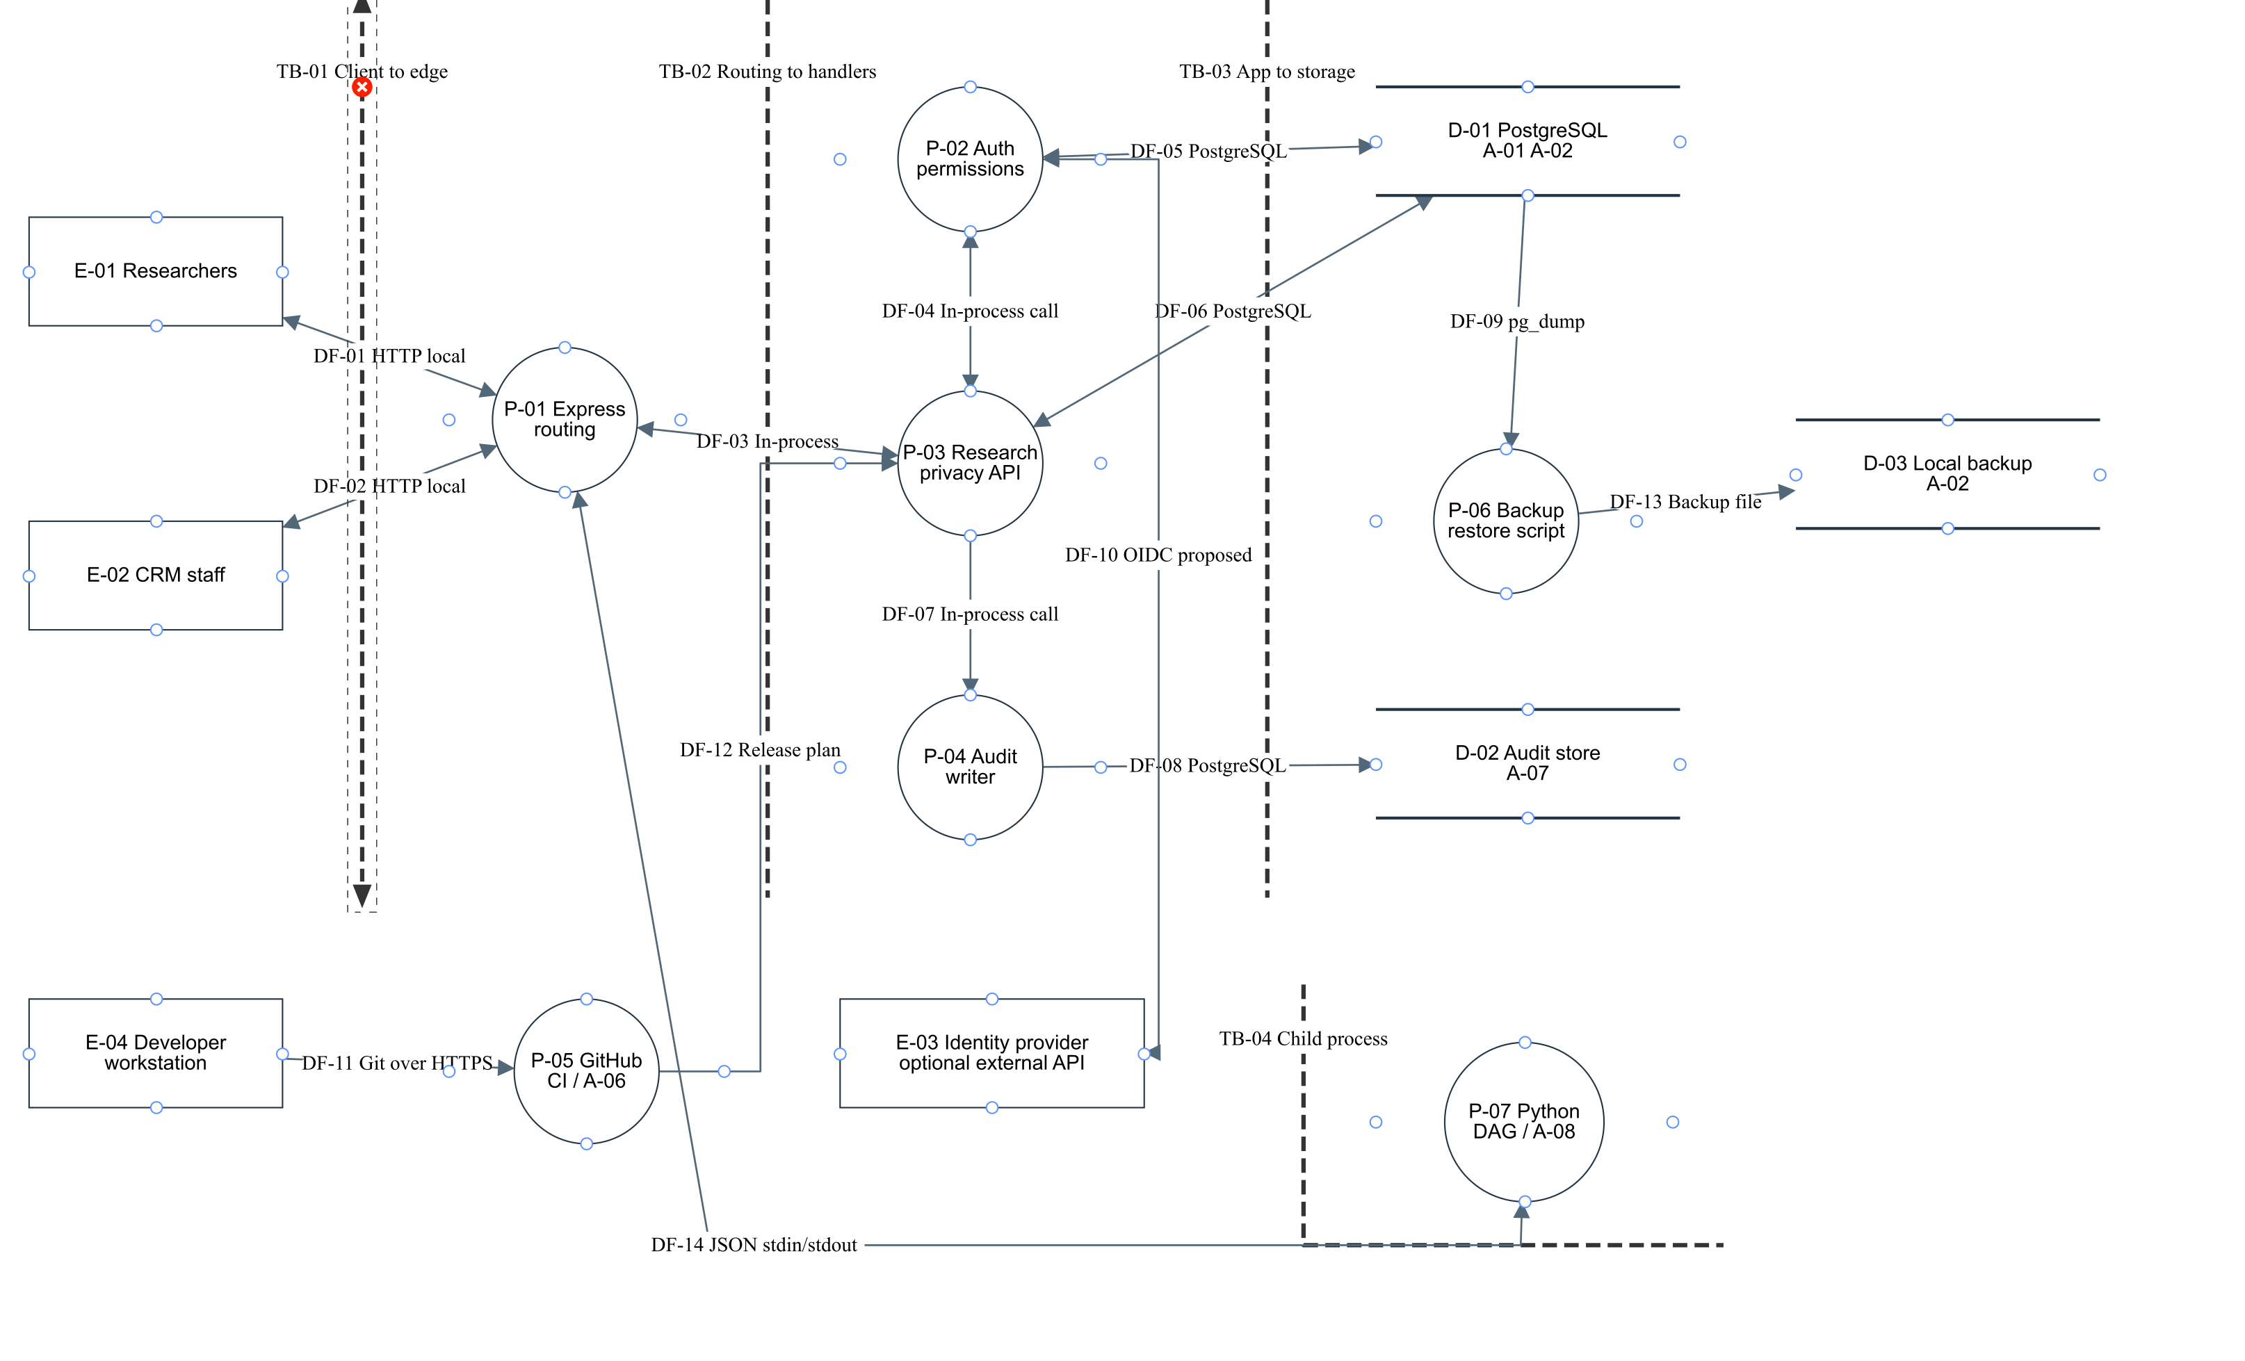
IAS / CRM · III-BCSAD · bolanatics
Threat Dragon Level 1 and trust boundaries
[14]. TB-01 client; TB-02 authorization; TB-03 DB grants; TB-04 child process (not OS sandbox).
github.com/a-a123456789/umak-research-management
11/14
Notes:
Sources and qualification: [14]. TB-01 client; TB-02 authorization; TB-03 DB grants; TB-04 child process (not OS sandbox).
[14]. TB-01 client; TB-02 authorization; TB-03 DB grants; TB-04 child process (not OS sandbox).

Slide 12
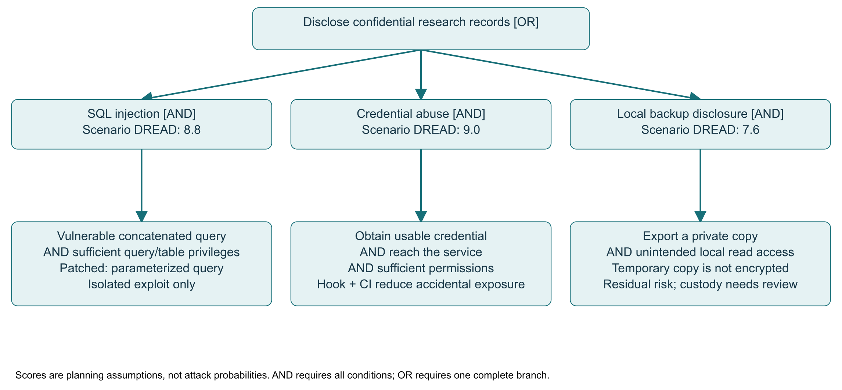
IAS / CRM · III-BCSAD · bolanatics
STRIDE and the AND/OR disclosure tree
Actor spoofing · process tampering · flow interception · store disclosure/repudiation.
DREAD leaders: credentials 9.0; SQLi 8.8; privileged extortion 8.6.
[14], [15]; AND needs every child, OR needs any complete branch. Metrics are analyst estimates.
github.com/a-a123456789/umak-research-management
12/14
Notes:
Actor spoofing · process tampering · flow interception · store disclosure/repudiation.
DREAD leaders: credentials 9.0; SQLi 8.8; privileged extortion 8.6.
Sources and qualification: [14], [15]; AND needs every child, OR needs any complete branch. Metrics are analyst estimates.
[14], [15]; AND needs every child, OR needs any complete branch. Metrics are analyst estimates.

Slide 13
IAS / CRM · III-BCSAD · bolanatics
Security tickets and executable acceptance
Ticket / owner | Control linked to asset | Assertion
SEC-04 / Gian | A-05: reject secret commits | Nonzero commit rejection; CI scan
SEC-01 / Gian | A-02: parameterize search | UNION disclosure only in demo
SEC-08 / Justin | A-02: recover synthetic DB | Six tables restored; runtime denies DDL
SEC-10 / Gian | A-08: validate worker result | Malformed SUCCESS → 502
CISO reviews traceability; each member independently verifies their own work.
Report VI and cross-traceability appendix; tests do not prove human acceptance.
github.com/a-a123456789/umak-research-management
13/14
Notes:
CISO reviews traceability; each member independently verifies their own work.
Sources and qualification: Report VI and cross-traceability appendix; tests do not prove human acceptance.
Report VI and cross-traceability appendix; tests do not prove human acceptance.

Slide 14
IAS / CRM · III-BCSAD · bolanatics
References and remaining external actions
[1] bolanatics / UMak, CRM Labs 1–6 and Research Manual, 2025–2026.
[10] Philippines, RA 10175: Cybercrime Prevention Act, 2012.
[2] NIST, Cybersecurity Framework 2.0, CSWP 29, 2024.
[11] NPC, Circular 16-03: Personal Data Breach Management, 2016.
[3] ISO/IEC, ISO/IEC 27001:2022, 2022.
[12] NIST, Incident Response Recommendations, SP 800-61 Rev. 3, 2025.
[4] Whitman and Mattord, Principles of Information Security, 7th ed., 2022.
[13] PostgreSQL, PostgreSQL 18: Privileges, 2025.
[5] OWASP, Application Security Verification Standard 5.0, 2025.
[14] OWASP, Threat Dragon and threat modeling guidance, accessed 2026.
[6] MITRE, CWE-89, CWE-862, CWE-400, accessed 2026.
[15] B. Schneier, “Attack Trees,” Dr. Dobb’s Journal, 1999.
[7] Lockheed Martin, Cyber Kill Chain, 2011; accessed 2026.
[16] NIST, Media Sanitization, SP 800-88 Rev. 2, 2025.
[8] MITRE, ATT&CK Enterprise technique entries, accessed 2026.
[17] NPC, Advisory 2021-01: Data Subject Rights, 2021.
[9] Philippines, RA 10173: Data Privacy Act, 2012.
Full IEEE references and links appear before this deck. Team review, signatures, real valuation and TBL submission remain.
github.com/a-a123456789/umak-research-management
14/14
Notes:
[1] bolanatics / UMak, CRM Labs 1–6 and Research Manual, 2025–2026.
[2] NIST, Cybersecurity Framework 2.0, CSWP 29, 2024.
[3] ISO/IEC, ISO/IEC 27001:2022, 2022.
[4] Whitman and Mattord, Principles of Information Security, 7th ed., 2022.
[5] OWASP, Application Security Verification Standard 5.0, 2025.
[6] MITRE, CWE-89, CWE-862, CWE-400, accessed 2026.
[7] Lockheed Martin, Cyber Kill Chain, 2011; accessed 2026.
[8] MITRE, ATT&CK Enterprise technique entries, accessed 2026.
[9] Philippines, RA 10173: Data Privacy Act, 2012.
[10] Philippines, RA 10175: Cybercrime Prevention Act, 2012.
[11] NPC, Circular 16-03: Personal Data Breach Management, 2016.
[12] NIST, Incident Response Recommendations, SP 800-61 Rev. 3, 2025.
[13] PostgreSQL, PostgreSQL 18: Privileges, 2025.
[14] OWASP, Threat Dragon and threat modeling guidance, accessed 2026.
[15] B. Schneier, “Attack Trees,” Dr. Dobb’s Journal, 1999.
[16] NIST, Media Sanitization, SP 800-88 Rev. 2, 2025.
[17] NPC, Advisory 2021-01: Data Subject Rights, 2021.
Sources and qualification: Full IEEE references and links appear before this deck. Team review, signatures, real valuation and TBL submission remain.
Full IEEE references and links appear before this deck. Team review, signatures, real valuation and TBL submission remain.

