Slide 1
ALGOCOM / CRM · III-BCSAD · bolanatics
CRM workflow readiness and critical path
Anjelo Benedict Arnaez · K12254175
Complexity / benchmarking
Justin Andrew Ducay · A12448793
Backlog / presentation
Aaliyah Marie Balocating · A12448769
Requirements / technical lead
Gian Brent Maligaya · A12448912
Algorithm designer
John David Bomediano · A12448927
Architecture
III-BCSAD · bolanatics · 5 October 2026
github.com/a-a123456789/umak-research-management
1/14
Notes:
Sources and qualification: III-BCSAD · bolanatics · 5 October 2026
III-BCSAD · bolanatics · 5 October 2026

Slide 2
ALGOCOM / CRM · III-BCSAD · bolanatics
Operational problem and limits
01
Determine the next permissible research-service action from prerequisites and evidence.
02
Estimate the dependency bottleneck using DAG dynamic programming and supplied durations.
03
No guaranteed calendar date: staff capacity and missing-evidence delays are excluded.
[1], [3], [7]. Proposed CRM model; institutional gates/durations need confirmation.
github.com/a-a123456789/umak-research-management
2/14
Notes:
Determine the next permissible research-service action from prerequisites and evidence.
Estimate the dependency bottleneck using DAG dynamic programming and supplied durations.
No guaranteed calendar date: staff capacity and missing-evidence delays are excluded.
Sources and qualification: [1], [3], [7]. Proposed CRM model; institutional gates/durations need confirmation.
[1], [3], [7]. Proposed CRM model; institutional gates/durations need confirmation.

Slide 3
ALGOCOM / CRM · III-BCSAD · bolanatics
Receipt is not verification
01
A received payment proof can enable staff verification.
02
It does not complete that action or satisfy a verified gate.
03
Service workflows are distinct from stored research records.
[1], [2]
github.com/a-a123456789/umak-research-management
3/14
Notes:
A received payment proof can enable staff verification.
It does not complete that action or satisfy a verified gate.
Service workflows are distinct from stored research records.
Sources and qualification: [1], [2]
[1], [2]

Slide 4
ALGOCOM / CRM · III-BCSAD · bolanatics
A precise graph model
01
Inputs: DAG G=(V,E), completed C, requirements R, evidence B, durations d.
02
Ready(v): every prerequisite completed AND every evidence gate satisfied.
03
Output: readiness reasons, earliest finishes, longest duration and path.
[3]
github.com/a-a123456789/umak-research-management
4/14
Notes:
Inputs: DAG G=(V,E), completed C, requirements R, evidence B, durations d.
Ready(v): every prerequisite completed AND every evidence gate satisfied.
Output: readiness reasons, earliest finishes, longest duration and path.
Sources and qualification: [3]
[3]

Slide 5
ALGOCOM / CRM · III-BCSAD · bolanatics
The objective is structural duration
01
r(v)=0 for completed steps; otherwise r(v)=d(v).
02
F(v)=r(v)+max predecessor F; an empty maximum is zero.
03
T=max F(v): unlimited parallel capacity; staffing and evidence waits excluded.
[3]
github.com/a-a123456789/umak-research-management
5/14
Notes:
r(v)=0 for completed steps; otherwise r(v)=d(v).
F(v)=r(v)+max predecessor F; an empty maximum is zero.
T=max F(v): unlimited parallel capacity; staffing and evidence waits excluded.
Sources and qualification: [3]
[3]

Slide 6
ALGOCOM / CRM · III-BCSAD · bolanatics
Why dynamic programming fits
01
Evaluate shared prerequisite subproblems once in topological order.
02
Joins take the maximum finish, not the sum of parallel branches.
03
Keep one maximizing parent to recover a path certificate.
[3]
github.com/a-a123456789/umak-research-management
6/14
Notes:
Evaluate shared prerequisite subproblems once in topological order.
Joins take the maximum finish, not the sum of parallel branches.
Keep one maximizing parent to recover a path certificate.
Sources and qualification: [3]
[3]

Slide 7
ALGOCOM / CRM · III-BCSAD · bolanatics
Walk through the certificate
01
S4 completed → S5 verification (15 min) → S6 processing (45 min).
02
Received proof makes S5 ready; S6 is blocked until S5 completes.
03
F={0,15,60}; critical path [S5,S6]; estimate 60 min.
Repository example.json
github.com/a-a123456789/umak-research-management
7/14
Notes:
S4 completed → S5 verification (15 min) → S6 processing (45 min).
Received proof makes S5 ready; S6 is blocked until S5 completes.
F={0,15,60}; critical path [S5,S6]; estimate 60 min.
Sources and qualification: Repository example.json
Repository example.json

Slide 8
ALGOCOM / CRM · III-BCSAD · bolanatics
Correctness depends on invariants
01
Queue indegree equals the count of unprocessed prerequisites.
02
Induction: every predecessor finish is final before a step is evaluated.
03
Backtracking actual maximizing edges certifies the reported longest path.
[3]
github.com/a-a123456789/umak-research-management
8/14
Notes:
Queue indegree equals the count of unprocessed prerequisites.
Induction: every predecessor finish is final before a step is evaluated.
Backtracking actual maximizing edges certifies the reported longest path.
Sources and qualification: [3]
[3]

Slide 9
ALGOCOM / CRM · III-BCSAD · bolanatics
Growth is linear in the full input
01
Proposed: O(V+E+Q+B) under expected constant-time hashing.
02
Repeated scans: O(V(V+E)+Q+B) upper bound; ordered cases can be linear.
03
Storage includes graph, normalized evidence and output—not just the queue.
[3]
github.com/a-a123456789/umak-research-management
9/14
Notes:
Proposed: O(V+E+Q+B) under expected constant-time hashing.
Repeated scans: O(V(V+E)+Q+B) upper bound; ordered cases can be linear.
Storage includes graph, normalized evidence and output—not just the queue.
Sources and qualification: [3]
[3]

Slide 10
ALGOCOM / CRM · III-BCSAD · bolanatics
Measured comparison: 1,000-step cases
Median milliseconds; ten warmed repetitions; same synthetic input per pair.
Timing and memory were measured separately. Speedups are machine/input dependent.
[4], [5]; extended_results.json
github.com/a-a123456789/umak-research-management
10/14
Notes:
Median milliseconds; ten warmed repetitions; same synthetic input per pair.
Timing and memory were measured separately. Speedups are machine/input dependent.
Sources and qualification: [4], [5]; extended_results.json
[4], [5]; extended_results.json

Slide 11
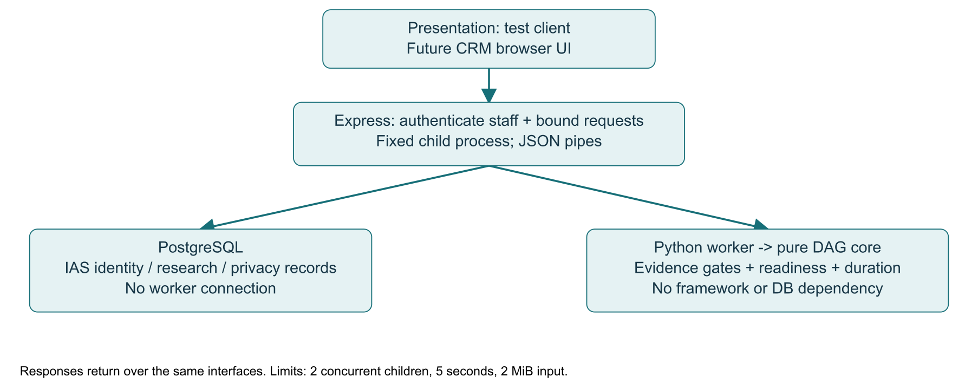
ALGOCOM / CRM · III-BCSAD · bolanatics
Decoupled client, API, database and worker
Staff authentication precedes 2 MiB parsing. Python receives no database credentials.
Complete worker-result validation; 2 jobs / 5 s / 8 MiB output.
[6], [8]; machine-readable schemas under algocom/schemas/.
github.com/a-a123456789/umak-research-management
11/14
Notes:
Staff authentication precedes 2 MiB parsing. Python receives no database credentials.
Complete worker-result validation; 2 jobs / 5 s / 8 MiB output.
Sources and qualification: [6], [8]; machine-readable schemas under algocom/schemas/.
[6], [8]; machine-readable schemas under algocom/schemas/.

Slide 12
ALGOCOM / CRM · III-BCSAD · bolanatics
Tickets make the claims testable
01
US-A1 / ALG-01: explain ready and blocked steps; receipt/verification tests.
02
US-A2 / ALG-02: prove hand-computed durations and valid certificates.
03
ALG-03/04: API failure tests; 5,000-step warmed p95 budget <1,000 ms.
Tests and CI; Q cap 50,000 memberships
github.com/a-a123456789/umak-research-management
12/14
Notes:
US-A1 / ALG-01: explain ready and blocked steps; receipt/verification tests.
US-A2 / ALG-02: prove hand-computed durations and valid certificates.
ALG-03/04: API failure tests; 5,000-step warmed p95 budget <1,000 ms.
Sources and qualification: Tests and CI; Q cap 50,000 memberships
Tests and CI; Q cap 50,000 memberships

Slide 13
ALGOCOM / CRM · III-BCSAD · bolanatics
Defense: exact model, estimated inputs
01
Why decouple? Testability, bounded lifecycle and event-loop isolation.
02
Why exact? This DAG objective is polynomial; harder resource scheduling is different.
03
Benchmarks complement proof; ML cold start is not a current feature.
Full six answers in report VI; review edge-case handling
github.com/a-a123456789/umak-research-management
13/14
Notes:
Why decouple? Testability, bounded lifecycle and event-loop isolation.
Why exact? This DAG objective is polynomial; harder resource scheduling is different.
Benchmarks complement proof; ML cold start is not a current feature.
Sources and qualification: Full six answers in report VI; review edge-case handling
Full six answers in report VI; review edge-case handling

Slide 14
ALGOCOM / CRM · III-BCSAD · bolanatics
References and evidence
[1] University of Makati, Research Manual, revised 2025. Operational applicability needs confirmation.
[5] Python Software Foundation, Python 3.12: tracemalloc, accessed 2026.
[2] bolanatics, ALGOCOM Task Guide and PBL Milestone 1 Specification, 2026. Course materials.
[6] OpenJS Foundation, Node.js v24: Child process, accessed 2026.
[3] Cormen et al., Introduction to Algorithms, 4th ed. MIT Press, 2022.
[7] Beránek, Böhm and Cima, “Analysis of Workflow Schedulers in Simulated Distributed Environments,” 2022.
[4] Python Software Foundation, Python 3.12: time, accessed 2026.
[8] Wright et al., JSON Schema Validation, Draft 2020-12, 2022 revision.
Synthetic results are machine/order dependent. AI assistance disclosed in report I–IV; human review remains required.
github.com/a-a123456789/umak-research-management
14/14
Notes:
[1] University of Makati, Research Manual, revised 2025. Operational applicability needs confirmation.
[2] bolanatics, ALGOCOM Task Guide and PBL Milestone 1 Specification, 2026. Course materials.
[3] Cormen et al., Introduction to Algorithms, 4th ed. MIT Press, 2022.
[4] Python Software Foundation, Python 3.12: time, accessed 2026.
[5] Python Software Foundation, Python 3.12: tracemalloc, accessed 2026.
[6] OpenJS Foundation, Node.js v24: Child process, accessed 2026.
[7] Beránek, Böhm and Cima, “Analysis of Workflow Schedulers in Simulated Distributed Environments,” 2022.
[8] Wright et al., JSON Schema Validation, Draft 2020-12, 2022 revision.
Sources and qualification: Synthetic results are machine/order dependent. AI assistance disclosed in report I–IV; human review remains required.
Synthetic results are machine/order dependent. AI assistance disclosed in report I–IV; human review remains required.

