Slide 1

Notes:
Project 100 Marketing Slider V2.0

Slide 2
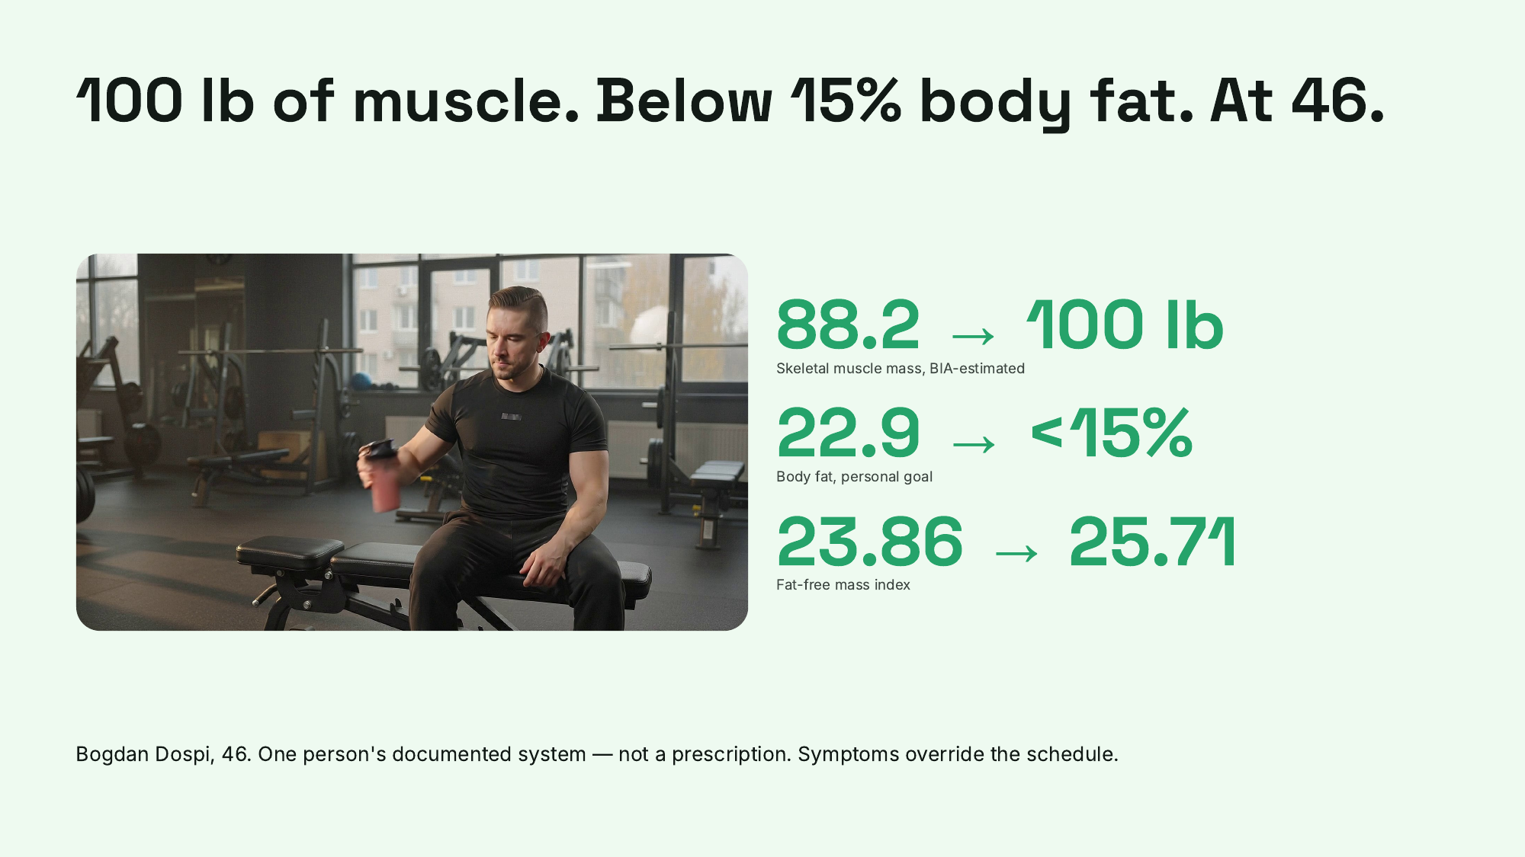
Notes:
100 lb of muscle. Below 15% body fat. At 46.

Slide 3
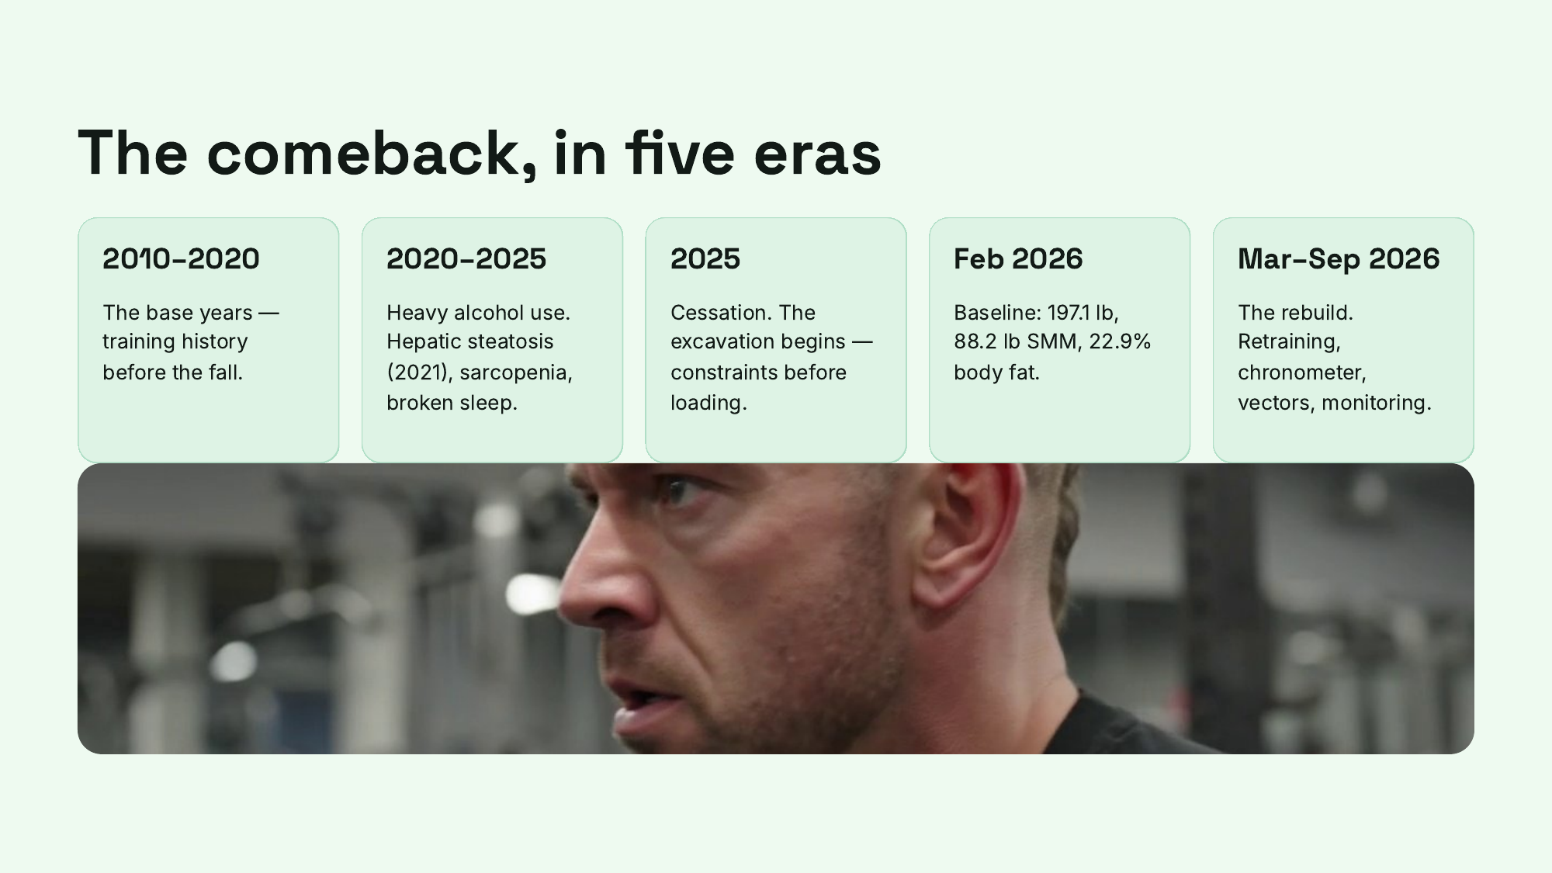
Notes:
The comeback, in five eras

Slide 4
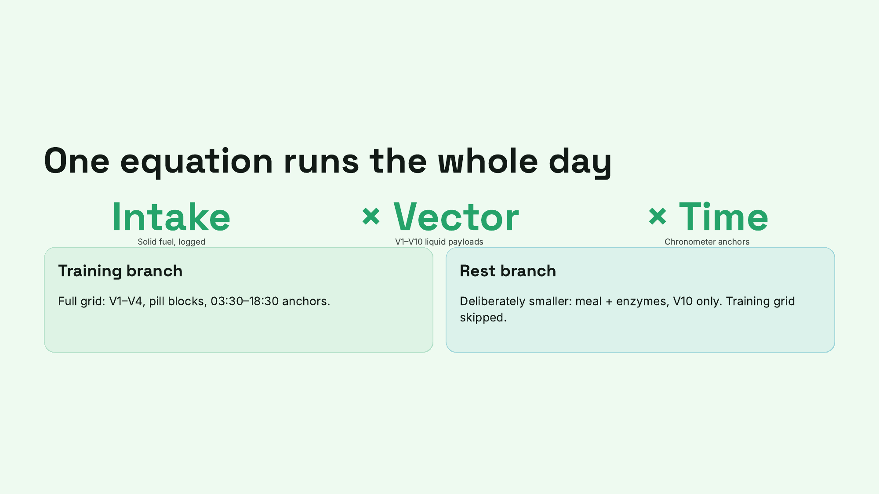
Notes:
One equation runs the whole day

Slide 5
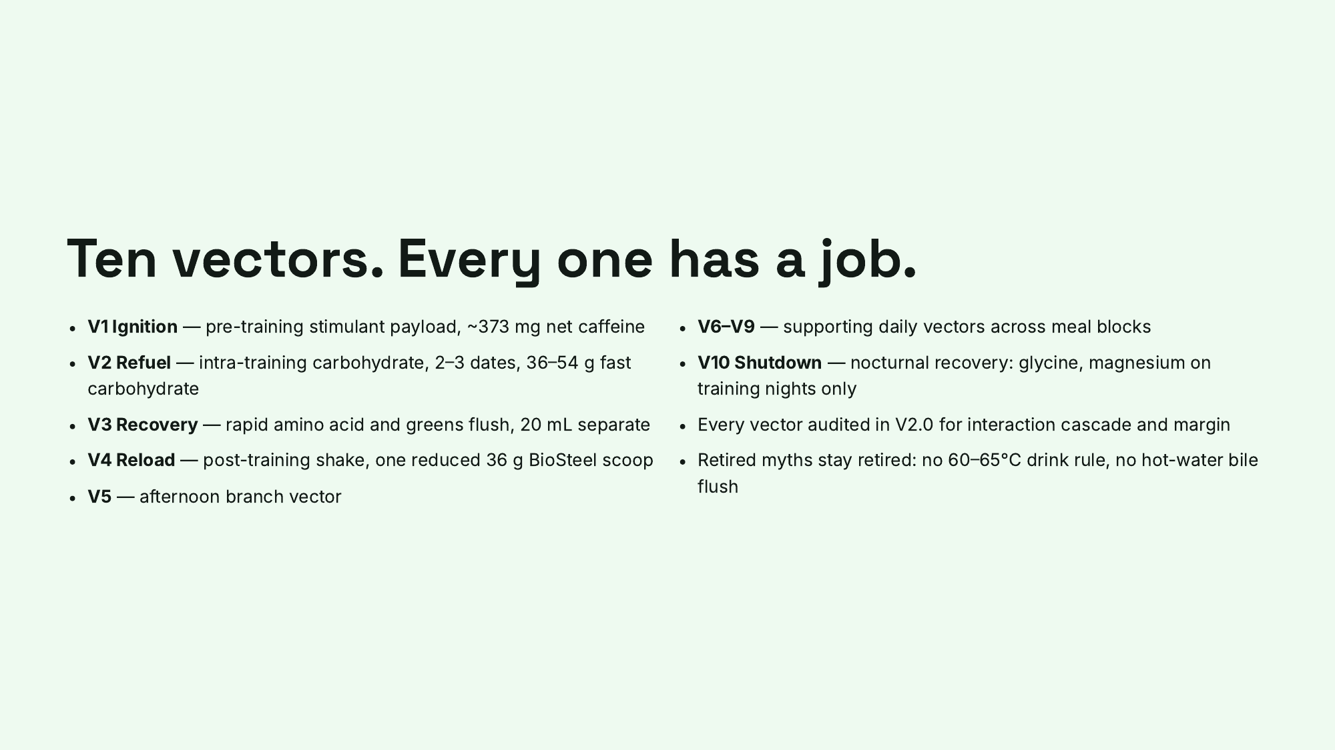
Notes:
Ten vectors. Every one has a job.

Slide 6
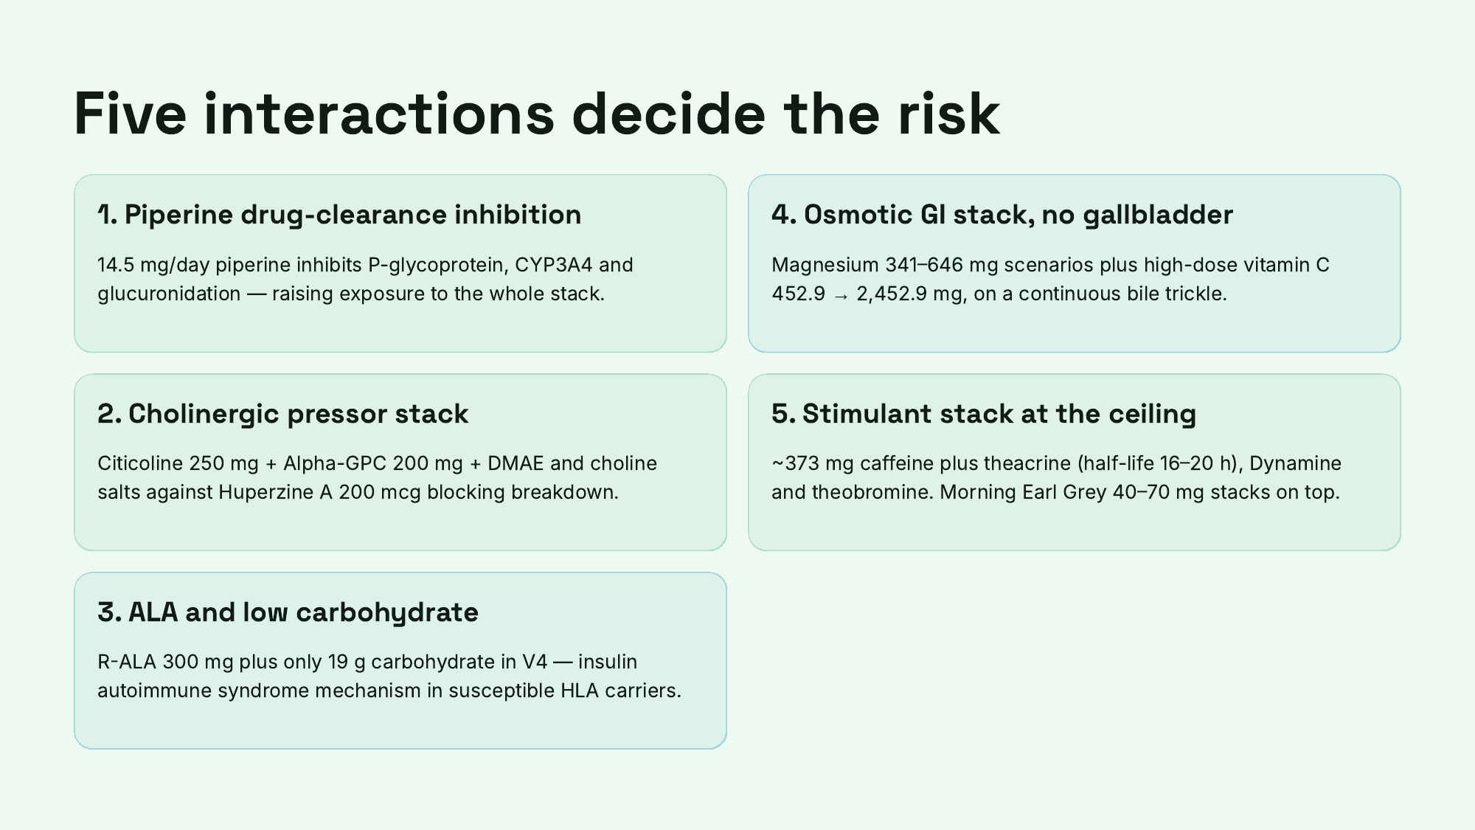
Notes:
Five interactions decide the risk

Slide 7
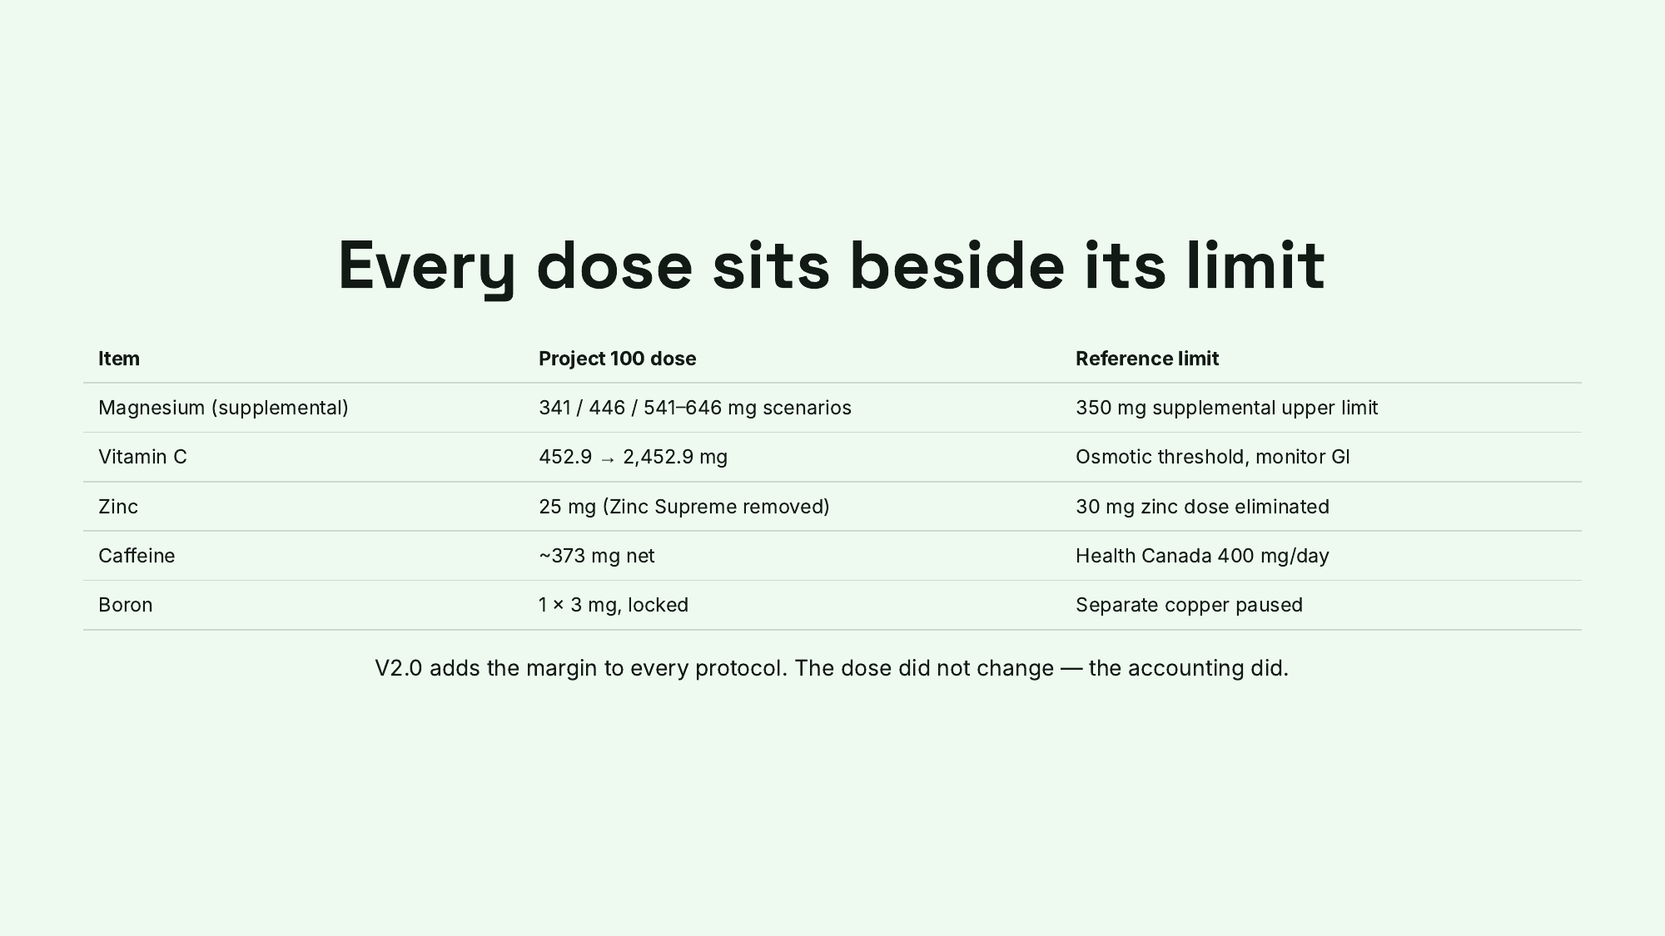
Notes:
Every dose sits beside its limit

Slide 8
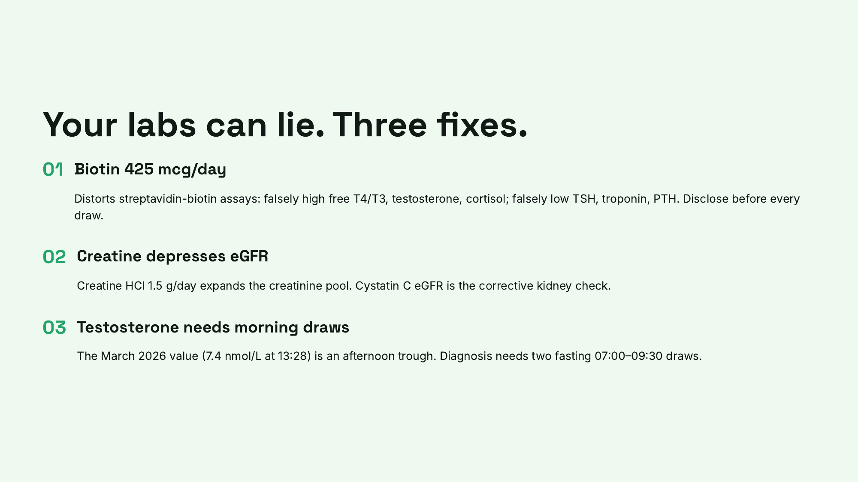
Notes:
Your labs can lie. Three fixes.

Slide 9
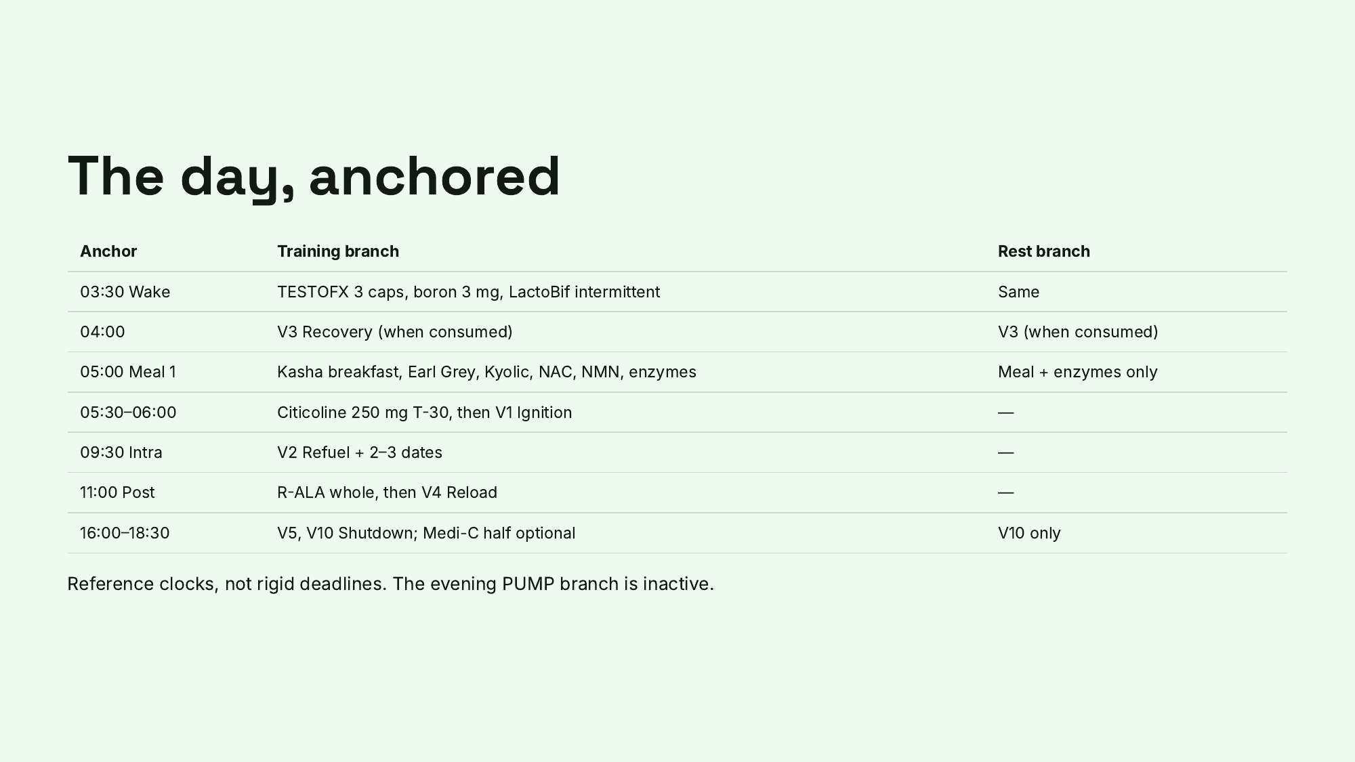
Notes:
The day, anchored

Slide 10
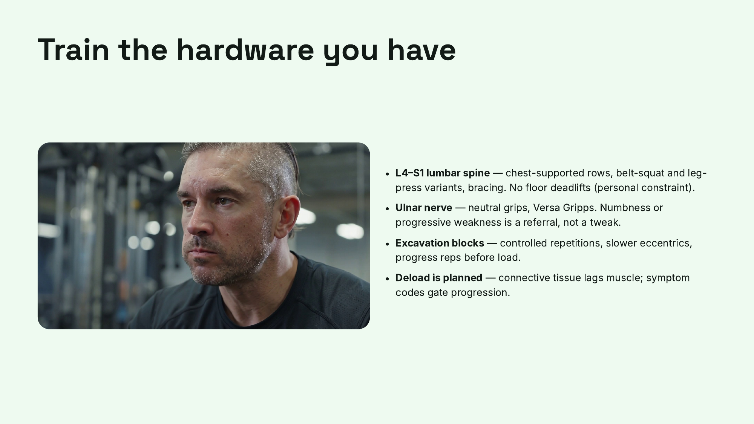
Notes:
Train the hardware you have

Slide 11
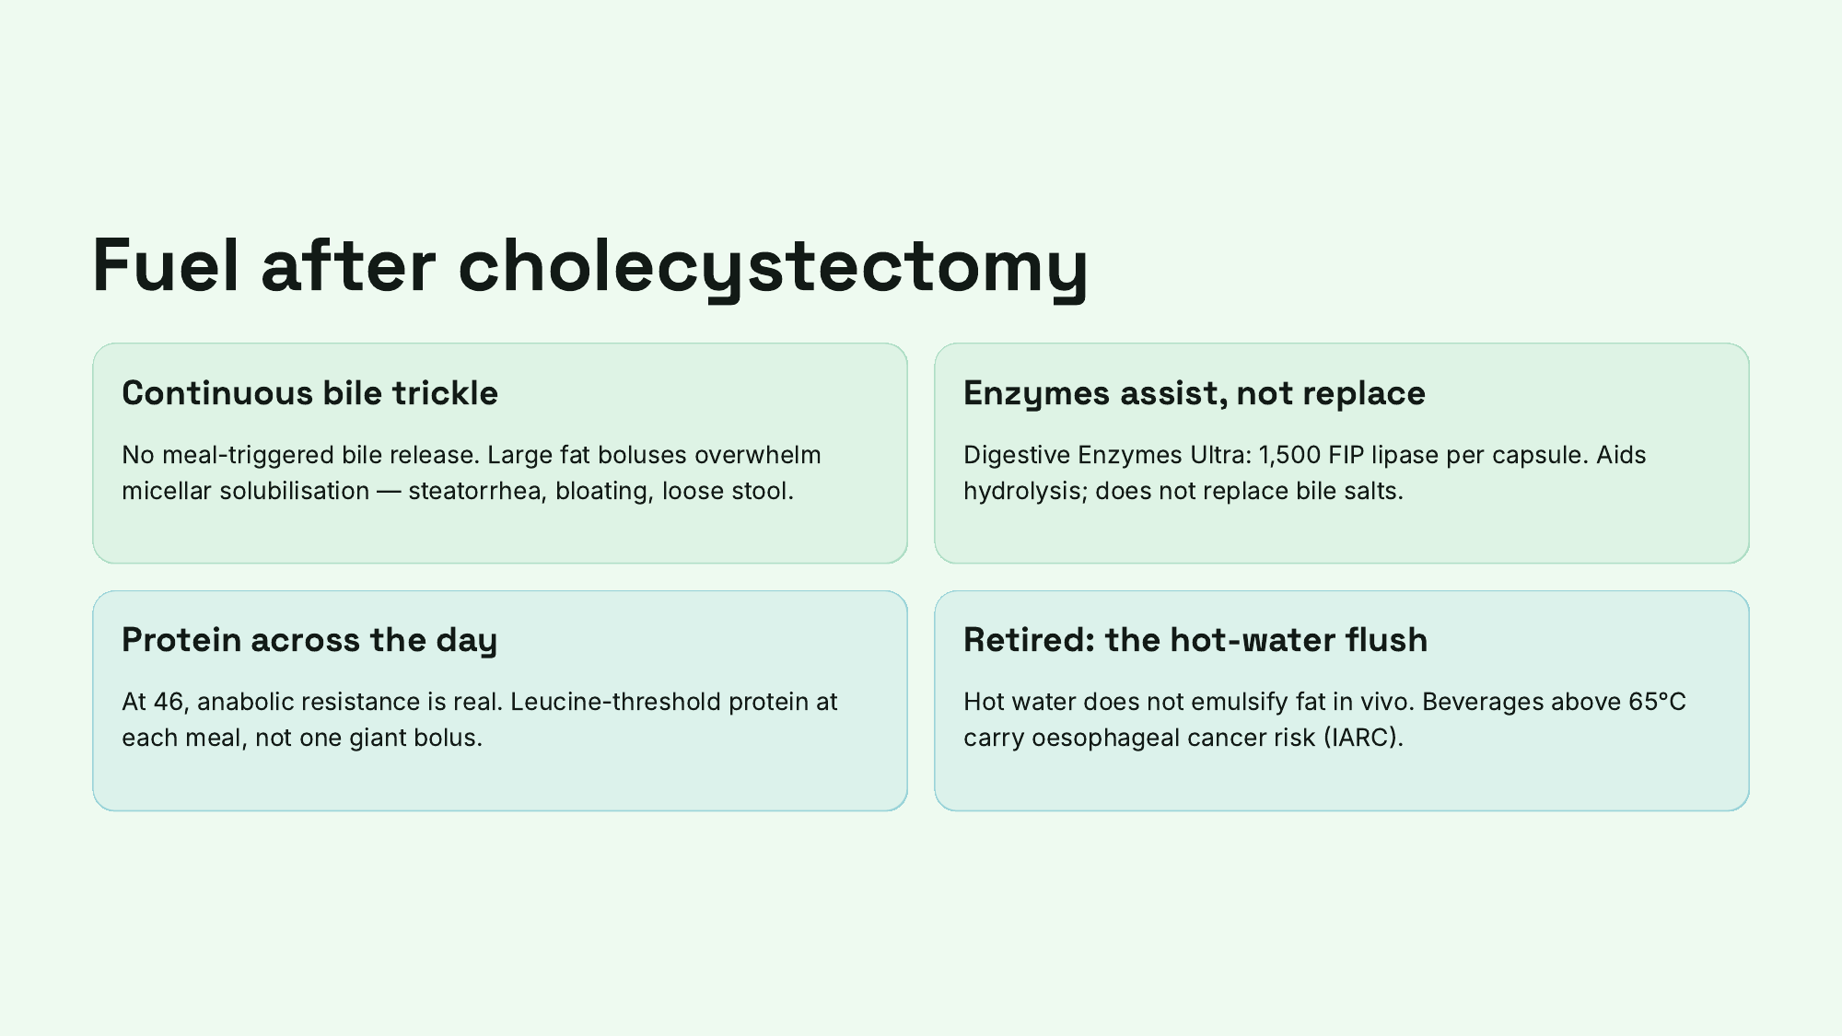
Notes:
Fuel after cholecystectomy

Slide 12
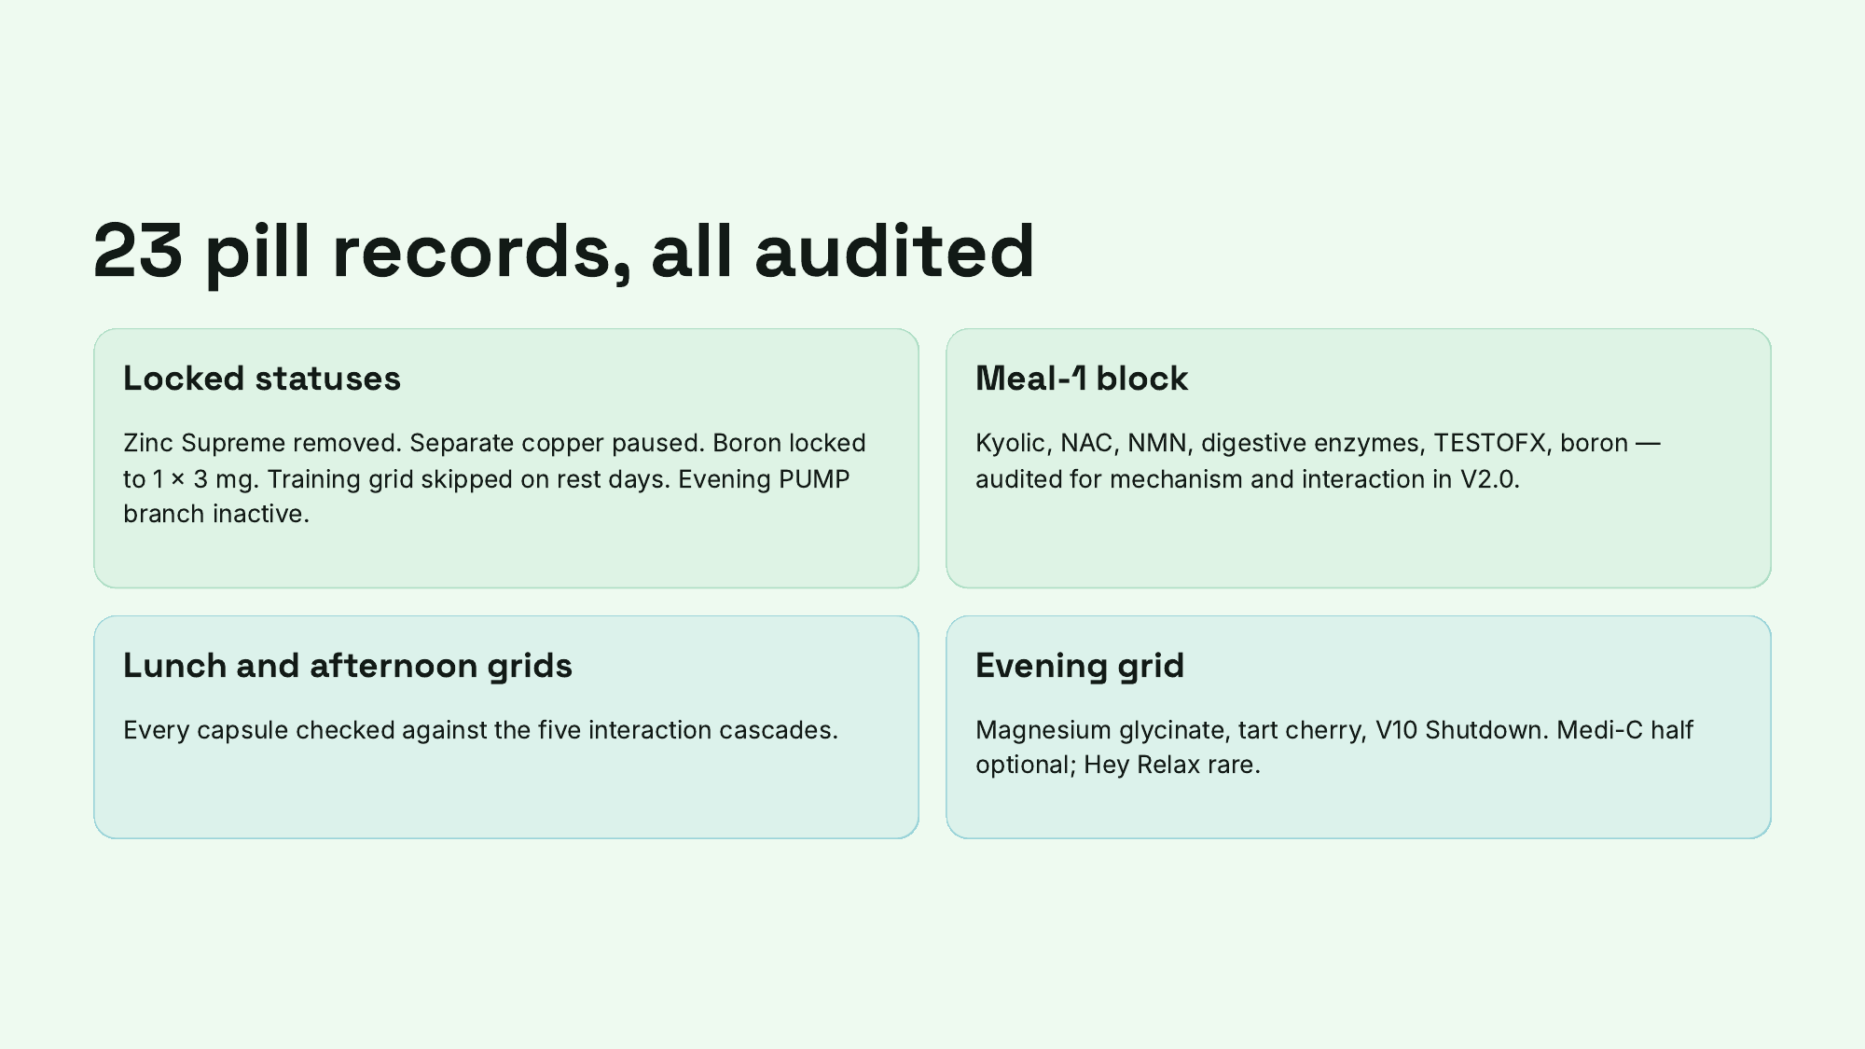
Notes:
23 pill records, all audited

Slide 13
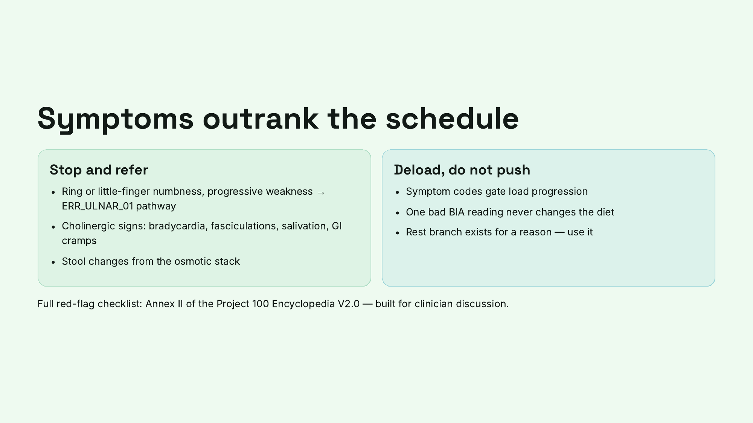
Notes:
Symptoms outrank the schedule

Slide 14
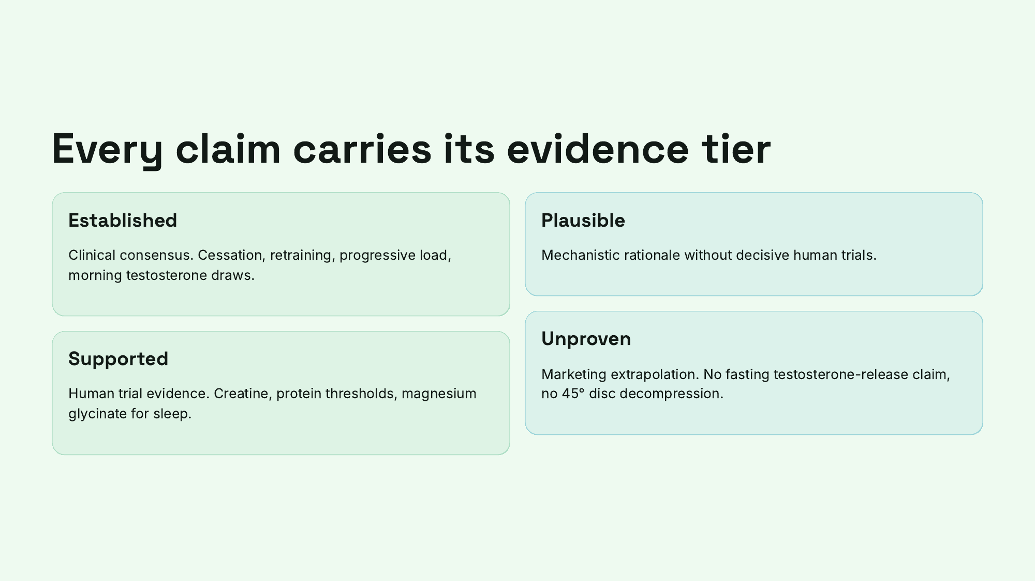
Notes:
Every claim carries its evidence tier

Slide 15
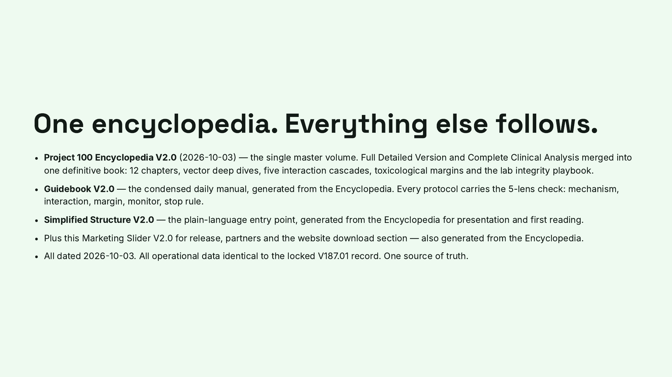
Notes:
One encyclopedia. Everything else follows.

Slide 16
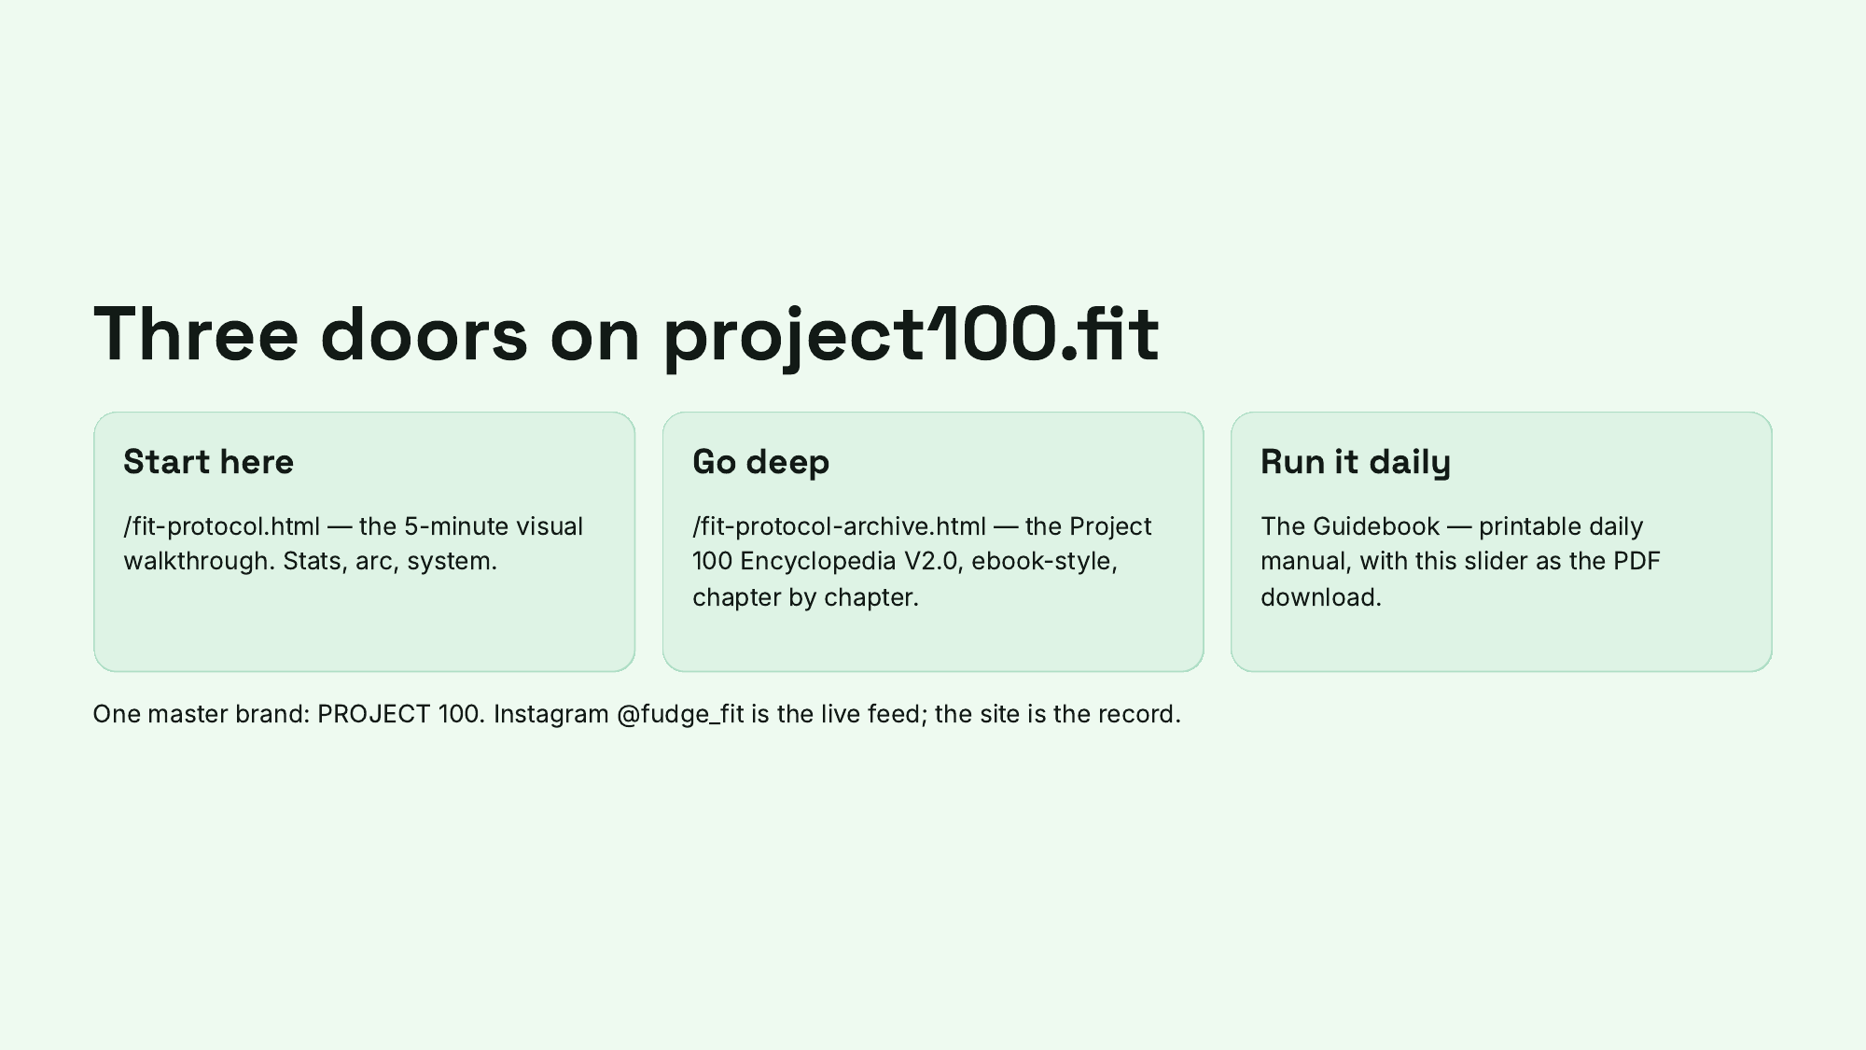
Notes:
Three doors on project100.fit

Slide 17
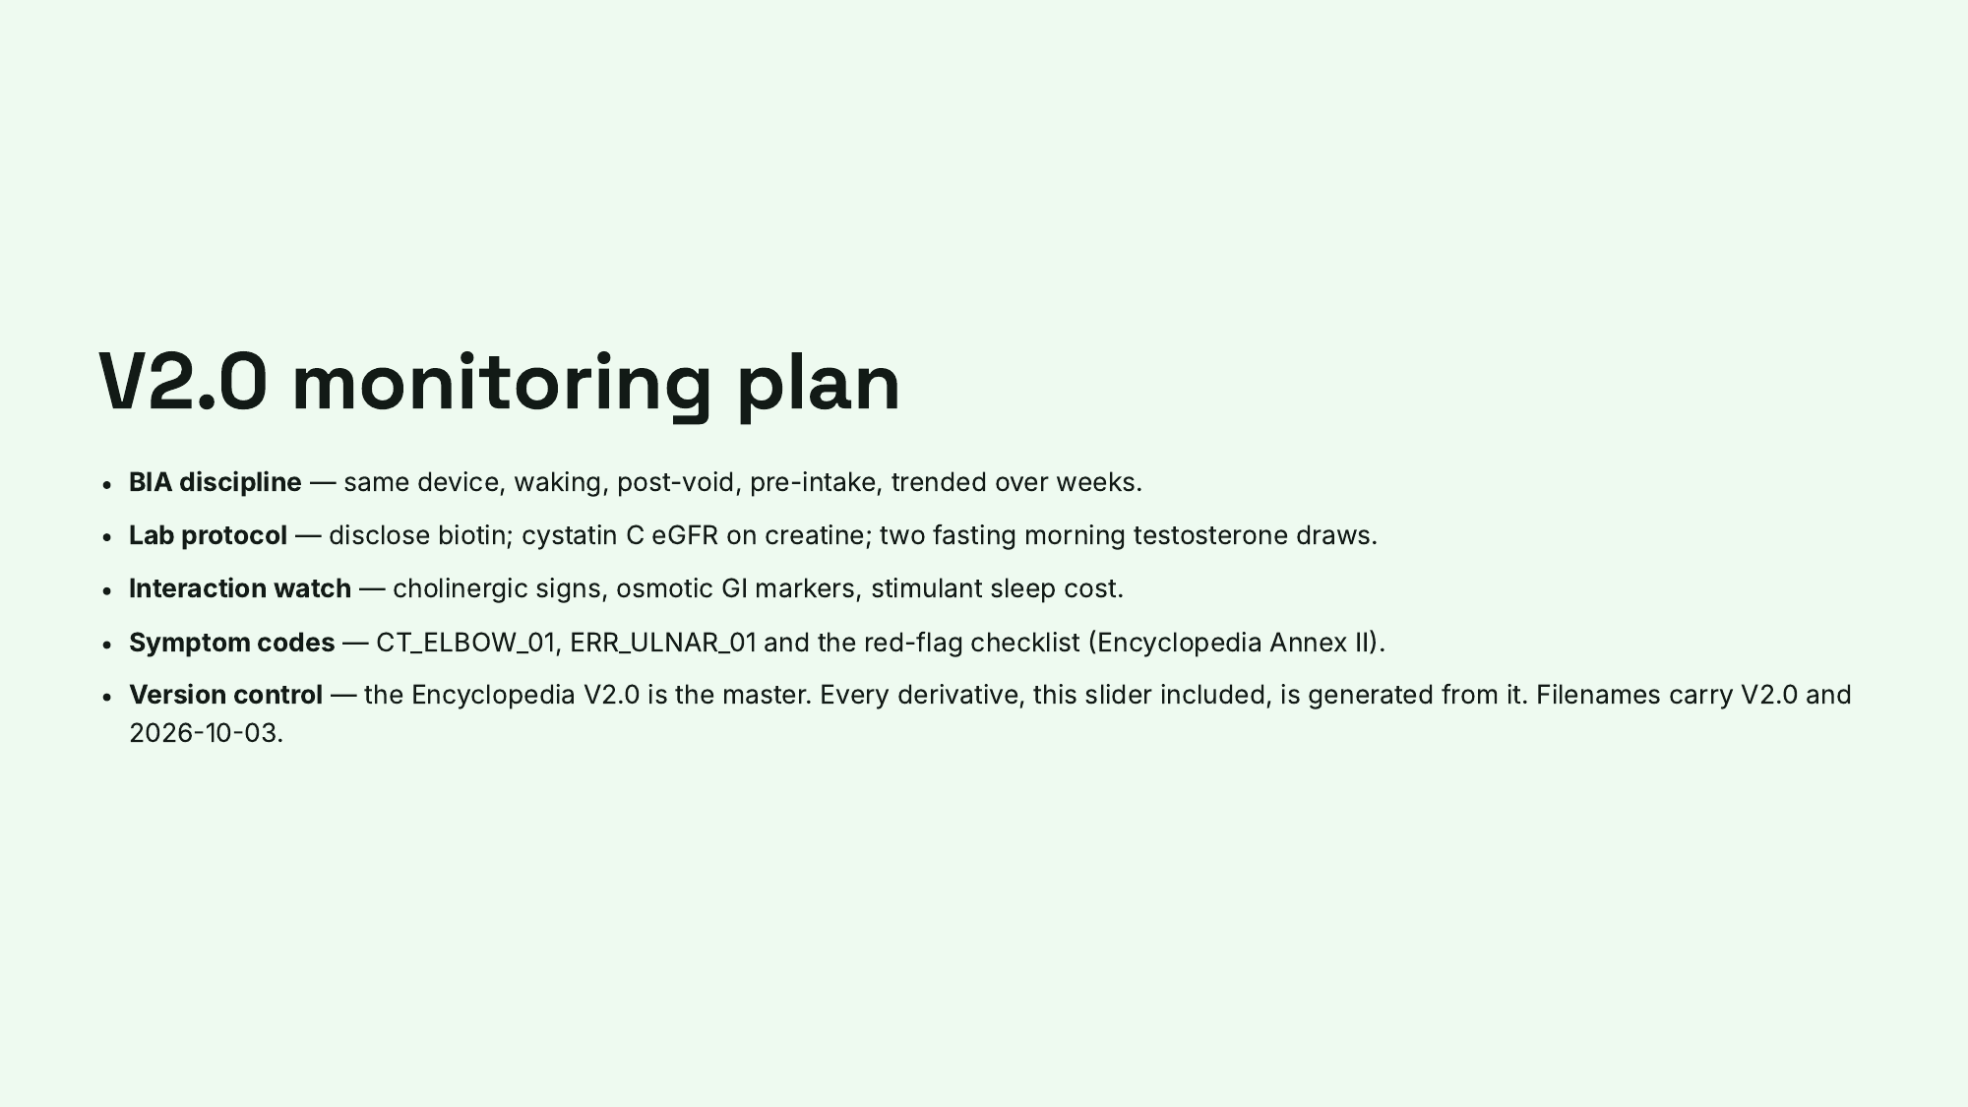
Notes:
V2.0 monitoring plan

Slide 18
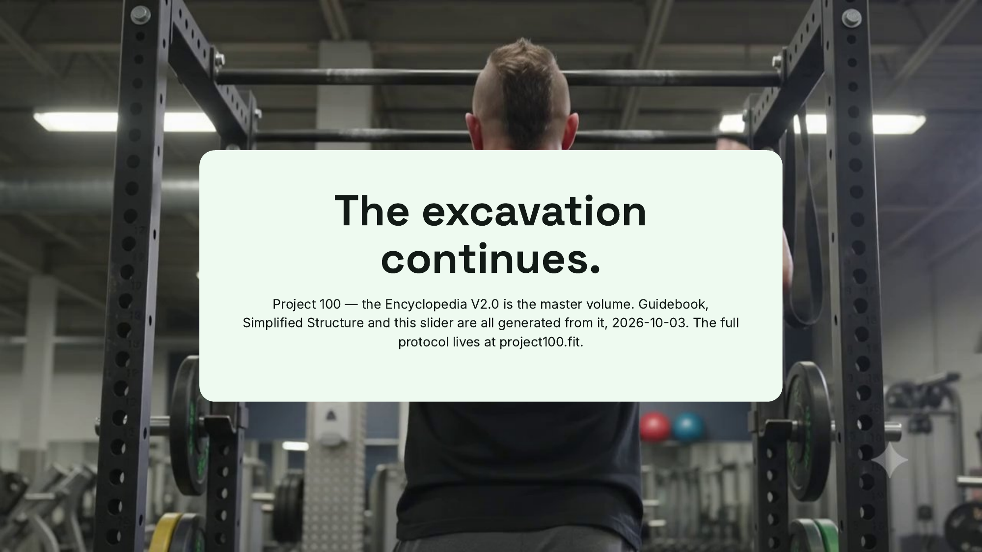
Notes:
The excavation continues.

