Slide 1
AUTOMATION OF STUDENT EDUCATION VERIFICATION AND SERVICES
H. POOJA[211417104184]
PRIYADARSHINI VENKATESAN[211417104201]
S.SHERLINE CALISTA[211417104256]
GUIDE: Dr.L.Jabasheela

Slide 2
INTRODUCTION
Rendering a Bonafide certificate, Letter of Recommendation and verifying a student's background is an obligatory activity of every college.
However, well established institutions at times may find it tedious to issue them when the procedure is extensive or when there is a substantial number of applicants.
The proposed system is completely automated which decreases the time consumption and manual tasks performed during background verification and while issuing a Bonafide or an LOR.
Using this web application, the student authentication process, request approval and providing letter can be done on a single platform from any place making it quickly accessible.
Also a software is implemented for background verification of passed out students the software parse out the data from them with help of keywords obtained ,while the reply mail is sent in tabular format.

Slide 3
PROBLEM STATEMENT
In order to get the Bonafide certificate, one has to appeal to the head of the institute/organization in writing. The entire procedure follows an extensive and a very complicated process.
The procedure for requesting of an Bonafide and LOR follows pretty much a similar process where as there is drafting of a letter by user requesting the particular staff for approval, getting an authorized sign of the staff and seal of officials and that could be a long walk.
Every detail are verified by the Admissions and Records office of the school or institution manually that includes cross verifications of the students with their Roll no, Name and joining year of the college with their earlier registers, marksheets etc.
These conventional methods are time consuming and require more of man-power and effort to complete the work

Slide 4
TECHNOLOGY STACK
HARDWARE REQUIREMENTS | SOFTWARE REQUIREMENTS
Hard Disk: 80GB and Above | Windows 7 and above(64 bit)
RAM: 4GB and Above | JDK 1.8
Processor:P IV and Above | Tomcat 8.5
 | MySQL 5.0
 | Apache Tomcat Server
 | Web designing: HTML 5,CSS3
 | Animation Effect : jQuery

Slide 5
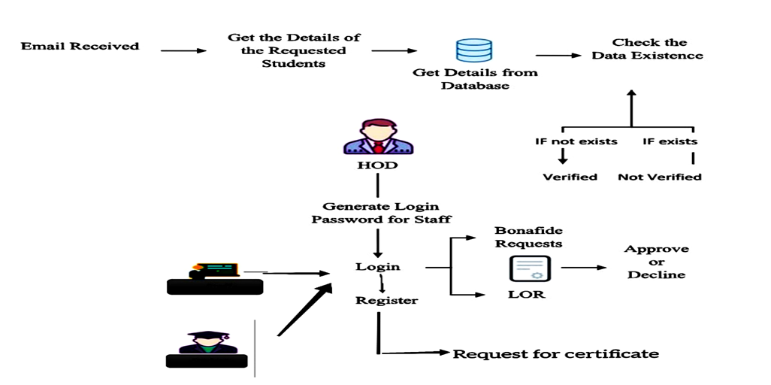
SYSTEM ARCHITECTURE

Slide 6
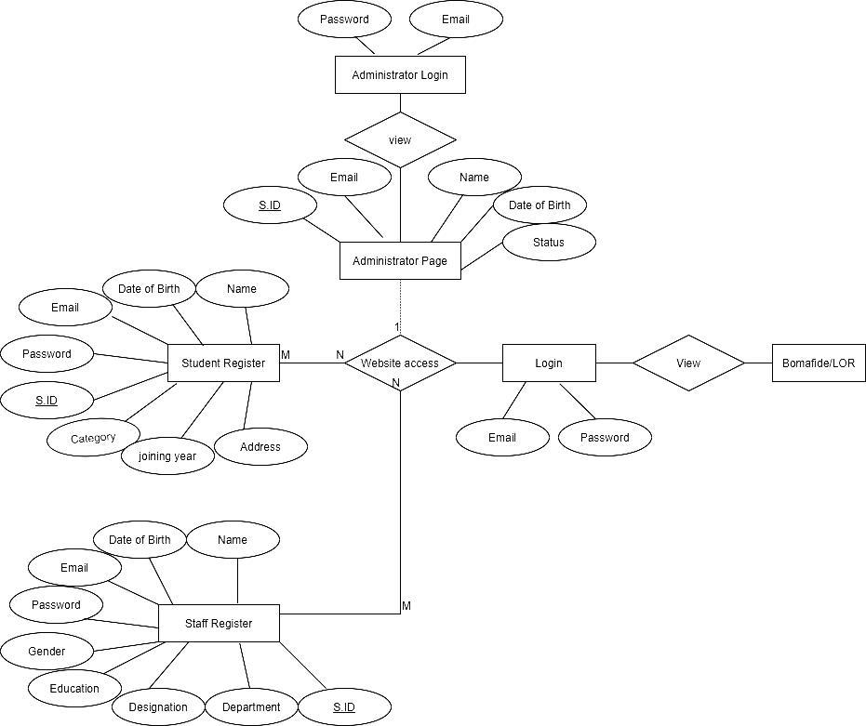
ER DIAGRAM

Slide 7
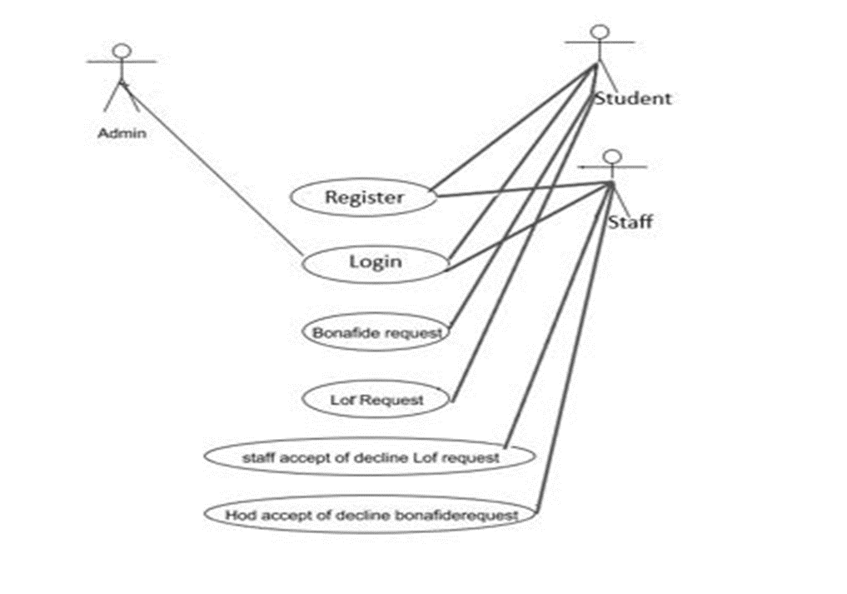
USE CASE DIAGRAM

Slide 8
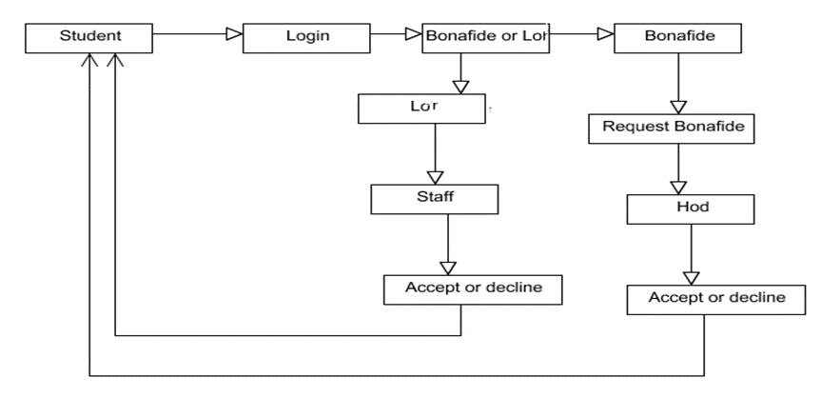
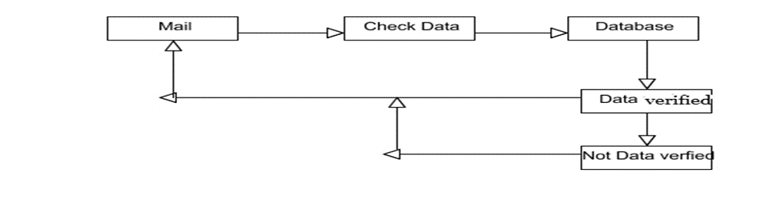
COLLABRATION DIAGRAM

Slide 9
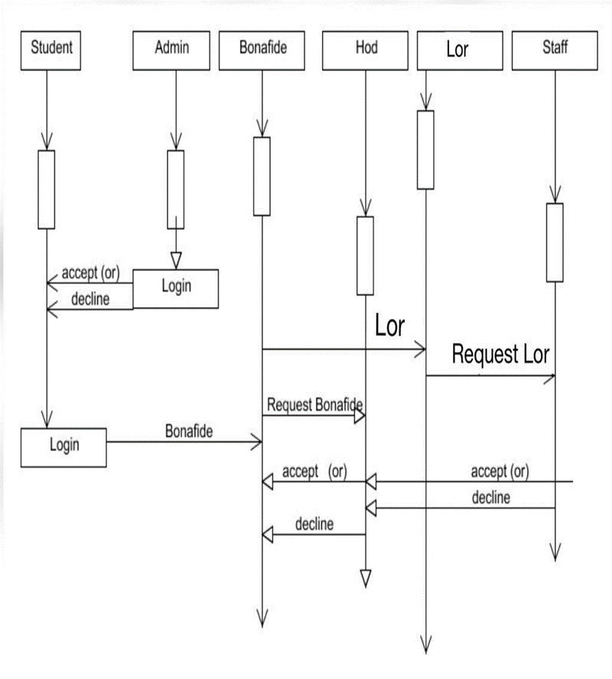
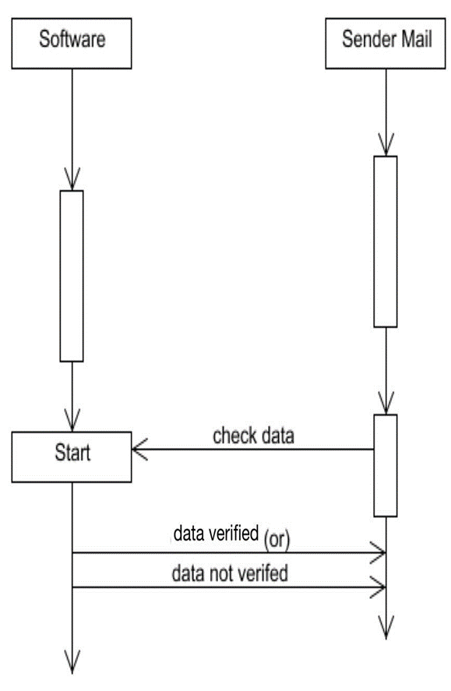
SEQUENCE DIAGRAM

Slide 10
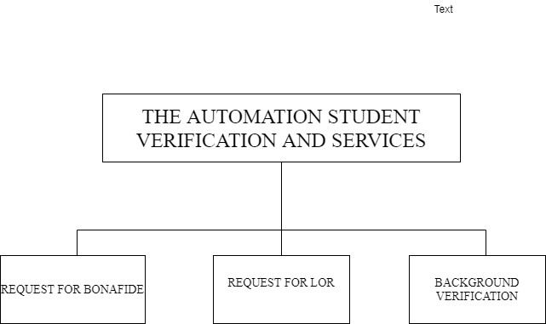
MODULE DESCRIPTION

Slide 11
REQUEST FOR BONAFIDE
In this module, student will register and the login with their login credentials. The students can request for the Bonafide certificate by selecting a reason from the pre-defined list which is present in the website.
The HOD can approve or decline the certificate which are requested by the students. If the HOD approves the request, the request has been approved.
Following which, the student’s name will be appended in the Bonafide template that is maintained already along with the seal and signature of the authority.
The student can check the status of their Bonafide by logging into their account with the correct credentials. If the HOD approves the request for Bonafide, a download button will be provided in the student login page from which they can download their Bonafide.

Slide 12
REQUEST FOR LOR (LETTER OF RECOMMENDATION)
In this module, the student will login with their login credentials.
The students can request for the Letter of Recommendation (LOR) certificate to any selected staff .Upload a letter of your LOR and choose the faculty's name from the pre-defined list.
Once the “Request for LOR” Button is clicked, the corresponding faculty is notified in their login. On approving there request, the student will be notified / a pop up message will appear in the login stating that the LOR request has been accepted.
Following which, the contents of the letter will be appended in the LOR template maintained in the website along with the seal and signature of the authority.
The student can check the status of their LOR by logging into their account with the correct credentials. A download button will be provided in the student login page by which they can download their LOR.

Slide 13
The functionalities under the website are:
STUDENT REGISTRATION
Initially the student has to register his/her details into the website.
The Information gathered would include (Student Name, DOB ,Email ,Password, Course, Category, Joining Year, Gender, Address, Location and pin code.
STAFF REGISTRATION
At first the staff has to register their details into the site.
Information gathered would include (Staff Name, DOB,Gender,Education,Email,Password, Designation, Department)
ADMIN LOGIN
They are the ones who verify the students and staff who has registered on the website and consent their access to it.
Once the verification process is being approved by the Administrator students can login into website by providing the registered mail Id and password and then apply for a Bonafide or an LOR.
STUDENT LOGIN
On clicking BONAFIDE or an LOR
A Student is provided to click there reasons which are provided from the drop down list.
Pop up message of Immediate request is sent

Slide 14
BACKGROUND VERFICATION
Initially, background verification companies/third-party background verifiers send an email to college requesting for background verification for passed out students.
The proposed software is implemented in such a way that whenever background verification companies send email to institutions requesting for background verification of passed out students, the software reads the unread mails, parse out the data from them with the help of keywords such as {Candidate Name, Register number, College Name, Qualifications, CGPA} obtained and cross-checks them with the existing student database to find if the information provided is genuine or not.
The reply email follows a tabular format. It consists of all the fields that are checked with the database with a corresponding field for each row stating if the data is verified or not

Slide 15
TESTING
Unit Testing and Integration Testing are been performed for the Website As well as for Software.
ID | Test case Objective | Expected Result | Actual Result | Pass/Fail
1 | Check the interface link between Register and Login Module. | To be directed to Login Page of Student / staff. | To be directed to Login Page of Student / staff. | PASS
2 | Check the interface Link between Admin Login and View List | The Admin will be able to approve/decline the students and staffs. | The Admin will be able to approve/decline the students and staffs. | PASS
3 | Check the interface link between Student Login and student home page. | The Students directed to Specific page Bonafide or LOR. | The Students directed to specific page of Bonafide or LOR. | PASS
4 | Check the interface link between student home page and student LOR. | Request for LOR is processed to that staff. | Request for LOR is processed to that staff. | PASS
5 | Check the interface link between Staff Login and staff home. | Letter will be displayed. | Letter will be displayed. | PASS

Slide 16
Integration Testing is performed for the Background Verification of software for the following Test scenarios.
Initially the software is provided with the legitimate data of a student in the correct keyword format to see if the software parses the data and check with the correct fields in the database and returns a result to the sender in table format.
In the same way, if a user mail doesn’t consist of the required keywords for the parsing to take place ultimately ,no action is performed by the software
ID | Test case Objective | Test Steps | Expected Results | Actual Results | Pass\Fail
1 | Check User provides with Data with correct keywords | 1.The mail sent is parsed | Data is been parsed with the Background verification software and mail and reply mail is sent | Data is been parsed with the Background verification software and mail and reply mail is sent | PASS
2 | Check User provides with missing keywords | 1.The mail is sent without any keywords | No process is been performed. | No process is been performed. | PASS

Slide 17
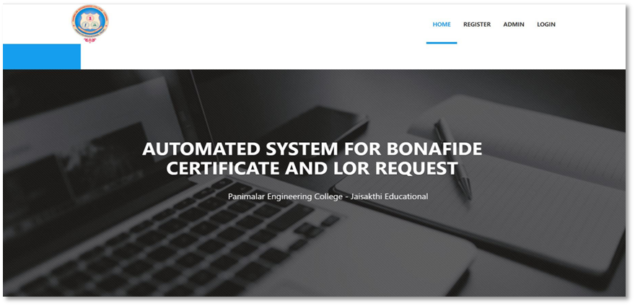
SCREENSHOTS

Slide 18
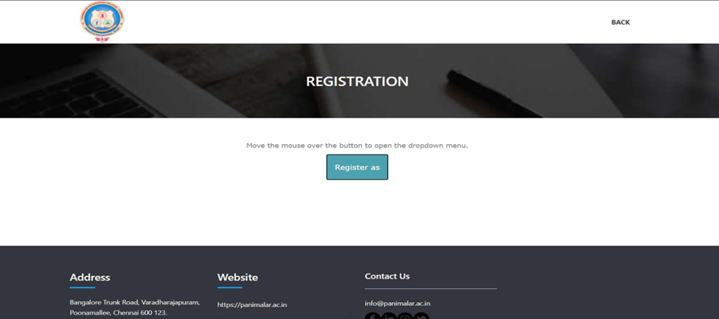
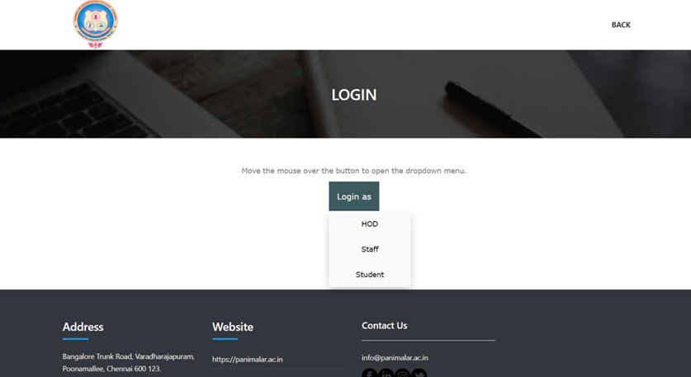

Slide 19
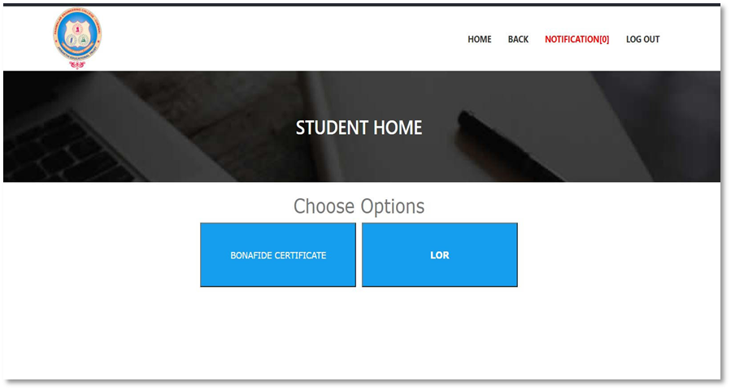
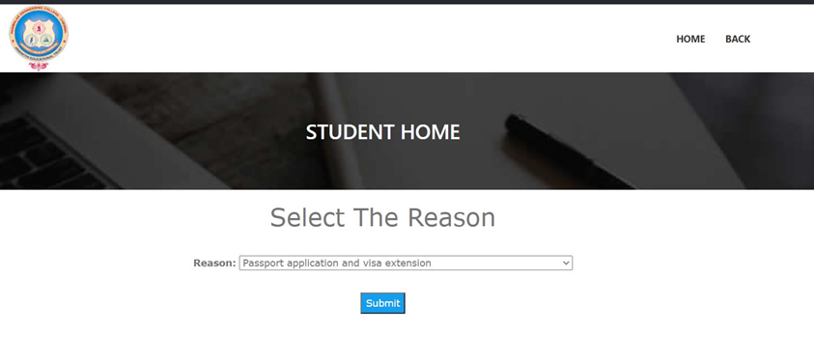

Slide 20
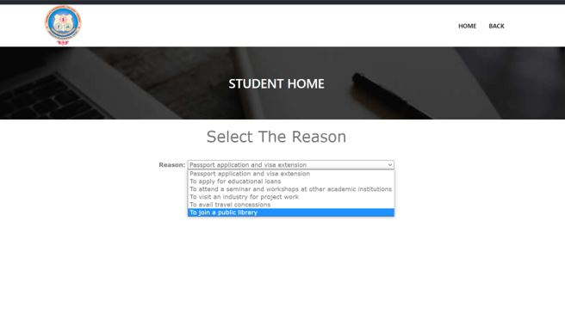

Slide 21
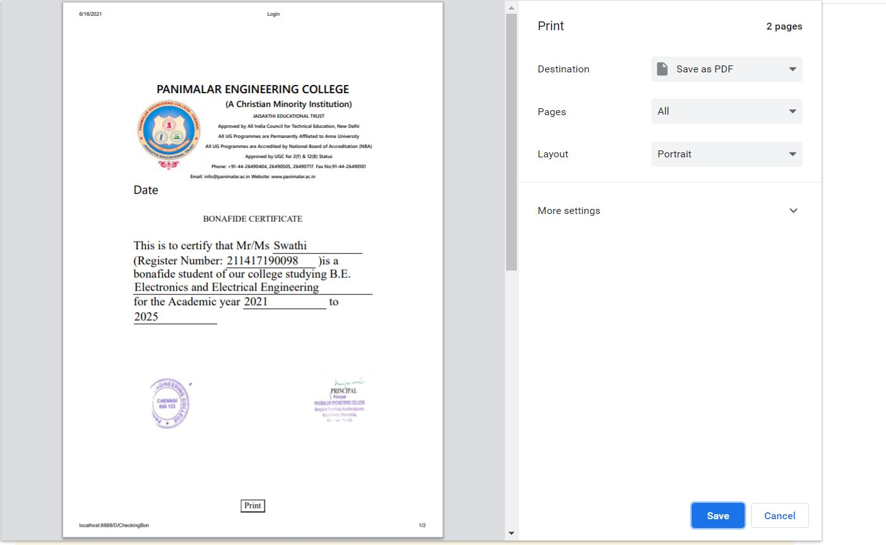

Slide 22
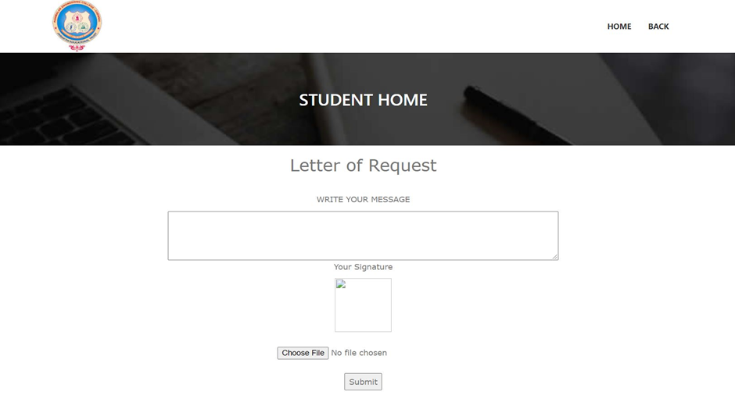

Slide 23
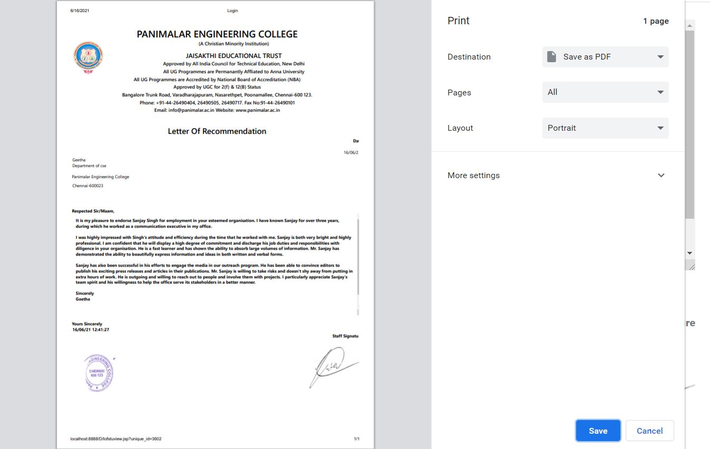

Slide 24
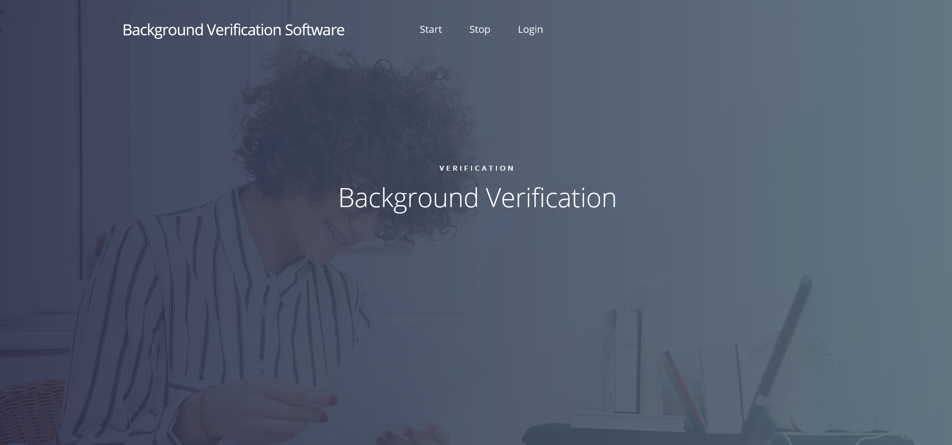
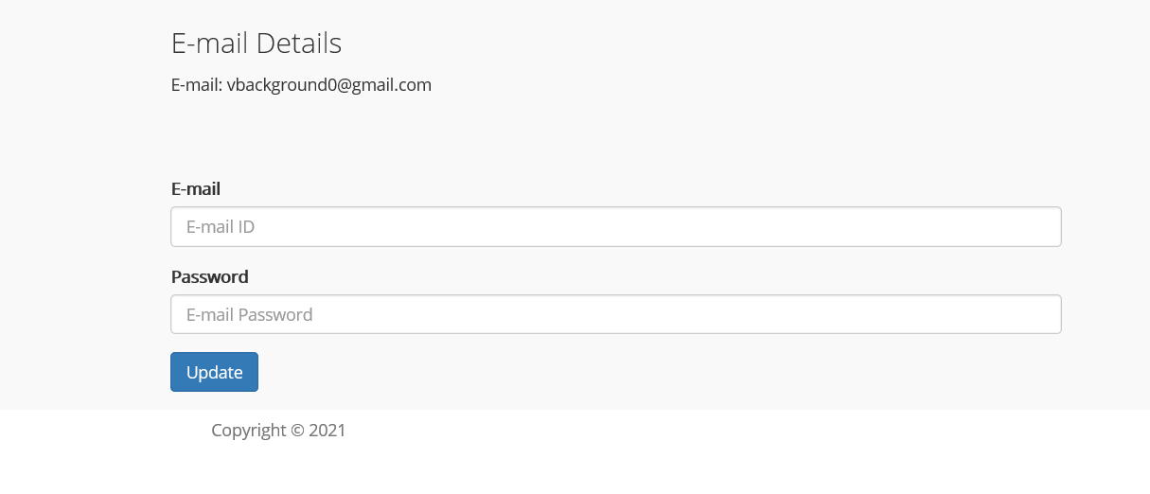

Slide 25
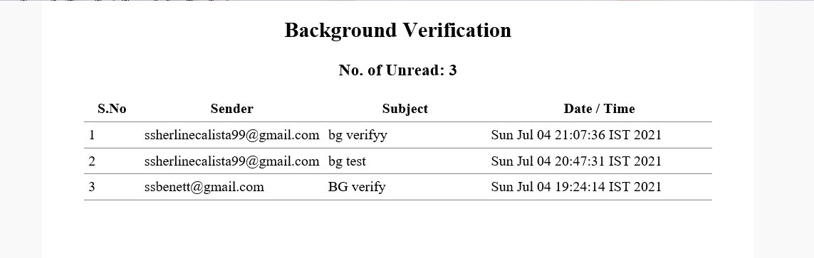
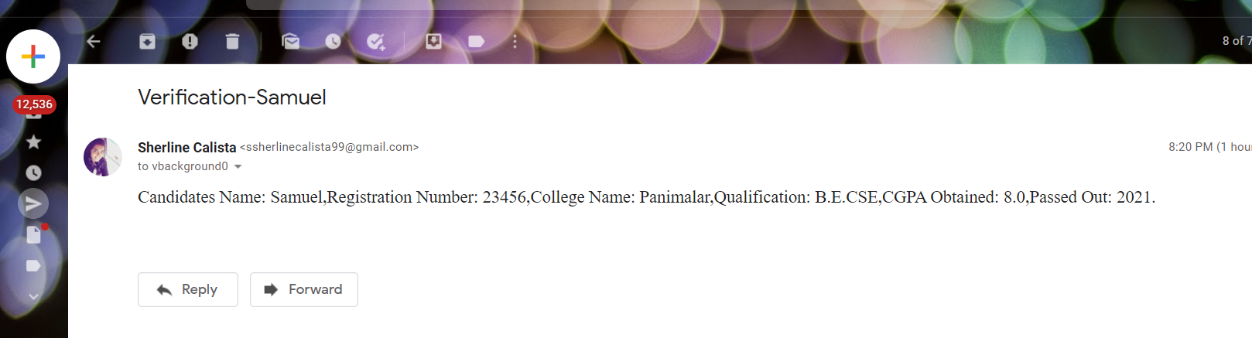

Slide 26
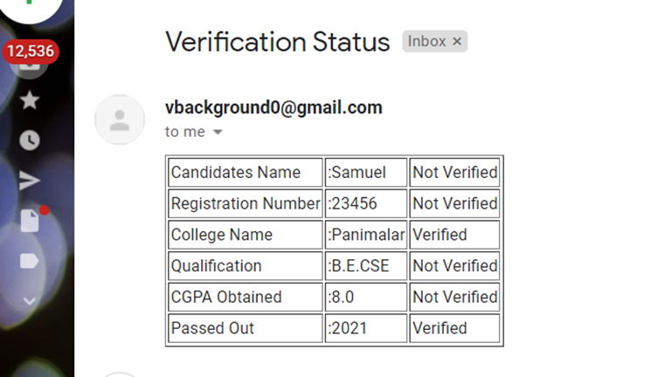
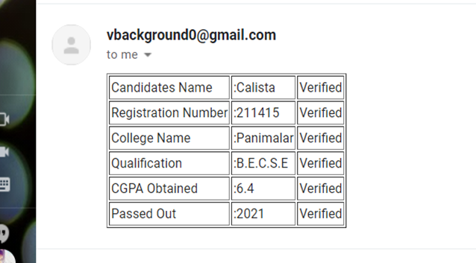

Slide 27
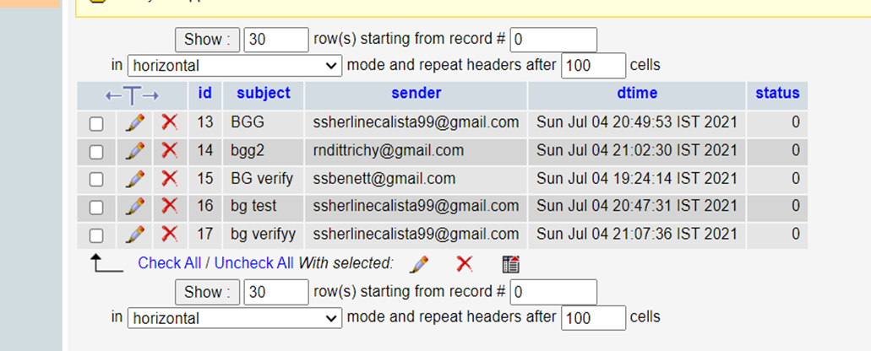

Slide 28
CONCLUSION
The proposed system will drastically reduce the amount of time required by the students and staffs to apply, process and issue a Bonafide and an LOR up to a very great extent as it is completely automated.
Students can avail them right from their place of residence even during times of emergency. Along with this, the organizations can also make use of the background verification software to verify a student’s background immediately.
It is definitely a mandatory thing to switch over from utilizing man power and make use of automated systems in this fast-paced world.

Slide 29
REFERENCES
[1] D. P. Mital and Goh Wee Leng, "Text segmentation for automatic document processing," Proceedings 1996 IEEE Conference on Emerging Technologies and Factory Automation. ETFA '96, Kauai, HI, USA, 1996, pp. 642-648 vol.2, doi: 10.1109/ETFA.1996.573971.
[2] K. Yang and J. Ho, "Parsing Publication Lists on the Web," 2010 IEEE/WIC/ACM International Conference on Web Intelligence and Intelligent Agent Technology, Toronto, ON, Canada, 2010, pp. 444-447, doi: 10.1109/WI-IAT.2010.206.
[3]Meng, "College Student Management System Design Using Computer Aided System," 2015 International Conference on Intelligent Transportation, Big Data and Smart City, Halong Bay, Vietnam, 2015, pp. 212-215, doi: 10.1109/ICITBS.2015.59.
[4]H. Baban and S. Mokhtar, "Online Document Management System for Academic Institutes," 2010 3rd International Conference on Information Management, Innovation Management and Industrial Engineering, Kunming, China, 2010, pp. 315-319, doi: 10.1109/ICIII.2010.555.
[5]V. Singrodia, A. Mitra and S. Paul, "A Review on Web Scrapping and its Applications," 2019 International Conference on Computer Communication and Informatics (ICCCI), Coimbatore, India, 2019, pp. 1-6, doi: 10.1109/ICCCI.2019.8821809.
[6]R. Diouf, E. N. Sarr, O. Sall, B. Birregah, M. Bousso and S. N. Mbaye, "Web Scraping: State-of-the-Art and Areas of Application," 2019 IEEE International Conference on Big Data (Big Data), Los Angeles, CA, USA, 2019, pp. 6040-6042, doi: 10.1109/BigData47090.2019.9005594.
[7]A. Rani, K. Mehla and A. Jangra, "Parsers and parsing approaches: Classification and state of the art," 2015 International Conference on Futuristic Trends on Computational Analysis and Knowledge Management (ABLAZE), Greater Noida, India, 2015, pp. 34-38, doi: 10.1109/ABLAZE.2015.7154963.
[8]F. Yue, "A study of student information management software," 2016 IEEE International Conference of Online Analysis and Computing Science (ICOACS), Chongqing, China, 2016, pp. 393-396, doi: 10.1109/ICOACS.2016.7563123.
[9]Fangxing Lv, Xiaoyao Xie, Cuicui Zhang and Xingjing Cheng, "Research and development of E-mail program based on Java," 2009 3rd International Conference on Anti-counterfeiting, Security, and Identification in Communication, Hong Kong, China, 2009, pp. 80-84, doi: 10.1109/ICASID.2009.5276955.

