Slide 1
AUTOMATION OF STUDENT EDUCATION VERIFICATION AND SERVICES
H. POOJA[211417104184]
PRIYADARSHINI VENKATESAN[211417104201]
S.SHERLINE CALISTA[211417104256]
GUIDE: Dr.L.Jabasheela M.E, Ph.D.,

Slide 2
INTRODUCTION
Rendering a Bonafide certificate, Letter of Recommendation and verifying a student's background is an obligatory activity of every college.
However, well established institutions at times may find it tedious to issue them when the procedure is extensive or when there is a substantial number of applicants.
The proposed system is completely automated which decreases the time consumption and manual tasks performed during background verification and while issuing a Bonafide or an LOR.
Using this web application, the student authentication process, request approval and providing letter can be done on a single platform from any place making it quickly accessible.
As an added feature, a unique software is developed that automatically parses the mail contents sent by a background verifier and matches it with the student database to find if the information is genuine or not with an automated reply email.

Slide 3
PROBLEM STATEMENT
In order to get the Bonafide certificate, one has to appeal to the head of the institute/organization in writing. The entire procedure follows an extensive and a very complicated process.
The procedure for requesting of an Bonafide and LOR follows pretty much a similar process where as there is drafting of a letter by user requesting the particular staff for approval, getting an authorized sign of the staff and seal of officials and that could be a long walk.
Every detail are verified by the Admissions and Records office of the school or institution manually that includes cross verifications of the students with their Roll no, Name and joining year of the college with their earlier registers, marksheets etc.
These conventional methods are time consuming and require more of man-power and effort to complete the work

Slide 4
TECHNOLOGY STACK
HARDWARE REQUIREMENTS | SOFTWARE REQUIREMENTS
Hard Disk: 80GB and Above | Windows 7 and above(64 bit)
RAM: 4GB and Above | JDK 1.8
Processor:P IV and Above | Tomcat 8.5
 | MySQL 5.0
 | Apache Tomcat Server
 | Web designing: HTML 5,CSS3
 | Animation Effect : jQuery

Slide 5
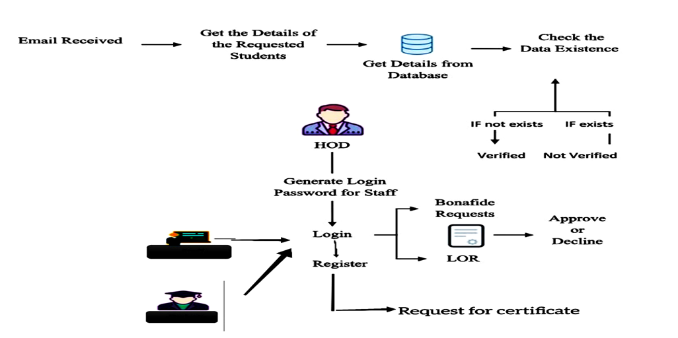
SYSTEM ARCHITECTURE

Slide 6
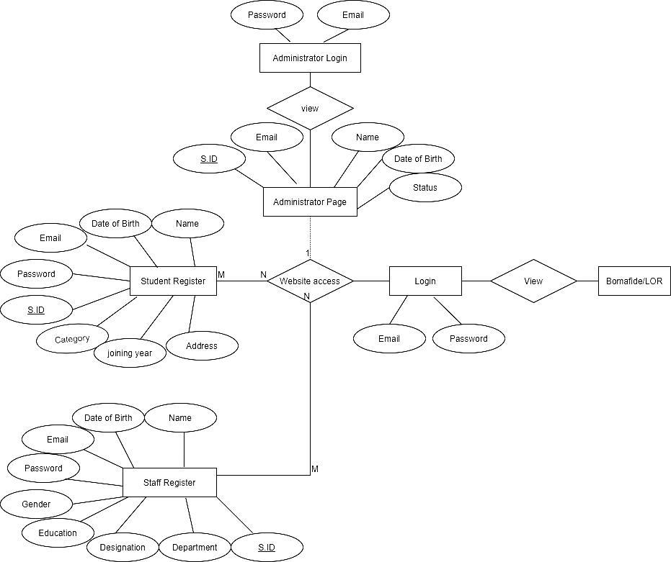
ER DIAGRAM

Slide 7
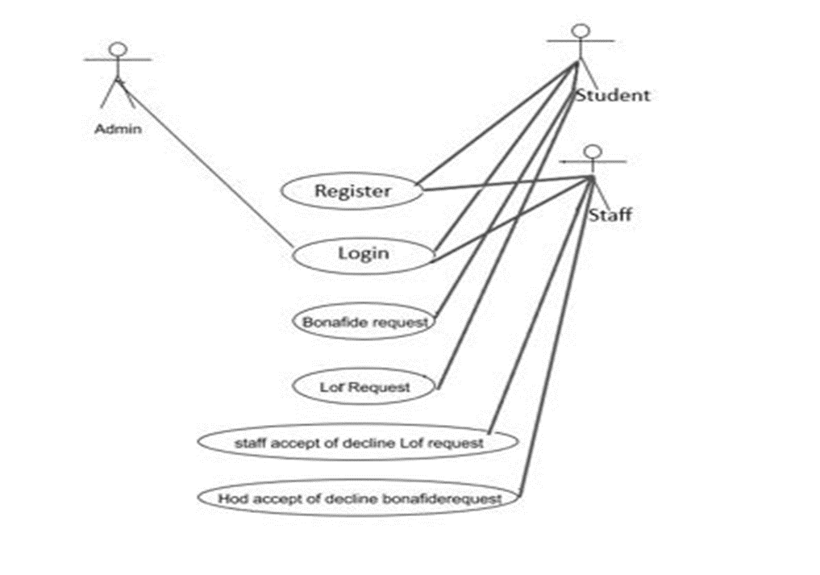
USE CASE DIAGRAM

Slide 8
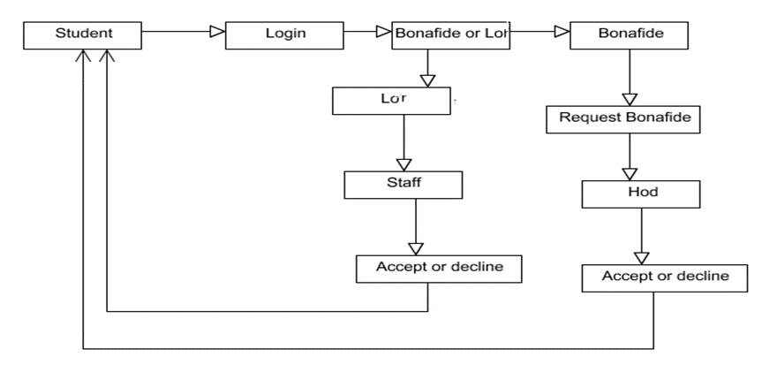
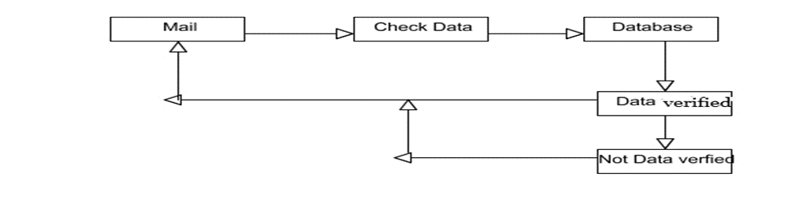
COLLABRATION DIAGRAM

Slide 9
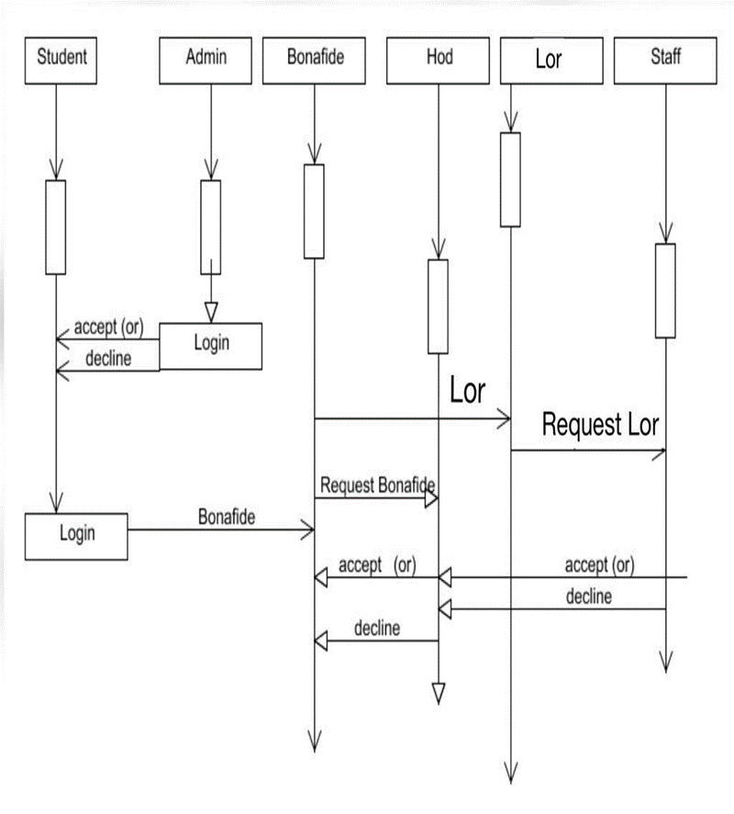
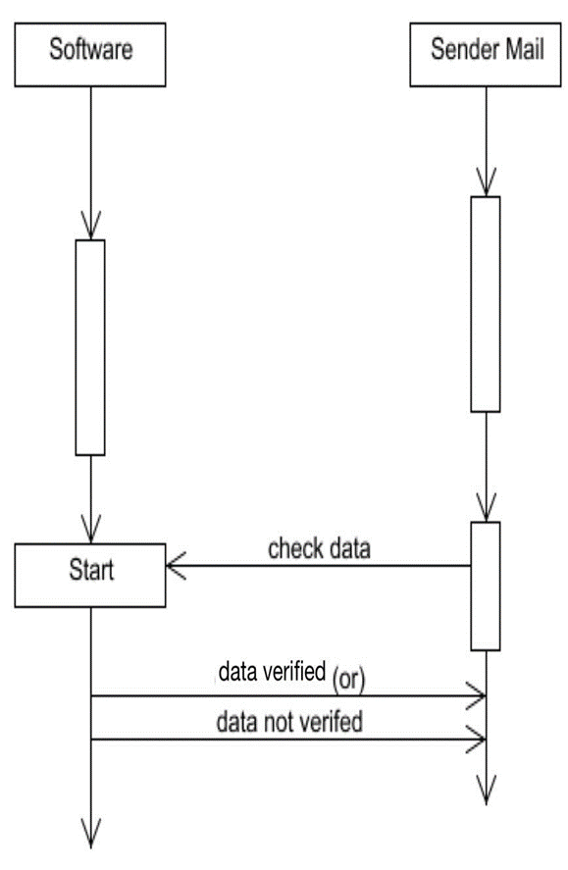
SEQUENCE DIAGRAM

Slide 10
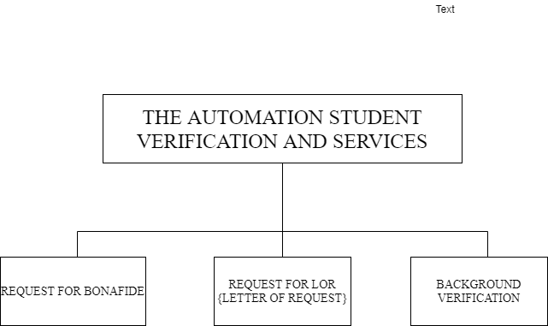
MODULE DESCRIPTION

Slide 11
REQUEST FOR BONAFIDE
In this module, student will register and the login with their login credentials. The students can request for the Bonafide certificate by selecting a reason from the pre-defined list which is present in the website.
The HOD can approve or decline the certificate which are requested by the students. If the HOD approves the request, the request has been approved.
Following which, the student’s name will be appended in the Bonafide template that is maintained already along with the seal and signature of the authority.
The student can check the status of their Bonafide by logging into their account with the correct credentials. If the HOD approves the request for Bonafide, a download button will be provided in the student login page from which they can download their Bonafide.

Slide 12
REQUEST FOR LOR(LETTER OF REQUEST)
In this module, the student will login with their login credentials.
The students can request for the Letter of Request (LOR) certificate to any selected staff .Upload a letter of your LOR and choose the faculty's name from the pre-defined list.
Once the “Request for LOR” Button is clicked, the corresponding faculty is notified in their login. On approving there request, the student will be notified / a pop up message will appear in the login stating that the LOR request has been accepted.
Following which, the contents of the letter will be appended in the LOR template maintained in the website along with the seal and signature of the authority.
The student can check the status of their LOR by logging into their account with the correct credentials. A download button will be provided in the student login page by which they can download their LOR.

Slide 13
The functionalities under the website are:
STUDENT REGISTRATION
Initially the student has to register his/her details into the website.
The Information gathered would include (Student Name, DOB ,Email , Password, Course, Category, Joining Year, Gender, Address, Location and pin code.
STAFF REGISTRATION
At first the staff has to register their details into the site.
Information gathered would include (Staff Name, DOB , Gender, Education, Email, Password, Designation, Department)
ADMIN LOGIN
They are the ones who verify the students and staff who has registered on the website and consent their access to it.
Once the verification process is being approved by the Administrator students can login into website by providing the registered mail Id and password and then apply for a Bonafide or an LOR.
STUDENT LOGIN
On clicking BONAFIDE or an LOR
A Student is provided to click there reasons which are provided from the drop down list.
Pop up message of Immediate request is sent

Slide 14
BACKGROUND VERFICATION
Initially, background verification companies/third-party background verifiers send an email to college requesting for background verification for passed out students.
The proposed software is implemented in such a way that whenever background verification companies send email to institutions requesting for background verification for passed out students, the software automatically open the mail account and parse/scrape out the data such as (name, register number, marks passed out year) and checks it with the database to find if the information provided is genuine or not.
If a student with the same data is present, then a reply e mail is sent to the verifier stating that the details are verified. If not, reply mail states that the details are not verified.

Slide 15
TESTING
Unit Testing and Integration Testing are been performed for the Website and Software.
Unit Testing for LOR and Bonafide is represented below in tabular format, there is a small nuances between both the Testing.
Test case Objective | Expected Result
Check the interface link between Register and Login Module. | To be directed to Login Page of Student / staff.
Check the interface Link between Admin Login and View List | The Admin will be able to approve/decline the students
Check the interface link between Student Login and Student Home Page | The Students directed to specific page of Bonafide or
Check the interface link between student home page and student LOR | Request for LOR is processed
Check the interface link between Staff Login and staff home | Letter will be displayed
Check the interface link between student home page and Bonafide. | The request for Bonafide is submitted successfully
Check the interface link between HOD login and student | On approval “ Request for Bonafide is Successfully processed” message is displayed

Slide 16
Integration Testing is performed for the Background Verification of software for the following Test scenarios.
In the first Test case, of checking the user on providing with valid Data for parsing of the mail, all the data provided should be mandatory, then the background verification software parses the data and provides the expected results.
Test Scenario | Test Steps | Test Data | Pass\Fail
Check User provides with valid Data | The mail is sent with the content. | Candidate Name: Ram.V Roll no:211417104001 Passing Year:Apr,2007 Course: B.E Department:CSE Backlog status:0 | Pass
Check User provides with invalid Data | The mail is sent without any content. | Null | Fail

Slide 17
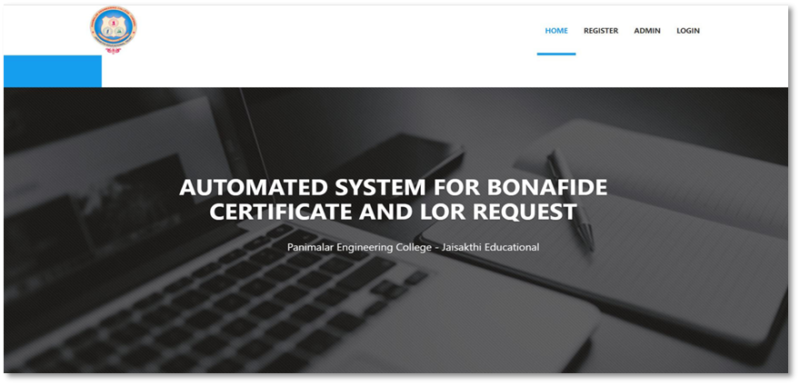
SCREENSHOTS

Slide 18
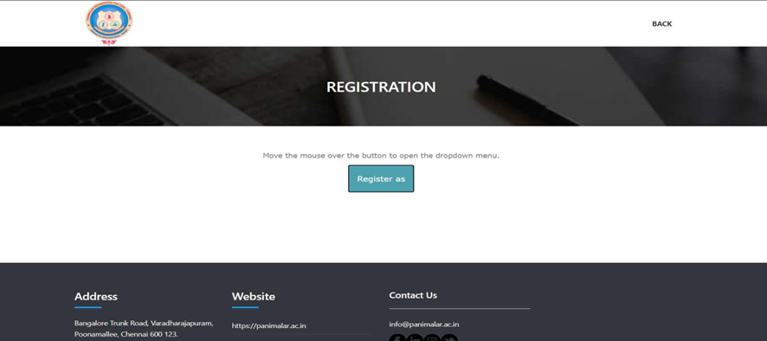
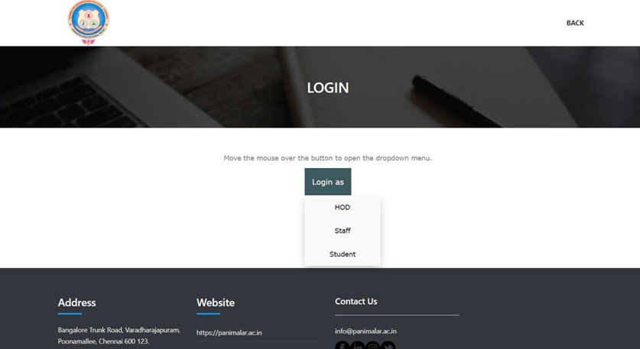

Slide 19
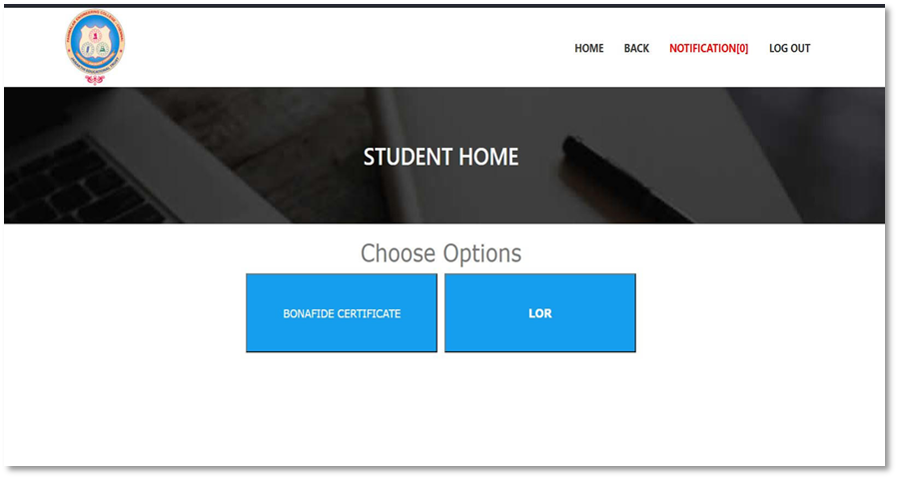
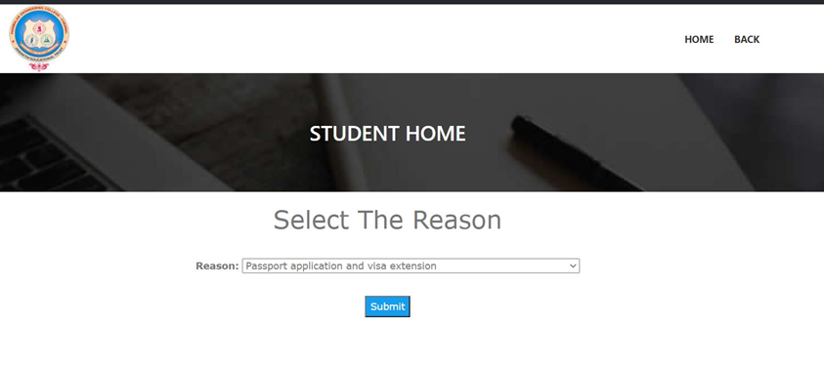

Slide 20
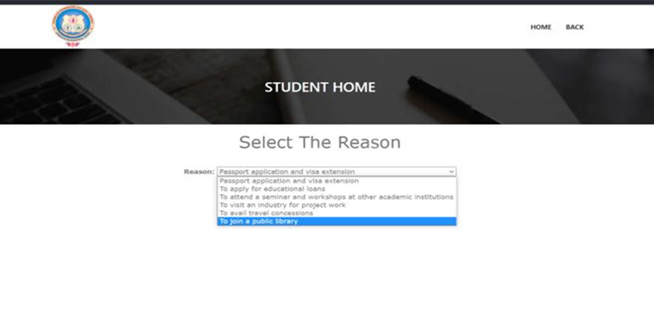
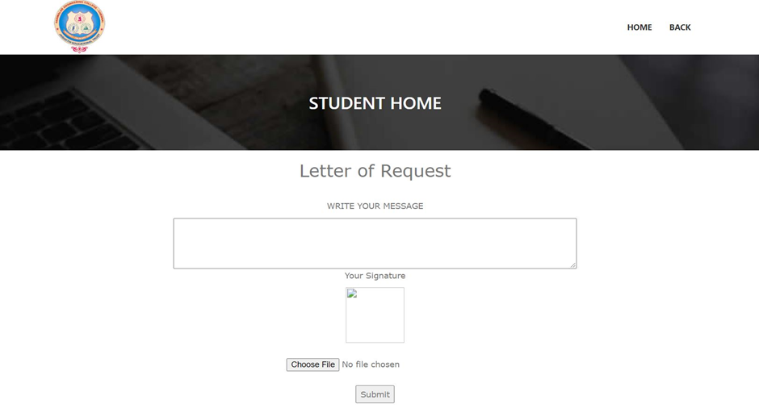

Slide 21
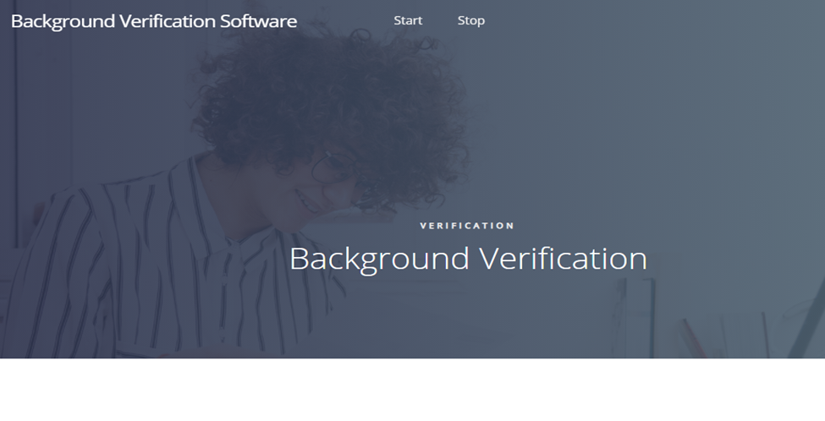
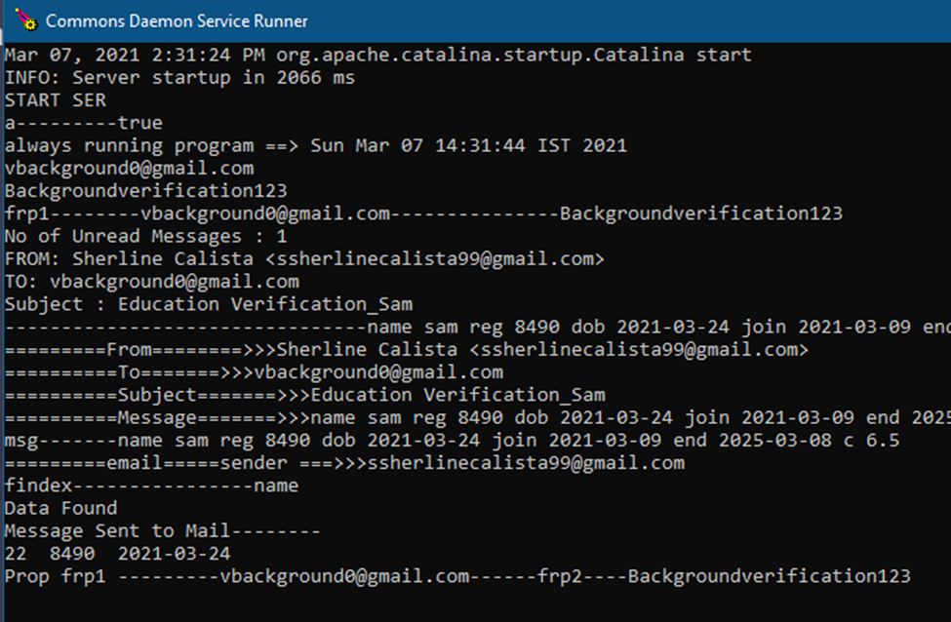

Slide 22
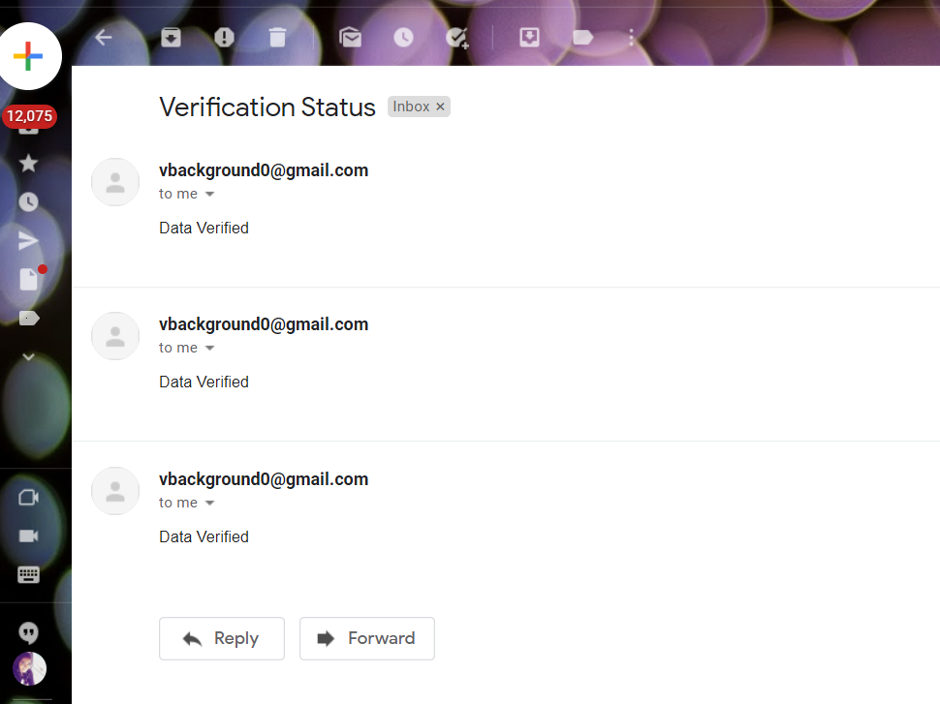

Slide 23
CONCLUSION
The proposed system will drastically reduce the amount of time required by the students and staffs to apply, process and issue a Bonafide and an LOR up to a very great extent as it is completely automated.
Students can avail them right from their place of residence even during times of emergency. Along with this, the organizations can also make use of the background verification software to verify a student’s background immediately.
It is definitely a mandatory thing to switch over from utilizing man power and make use of automated systems in this fast-paced world.

Slide 24
REFERENCES
[1] D. P. Mital and Goh Wee Leng, "Text segmentation for automatic document processing," Proceedings 1996 IEEE Conference on Emerging Technologies and Factory Automation. ETFA '96, Kauai, HI, USA, 1996, pp. 642-648 vol.2, doi: 10.1109/ETFA.1996.573971.
[2] K. Yang and J. Ho, "Parsing Publication Lists on the Web," 2010 IEEE/WIC/ACM International Conference on Web Intelligence and Intelligent Agent Technology, Toronto, ON, Canada, 2010, pp. 444-447, doi: 10.1109/WI-IAT.2010.206.
[3]Meng, "College Student Management System Design Using Computer Aided System," 2015 International Conference on Intelligent Transportation, Big Data and Smart City, Halong Bay, Vietnam, 2015, pp. 212-215, doi: 10.1109/ICITBS.2015.59.
[4]H. Baban and S. Mokhtar, "Online Document Management System for Academic Institutes," 2010 3rd International Conference on Information Management, Innovation Management and Industrial Engineering, Kunming, China, 2010, pp. 315-319, doi: 10.1109/ICIII.2010.555.
[5]V. Singrodia, A. Mitra and S. Paul, "A Review on Web Scrapping and its Applications," 2019 International Conference on Computer Communication and Informatics (ICCCI), Coimbatore, India, 2019, pp. 1-6, doi: 10.1109/ICCCI.2019.8821809.
[6]R. Diouf, E. N. Sarr, O. Sall, B. Birregah, M. Bousso and S. N. Mbaye, "Web Scraping: State-of-the-Art and Areas of Application," 2019 IEEE International Conference on Big Data (Big Data), Los Angeles, CA, USA, 2019, pp. 6040-6042, doi: 10.1109/BigData47090.2019.9005594.

