Slide 1

The Most Awesome Personality Quiz Ever
Joana Ibarra
Monica Tucker
Oghenekaro Durojaiye

Slide 2
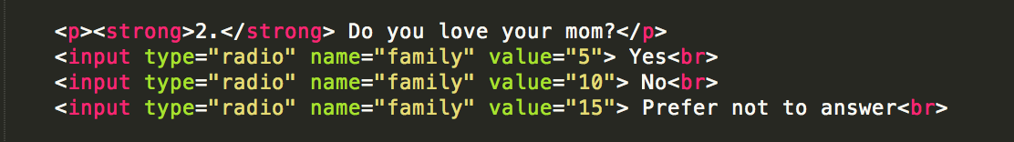
Code Samples <html>
The form sheet where users will be directed to and input answers
Consists mostly of our questions and answer choices
Linked to external stylesheet and php form

Slide 3
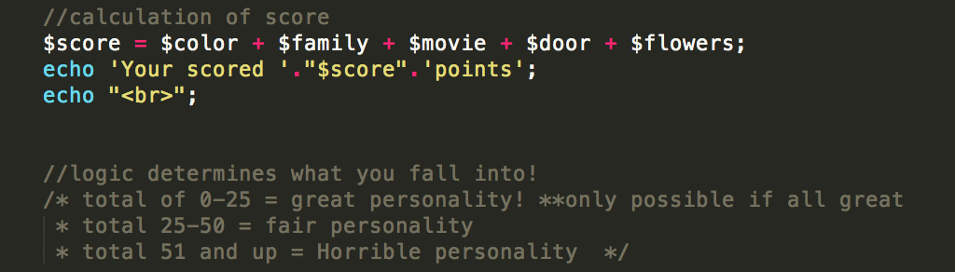
Code Samples PHP
Uses names given in html file to POST
Uses values given in html to calculate score
Logic determines which type of personality you fall under.

Slide 4
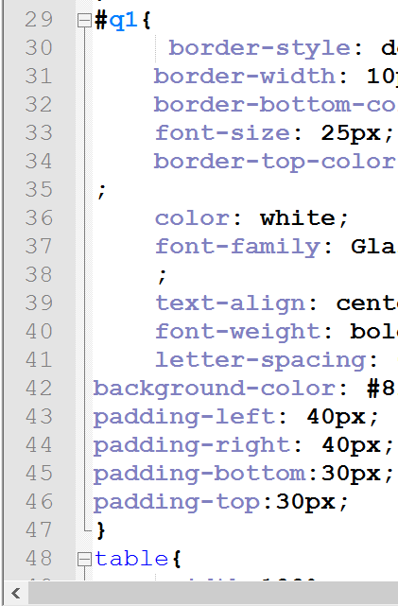
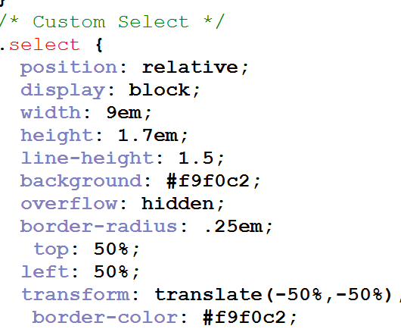
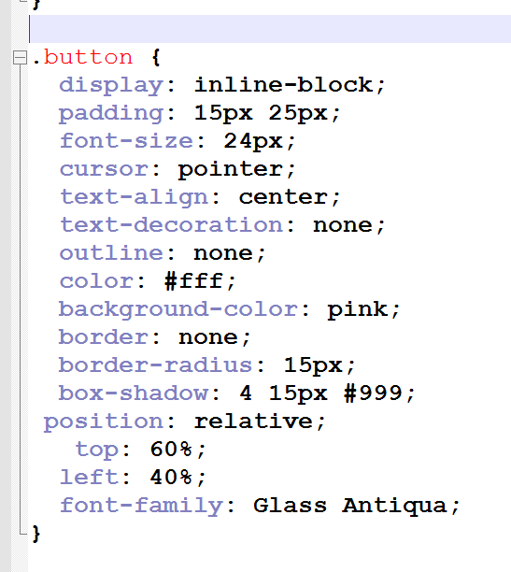
Code Samples css
Main styling done in external stylesheet
Special features include:
Floating Questions
Animated Buttons
Customized dropdown box

Slide 5
DEMO TIME
http://codd.cs.gsu.edu/~odurojaiye1/homepage.html

