Slide 1
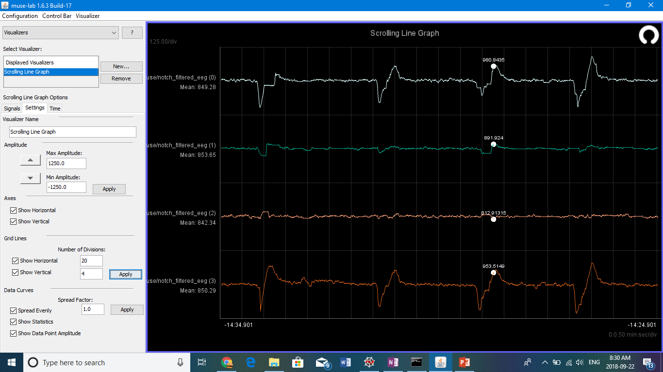
Blink - Naser

Slide 2
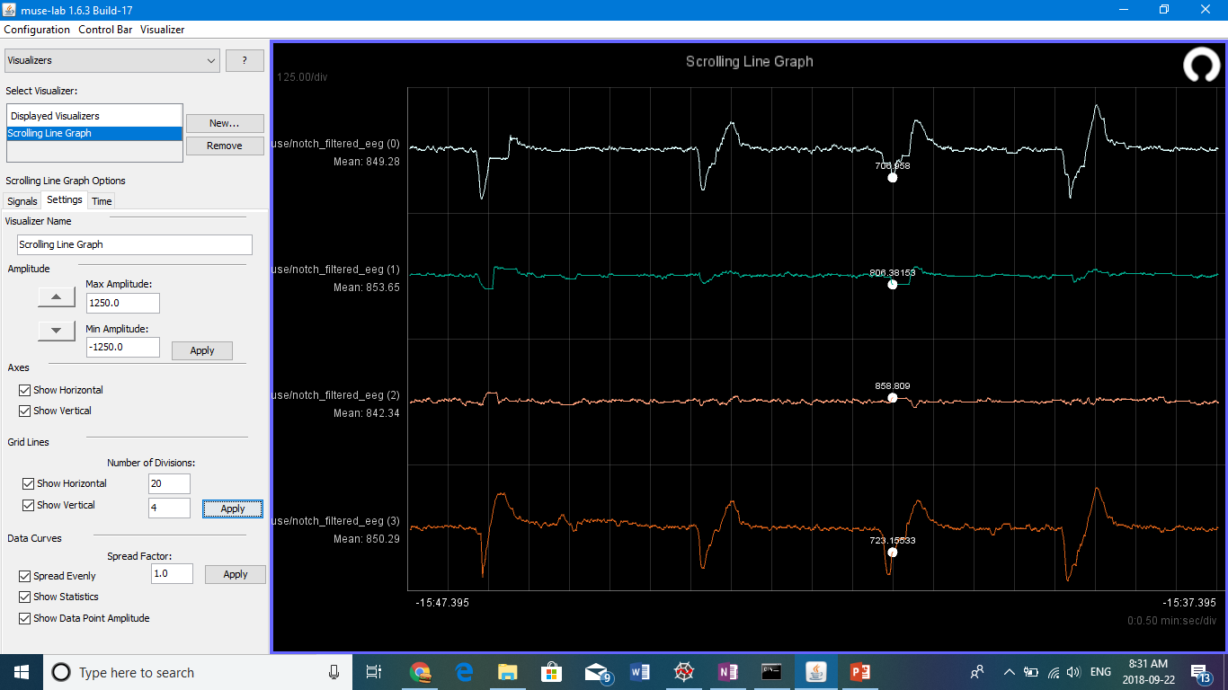
Blink - Naser

Slide 3
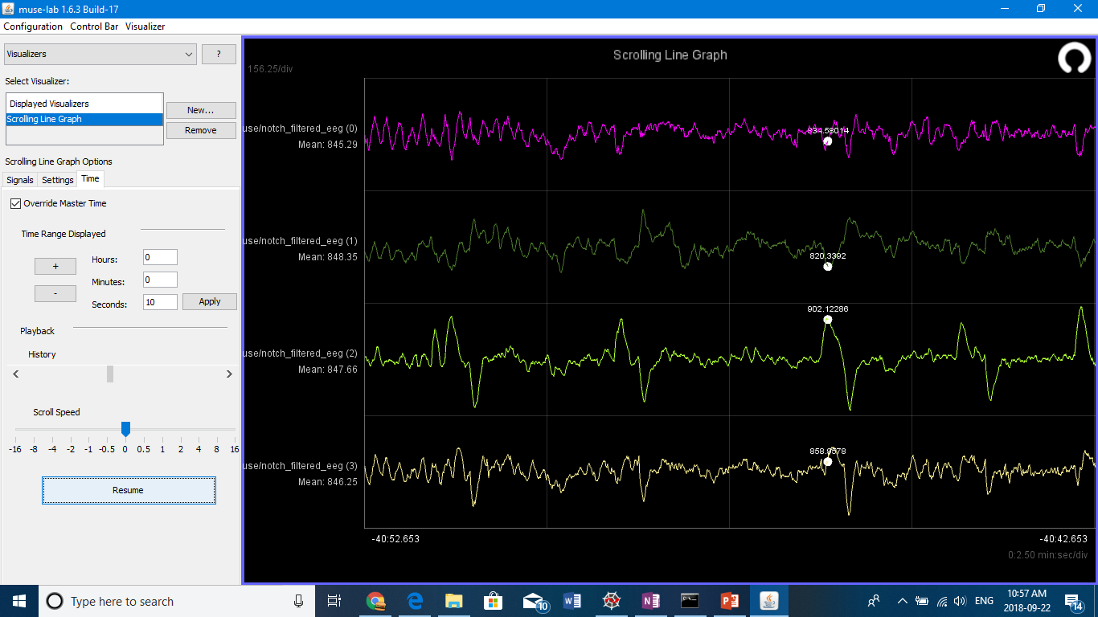
Look Right - Naser

Slide 4

Look Right - Naser

Slide 5
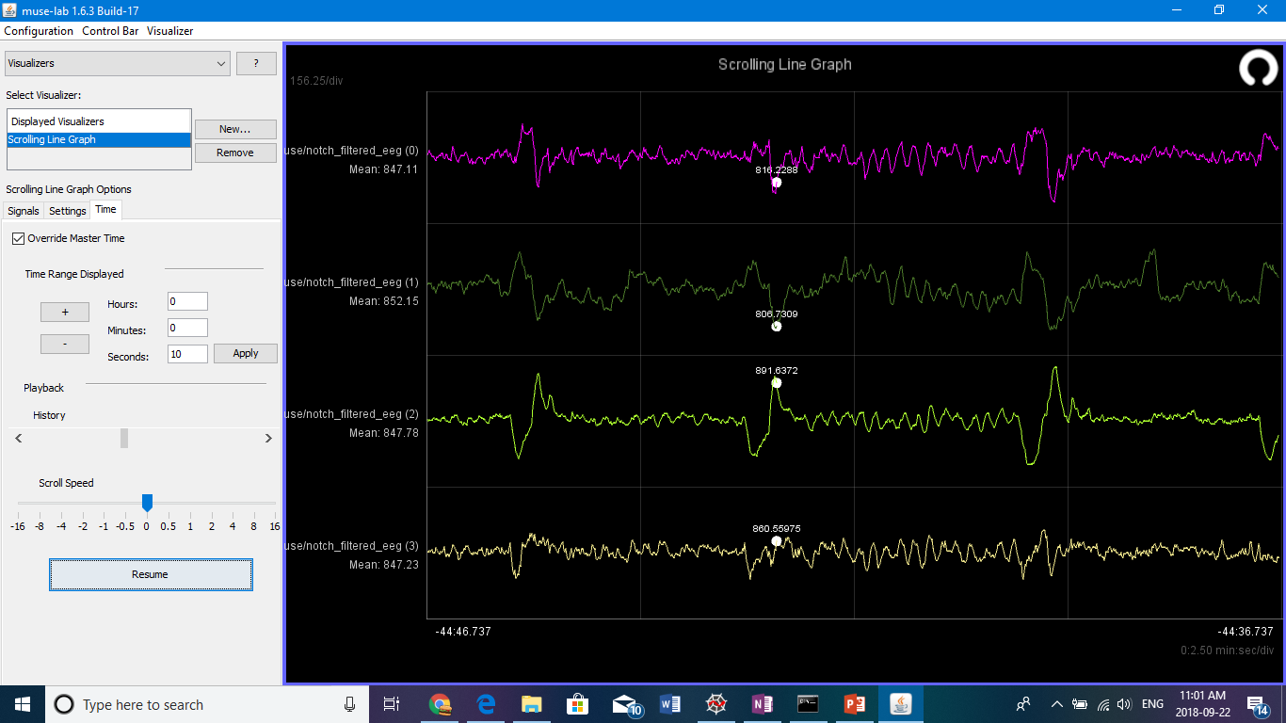
Look Left - Naser

Slide 6

Look Left - Naser

Slide 7
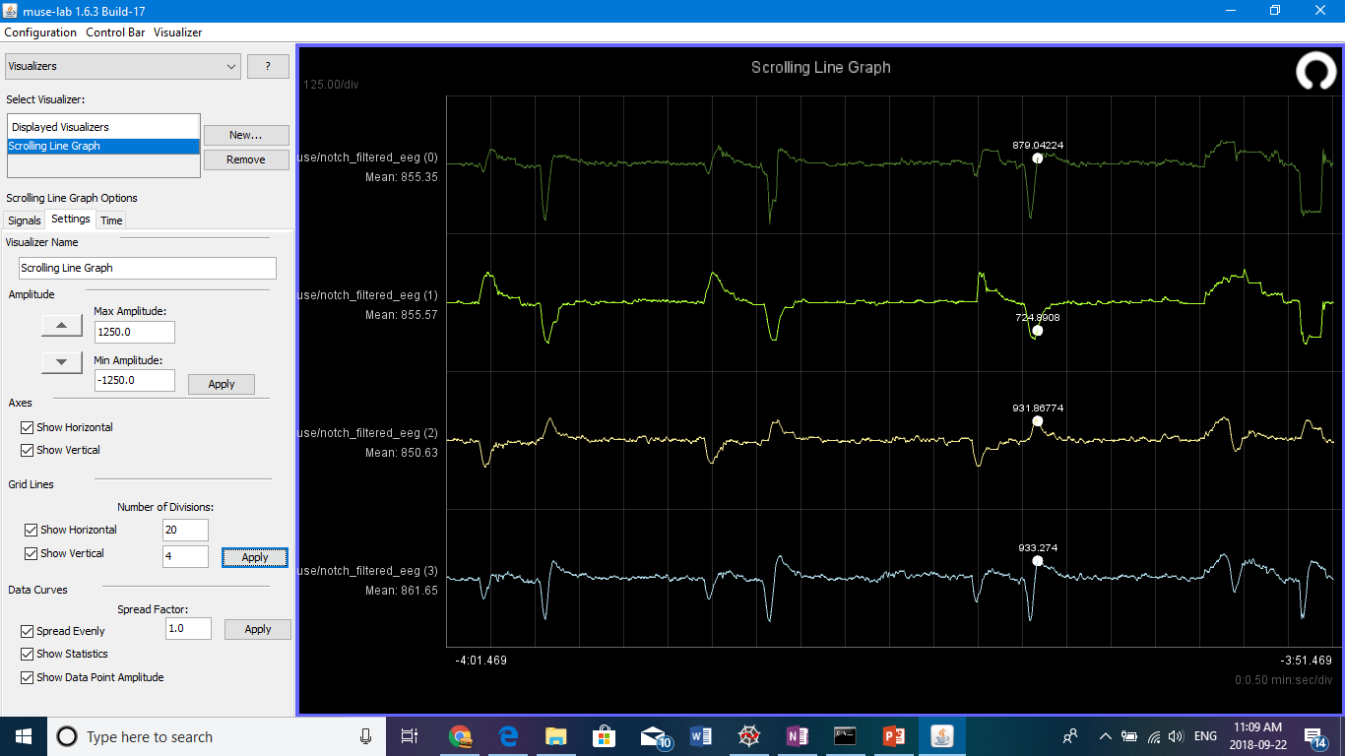
Look Left - Evan

Slide 9
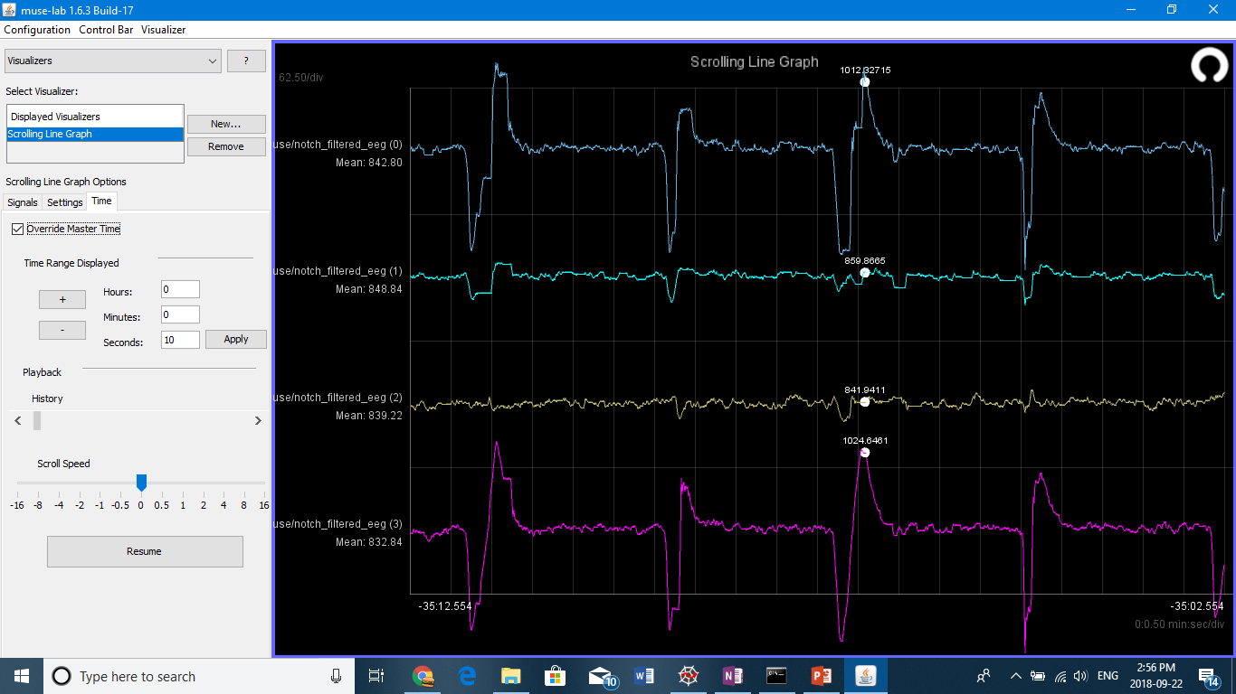
Blink- Naser

Slide 10
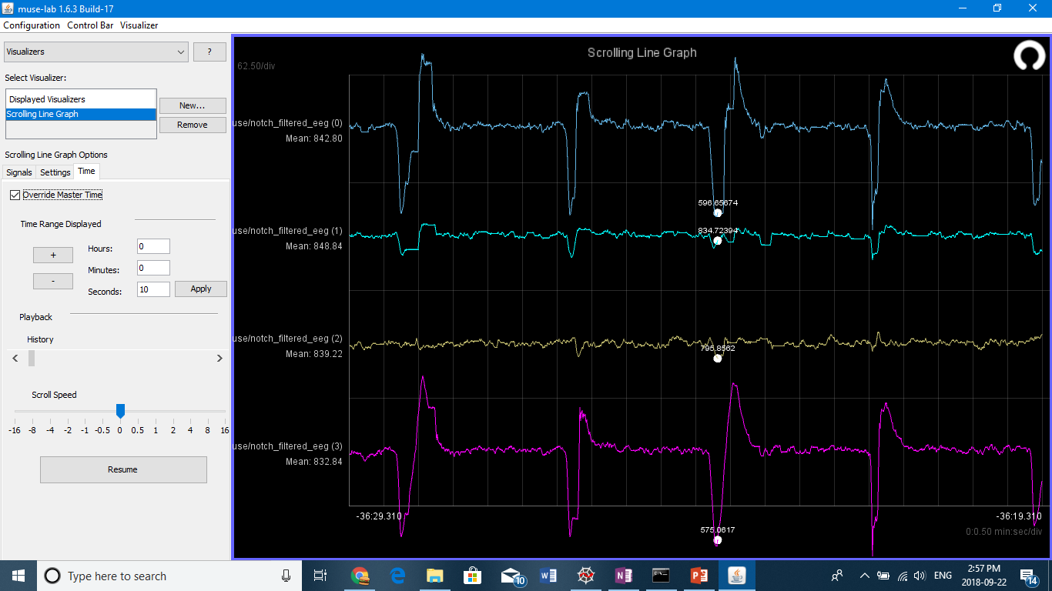
Blink- Naser

Slide 11
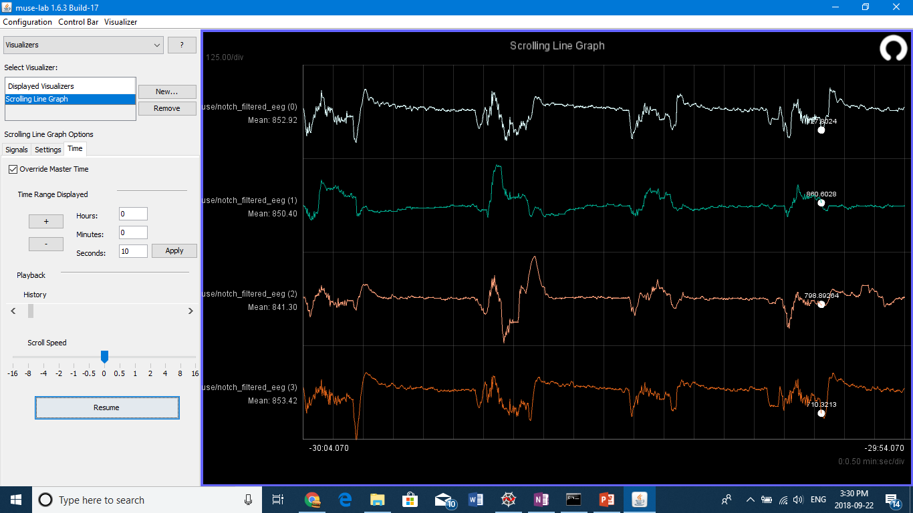
LookUp - Evan

Slide 12
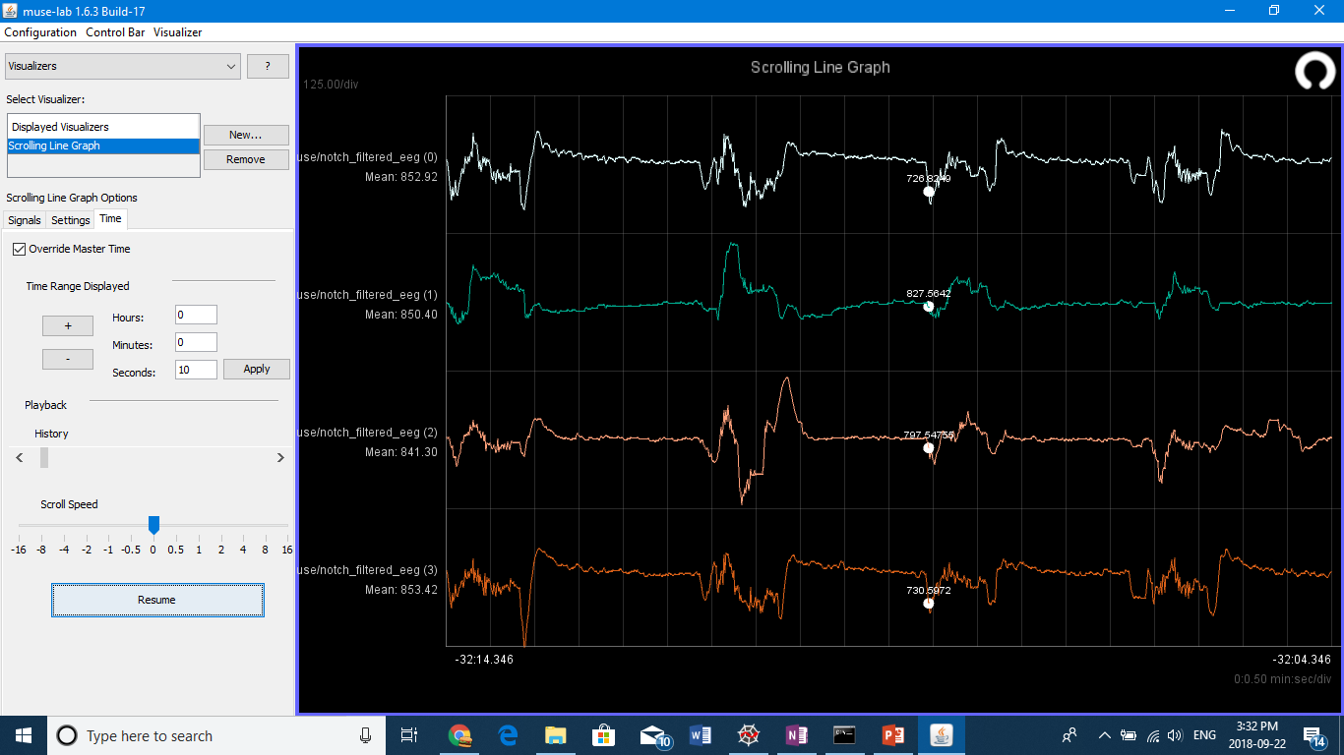
LookUp - Evan

