Slide 1
How big can a static site be?
Staticizing a census database
Martin Holmes and Greg Newton
University of Victoria Humanities Computing and Media Centre

Slide 2
Project Endings and static websites: Why?
According to our research the long-term viability of DH projects is tenuous at best
More than half of all DH projects do not have long-term preservation plans
More than half of all DH projects do not include planning for an endpoint
Only 10% of all DH projects consider their documentation to be adequate
Notes:
Maintenance burden of old sites; incoherence of rolling publication sites.

Slide 3

The long-term viability of DH projects is tenuous at best
Over 20% of DH projects stop working due to software obsolescence
Responsibility for long-term maintenance falls to PI or nobody in nearly half of all DH projects
Ongoing funding for maintenance is a major obstacle
Notes:
Maintenance burden of old sites; incoherence of rolling publication sites.

Slide 4
Project Endings and static websites: Why?
Restoring/updating old projects is time-consuming and costly.
Project Endings offers practical solutions for obviating the need for long-term maintenance.
Is your project viable in the long term? https://hcmc.uvic.ca/endings/questionnaire.htm

Slide 5
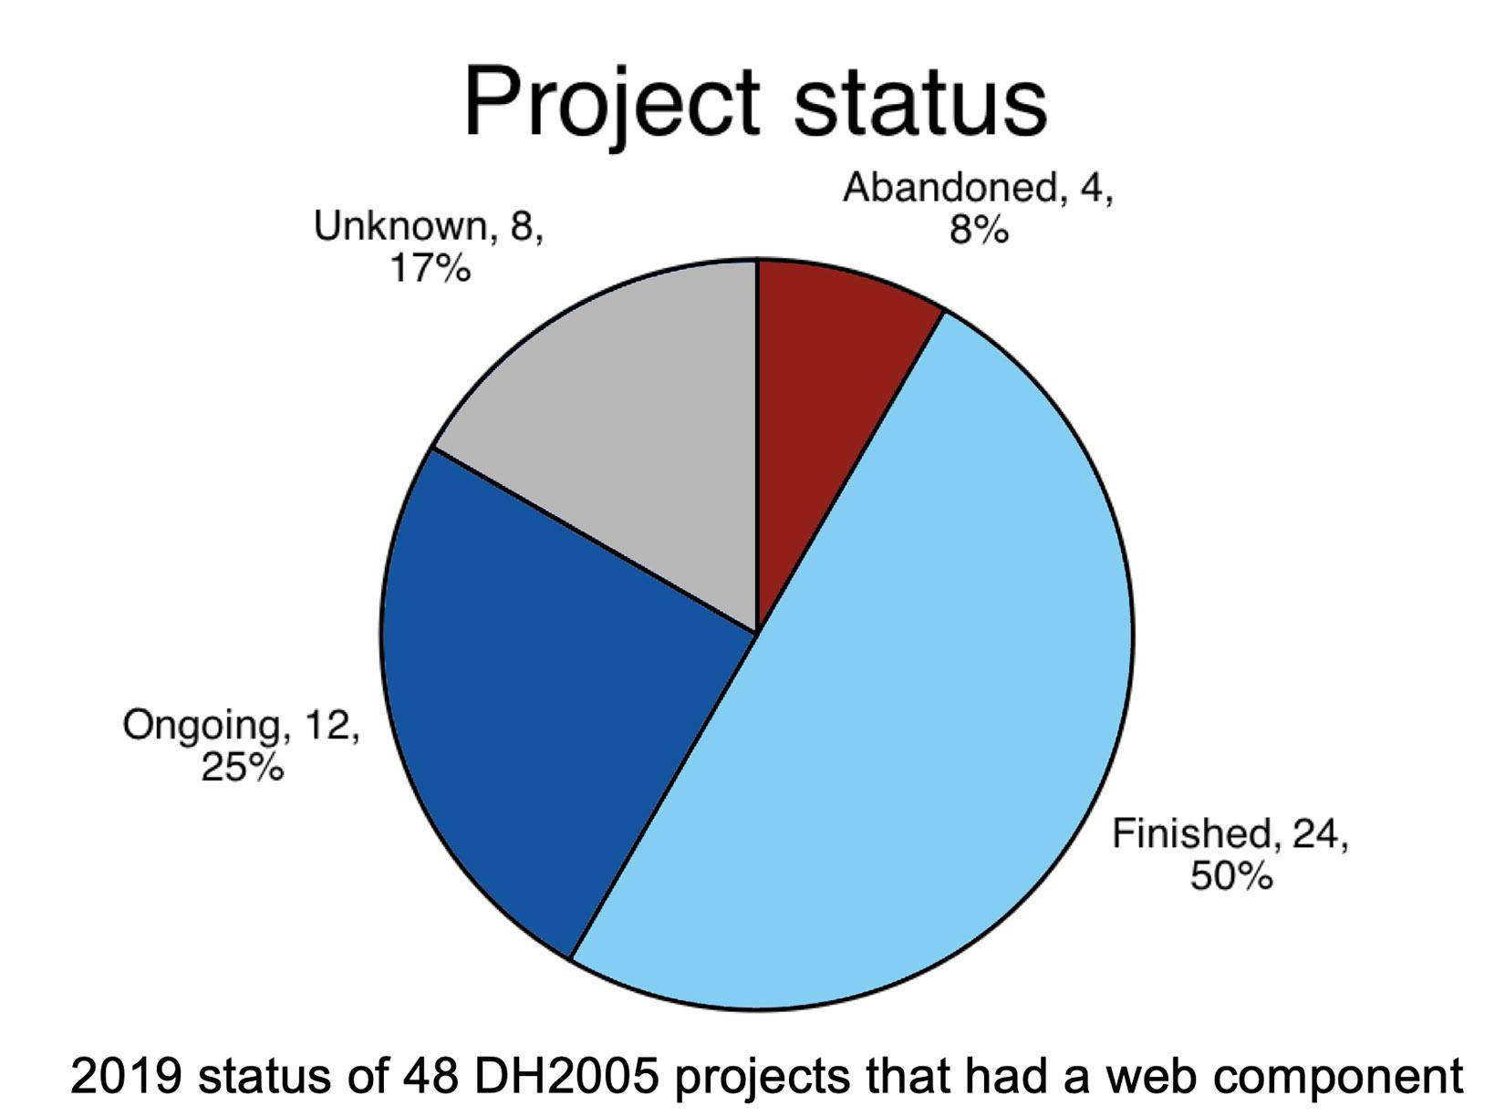
The Final Death(s) of Digital Scholarship, Davis (2019)

Slide 6

Project has the most which is most content with the least.
– Diogenes
Be like Diogenes and throw away the cup
Keep: HTML, CSS, Javascript
Avoid: external dependencies
Discard databases
Say no to CMSs
Notes:
Build process; HTML5, CSS, JS; for search, a staticSearch engine.

Slide 7
Project Endings and static websites: How?
Perceived realities
Applications needs maps, graphs and all sorts. Can I avoid third-party tools?
I need a database! / Where does my data live?
How do I search my data?
Can big applications operate with such constraints?

Slide 8
Project Endings and static websites: Working examples
The Map of Early Modern London (13,086 pages: mapoflondon.uvic.ca)
The Colonial Despatches (10,826 pages: bcgenesis.uvic.ca)
Digital Victorian Periodical Poetry (20,685 pages: dvpp.uvic.ca)
Our main focus has been doing this for real to demonstrate that it is practical.
Notes:
To our surprise, even large sites worked just fine.

Slide 9
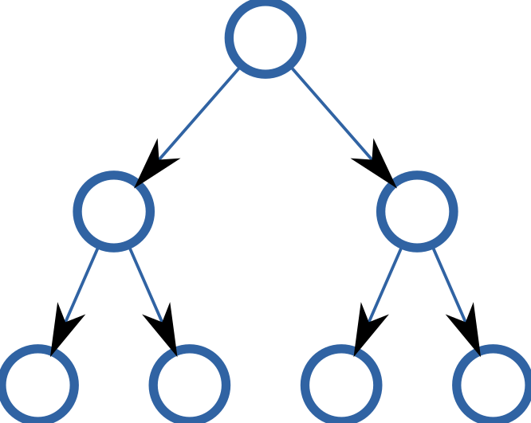

But is there a limit?
Document collections such as digital editions need:
browsability (drill down through a hierarchy to find documents)
searchability (look for text, filter results based on dates, document types and so on)
Is there a limit on the scale of project which can be staticized, and if so, what is it?
We searched for a candidate to push the boundaries.

Slide 10
VIHistory (Vancouver Island History)
PostgreSQL/PHP project
15 years old
Primarily census data from Vancouver Island
Census records from 1871, 1881, 1891, 1892*, 1901, 1911
Around 150,000 records
Associated tables of occupations, familial relationships, locations, addresses, religions, languages, nationalities and more.
Already partially broken due to PHP and DB updates.
Notes:
The citizens of Victoria were unhappy with the population numbers reported in the federal census of 1891, so they commissioned their own, and it was published in the following year.

Slide 11
Challenges:
The quality of the data
The nature of census data itself
The organization of the data in the db

Slide 12
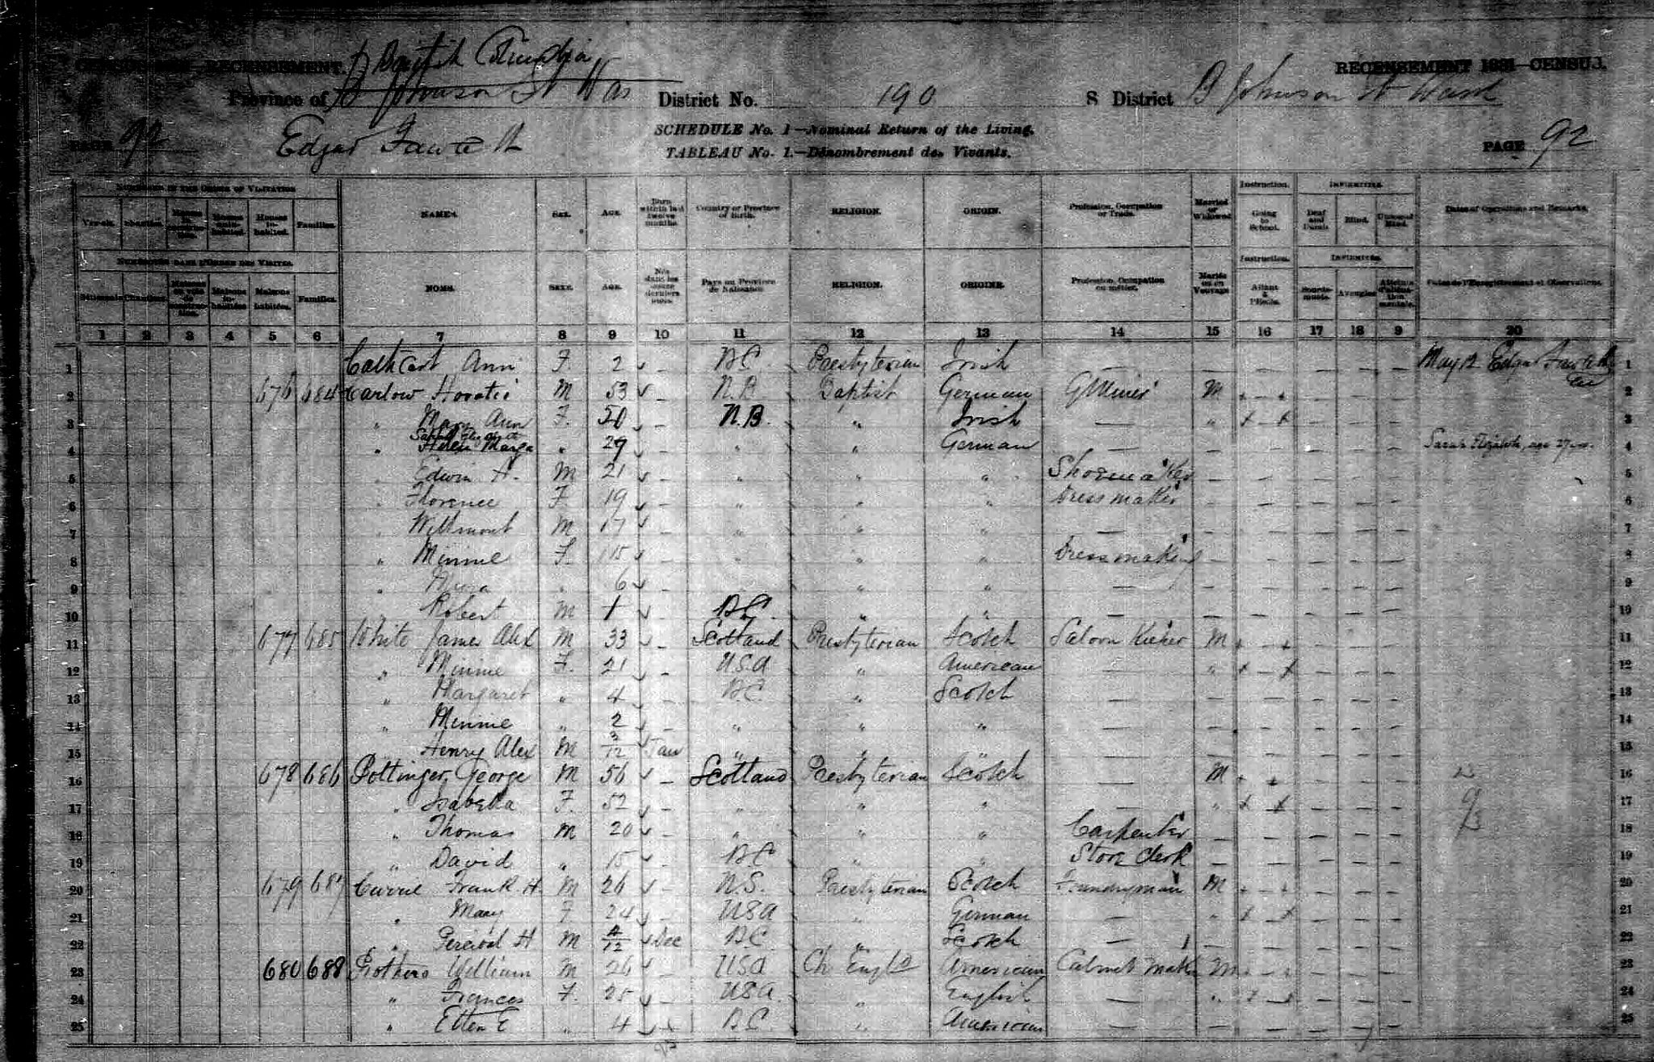
Quality of the data

Slide 14
Opportunities for error
Original enumerators make mistakes
Transcribers working from grainy microfiche make mistakes
Entry into spreadsheets with no data-constraints adds more
Ingestion from spreadsheets into database creates yet more

Slide 15
So:
Values for gender (should be “M” or “F”)
Values for hourly wage (1911):
0
9
S
D
!
$40.00
$100.00
$500.00
$3,000.00

Slide 16
Challenges of census data
Each census collects information different from the last, because the preoccupations of society and government change.

Slide 17
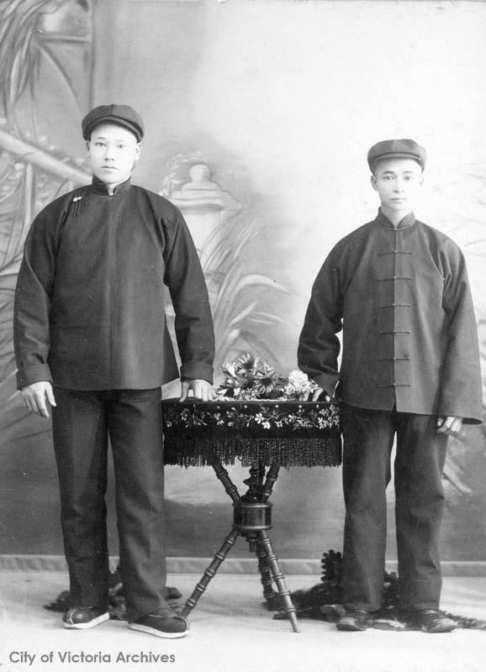
The 1871 census is obsessed with race:
There are fields for counts of how many of these are in the household:
white male
white female
chinese male
chinese female
colored [sic] male
colored female
native male
native female
Chinese houseboys for the Kenneth McKenzie family at Craigflower and Lakehill

Slide 18
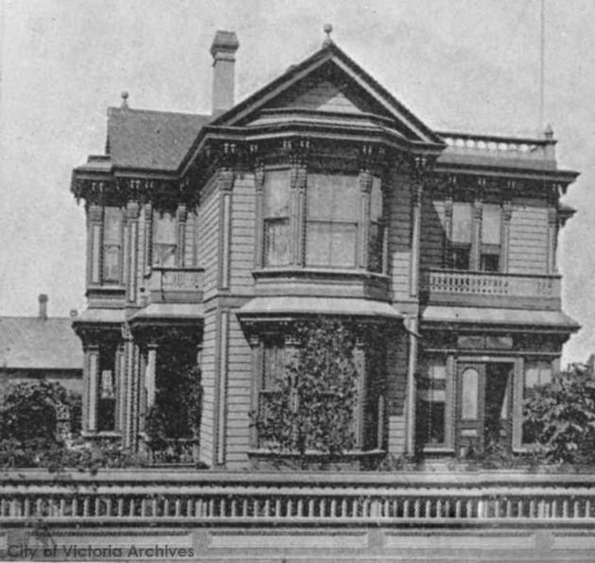
In 1891, there’s a sudden interest in living conditions:
building type (shanty, house, hotel)
construction (wood, brick, stone, longhouse)
number of floors
number of rooms
506 Government Street, Hon. John Robson, M.P.P., residence, 1891

Slide 19
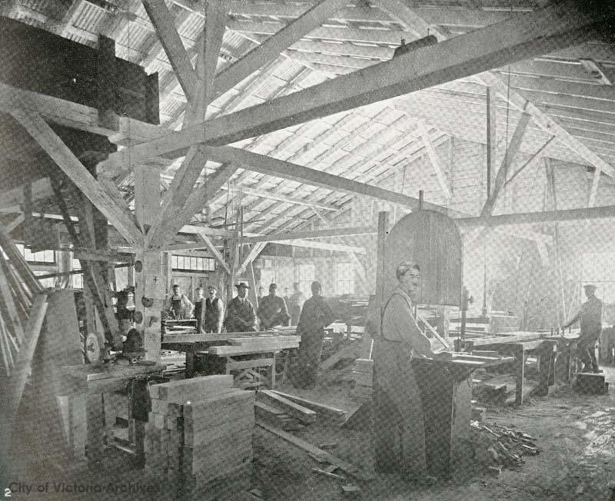
By 1911, the focus is on work and money:
occupation
earnings
employment, employment state, other employment
weeks working
hours working
weekly wage, hourly wage
insurance (life and health)
Woodworkers Ltd. Sash and Door Factory, 2843 Douglas Street, c. 1912

Slide 20
This variability was reflected in the DB structure…
Every census was in a separate table.
Every census table had different fields.
Linked tables for common values (location, nationality, religion) were chaotic because these values were expressed differently from year to year.
Most fields were “text” because the incoming data was so variable.

Slide 21
…and in the web application interface
Every census had a separate search page with a different interface.
There was a global search that attempted to schmush everything together, but omitted one entire census by accident, or perhaps in despair.
Searching was only possible within specific fields, not across an entire record.

Slide 22
Stage 1: convert to XML
We wrote a custom XML schema.
We have datatypes such as “moneyAmountOrGarbage”:
<dataSpec ident="vih.moneyAmountOrGarbage" module="vihistory">
<desc>An amount of money in dollars and optional cents, or some garbage from the source.</desc>
<content>
<dataRef name="token" restriction="(\d+(\.\d\d)?)|(QUERY: .+)"/>
</content>
</dataSpec>

Slide 23
One content model to rule them all
All entries use the same content model, with optional components and flexible structures smoothing out the differences between census years:

Slide 24
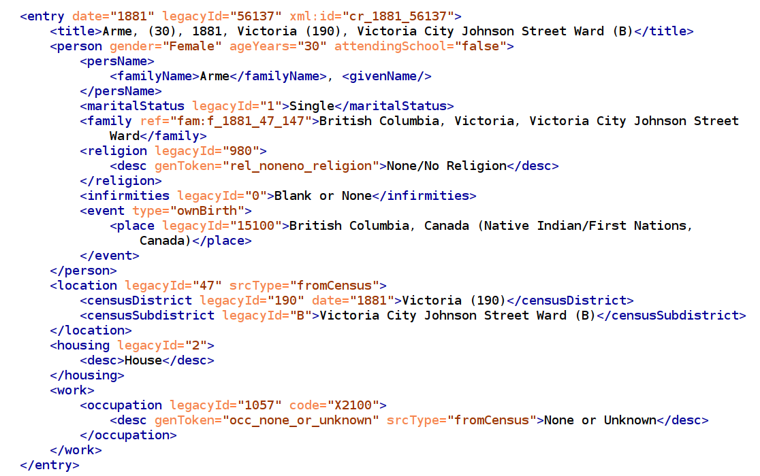
Notes:
XML hierarchy allows better data organization; RELAX NG/Schematron allow us to identify bad data and fix it or allow for it.

Slide 25
Payoffs from data conversion
Removed over 500 completely empty records.
Removed about 4,500 mysterious unsourced records, possibly consisting of generated test data.
Normalized and corrected errors in hundreds of records.

Slide 26
Stage 2: Render to HTML
Granularity: 1 census record = 1 page
Browsability/drill-down: 1 data-point (a religion, a nationality, a family) = 1 listing page
Searchability: each census record has many <meta> tags from which staticSearch creates search filters (date, religion, nationality, location, race…)

Slide 27
Result
138,744 individual census record pages
166,528 pages across the site (because of generated listings pages)
Site size on disk: 3.6GB (of which 2.0GB is search index files)
Site build time: 1 hour 46 minutes (on Jenkins CI server)
staticSearch works fine – feel free to try it at the temporary site location:
https://hcmc.uvic.ca/project/vicensus/

Slide 28
Conclusions
We don’t need no stinking database. Even projects that look like a “natural” fit for a database may work better as static sites.
150,000 pages is not a big number for a static site, especially if they’re small.
Sophisticated data constraints are easier in XML, so bad data is easier to control.
HOWEVER…

Slide 29
Conclusions (2)
We may be approaching a limit with the current staticSearch, because the index file containing document titles is approaching 16MB. This file has to be downloaded to the client for any search to be run.
We can imagine workarounds for this, involving changing the granularity (i.e. aggregating records into larger pages) at the project level, or splitting out the title file at the staticSearch build level.

Slide 30
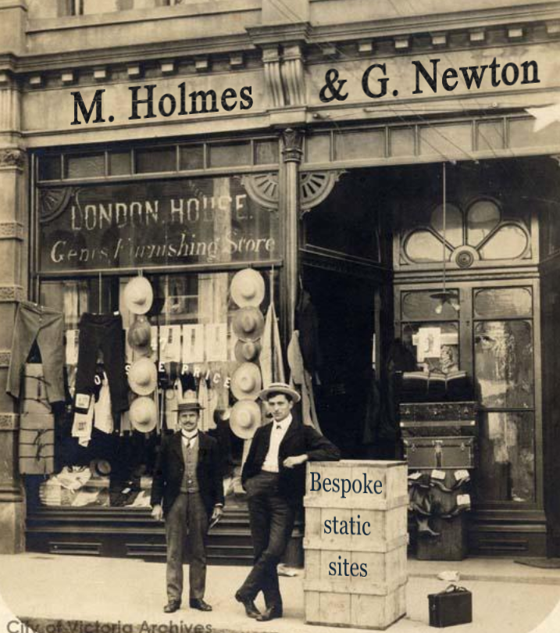
Acknowledgements & links
Thank you SSHRC for Endings funding.
Thank you Pat Dunae, VIHistory PI, for clear explanations and infinite patience.
Thank you Joey Takeda for co-authoring staticSearch.
endings.uvic.ca
github.com/projectEndings/staticSearch

