Slide 1
Using Releases to Stick to Your Project Plan
Janelle Jenstad

Slide 2
Outcomes, objectives, deliverables, tasks, and subtasks
The four quadrants
Motivating contributors
Release blockers versus roll-overs
Timing all the facets of the release
In every release: Release Notes

Slide 3
Outcomes, Objectives, and Deliverables
Way of thinking through your project plan.
Outcome: Team will be stronger because they’ve connected socially.
Objective: Provide a nice dinner and lots of beer.
Deliverables: Burgers, beer, condiments.
Tasks: Buy the buns, make the burgers, et cetera.

Slide 4
What’s an Outcome?
What will be possible when you’re done?
How will the world be different for whom?

Slide 5
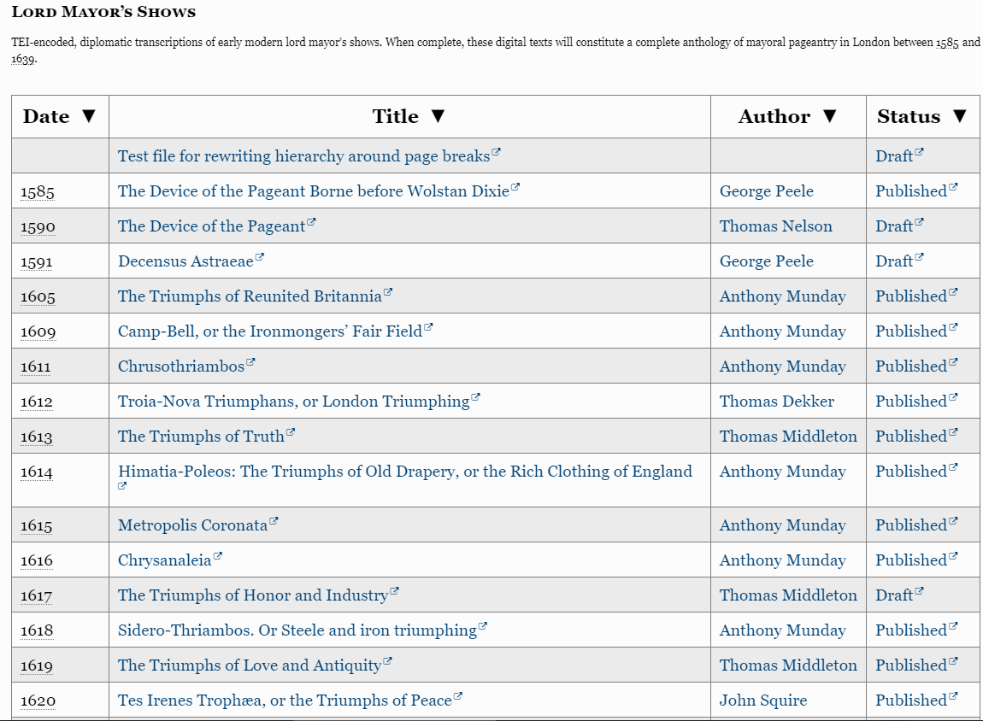
https://jenkins.hcmc.uvic.ca/job/MoEML/lastSuccessfulBuild/artifact/static/site/mdtPrimarySourceLibraryMayoral.htm

Slide 6
Formula for an Outcome:
User will be able to ….
Scholars will be able to use our old-spelling transcriptions of all the mayoral shows and understand how we prepared them.
The peer reviewer will be able to review the complete OS anthology.
Our modern editors will have base texts from which to work.

Slide 7
What’s an objective?
What do you and your team need to do?

Slide 8
Formula: We + verb …
We will complete all the tasks on the Progress Chart.
2. We will write, encode, and publish introductory note.

Slide 9
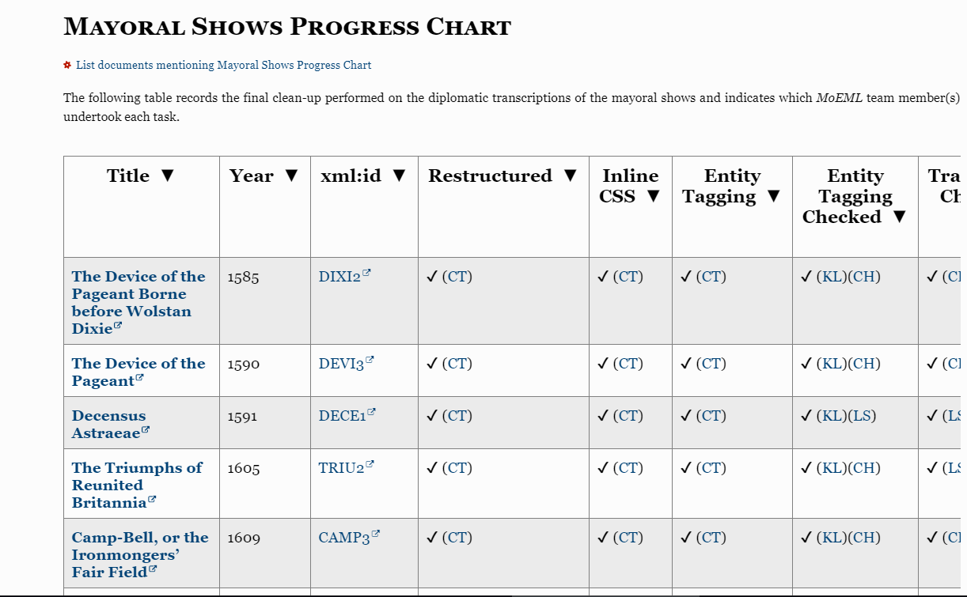
Progress Charts

Slide 10
What’s a Deliverable?
What do you have to supply, produce, create, or find in order to achieve your objectives?

Slide 11
Formula: Nouns
31 OS transcriptions with all entities tagged, bibliographic features captured, and transcription perfected.

Slide 12
Tasks
Tasks are the things that need to be done to achieve objectives and deliver the deliverables.
Tasks can be assigned to team members (or team members can sign up for them), reassigned, and checked off.

Slide 13
Formula: verb
Create PDF
Convert <sp> to <label>
Combine split paragraphs
Transform split paragraphs and correct margins
Assure correctness of margins (Inline CSS)
Double Check EEBO Pages (Entity Tagging)
Double Check <pb facs>
Check transcription carefully
Proof notes
Re-check entity tagging
Do final CSS check
Tell JJ that the transcription is ready for last two checks
Do first editorial check.
Tell Editor 2 that Check 1 is done
Do second editorial check.
Tell JJ that Check 2 is done.
Change status to "Published"

Slide 14
For the deliverable “Project Release Notes”:
Itemize menu changes.
Flag changes to mission statement.
Highlight Mayoral Shows OS Texts as featured content in this release.
Write paragraph on ePubs and PDFs.
Count new entities, pages, links, et cetera.

Slide 15
Using Release Management and Project Planning Together
Release 6.4 is going to deliver X, Y, Z deliverables.
Don’t work on A, B, or C!

Slide 16
Do not add new objectives and deliverables.
Do not add new tasks unless they help achieve the objectives and deliver the deliverables.
Keep your eye on the outcomes: will today’s tasks contribute to that outcome?
How long will new tasks take? And how many other tasks will they generate?

Slide 17
Examples
RA wants to go back and add spaces between letter and number in signature line. → Y/N?
RA wants to make PDFs of the shows. → Y/N?
PI wants to add new id numbers to the Mapography. → Y/N?
PI wants to add metadata for the digital surrogates. → Y/N?
PI wants to add a chart with titles, mayors, years, and companies. → Y/N?

Slide 18
Quadrants (Franklin-Covey)
 | Urgent | Not-Urgent
Important | Important and Urgent Q1 | Important and Non Urgent Q2
Not Important | Not important but somehow urgent! Q3 | Not important and not urgent Q4

Slide 19
Quadrants (Franklin-Covey)
 | Urgent | Not-Urgent
Important | Important and Urgent DROP EVERYTHING ELSE | Important and Non Urgent JOY, PURPOSE
Not Important | Not important but somehow urgent! RESENTMENT | Not important and not urgent PLAY

Slide 20
Quadrants (Franklin-Covey)
 | Urgent | Not-Urgent
Important | Fixing broken build | Tasks on the list for the release. Making chart with titles, mayors, years. Adding metadata for digital surrogates.
Not Important | Adding spaces | Adding ID numbers

Slide 21
Motivating Contributors
Rolling release meant that contributors didn’t take deadlines seriously.
Now: “If you want your work to appear in v.6.4, which is being released in YYYY-MM, I will need it by YYYY-MM-DD. The next release after that will be no earlier than YYYY-MM.”

Slide 22
Release Blockers versus Roll-Overs
Release blockers = things you must do before the release
Says who?!
You say.

Slide 23
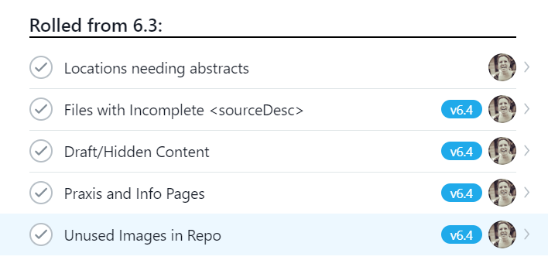

Slide 24
Featured Content
Build your release around a key deliverable from your overall project plan (or grant application).
Examples:
  A major text (or sections thereof)
  An anthology
  A major new feature/functionality
  A new dataset
  A new layer of annotation on your text
Gets stuff done! Keeps you moving towards those key objectives and outcomes.

Slide 25
Timing all the Facets of the Release
Programming Team (new features)
Research Team (3.5 FTE RAs)
External Contributors
Leaders

Slide 26
Release Notes
Every release must have release notes.
Borrowing the practice of the programming world.

Slide 27
What to Include
Descriptions of new content (with links)
New features
New design
Any changes to menus
Additions of new interstitial data (people, places, links – count them!)
Acknowledgements

Slide 28
Where to Publish Release Notes
Blog post? News item? https://mapoflondon.uvic.ca/news.htm

Slide 29
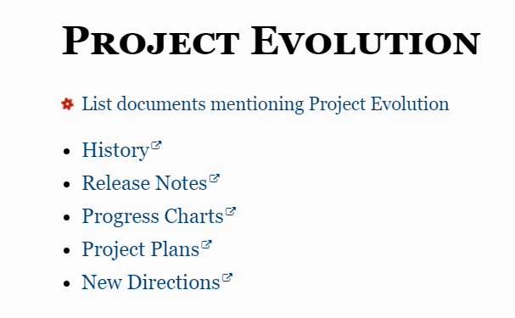
https://jenkins.hcmc.uvic.ca/job/MoEML/lastSuccessfulBuild/artifact/static/site/project_evolution.htm

