Slide 1
Building static websites
It’s the </endings> way.

Slide 2
I am seeking to rescue the poor stockinger, the Luddite cropper, the "obsolete" hand-loom weaver, the "utopian" artisan, and even the deluded follower of Joanna Southcott, from the enormous condescension of posterity.
(E.P. Thompson, The Making of the English Working Class)

Slide 3
A little detour into history
Here's an old old site of mine:
  http://web.uvic.ca/lancenrd/martin/weblang/contents.htm
It still works. It's also in the Wayback Machine...
...where it also still works.
The HTML still works.
The JavaScript still works.
It predates CSS, but if it didn't, the CSS would still work.
Out of 17 links on the Links page, only 11 work in the Wayback Machine; only 7 work on the current Web.
Notes:
See also:
http://victorianweb.org/

Slide 4
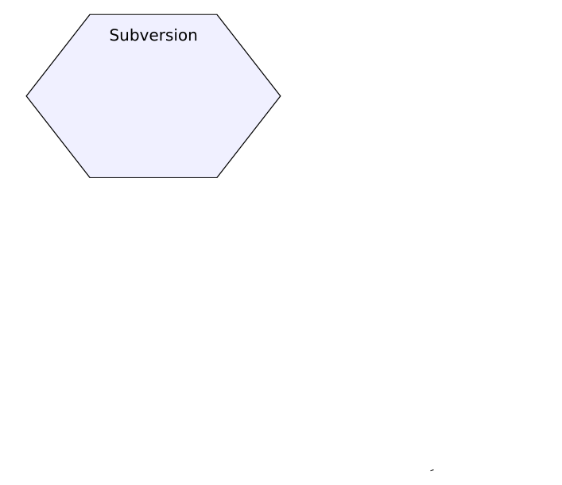
MoEML: The original workflow

Slide 5
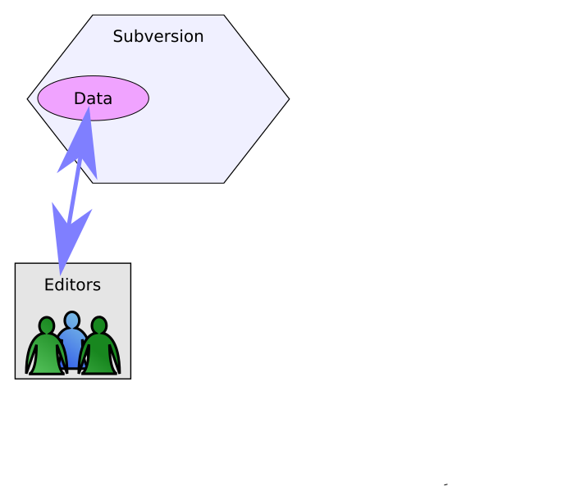
The original workflow

Slide 6
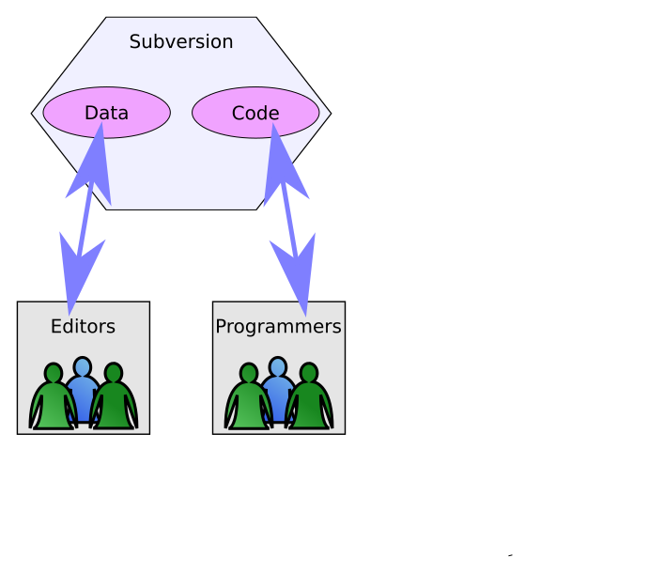
The original workflow

Slide 7
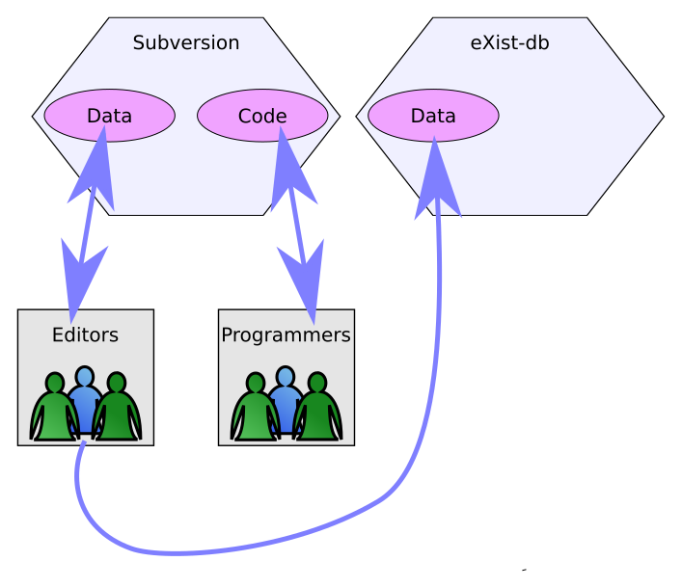
The original workflow

Slide 8
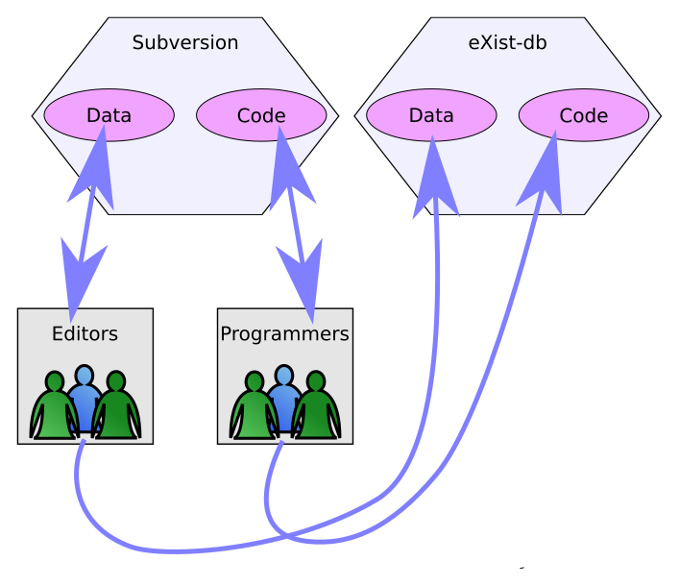
The original workflow

Slide 9
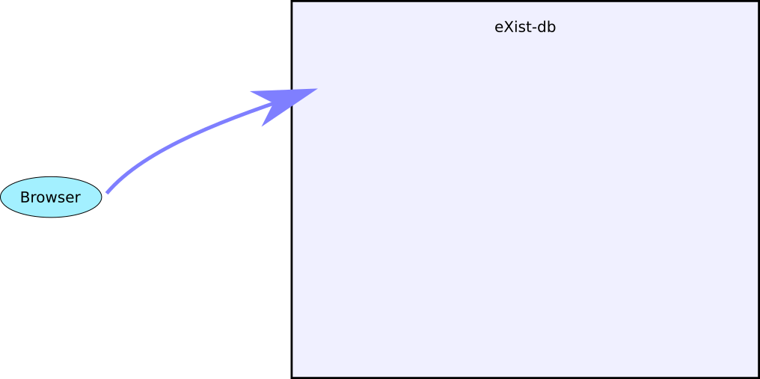
The original webapp

Slide 10
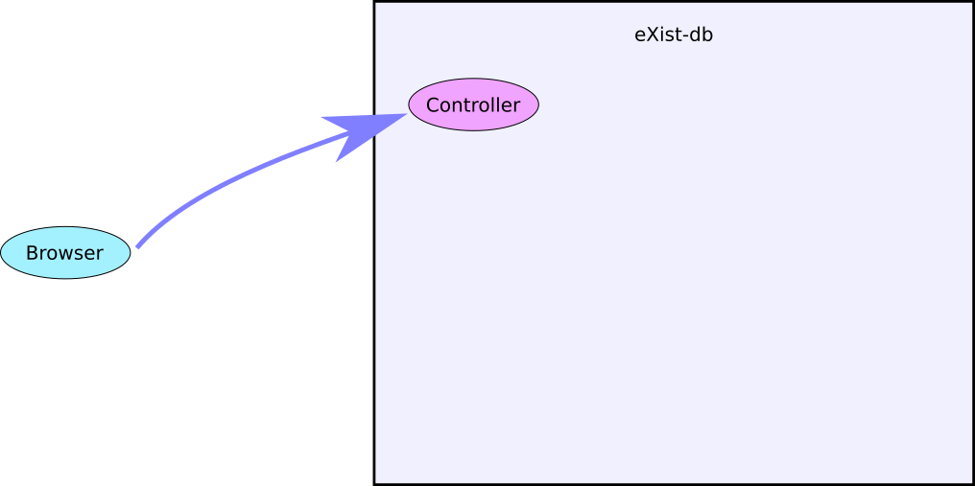
The original webapp

Slide 11
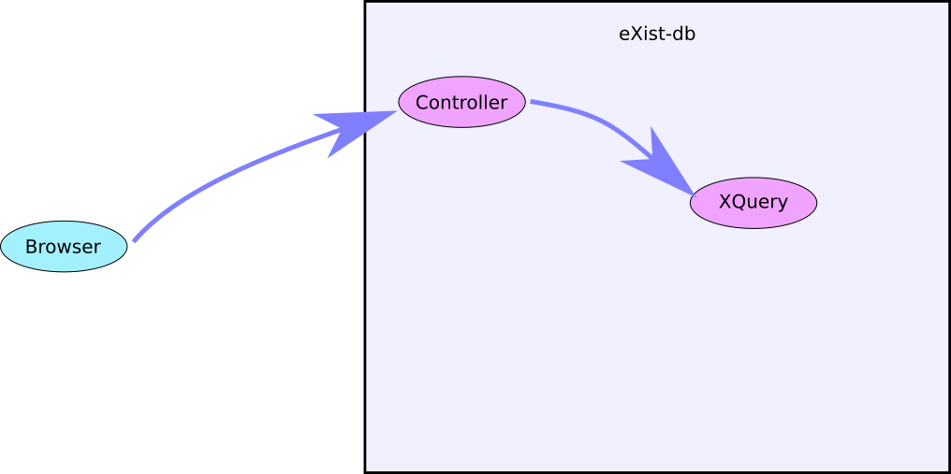
The original webapp

Slide 12
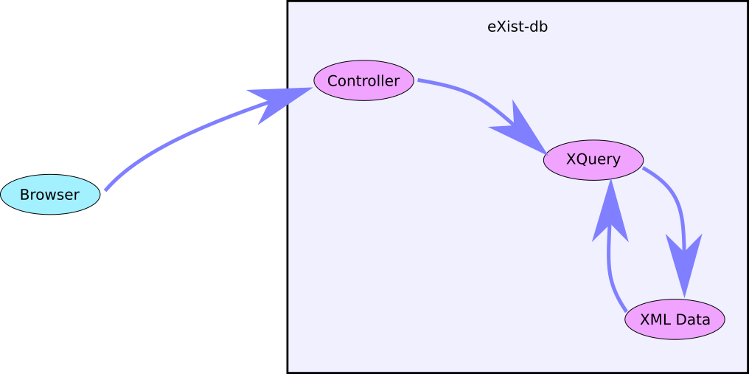
The original webapp

Slide 13
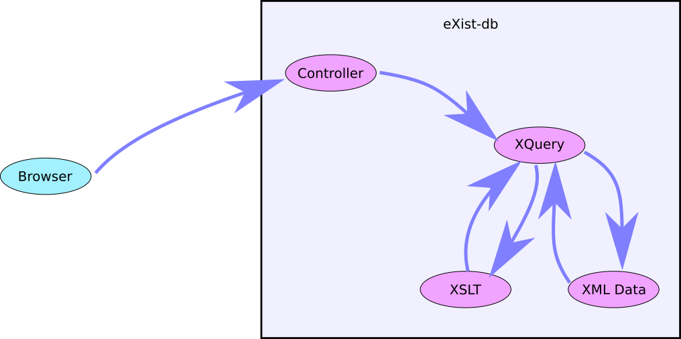
The original webapp

Slide 14
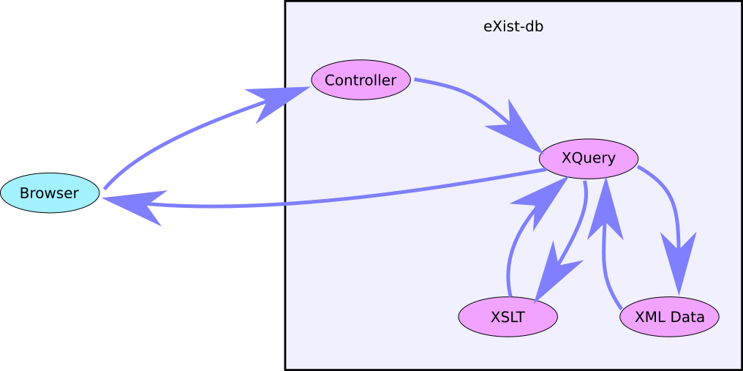
The original webapp

Slide 15
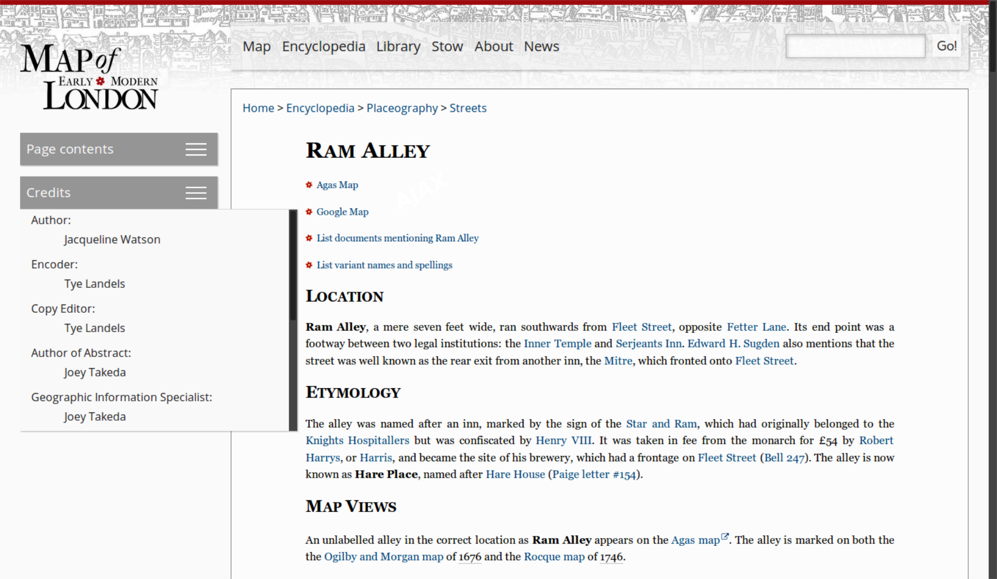
Original MoEML page

Slide 16
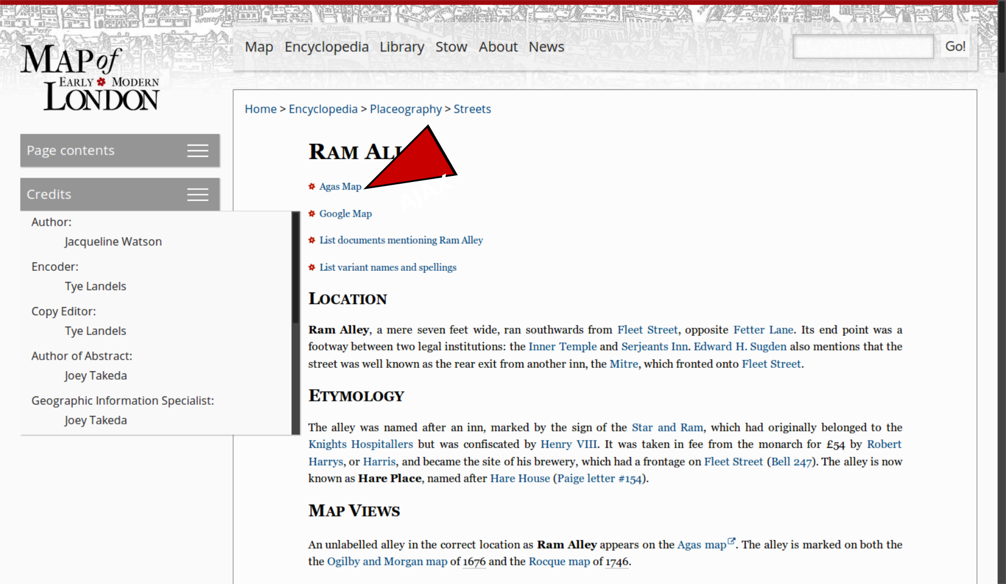
Original MoEML page

Slide 17
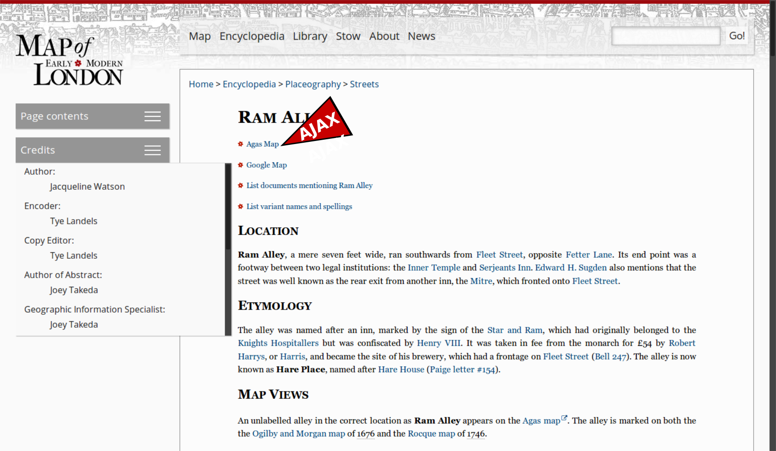
Original MoEML page

Slide 18
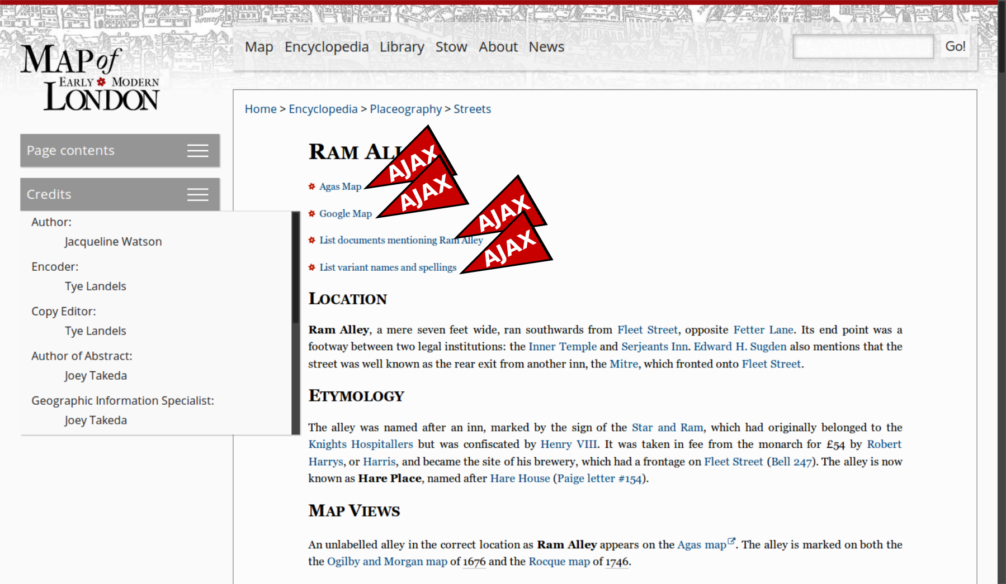
Original MoEML page

Slide 19
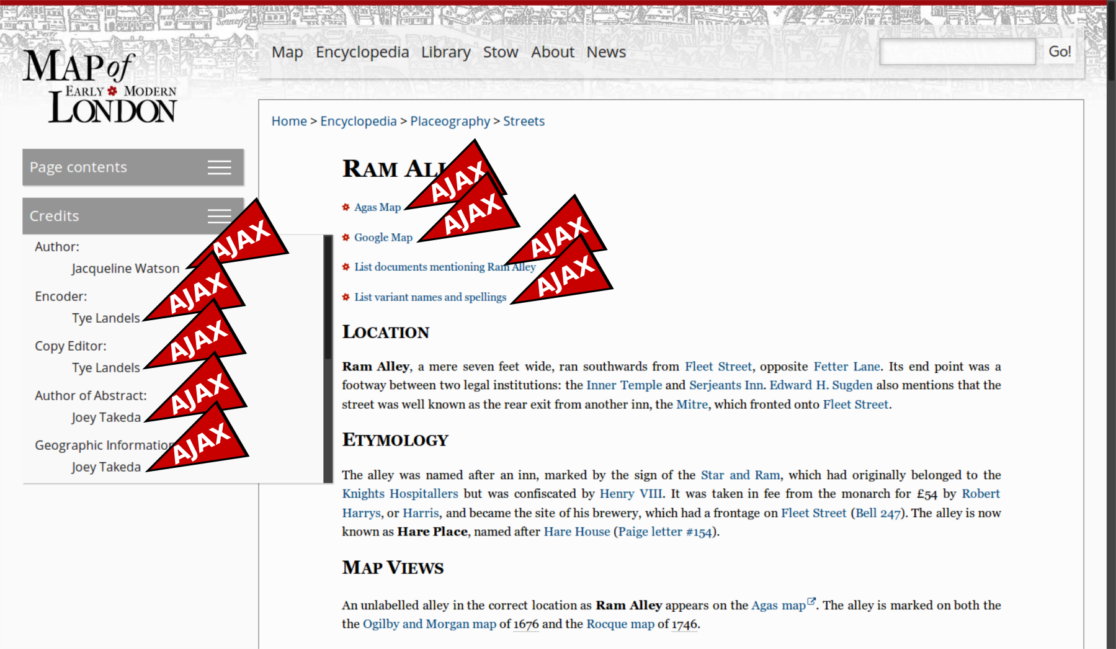
Original MoEML page

Slide 20
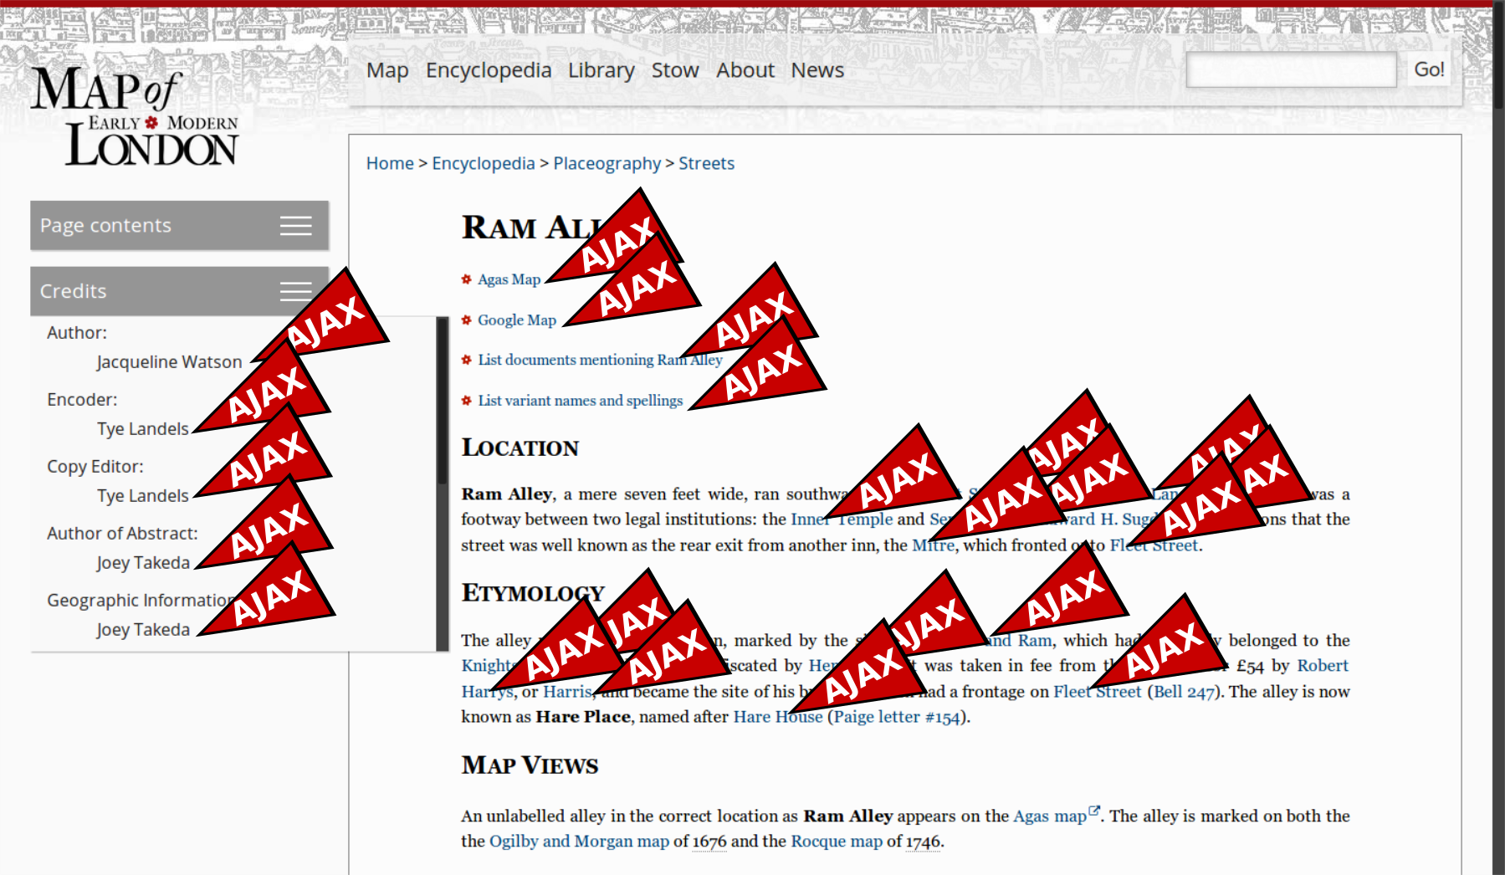
Original MoEML page

Slide 21
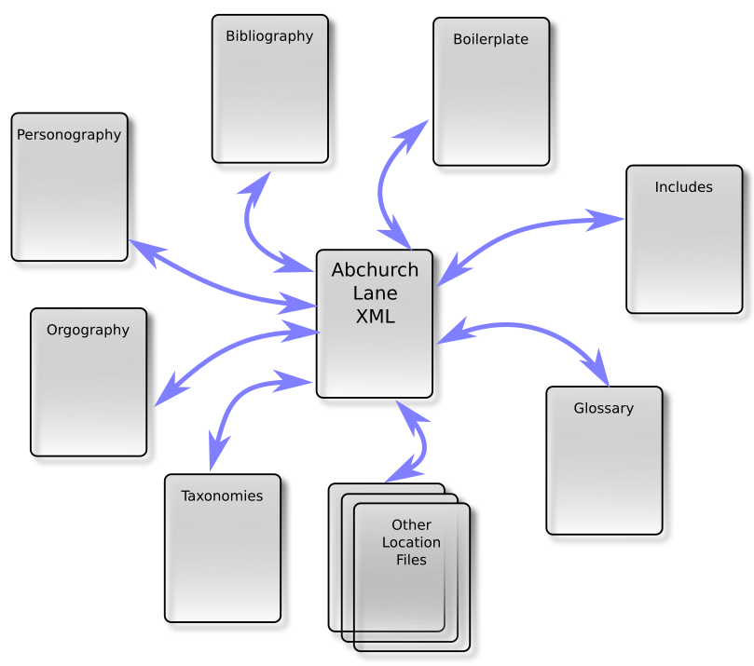

Slide 22
Problems with that model
Collection-level coherence is difficult to maintain.
Web applications are difficult to archive.
Taking and using a single document from the collection is tricky.
Search has to be specially-crafted for each application.
Versioning is incoherent and editions don't exist.

Slide 23
Static build principles
Build everything all the time.
Validate and diagnose relentlessly.
Make every document coherent and complete.
Duplicate everything wherever you need it.
Make HTML documents degrade gracefully.
Create every possible version of your documents you can imagine being useful.

Slide 24
The MoEML Build Process (1)
Validate the source XML (RNG and Schematron).
Create a better version of those documents (“original XML”).
Add generated XML versions of all the index, TOC, JSON, tabular and other pages previously created on the fly by eXist.
Validate this “original XML”.
Create “standalone” versions of all the original XML documents (“standalone XML”).
Validate the standalone XML.
Create more normative versions of all the XML documents, in which project-specific idiosyncracies are replaced with more conventional encoding strategies (“standard XML”).
Validate the standard XML.

Slide 25
MoEML build process (2)
Create TEI Simple versions of all the docs.
Validate the TEI Simple documents.
Create TEI Lite versions.
Validate the TEI Lite.
Create KML output from all the location files.
Validate the KML.
Create all the fragments required for responses to AJAX requests (12,172 items).
Create XHTML5 versions of the documents.
Validate the XHTML5 versions.

Slide 26
“Standalone XML” contains:
  Every person mentioned
  Every org mentioned
  Every bibliography item referenced
  The abstract for every location mentioned
  All the variant spellings for all locations mentioned
  Full copies of the document type taxonomy and the responsibility taxonomy.

Slide 27
So instead of this:

Slide 28
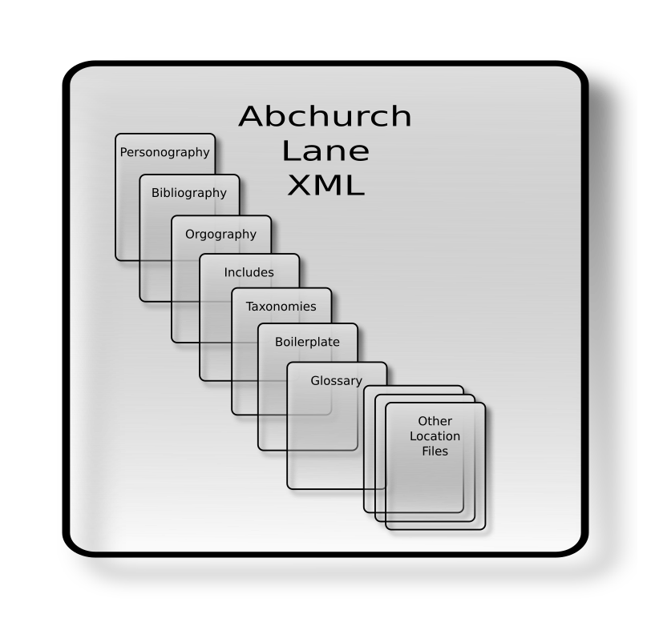
...we now have this:

Slide 29

Who does all this building?
Meet Mr Jenkins.

Slide 30
Advantages
All your documents actually exist.
All your documents actually contain what they appear to contain.
Searching your documents will work more intuitively.
Each build is globally coherent, and can constitute a single edition.
Every document can function outside the collection.
Future users can take what they want, in a convenient self-contained package, in the format they need.
Everything works without a web server.*
*Search is a special case. But we can do that too...

Slide 31
Disadvantages
GREG HERE...

Slide 32
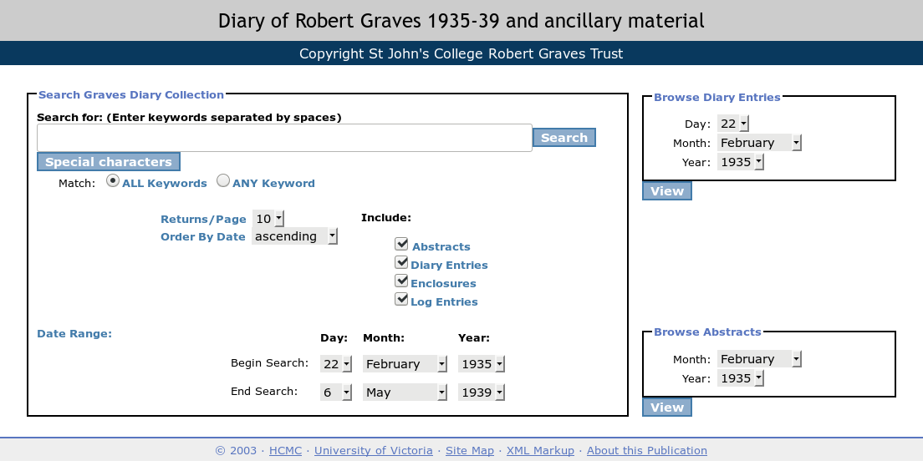
Appendix: What about search?

Slide 33

A static search engine
Standalone all-JavaScript no-backend keyword search with stemming and relevance scoring

Slide 34
How it works (1)
Graves site build process:
  …
  TEI XML → XHTML5
  Tokenize HTML body.
  Stem the tokens (Porter stemming).
  For each token, create a JSON file named for the token.
  In the JSON file, place a pointer to each document containing the token, with a score for the number of times it occurs in the document.
  = 11,776 files, 23.2 MB

Slide 35
{ "token" : "childish",
"instances" :
[
{ "docId" : "diary_1938-03-18",
"docTitle" : "Entry for 1938-03-18",
"docType" : "diaryentry",
"docStartDate" : "1938-03-18",
"docEndDate" : "1938-03-18",
"count" : 1 },
{ "docId" : "abstract_1938-03",
"docTitle" : "Abstract for March 1938",
"docType" : "abstract",
"docStartDate" : "1938-03-01",
"docEndDate" : "1938-03-31",
"count" : 1 }
]
}

Slide 36
How it works (2)
Search page:
  User types in keywords.
  Keywords are stemmed by JavaScript.
  For each unique token, retrieve the JSON file named for it.
  Combine the scores for each document across the tokens.
  Do additional filtering by date and document type.
  Present results ordered by score.

Slide 37
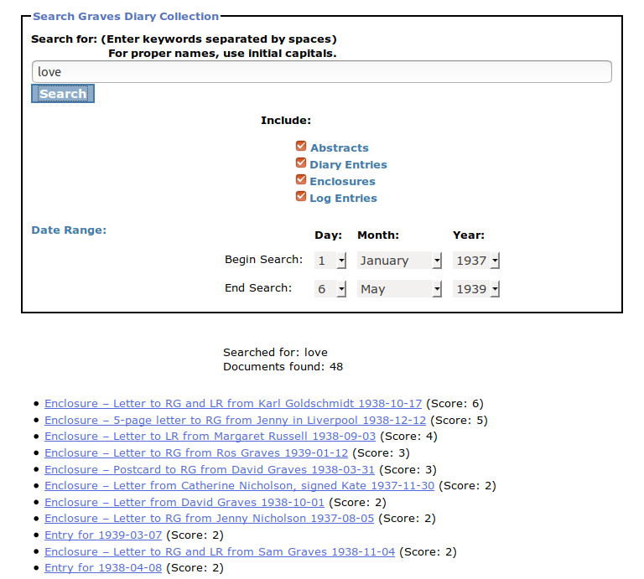

Slide 38
Pros and cons
Lightning fast ✔
Works anywhere ✔
Usable and effective ✔
No keywords-in-context ✘
Only practical for small projects ✘

