Slide 1
Why do I need four search engines?
Martin Holmes and Joey Takeda
University of Victoria Endings Project

Slide 2
Project Endings
How to complete, publish and walk away from your digital edition project…

Slide 3
Project Endings
How to complete, publish and walk away from your digital edition project…
...and have it last for 50 years.

Slide 4
The Projects
The Map of Early Modern London ↗
Le Mariage sous l’ancien régime ↗
The Nxaʔamxcín Dictionary Database
The Robert Graves Diary ↗
Mapping Keats’s Progress ↗
The Scandinavian-Canadian Studies Journal ↗

Slide 5
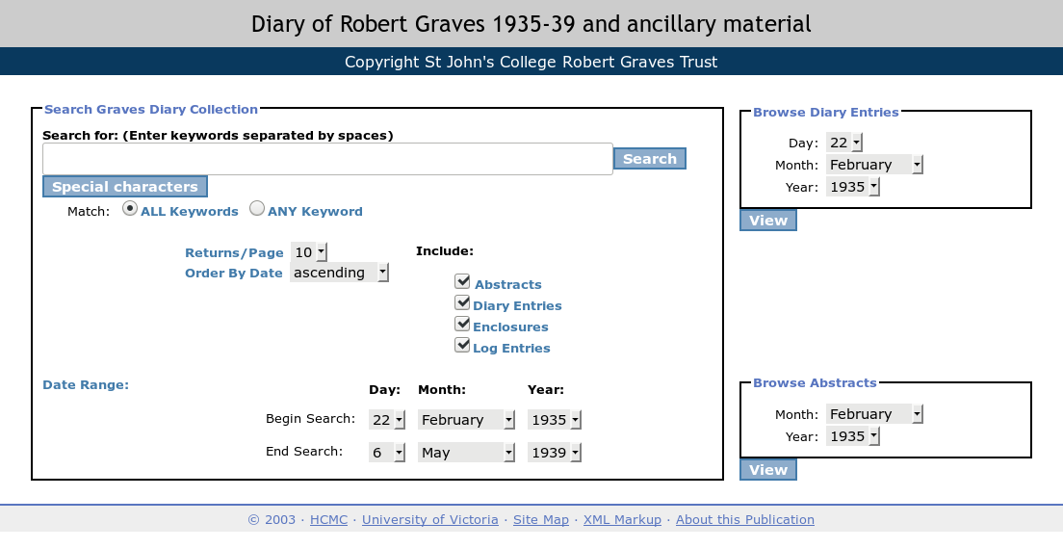

Slide 6
Previous work
Arneil, Stewart and Martin Holmes. 2017. “Archiving form and function: preserving a 2003 digital project.” DPASSH Conference 2017: Digital Preservation for Social Sciences and Humanities, Brighton, UK, 14th June 2018.
Holmes, Martin. 2017. “Selecting Technologies for Long-Term Survival.” SHARP Conference 2017: Technologies of the Book, Victoria, BC, Canada, 10th June 2017. [PDF].
Holmes, Martin and Joseph Takeda. 2017. “Beyond Validation: Using Programmed Diagnostics to Learn About, Monitor, and Successfully Complete Your DH Project.” Digital Humanities 2017 Conference, Montreal, Canada, 1th August 2017. [PDF]

Slide 7
Endings Principles
Endings principles cover five components of a digital project:
  DATA
  PRODUCTS
  PROCESSING
  DOCUMENTATION
  RELEASE MANAGEMENT

Slide 8
Endings Principles
Endings principles cover five components of a digital project:
  DATA
  PRODUCTS
  PROCESSING
  DOCUMENTATION
  RELEASE MANAGEMENT

Slide 9
Principles for Products
Products are the project output intended for end-users, typically in the form of websites or print documents. The following principles apply to products intended for the web:
2.1 No dependence on server-side software: build a static website with no databases, no PHP, no Python.

Slide 10
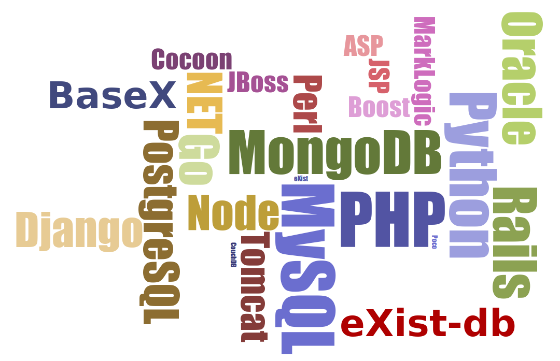

Slide 11
It’s ALL GOING AWAY.
X

Slide 12
Principles for Products
2.2 No boutique or fashionable technologies: use only standards with support across all platforms, whose long-term viability is assured. Our choices are HTML5, JavaScript and CSS.

Slide 13
Principles for Products
2.3 No dependence on external libraries: no JQuery, no AngularJS, no Bootstrap.

Slide 14
Principles for Products
2.4 No query strings: every entity in the site has a unique page with a simple URL.

Slide 15
Principles for Products
2.6 Massive redundancy: every page contains all the components it needs, so that it will function without the rest of the site if necessary, even though this means duplicating information across the site.

Slide 16
Principles for Products
2.7 Relentless validation: every site build involves validation of all input data (XML) and all output code (HTML5, JavaScript, CSS).

Slide 17
Principles for Products
2.8 Inclusion of data: every site should include a documented copy of the source data, so that users of the site can repurpose the work easily.
Endings principles document:
https://raw.githubusercontent.com/
projectEndings/Endings/master/
principles.txt

Slide 18
Result:
A completely static site consisting of HTML (XHTML5), JavaScript and CSS.
Graceful degradation for JS and CSS.
Each page is coherent, consistent and complete.
The site works on any webserver, or from a local drive, USB stick, DVD, etc.

Slide 19
What about search?
All sites need a half-decent search engine.
But search engines typically depend on one or more of:

Slide 20
Pact with the devil clause:
2.9 Once a fully-working static site is achieved, it may be enhanced by the use of other services such as a server-side indexing tool (Solr, eXist) to support searching and similar functionality.

Slide 21

Search engine #1

Slide 22
Search engine #1
Searches the HTML, not the XML.
Provides faceting based on metadata in the HTML.
Provides keyword-in-context results.

Slide 24
But...
exist-db is a small open-source project. ✘
It needs Java. ✘
Sysadmins don’t know or care about it. ✘
It’s likely to require periodic updates, rebuilds, migration and other TLC. ✘

Slide 25
But...
exist-db is a small open-source project. ✘
It needs Java. ✘
Sysadmins don’t know or care about it. ✘
It’s likely to require periodic updates, rebuilds, migration and other TLC. ✘
NOT GOOD ENOUGH!

Slide 26
Search engine #2

Slide 27
Search engine #2
™

Slide 28
Search engine #2
™
Easy to set up ✔
Familiar user interface ✔
Cheap on resources (for us) ✔
Provides keyword-in-context results ✔

Slide 29
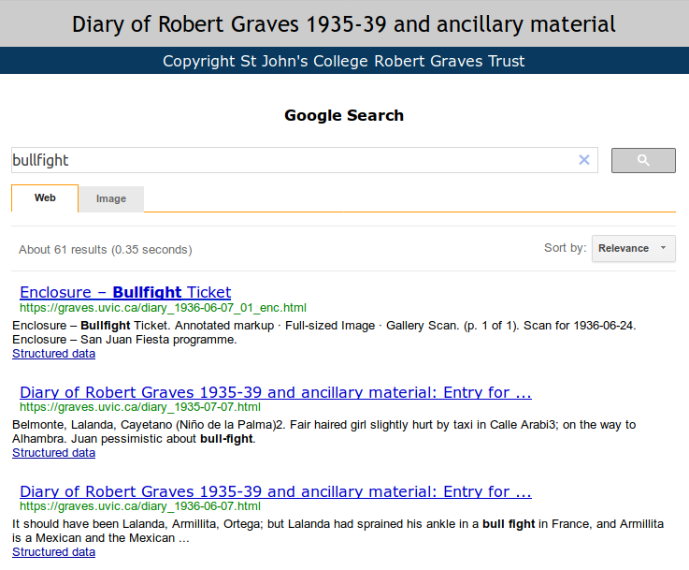

Slide 30
But...
Trust Google?

Slide 31
But...
Trust Google?
NO WAY!

Slide 32
But...
Trust Google?
NO WAY!
Works today, breaks tomorrow. ✘

Slide 33
But...
Trust Google?
NO WAY!
Works today, breaks tomorrow. ✘
Exists today, disappears tomorrow. ✘

Slide 34
But...
Trust Google?
NO WAY!
Works today, breaks tomorrow. ✘
Exists today, disappears tomorrow. ✘
Free today, costs tomorrow. ✘

Slide 35
But...
Trust Google?
NO WAY!
Works today, breaks tomorrow. ✘
Exists today, disappears tomorrow. ✘
Free today, costs tomorrow. ✘
Depends on a stable domain. ✘

Slide 36
But...
Trust Google?
NO WAY!
Works today, breaks tomorrow. ✘
Exists today, disappears tomorrow. ✘
Free today, costs tomorrow. ✘
Depends on a stable domain. ✘
NOT GOOD ENOUGH!

Slide 37

So who do we trust?

Slide 38

Search engine #3
University Library’s Solr instance.

Slide 39
How it works
Graves site build process:
  …
  TEI XML → XHTML5
  …
  XHTML5 → Solr index files (XML)
Solr index files → Solr administrator
Application queries Solr instead of eXist indexes.

Slide 40
But...
Solr only accepts connections from a known IP address. ✘
Solr itself may go away, or change beyond recognition. ✘
The library itself may go away, or change beyond recognition. ✘
NOT GOOD ENOUGH!

Slide 41

Search engine #4

Slide 42
Search engine #4
Standalone all-JavaScript no-backend keyword search with stemming and relevance scoring

Slide 43
How it works (1)
Graves site build process:
  …
  TEI XML → XHTML5
  Tokenize HTML body.
  Stem the tokens (Porter stemming).
  For each token, create a JSON file named for the token.
  In the JSON file, place a pointer to each document containing the token, with a score for the number of times it occurs in the document.
  = 11,776 files, 23.2 MB

Slide 44
{ "token" : "childish",
"instances" :
[
{ "docId" : "diary_1938-03-18",
"docTitle" : "Entry for 1938-03-18",
"docType" : "diaryentry",
"docStartDate" : "1938-03-18",
"docEndDate" : "1938-03-18",
"count" : 1 },
{ "docId" : "abstract_1938-03",
"docTitle" : "Abstract for March 1938",
"docType" : "abstract",
"docStartDate" : "1938-03-01",
"docEndDate" : "1938-03-31",
"count" : 1 }
]
}

Slide 45
How it works (2)
Search page:
  User types in keywords.
  Keywords are stemmed by JavaScript.
  For each unique token, retrieve the JSON file named for it.
  Combine the scores for each document across the tokens.
  Do additional filtering by date and document type.
  Present results ordered by score.

Slide 46
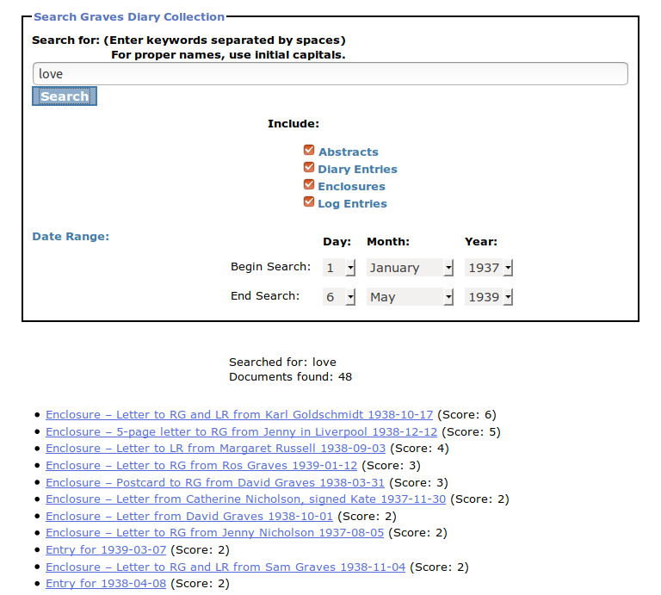

Slide 47
Pros and cons
Lightning fast ✔
Works anywhere ✔
Usable and effective ✔
No keywords-in-context ✘
Only practical for small projects ✘

Slide 48
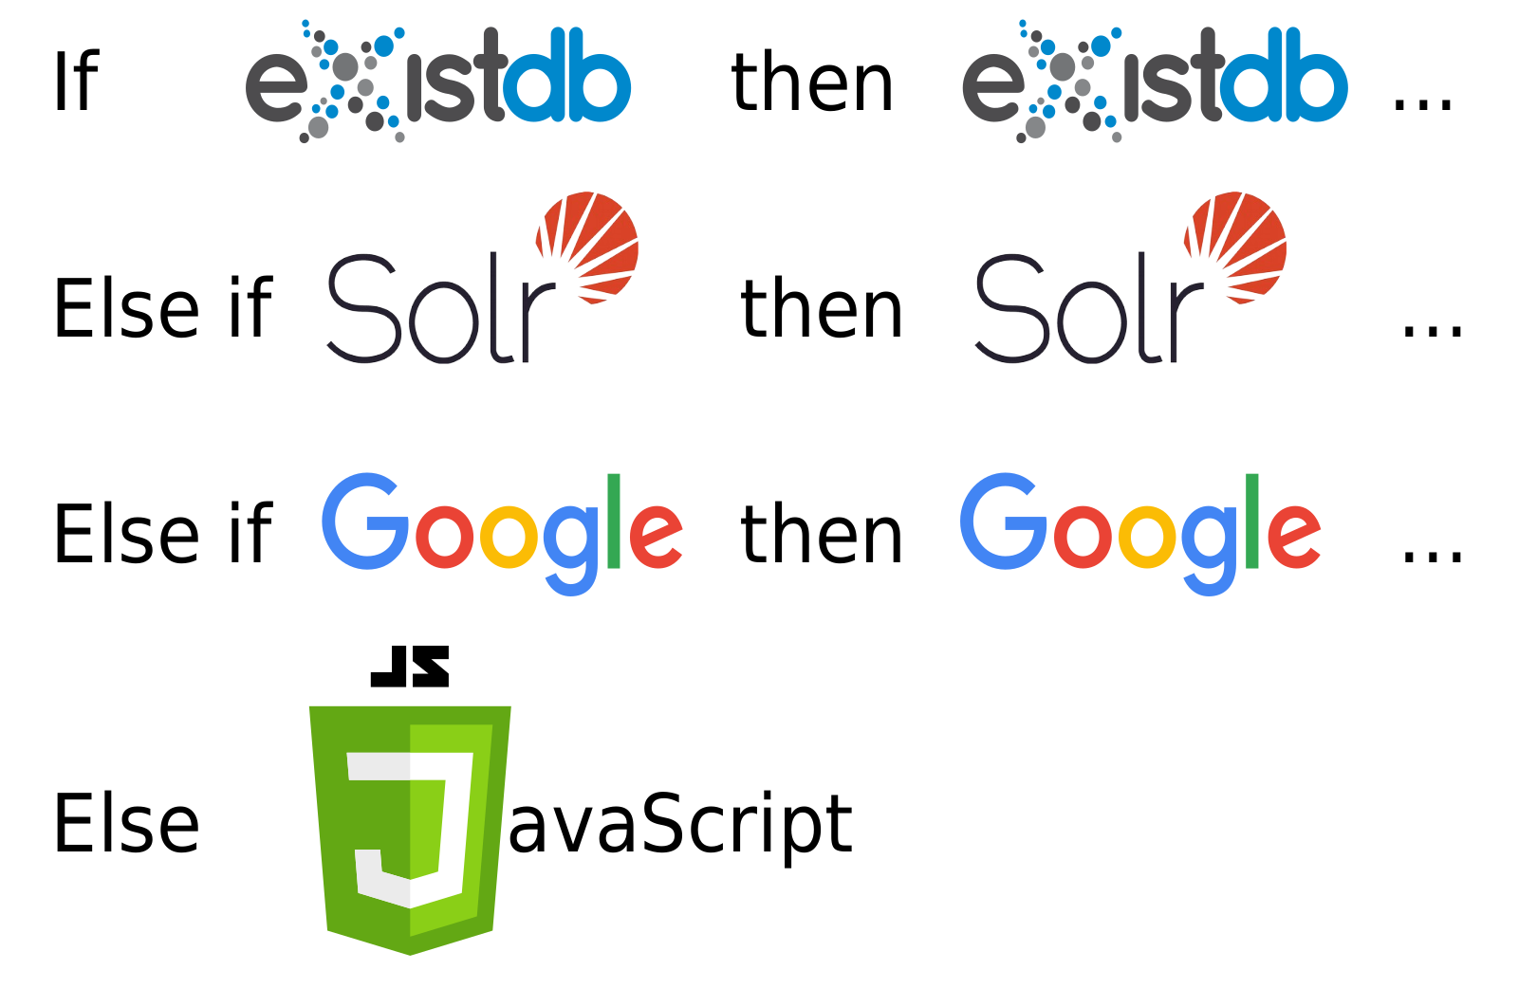
Graceful degradation

Slide 49
Insane?
eXist-db we're doing anyway. ✔
Solr invokes institutional support / responsibility / attention. ✔
Google is easy – why not? ✔
JavaScript is easy (once coded) and bulletproof. ✔

