Slide 1
Digital Dependencies
Part of "Endings: How to End Your Digital Project"
@ DHSI 2019
Stewart Arneil (UVic)

Slide 2
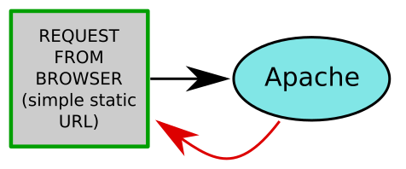
What Appears to Happen

Slide 3
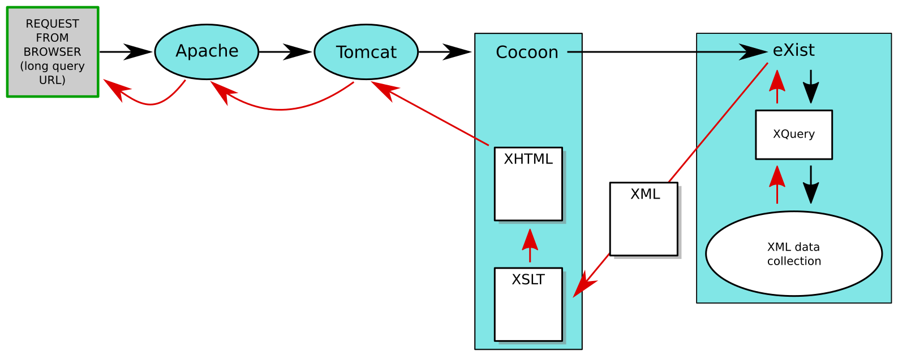
What Might Typically Happen

Slide 4
What Has Happened to Us
Browser
Apache
Tomcat
Cocoon
xwiki
eXist
AnnotateIt
GoogleDrive
MySql
PostGres

Slide 5
Stack of Dependencies
Your code and data
Plugins/customizations
Applications and libraries
Server
Operating System
Hardware

Slide 6
Stack of Dependencies
Your code and data
Plugins/customizations
Applications and libraries
Server
Operating System
Hardware
My Research
Jo's Photo Gallery
WordPress
PHP
Apache, MySQL servers
Unix
Dell, IBM, etc.

Slide 7
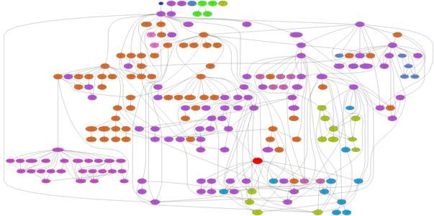
What Can Happen

Slide 8
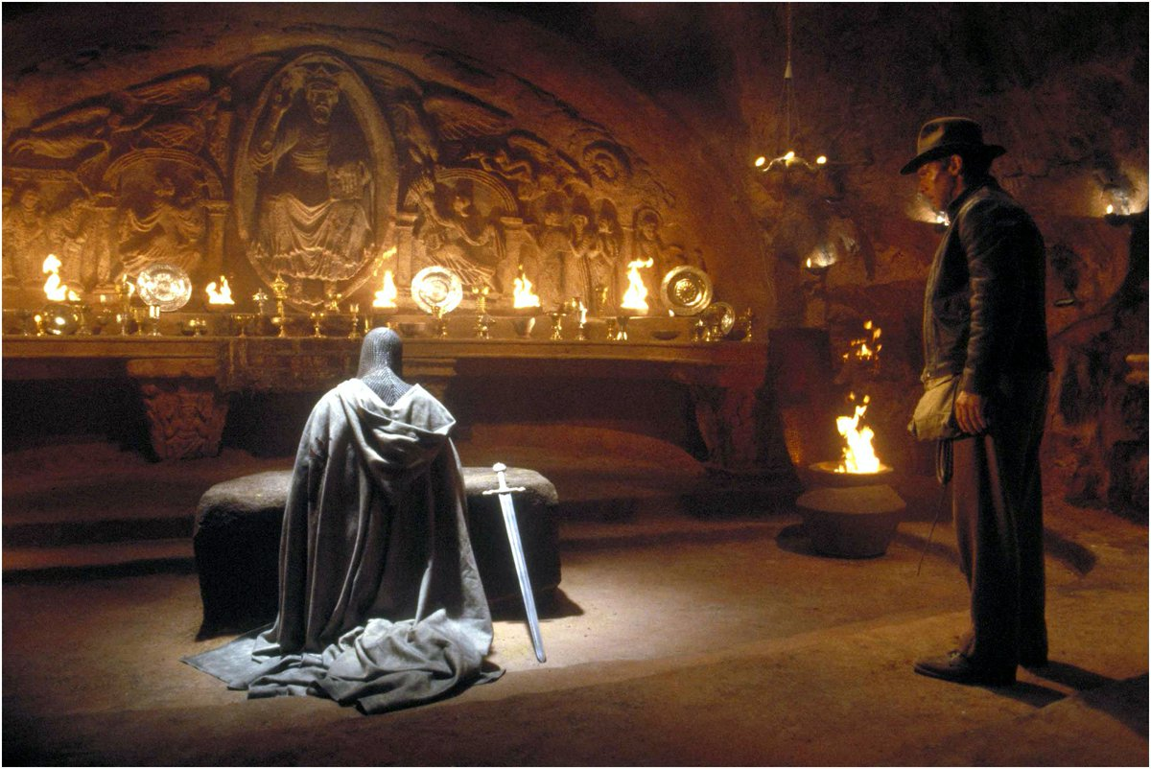
Choose Dependencies Wisely

Slide 9
Dependency Choices (1)
 | Poor | Wise
Thought put in | Unwitting, casual | Conscious
Number | Many, varied | None or few
Legal, terms issues | Yes or commercial | No or open source
Own dependencies | Yes, poor ones | No or wise ones
Provider | Unreliable | Reliable
Documentation | Absent, incomplete | Thorough

Slide 10
Dependency Choices (2)
 | Poor | Wise
Feature importance | Minor | Critical
Replaceable | Yes | No or at high cost
Effect of failure | Major or widespread | Minor or contained
Time | Indefinite | Limited
Thought put in | Unwitting, casual | Conscious

Slide 11
Managing Dependencies
Embrace short-term pain for long-term gain
Align risk with resources
Separate concerns: data, processing, products

Slide 12

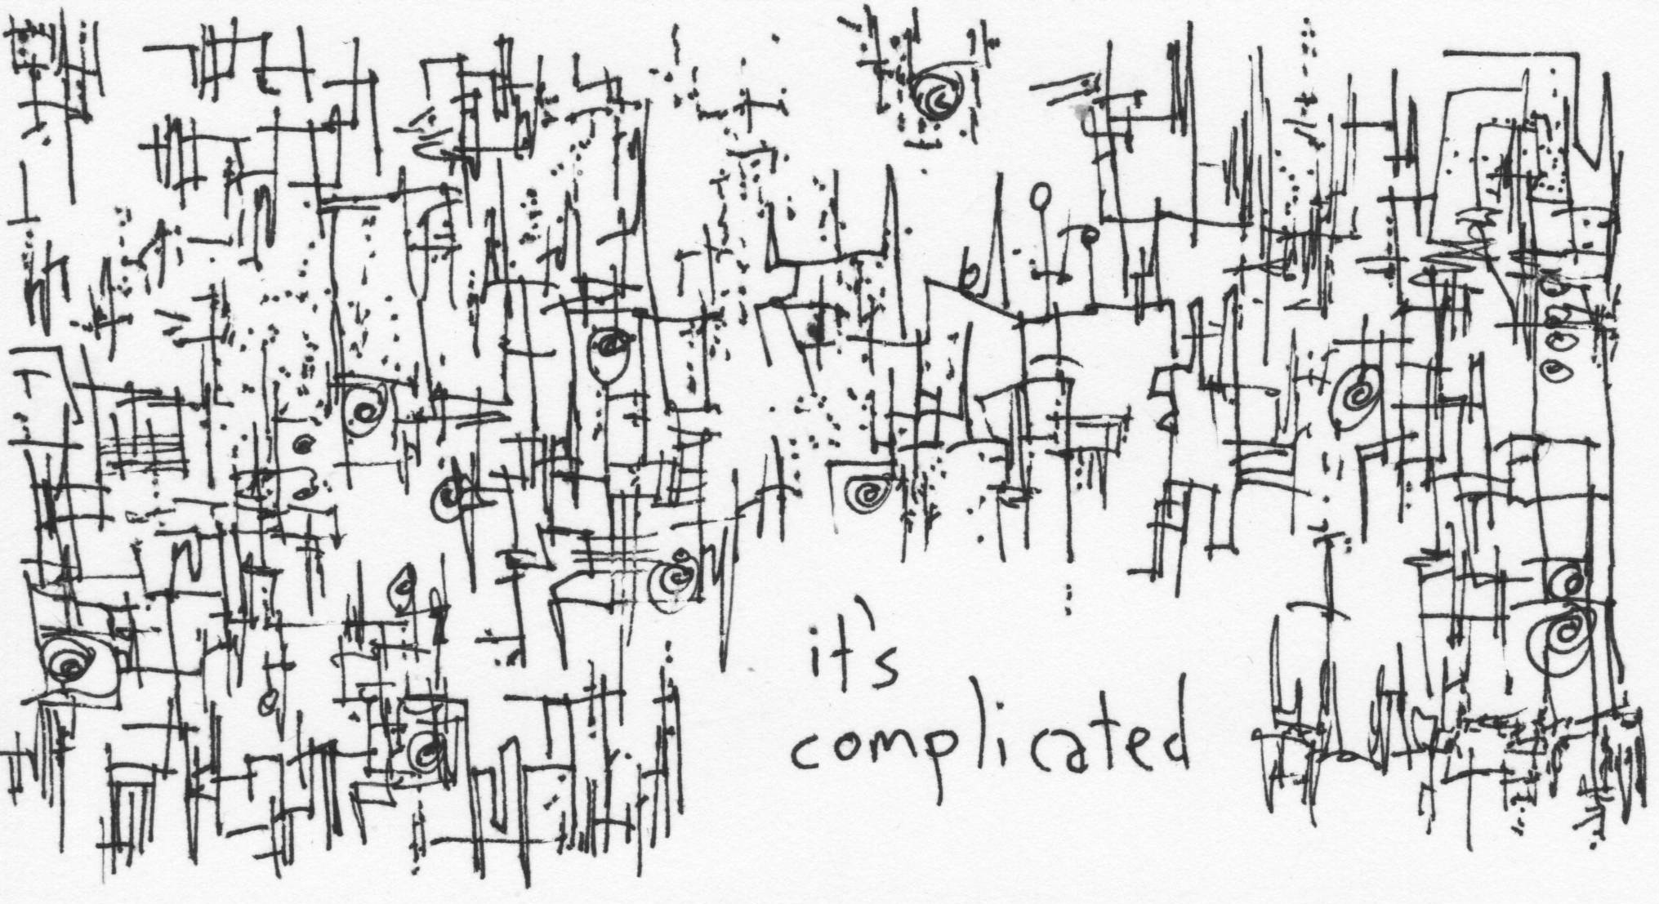
Endings-Oriented Approach
Data
Process
Product

Slide 13

Who Ya Gonna Call?
Researchers (content)
Researchers (treatment)
Librarians
Sysadmins
DH developers

Slide 14
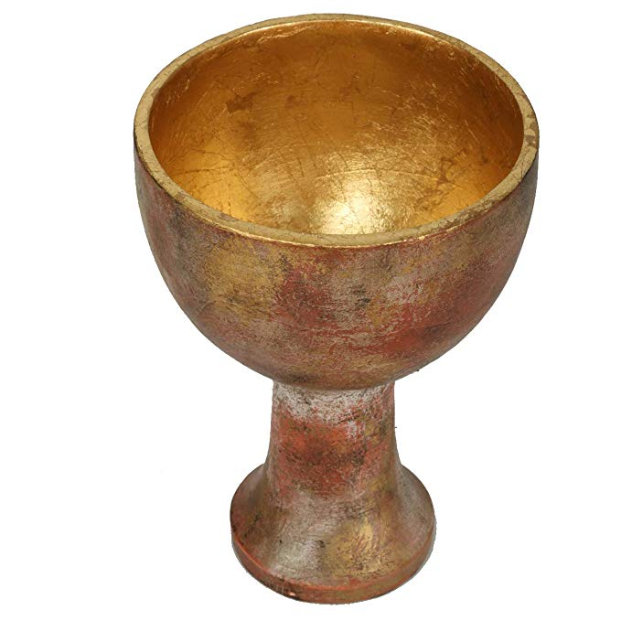
Choose Wisely

Slide 15
Example Dependencies
Purpose | Blog comments | Timeline | Interactive Map | Complex Query
Using | WordPress | JQuery add-on | GoogleMaps | MySQL DB
Legal/terms | No | No | Yes | No
Dependencies | Yes, sql + php | Yes, jquery + js | Yes, tileserver | Yes, php
Provider | Reliable,?plugin | ?addon, reliable | Opinion varies | Reliable
Documentation | Good | Good | Good | Good
Feature impact
Replaceable
Effect of fail
Duration
Poor/Wise

