Slide 1
What does ending mean?
Janelle Jenstad
Martin Holmes
</endings>

Slide 2
Ending is either:
completion
  or
stopping

Slide 3
Completion is desirable.

Slide 4
Completion is desirable.
Stopping is inevitable.

Slide 5
Completion is desirable.
Stopping is inevitable.
Stopping without completion is bad.

Slide 6
Completion is desirable.
Stopping is inevitable.
Stopping without completion is bad.
Stopping can happen at any time.

Slide 7
Completion is desirable.
Stopping is inevitable.
Stopping without completion is bad.
Stopping can happen at any time.
Therefore your project should always be complete.

Slide 8




How is that possible?
Consider:

Slide 9
How is that possible?
Consider:
  Printed books
  Vinyl records
  Paintings (framed and sold)
  Movies (released)

Slide 10
These products are finished.
Nobody is in any doubt about whether they’re finished or not.
Digital projects should be the same.

Slide 11
Symptoms of incompleteness...
Missing sections
Pages apologizing for missing sections
Broken links and 404s
Vague promises of things coming soon

Slide 12
Symptoms of incompleteness...
Errors
  Of fact
  Of spelling/grammar
  Of style
Frequent changes without clear information about what and why

Slide 13




Symptoms of incompleteness...

Slide 14
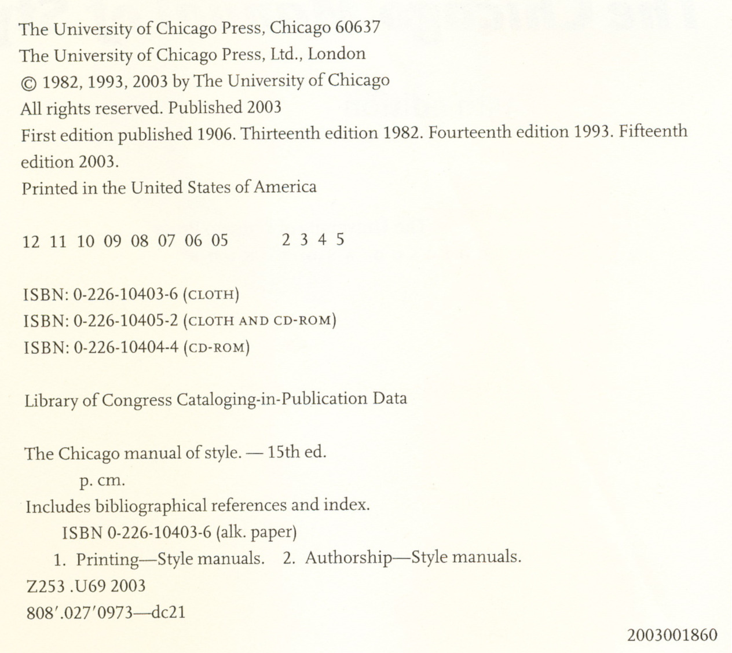

Slide 15
The edition model

Slide 16
The edition model
An edition is completed, edited, copyedited, proofed, corrected, finalized, printed and released.

Slide 17
The edition model
An edition is completed, edited, copyedited, proofed, corrected, finalized, printed and released.
The edition and date is clearly specified in the product.

Slide 18
The edition model
An edition is completed, edited, copyedited, proofed, corrected, finalized, printed and released.
The edition and date is clearly specified in the product.
Work may or may not begin on a subsequent edition.

Slide 19
The edition model
An edition is completed, edited, copyedited, proofed, corrected, finalized, printed and released.
The edition and date is clearly specified in the product.
Work may or may not begin on a subsequent edition.
Each edition remains current until a subsequent one is released.

Slide 20
Goals for an edition

Slide 21
Goals for an edition
Coherent (everything fits together logically; every link works)

Slide 22
Goals for an edition
Coherent (everything fits together logically; every link works)
Consistent (the same thing is always done in the same way)

Slide 23
Goals for an edition
Coherent (everything fits together logically; every link works)
Consistent (the same thing is always done in the same way)
Complete (everything required or promised is delivered in full)

